Slide 1
Smart Building Council (SBC)
Webinar/Meeting will commence 12:05pm ET
Wednesday, November 4, 2026 | 12 NOON – 1:30 PM (ET)
SBC Chair: Bob Allan (NAVCO Inc.)
Vice-Chair: Harsha Chandrashekar (Honeywell International Inc.)
Vice-Chair: Robert Lane (Robert H. Lane and Associates Inc.)
Vice-Chair: Chris Larry (exp US Services Inc.)

Slide 2
Agenda
Marta Klopotowska (ASHB)
Call to Order, Welcome, Introductions, About the SBC
Administrative
Research Update
Keynote: Foundation First: How Autonomous Commissioning Unlocks the Full Potential of Smart Building Technologies - Saheel Chandrani (PingCx)
ASHB Podcast
ASHB Whitepapers & Research Library
ASHB Journal
New Business
Announcements
Adjournment

Slide 3
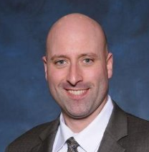
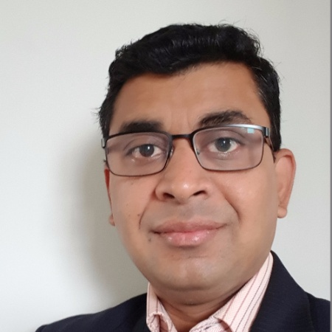
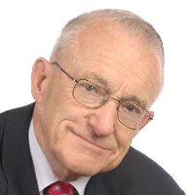
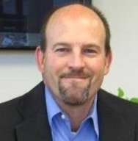




1. Call to Order, Welcome, Introductions, About the SBC
Robert Lane (Robert H. Lane & Associates Inc.)
SBC Chair
Bob Allan
Senior Vice President of Sales, East Region
NAVCO, Inc.
SBC Vice-Chair
Harsha Chandrashekar
Product Approvals & Regulatory Leader
Honeywell International
SBC Vice-Chair
Robert Lane
President & Managing Partner, Robert H. Lane and Associates Inc.
SBC Vice-Chair
Chris Larry
Director of Energy Engineering
Exp US Services Inc.
The ASHB Smart Building Council works to strengthen the large building automation industry through innovative technology-driven research projects. The Council was established in 2001 by ASHB to specifically review opportunities, take strategic action, and monitor initiatives that relate to integrated systems and automation in the large building sector. The Council's projects promote the next generation of smart building technologies and incorporate a holistic approach that optimizes building performance and savings. www.ashb.com/sbc

Slide 4

2. Administrative
Robert Lane (Robert H. Lane & Associates Inc.)
Approval of SBC Minutes
May 27, 2026
www.ashb.com/sbc

Slide 5
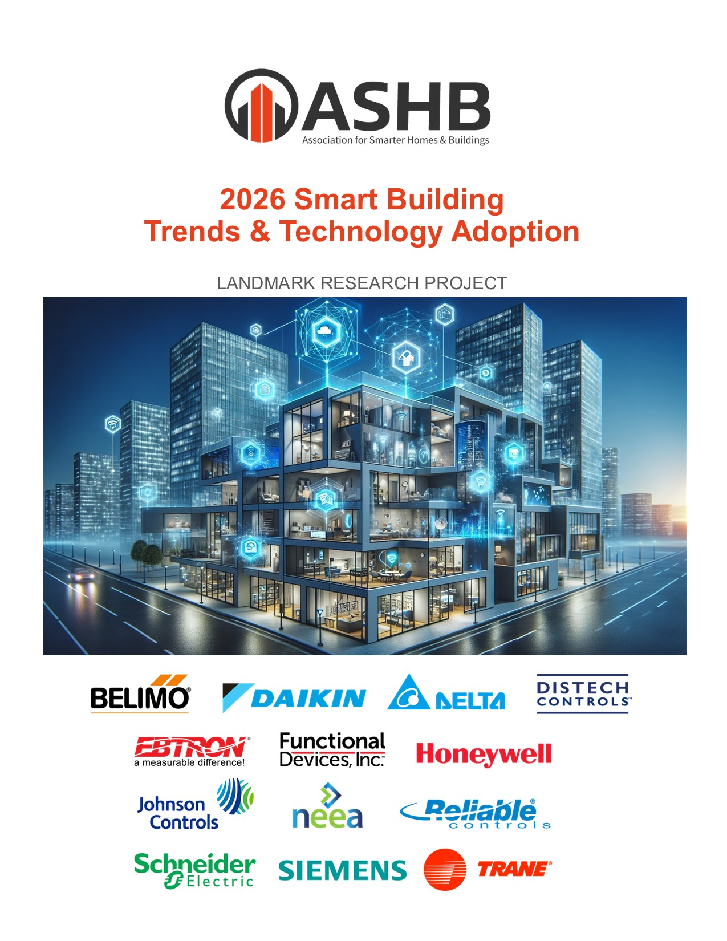













3. Research Update
Greg Walker (ASHB)
2026 SBC Landmark Research
Smart Building Trends & Technology Adoption
Funders
Contact admin@ashb.com to obtain research findings and to join as a funder.

Slide 6












3. Research Update
Greg Walker (ASHB)
Annual BACS
Market Sizing North America

Slide 7














3. Research Update
Greg Walker (ASHB)
Annual BACS
Market Sizing Europe

Slide 8
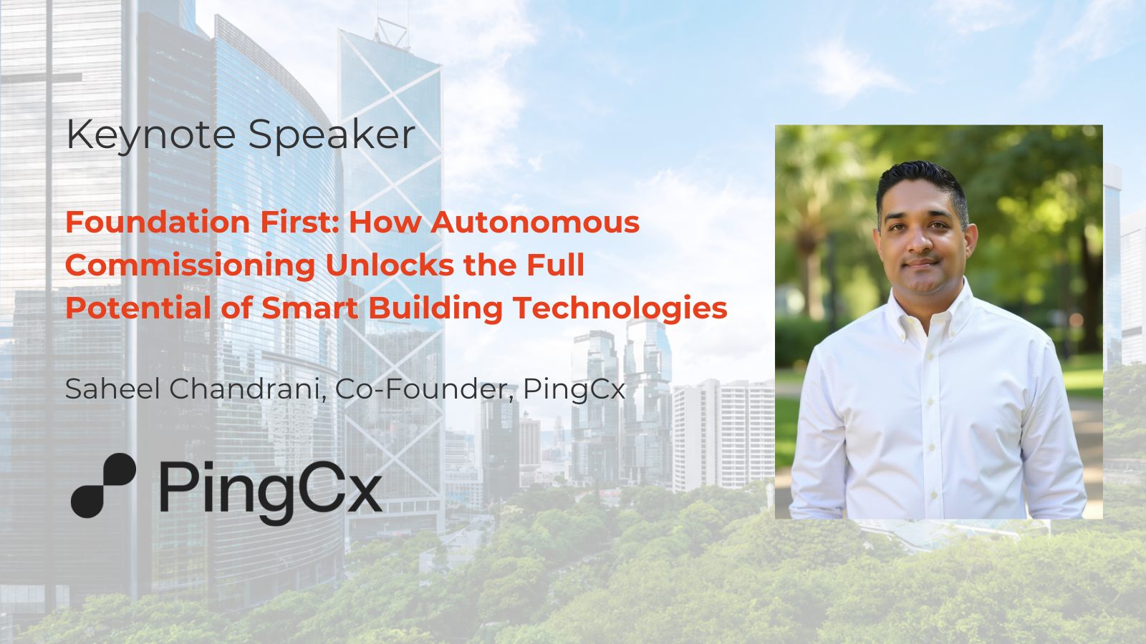
4. Panel Discussion
Harsha Chandrashekar (Honeywell International, Inc.)

Slide 9
THANK YOU!
Questions?

Slide 10
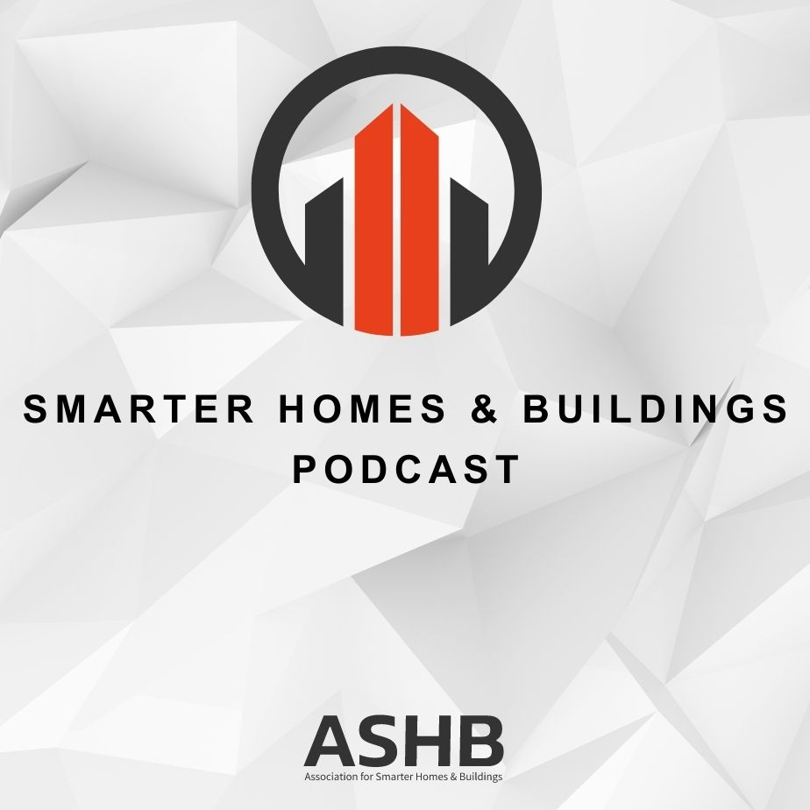


5. Smarter Homes & Buildings Podcast
Chris Larry (EXP)
Join industry experts and leaders from around the globe as they discuss everything smart home and intelligent buildings.
ASHB is looking for guests and hosts for future pre-recorded episodes. Contact admin@ashb.com for more information.
ashb.com/podcast
Recent Recordings:
From Invisible to Actionable: Unlocking Real-Time Energy Insights in Buildings
Seeing the Unseen: How Water Visibility Is Changing Facility Management
Building Cybersecurity, Cybersecurity 101 - Tools and Methods

Slide 11

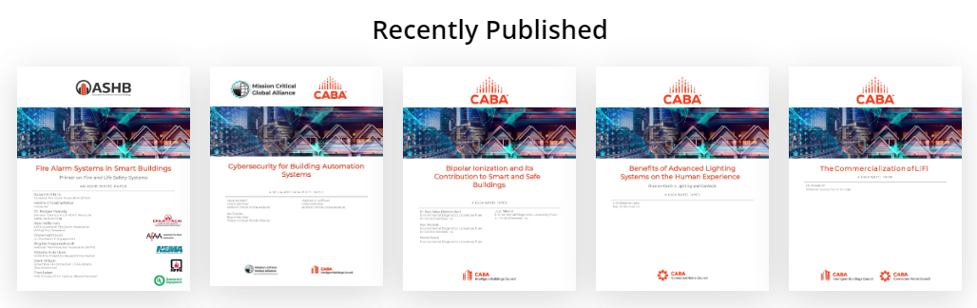
6. ASHB Whitepapers
Ken Wacks (Ken Wacks Associates)
Published SBC White Papers can be downloaded at:
ashb.com/whitepapers
Send proposals to admin@ashb.com

Slide 12
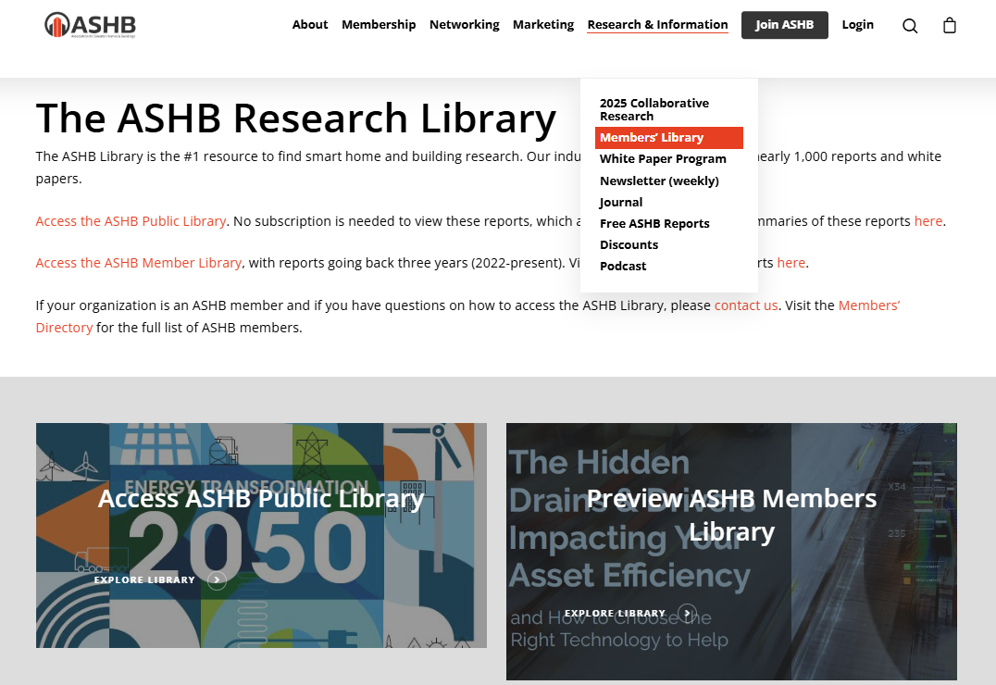
6. ASHB Research Library
Ken Wacks (Ken Wacks Associates)

Slide 13
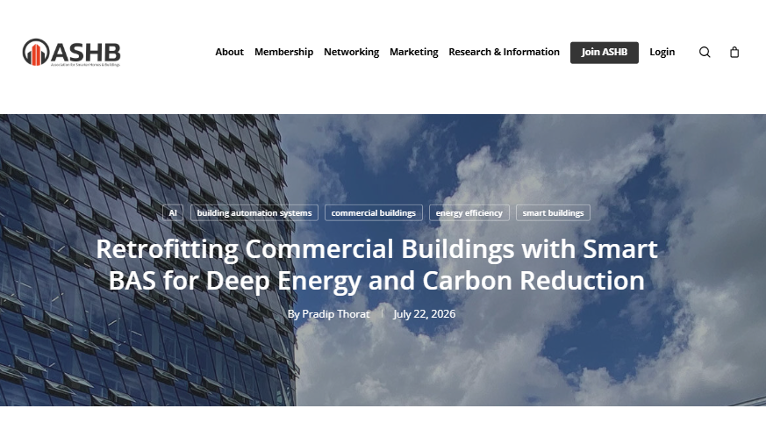
7. ASHB Journal
Ken Wacks (Ken Wacks Associates)
The ASHB Journal aims to educate and inform the ASHB membership and industry at large on emerging research, issues, challenges, and opportunities in the smart home and building sectors.
New articles are posted to the ASHB website, included in the weekly NewsBrief, and circulated on Twitter and LinkedIn.
Send proposals to admin@ashb.com
Recent posts:
Retrofitting Commercial Buildings with Smart BAS for Deep Energy and Carbon Reduction
Ken Wacks’ Perspectives: CES 2026: From AI and flying machines to typewriters
From Passive Monitoring to Energy Intelligence: Controlling the Invisible Drain in Commercial Buildings
13

Slide 14

8. New Business
Robert Lane (Robert H. Lane & Associates Inc.)
New SBC Business?

Slide 15

9. Announcements
Chris Larry (EXP)
IFMA World Workplace
November 18-20 | Anaheim, CA
The Buildings Show
December 2-4 | Toronto, ON
Light + Intelligent Building
January 12-14 | Dubai, UAE
AHR
January 25-27 | Chicago, IL
BICSI Winter Conference & Expo
February 14-18 | Orlando, FL
DTECH
March 1-4 | Atlanta, GA

Slide 16

10. Adjournment
Robert Lane (Robert H. Lane & Associates Inc.)
Next SBC Meeting: February 2027
Association for Smarter Homes & Buildings (ASHB)
admin@ashb.com | www.ashb.com | www.ashb.com/sbc
Connect to what’s next™

