Slide 1
Smart Building Council (SBC) Webinar/Meeting will commence 12:05pm ET Wednesday, February 11, 2026 | 12 NOON – 1:30 PM (ET)
SBC Chair: Bob Allan (NAVCO Inc.)
Vice-Chair: Harsha Chandrashekar (Honeywell International Inc.)
Vice-Chair: Robert Lane (Robert H. Lane and Associates Inc.)
Vice-Chair: Chris Larry (exp US Services Inc.)

Slide 2
Agenda Marta Klopotowska (ASHB)
Call to Order, Welcome, Introductions, About the SBC
Administrative
Research Update
Panel: Winning Mindshare with Mechanical Engineers and Consultants in Building Controls Panel Members: Marc Petoc and Terry Swope (Lynxspring), J Christopher Larry (EXP US Services), Jacob Jackson (Aptitude: Intelligent Integration), Ed Merwin (Tridium), and Troy Windom (Chinook Systems)
ASHB Podcast
ASHB Whitepapers & Research Library
ASHB Journal.
New Business
Announcements
Adjournment

Slide 3
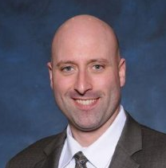
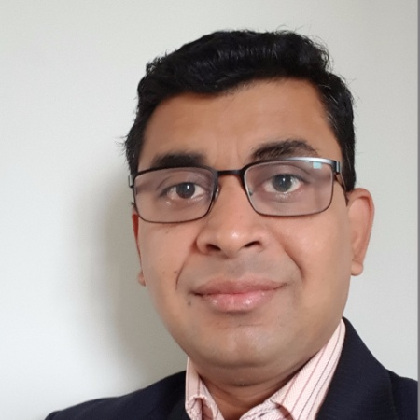
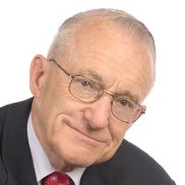
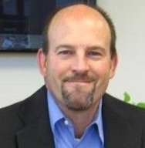




1. Call to Order, Welcome, Introductions, About the SBC Robert Lane (Robert H. Lane & Associates Inc.)
SBC Chair
Bob Allan
Senior Vice President of Sales, East Region
NAVCO, Inc.
SBC Vice-Chair
Harsha Chandrashekar
Product Approvals & Regulatory Leader
Honeywell International
SBC Vice-Chair
Robert Lane
President & Managing Partner, Robert H. Lane and Associates Inc.
SBC Vice-Chair
Chris Larry
Director of Energy Engineering
Exp US Services Inc.
The ASHB Smart Building Council works to strengthen the large building automation industry through innovative technology-driven research projects. The Council was established in 2001 by ASHB to specifically review opportunities, take strategic action, and monitor initiatives that relate to integrated systems and automation in the large building sector. The Council's projects promote the next generation of smart building technologies and incorporate a holistic approach that optimizes building performance and savings. www.ashb.com/sbc

Slide 4

2. Administrative Robert Lane (Robert H. Lane & Associates Inc.)
Approval of SBC Minutes November 20, 2025
www.ashb.com/sbc

Slide 5
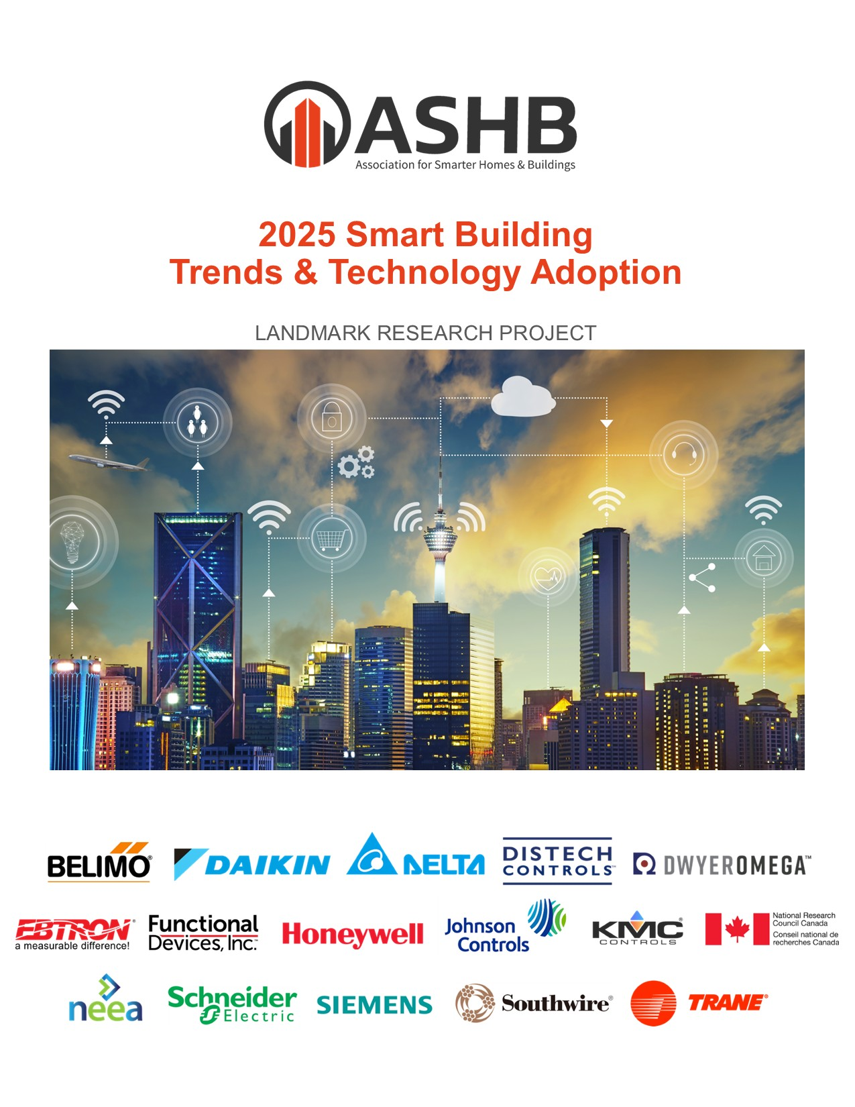

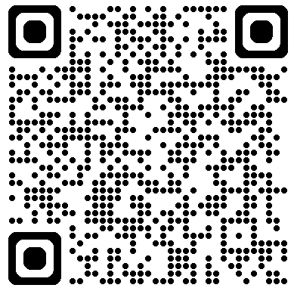
3. Research Update Greg Walker (ASHB)
2025 SBC Landmark Research Smart Building Trends & Technology Adoption
Funders
Contact admin@ashb.com to obtain research findings and to join as a funder.

Slide 6











3. Research Update Greg Walker (ASHB)
Annual BACS
Market Sizing North America

Slide 7









3. Research Update Greg Walker (ASHB)
Annual BACS
Market Sizing Europe

Slide 8
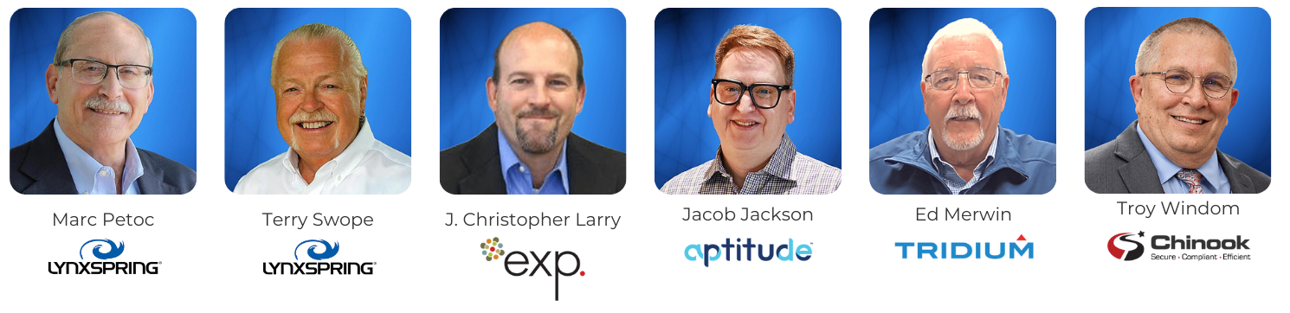
4. Panel Discussion Harsha Chandrashekar (Honeywell International, Inc.)
Panel Discussion:
Winning Mindshare with Mechanical Engineers and Consultants in Building Controls

Slide 9
THANK YOU!
Questions?

Slide 10
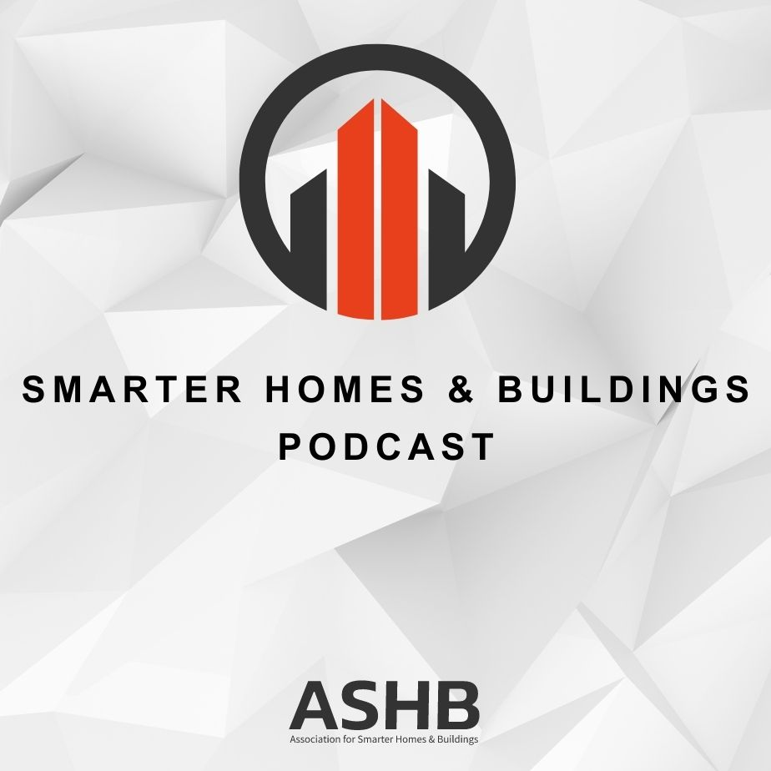


5. Smarter Homes & Buildings Podcast Marta Klopotowska (ASHB)
Join industry experts and leaders from around the globe as they discuss everything smart home and intelligent buildings.
ASHB is looking for guests and hosts for future pre-recorded episodes. Contact admin@ashb.com for more information.
ashb.com/podcast
Recent Recordings:
Seeing the Unseen: How Water Visibility Is Changing Facility Management
Building Cybersecurity, Cybersecurity 101 - Tools and Methods

Slide 11

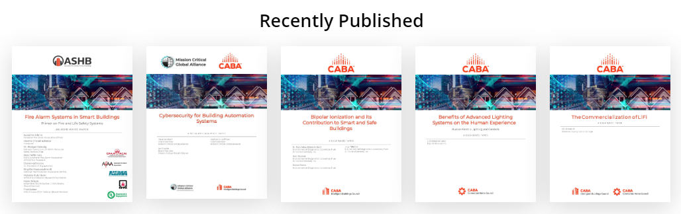
6. ASHB Whitepapers Ken Wacks (Ken Wacks Associates)
Published SBC White Papers can be downloaded at:
ashb.com/whitepapers
Send proposals to admin@ashb.com

Slide 12
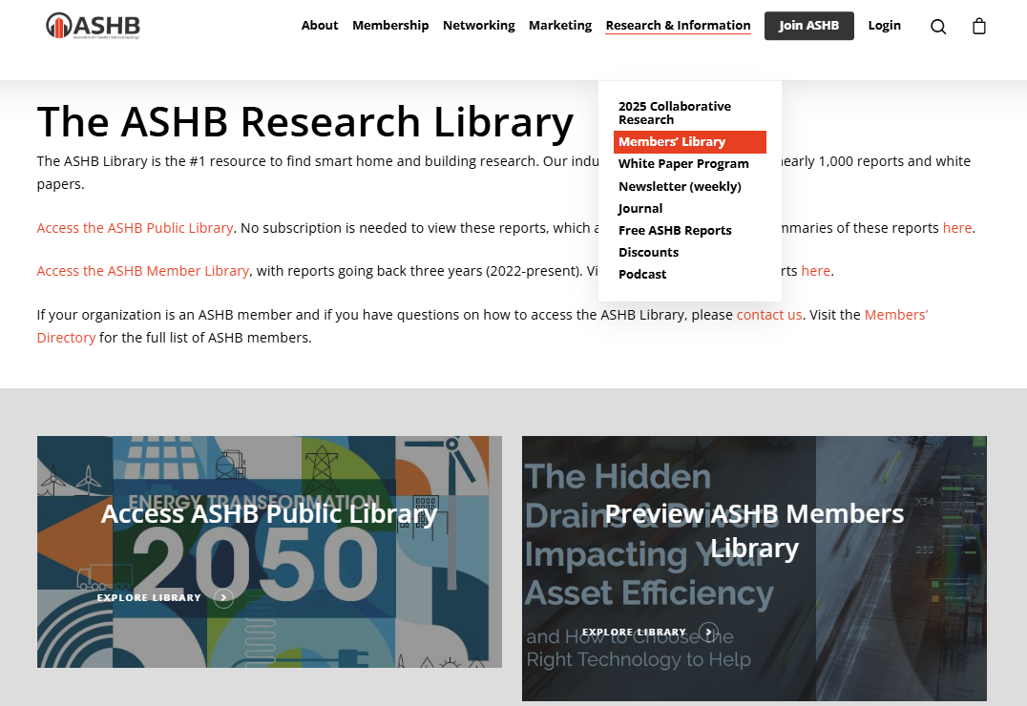
6. ASHB Research Library Ken Wacks (Ken Wacks Associates)

Slide 13
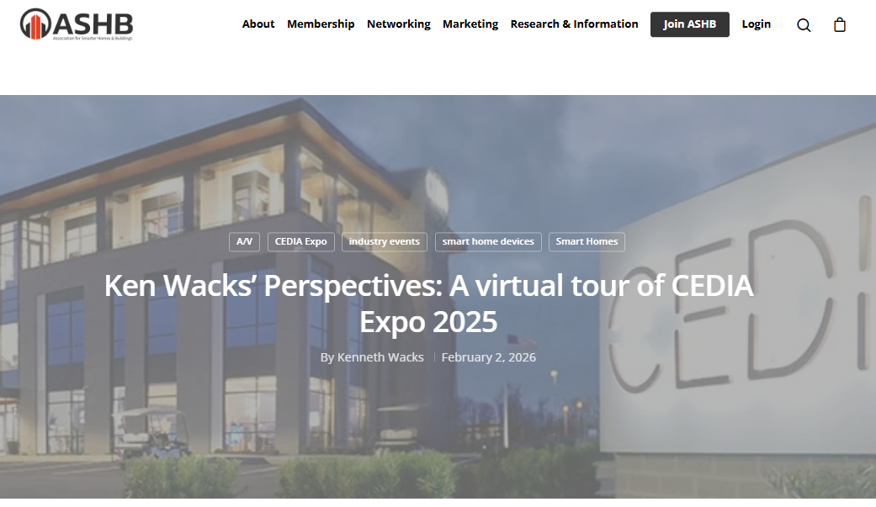
7. ASHB Journal Ken Wacks (Ken Wacks Associates)
The ASHB Journal aims to educate and inform the ASHB membership and industry at large on emerging research, issues, challenges, and opportunities in the smart home and building sectors.
New articles are posted to the ASHB website, included in the weekly NewsBrief, and circulated on Twitter and LinkedIn.
Send proposals to admin@ashb.com
Recent posts:
Ken Wacks’ Perspectives: A virtual tour of CEDIA Expo 2025
Unlocking Smarter, Cleaner Energy with Geo-Exchange Systems
Ken Wacks’ Perspectives: A virtual tour of CES 2025
13

Slide 14

8. New Business Robert Lane (Robert H. Lane & Associates Inc.)
New SBC Business?

Slide 15

9. Announcements Marta Klopotowska (ASHB)
Light + Building
March 8-13 | Frankfurt, Germany
CX Energy
April 21-24 | Chicago, IL
Connect (X)
May 4-6 | Fort Lauderdale, FL
Controls-Con
May 14-15 | Denver, CO
Realcomm | IBCon
June 3-4 | San Diego, CA

Slide 16

10. Adjournment Robert Lane (Robert H. Lane & Associates Inc.)
Next SBC Meeting: May 2026
Association for Smarter Homes & Buildings (ASHB) admin@ashb.com | www.ashb.com | www.ashb.com/sbc
Connect to what’s next™

