Slide 1
Intelligent Buildings Council (IBC) Webinar Webinar/Meeting will commence 12:05pm ET Tuesday, August 13, 2024 | 12 NOON – 1:30 PM (ET)
IBC Chair: Bob Allan (NAVCO Inc.)
Vice-Chair: Harsha Chandrashekar (Honeywell International Inc.)
Vice-Chair: Robert Lane (Robert H. Lane and Associates Inc.)
Vice-Chair: Chris Larry (exp US Services Inc.)

Slide 2
1. Agenda Greg Walker (ASHB)
Agenda
Call to Order, Welcome, Introductions, About IBC
Administrative
Research Update
Keynote: Orchestrating and Automating the Value of AI-Enabled Solutions for Smart Buildings﻿ - Glen Allmendinger (Harbor Research)
ASHB Podcast
ASHB Whitepapers
ASHB Journal
New Business
Announcements
Adjournment

Slide 3
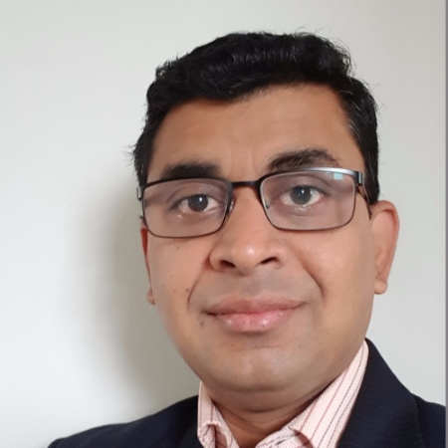
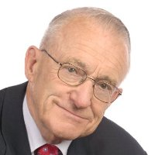
2. Call to Order, Welcome, Introductions, About the IBC Bob Allan (NAVCO, Inc.)
IBC Chair
Bob Allan
Vice President of Sales, East Region
NAVCO, Inc.
IBC Vice-Chair
Harsha Chandrashekar
Product Approvals & Regulatory Leader
Honeywell International
IBC Vice-Chair
Robert Lane
President & Managing Partner, Robert H. Lane and Associates Inc.
IBC Vice-Chair
Chris Larry
Director of Energy Engineering
Exp US Services Inc.
The ASHB Intelligent Buildings Council works to strengthen the large building automation industry through innovative technology-driven research projects. The Council was established in 2001 by ASHB to specifically review opportunities, take strategic action, and monitor initiatives that relate to integrated systems and automation in the large building sector. The Council's projects promote the next generation of smart building technologies and incorporate a holistic approach that optimizes building performance and savings. www.ashb.com/ibc ,

Slide 4
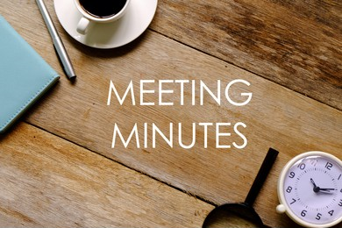
3. Administrative Bob Allan (NAVCO, Inc.)
Motion to approve past IBC Minutes May 9, 2024
www.ashb.com/ibc

Slide 5
4. Research Update Greg Walker (ASHB)
2024 IBC Landmark Research Smart Building Trends & Technology Adoption

Slide 6
4. Research Update Greg Walker (ASHB)
Annual BACS Market Sizing North America

Slide 7
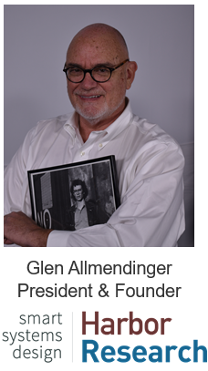
5. Keynote Chris Larry (Exp US Services Inc.)
Orchestrating and Automating the Value of AI-Enabled Solutions for Smart Buildings
Glen Allmendinger will explore emerging AI-enabled applications that are transforming how we innovate, operate, and provide value in intelligent buildings. Glen will address several critical questions:
How will AI innovations impact your business and ecosystem?
How can future scenarios help you strategize your organization’s response?
What maneuvers can your company take to leapfrog others by being an early mover in this space?

Slide 8
THANK YOU!
Questions?

Slide 9
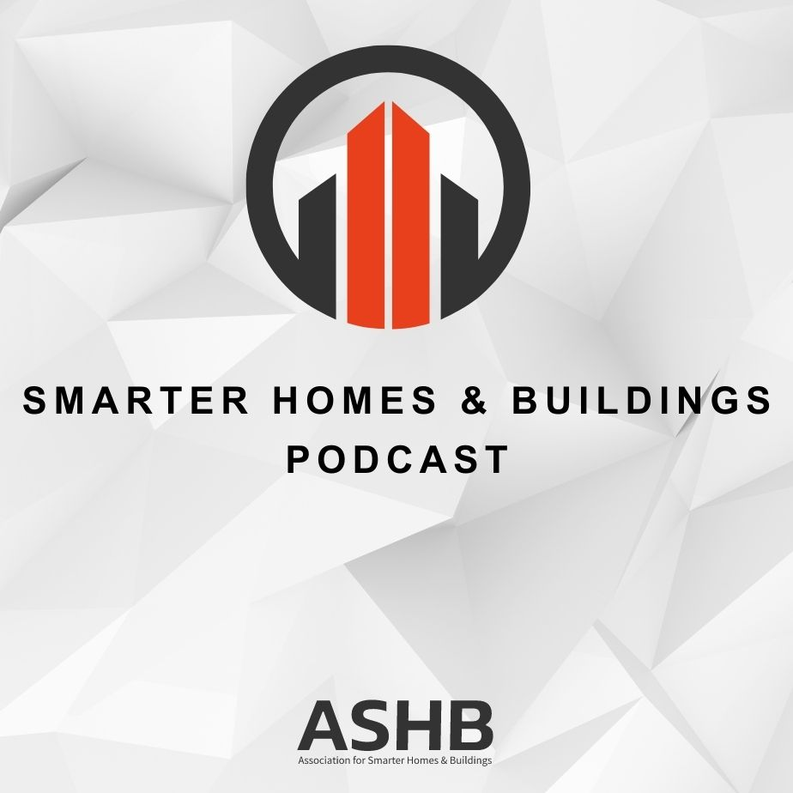
6. Smarter Homes & Buildings Podcast Robert Lane (Robert H. Lane & Associates Inc.)
Join industry experts and leaders from around the globe as they discuss everything smart home and intelligent buildings.
ASHB is looking for guests and hosts for future pre-recorded episodes. Contact admin@ashb.com for more information.
ashb.com/podcast
Recent Recordings:
’Killer Apps’ and Actionable Data Migration - Make Yourself the Smart Building Hero!
Utilize Native Functionality in Building Automation PLCs to Improve Security
Transforming Energy Management - ABB and Lumin on Smart Electrification Strategies
Bridging Policy and Innovation - Energy Efficiency in Window and Door Automation with AERC

Slide 10
7. ASHB Whitepapers Ken Wacks (Ken Wacks Associates)
Published IBC White Papers can be downloaded at:
ashb.com/whitepapers
Send proposals to admin@ashb.com

Slide 11
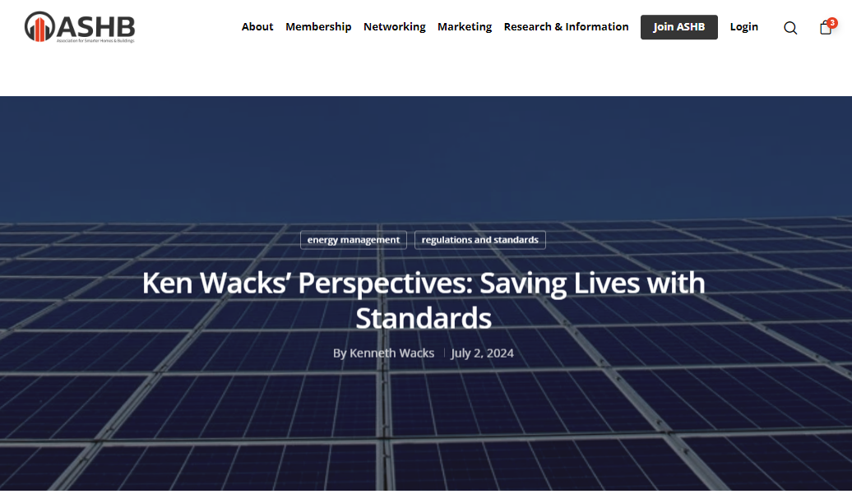
8. ASHB Journal Ken Wacks (Ken Wacks Associates)
The ASHB Journal aims to educate and inform the ASHB membership and industry at large on emerging research, issues, challenges, and opportunities in the intelligent buildings and/or connected home sectors.
New articles are posted to the ASHB website, included in the weekly NewsBrief, and circulated on Twitter and LinkedIn.
Send proposals to admin@ashb.com
Recent posts:
Ken Wacks Perspectives: Saving Lives with Standards
Ken Wacks Perspectives: CES 2023: A Sampling of Product Diversity
Facilio: The Relevance of Decarbonizing Goals During the Downturn

Slide 12
9. New Business Bob Allan (NAVCO, Inc.)
New IBC Business?

Slide 13
10. Announcements Greg Walker (ASHB)
Upcoming Events
BICSI Fall Conference & Expo
September 15-19 | Las Vegas, NV
IFMA World Workplace October 9-11 | San Antonio TX
Greenbuild
November 12-15 | Philadelphia, PA
Smart Living Expo
November 13-15 | Toronto, ON
The Buildings Show December 4-6 | Toronto, ON

Slide 14
11. Adjournment Bob Allan (NAVCO, Inc.)
Next IBC Meeting: November 2024
Association for Smarter Homes & Buildings (ASHB) admin@ashb.com | www.ashb.com | www.ashb.com/ibc
Connect to what’s next™

