Slide 1
Intelligent Buildings Council (IBC) Webinar Webinar/Meeting will commence 12:05pm ET Thursday, February 22, 2024 | 12 NOON – 1:30 PM (ET)
IBC Chair: Bob Allan (NAVCO Inc.)
Vice-Chair: Harsha Chandrashekar (Honeywell International Inc.)
Vice-Chair: Robert Lane (Robert H. Lane and Associates Inc.)
Vice-Chair: Chris Larry (exp US Services Inc.)

Slide 2
1. Agenda Bob Allan (NAVCO, Inc.)
Agenda
Call to Order, Welcome, Introductions, About IBC
Administrative
Research Update
Keynote: Smart Building Solutions Integration in the "Built Spaces"﻿- Gary Harvey(Delta Electronics)
ASHB Podcast
ASHB Journal
ASHB Whitepapers
New Business
Announcements
Adjournment

Slide 3
2. Call to Order, Welcome, Introductions, About the IBC Bob Allan (NAVCO, Inc.)
IBC Chair
Bob Allan
Vice President of Sales, East Region
NAVCO, Inc.
IBC Vice-Chair
Harsha Chandrashekar
Product Approvals & Regulatory Leader
Honeywell International
IBC Vice-Chair
Robert Lane
President & Managing Partner, Robert H. Lane and Associates Inc.
IBC Vice-Chair
Chris Larry
Director of Energy Engineering
Exp US Services Inc.
The ASHB Intelligent Buildings Council works to strengthen the large building automation industry through innovative technology-driven research projects. The Council was established in 2001 by ASHB to specifically review opportunities, take strategic action, and monitor initiatives that relate to integrated systems and automation in the large building sector. The Council's projects promote the next generation of intelligent building technologies and incorporate a holistic approach that optimizes building performance and savings. www.ashb.com/ibc ,

Slide 4
3. Administrative Bob Allan (NAVCO, Inc.)
Motion to approve past IBC Minutes November 21, 2023
www.ashb.com/ibc

Slide 5
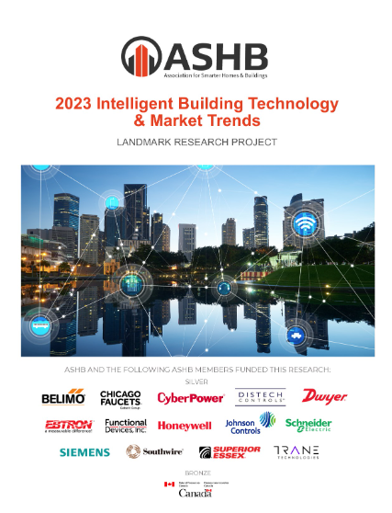
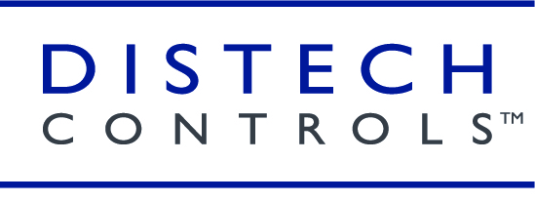
4. Research Update Robert Lane (Robert H. Lane and Associates Inc.)
2023 IBC Landmark Research Intelligent Building Technology & Market Trends
Funders
Contact Klopotowska@ashb.com to obtain research findings.

Slide 6
4. Research Update Robert Lane (Robert H. Lane and Associates Inc.)
2024 IBC Landmark Research Smart Building Trends & Technology Adoption

Slide 7
5. Keynote Harsha Chandrashekar (Honeywell International, Inc.)
DESIGNING A GREENER FUTURE:
Smart Building Solutions Integration in the "Built Spaces"﻿

Slide 8
IoT Device Trends
BIoT has transformed building automation, enhancing building performance and efficiency.
Reduced energy consumption, environmental impact, and improved occupant comfort and flexibility.
Optimization through BIoT: Energy usage, space utilization, and well-being optimization while interacting with external systems.

Slide 9
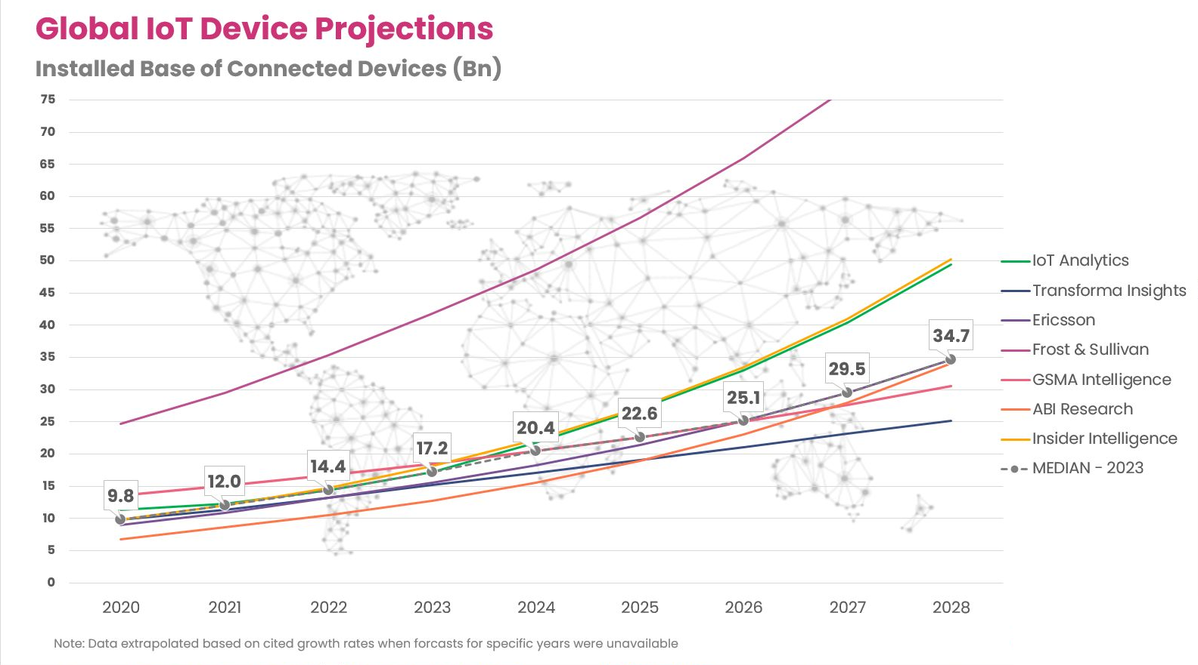
Conservative Reality

Slide 10
ESG & Sustainability
Buildings still consume 36% of energy & output 37% of global emissions (IEA) and the CRE sector is still falling way short of its targets to improve on energy efficiency.
The IEA calls for rates of sustainable retrofit to rise from a current level of 1% to over 2% per year in order to hit Net Zero targets by 2050.
Regulatory reporting pressure is growing, 192 countries have now adopted “Nationally Determined Contributions” to meet Paris Climate Agreement Goals and 63% of these include building energy efficiency targets.
Failure to conform to emerging legislation leaves commercial properties at risk
However, ESG policy adoption is an increasing priority at boardroom level, and volatile energy prices strengthen the investment case.

Slide 11
Technology Innovation
We are slowly transitioning to cloud based AI/ML driven solutions, most building owners and operators remain at the early stages of this journey.
The adoption of open standards, protocols, and non-proprietary solutions continue to drive innovation and scalability and are critical to overcoming challenges associated with soiled legacy systems.
Solutions for AI & Machine Learning in Smart Buildings are now capable of delivering genuine, cost-effective efficiencies or new opportunities for market differentiation.
Both Edge and Cloud Compute are proving essential for additional processing, storage, and analytics in IoT architectures.

Slide 12
What components define “Smart Building”?
A smart building system consists of various essential components that work together to enable efficient and automated control of building systems.
They generally include:
Sensors
Lighting
Controllers
User Interface
Video
Communication infrastructure
Integration with Other Systems
Notes:
What components does a BAS commonly require?
A building automation system (BAS) consists of various essential components that work together to enable efficient and automated control of building systems.
In truth, the list of components is endless, but they generally include the following:
Sensors: Sensors are essential in a BAS, collecting data on temperature, humidity, occupancy, light levels, and air quality. They are placed strategically throughout the building and provide accurate and real-time information. This data guides the BAS in making informed decisions to control and optimize systems.
Controllers: They also include controllers, which act as the central "brains" of the BAS. Controllers receive sensor data and processes it using predefined rules, algorithms or programming. They analyze the information and make decisions to optimize performance by adjusting setpoints, activating or deactivating equipment, regulating airflow or controlling lighting levels. Controllers can be centralized, managing the entire BAS, or distributed throughout the building, overseeing specific zones or systems.
User Interface: There is also the user interface, which is the interaction point between operators and the BAS. It often uses a software application or graphical user interface for real-time data visualization and control. This interface provides facility managers with full visibility and control, supporting informed decision-making. Examples include cell phones and other touchscreen pads, as well as voice and facial recognition software.
Video: In some applications, video can be an integral part of a building automation system. Integrated strategically, video cameras provide real-time visual data for security and operational efficiency. For security, video systems can detect unauthorized access and record security incidents, offering valuable evidence. Operationally, video analytics can optimize energy use by adjusting lighting and HVAC systems based on room occupancy. Video can also improve space allocation by monitoring usage patterns and optimize traffic flow within the building by identifying high-traffic areas. Real-time video data, coupled with advanced analytics and machine learning, can transform building management into a smart, sustainable operation.
Communication Infrastructure: A robust communication infrastructure is vital for a well-functioning BAS. It enables seamless data exchange between components through wired and wireless protocols like Ethernet, BACnet, Modbus, Zigbee or Wi-Fi. These protocols ensure secure and reliable transmission, connecting sensors, controllers and the user interface for a cohesive BAS ecosystem.
Integration with Other Systems: Integration is vital for a BAS. It ensures coordination and interoperability of building systems. The BAS must integrate seamlessly with other building systems such as fire alarms, security, access control and elevator systems. This synchronization enables comprehensive control and automation of the entire building.

Slide 13
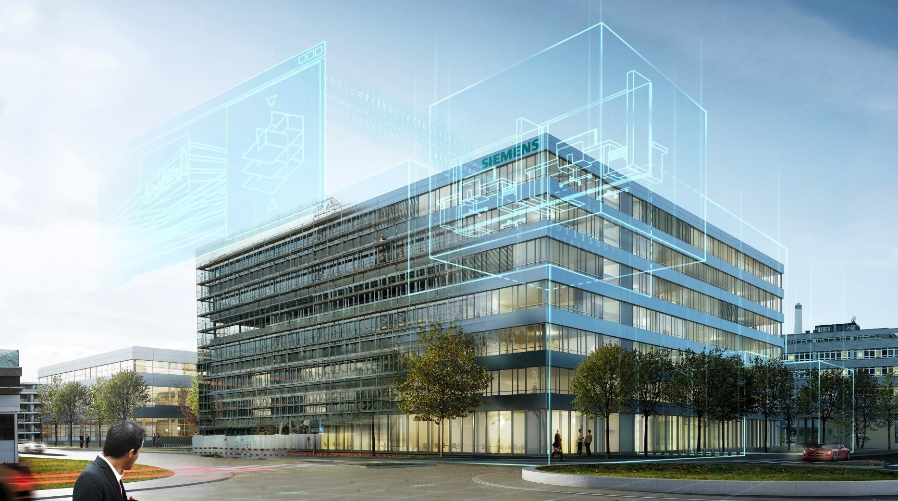
Building a “Smart Building”
Keep it simple. In fact, the simpler the better. This applies to all components – IoT devices, data storage, visualizations… everything!
Make it accessible. Most smart building systems fail to deliver because they are too complex, needing deep technical skills, rendering them unusable.
Keep it open. Open platforms allow easy extendibility e.g. using flexible and dynamic dashboards for further processing insights.
Insight, not data. Data is the new oil – but like the old oil it needs processing and refining to turn into value. Therefore, focus on insights.
This Photo by Unknown Author is licensed under CC BY-SA-NC
AEC magazine – Dr. Shrikant B Sharma

Slide 14
Low Carbon Integration

Slide 15
Building Infrastructure Integration

Slide 16
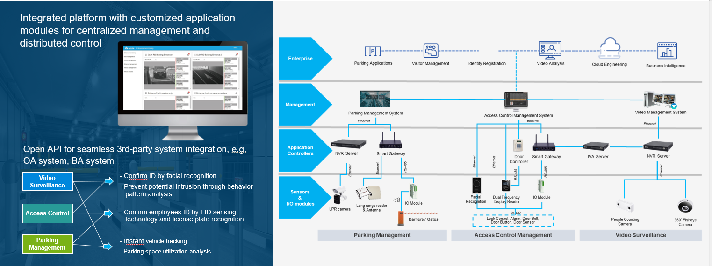
Multi Point Access Control Integration

Slide 17
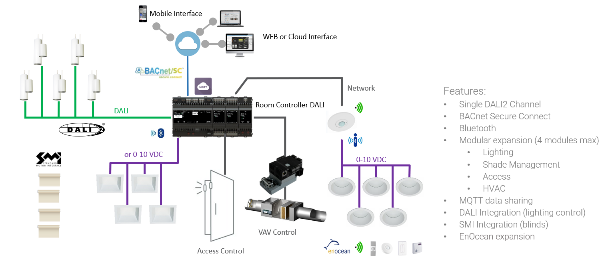
Network Lighting Integration

Slide 18
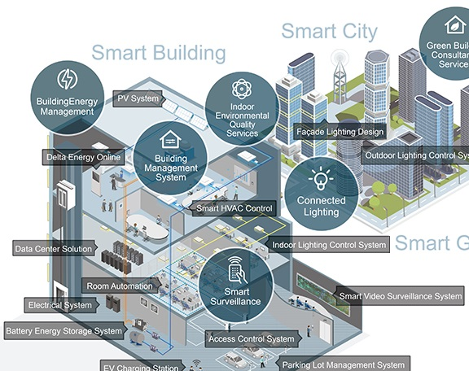
Case study examples of BAS integration
Notes:
Case study examples of BAS integration
In this webinar, we've covered the definition of a building automation system and its components. We've discussed how it systematically reduces energy consumption while enhancing productivity and comfort. A commercial space sounds pretty good with a BAS.
Is it?
What real-world applications are there to show how effective a building automation system is?
We did some research and found three case studies from around the world that highlight the effectiveness of building automation systems in commercial and institutional spaces.
Let’s get started, first in The Netherlands.

Slide 19
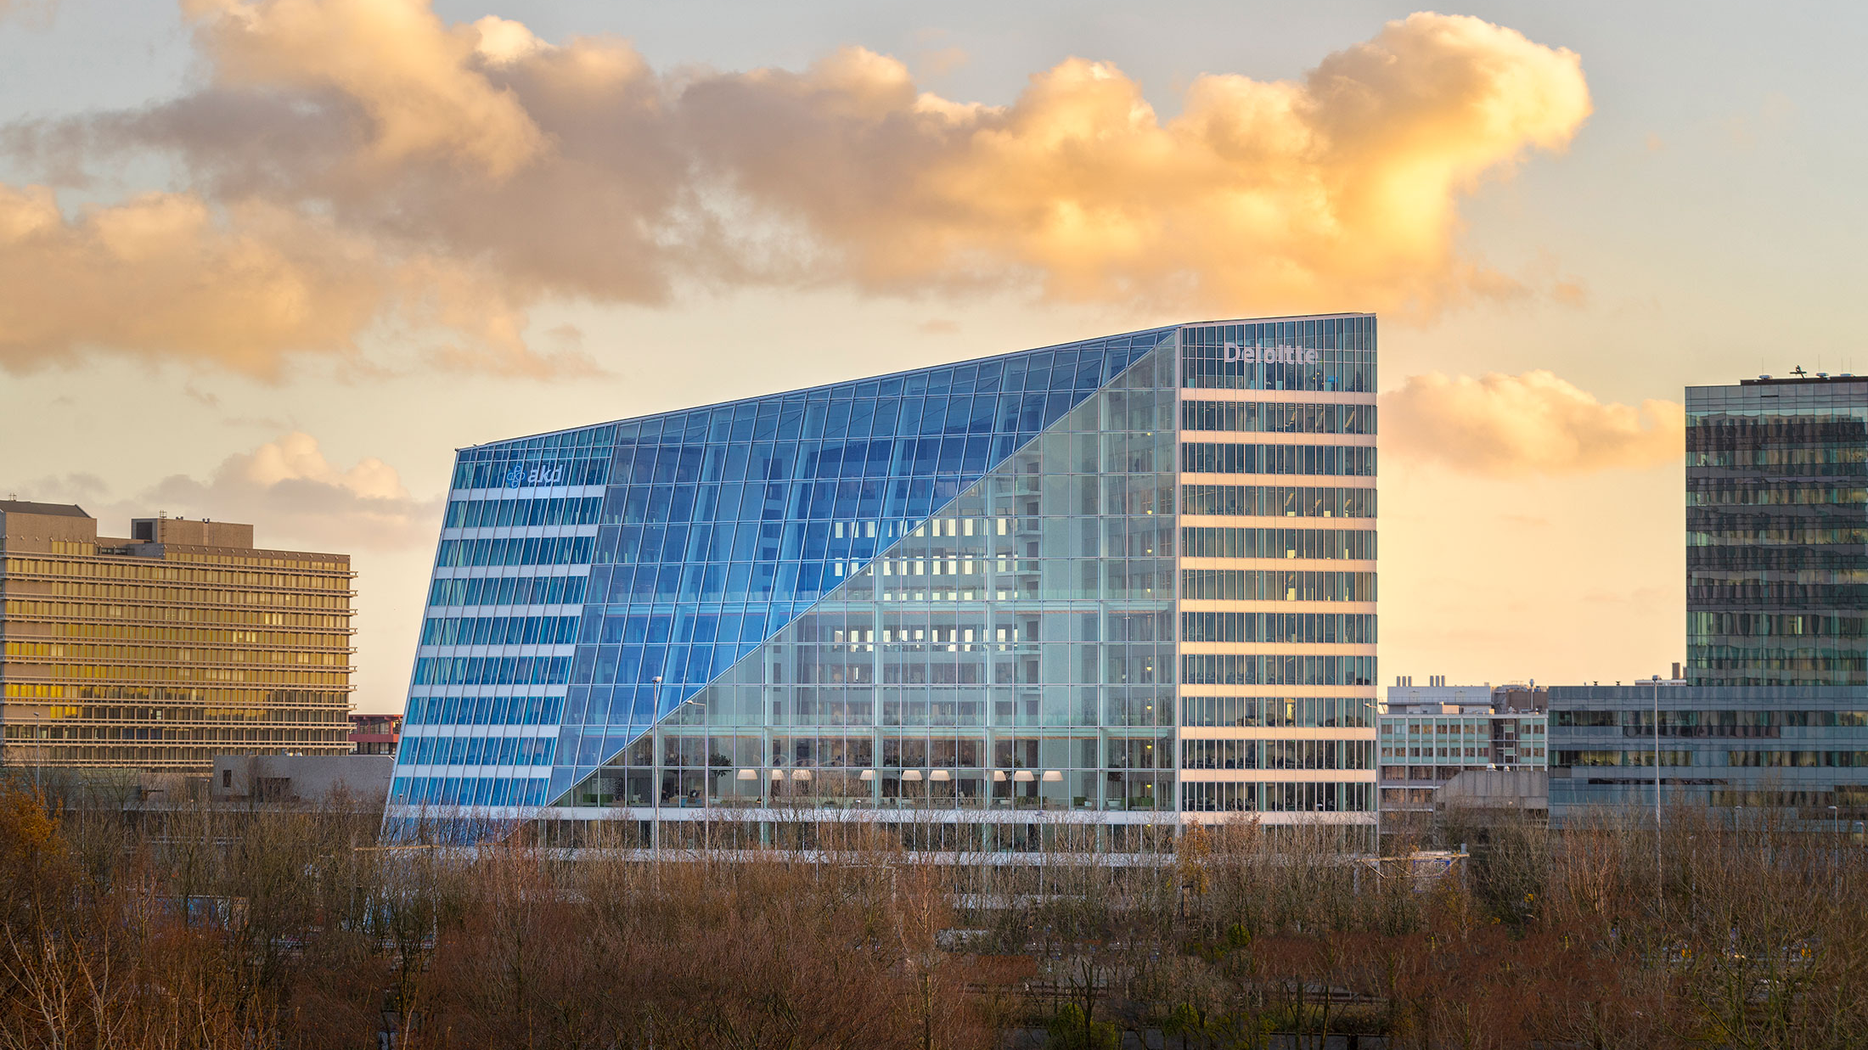
Case Study #1: The Edge, Amsterdam, Netherlands
Problem addressed: The Edge, a 430,556-square-foot office building, wanted to create a smart and sustainable workspace that enhances employee productivity and reduces energy consumption.
Solution and design: The building automation system integrated with the Internet of Things (IoT) and a mobile application to control:
Lighting
Heating, ventilation and air conditioning (HVAC) systems
The BAS also featured occupancy sensors and solar panels on the roof and facades.
Notes:
Case Study 1: The Edge, Amsterdam, Netherlands
In the heart of Amsterdam stands an architectural marvel and a testament to the promise of building automation technology. The building is called The Edge and is about 430,000-square-feet.
Architects had one thing in mind when they designed the structure: They wanted to redefine the concept of a workspace. They wanted to create a space that not only boosted employee productivity but also significantly reduced energy consumption.
To achieve this, they implemented a building automation system designed to harmonize with the Internet of Things and a dedicated mobile application.
This BAS was engineered to control the building's lighting, heating, ventilation and air conditioning systems seamlessly. Equipped with advanced occupancy sensors, the BAS intelligently adapted the building's operation based on real-time usage patterns.

Slide 20
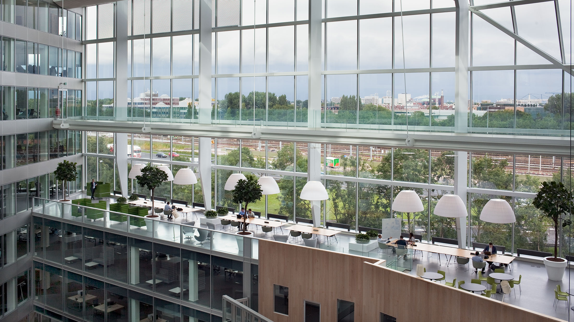
Case Study #1: The Edge, Amsterdam, Netherlands (cont.)
Energy and productivity findings: The BAS resulted in a 70% reduction in energy consumption compared to traditional office buildings.
The Edge also achieved a BREEAM rating of 98.36%, making it the world's most sustainable office building.
Employee productivity increased due to the personalized work environment and improved indoor air quality.
Notes:
Result: 70% reduction in energy consumption
The results of this ambitious endeavor were nothing short of spectacular.
With the integration of BAS, The Edge witnessed a 70% reduction in energy consumption when compared to traditional office buildings.
There’s more. There is an international standard for assessing, rating and certifying the sustainability of buildings. It’s called the Building Research Establishment Environmental Assessment Method. After the implementation of a BAS, The Edge scored a 98.36%. That rating crowned it the most sustainable office building in the world.

Slide 21
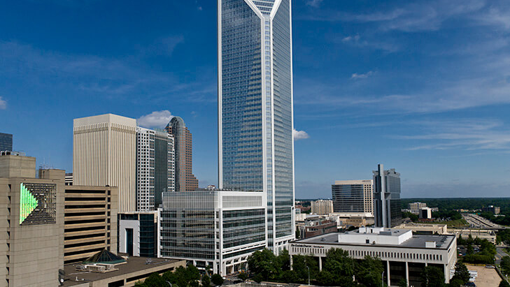
Case Study #2: 550 South Tryon, Charlotte, NC
Problem addressed: The Duke Energy Center wanted to achieve the highest levels of sustainability, energy efficiency and occupant comfort.
Solution and design: A building automation system was installed to monitor and control the building's HVAC, lighting and security systems.
Components included:
HVAC systems, including variable air volume (VAV) units and air handlers.
Real-time energy monitoring, for reporting and management.
Occupancy sensors
Daylight harvesting
Advanced metering infrastructure (AMI) to collect energy usage data for analysis and optimization.
Notes:
Case Study 2: 550 South Tryon, Charlotte, North Carolina, U.S.A.
Next, let’s head over to the United States. In Charlotte, North Carolina, there is a 48-story structure amid the skyline called 550 South Tryon, formerly known as the Duke Energy Center. It stands as a testament to the kind of sustainability a BAS can deliver.
The owners and management of the building wanted to achieve new levels of sustainability, energy efficiency and occupant comfort. They also wanted a thriving, productive workspace for tenants.
To realize this vision, a comprehensive building automation system was deployed. This system monitored and controlled the building's HVAC, lighting and security. It also integrated real-time energy monitoring software, occupancy sensors and daylight harvesting technology to optimize lighting, reduce energy consumption and gather vital energy usage data for optimization.

Slide 22
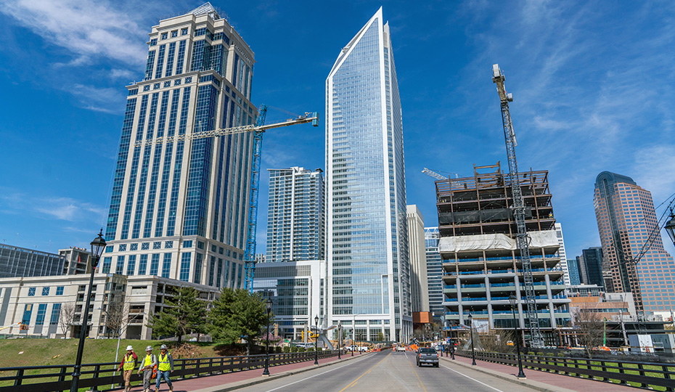
Case Study #2: 550 South Tryon, Charlotte, NC (cont.)
Energy and productivity findings: Duke Energy Center achieved significant energy savings and improved occupant comfort.
Key findings include:
LEED Platinum certification
A 22% reduction in energy consumption
Improved indoor air quality
Enhanced space utilization and tenant satisfaction
Increased operational efficiency
Notes:
The results of this ambitious implementation were striking. The skyscraper saw significant energy savings, reducing energy use by 22%. The building's occupants also experienced an unprecedented level of comfort.
The building also earned the coveted LEED Platinum certification, which ranked it among the most sustainable office buildings in the United States.
The transformation surpassed just sustainability and efficiency. Indoor air quality improved with demand-controlled ventilation. Space utilization grew. Tenant satisfaction rose.
Real-time data and system monitoring drove these changes, all thanks to the tower’s new building automation system.

Slide 23
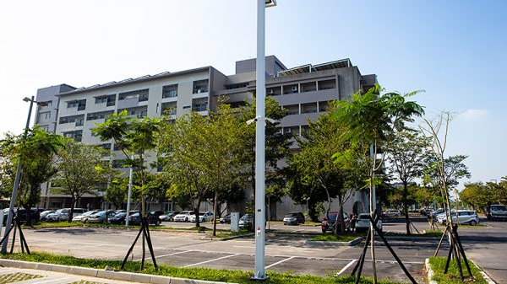
Case Study #3: Zhiyuan Building, Taiwan
Problem addressed: The Zhiyuan Building on the Taiwan campus of National Chiao Tung University is a research and development center.
The building wanted to improve operational efficiency and create a smart, energy-saving and safe innovation center.
Solution and design: The university implemented an IoT-based building automation system that included:
Smart management system for central monitoring
Smart elevator calls
Automated Control of meeting rooms
Variable water volume system
LED lighting and controls
Notes:
Case Study 3: Zhiyuan Building at National Chiao Tung University, Taiwan
So far, we’ve had a case study from Europe and another from North America. But this technology can be implemented in nearly any structure worldwide, including Asia.
Take, for instance, Taiwan.
On the Taiwan campus of National Chiao Tung University stands the Zhiyuan Building. It’s a five-story research and development hub, spanning 23,000-plus square meters. It was a good, sound structure, but the University wanted more. They wanted it to be an innovative center that exemplified smart, energy-saving operations.
To realize this, the university deployed an IoT-based building automation system. This advanced system included a smart management system for central monitoring, smart elevator calls and automated control of meeting rooms. An energy-efficient Variable Water Volume System was also integrated alongside energy-saving LED lighting and controls.

Slide 24
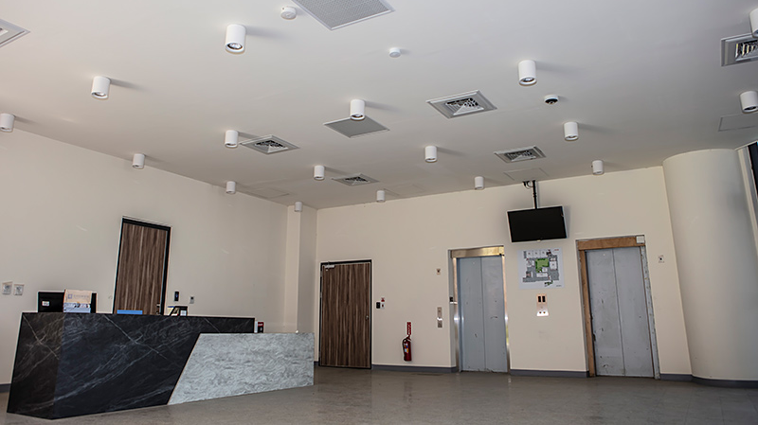
Case Study #3: Zhiyuan Building, Taiwan
Energy and productivity findings:
The BAS led to a 17.5% increase in the efficiency in the air-conditioning system.
The energy efficiency of the LED lighting system with zone-based DALI lighting control increased 75%.
The energy monitoring system analyzed energy consumption data to find the best potential points for energy conservation.
Notes:
Result: DALI-Lighting Efficiency Increases 75%
The building automation system led to a notable upturn in operational efficiency. The air conditioning system saw a 17.5% boost in efficiency, and the LED lighting system's efficiency skyrocketed by 75% with zone-based DALI lighting control.
Furthermore, the energy monitoring system utilized consumption data to pinpoint prime opportunities for energy conservation.
The Zhiyuan Building in Taiwan, the former Duke Energy Center in Charlotte and The Edge in Amsterdam serve as remarkable examples of building automation systems. These iconic structures demonstrate the incredible possibilities that can be achieved when architects dare to push the boundaries of innovation and design with building automation.

Slide 25
Future Outlook
While general supply chain issues should ease, trade tensions look set to persist into 2024.
While the CRE sector will face liquidity pressure, investment into IoT solutions to improve sustainability and user experience solutions will be essential to maintain.
Cyber related investment and corporate focus will need to increase to mitigate rising risk and breach related costs.
AI innovations will continue to drive investment and innovation activity, unlock new novel use cases, and improve the ROI of data driven smart building investments.

Slide 26
Thank You Questions

Slide 27
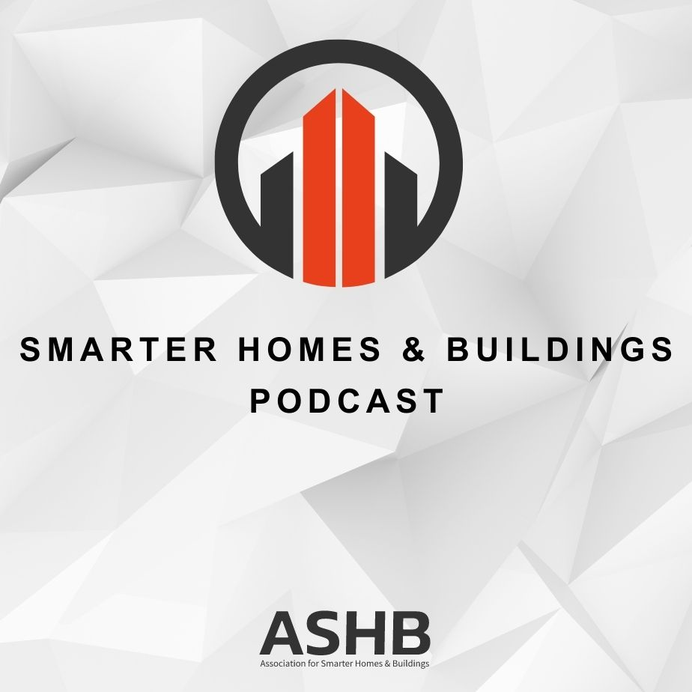
6. Smarter Homes & Buildings Podcast Chris Larry (Exp US Services Inc.)
Join industry experts and leaders from around the globe as they discuss everything smart home and intelligent buildings.
ASHB is looking for guests and hosts for future pre-recorded episodes. Contact admin@ashb.com for more information.
Recent Recordings:
Business Drivers for Smart Buildings
Smart Buildings: New Builds or Transformations Require Solid Footing
Optimizing Your Environment: The Building Performance Blueprint

Slide 28
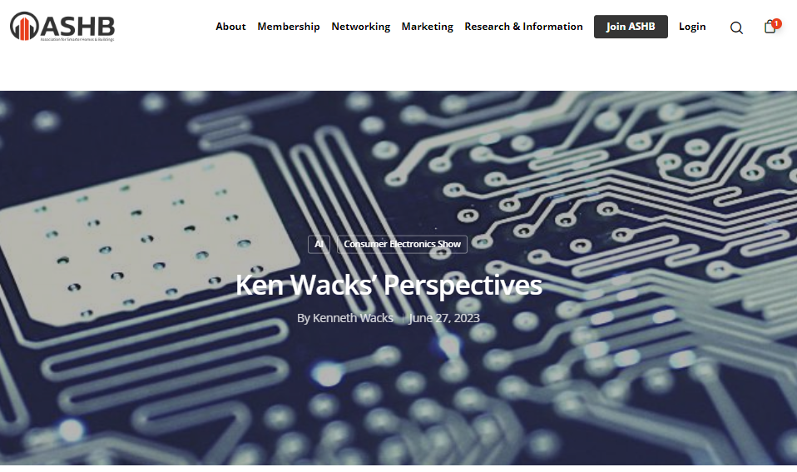
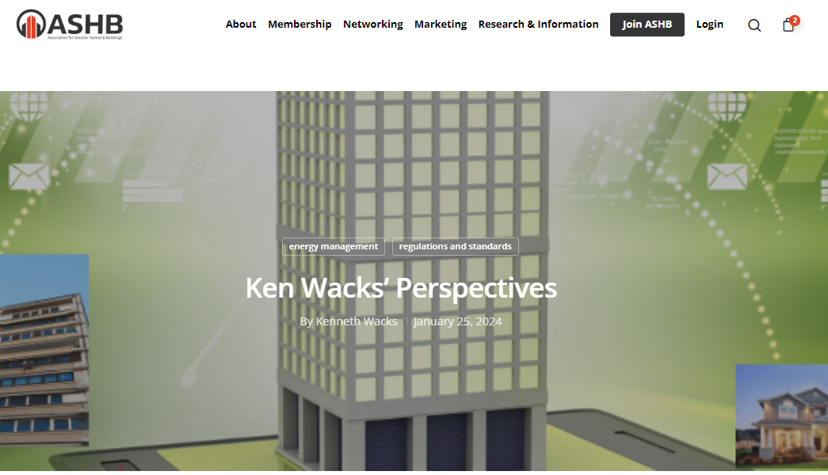
7. ASHB Journal Ken Wacks (Ken Wacks and Associated)
The ASHB Journal aims to educate and inform the ASHB membership and industry at large on emerging research, issues, challenges, and opportunities in the intelligent buildings and/or connected home sectors.
New articles are posted to the ASHB website, included in the weekly NewsBrief, and circulated on Twitter and LinkedIn.
Send proposals to admin@ashb.com
Recent posts:
Ken Wacks Perspectives: The Business Case for Energy Management
Ken Wacks Perspectives: CES 2023: A Sampling of Product Diversity
Facilio: The Relevance of Decarbonizing Goals During the Downturn

Slide 29
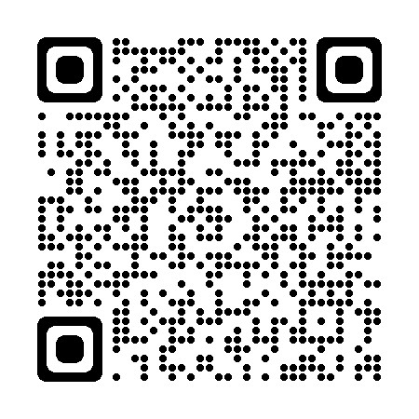
8. ASHB Whitepapers Ken Wacks (Ken Wacks Associates)
Published IBC White Papers can be downloaded at:
www.ashb.com/whitepapers
Send proposals to admin@ashb.com

Slide 30
9. New Business Bob Allan (NAVCO, Inc.)
New IBC Business?

Slide 31
10. Announcements Robert Lane (Robert H. Lane & Associates Inc.)
Upcoming Events
DISTRIBUTECH February 26-29 | Orlando, FL
IFMA World Workplace
March 6-7 | Netherlands
Controls-Con May 16-17 | Dallas, TX
Realcomm IBcon
June 20-21 | Tampa, FL

Slide 32
11. Adjournment Bob Allan (NAVCO, Inc.)
Next IBC Meeting: May 2024
Association for Smarter Homes & Buildings (ASHB) admin@ashb.com | www.ashb.com | www.ashb.com/ibc
Connect to what’s next™

