Slide 1
Landmark Research Report:
Smart Home Energy Management
Think Tank
Harbor Research
Harry Pascarella Daniel Chmil
Jamil Muna Martina Guglielmone

Slide 2
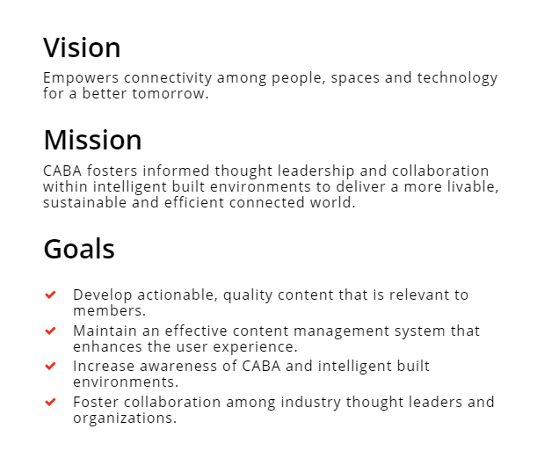
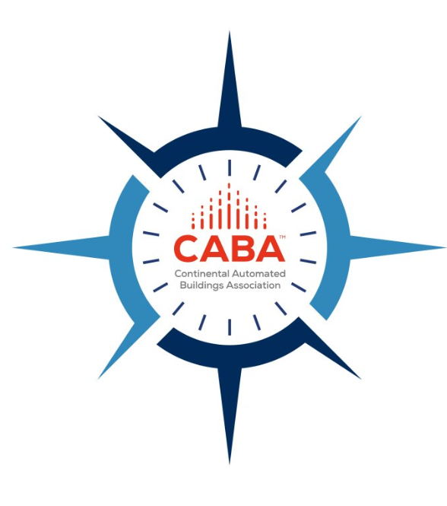
CABA Vision, Mission, Goals

Slide 3
About Harbor Research

Slide 4
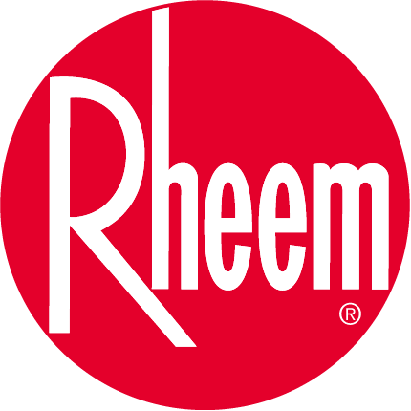
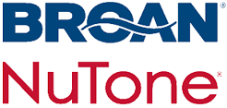
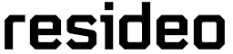



CABA Steering Committee & Funders
The Steering Committee represents a cross-section of solution providers in the indoor environmental quality marketplace. Representatives from each organization joined Harbor Research and CABA on regular collaboration calls to ensure the research scope met the project objectives. The Steering Committee played a vital role in outlining the research product in terms of defining the required content as well in collaboration on the research approach including the development of the interview scripts and surveys.
Steering Committee
Bronze & Titanium Funders

Slide 5
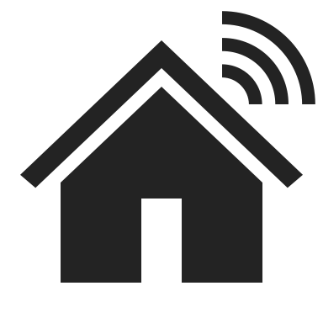

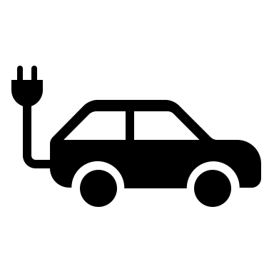

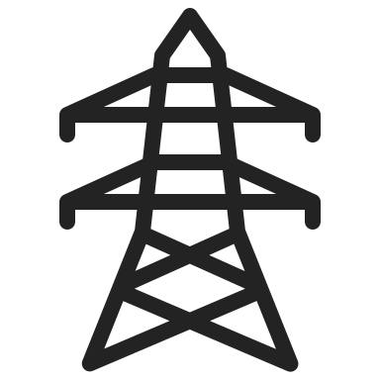


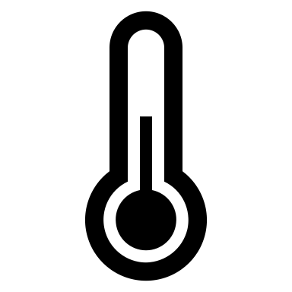

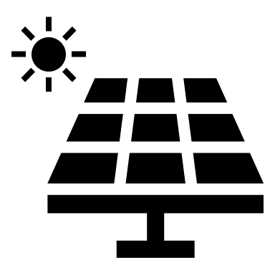


Time & Investment In Smart Homes Will Likely Develop Improved Energy Management Habits
Investments made in making homes smarter and more energy efficient, combined with the increase in time spent at home, will enable more sophisticated energy monitoring and management habits
Expanding Smart Homes
Smart homes are expanding rapidly due to various factors, including the adoption of IoT devices, demand for energy efficiency, increasing awareness of smart home technology, and the rise in electric vehicles.
Adoption-related trends for homeowners​
Trends Related to Social, Economic and Environmental Influence
Home Automation
Electric Vehicles Proliferation​
Grid Integration
HEMS are now able to integrate with the energy grid to reduce peak energy consumption and enhance grid reliability, as well as help homeowners maximize the benefits of their renewable energy investments.
Energy Price Trends
Connectivity Improvements, Sensor Proliferation, and Data Utilization​
Homes Sold with Built-in Energy Management Systems​
Impact of
COVID
Covid-19 has led to increased demand for smart home remote access and control, automation and optimization, and health and wellness solutions. With more people working from home, smart devices are used to optimize energy usage and comfort, while sensors and machine learning algorithms adjust settings. Homeowners also adopt smart devices for air quality and fitness to maintain physical and mental health while spending more time at home.
Climate Change
Distributed Energy (DER)​, Clean Energy, & Sustainability​
Smart Heating & Cooling Innovations
Regulations around Sustainability
Notes:
Smart home adoption has been steadily increasing over the past few years, as homeowners seek to use technology to improve the comfort, convenience, and security of their homes.
"One of the key benefits of smart home energy management systems is their ability to integrate with the energy grid, allowing homeowners to participate in demand response programs and other initiatives that help reduce peak energy consumption and enhance grid reliability."
"Smart home energy management systems have the potential to play a critical role in renewable energy integration by allowing homeowners to monitor energy production and consumption and adjust energy usage patterns to ensure that excess energy is stored or sold back to the grid when appropriate.

Slide 6
Energy Price Spikes Leading To Energy Management Awareness & Adoption
Rising energy prices will naturally create opportunities for innovation and growth in the smart home energy management market. This has been witnessed in regions most significantly affected by the recent energy supply shock
Energy prices are on a rise rise due to factors such as:
  Limited supply
  Increasing demand
  Environmental regulations
  Impact of geopolitical tension
As more people adopt these systems, the energy management market is likely to grow, leading to increased competition and accessibility for consumers.
The ongoing conflict between Russia and Ukraine is a good example of supply shock causing energy prices to rise globally. This situation has led consumers to prioritize energy efficiency and cost savings, making smart home technologies increasingly popular.
CASE STUDY
The Problem
The ongoing conflict between Russia and Ukraine has disrupted the global energy market, causing an increase in energy prices worldwide
European Energy Crisis
Although the recent energy spikes haven't directly translated to increased adoption of Smart Home Energy Management Systems (SHEMS), they have generated significant interest and action around other energy-saving investments in homes.
The Solution
Homeowners are increasingly curious and motivated to explore adjacent technologies and solutions that can help them save on energy bills, such as smart thermostats, heat pumps, energy-efficient appliances, and rooftop solar
The Results
As a result, this trend has created a promising market for energy-related home investments and an opportunity for companies to develop and promote innovative solutions that can help homeowners reduce their energy consumption and costs.

Slide 7


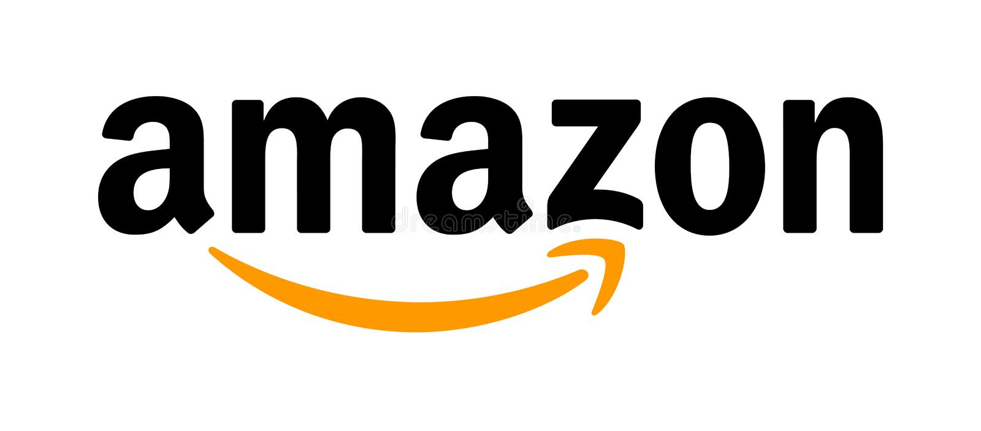









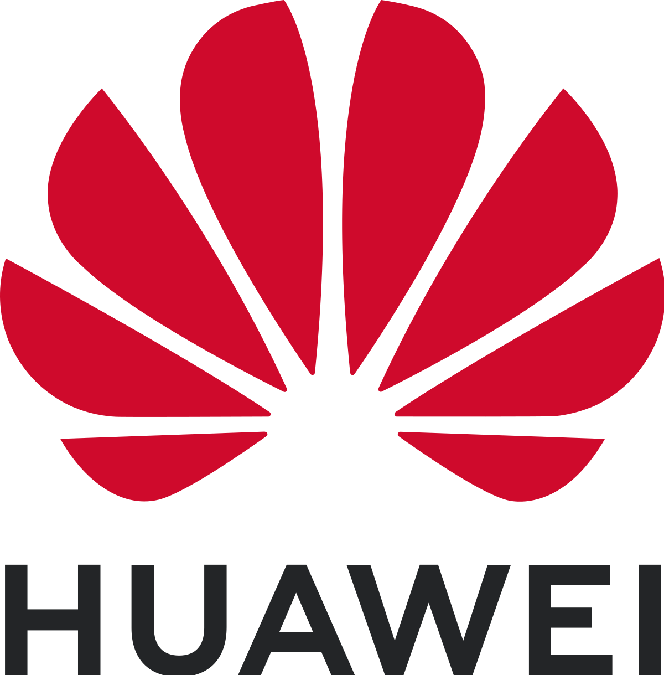

Home Automation, Smart Hubs & Wearables Driving Driving Requisite Energy Mgmt. Habits
Smart home adoption has been steadily increasing over the past few years, as homeowners seek to use technology to improve the comfort, convenience, and security of their homes. Home automation, Smart hubs and wearables are driving habits that are paving the way for SHEMS adoption.
Smart hubs have become popular due to various reasons such as the availability of numerous smart home devices, the need for remote control and automation, and the desire for an integrated system to manage multiple devices and functions.
Wearables are increasingly being adopted in smart homes due to various reasons such as the focus on health and wellness, availability of wearable devices, and the desire for a personalized and connected living experience.
Key Advancements
Most Popular Devices
Key Advancements
Most Popular Devices
Voice Recognition
Voice Assistants
Apple Watch Series
The Amazon Echo
Smart Hubs and Voice Assistants
Google Nest Hub
Wearables
Garmin Smart Watch
Gesture Control
Increased use of advanced sensors
Aeotec Smart Home Hub
Fitbit Fitness Trackers and smart watches
Better Integration with other smart home devices
Apple HomePod
Wireless
Charging
Huawei Smartwatches
Starling Home Hub
Notes:
Wearables, such as smartwatches and fitness trackers, are increasingly being integrated into smart homes, allowing homeowners to track and manage their health and wellness goals from a central platform. These devices can be connected to other smart home devices such as smart thermostats and lighting systems, allowing for automated adjustments based on the user's activity level, sleep patterns, and other biometric data.
Voice assistants like Amazon Alexa and Google Assistant are becoming popular tools for controlling smart home devices with voice commands. This trend is expected to continue as more devices are built with the ability to be controlled by voice commands. Additionally, smart home devices are increasingly being designed with interoperability in mind, enabling users to control multiple devices from a single interface.
The adoption of wearables and voice assistants in smart homes is driven by several factors, including the increasing focus on health and wellness, the desire for convenience and seamless user experience, and the need for remote control and automation. As the technology becomes more widely available and accessible, it is expected to continue to grow and evolve, with advancements in connectivity standards and artificial intelligence having a significant impact on the future of smart homes.

Slide 8
EVs and Renewable Energy Investments Drive Higher Interest in Energy Monitoring
More than 80% of EV owners and renewables users reported that they monitor their energy bills while the total sample average was 59%. When looking at responders who are interested in EVs and renewable energy, 21% and 19% responded No while the total sample average was 17%.
Electric vehicle owners and renewable energy users tend to be far more environmentally minded and interested in new technologies than homeowners who don’t use them.
No EV owners or renewable users report not wanting to monitor their energy bills.

Slide 9
Awareness & Adoption of SHEMS is Still Low
It will be imperative for industry members to work to raise general awareness of the potential of smart home energy management systems to manage energy usage and lower bills. Our research suggests using EV providers, renewable energy device and software companies, and utilities providers to accelerate awareness and communicate with interested parties
Just 32.66% of respondents had heard of home energy management systems. Of those who had not heard of home EMS, 17.94% were interested in learning more, an indication that more people are receptive to the messaging around EMS than are being reached.

Slide 10
Rising Energy Cost Are a Key Concern Driving Curiosity Around Energy Management
Four key factors seem to drive adoption: economic concerns, an interest in sustainability and concern for the environment, interest in trying new technologies, and desire to optimize energy usage.

Slide 11
Sustainability Concerns are Less Widespread Than Rising Energy Cost concerns
81.65% of homeowners reported that reducing their energy consumption and carbon footprint is important to them and their family members, and 58.06% reported it was “very important.” Just 18.35% said that reducing their energy consumption and carbon footprint was “not very important” to them or their household. Interesting This is not the main driver of EMS installation

Slide 12
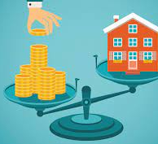
Rising Cost of Living and Energy Price Volatility
The economic impact of energy costs on households has become a significant concern in recent years, with the cost of living steadily rising and energy price fluctuations causing uncertainty. High energy costs can burden households, particularly those with limited income, making energy-efficient solutions like SHEMS essential.
Strategies SHEMS providers can take for targeting geographies with rapid energy price increases:
Market Research: Identifying regions with the most significant energy price increases is essential for targeting potential customers who can benefit the most from SHEMS.
Customized Solutions: Develop customized SHEMS solutions tailored to the unique energy needs and consumption patterns of each region, considering factors such as climate, local energy sources, and building designs.
Partnerships and Collaboration: Form strategic partnerships with local utility companies, governments, and non-governmental organizations to create awareness about the benefits of SHEMS, offer incentives, and facilitate easier adoption.
Flexible Pricing Models: Introduce flexible pricing models and financing options to make SHEMS more accessible and appealing to a wider range of customers.

Slide 13

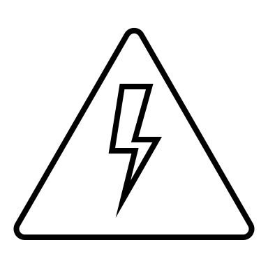
Personas Most likely to Adopt Energy Management Solutions
To successfully promote the adoption of Smart Home Energy Management Solutions, it is essential to understand the different personas interested in these technologies. By comprehensively analyzing the characteristics, motivations, and preferences of these key personas, SHEMS providers can develop more effective marketing strategies and cater to the unique needs of each customer segment
Tech-Obsessed Early Adopters:
Early adopters play a crucial role in the adoption of any new technology. These tech-savvy individuals are driven by their passion for innovation and are usually the first to experiment with new products.
Understanding the motivations and priorities of early adopters:
Intrigued by the latest technological advancements and innovations
Keen to enhance personal efficiency, convenience, and control through the use of smart home solutions
Eager to share their experiences with their social circle, thus influencing others to adopt the technology
Targeting tech-obsessed early adopters effectively should include:
Utilize their preferred learning channels, such as YouTube, podcasts, online tech newsletters, and blogs
Develop collaborations with influencers and tech experts to create awareness and trust
Run display ads and sponsored content on technology-oriented websites and forums
Energy Conscious Individuals
Energy-conscious individuals prioritize cost savings and energy efficiency, often driven by financial concerns rather than sustainability. This group tends to be more practical and focuses on the tangible benefits of energy management.
Analyzing the factors driving energy-conscious individuals to adopt SHEMS:
Desire to save money on energy bills and reduce household expenses
Interest in managing energy consumption more effectively to optimize efficiency
Preference for practical home investments, such as solar energy or insulation upgrades, which offer immediate cost savings
Targeting energy conscious individuals effectively should include:
Developing informative content that highlights the cost-saving benefits of SHEMS, including case studies and testimonials
Collaborating with utility companies and government agencies to offer rebates, incentives, or financing options that make SHEMS more affordable
Running targeted display ads based on search history, particularly if they have searched for energy management solutions or related topics

Slide 14
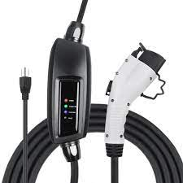
EV Ownership & Charging Recommendations
Our homeowner survey has revealed that the motivations and priorities of EV owners are primarily driven by cost, and secondarily drive by sustainability. As a result of the high cost of purchasing an EV, owners feel that they have made a substantial investment towards sustainability, and their attention subsequently shifts towards avoiding additional costs. This shift in focus can be attributed to the unpredictable energy spikes and rising prices of energy that can result in unwanted added costs.
Messaging:
SHEMS is a direct path to offsetting unexpected costs or ballooning energy costs associated with charging an electric vehicle at home.
Potential Paths Forward:
One approach is to integrate SHEMS software with EV charging hardware at the point of sale as an upsell or free incentive.
Targeting EV owners through online display advertising can also drive curiosity and eventually sales of energy management solutions.
Recommendations for SHEMS Providers:
Establish partnerships with EV charging hardware manufacturers and installers to offer bundled services, making it more convenient for EV owners to adopt SHEMS alongside their EV charging solutions.
Develop targeted marketing campaigns to educate EV owners about the benefits of SHEMS, emphasizing its potential to reduce energy costs and improve sustainability.
Develop user-friendly interfaces and dashboards that help EV owners visualize their energy consumption and savings, enabling them to make data-driven decisions about their energy usage.
Integrate EV charging data into SHEMS software to provide a holistic view of energy consumption and management, helping EV owners better understand their charging patterns and optimize energy usage.
Create software solutions compatible with a wide range of EV charging hardware, ensuring seamless integration and making it easier for EV owners to adopt SHEMS solutions.

Slide 15
Q & A

Slide 16





Harbor Research Team
Key Project Contacts
Jamil Muna
Project Manager - Consultant
+707-968-17570
jmuna@harborresearch.com
Harry Pascarella
Project Oversight - Vice President
+1.303.786.9000 x36
hpascarella@harborresearch.com
Daniel Intolubbe-Chmil
Subject/Process Expert - Consultant
434-806-4334
dintolubbechmil@harborresearch.com
Glen Allmendinger
Project Advisor - President
617-290-3797
gallmendinger@harborresearch.com

Slide 17
Contact Harbor Research
Harbor Research, Inc. (HRI)
1801 Broadway UNIT 408
Denver, Colorado 80202
Daniel Intolubbe-Chmil
Project Manager (Primary Contact)
dintolubbechmil@harborresearch.com
M: +434.806.4334
Michael Levy
Lead Associate (Primary Contact)
mlevy.com@harborresearch.com
M: +1.404.791.4754
Harry Pascarella
Director (Secondary Contact)
hpascarella@harborresearch.com
O: +1.303.786.9000 x36
17

Slide 18
Contact CABA
Continental Automated Buildings Association (CABA)
613.686.1814
Toll free: 888.798.CABA (2222)
caba@caba.org
www.CABA.org
www.twitter.com/caba_news
www.linkedin.com/groups?gid=2121884
Connect to what’s next™

