Slide 1
Connected Home Council (CHC) Webinar
Meeting will commence 12:05pm ET
Tuesday, July 25, 2023, 12 PM – 1:30 PM (ET)
CHC Chair: Ken Wacks (Ken Wacks Associates)
Vice-Chair: Charles Hume (Southwire Company, LLC)

Slide 2


1. Agenda
Greg Walker (CABA)
Agenda
Call to Order, Welcome, Introductions, About the CHC
Administrative
Research Update
Keynote: “A U.S. National Cybersecurity Label for Consumer-Connected Devices, and Beyond” (30 min)
  Mike Bergman (Consumer Technology Association)
CABA Journal
CABA Podcasts
New Business
Announcements
Adjournment

Slide 3
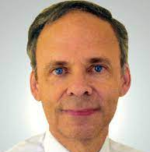
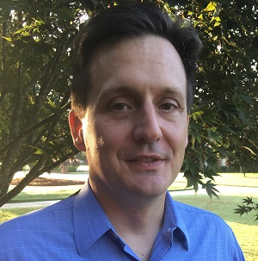

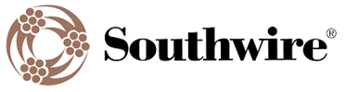
2. CHC Meeting Call to Order, Intros, About the CHC
Ken Wacks (Ken Wacks Associates)
Established in 2004, the CABA Connected Home Council initiates and reviews projects that relate to connected home and multiple dwelling unit technologies and applications. The Council also examines industry opportunities that can accelerate the adoption of new technologies, consumer electronics and broadband services within the burgeoning connected home market. www.caba.org/chc
CHC Chair
Dr. Kenneth Wacks
Management & Engineering Consultant
Ken Wacks Associates
CHC Vice-Chair
Charles Hume
Director of Digital Power Technologies
Southwire Company, LLC
3

Slide 4
3. Administrative
Ken Wacks (Ken Wacks Associates)
3.1 Motion to approve past CHC Minutes May 9, 2023
www.caba.org/chc
3.2 Call for CHC Vice Chairs

Slide 5

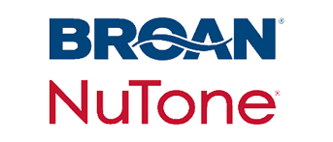




4. Research Update
Greg Walker (CABA)
2022 CHC Landmark Research
Smart Home Energy Management

Slide 6


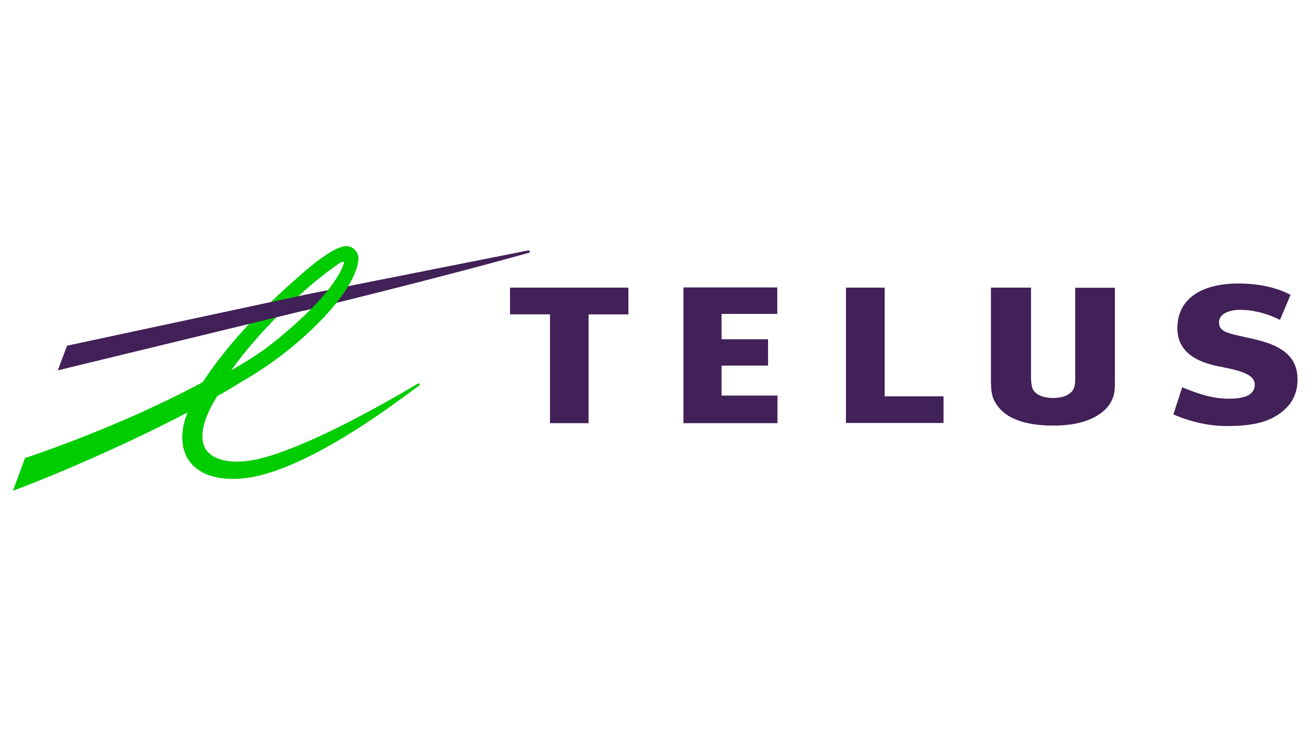
4. Research Update
Greg Walker (CABA)
2023 CHC Landmark Research
Smart Home Technology & Market Trends

Slide 7
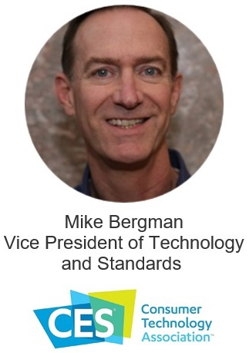
5. Keynote
Greg Walker (CABA)
A U.S. National Cybersecurity Label for Consumer-Connected Devices, and Beyond

Slide 8


Slide 9
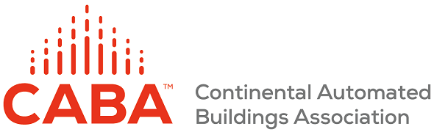
A U.S. National Cybersecurity Label for Consumer Connected Devices — And Beyond
Mike Bergman
VP of Technology & Standards
Consumer Technology Association
mbergman@CTA.tech

Slide 10
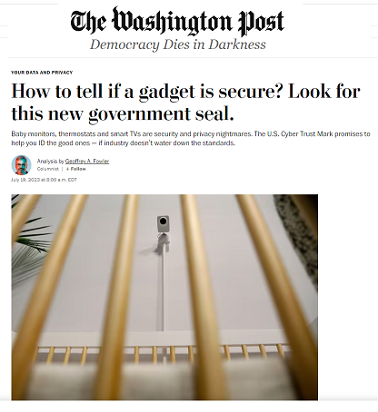

The U.S. Cyber Trust Mark

Slide 11
Background, Launch & Status
11

Slide 12
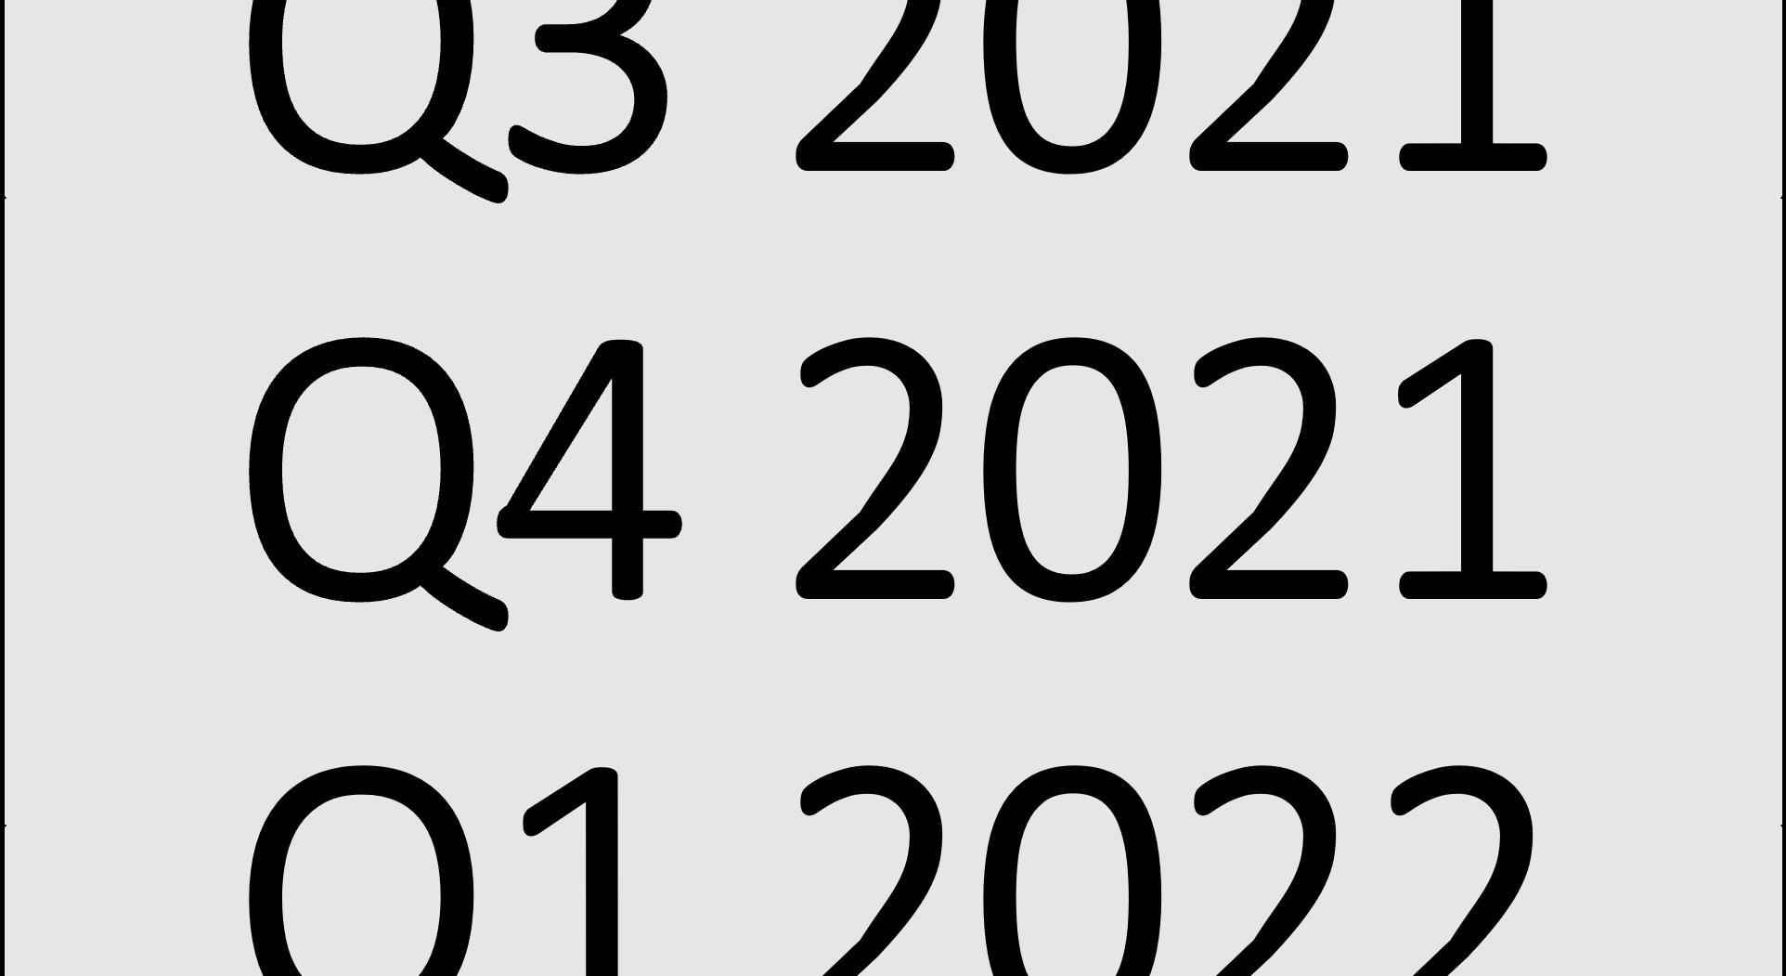
Motivation: Cyber Attacks Just. Keep. Growing.
Example: Huge Increase in DDoS Attacks in Q4 2021
  95% increase in “L3/L4” DDoS attacks overall;
  Attacks on Manufacturing companies increased by 641% QoQ; and
  Attacks on the Business Services industry increased by 97%.
Example: Ransomware attacks increased by 29% YoY and 175% QoQ in 2021.
USG is concerned about “Critical Infrastructure” as an element of National Security.
Much of this activity is powered by hordes of hacked IoT devices.
Single hacked IoT devices can be an entry point into corporate networks or critical infrastructure plants or enterprises.

Slide 13
U.S. National Mark – Top-Line Status
It was launched July 18th 2023 at the White House.
It is a voluntary cyber mark for consumer connected devices.
The White House has been driving the effort based on NIST work…
…and on a private sector proposal based on 3rd party certification & self-attestation.
FCC is the program administrator and will release an NPRM for program rules.
There is broad public/private support.
International coordination is strongly desired by all parties.
13

Slide 14
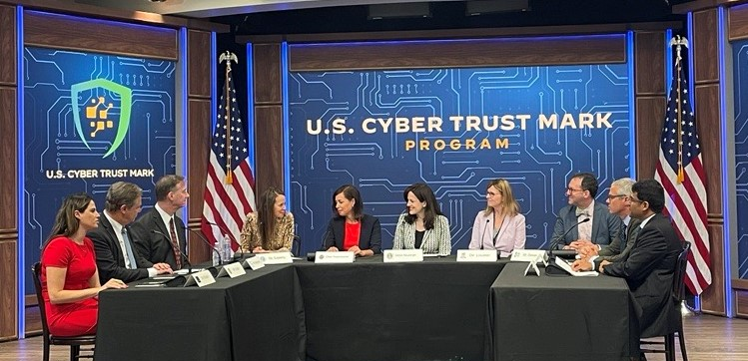
Launch: Director of CISA Jen Easterly, FCC Chairwoman Jessica Rosenworcel, Deputy National Security Advisor Anne Neuberger, NIST Director Laurie Locascio

Slide 15
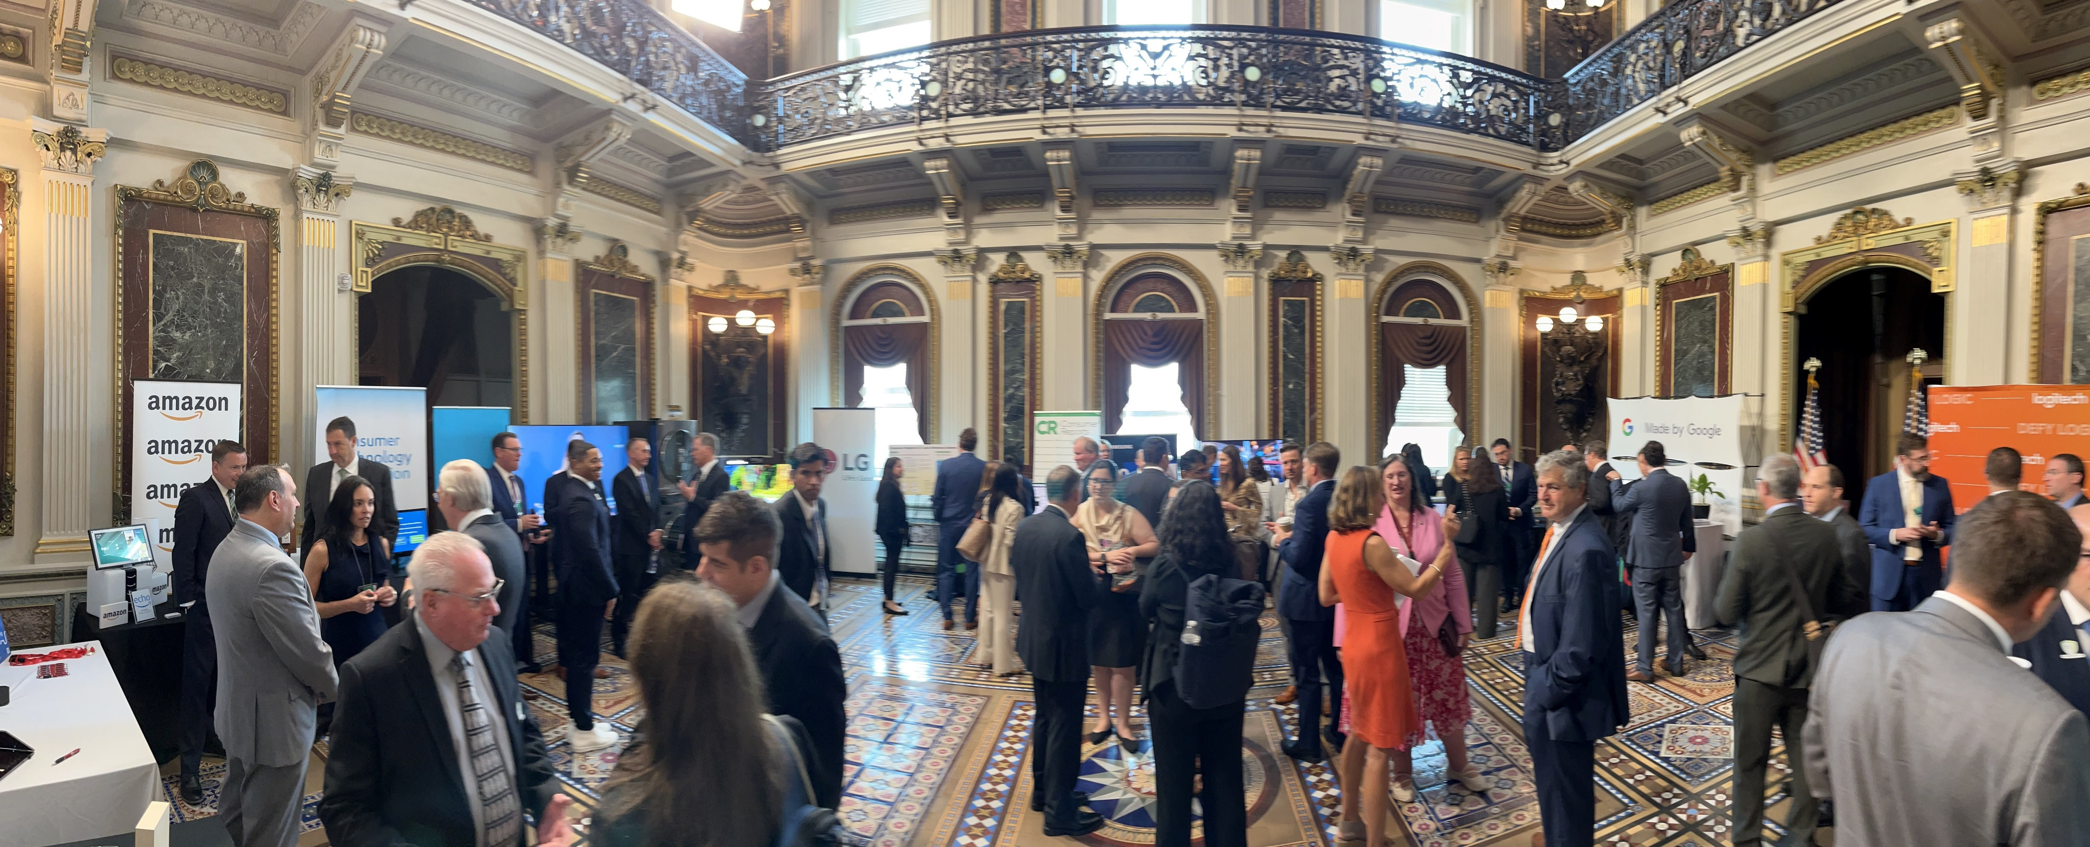
Concurrent Trade Show of Supporters and Mark-Ready Product

Slide 16
The U.S. National Cybersecurity Mark
16

Slide 17
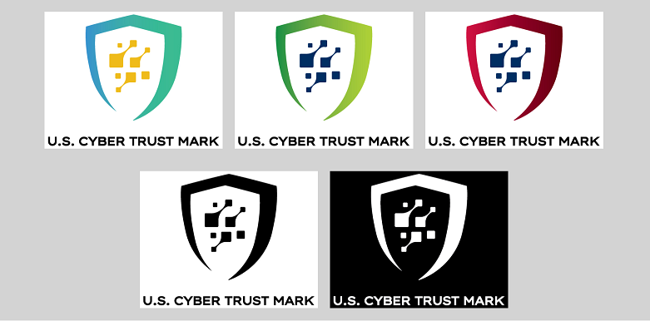
The U.S. Cyber Trust Mark
Source: https://www.fcc.gov/cybersecurity-certification-mark

Slide 18
U.S. Cyber Trust Mark – The Plan of Record
Create a single common U.S. mark.
Set criteria for use of the mark.
License existing industry cert/label programs to issue the mark.
Create a national registry of certified product
Promote & advertise domestically / Work internationally for harmonization.
This is a voluntary program—not a regulatory requirement.
The effort is aimed at consumer IoT, but industrial IoT is widely expected to follow.
18

Slide 19
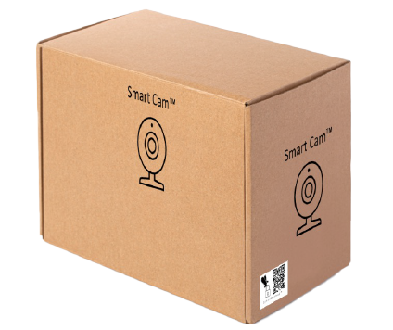
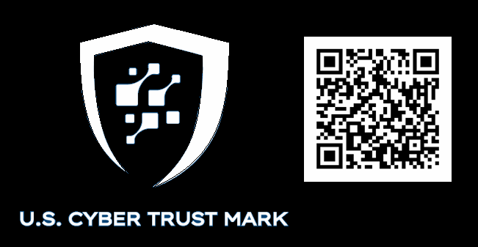
On The Package

Slide 20
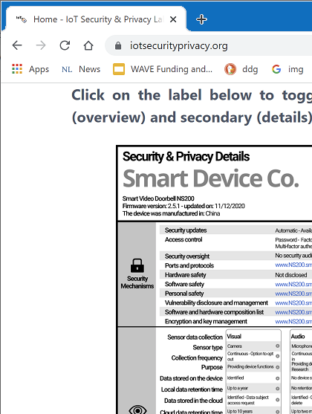


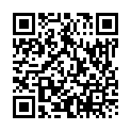
On The Package But Also Online
Digital link to more info
Online details:
Landing page is consumer-friendly
Secondary page is more technical

Slide 21
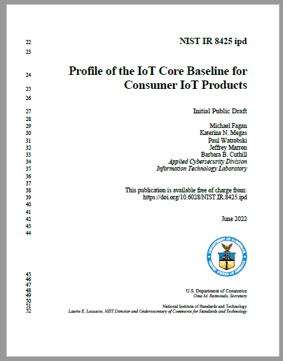
Established Criteria for Use of the Mark
NIST IR 8425: The Consumer IoT Label Criteria
Based on prior NIST IoT baseline (NIST IR 8259)
Generally accepted as the U.S. government’s “expression of national intent” for the program.
Consistent with EN 303 645 & ANSI/CTA-2088
21

Slide 22
Trust Mechanisms At Scale
Self Declaration of Conformity (Self Attestation)
Self Declaration of Conformity (Self Attestation)
Proprietary Certification
Alliance Certification
Full Third-Party Certification
Examples
SDOC: Manufacturers in contracts
Proprietary Certification: Samsung Works With SmartThings, Apple HomeKit
Alliance Certification: CSA/Matter, IoXT
Full 3rd-Party Certification: Outside test lab

Slide 23

Cybersecurity Marks At Scale
Oversight Structure
Self-Attestation
Scheme 4
NISTIR 8425 Criteria
Proprietary Certification #1
Scheme 3
U.S. Cyber Trust Mark
Alliance Certification #1
Scheme 2
3rd Party Certification Vendor #1
Scheme 1
The ecosystem provides multiple tools—how to effectively integrate them?
23

Slide 24


The “Gestalt” Connected Product
WAN
Associated System Services
Home ISP Router
Wi-Fi Access Point
The IoT Product is:
Hardware +
Smartphone App +
Cloud services + …
…everything that is needed
for full product
Functionality as sold
5G/Mobile Broadband
Wi-Fi®
Smartphone
Smartphone App
Device 1
(connected speaker)
Example of the scope of a basic “IoT Product”

Slide 25
National Product Registry
Should be accessible by consumers and small professionals.
Should work for tool vendors who support installers, enterprises.
Should work for e-commerce sites for filtered product search.
Should be secured against malicious use.
Should be updated in real-time, with revocation as needed.
And with high uptime, speed, backed up…

Slide 26
U.S. Cyber Trust Mark – What’s Next
The FCC is preparing an NPRM that will consider program rules over a 60-90 day comment/reply period
Private sector (industry + advocates) has significant work and consensus already (“The Plan of Record”)
The FCC will make the final program rules after considering public input
Timeline: Widely expected to be one year
White House Announcement
(of the agency & goals)
Notice(s) of Proposed
Rule Making
(public consultation period)
FCC Report & Order
(to adopt rules and start)

Slide 27


And Beyond
Similar program for Industrial IoT is being launched with DoE and National Labs for smart meters and power inverters
NIST is working on a Consumer Router profile version of NIST IR 8425
State will work with FCC on
harmonizing international
standards and mutual
recognition of the U.S. mark

Slide 28
Learn More & Participate
https://CTA.tech/Cyber-Labeling
Mike Bergman
VP of Technology & Standards
Consumer Technology Association
mbergman@CTA.tech
28

Slide 29
THANK YOU!
Questions?

Slide 30
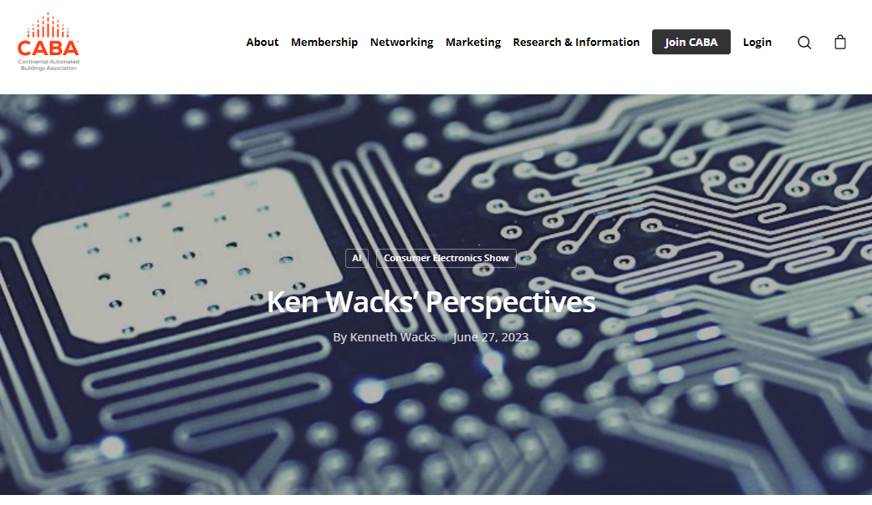
6. CABA Journal
Ken Wacks (Ken Wacks and Associated)
The CABA Journal aims to educate and inform the CABA membership and industry at large on emerging research, issues, challenges, and opportunities in the intelligent buildings and/or connected home sectors.
New articles are posted to the CABA website, included in the weekly CABA NewsBrief and circulated on CABA’s Twitter and LinkedIn accounts.
Send proposals to klopotowska@caba.org
Recent posts:
Ken Wacks Perspectives: CES 2023: The Expansion of Consumer Electronics
Ken Wacks Perspectives: Cybersecurity Provided by the HES Gateway
Facilio: The Relevance of Decarbonizing Goals During the Downturn
30

Slide 31
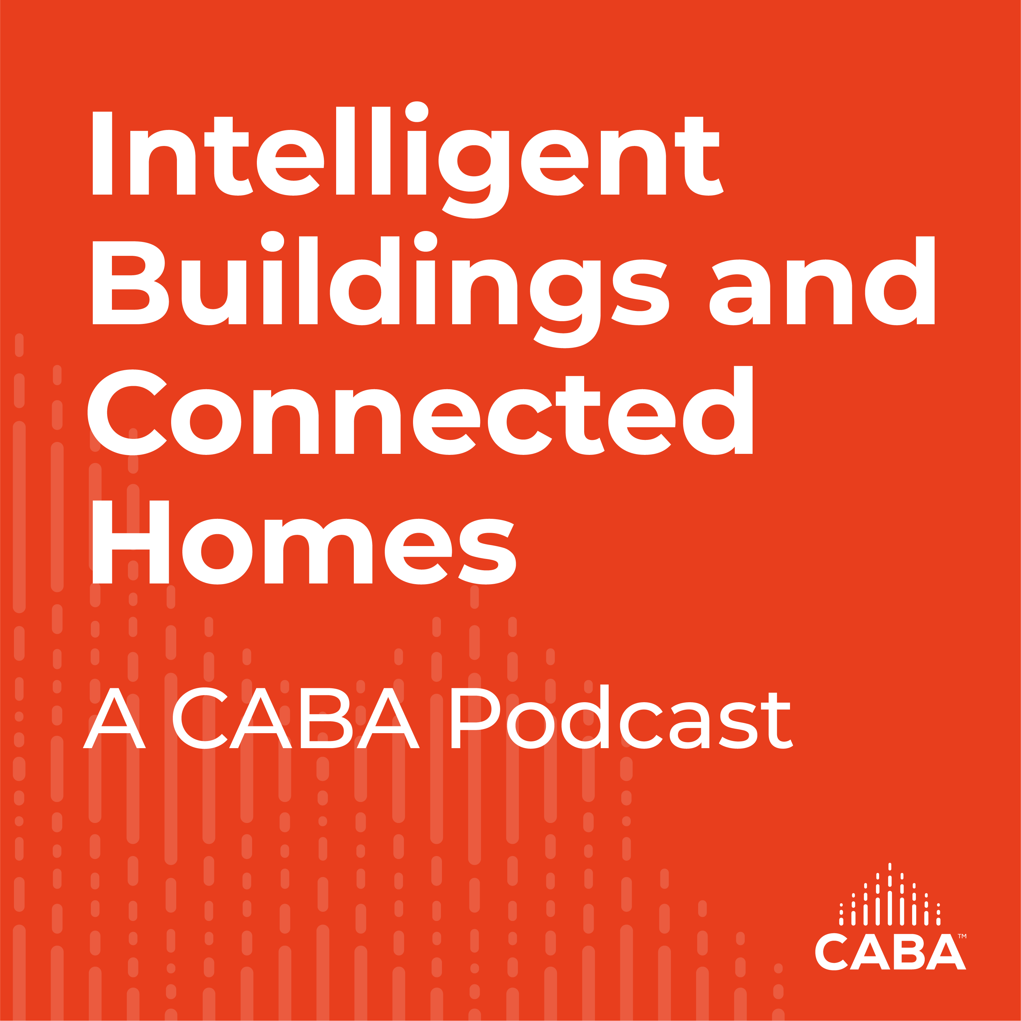
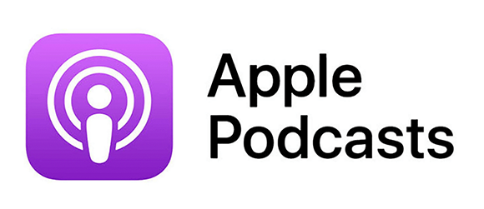

7. CABA Podcasts
Marta Klopotowska (CABA)
Join industry experts and leaders from around the globe as they discuss everything smart home and intelligent buildings.
CABA is looking for guests and hosts for future pre-recorded episodes. Contact Marta Klopotowska (Klopotowska@caba.org) for more information.
31

Slide 32

8. New Business
Ken Wacks (Ken Wacks Associates)
New CHC business?

Slide 33

9. Announcements
Greg Walker (CABA)
Past Events
Connections (Parks Associates) Connected Home Summit
May 23-25 | Frisco, TX
Upcoming Events
Shanghai Smart Home Technology
August 29-31 | Shanghai, China
CEDIA Expo
September 7-9 | Denver, CO
Connections (Parks Associates) Connected Home Summit
Virtual – Oct 5
Smart Spaces (Parks Associates)
Virtual – Oct 5, Nov 30

Slide 34
10. Adjournment
Ken Wacks (Ken Wacks Associates)
Next CHC Meeting: Wednesday, November 29, 2023
Continental Automated Buildings Association (CABA)
caba@caba.org
www.CABA.org
www.caba.org/chc
Connect to what’s next™
34

