Slide 1
CABA Connected Homes 2023 Research Service
research proposal & pitch

Slide 2
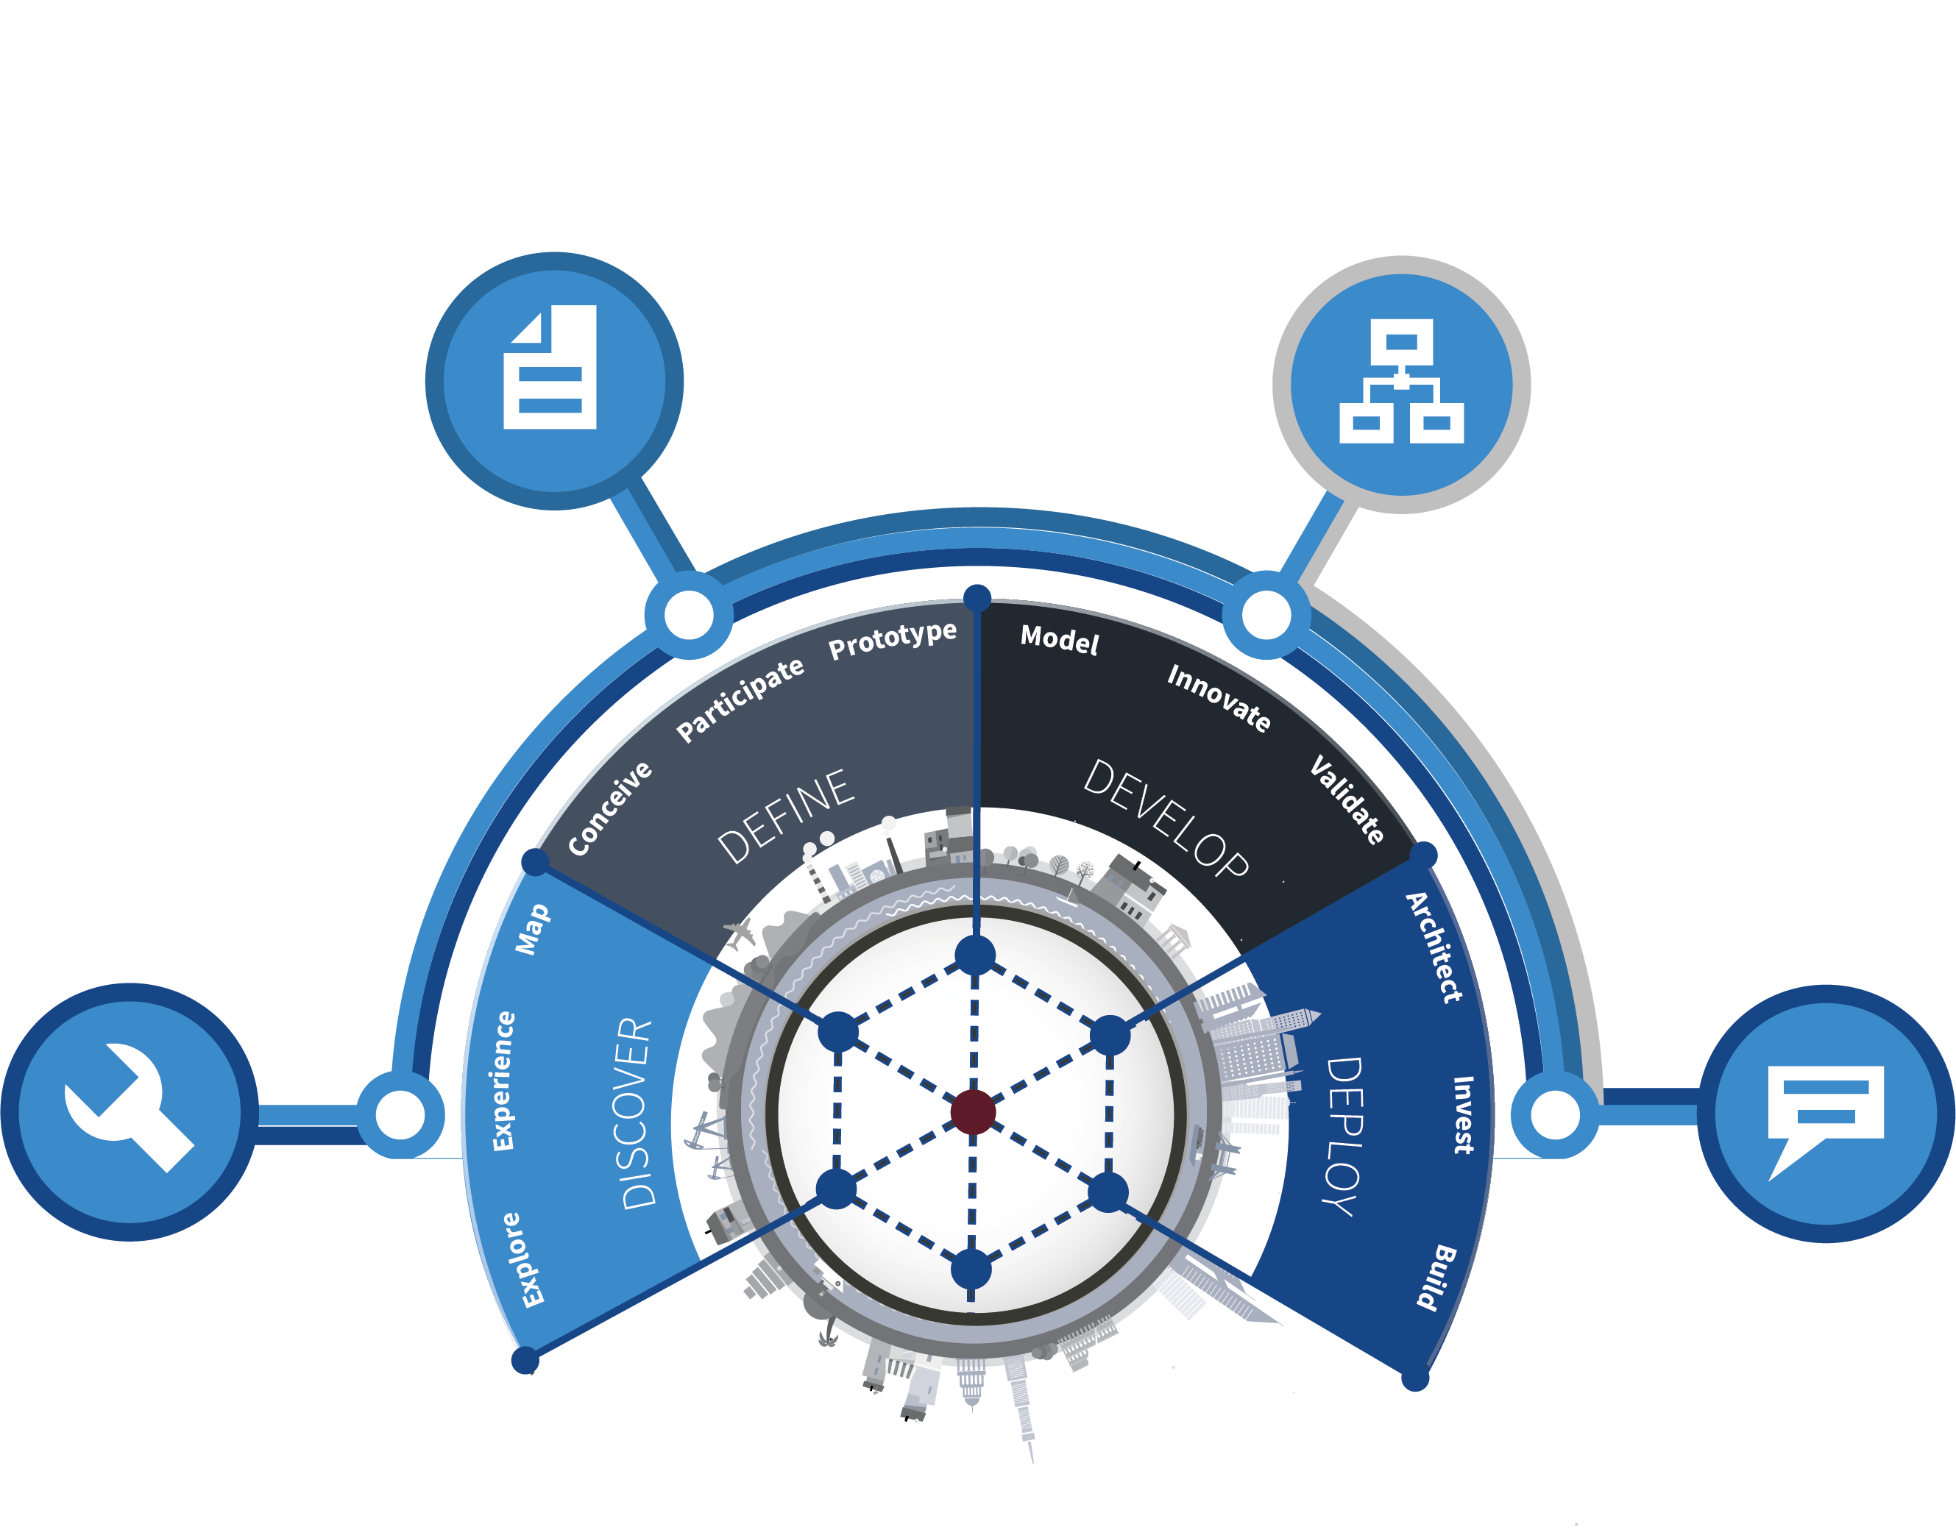
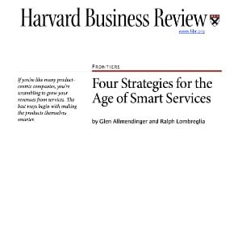
Overview of Harbor Research & Our Scope of Services
Overview of Harbor’s Services
Firm History
Harbor Research was the first firm to focus on Smart Systems, Services and the Internet of Things (IoT) and first to publish groundbreaking research on new business models in the Harvard Business Review in 2004 & 2005.
Research Services
Research, tracking, market intelligence and Harbor’s Smart Systems forecast
Strategy Consulting
Business development & growth strategy consulting services
Smart Systems Lab
Venture development, start-up advisory and community networking to implement strategies
STRATEGY
Growth
Strategy
Development
Business
Model
Design
DESIGN
Clients and Engagements
For over 30 years we have focused on identifying, analyzing and helping clients to develop or adopt emergent technologies. Every relationship we develop is enhanced by the range and depth of these experiences.
Analyst Interactions & Support
Collaboration Workshops
Scenario Planning,
Modeling & Forecasts
Tech Discovery Forums
Innovation Workshops
Technology Research
& Market Analysis
Smart Systems Lab
Technology Developers & Suppliers
RESEARCH
FACILITATE
100+
400+
clients
engagements
OEMs and Service Providers
We work with clients across corporate functions
150+
600+
Corporate Strategy & Development
Business Development
Market Intelligence
Strategic
Marketing
New
Growth
Research &
Development
clients
engagements
Offices
Flexible formats & configurations
Denver, Colorado - USA
Berlin, Germany - Europe
Research, Analysis, Modeling & Content
Services Subscriptions & Retainers
Bespoke Engagements & Consulting Projects

Slide 3













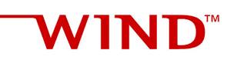

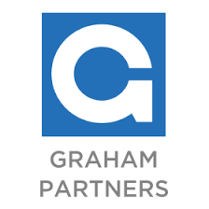

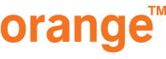
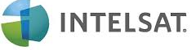

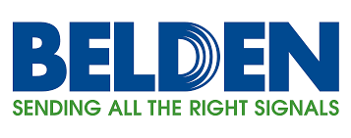

















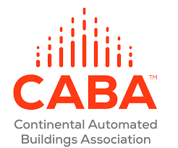




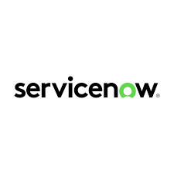




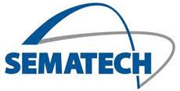


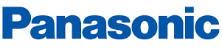
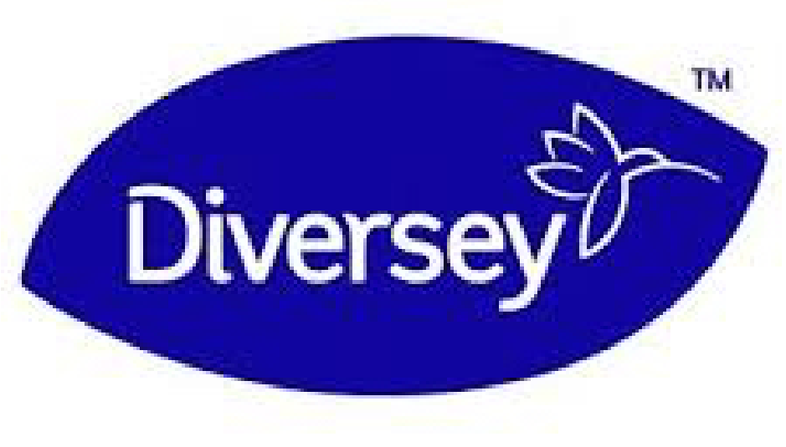















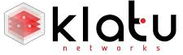




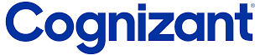






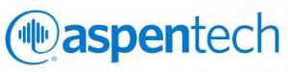



Harbor Research Serves Technology Innovators, OEMs & Services Providers
Illustrative Technology Supplier Clients
Computing & Connectivity
Ecosystem Participants: Private Equity & Associations
Network Infrastructure & Services
Software, Apps, Platforms & Infrastructure
Illustrative OEMs, Service Providers & Vertical-specific Software Clients
Energy &
Resources
Industrial & Manufacturing
Buildings &
Facilities
Transportation & Logistics
Retail, Healthcare & Consumer
Diversified

Slide 4
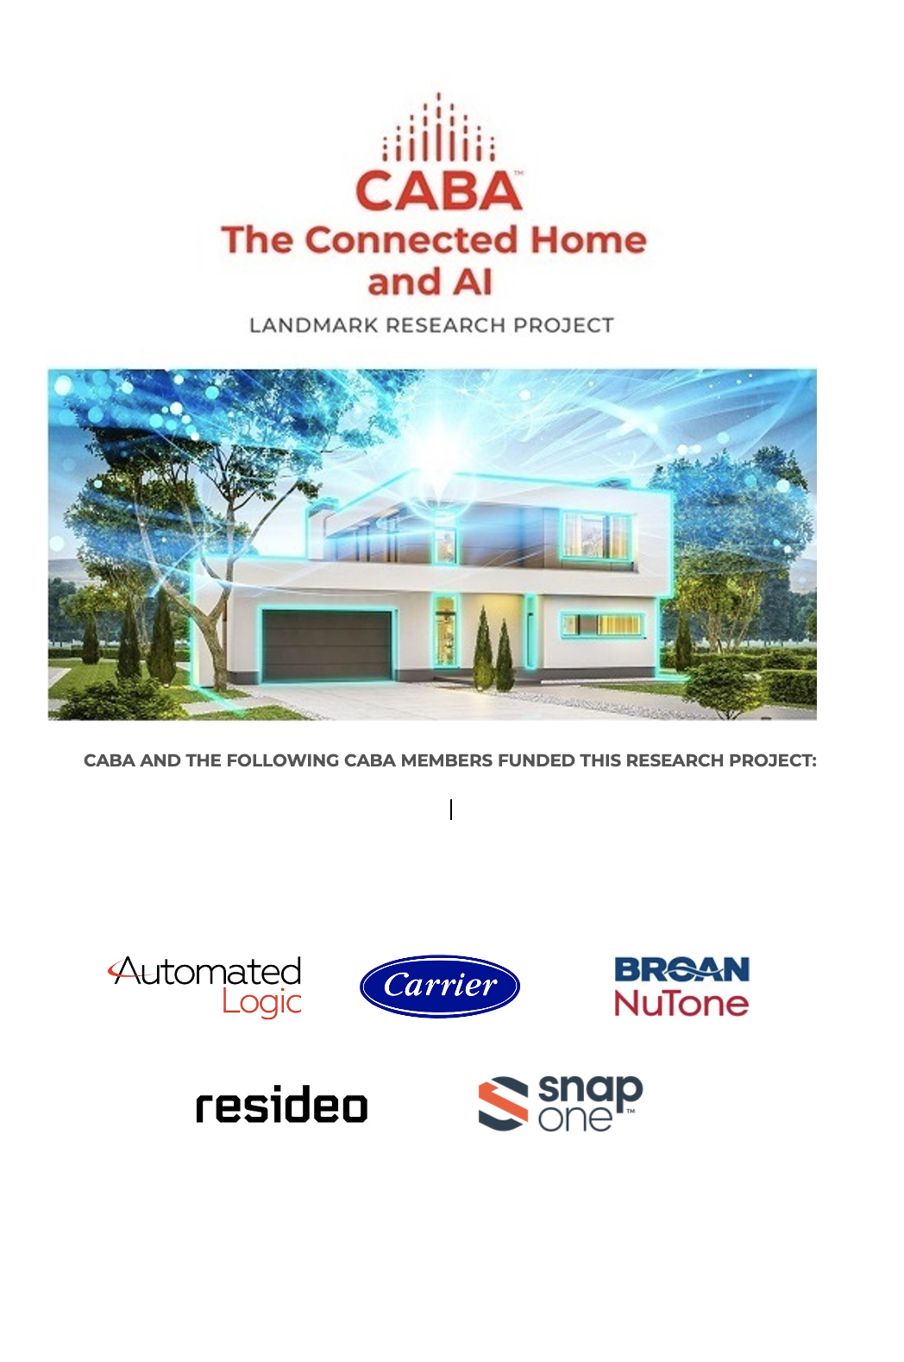
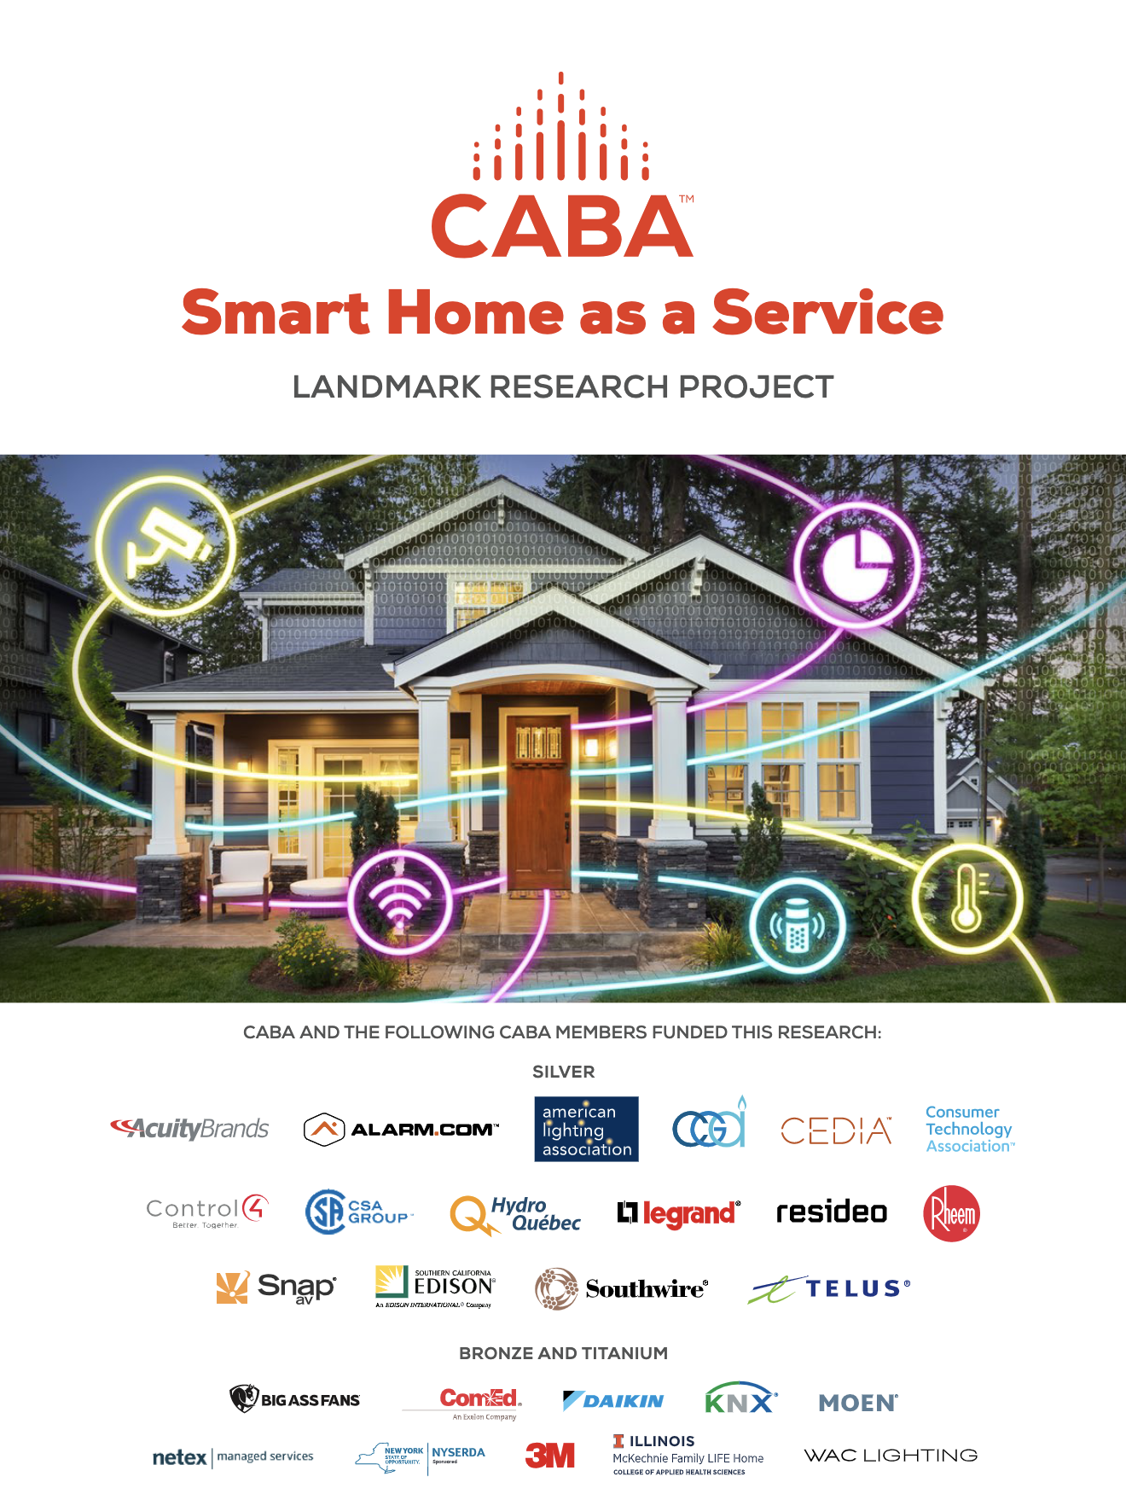
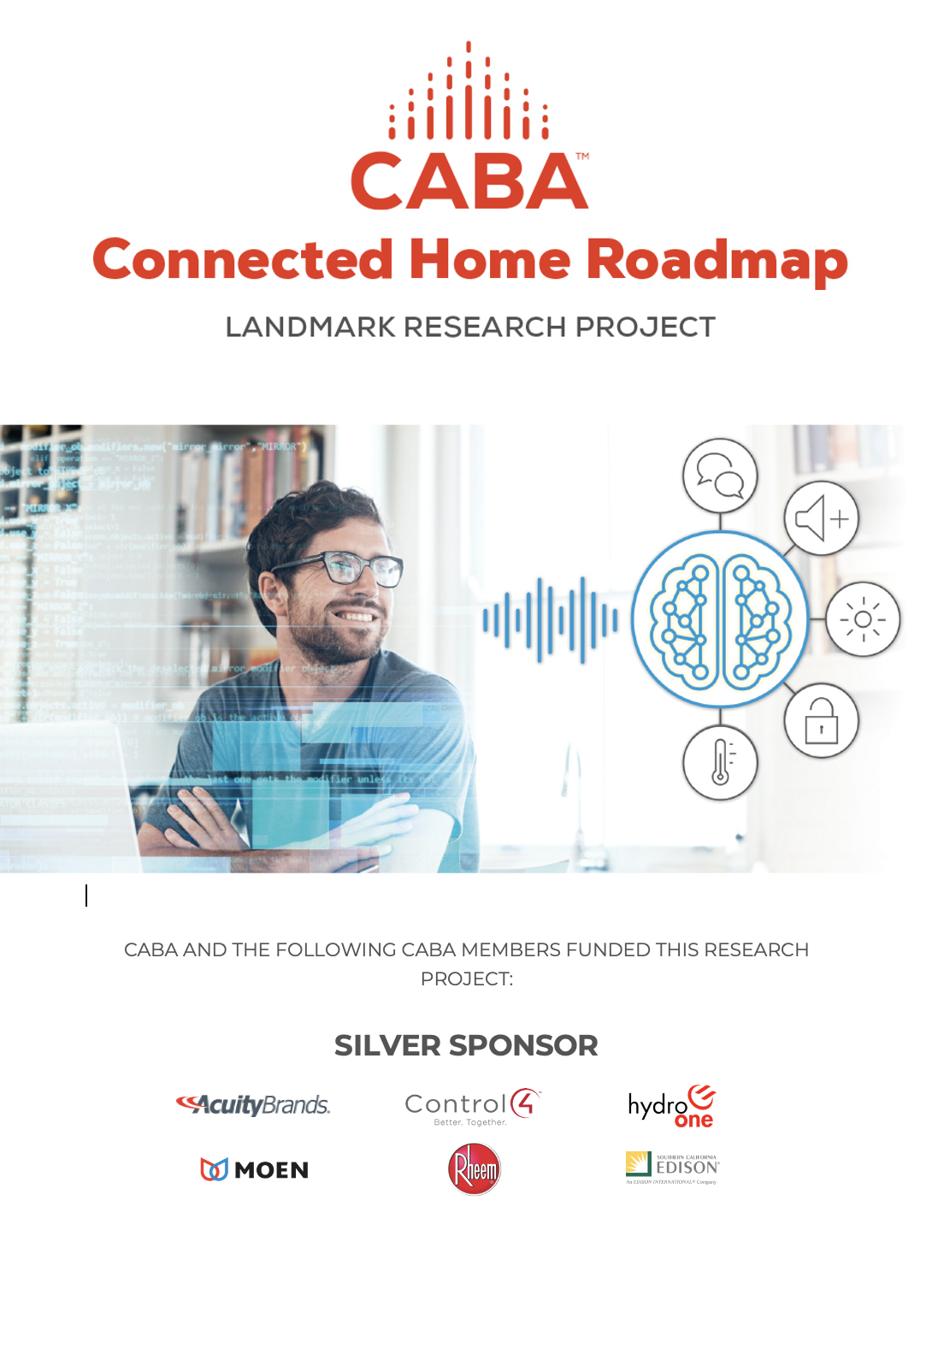

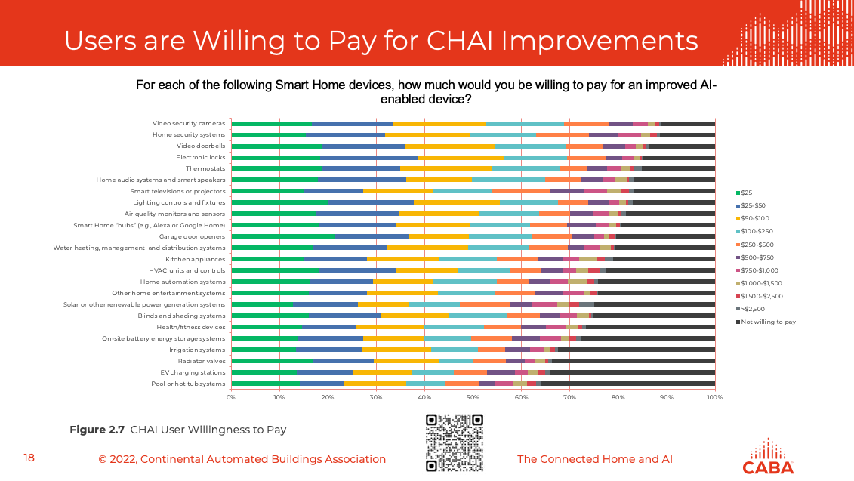
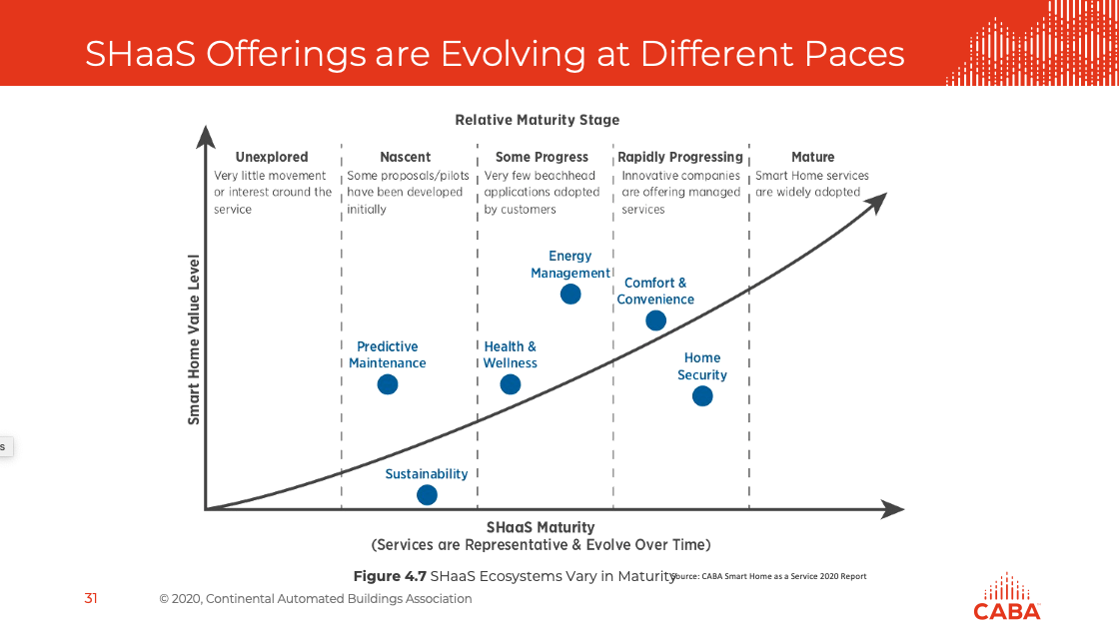
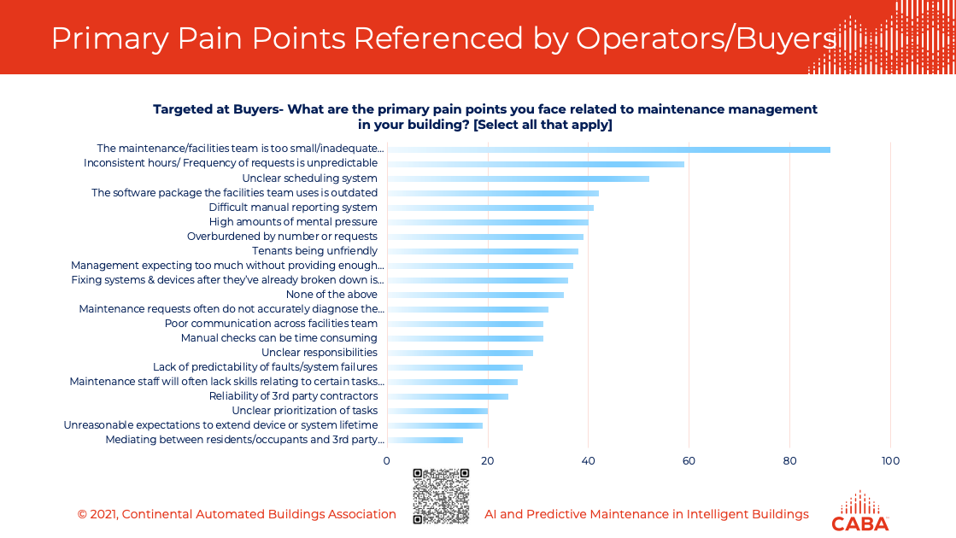
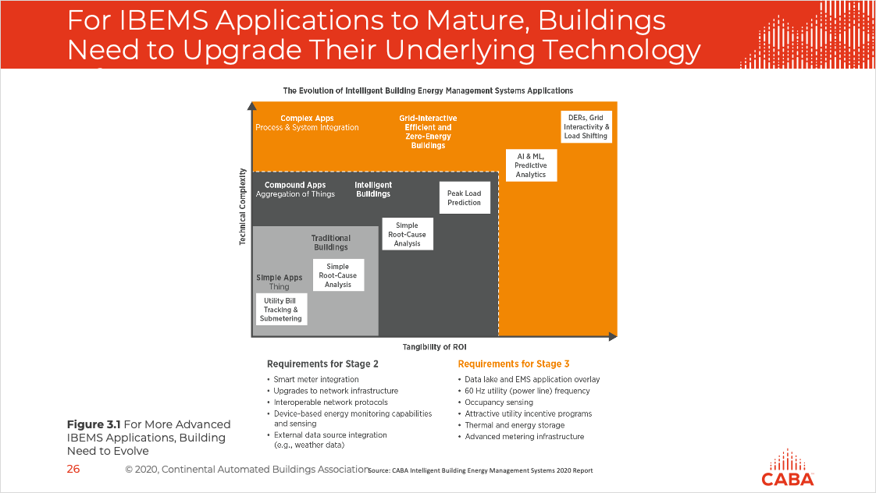
Harbor is Pleased to Have Served CABA CHC Several Times in Recent Years
Harbor’s long-standing support for the Continental Automated Buildings Association
  Harbor has developed a sustaining relationship with CABA and its constituent members conducting research and analysis into new building, facility and residential technologies
  CABA Landmark Research Projects include a combination of quantitative surveys and qualitative interviews that inform a comprehensive report on the market opportunity for smart systems-related technologies and related digital services, including:
    Smart Home Energy Management (2023)
    analyzed the opportunities and solutions for managing energy usage in the home, including various business models, technologies and benefits available to suppliers and consumers
    Connected Home Artificial Intelligence (2022)
    created a foundational framework for understanding the evolution of AI and its relationship with connected home solutions and services, along with related challenges and barriers to adoption including consumer perceptions of privacy and security
    Smart Home as a Service (2021) explored service-based business models to smart home solutions, and how consumers perceived certain suppliers and solutions in their impact and value
Harbor/CABA CHC Collaboration Examples
2023
2022
2021
2019
2017
WIP
Smart Home Energy Management
Connected Home & Artificial Intelligence
Smart Home as a Service
Connected Home Roadmap
Connected Multi-Dwelling Units and the IoT
Notes:
Collaboration with CABA on Monetization of Intelligent Buildings (2018) that examined how to monetize intelligent buildings from the perspective of building owners, developer, solution providers (OEM manufacturers and service providers) and other stakeholders including stakeholder analysis, business opportunities, technical barriers and opportunities, future market direction, issues, use-cases and industry recommendations.;
Collaboration with CABA on Intelligent Building Energy Management Systems (2021) that provided a framework, market requirements, ecosystem analysis and market sizing for the building automation systems, energy storage, and other energy management hardware and software solutions including services, security, data analytics, systems, and processes for building operators and technology suppliers based on top identified use cases within the target market
Collaboration with CABA on AI and Predictive Maintenance in Intelligent Buildings (2021) that defined and developed business opportunities within predictive maintenance and artificial intelligence technologies as they relate to intelligent buildings.

Slide 5
Project Team Overview: Over 60 years of collective experience
Each member of the team has led or assisted on multiple intelligent buildings-related engagements, including at least one previous CABA Landmark Research project.
Glen Allmendinger - President and Founder
Glen is the founder and president of Harbor Research, a strategy consulting firm with offices in Boulder, Colorado and Berlin, Germany. Since the firm's inception in 1983, Allmendinger has worked closely with a broad spectrum of telecommunications, information systems, security, electronics, and automation and equipment manufacturing companies in North America, Europe, and the Far East. These companies range in scope from small, entrepreneurial start-ups to major multi-national corporations. His project direction and consulting has assisted these firms in the development of corporate and business unit strategies, new product, market and service opportunities, and new core capabilities. Glen has consulted to the National Research Council on technology and competitiveness as well as emerging technologies for social wellbeing. He is a member of IEEE, ASME, and ACM and has worked closely with several industry trade associations including CABA. He has worked on DARPA-funded research focused on advanced analytics and sensing systems technology and was a key participant in the planning and development of the National Center for Manufacturing Sciences. Allmendinger received his BA from New York University, and completed graduate studies at MIT’s Center for Advanced Media Studies.
Harry Pascarella – Vice President
Harry specializes in Industrial IoT with a focus on manufacturing and natural resources markets. Harry works with clients across a variety of industries to validate and dimension their growth strategies and advise on industry segment and application target selections. Recently, Harry conducted several studies in smart buildings including a deep dive into energy management as well as a market study on the larger market that looked at usage behavior. Harry also worked with the largest LED lighting manufacturer in the United States to develop a business case for connected lighting platforms. Harry received his bachelor’s degree in Economics from the University of Colorado – Boulder.
Martina Guglielmone – Project Manager
As a consultant and project manager at Harbor Research, Martina leads a diverse range of client engagements in Industrial, Buildings, and IT industries. She is adept at drawing out a critical research and analysis path that results in the identification and development of new growth opportunities. This has helped clients better understand their own organization's capabilities and competitive positioning, develop more compelling value propositions for their customers and partners, and identify and address attractive growth opportunities in both established and emerging markets. Prior to joining Harbor, Martina worked as a Manager in the Economic Development practice of Smart Growth America, helping communities of any type or size design, plan for, and execute long-term growth and development goals. Martina graduated with a bachelor’s degree in political science from Lynn University and holds a Master’s in Political Sociology from George Washington University.
Jamil Muna – Consultant
As a Consultant, Jamil has owned the delivery of strategic and deeply technical research. He has operated in variety of industries and implements a process-oriented approach to achieve a comprehensive understanding of his clients' needs. Jamil led CABA's landmark research report on AI & Predictive Maintenance in Buildings and supported on the Connected Home & AI report as well. Prior to Harbor, Jamil worked with Accenture as a management consultant. He graduated from Columbia University with a degree in Financial Economics, and completed his MBA from Cambridge University.
Daniel Intolubbe-Chmil – Consultant
As a Consultant, Daniel has led research initiatives shaping critical insight around the evolution of high-performance networks across industrial, commercial and enterprise verticals. Daniel also helps keep a pulse on the market, providing curated content and updates to Harbor’s real-time market tracking across all sectors of the economy. Dan has helped lead two previous CABA Council engagements, and has deep expertise across networking technologies within buildings and homes. Prior to Harbor, Daniel has conducted economic research to complete his Honors thesis regarding Education Policy, entailing policy/market research and econometric analysis. He graduated from CU Boulder with a degree in Economics and a minor in Humanities.

Slide 6

Introduction & Overview: Adjusting the Approach to CABA’s Research Projects
Harbor Research is proposing an alternative to the traditional approach to CABA’s Landmark Research projects. Below is a description of why this approach is valuable, and how we can further configure the approach to meet the needs of funders.
Harbor’s Approach and the Value of Configured Research Services
For 2023, Harbor Research is proposing a different approach to conducting research for CABA. In the past, a single, broad topic was selected, researched, and analyzed, resulting in a 100+-page written report. While informative and valuable, these long-form reports are difficult to digest and may not cover other topics of interest to research funders.
Instead of this single-report approach, Harbor is proposing to complete smaller, more focused and configured research reports in PowerPoint. This will allow Harbor and the Steering Committee to cover multiple important topics over the course of the year, which can be selected and adjusted based on the Steering Committee’s priorities. In addition to these “configured research projects,” Harbor will also provide a survey of consumer needs and trends, and a set of interactions to help the Steering Committee understand what’s important and support strategic decision-making on a variety of topics throughout the year.
If this approach is too complex, or the Steering Committee would like to focus on an inter-related set of topics, we can instead provide a broader PowerPoint-based report in place of the configured research projects, along with the other deliverables described in this proposal.
We believe CABA and the project funders will receive a significant amount of value through this adjusted approach. We look forward to the opportunity to work together.

Slide 7
2023 Connected Homes Research Service: Overview of Proposed Approach
CABA would like to update the way it conducts research to support its members. Instead of one, long-form landmark research report each year, it would like to try a more configured set of research activities that focuses on multiple topics of interest to funders throughout the year. With significant experience in providing such services and supporting CABA over the years, Harbor can support CABA and the Board of Directors well in this endeavor.
Connected Homes Research Service: Overview of Components
1
Annual Consumer Smart Home Survey (x1)
Survey covering key topics/opportunities to gain annual perspective of operator needs/outlook
Co-branded 10-15-page survey highlights report
2
Configured Research Project (x2)
Based on Q1 discussions and activities, determine 2 configured research projects to complete, 1/quarter
Limited to 100 hours of analyst time per project
One summary infographic per research project (x2 total)
3
Steering Committee Meetings (x6) and other interactions (e.g., 1:1 meetings, think tank, organizational webinars)

Slide 8
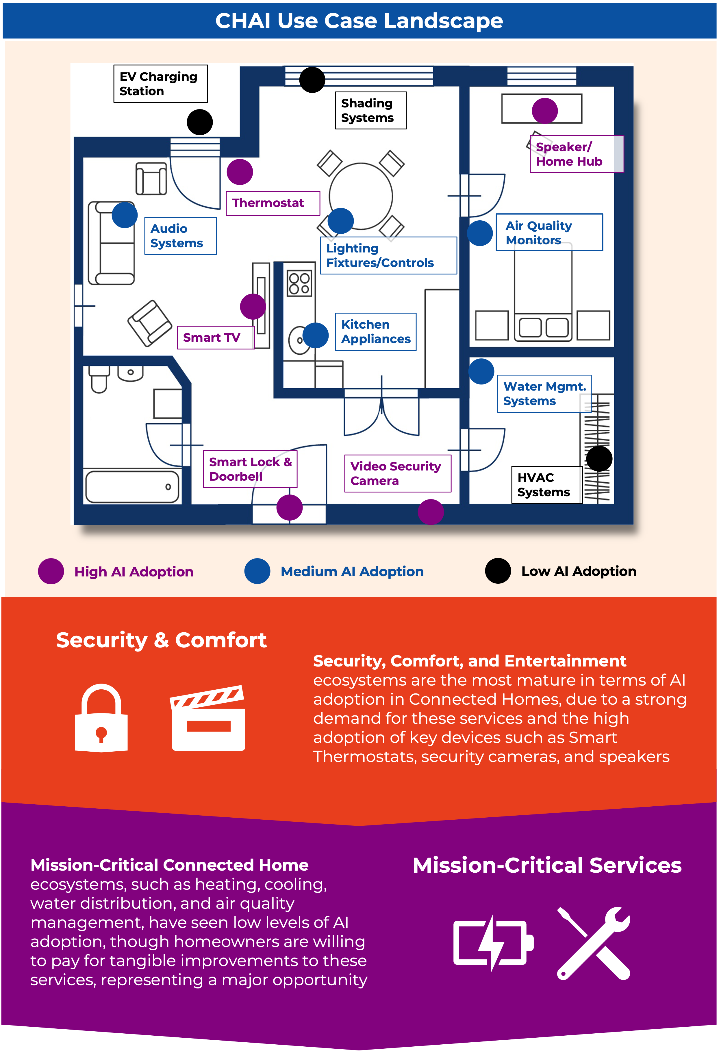
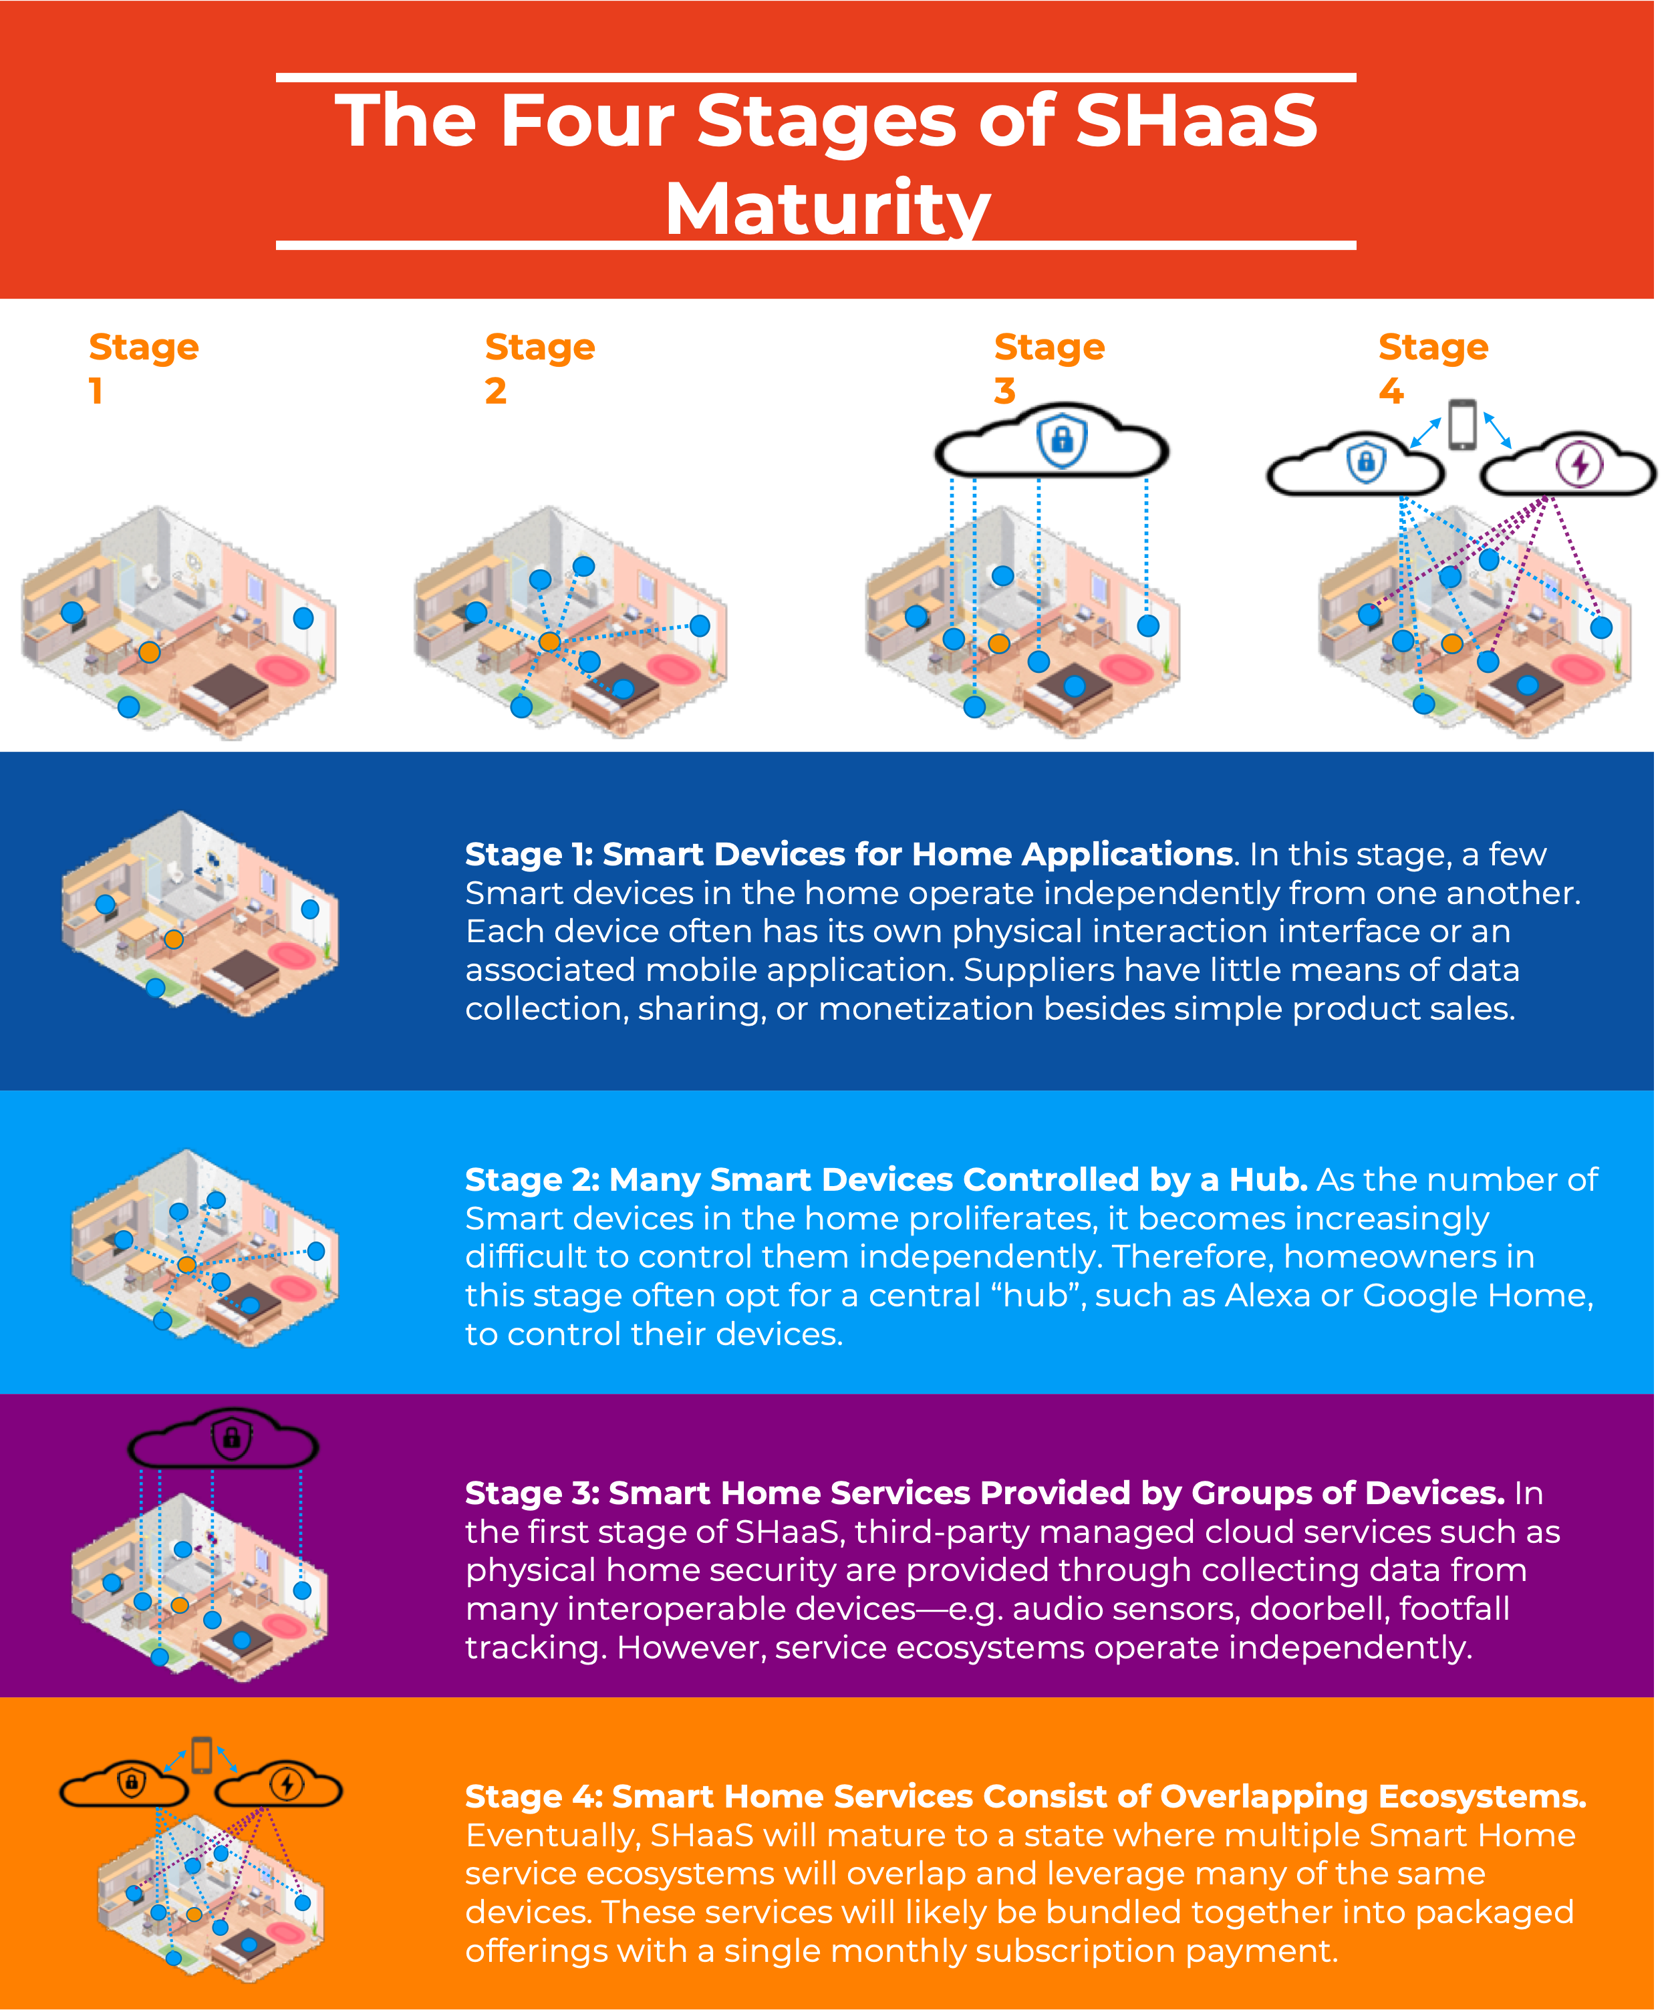
Annual Consumer Smart Home Survey
1
Harbor will develop and conduct an annual survey for connected homes with the goal of staying up to date on consumer perceptions, adoption trends, and needs related to connected homes.
Connected Homes Survey & Report
Deliverables
Survey questionnaire
Raw data and summary charts in Excel and PPT
10-15-page survey PPT ebook and trends report
2-page long-form executive summary (Word doc)
1 summary infographic
Target Audience
~500 Consumers in Canada and USA
Proposed Scope
Annual survey to understand current perceptions and future priorities related to connected homes
Key Topics to Cover (starting point):
Current state of smart home adoption
Key trends impacting investment and priorities
Next 12 months investment priorities
Preferred suppliers
Other annual topics as appropriate
Benefits & Values
Stay up-to-date on consumer perceptions, adoption, and needs related to connected homes
Understand the impact of recent market developments on users
Leverage graphics and charts from PPT-based trends report in key external presentations
Identify and/or focus on topic areas for further research in configured research projects
Draft starting point for Annual Survey scope, to be refined via steering committee meetings
2

Slide 9
Configured Research Projects: Overview of Process
2
Harbor will conduct 2x configured research projects on topics of interest to the steering committee.
Draft starting point for Configured Research Process/Approach, to be refined via steering committee meetings
Step 1: Scope Development
Determine configured research topic and develop scope of work
Step 2: Scope Finalization
Review scope with steering committee, finalize scope based on feedback
Step 3: Project Execution
Execute project workstreams
Step 4: Review & Finalization
Send draft report for review, finalize based on feedback
Week 0
2
12
14
Harbor develops a short poll to send the steering committee regarding preferences for configured research project
Based on responses, Harbor outlines scope for configured research project to present at quarterly steering committee meeting (limited to 100 hours of analyst time)
During quarterly steering meeting
Review defined scop with steering committee to field feedback
Following the meeting, send steering committee updated scope for final comments and adjustments
Configured research project execution
Execute configured research project based on scope defined in previous steps
Harbor sends draft final configured research report to steering committee for review and feedback
Harbor presents final output from configured research project in next quarterly steering committee meeting
Send poll for next configured research topic and define scope (as applicable)
Key Deliverables
2x configured research projects, 15-20-page PPT report with 1 summary infographic per report
(see more on next page)

Slide 10
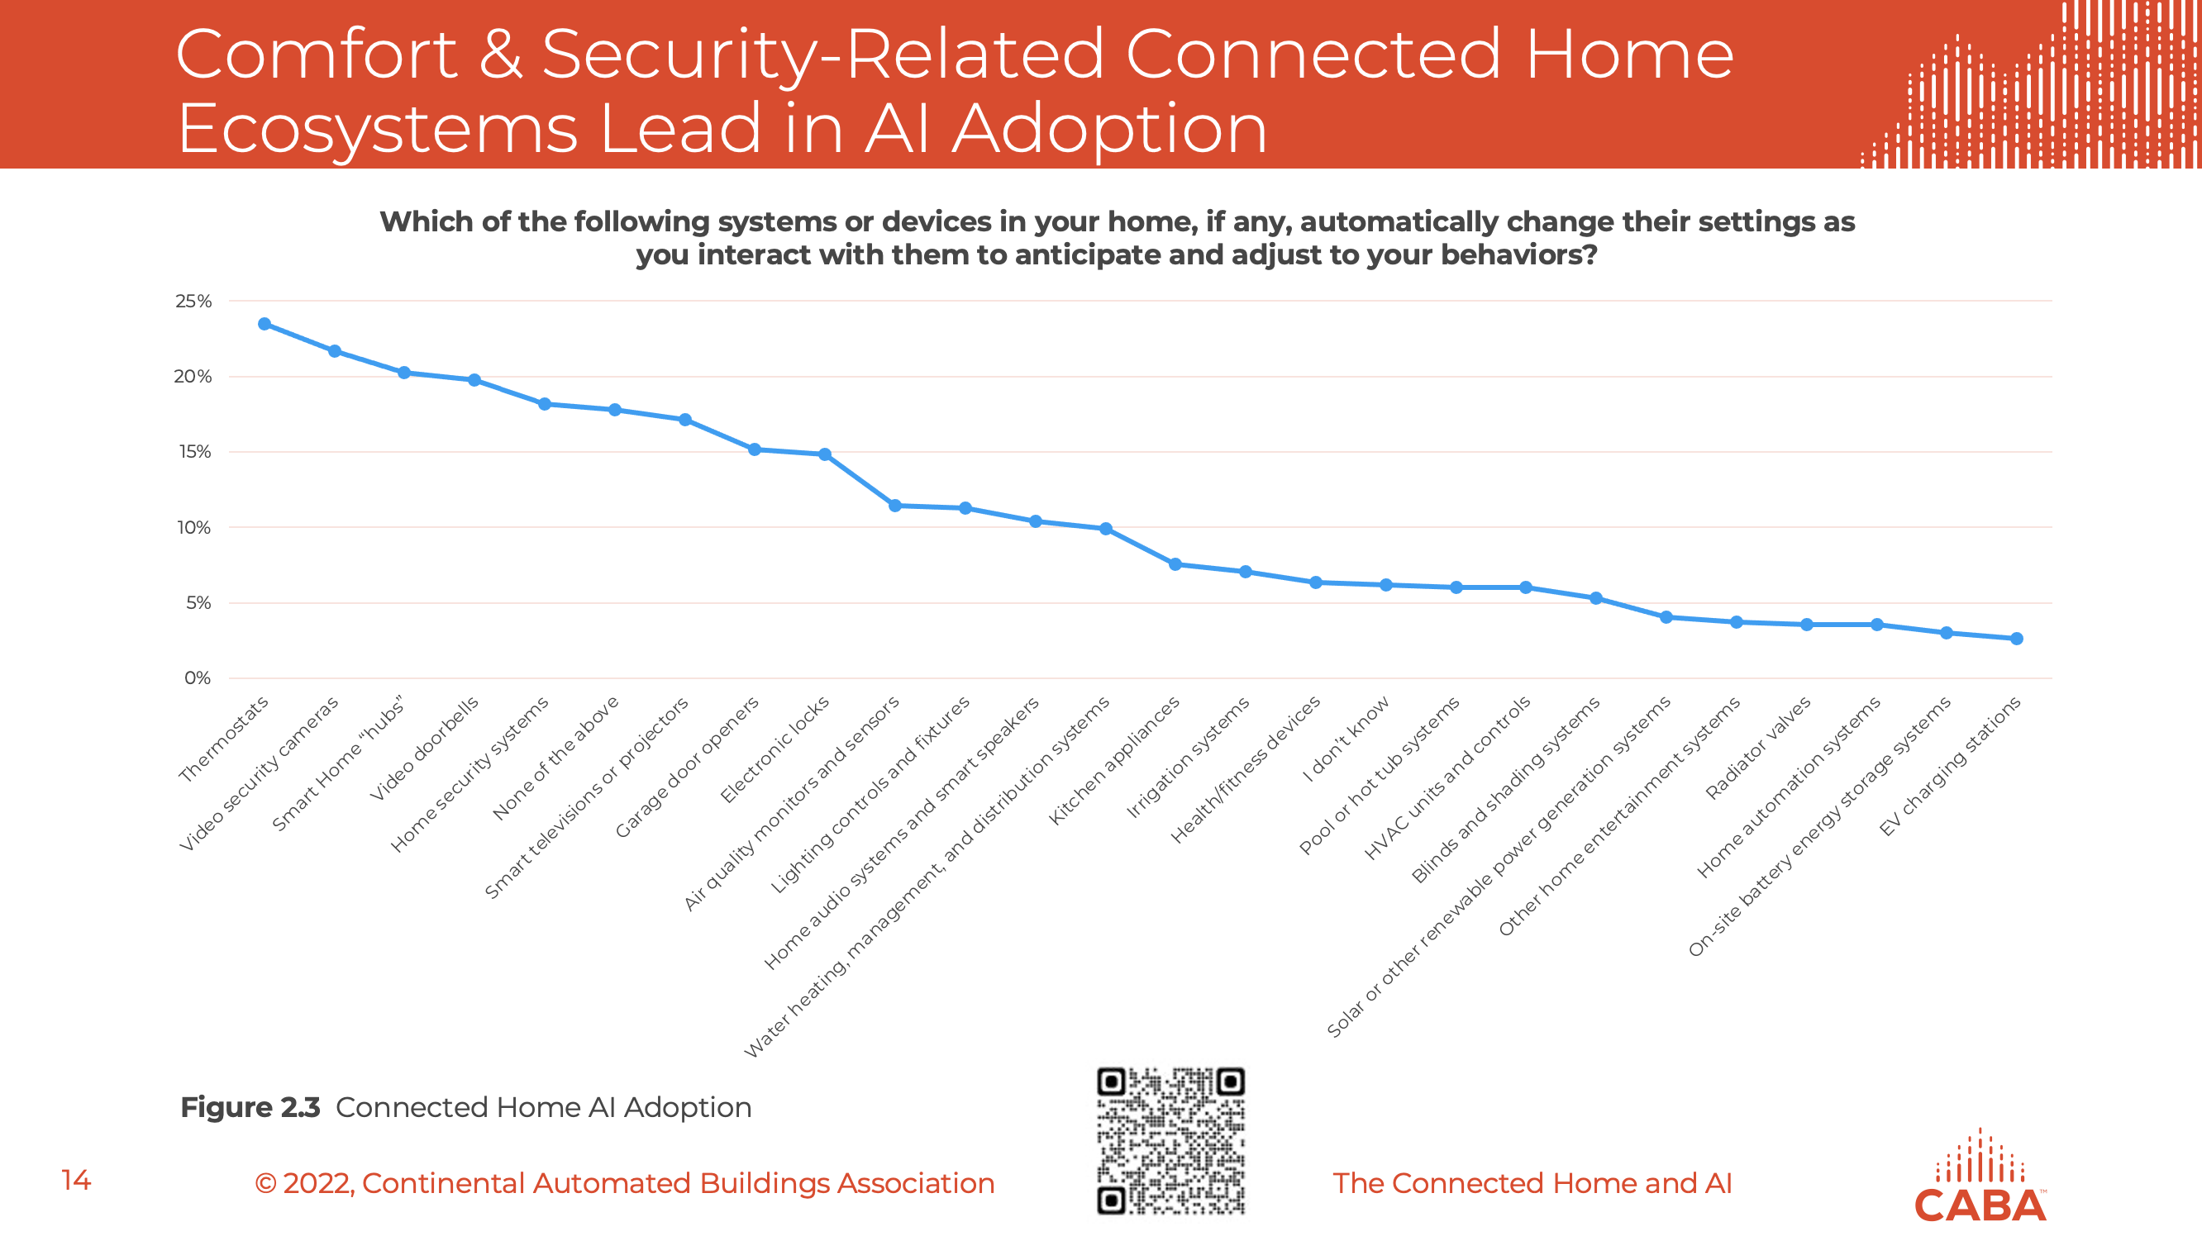
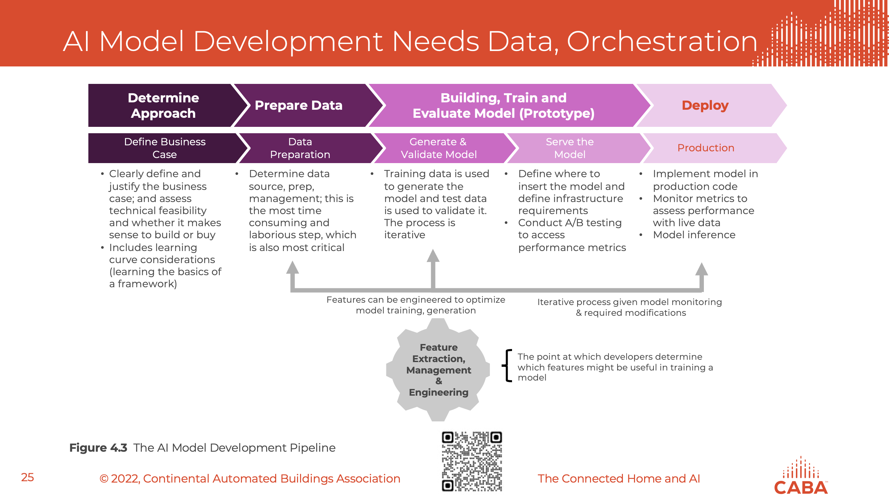
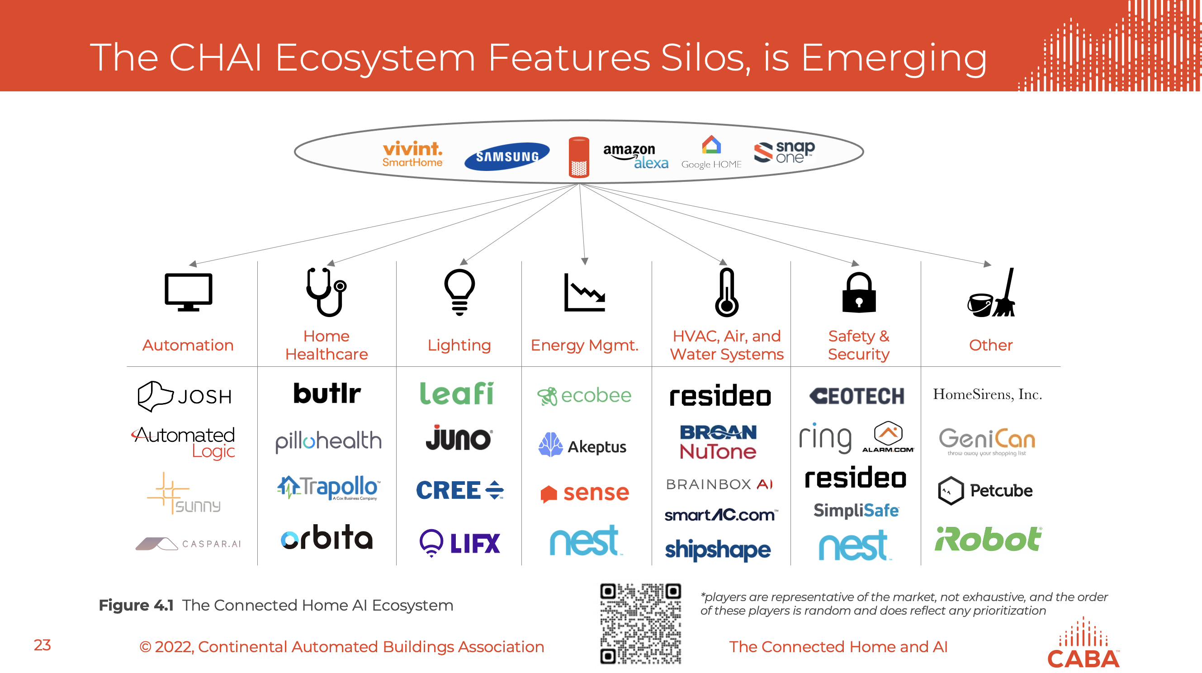
Configured Research Project Deliverables & Benefits
2
Through close collaboration with the Steering Committee, Harbor will analyze key topics of interest, producing a PPT-based report that includes re-usable outputs and key recommendations for steering committee members
Example Research Topics
Deliverables (x2 configured research reports)
15-20-page powerpoint report on the topic agreed to and as scoped with the steering committee, which could include the following types of output:
  Market dynamics, trends and forces
  Technology architecture & landscape
  Customer needs and buying behaviors
  Ecosystem, value chain & competitive landscape
  Market sizing and forecast
  Strategy recommendations
Summary infographic for each report
Benefits & Values
Receive data and analysis on multiple topics of interest throughout the year
Focus on the topics and workstreams that matter most, and have the flexibility to decide on each topic before it is analyzed
Short time to value—receive research and analysis inputs within 8-10 weeks after agreeing to scope
Leverage PPT-based material in external presentations
Changing UX technologies impacting how consumers interact with smart home systems
Canadian brownfield market for residential smart home, including market breakdown, top priorities, best points of entry, decision-makers, what influences purchasing, etc.
Cybersecurity in the built space and how to monetize related solutions
Sustainability trends in a residential settings, including water and energy. Current market penetration, top priorities for our customers, willingness to pay, etc.
How AI is impacting smart home technologies
Smart homes market sizing update
…More to be added through discussion with steering committee

Slide 11
Steering Committee Meetings, Interactions, & Example Collaboration Timeline
3
With the shortened year, Harbor will hold a total of 6-7 steering committee meetings (1 per month) for Connected Homes, including a kickoff meeting, with the funders of the research engagement. Additional interactions will be provided as well.
Purpose: Maintain alignment on scope of work, review completed deliverables, and discuss upcoming activities.
Agenda (1-1.5 hours depending on the scope of work activities occurring)
Introduction, attendance, review of agenda, (5min)
Review and discuss annual survey (Q1 only, 30min)
Review current Configured Research Project progress (30min)
Review poll results and proposed scope for upcoming configured research report (20min)
Wrap-up, actions & Next steps (5min)
Key Deliverables
6-7 Steering Committee meetings, with minutes and recordings
1:1 meetings with funders to understand needs and priorities
Think Tank for CABA community
Organization webinars for each funder to review research findings
Final webinar to review research findings
Draft starting point for Steering Committee Meeting agenda and timeline to be refined via steering committee meetings
Connected Homes
Quarterly Support Timeline
Scope Options/Alternatives
Q2
Q3
Q4
Replace the Annual Survey with Market Sizing for Connected Homes
Replace Annual Survey with another Configured Research Project
Replace one Configured Research Project with Market Sizing for Connected Homes
Annual Building Operator Survey
Configured research #1
Configured research #2
Steering Committee Meeting
(final webinar)
Other Interactions
Funder 1:1 Meetings to discuss needs and priorities
Think Tank for CABA Community on 1 of 2 configured research topics
Organization-specific webinars covering findings from research

Slide 12
CONTACT US FOR IN-DEPTH RESEARCH & CONSULTING
info@harborresearch.com | +1 303.786.9000 | HarborResearch.com
STRATEGY
Growth
Strategy
Development
Business
Model
Design
DESIGN
Market Analysis
& Analyst Support
Collaboration Workshops
Scenario Planning,
Modeling & Forecasts
Tech Discovery Forums
Innovation Workshops
Technology & Human
Sciences Research
Smart Systems Lab
RESEARCH
FACILITATE
Harbor Research has over thirty years of experience working with clients on growth strategy and new business creation. At the core of Harbor’s approach is a deep understanding of the core technologies, markets and business characteristics as well as the management and organizational challenges companies face adopting and developing digital and smart systems technologies. We strive to generate deep insight into how emergent technologies drive value creation and competitive advantage in our clients’ businesses and the economy as a whole.

Slide 13







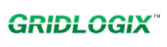
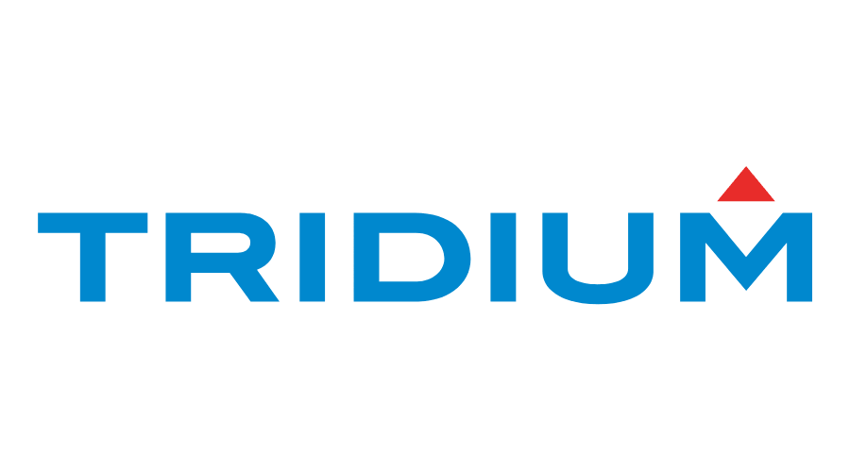
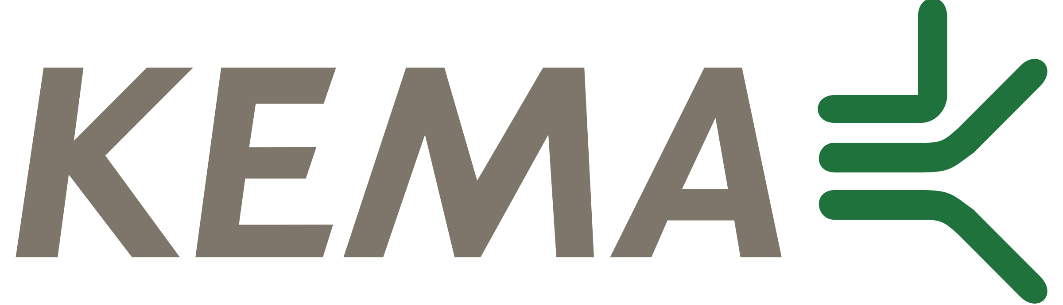


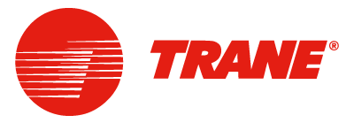
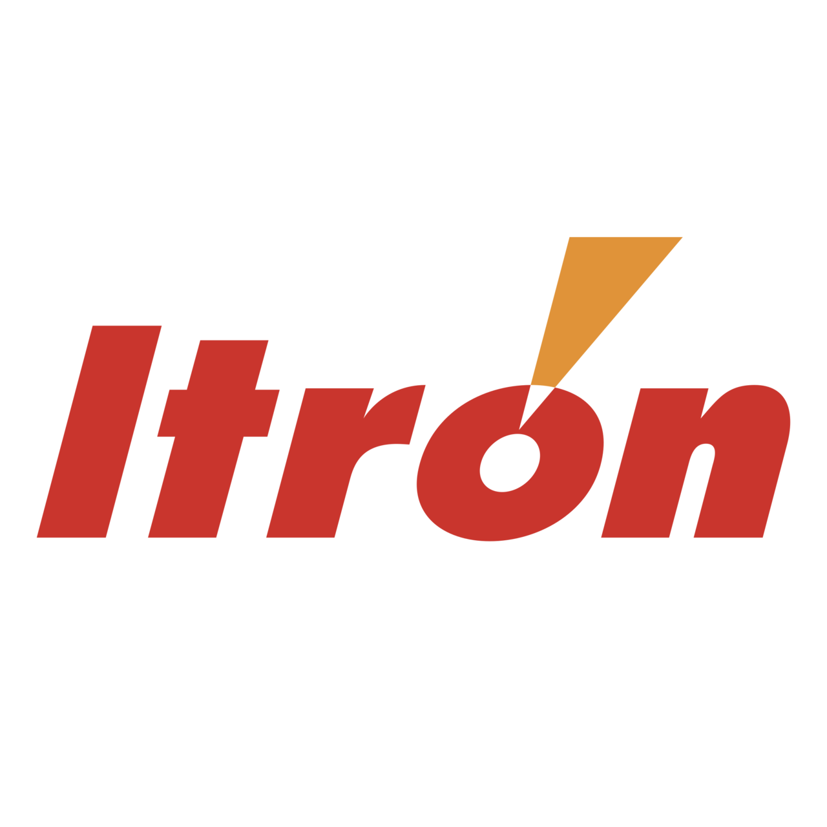












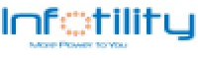

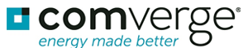

Reference Assignments for the Leaders in HVAC, Buildings, Energy & Facilities
Over the last decade, Harbor has executed assignments for a broad cross section of players in the energy, HVAC and facilities arena — below is a representative range of clients we have worked closely with in recent years
Energy Services
HVAC Manufacturers
Building Controls
Power Equipment
Software & New Tech.
Energy Services
HVAC Manufacturers
Building Controls
Power Equipment
Software & New Tech.
(Building & Energy Networks)
(design new energy efficiency business)
(acquired by Johnson Controls)
(Drives & HVAC Equipment)
(Hirschmann)

Slide 14
Additional Connected Homes & Related Experience
For a multinational provider of cleaning and hygiene products in the hospitality, healthcare, food and beverage, food service, retail, and facility management sectors, we provided a comprehensive analysis of the ‘Internet of Clean’ sector including key market dynamics, current competitor and peer supplier strategies and maneuvers, as well as competitor solution features & packaging, use cases and services delivery models
For the largest social media and networking company in the US, we conducted a demographic research study on a consumer-device prototype to understand the use cases, applications and target constituents in support of a Market Requirements Document.
For the largest manufacturer of electrical products in North America, we conducted user survey research as well as competitor, peer and alliance candidate direct interviews to uncover unmet customer and user needs for new and evolving “connected” energy management and services opportunities.
For the global leader in network infrastructure equipment, Harbor conducted an analysis of managed services opportunities in connected residential multi-dwelling and commercial properties, including market sizing, competitor analysis, alliance development analysis and go-to-market design.
For the world’s largest semiconductor and processor manufacturer, Harbor conducted an analysis of IoT opportunities within the residential sector. Primary emphasis was placed on opportunities where media and content were dominant values to determine core computing and network bandwidth requirements.
For a venture-backed startup, conducted an analysis of consumer energy services offerings to help target candidate developer alliances as well as partnership opportunities with utilities and related services providers.
Worked with CABA to develop an opportunity assessment within Connected MDUs, conducting a survey of 1,500 MDU owners, technology suppliers and service providers in the space, including 60 in-depth interviews to validate research findings. The engagement summarized the top IoT application and use case opportunities among primary buyers of technologies in the space, supported by a 5-year smart systems forecast model.
For a large silicon player, Harbor defined and developed a software architecture for competitive analysis of IoT platforms. This research examined twenty-five supplier and OEM platform providers in the IT, Telco and OEM markets to validate and segment monetization and pricing models.
For a leading connected lighting solution provider, Harbor defined new and expanded smart services and IoT solutions as well as building the business case required to support this critical growth initiative. Harbor clearly articulated alternative strategies and solutions available to the company and defined clear steps and a program of actions to fully prosecute the market opportunity.
For the software branch of a leading industrial and energy OEM, Harbor analyzed of the costs and economics of asset performance management in support of asset health, productivity, optimization, and compliance and integrity. Harbor developed a market model that broke down the costs of data management and analytics tools, and located gaps the company’s software may not address currently and can be added to the product roadmap.
For the largest manufacturer of electrical products in North America, Harbor conducted user survey research as well as competitor, peer and alliance candidate direct interviews to uncover unmet customer and user needs for new and evolving “connected” energy management and services opportunities.
For the global leader in network infrastructure equipment, Harbor conducted an analysis of managed services opportunities in connected residential multi-dwelling and commercial properties, including market sizing, competitor analysis, alliance development analysis and go-to-market design.
For a venture-backed startup, conducted an analysis of consumer energy services offerings to help target candidate developer alliances as well as partnership opportunities with utilities and related services providers

