Slide 1
Intelligent Buildings Council (IBC) Webinar Meeting will commence 12:05pm ET Tuesday, May 30, 2023 | 12 NOON – 1:30 PM (ET)
IBC Chair: Bob Allan (NAVCO Inc.)
Vice-Chair: Harsha Chandrashekar (Honeywell International Inc.)
Vice-Chair: Robert Lane (Robert H. Lane and Associates Inc.)
Vice-Chair: Chris Larry (exp US Services Inc.)

Slide 2
1. Agenda Greg Walker (CABA)
Agenda
Call to Order, Welcome, Introductions, About IBC
Administrative
Research Update
Keynote: “Interpreting and Leveraging IAQ Data in the Connected Building” (30 min) - Liam Bates (Kaiterra)
CABA Podcast
White Paper Sub-Committee Update
New Business
Announcements
Adjournment

Slide 3
2. Call to Order, Welcome, Introductions, About the IBC Bob Allan (NAVCO, Inc.)
IBC Chair
Bob Allan
Bob Allan
Vice President of Sales
East Region
NAVCO, Inc.
IBC Vice-Chair
Harsha Chandrashekar
Product Approvals & Regulatory Leader
Honeywell International Inc
IBC Vice-Chair
Robert Lane
President & Managing Partner
Robert H. Lane and Associates Inc.
IBC Vice-Chair
Chris Larry
Director of Energy Engineering
Exp US Services Inc.
The CABA Intelligent Buildings Council works to strengthen the large building automation industry through innovative technology-driven research projects. The Council was established in 2001 by CABA to specifically review opportunities, take strategic action and monitor initiatives that relate to integrated systems and automation in the large building sector. The Council's projects promote the next generation of intelligent building technologies and incorporates a holistic approach that optimizes building performance and savings. www.caba.org/ibc

Slide 4
3. Administrative Bob Allan (NAVCO, Inc.)
Motion to approve past IBC Minutes February 28, 2023
www.caba.org/ibc

Slide 5
3. Administrative Greg Walker (CABA)
Call for Board Members

Slide 6
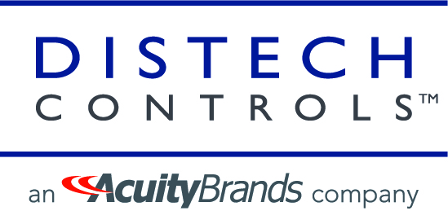
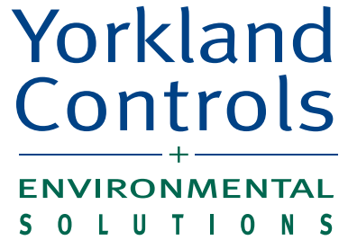
4. Research Update Greg Walker (CABA)
4.1 2022 IBC Landmark Research
Healthy Buildings and Indoor Environmental Quality

Slide 7
4. Research Update Greg Walker (CABA)
4.2 2023 IBC Landmark Research

Slide 8
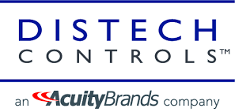
4. Research Update Greg Walker (CABA)
4.3 Annual BACS Market Sizing North America

Slide 9
5. Keynote Marta Klopotowska (CABA)
Interpreting and Leveraging IAQ Data in the Connected Building

Slide 10
Interpreting and Leveraging IAQ Data in the Connected Building
Liam Bates
CEO
at Kaiterra
WELL Air & Performance Advisory Board Member
| WELL Faculty

Slide 11
Liam Bates
CEO at Kaiterra
WELL Faculty & IWBI Advisor
Notes:
Self-intro
Story of the person teaching the webinar and why they’re the expert. Who they are and how they learned about the thing they’re telling you
The story section is about “earning the right”. We’re telling the story that earns them the right to listen and establishes credibility as the expert

Slide 12
A Short
Story
Notes:
Back in 2014 Beijing's air had just hit peak levels, and the city was basically drowning in smog - it was pretty unbearable. I was looking to buy an air purifier for the first time, and had no idea where to start. I visited friends with air purifiers and asked several of them how well they worked. The answers were identical: "pretty good, I guess? You know what, I'm not actually sure...".
I couldn't find a single person that could actually give me a rational, scientific explanation of how good the air in their house was after having bought one of these.
That’s why we decided to build an air quality monitor, and I started off on the journey of IAQ monitoring.
We made all sorts of discoveries that now are obvious and common knowledge, but that shocked everyone around us. For example, opening windows while running an air purifier completely negates the impact of the purifier. Or that closing the door of a room makes an enormous difference to the efficacy of a purifier. We finally started to have some clarity on the impact of our actions on air quality, and how we could actually take concrete steps to improve the air around us.

Slide 13
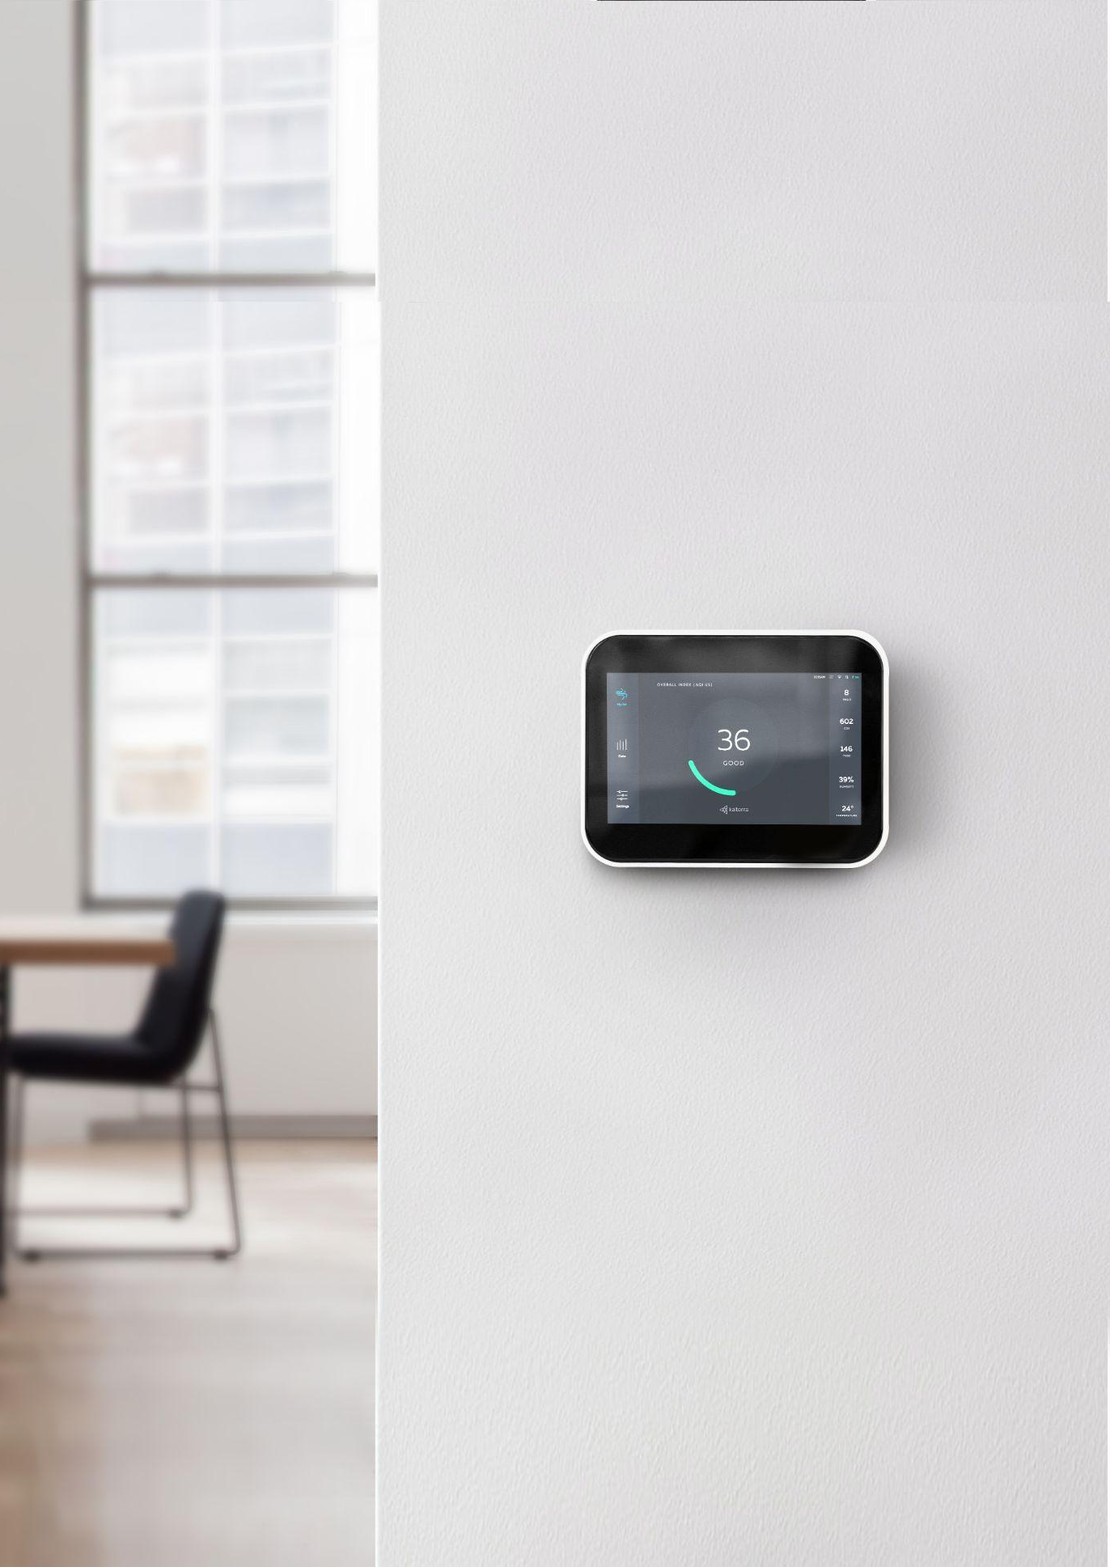
About Kaiterra
Kaiterra provides a complete air quality optimization platform leveraging hardware, software and a team of experienced professionals to help companies assess and improve their indoor air quality for better workplace experience and occupant wellbeing.
Kaiterra’s solutions can be found in many of the world’s most iconic buildings and workplaces, such as the Empire State Building and the Burj Khalifa.

Slide 14
Agenda
1
2
3
4
Importance of Healthy, Connected Buildings & Fundamentals of IAQ
The Bottom Line of Clean Air
Collecting and Interpreting IAQ Data
Case Studies and Best Practices

Slide 15
Healthy, Connected Buildings and the
Fundamentals of IAQ
01.
Notes:
First, let’s go over some basics -

Slide 16
01 - Healthy, Connected Buildings and the Fundamentals of IAQ
Health and wellness have never been more important than they are now.
Why?
→ Increased environmental awareness
→ Popularization of energy saving programs
→ Residential and office buildings are tightly sealed
→ Increases in the sources of indoor air pollution
Notes:
Here you can talk about how healthy buildings have been popularized over the last few years and how there is a shift taking place toward mitigation strategies, smart building design, and leveraging smart building technology
Indoor air quality has never been more important than it is right now, and whether you realize it or not, the economic impact of poor air quality is palpable.
IAQ affects everyone—but many of us take it for granted. From workplaces and retail spaces to restaurants and care facilities, any indoor space needs good ventilation and proper airflow which is critical to curbing the spread of airborne viruses and the negative effects associated with poor air quality.
In buildings around the world, building owners and facility managers are regularly monitoring air quality and taking precautions to mitigate pollution and provide a safe space for the health, wellbeing, and productivity of their employees, tenants, or clients.
There has been a shift in the design and operations of office buildings in recent years from dull and undistinguished, to spaces that prioritize the needs and desires of their tenants. While there is recognition that a healthy, happy workforce is a crucial component of a productive, successful business, investments have been made into design and technology while IAQ remains one of the most crucial yet often overlooked variables. The economic loss due to poor indoor air quality has been estimated to be in the tens of billions of dollars per year.

Slide 17
“
Workplaces need fresh air, not foosball tables and coffee bars.”
Dr. Joseph Allen,
Associate Professor, Harvard T.H.Chan School of Public Health
Notes:
This quote talks about workplaces, but can generalize/adapt it to speak to most indoor environments
Quote by Joseph Allen, who is famously known to have popularized the term ‘healthy buildings’ in recent years
Employers and commercial-real-estate developers have tried to appeal to workers by adding over-the-top amenities like foosball tables, coffee bars, and beanbag chairs, throughout most of the 21st century
Before the pandemic, designers and HR professionals paid little attention to ventilation
Now, the cool new must-have for workplaces isn’t a foosball table. It’s clean air
It’s well-known that we spend close to 90% of their time indoors. Even before the pandemic, it’s grown increasingly clear that the way buildings are designed and maintained has a profound impact on the people inside them, and the shift towards ‘healthy buildings’ is gaining momentum

Slide 18
An Introduction to Healthy Buildings
01 - Healthy, Connected Buildings and the Fundamentals of IAQ
A healthy building is a commercial, residential, or public building which is designed in ways that promote the health, safety and wellbeing of its inhabitants.
Notes:
Here we introduce the concept of a healthy, connected building
A healthy building is a commercial, residential, or public building which is designed in ways that promote the health, safety and wellbeing of its inhabitants. This is achieved by combining principles and insights from the fields of engineering, construction, medicine, and psychology in order to create better indoor environments in the buildings where people spend most of their time.
Architects, city planners, and engineers have been concerned with green or sustainable building for decades. But while green building focuses on the way buildings interact with their environments, in recent years there has been a growing interest in understanding and improving indoor environments.
While much of the recent focus in healthy building has been on public buildings such as schools, the field also has a lot to say about commercial properties.
Why the shift to healthy buildings?
While employee wellbeing is a lofty goal, it’s one that becomes necessary when you consider the true cost of NOT implementing healthy building principles:
Costs of absenteeism and presenteeism
Employee morale and retention
Improved return on real-estate investment

Slide 19
01 - Healthy, Connected Buildings and the Fundamentals of IAQ
Foundations of a Healthy Building
Ventilation
Air quality
Water quality
Thermal health (Temp & RH)
Dust and pests
Lighting and views
Noise
Moisture
Safety and security
Notes:
Speak to the foundations of a healthy building, with a focus on IAQ (in our humble opinion, the best place to start/focus)
So, what makes a building healthy?
Healthy buildings can encompass a broad range of design patterns - from fundamental health and safety measures to dedicated yoga and meditation rooms. However, in the oft-cited 9 Foundations of a Healthy Building, researchers from the Harvard T.H. Chan School of Public Health highlight 9 key areas to focus on: 1-9
In our experience, the best place to start would be with indoor air quality (IAQ) - and here’s why:
Indoor air quality has a larger impact on employee satisfaction than other factors. A study conducted in the Netherlands, in which 70% of a company’s workforce was relocated to a different building with better perceived environmental conditions, found that improvement in air quality had the largest effect on reducing employee dissatisfaction
Indoor air quality can help get employees back in the office. In a recent survey, 82% of millennial workers reported that they would feel safer returning to the office if they would receive timely and transparent IAQ data.
The cost savings are substantial. Exposure to indoor pollutants can have a direct impact on cognitive functions and decision-making capabilities, negatively impacting productivity. A 2015 study estimated that the productivity benefits of improving air quality through ventilation are around $6,500 per person per year.
There are many ways to improve IAQ in an office building, and some might be more applicable than others in your particular space. The one tried and true method that has proven to be effective time and again, is to invest in real-time air quality monitoring. Monitoring will help you understand both the scale of the problem and your progress towards solving it over time.

Slide 20
The Various Elements of IAQ
01 - Healthy, Connected Buildings and the Fundamentals of IAQ
PM_{2.5}
TVOC
CO₂
O₃
Temperature
Humidity
Notes:
The Various Elements of IAQ
Let me walk you through and the different components that have a measurable impact on indoor air quality. While it's important to note that IAQ is a complex topic with many moving parts, our goal is to simplify each of these components for you
PM
Particulate matter (PM) is a mixture of solid and liquid particles suspended in the air
PM is classified into three size profiles: coarse particles (PM10), fine particles (PM2.5), and ultrafine particles (PM0.1)
The size of the particles is directly linked to their potential for causing health problems, with PM2.5 being the most hazardous
PM exposure can lead to both short-term (acute) and long-term health effects due to its ability to enter your lungs and permeate your bloodstream. PM2.5 can then flow to other parts of your body like your brain and heart causing inflammation and damage
There are several ways to measure PM but the vast majority of particulate monitors available today are optical particle counters which work by counting the number of particles in the air
TVOC
Volatile organic compounds (VOCs) are a group of compounds with high vapor pressure and low water solubility.
Total volatile organic compounds (TVOC) is a group of VOCs used to represent the entire pool of pollutants
Emissions of VOCs stem from many sources including building materials, maintenance equipment, and custodial products
The effects of VOCs will depend on their chemical makeup, the amount of exposure, and the surrounding ventilation. It's known that VOCs have short-term and long-term adverse health effects
Unfortunately, TVOC isn’t uniformly defined. This can make the definition of TVOC difficult to parse, as we can’t say definitively what VOCs are in TVOC
For the continuous monitoring of TVOC, MOS sensors are generally used
CO2
Carbon dioxide, also known as CO2, is a colorless gas continuously released through naturally occurring events as well as manmade activities
Most indoor carbon dioxide comes from people as they exhale, and in smaller and less ventilated spaces, like meeting rooms, CO2 can potentially accumulate and occupants may feel more drowsy and find it more difficult to concentrate
High levels of CO2 will negatively impact your brain and health. One workplace study found people breathing in CO2 levels of 2,500 ppm struggled to perform tasks like basic proofreading or simple math problems
Simply put, NDIR sensors are currently one of the best methods for accurately measuring indoor CO2. NDIR sensors use specific wavelengths of light to measure the amount of CO2 in the air
O3
Usually thought of as an outdoor air pollutant, ozone is becoming an increasing concern indoors as well
Indoor ozone emission devices, or IOEDs, include air purifiers, disinfectors, laser printers, photocopiers, and others
Temp & RH

Slide 21
Collecting and Interpreting
IAQ Data
02.
Notes:
This next section is where we start to make the connection between shifting toward healthier buildings and focusing on IAQ, and the importance of data in this process. Specifically, modern IAQ technology and it’s capabilities within a connected building

Slide 22
“
What gets measured, gets managed.”
Peter Drucker
Notes:
The goal of indoor air quality monitoring is to take action on your IAQ data and prove that your efforts have paid off. So, once you’ve implemented a new strategy to resolve a problem, it’s important to keep track of your progress.
Interpreting IAQ Data:
Data is meaningless unless it helps make decisions that have measurable impact. Generating value is a matter of connecting data to insights to action in a fast, repeatable way.

Slide 23
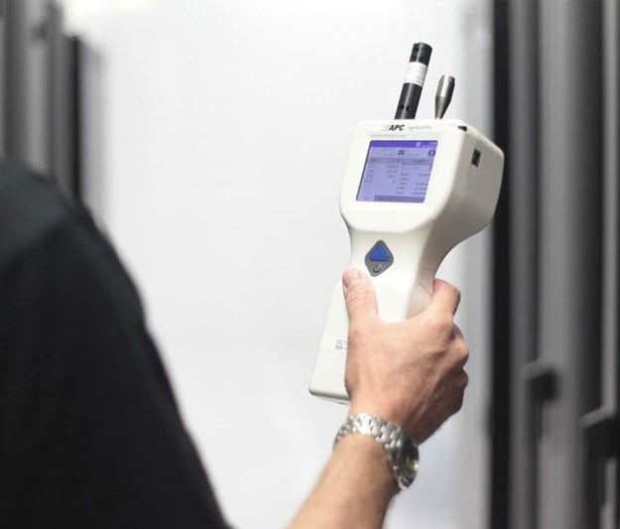
02 - Collecting and Interpreting IAQ Data
Air Quality Spot Checks:
What We Used to Do
→ One-time measurement = limited data points.
→ One-location measurement = lack of comprehensive coverage.
→ Only reporting = no access to raw data.
Notes:
Here you can speak to the outdated (though sometimes necessary in certain instances) limitations of spot testing
Spot testing is common approach when it comes to measuring air quality.
In spot testing, the indoor space is sampled periodically, ranging anywhere from a few hours to a few days, for common air pollutants such as VOCs and particulate matter. The building manager or facility manager typically doesn’t own the air quality monitors, and instead relies on an external team to come on-site on one or more occasions, collect and analyze samples, and send a detailed report after the fact.
This obviously has its shortcomings …
Limitations of Spot Testing
Spot testing was the more common approach to indoor air quality monitoring in the past, since purchasing air quality monitors used to be prohibitively expensive and the devices were difficult to maintain. However, this approach suffers from multiple disadvantages due to the very limited scope of measurement that it permits:
Gameable
The results of a spot test often depend on the time in which the sample is collected, which makes them easy to game and hurts their reliability. For example, an organization might schedule a test during low-occupancy periods, such as during a building’s flush-out phase (see illustration below). This can result in building occupants living or working in unhealthy conditions that go unnoticed, which leads to myriad costs in lost productivity, absenteeism and employee dissatisfaction.
Snapshot data makes it difficult to see trends
Unlike in continuous monitoring approaches, which will be covered further in this article, a spot test ends with a report detailing the air quality situation during the period when samples were collected. When samples are collected only a handful of times each year, it’s difficult to gain a reliable understanding of trends (as there is only a very small number of data points to extrapolate from).
Usually not actionable in real time (or at all)
Since data isn’t collected or analyzed on a day-to-day basis, it’s much harder to catch problems when they’re small. With spot testing, the best case scenario would be that you notice an air quality problem or an issue with HVAC systems at a fairly late stage; and the more likely scenario is that you would fail to notice the problem at all due to the very limited amount of data that’s being collected.
High ongoing costs with low ROI
Despite low upfront costs, many buildings, especially those who are applying for green and healthy building certifications, need to have their air quality tested at least annually. These costs accumulate over time. In addition, testing companies generate static reports that pertain only to the specific moment in time when data was collected, making them less actionable - for example, data from spot sampling cannot be used to inform building automation systems. The data is simply less useful than alternative approaches -and reliance on spot testing is thus less cost-effective in the long term.

Slide 24
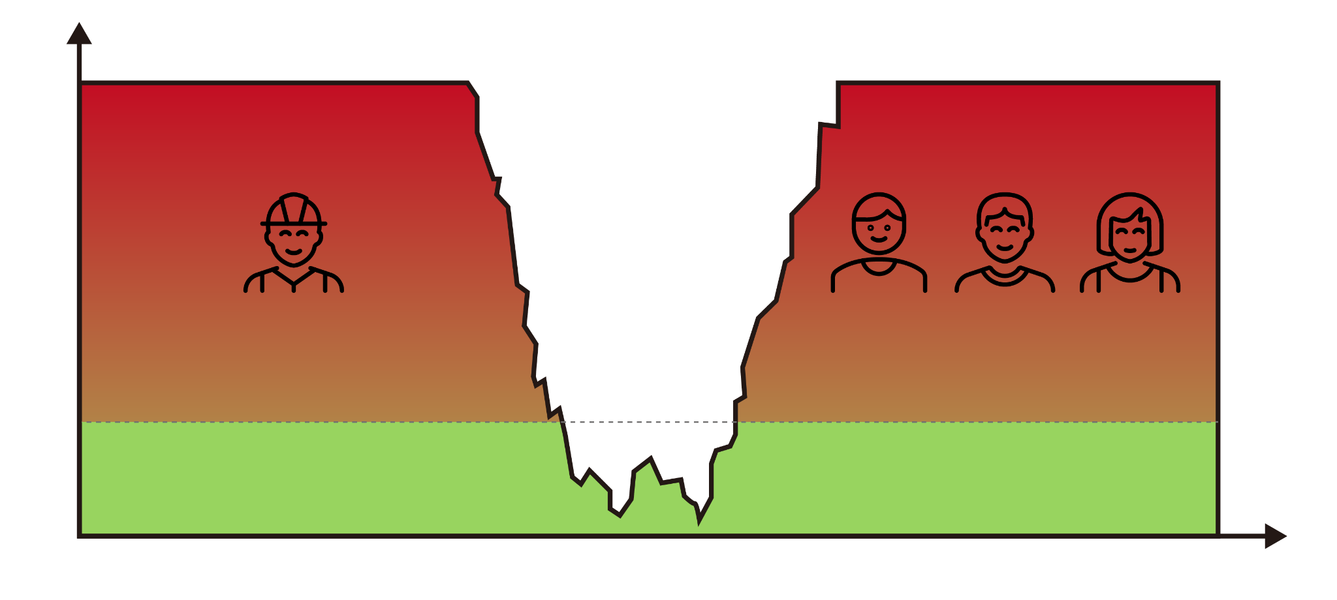
The Trouble With Spot Checks
02 - Collecting and Interpreting IAQ Data
Hazardous: Beyond measurable level
Source: The RESET® Standard
FLUSH-OUT PHASE (PASS)
CONSTRUCTION PHASE
OCCUPANCY PHASE
Healthy level
0
Time
Notes:
The results of a spot test often depend on the time in which the sample is collected, which makes them easy to game and hurts their reliability.
For example, an organization might schedule a test during low-occupancy periods, such as during a building’s flush-out phase (see illustration below). This can result in building occupants living or working in unhealthy conditions that go unnoticed, which leads to myriad costs in lost productivity, absenteeism and employee dissatisfaction.
Or even the building down the street being in construction, impacting your readings!

Slide 25
Why Continuous Monitoring?
02 - Collecting and Interpreting IAQ Data
→
→
→
Real-time monitoring and consistent data points:
Identify trends and problems faster
Comprehensive coverage across portfolio:
Know the true air quality across your building
Make data-driven decisions to improve HVAC performance:
Save energy without sacrificing comfort and wellbeing
Notes:
Here is where we introduce continuous monitoring, its benefits, and the role it plays in the connected building
Continuous Monitoring: The Modern Approach to Indoor Air Quality
In continuous monitoring, an organization uses air quality monitors that are installed throughout the building in order to collect data on an ongoing basis, and gain real-time visibility into the current state of air quality in an office or other indoor space. Unlike spot tests which are only conducted a handful of times each year, this type of monitoring happens consistently in the background, allowing building managers and facility managers to track the data and find anomalies or optimization opportunities.
Advantages of Continuous Monitoring
In recent years, as more simple and affordable commercial air monitors have been introduced (by Kaiterra and other companies), the balance has shifted towards continuous monitoring. With affordability no longer as much of an issue, companies are choosing this approach as it presents numerous advantages over the alternative:
Accurate and actionable data in real-time
With continuous monitoring, organizations can be aware of the state of air quality in their building at any given moment, and respond to changes as they occur, rather than wait for samples to be collected and analyzed or rely on one single data point that’s taken in the past to define your indoor air quality optimization strategy. Changes in air quality are addressed more rapidly and effectively, which has a positive impact on occupant wellbeing and productivity.
More comprehensive representation of your indoor space
Spot testing is typically conducted in a limited area, and within the occupancy rates in the building on the day the samples are collected. This results in a limited scope of insights that can be gleaned from the data, especially in larger indoor spaces, as it is only relevant for the specific spaces that were sampled and the specific occupancy at the time of sampling. Continuous monitoring allows you to place monitors across multiple locations and examine data throughout different periods and times of day, providing a significantly more accurate representation of the state of air quality in your buildings.
Ability to see long-term trends
Since data is collected on an ongoing basis and can be stored indefinitely, organizations are able to analyze changes in air quality parameters (such as TVOC) over time and see long-term trends as well as temporary peaks in the data. These trends are almost impossible to identify with spot sampling, which produces only a handful of data points.
Higher ROI
While air quality monitors require an upfront investment, organizations typically see returns within a moderate timeframe by eliminating the cost of repeated testing, working with higher-quality data, and gaining certifications. Additionally, ownership over data and the ability to act based on fresh data presents opportunities to reduce operational costs and ultimately improve profitability. For example, building managers can notice degradation in some parameters as an indication to run maintenance on HVAC systems before a more serious breakdown occurs, or identify opportunities to reduce over-ventilation to save energy costs.

Slide 26
02 - Collecting and Interpreting IAQ Data
Key Considerations For Choosing
an IAQ Monitor
→ Your project’s goals, requirements, and limitations
→ Data collection, storage, and display preferences
→ Building automation specifications
→ Maintenance requirements
Notes:
Here you can speak specifically to what to look for in a smart IAQ monitor
Building certifications like LEED, WELL, Fitwel, and RESET are becoming more and more popular as people turn their attention to the wellness impacts of the built environment. These certifications reflect a scientific-based, unbiased effort to make sure the indoor environment maximizes occupant health and well-being, and air quality plays a key role in it.
As a result, when scouting around for a commercial air quality monitor, finding a monitor that conforms to certification requirements is crucial. Whether you are applying for WELL, RESET, or a different standard, the first step you should take is to dig into the air quality monitoring requirements of the standard. These requirements often vary between programs, so you need to check the specifications of the standard before choosing an air quality monitor.
The different ways a commercial IAQ monitor can collect, store, and display your air quality readings are essential aspects to consider. Whether you are collecting data to meet building certification requirements, or you are trying to gather insights on your own to further improve your indoor space, having the flexibility to make use of your data in the way you prefer is crucial.
Data Collection
Relating to building certifications, you should check the data output interval of any prospective device. The data output interval of an IAQ monitor is the time between recorded readings, including transmitting the measurement to the data provider. WELL requires that your air quality monitor take measurements over an interval no shorter than one hour. RESET, on the other hand, requires a data output interval of 1 minute.
Data Storage
Similar to data collection, data storage needs will vary both according to certification requirements and your additional needs. You should check how many data points the device can store and how the device stores them. Does it store data in built-in memory or the cloud? Do you prefer to send your data via the Internet, or through a USB drive? These are some questions you should answer before investing in a commercial air quality monitor.
Data Display
The way you view your air quality data is important and can make a device stand out from the crowd. For some building certifications, particularly RESET, real-time readings must be readily accessible for a regularly-occupied space.
A consolidated dashboard, available to all our enterprise products including the Sensedge and Sensedge Mini, allows you to view performance reports, manage multiple devices, set notifications, and compare readings over your other devices. A mobile app also provides some of these functions, with the added benefit of mobility.
Another essential component of commercial IAQ monitors is the potential for building automation.
Building automation is becoming increasingly prevalent and increasingly doable in today’s modern world. Integrating an air quality monitor into your network can save you money and time in more ways than one.
For example, incorporating air quality monitoring into your building automation system can maximize your HVAC performance, as well as save energy for your building. Additionally, the automated system will significantly reduce the amount of time and manpower the building management team needs to put into managing air quality, resulting in lower operational costs and higher profits.
There are many ways to incorporate air quality monitoring into building automation through API, Modbus, local MQTT, BACnet, and more. With the range of protocols and connectivity options available, you want to make sure the devices support the standard you choose.
When looking for an IAQ monitor, you should look at the monitor’s calibration process. All monitors will need to be recalibrated to maintain accuracy. Many manufacturers suggest once per year, and some certification programs like WELL and RESET also require recalibration once per year.
This recalibration process can be time-consuming and costly. For many monitors on the market, recalibration involves removing the unit, packaging it up, shipping it back to the manufacturer, waiting for them to calibrate and send the monitor back to you, and then reinstalling the unit. All of these steps waste time and resources that could be better utilized elsewhere. Not to mention that you will collect zero data point while your monitor is in the factory being recalibrated. Oh, that’s bad!
The inconvenience of recalibration can be avoided with the modular system in our Sensedge and Sensedge Mini. Instead of removing the entire unit, only the specific sensors that need to be calibrated are removed from the device and replaced with new sensors. The Sensedge’s complete recalibration process only takes seconds compared to the weeks-long, even months-long, traditional calibration processes.

Slide 27
4-Step Action Plan for Managing IAQ in the Built Environment
02 - Collecting and Interpreting IAQ Data
1
2
3
4
Plan & Set IAQ Objectives
Gather Data
Analyze Data & Reporting
Automation and Control
Notes:
This section is where we get prescriptive into leveraging the data you collect to action on it and make it work for you via smart reporting, automation, etc.
A typical IAQ data strategy requires several steps:
Planning—
Gather background information about the building and its systems.
Interview affected people—understand the complaints and symptoms and check for patterns as to where and when they occur.
Set objectives.
Determine the strategy to be employed.
Gathering data—make necessary measurements throughout the building, possibly including temperature, humidity, PM2.5, CO2, VOCs, chemicals and bioaerosols.
Analyzing the data—check for acceptable measurements to eliminate certain areas or suspected problems, as well as anomalies that direct you to areas requiring additional focus (remember, there can be multiple problems).
Reporting findings—all results indicating a need for corrective action should be reported.
Offering assistance—prepare an IAQ management plan that includes setting policies and conducting routine measurements to ensure good air quality is maintained.
Automation—sensors make up a crucial component of any building automation system. Sensors collect the data inputs used to control output devices like ventilation systems, and indoor air quality sensors are some of the primary sensors used in these building automation networks. When implemented correctly, these systems can reduce energy consumption, lower maintenance costs, extend the lifecycle of utilities, and ensure the safety and comfort of building occupants.

Slide 28
The Bottom Line of
Clean Air
03.
Notes:
This next section we can speak to the ROI of clean air/IAQ monitoring
In buildings around the world, building owners and facility managers are regularly monitoring air quality and taking precautions to mitigate pollution and provide a healthy space for their people. The economic loss due to poor indoor air quality has been estimated to be in the tens of billions of dollars per year. Even the most modest investment towards improved air quality is sure to produce considerable cost savings.
When investing in IAQ monitoring, it’s important to understand that you’re not just investing in equipment and technology. You’re also investing in your people and access to the data showcasing how your building serves them.
Let’s take a deeper look at some of the specific ROI you can expect to realize through IAQ monitoring

Slide 29
3 Benefits of IAQ Monitoring
03 - The Bottom Line of Clean Air
Generate Value
Reduce Costs
Maximize Time
Notes:
Here is a figure we’ve put together to illustrate the 3 main benefits of IAQ monitoring:
Generate value (make money)
Reduce costs (save money)
Maximize time (save time)
You can realize any one of these or all of them at the same time
Let’s take a look at each one in closer detail

Slide 30
Generate Value
03 - The Bottom Line of Clean Air
→ Healthy and Productive People
→ Top Employer
→ Commercial Real Estate Value
Notes:
Here is a figure we’ve put together to illustrate the 3 main benefits of IAQ monitoring:
Generate value (make money)
Reduce costs (save money)
Maximize time (save time)
You can realize any one of these or all of them at the same time
Let’s take a look at each one in closer detail

Slide 31
03 - The Bottom Line of Clean Air
For every
400 ppm increase in CO₂, productivity drops by
21%.
Notes:
example/figure on productivity

Slide 32
03 - The Bottom Line of Clean Air
Healthy indoor air quality can boost tenant satisfaction and reap long-term returns.
Notes:
Example of RE value

Slide 33
Reduce Costs
03 - The Bottom Line of Clean Air
Most buildings are not energy efficient, and this happens for a couple of reasons:
→ Non-optimal design of buildings
→ Imperfect HVAC systems that consume energy
higher than the building itself demands
Notes:
Heating, Ventilation and Air Conditioning (HVAC) Energy Savings
Buildings represent nearly 40% of global energy consumption, with heating, ventilation and air conditioning (HVAC) systems contributing up to 40% of a single building’s consumption. What’s more, most of these buildings are not energy efficient, and this happens for a couple of reasons — a) non-optimal design of buildings and b) imperfect HVAC systems that consume energy higher than the building itself demands, thereby resulting in inefficient spaces that cost millions in the long run. It isn’t unusual for a building’s HVAC system to operate at its maximum ventilation rate continuously, even if the space is only partially occupied. This often results in over-ventilation, thereby causing higher-than-necessary energy costs.
One solution, demand controlled ventilation (DCV), is a method of using monitors to assess real-time air quality data and introduce variable amounts of fresh air "on-demand" based on occupancy patterns. The system provides a means to adjust the rate of ventilation continuously and automatically.
Energy savings of 10% to 21% are possible with smart HVAC systems introducing variable amounts of fresh air based on occupancy patterns.
By retrofitting older, more traditional HVAC systems in a building to variable air volume systems that are capable of making automated adjustments, The US Environmental Protection Agency (EPA) has found that annual energy savings of 10% to 21% are possible (the equivalent of $0.10-$0.20/ft2). Depending on the size of the building, savings can be substantial. With smart air quality monitoring, systems can operate only when they have to, reducing costs and keeping them at a minimum while maximizing ROI.

Slide 34
03 - The Bottom Line of Clean Air
A typical HVAC system accounts for approximately 40% of total building energy consumption.
Notes:
example/figure on poor HVAC performance

Slide 35
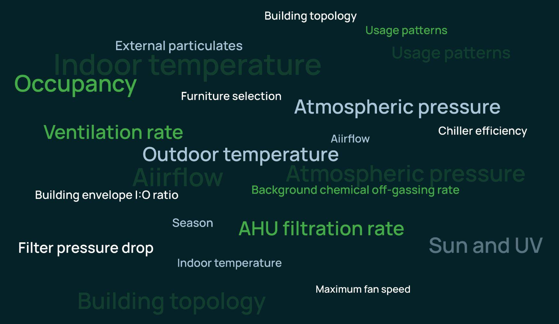
Maximize Time
03 - The Bottom Line of Clean Air
Notes:
You’ve gathered all of this data, now what? The problem is...IAQ data can be complicated.
There are several ways to make your consolidated data insights actionable. One of those commonly used is automations through a building management system. This gives you the ability to seamlessly automate what once was once a complex task or not possible at all, saving you LOTS of time.
Another way that we can turn insight into action is through discovery. By visualizing data sets side-by-side that previously could not be compared, questions are raised and curiosity is ignited. You can see where there is opportunity for optimization, current system effectiveness, and instantly make changes to enhance the occupant comfort.
Partnering with a provider that offers powerful software capabilities can help capture complex and under-utilized information and turn it into actionable insights and controls to help optimize the health & energy efficiency of buildings.
Touch on manual vs. our weekly smart reporting to take the guesswork out and save time
Traditional IAQ Reporting
Manual
Technical
Degree of data literacy required
Time-consuming
Potential for mistakes and inaccuracies
Benefits of our smart reporting:
Weekly Reports
Detailed Insights
Week-to-Week Comparisons
IAQ Optimization Tips
Device Health Updates
Actionable Advice

Slide 36
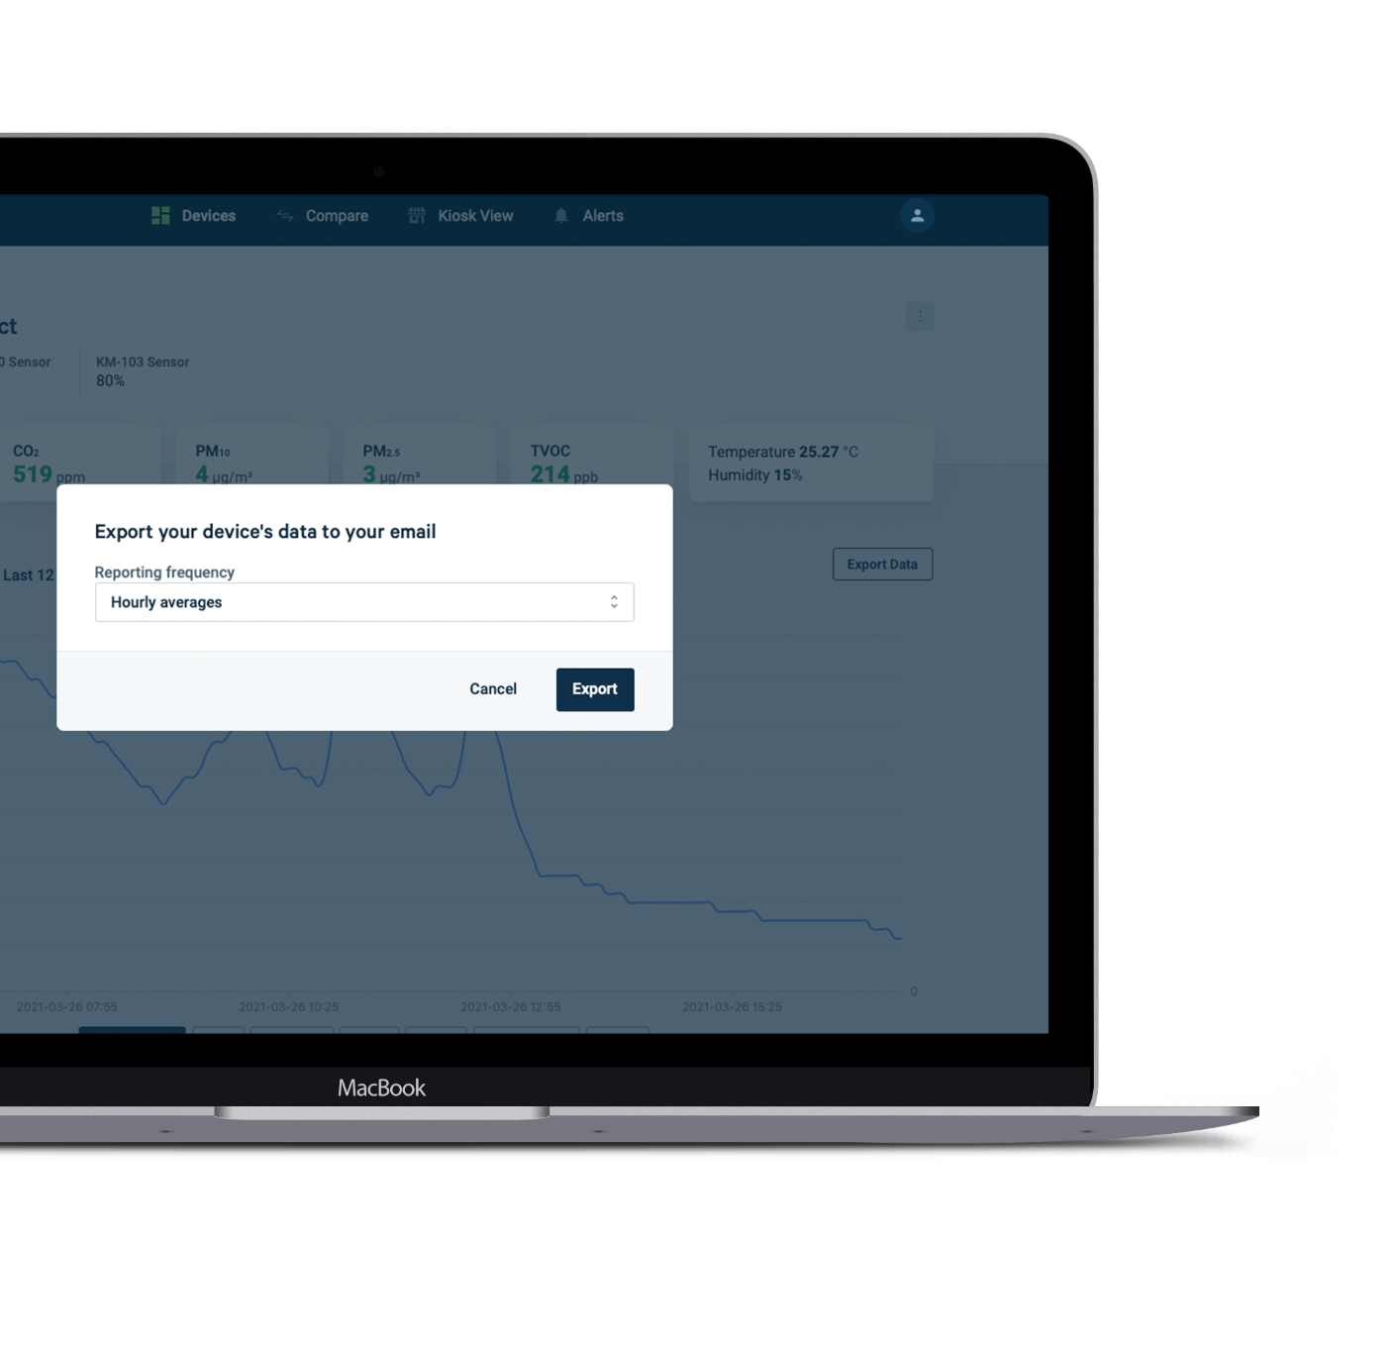
03 - The Bottom Line of Clean Air
Optimize
Uncover actionable insight.
Visualize current and historical data to uncover patterns and determine the optimal times for operating your building’s HVAC system, address your occupants' indoor climate complaints with live data and be informed when action is necessary.
Export
Create and export certified performance reports.
Kaiterra Dashboard collects minute-by-minute readings and makes your data available in formats recognized and supported by the WELL, RESET and LEED standards. You can view detailed and customized reports for individual devices, and export & save them as .csv files.
Notes:
Ability to visualize and export data like with the Kaiterra Dashboard helps you optimize your IAQ strategy and simplifies the complex.

Slide 37
Best Practices and Case Studies
04.
Notes:
This next section is to introduce case studies from projects we work on, and to tie a ‘best practice’ into each example to dry the point home
In buildings around the world, building owners and facility managers are regularly monitoring air quality and taking precautions to mitigate pollution and provide a healthy space for their people. The economic loss due to poor indoor air quality has been estimated to be in the tens of billions of dollars per year. Even the most modest investment towards improved air quality is sure to produce considerable cost savings.
When investing in IAQ monitoring, it’s important to understand that you’re not just investing in equipment and technology. You’re also investing in your people and access to the data showcasing how your building serves them.
Let’s take a deeper look at some of the specific ROI you can expect to realize through IAQ monitoring

Slide 38
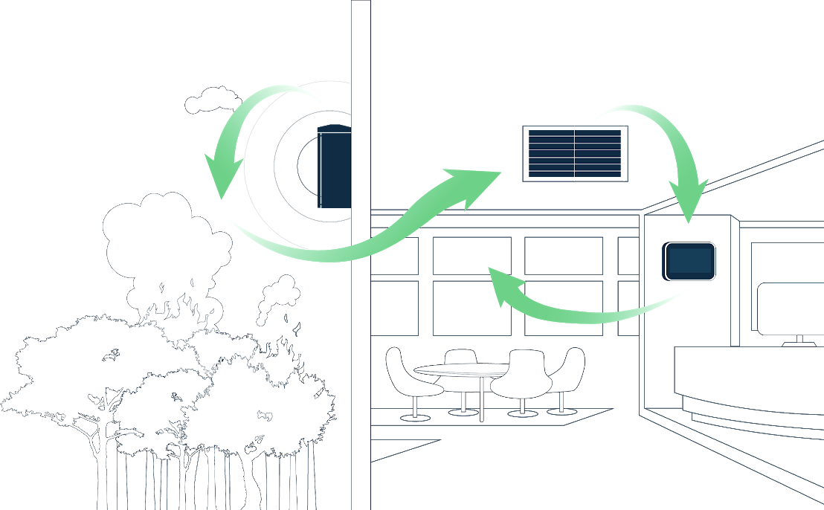
Case
Study
04 - Best Practices and Case Studies
Outdoor
monitoring
Optimized filtration
Microsoft uses our technology to measure air quality inside and outside their buildings during wildfires.
This data automatically controls their filtration system to improve air quality, while reducing energy consumption.
Indoor verification

Slide 39
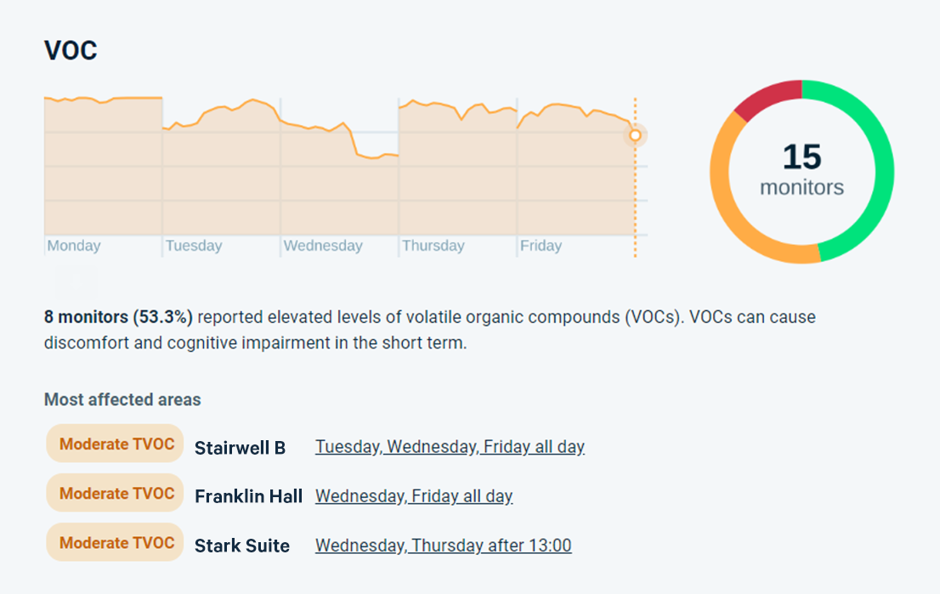
Detailed Insights & Optimization Tips
04 - Best Practices and Case Studies
Smarter insights, collected from thousands of data points. Learn how healthy your air is and transform insights to action with helpful IAQ optimization tips.
Notes:
By receiving timely optimization tips through our smart reporting, companies like Microsoft are able to swiftly make adjustments to their filtration systems in times of need, like wildfire season.

Slide 40
Case Study
04 - Best Practices and Case Studies
The Pontifical Catholic University of Puerto Rico
→ Invested over $1.4 million in a new air quality system for all campus buildings and administrative offices
→ Implementation of real-time, continuous air quality monitoring throughout campus
→ Increased capabilities for air filtration and purification
Notes:
Context:
After a significant period of pandemic-induced disruption and online learning, the Pontifical Catholic University of Puerto Rico (PUCPR) was looking to enable students and staff to return to in-person classes on its campus in Ponce.
To make the return safe for all and inspire trust and confidence, the university committed to making a large investment in monitoring and improving air quality. SAEG Engineering Group was chosen to lead the project due to its world-renowned expertise in HVAC, energy, and environmental solutions.
Building on Kaiterra’s monitoring solutions and a host of purification and ventilation technologies, SAEG engineering designed a best-in-class system to monitor, improve, and display air quality.
The university has invested over $1.4 million in a new air quality system for all of the campus buildings and administrative offices, spanning over 1,400 pieces of equipment. Designed by SAEG engineers, this system innovatively integrates several technologies and makes the results transparently available to any student, professor, or university worker.
SAEG implemented Kaiterra’s air quality monitors to measure key IAQ metrics across many different locations in the university - gaining real-time visibility into ozone, particulate matter, TVOC, and CO2 levels at different areas and during different times of the day.
Data collected by Kaiterra devices enabled SAEG to install and manage various technologies used to clean the air or pump fresh air into the building - including HEPA and carbon filters, bipolar ionization, and ultraviolet lights. For example, in places where many people congregate such as conference rooms, the team can activate bipolar ionization and other systems for as many hours as needed after the conference is over, until the data shows that the air is safe for inhabitants.
The technology-enabled air quality system has created a safe learning environment for students and staff. The university can now understand air quality along with parameters that can affect the health and wellbeing of occupants such as temperature and humidity.
The solution enables PUCPR to tackle not just COVID-19, but other viruses such as influenza, as well as respiratory issues caused by colds, fungi, and allergens. With the data and devices that were installed, the university has a path towards continuously optimizing its performance in these areas. Furthermore, it reaffirms the institution’s public commitment to safety and instills a sense of confidence in students and staff as they gradually return to in-person university life.

Slide 41
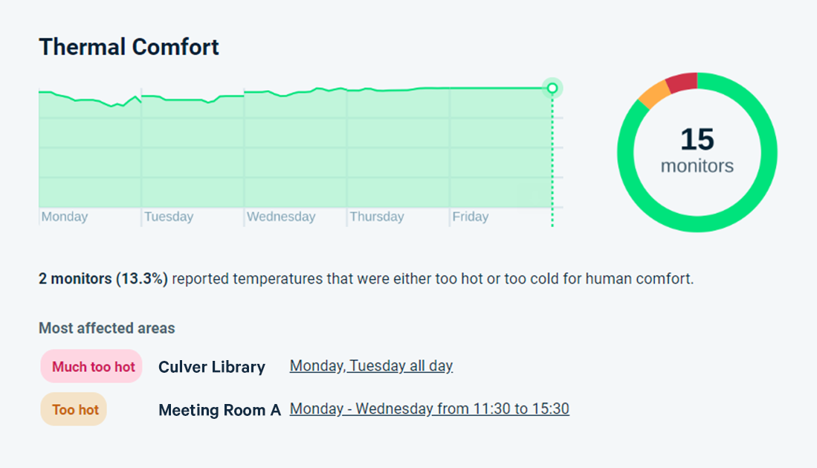
Dive Into Each Parameter and Identify Any Trends
04 - Best Practices and Case Studies
Indoor spaces are unique—so is the collection of air inside of them. Analyze individual parameters you’re monitoring and act on any troubling trends before they become a problem.
Notes:
Not every classroom, building, or office is made equally - by being able to visualize data and identify trends through our weekly smart reporting, spaces like PCUPR are able to keep tabs on the air quality around the entire campus and address emerging trends in certain spaces before they become troubling.

Slide 42
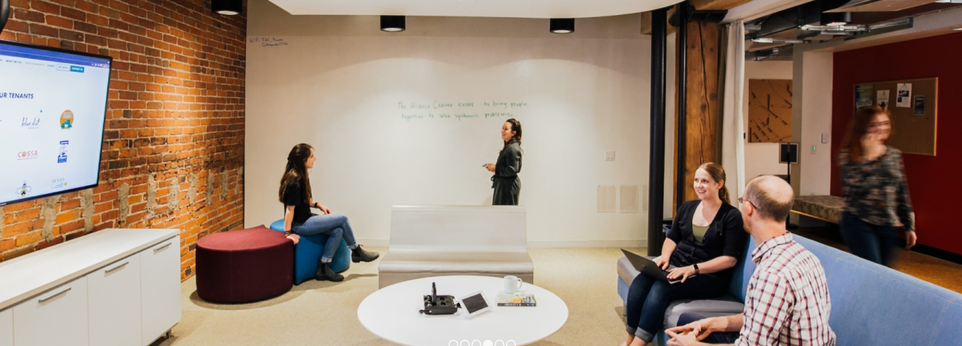
Case Study
04 - Best Practices and Case Studies
The Alliance Center
In the wake of the COVID-19 pandemic, The Alliance Center was looking to increase tenant confidence, mitigate poor outdoor air quality due to wildfires, and better understand the impact of their efforts through research and data sharing.
After implementing Kaiterra’s Sensedge and Sensedge Mini monitors, the company gained a better understanding of air quality in different parts of the building, facilitated tenants’ safe return to the office, and is expanding its project with further research, data sharing, certification, and automation.
Notes:
Customer
The Alliance Center is a coworking space, event venue, and environmental nonprofit based in a historic building in Denver, Colorado. Their mission is to bring people together in order to create a sustainable and inclusive future - supporting a healthy planet, a strong democracy, and a thriving economy. The organization’s Living Lab program pilots innovative sustainability solutions, using its building as a demonstration site - which means the building needs to operate at the highest levels of performance for occupants and the environment.
The Challenge
The COVID-19 pandemic brought air quality to the forefront for tenants and other occupants
The climate crisis in Colorado: fires in and around the state had become more prevalent, increasing particulate matter (PM) values and impacting outdoor air quality.
Research and educational goals: as a nonprofit focused on health and sustainability, collecting air quality data would provide an opportunity to share data with others through the company’s Living Lab program.
Balancing air quality against energy consumption: the company is planning modifications to the building’s mechanical system, supported by air quality data, in order to improve energy efficiency without compromising occupant health.
Support for certification requirements, specifically RESET
The Solution
The Alliance Center set out to improve air quality and increase transparency through a multi-faceted effort which included HEPA filtration and improvements to mechanical ventilation. Within this project, Kaiterra's air quality monitors were an important piece of the puzzle, as they would enable the company to collect much more accurate and granular data about the performance of different spaces in the building.
The Result
New air quality insights: Almost immediately after implementing the monitors, The Alliance Center uncovered new insights about air quality in its building. They were able to identify a particular area that was experiencing higher values of TVOCs. They would not have known about this issue without accurate, continuous measurement in multiple locations.
Research into visual air quality cues: While research is still ongoing on quantifying the impacts of sharing air quality data with occupants, Chris says that the visual cue of IAQ sensors has been valuable to instill confidence in tenants.
Ongoing partnership: Kaiterra is participating in research efforts, data sharing, and system integration, with the ultimate goal and commitment to share information with the commercial sector.

Slide 43
Easily Identify Opportunities to Improve IAQ
04 - Best Practices and Case Studies
Weekly scoring is a way to quickly assess the quality of your air. See what’s impacting your score and what you can do to address it.
Notes:
The more data you have, sometimes the more complicated it can be to interpret. By assigning scores and having a target to measure up to, weekly scorecards from our smart reporting helps spaces like The Alliance Center quickly assess the quality of their air and identify which potential issue to address first.

Slide 44
Get a Headstart on Your IAQ Journey!
Connect with me on LinkedIn: @LiamBates
For questions and inquiries, email: info@kaiterra.com

Slide 45
THANK YOU!
Questions?

Slide 46
6. CABA Podcasts Chris Larry (Exp US Services Inc.)
Join industry experts and leaders from around the globe as they discuss everything smart home and intelligent buildings.
CABA is looking for guests and hosts for future pre-recorded episodes. Contact Marta Klopotowska (Klopotowska@caba.org) for more information.
May 2023 Intelligent Buildings and Connected Homes Recordings:
- The Advantages of PoE Lighting and IoT for Buildings and Facility Management
- Part 3 | Post-Pandemic Building Issues, Cybersecurity, & Intelligent Amenities – Cybersecurity Issues

Slide 47
7. White Paper Sub-Committee Update Ken Wacks (Ken Wacks Associates)
All proposals and previously completed IBC White Papers can be downloaded at:
www.caba.org/whitepapers

Slide 48
7. White Paper Sub-Committee Update Ken Wacks (Ken Wacks Associates)
Call for Working Group Members
Whitepaper Title: ADA Compliance in a Smart Technology Environment
Working Group Chair & Author: Mark Reynolds reynolds@unm.edu
The purpose of this white paper is to provide a comprehensive analysis of how smart technologies can enhance the reasonable accommodation requirement in the next generation of smart buildings. By examining various applications, AI advancements, and interactive smart devices, the aim is to identify solutions that improve the overall experience for individuals with impairments. The focus is to identify existing technologies that either fully or partially meet the reasonable accommodation needs in building designs, catering to small, medium, and large-scale implementations.
In addition, this paper seeks to explore the functionalities that can facilitate major life activities for people with impairments. By investigating these functionalities, we intend to propose best practices that building owners can adopt to ensure inclusivity and accessibility for all occupants. Lastly, the aim is to establish a rating system that informs occupants about the level of accommodations they can expect in a particular building.

Slide 49
8. New Business Bob Allan (NAVCO, Inc.)
New IBC business?

Slide 50
9. Announcements Robert Lane (Robert H. Lane & Associates Inc.)
9.1 Past Events Overview
ISH
March 13-17 | Germany
IFMA World Workplace
March 22-23 | Netherlands
IFMA Facility Fusion
April 11-13 | San Francisco, CA
Lightfair
May 21-25 | New York, NY

Slide 51
9. Announcements Robert Lane (Robert H. Lane & Associates Inc.)
9.2 Upcoming Events
Realcomm Ibcon
June 14-15 | Las Vegas, NV
Shanghai Intelligent Building Technology
August 29-31 | Shanghai, China
BICSI
September 10-14 | Las Vegas, NV
Greenbuild
September 26-29 | Washington DC

Slide 52
10. Adjournment Bob Allan (NAVCO, Inc.)
Next IBC Meeting: Monday, August 21, 2023
Continental Automated Buildings Association (CABA) caba@caba.org www.CABA.org
www.caba.org/ibc
Connect to what’s next™

