Slide 1
Connected Home Council (CHC) Webinar Meeting will commence 1:05pm ET Tuesday, May 9, 2023, 1 PM – 2:30 PM (ET)
CHC Chair: Ken Wacks (Ken Wacks Associates)
Vice-Chair: Charles Hume (Southwire Company, LLC)

Slide 2
1. Agenda Greg Walker (CABA)
Agenda
Call to Order, Welcome, Introductions, About the CHC
Administrative
Research Update
CABA Podcasts
Keynote: “Residential Battery Energy Storage” (30 min)
Jonathan Robinson (Frost & Sullivan)
New Business
Announcements
Adjournment

Slide 3
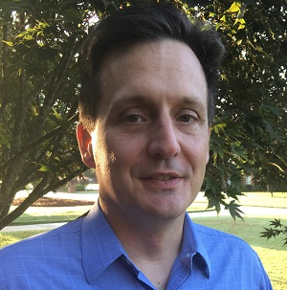
2. CHC Meeting Call to Order, Intros, About the CHC Ken Wacks (Ken Wacks Associates)
Established in 2004, the CABA Connected Home Council initiates and reviews projects that relate to connected home and multiple dwelling unit technologies and applications. The Council also examines industry opportunities that can accelerate the adoption of new technologies, consumer electronics and broadband services within the burgeoning connected home market. www.caba.org/chc
CHC Chair
Dr. Kenneth Wacks
Management & Engineering Consultant
Ken Wacks Associates
CHC Vice-Chair
Charles Hume
Director of Digital Power Technologies
Southwire Company, LLC
3

Slide 4
3. Administrative Ken Wacks (Ken Wacks Associates)
3.1 Motion to approve past CHC Minutes February 21, 2023 www.caba.org/chc
3.2 Call for CHC Vice Chairs
3.3 Call for future CHC Keynote Speakers

Slide 5
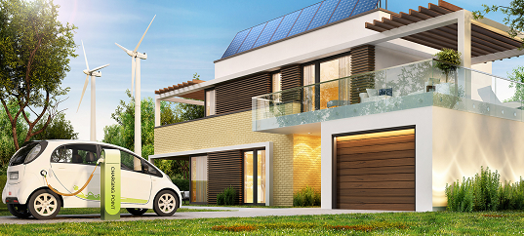
4. Research Update Greg Walker (CABA)
2022 CHC Landmark Research
Smart Home Energy Management

Slide 6
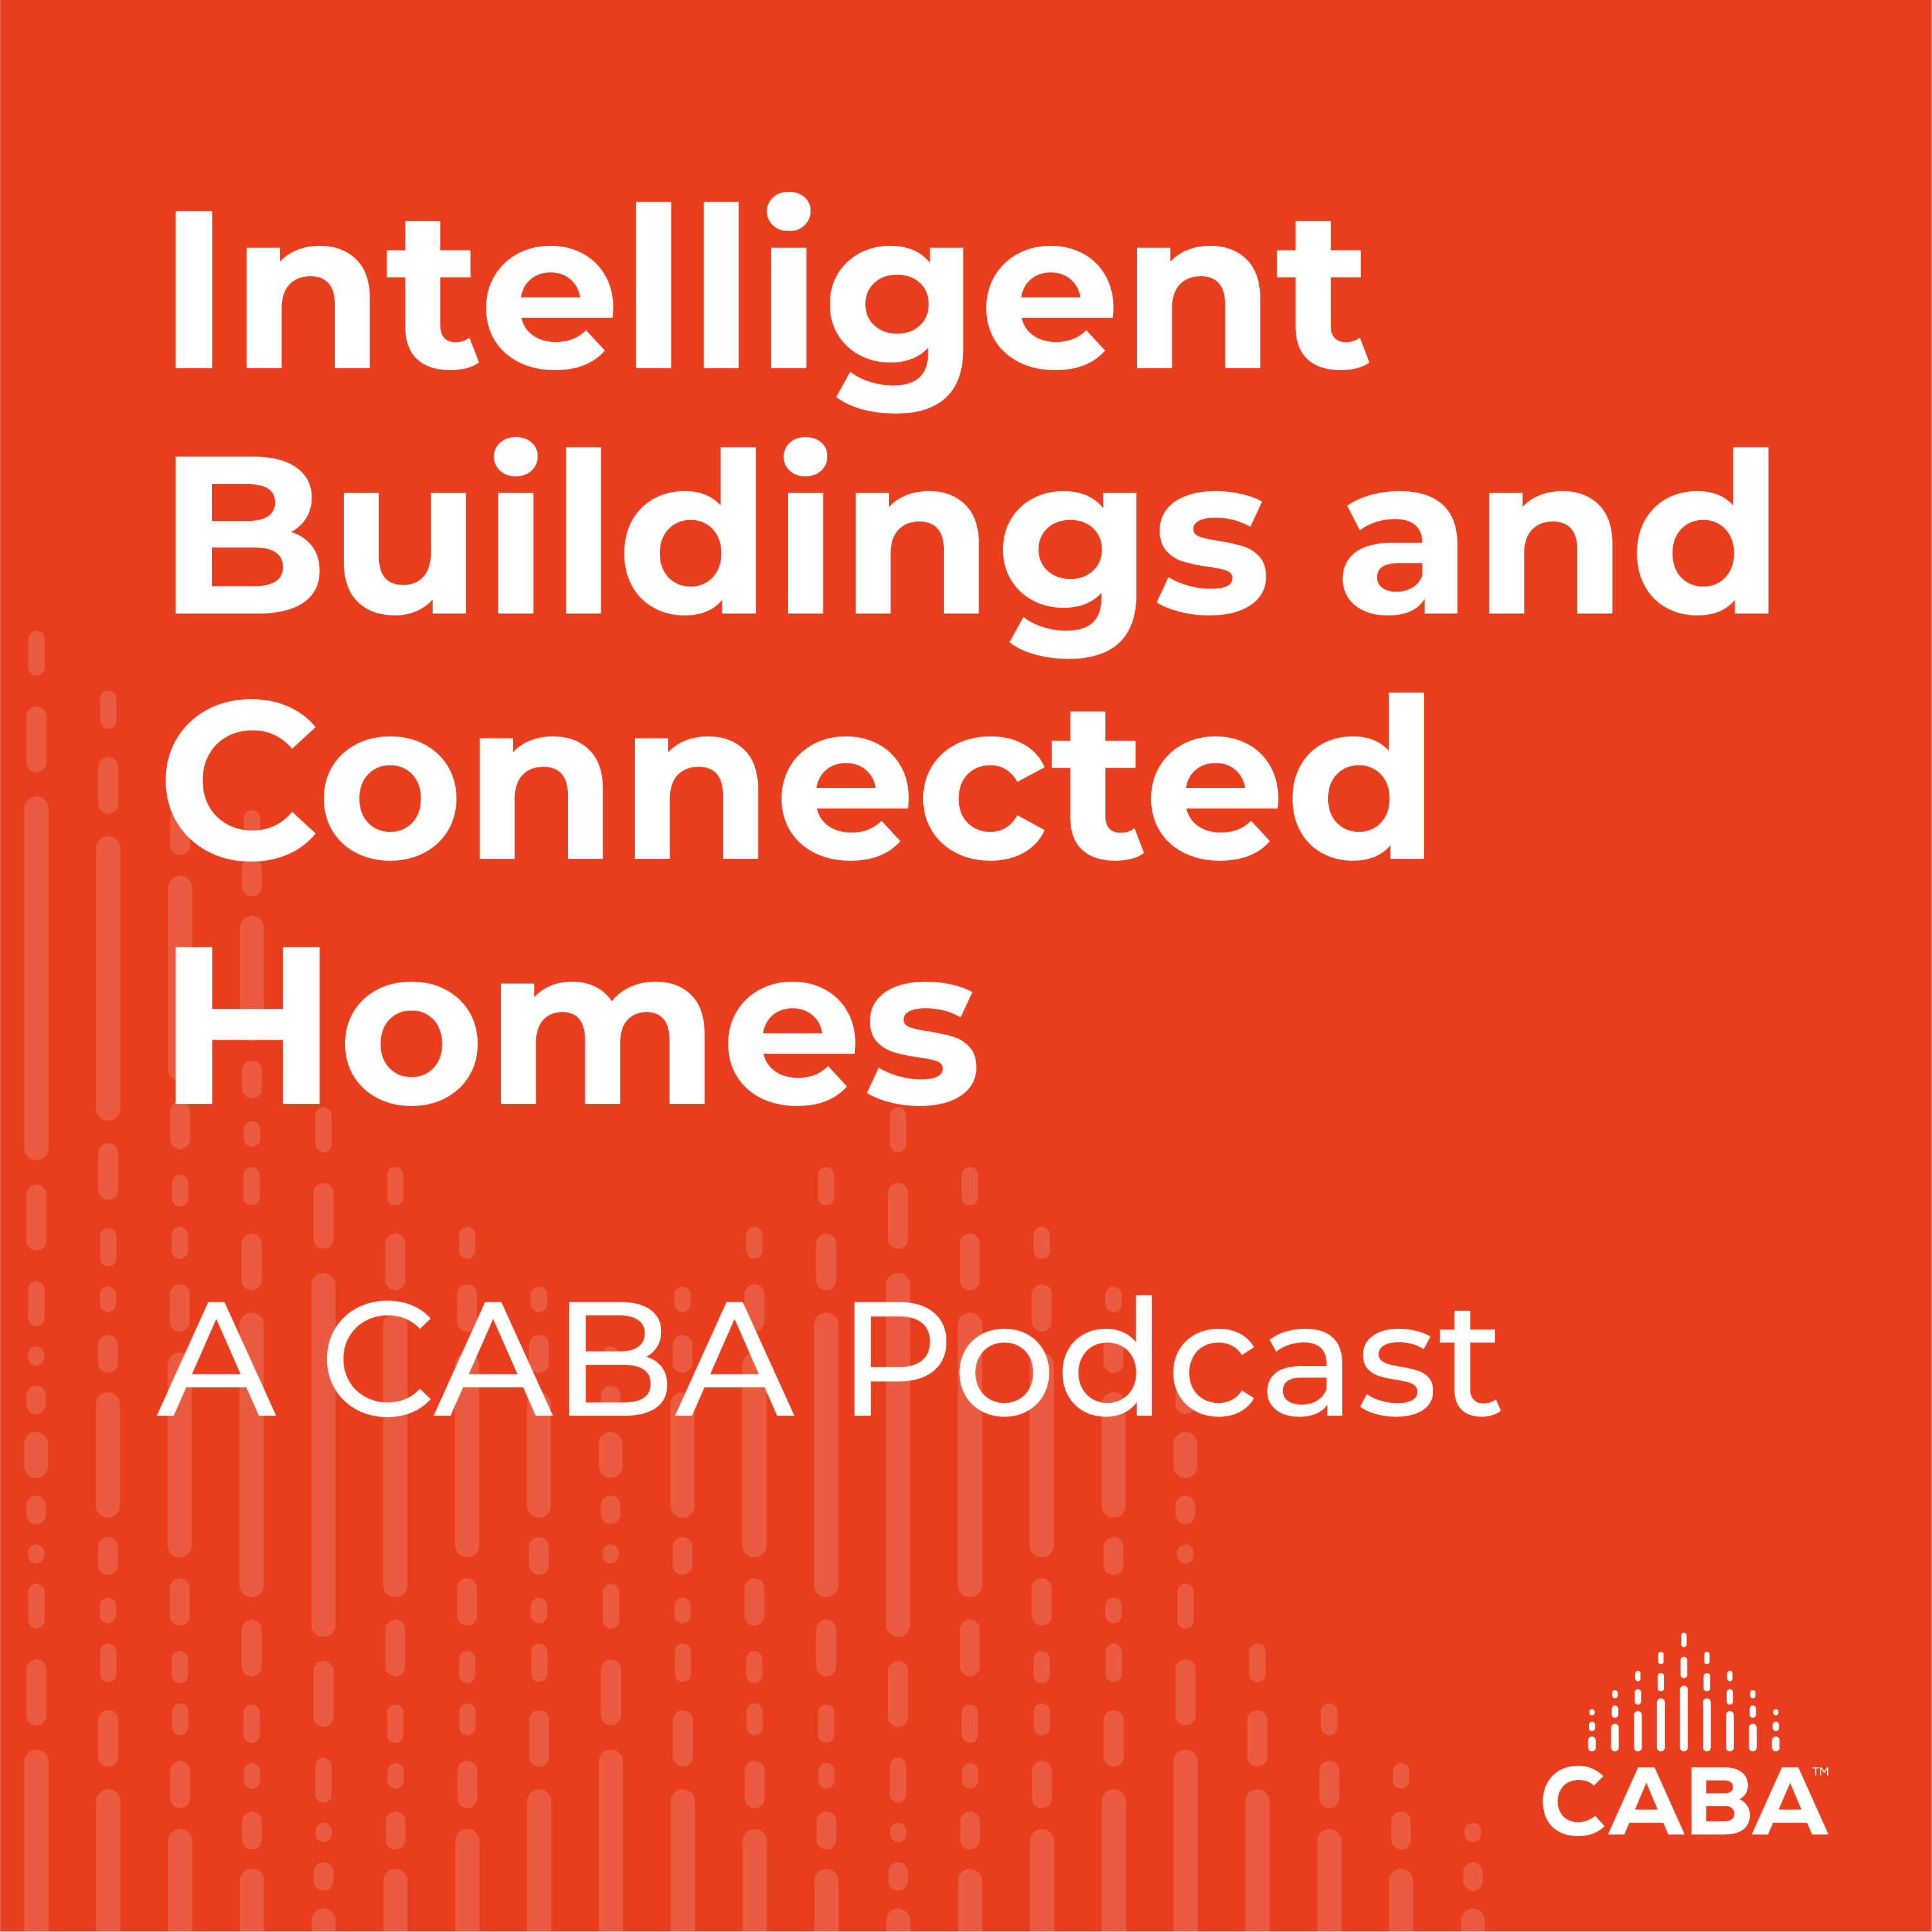
5. CABA Podcasts Marta Klopotowska (CABA)
Join industry experts and leaders from around the globe as they discuss everything smart home and intelligent buildings.
CABA is looking for guests and hosts for future pre-recorded episodes. Contact Marta Klopotowska (Klopotowska@caba.org) for more information.
May 2023 Intelligent Buildings and Connected Homes Recording:
Part 3 | Post-Pandemic Building Issues, Cybersecurity, & Intelligent Amenities – Cybersecurity Issues
6

Slide 7
6. Keynote Greg Walker (CABA)
Residential Battery Energy Storage

Slide 8
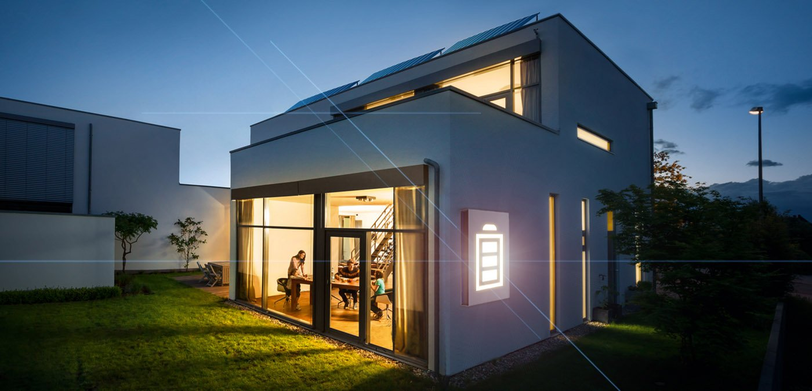
Key Developments and Opportunities for Residential Battery Energy Storage
2023

Slide 9
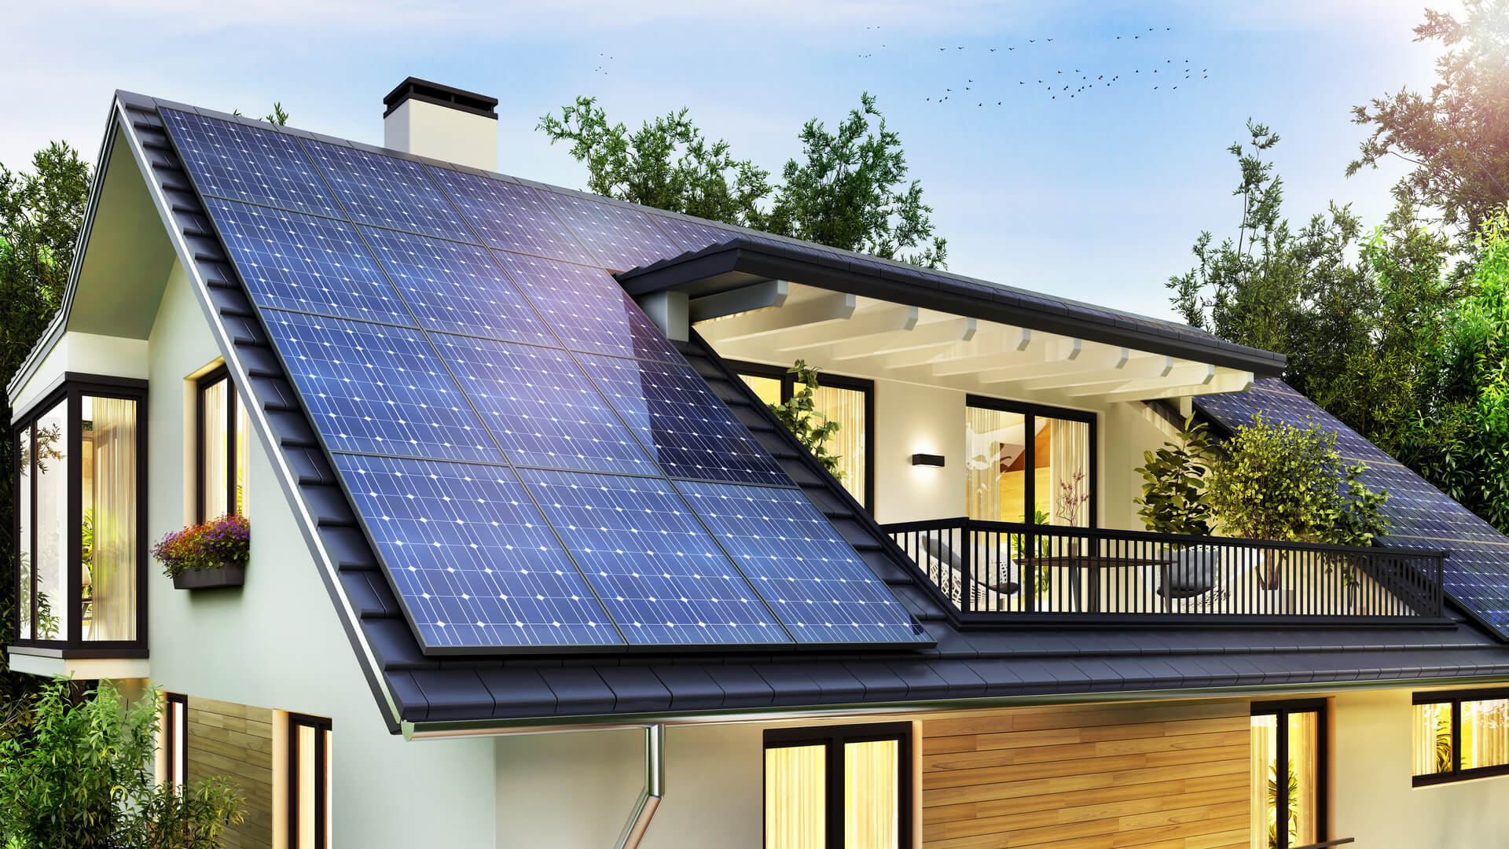
Major trends shaping the battery storage market
Focus now is very much on scaling up the industry to reach the wider mass market
Electrification of Transport
Aggressive Investment in Material Sourcing
Manufacturing Capacity is Ramping Up
High Energy Costs Drive Residential Solar PV
Source: Frost & Sullivan

Slide 10
Electrification of transport
EV’s account for the lion’s share of battery demand – accelerated growth in this market directly impacts the storage market
Source: RMI

Slide 11
LITHIUM CONSUMPTION VS. RESERVES
Known reserves will last at least through 2050 with recycling extending it further – Chile, Argentina, Australia and China dominate proven reserves
Total lithium reserves available
(assuming addition + recycling = consumption) ( in million tons)
Excess
Cumulative Lithium consumption: All purposes
( in million tonnes)
Cumulative Lithium consumption from source for BEV cars & trucks batteries
( in million tons)
Global BEV new cars & truck
sales/yr ( in million units)
Significant market growth, but ICE still dominates
Aggressive addition of Lithium mining?
Shift to newer materials?

Slide 12
Lithium-ion battery manufacturing capacity
Global battery manufacturing capacity forecast to increase x 4 in 5 years – China remaining dominant, EU stepping up its focus on battery production – US likely to improve post-2025 because of IRA incentives
2020 540 GWh
2025 (Expected 2,015 GWh
Source: RMI

Slide 13
Residential solar PV
High residential energy costs, concerns over grid reliability and environmental consciousness amongst the factors driving residential solar PV investment
PV Systems as a Percentage of Households, 2030
Source: Frost & Sullivan

Slide 14
Residential BESS – regional trends
US and China catching up on early movers Germany, Japan and Australia
Europe
Germany dominates
High price electricity markets
Lower incentives encourage self consumption
North America
California key market – slowdown in 2023
Grid resiliency key issue
Asia
Japan and Australia leading markets
China key hub for future growth
Latin America
Immature market with low volumes of sales
Africa and Middle East
Low volume market
Gulf region key pocket of growth
Source: Frost & Sullivan

Slide 15
Global bess: Europe the leading regional market
High growth rates across all geographies
Residential Battery Energy Storage: System Installations Forecast by Region, Global, 2020–2030
System Installations (’000s)
Source: Frost & Sullivan

Slide 16
global residential BESS market shares
Sonnen lead the market by virtue of strong sales in home market Germany and decent presence in the US, Australia and Europe. US and Australia key for Tesla. BYD gaining in recent years; very price competitive
Source: Frost & Sullivan

Slide 17
North American residential BESS market forecasts
Inflation Reduction Act could see forecasts revised higher in the longer-term, but market highly dependent on supportive incentives and policies
Residential Battery Energy Storage: System Installations Forecast, North America, 2020–2030
System Installations (’000s)
Source: Frost & Sullivan

Slide 18
What makes bess more attractive for a potential buyer?
Incentives, education and payback the top three things to focus on
What would be required to make battery energy storage more attractive for you?
Incentives from government
Payback in shorter timeframe
More matured/reliable technology
More explanation on what benefits I can expect from battery energy storage
Flexible payment options
Detailed training on how to use this battery energy storage
More tests of the devices to better investigates all possible effects of the solution
Lease based model with zero installation and operational effort for households (you).
Bundled with PV contract
Source: Frost & Sullivan

Slide 19
Key perceived benefits
Energy independence features highly for prospective buyers
In your opinion, what benefits do battery energy storage systems provide?
Savings on electricity bill
Energy independence
Provides an environment-friendly solution
Ability to charge electric devices (vehicle, laptops, etc.)
Ability to monitor/control energy consumption in household
Increase the home value
Incentives from government
Peer-2-peer energy trading with neighbours
Other
Source: Frost & Sullivan

Slide 20
What deters a potential bess purchase?
Predictably cost and payback come up, but maintenance and fire risks show the need to drive greater education in the market
In your opinion, what benefits do battery energy storage systems provide?
Device is too expensive to purchase or rent
Payback time is too long for me
Maintenance costs are too high
Fire hazard
It requires house reconstruction/ I am afraid of house damage while installing this system
Solution is not tested properly/is not properly developed
It is difficult to use
Solution does not work as it should/it is expected from this kind of device
Other
I do not see any problems
Don't know
Source: Frost & Sullivan

Slide 21
Key players in the residential solar+storage value chain
Consolidation within the value chain likely to drive further efficiency savings and lower price points for customers
PV Kit Component Suppliers
Battery Suppliers
Distributors/Financers
Installers
PV Panels, Power Racking
Power Optimisers, Inverters
Behind-the-meter battery systems
Finance, Installation & Maintenance
PV Kit Supplier (Residential Rooftop)
PV Modules
Residential
Residential
Inverters/PV Monitoring
C&I
C&I
Primary Route-to-Market
Partnership with distributors/financers for product marketing and sale
Partnership with distributors/financers for product marketing and sale
Direct to market via PPA/lease and loan agreements and partnership
Direct to market via direct sales and partnership with distributors
Source: Frost & Sullivan

Slide 22
residential bess market shares
Tesla clear market leader thanks to relationship with Tesla owned SolarCity
Source: Frost & Sullivan

Slide 23
Key partnerships
Partnerships and co-operation between industry participants vital to overall success as companies aim to drive solar+storage propositions more
Primary Suppliers
PV Modules
3rd Parties
Inverters, Power Electronics & Monitoring Software
3rd Parties
Battery Suppliers
37%
18%
12%
10%
10%
Supplier Market Share
Source: Frost & Sullivan

Slide 24
THANK YOU!
Questions?

Slide 25
7. New Business Ken Wacks (Ken Wacks Associates)
New CHC business?

Slide 26
8. Announcements Greg Walker (CABA)
Past Events
Smart Spaces (Parks Associates)
April 17-18 | Dallas TX
(Virtual – Jul 20, Oct 5, Nov 30)
Upcoming Events
Connections (Parks Associates) Connected Home Summit
May 23-25 | Frisco, TX
(Virtual – Jul 20, Oct 5)
Shanghai Smart Home Technology
August 29-31 | Shanghai, China
CEDIA Expo
September 7-9 | Denver, CO

Slide 27
9. Adjournment Ken Wacks (Ken Wacks Associates)
Next CHC Meeting: Tuesday, July 25, 2023
Continental Automated Buildings Association (CABA) caba@caba.org www.CABA.org
www.caba.org/chc
Connect to what’s next™
27

