Slide 1
Landmark Research Report: Healthy Buildings & Indoor Environmental Quality Think Tank
Harbor Research
Harry Pascarella Daniel Chmil
Jamil Muna Martina Guglielmone

Slide 2
About CABA

Slide 3
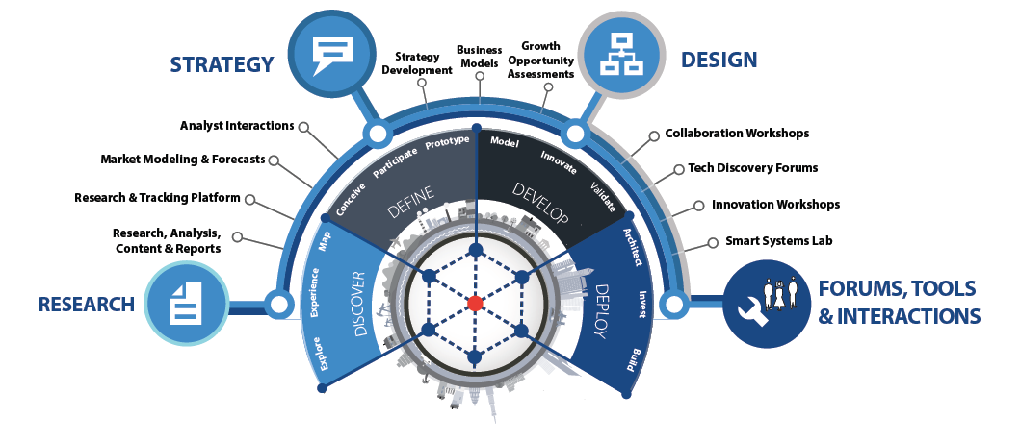
About Harbor Research
Harbor Research was selected through a competitive RFP process to conduct this research.
Strategy Consulting
Our strategy and business development consulting services deliver creative innovation tools, practical methods and applied problem solving.
Research and Content
Our research, tracking, and market intelligence services provide an accessible learning environment for those who are trying to wrap their arms and minds around emerging disruptive opportunities.
Smart Systems Lab
We are creating a real-world laboratory where organizations design, prototype, and test new models for delivering value and differentiation. The Lab’s mission is to enable business model, technology, and system-level innovation enabled by the Internet of Things.

Slide 4
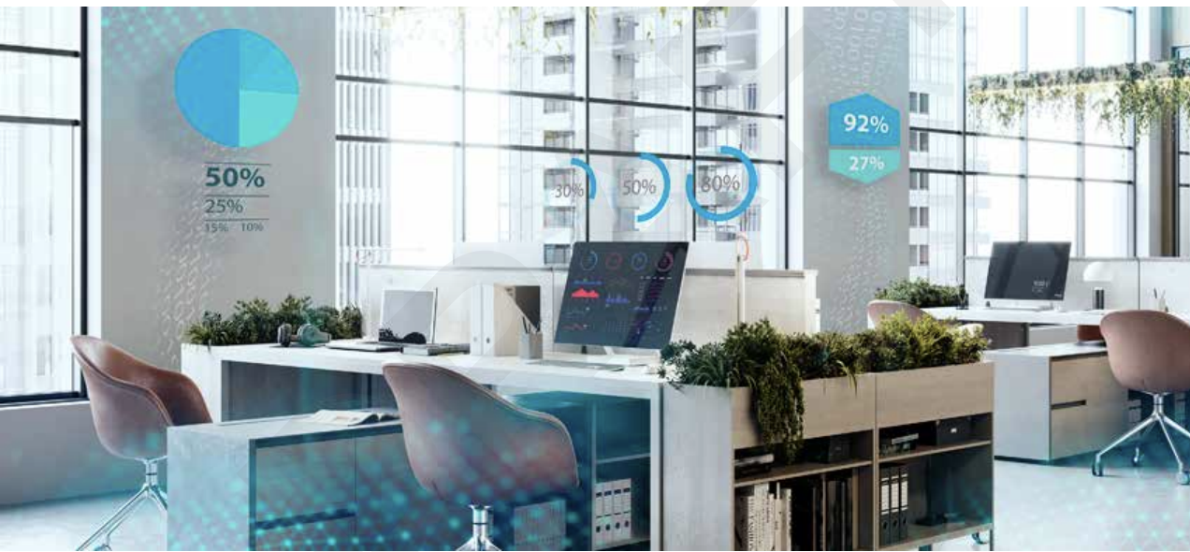
Healthy Buildings Project Overview
The Continental Automated Buildings Association (CABA) commissioned Harbor Research to define, investigate, and provide actionable recommendations to industry participants regarding the current state of Healthy Buildings and Indoor Environmental Quality (IEQ) from an adoption standpoint.
The topics analyzed throughout the report include:
Market Trends and Forces,
Traditional and new return of investment (ROI) metrics
Emerging technologies
Innovative business and GTM models,
Issues around integration and data management
Specific recommendations for all industry players to tap into these opportunities

Slide 5
Overview of Research Methodology
The findings presented in this report showcase the results of primary and secondary research, including in-depth executive interviews; a broad online survey among intelligent building owners, operators, and occupants; and a comprehensive market forecast model.
Conduct Secondary Research and Review Relevant HRI Data & Past Analyses: Leverage previous HRI research and outputs related to facility operations and management technology, B2B and channel models, consumer and occupant behavior related to commercial facilities, and overall ecosystem evolution trends.
Conducted Interviews with End-Users and Experts: Conduct interviews with a pre-selected group of industry thought leaders and experts in the healthy building and IEQ technology space, and end-users of the technologies and solutions being evaluated for this study across North America.
Validate and Refine Hypotheses and Secondary Research Findings Through Consumer Surveys: Deploy two surveys targeting participants from the United States and Canada with the following backgrounds: (a) commercial building occupants/tenants and (b) commercial building owners and operators.

Slide 6
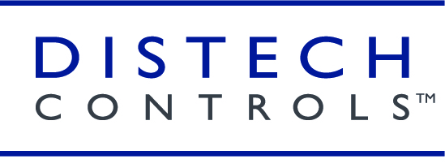
The HBIEQ Steering Committee
The Steering Committee represents a cross-section of solution providers in the indoor environmental quality marketplace. Representatives from each organization joined Harbor Research and CABA on regular collaboration calls to ensure the research scope met the project objectives. The Steering Committee played a vital role in outlining the research product in terms of defining the required content as well in collaboration on the research approach including development of the interview scripts and surveys.

Slide 7
IEQ Likened to Canary in the Coal Mine
The proverbial canary in the coal mine refers to an outdated mining tradition dating back to 1911. Coal mines notoriously released colorless, odorless carbon monoxide and other noxious gases. To help protect the miners from these outbreaks, canaries were introduced to the mines as an alert mechanism. If the bird, which is more sensitive to the poisonous gases than humans, were to fall sick, this would give miners ample warning to evacuate the mine.
Notes:
Thankfully, in 1986, this tradition was finally retired for more modern and humane sensor-based automation.

Slide 8
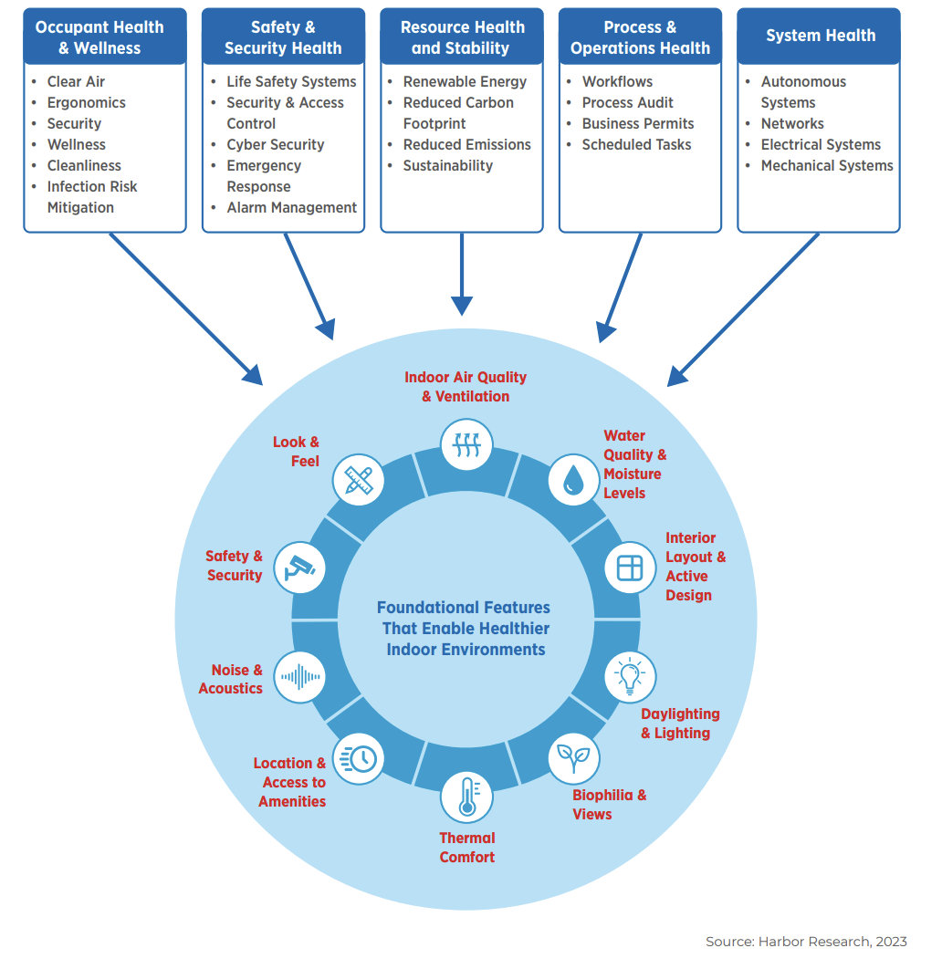
IEQ is a Holistic Building Management Process
Given than the average individual spends 87% of their time within the built environment, it is imperative to apply the needed focus to improve the health of these indoor environments.
With the exception of hospitals, clinics, and labs, very few large buildings are designed to limit the spread or pathogens.
This leaves us vulnerable to the spread of harmful diseases, as well as the social and economic repercussions that could then ensue.

Slide 9
Covid Introduce Changes to How We Live
The changes that occurred as a result of the Covid-19 outbreak may have long-lasting impacts on the way people interact with buildings
Remote
Working
Physical Distancing
Online Shopping
Attention on Health
Population Migration
In preparation for this potential long-term threat, building owners and operators need to make sure they impress upon their visitors and tenants the priority they place on health and wellness. This includes messaging around direct investments being made to ensure a healthy indoor environment.

Slide 10
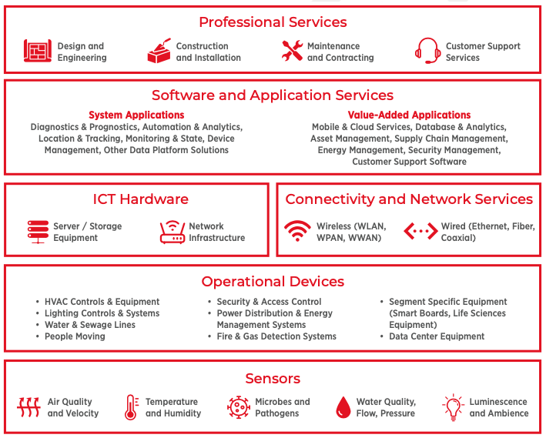
Value Potential Contingent on Creative Combinations of Emerging Technologies
The combination of integrated sensing, automation & analytics, and reporting / dashboard tools are critical components for effective HBIEQ implementation
Suppliers will need to find ways to collaborate with building owners to design solutions that provide integrated value across the HBIEQ data and solution lifecycle

Slide 11
Complex Applications Require Orchestration & Gov. Enforcement
As building automation technologies has evolved, different building segments and types have adopted these technologies at varying rates. Standards bodies have gotten involved in setting rules and regulations for buildings in hopes of creating a more unified approach to sheltering residents, workers, and visitors. However, the enforcement of these rules has been a significantly more arduous task

Slide 12
Early Attention to IEQ is key to Differentiation
A large portion of the health problems related to the indoor environmental quality of a building can be avoided if building practitioners establish occupant health as a functional objective in the design, construction, and operation of buildings

Slide 13
Illustrative Scenario for Building Operator HBIEQ Assessment & Strategic Planning
HBIEQ Scenario Analysis
Microbes, such as pathogens and allergens, can be found in virtually any environment; in the air, on surfaces, and in the water. The wealth, composition, and variety of microbial communities inhabiting the built environment is a direct result of interactions between outdoor air, indoor environmental quality, building strategies and systems, as well as the occupants and visitors of the building.
Academic research on the link between the environmental microbiology and non-infectious disease, such as a sore throat or dry eyes, is a rapidly evolving field of study. Sick building syndrome refers to phenomenon where occupants experience severe health- related symptoms from spending too much time in the sick building. The most frequent symptoms referenced include dry eyes, headaches and irritation of the nose or throat.
What Building Operators Need to Consider
3a
Isolate building control functions to remediate negative IEQ impacts
1
2
4
Assess Indoor Environmental Quality traits
Develop Profile of Systems Impacting Target HBIEQ metrics
Establish process for ongoing impact analysis
3b
Identify where supplier engagement is required for BMS configuration
R. Adams et al. (2016), Ten questions concerning the microbiomes of buildings, International Journal of Building Science and its Applications. Link: https://www.sciencedirect.com/science/article/pii/S0360132316303419#bib28

Slide 14
Enforcement & Ratings Are Key to Success
Standards bodies play an important role in safeguarding public health and wellness. Unfortunately, enforcing guidelines has been a difficult objective to achieve. Ratings Systems contribute directly to customer demand, and can act as a market-oriented system to motivate building owners to invest in IEQ
Compliance Requirements are a great way to force building operators to conform to a healthier, more bio-informed approach to building management
Ratings Systems provide insight to underappreciated practices that would otherwise be undetectable to occupants and visitors.
` Moreover, they add a layer of potential comparison for patrons to use when selecting between two establishments
Measuring and enforcing compliance standards or certifications will require the use of IoT, internet of things, technology innovations

Slide 15
Q & A

Slide 16
Contact Harbor Research
Harbor Research, Inc. (HRI) 1801 Broadway UNIT 408
Denver, Colorado 80202
Daniel Intolubbe-Chmil
Project Manager (Primary Contact)
dintolubbechmil@harborresearch.com
M: +434.806.4334
Michael Levy
Lead Associate (Primary Contact)
mlevy.com@harborresearch.com
M: +1.404.791.4754
Harry Pascarella
Director (Secondary Contact)
hpascarella@harborresearch.com
O: +1.303.786.9000 x36

Slide 17
CONTACT CABA
Continental Automated Buildings Association (CABA) 613.686.1814 Toll free: 888.798.CABA (2222)
caba@caba.org www.CABA.org www.twitter.com/caba_news www.linkedin.com/groups?gid=2121884
Connect to what’s next™

