Slide 1
Intelligent Buildings Council (IBC) Webinar
Meeting will commence 12:05pm ET
Tuesday, February 28, 2023 | 12 NOON – 1:30 PM (ET)
IBC Chair: Bob Allan (NAVCO, Inc.)
Vice-Chair: Harsha Chandrashekar (Honeywell International Inc)
Vice-Chair: Robert Lane (Robert H. Lane and Associates Inc.)
Vice-Chair: Chris Larry (Exp US Services Inc.)

Slide 2


1. Agenda
Greg Walker (CABA)
Agenda
Call to Order, Welcome, Introductions, About IBC
Administrative
Research Update
CABA Podcast
Keynote: “Holistic Intelligent Buildings: An open approach to looking at advancing building intelligence” (30 min)
Chris Larry (exp US Services), Stephen Holicky (Tridium) & Journey Williams (Tapa Solutions)
White Paper Sub-Committee Update
New Business
Announcements
Adjournment

Slide 3
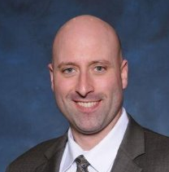
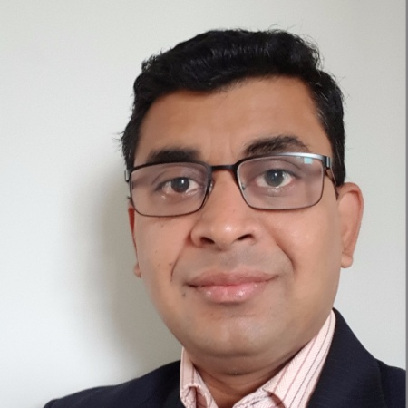
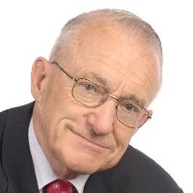
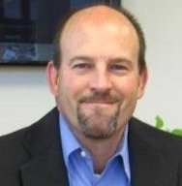




2. Call to Order, Welcome, Introductions, About the IBC
Bob Allan (NAVCO, Inc.)
IBC Chair
Bob Allan
Bob Allan
Vice President of Sales
East Region
NAVCO, Inc.
IBC Vice-Chair
Harsha Chandrashekar
Product Approvals & Regulatory Leader
Honeywell International Inc
IBC Vice-Chair
Robert Lane
President & Managing Partner
Robert H. Lane and Associates Inc.
IBC Vice-Chair
Chris Larry
Director of Energy Engineering
Exp US Services Inc.
The CABA Intelligent Buildings Council works to strengthen the large building automation industry through innovative technology-driven research projects. The Council was established in 2001 by CABA to specifically review opportunities, take strategic action and monitor initiatives that relate to integrated systems and automation in the large building sector. The Council's projects promote the next generation of intelligent building technologies and incorporates a holistic approach that optimizes building performance and savings. www.caba.org/ibc

Slide 4

3. Administrative
Bob Allan (NAVCO, Inc.)
Motion to approve past IBC Minutes November 10, 2022
www.caba.org/ibc

Slide 5





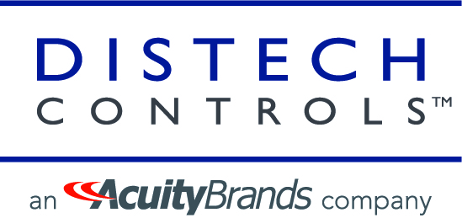








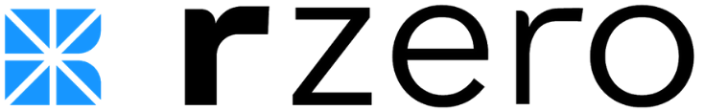

4. Research Update
Harsha Chandrashekar (Honeywell International, Inc.)
4.1 2022 IBC Landmark Research
Healthy Buildings and Indoor Environmental Quality

Slide 6







4. Research Update
Greg Walker (CABA)
4.2 Annual BACS Market Sizing North America

Slide 7
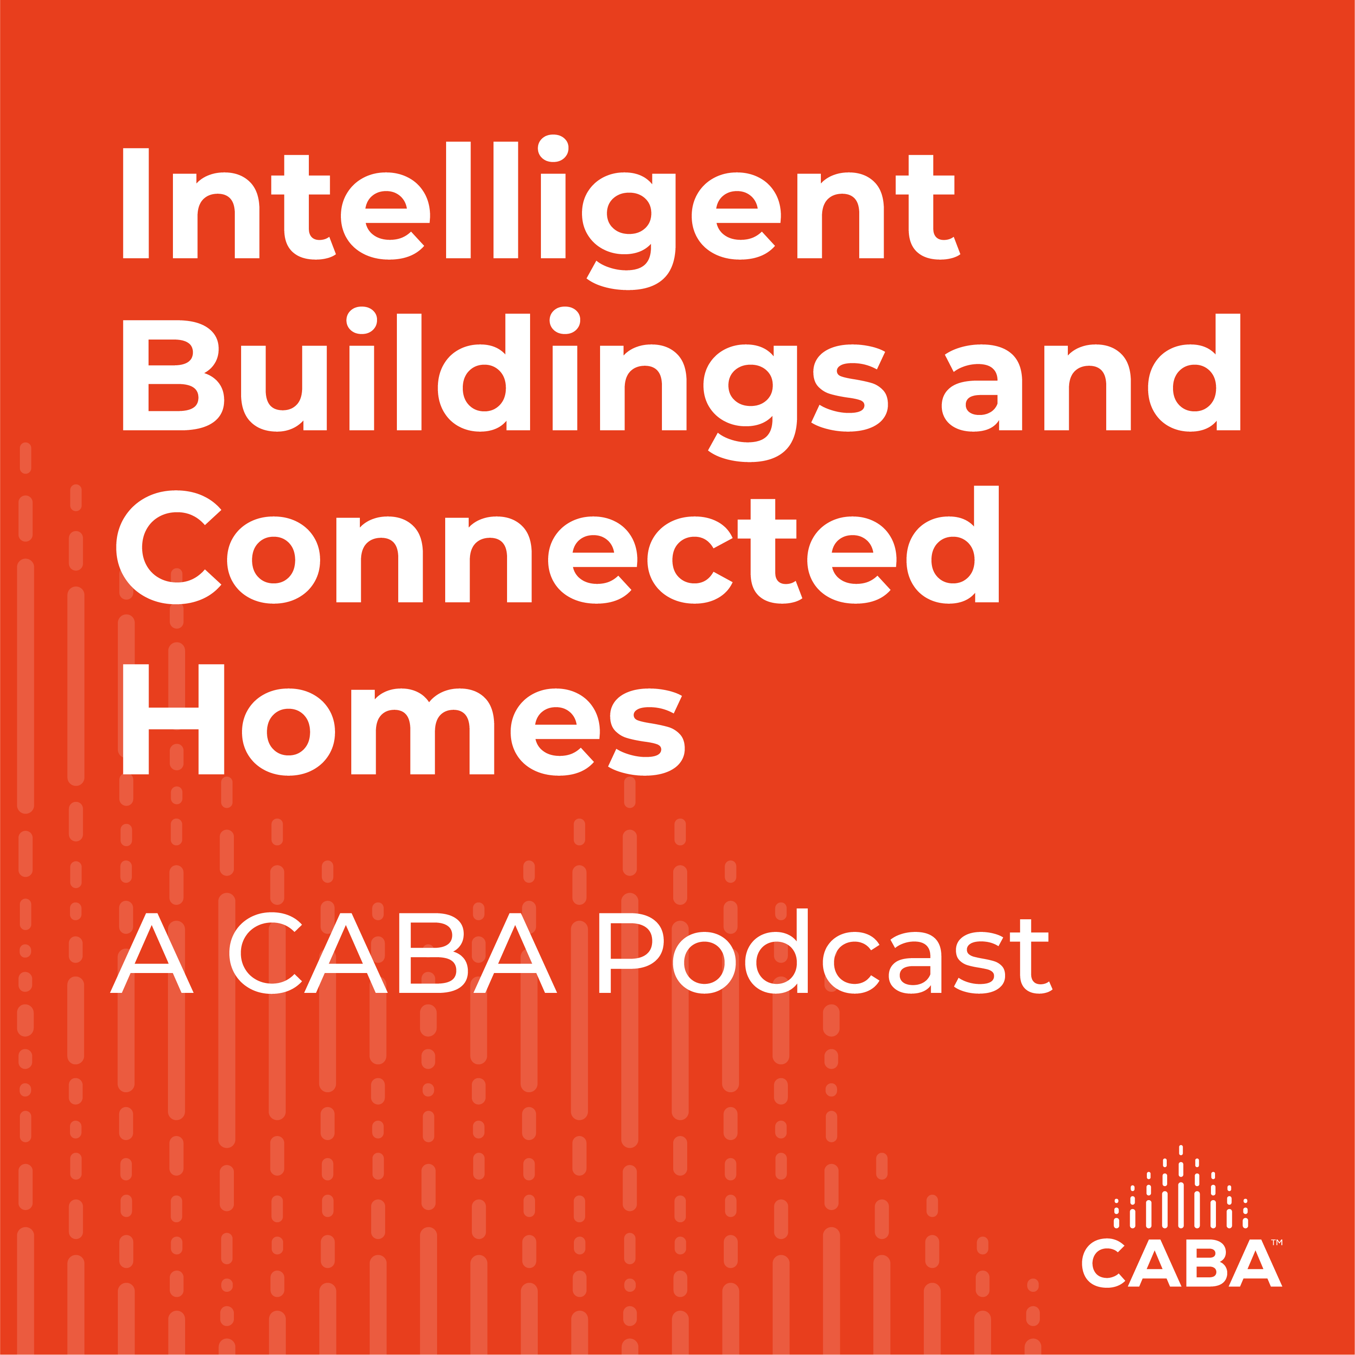
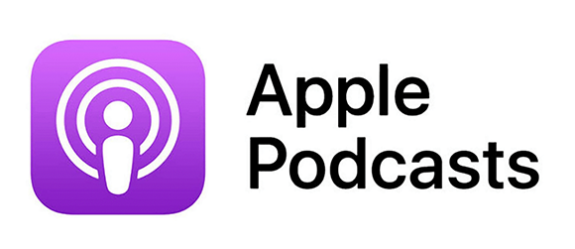

5. CABA Podcasts
Marta Klopotowska (CABA)
Join industry experts and leaders from around the globe as they discuss everything smart home and intelligent buildings.
CABA is looking for guests and hosts for future pre-recorded episodes. Contact Marta Klopotowska (Klopotowska@caba.org) for more information.
February 2023 Intelligent Buildings and Connected Homes Recording:
Part 1 | Post-Pandemic Building Issues, Cybersecurity, & Intelligent Amenities - Overview

Slide 8

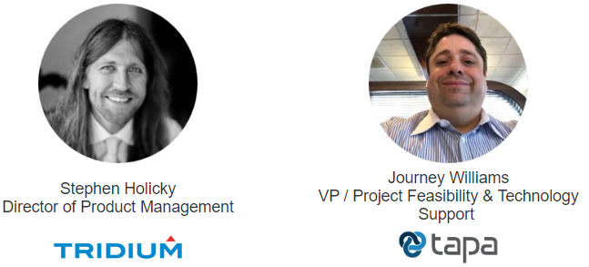
6. Keynote
Chris Larry (exp US Services)
Holistic Intelligent Buildings: An open approach to looking at advancing building intelligence

Slide 9
Holistic Intelligent Buildings: An open approach to looking at advancing building intelligence
CABA Intelligent Buildings Council (IBC) Webinar
Tuesday, February 28 | 12 Noon – 1:30 PM (EST)
Multiple experts all focused on system conductivity and improved building performance through intelligent buildings. Address the need for intelligent buildings. Define an approach for building owners to address this need. Discuss products and the concerns these products and their interfaces may alter the solution. Specific applications and fixes used to enable conductivity.
Provide a holistic approach to integrated buildings to share data and make buildings more intelligent.
Notes:
We want to thank CABA and its members for giving us this time to talk to you. We are very passionate about this subject and we have a great group of people here today to explain our approach. The CABA Intelligent Building Council has discussed smart buildings for many years and has been a driver in the industry for building intelligence. Today we are going to explain our holistic approach to taking building intelligence to the next level.

Slide 10
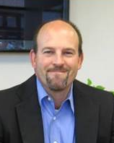
Jon Christopher Larry, PE, CxA, LEED AP, CEM
Experience
Exp US Services Inc. - Director of Solutions
35 years of comprehensive experience on energy-efficient high-performance smart and intelligent buildings.
CABA – Vice-Chair of CABA IBC, Chair of (BIQ) Building Intelligence Quotient and Zero Energy Consortium Committees.
AEE – Past President and named “Energy Engineer of the Year 2000” by the Association of Energy Engineers (AEE)
ASHRAE - Chairman of Technology, Energy and Governmental Activities, Chapter Technology Transfer Committees.
NIST GCTC SBSC - Chairperson for the National Institute of Standards and Technology (NIST) Global Cities Team Challenge (GCTC) on Smart Buildings and Smart Cities (SBSC).
Notes:
My name is Chris Larry. I am Director of Exp’s Solutions Sector which helps our clients define their smart building needs. We have been a supporter of CABA since its inception. I have been involved with the Association of Energy Engineers and ASHRAE my whole career. I am of the board on the National Institute of Standards and Technology Global Cities Team Challenge on Smart Buildings and Smart Cities. This group’s goal is to take smart technologies to improve humanity. I will discuss the overall planning and design of a holistic smart building.

Slide 11

Stephen Holicky
Experience
Director of Product Management - Tridium, Inc.
15 years of experience in building control systems and advanced interface solutions for smart and intelligent buildings.
Design and Construction experience in advanced control systems
Responsible for overall strategy, product planning, marketing, and financials for all products built on the Niagara Framework. Works closely with customers, engineering teams, and business stakeholders to define, manage and deliver a product roadmap and vision which impacts over 1 million instances worldwide”.
Notes:
Today we are honored to have Stephen Holicky is the Director of Product Management at Tridium and is responsible for overall strategy, product planning, marketing, and financials for all products built on the Niagara Framework. He works closely with customers, engineering teams, and business stakeholders to define, manage and deliver a product roadmap and vision which impacts over 1 million instances worldwide. Tridium has been on the forefront of building systems integration and conductivity since buildings first began being more intelligent. Stephen has many years of experience in design, construction and manufacturing of smart building systems. He will outline the proper application of products and how products should be applied for a holistic approach to intelligent buildings.

Slide 12
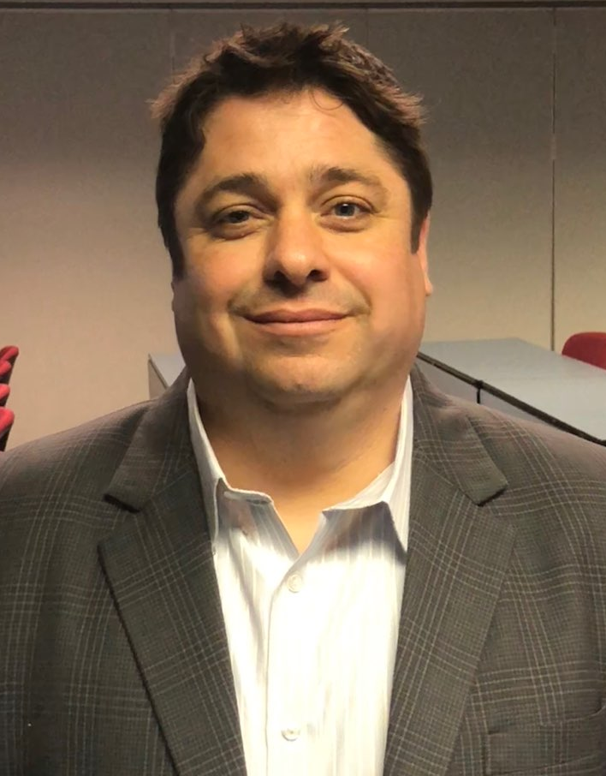
Journey Williams
Vice President - Project Feasibility & Technology Support - Tapa.
25 years of experience in building control systems and advanced interface solutions for smart and intelligent buildings.
Product expertise with Distech and other interface devices.
Smart Building Technologies, Vice President providing computerized, intelligent control systems. factory-certified in Tridium, American Automatrix and Distech Controls HVAC Control Platforms, and is expertly qualified in installing, maintaining, and upgrading all major brands of building, mechanical, automation, and control systems.
Experience
Notes:
As an added surprise we have Journey Williams, Vice President of Project Feasibility & Technology Support for Tapa. Journey’s experience with applications of building intelligent systems is well known in the industry. Journey will discuss how our holistic approach can be applied.

Slide 13
Why do we need Intelligent – Smart Buildings
Definition CABA:
An intelligent building gives building owners the flexibility to integrate individual building systems to deliver an enhanced working or living environment for occupants, and optimal equipment functionality and better management of resources for owners.¹
Needs or benefits:
  Better performance
  Interoperability
  Occupant Satisfaction
  Return of Investment
Notes:
Why do we need Intelligent – Smart Buildings? Well, CABA definition is “An intelligent building gives building owners the flexibility to integrate individual building systems to deliver an enhanced working or living environment for occupants, and optimal equipment functionality and better management of resources for owners.”
In summary the benefits of smart buildings are better performance, interoperability, occupant satisfaction and return of investment. People want better technology, systems that think for themselves, Occupants want services to support their stay in buildings. Businesses see how they can reduce costs and increase revenue.

Slide 14
The holistic approach
Educate building owners, architects and Contractors.
Discuss the huge benefits to connected buildings.
Set and plan and foundation. Short cuts never maximize the opportunity, don’t let vendors direct the design.
Educate Contractors on integrated systems. There is a greater need for coordination and the change in bidding, budgeting and management.
Use Division 25 which addresses the Integrated Automation Systems (IAS).
Use a Master System Integrator to lead the IAS design and coordination.
The contractor should have a System Integration contractor responsible for the IAS scope of work.
Notes:
So, what is our holistic approach. It is smart building creation approached from multiple directions in the building’s evolution. Smart buildings need to be well thought out, it starts with an idea and a vision and all parties (i.e. owner, design team, contractors) must be well educated on these systems and how they work. Before the design, this group needs to brainstorm ideas. We see a lot of short cutting in the industry – contractors pushing their ideas, vendors overselling their product benefits, designers not leading the development. Smart building development needs to be an evolution from idea, to understanding, to education, to planning, budget development and management, integration and commissioning. Then training the operations team and expanding those applications to meet the changing building needs. Using the CSI Division 25 specification and contract separation is key to a smart building.

Slide 15
Holistic approach to integrated buildings
Start with a well-designed, security network framework where all OT systems communicate.
Design around Open Systems:
  Open Protocol
  Open Products
  Open Delivery
  Open Services and Support
Every project is different and to maximize result get building owners and users involved and focus on KPI.
Build a core team of professionals experienced in IB/SB – over communicate.
All IB/SB should have a tenant master specification for tenant fit outs to ensure an integrated solution
Solution should include final commissioning and an ongoing commissioning process.
Notes:
The foundation of an intelligent building is its communication infrastructure. How will the systems intercommunicate and interface. Security of this system must be addressed early in the design.
Using open systems is more than using an open protocol (like BACnet), the products, their delivery and their service delivery must be open also. You don’t want to be locked into a system. 50% of a smart building will be developed after construction.
Defining the Key Performance Indicators early will help outline your vision.
Regular meetings early in the teams including all the team members is important. You almost want the team to feel that some items are being repeated. Over communicate. We have had clients say “oh I get it” late in the process. Sometimes it takes time to understand.
A tenant master specification is a must for all core and shell Intelligent Buildings.
All Smart Building projects must be commissioned, and they should have an ongoing commissioning plan.

Slide 16
share data and make buildings more intelligent
Data and conductivity will be extremely valuable but:
  Data storage will be key
    Who, where and what
  Need a data analytics process so you don’t get overwhelmed
    Data overload – deer in the headlights
  Determine the business case
Notes:
The building system data and how the systems are interconnected are very important but where and how the data will be stored is something that should be decided early. Data analytics will be critical to meet the KPI and how that is applied needs to be defined. Is it on the edge or at the server? You also need to discuss what data is needed and what may be clutter. Think down the road on what might be important. Don’t just bring in every point.

Slide 17
Interconnectivity and Interoperability
What systems can and should be connected?
What data and operations can be improved?
How can a return on investment be supported through share data and operations improvements?
Don’t be afraid to look beyond HVAC, Lighting, Metering:
How can IB/SB be used to create more business or make that business more profitable.
Stephen will now discuss how open products and devices can enhance these ideas.
Notes:
Looking at the design before it is developed. What are the systems? How will the building team and management interact with the building. KPIs and ROIs should be defined but understand the future building and its KPI will most likely change. The design needs to evolve and be flexible. Look to connect to the occupant and the visitor, that is often where the money is. Follow the ROI.
Stephen will now discuss how open products and devices can enhance these ideas.

Slide 18
Stephen Holicky –
How Products make a Building Smart
Products

Slide 19

Discuss products that help IB solutions
The Niagara Framework
World’s leading open integration platform that is behind many of the most successful BMS systems
Can run on a building or equipment controller or on a BMS supervisor workstation
  Workbench tools to design control strategy and graphical interfaces
Retrofit over existing controls or new build
  Edge to cloud
Over 200 different drivers allowing integration into third party systems and connection to equipment using standard protocols
  Connects to HVAC, Security, Power, Lighting, etc….

Slide 20

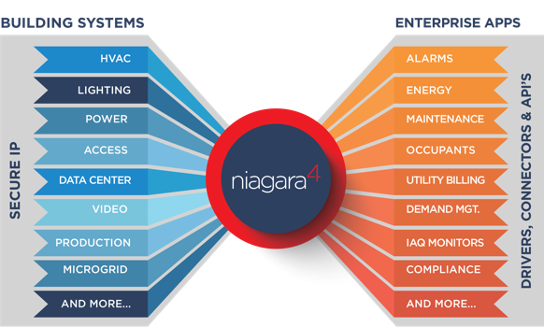
Discuss products that help IB solutions
is a Standard, unifying platform
Niagara provides device connectivity and data normalization capabilities needed to acquire and unlock operational data from device-level and equipment-level silos.
Niagara helps institutions address energy savings, resource planning, usage and threat management (“lockdown events”) in one secure software platform that sets the standard across entities as diverse and demanding as the U.S. State Department and DoD, Amazon, Google, Wawa, Kohl’s and Bank of America

Slide 21













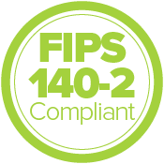

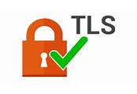
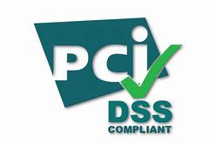



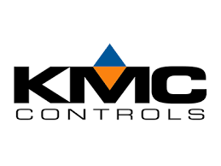





Discuss products that help IB solutions
What does “Open” really mean?
Open APIs, Tools and Connectivity
Open Protocols
Public APIs and SDK
Hundreds of device drivers
Database connections for
MS SQL, DB2, Oracle and more
Open Availability
Open and Secure
RMF
…with thousands of partners and Community members

Slide 22










Discuss products that help IB solutions
Delivering What You Want in a Data Integration Platform
Fast Provision; Time Savings
Cyber Defense
Impactful UI, Visualization
Connectivity Options
Certifications
& Compliance
Edge Control
Leveraging these six Niagara value propositions, you can achieve outcomes like….
And more….
Enhanced Occupant Experience
Progress Toward a Sustainable Carbon-Free Future
Analytics Supporting
Enterprise Data
Strategy
Preparedness AI

Slide 23
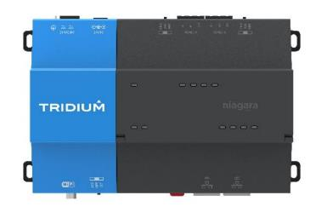








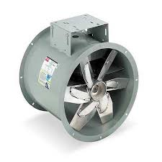

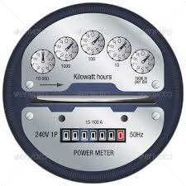



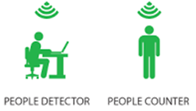

Discuss products that help IB solutions
It’s all about that JACE + Portability
Devices communicate with multiple data types, using differing protocols, across a variety of network types
Ensures Distributed Control of Building Systems
The JACE connects to wired (and wireless) networks to aggregate and normalize the data
Control commands are sent back to the equipment. Data communicated ‘northbound’ is encrypted and secured
When the JACE isn’t necessarily the ideal fit for all scenarios where Niagara can be of benefit;
  Portability is the process of ‘porting’ Niagara onto hardware designed for different functions
  Allows seamless interaction across multiple platforms
  Provides benefits of a single toolset and interface for the design and implementation of the Niagara system

Slide 24
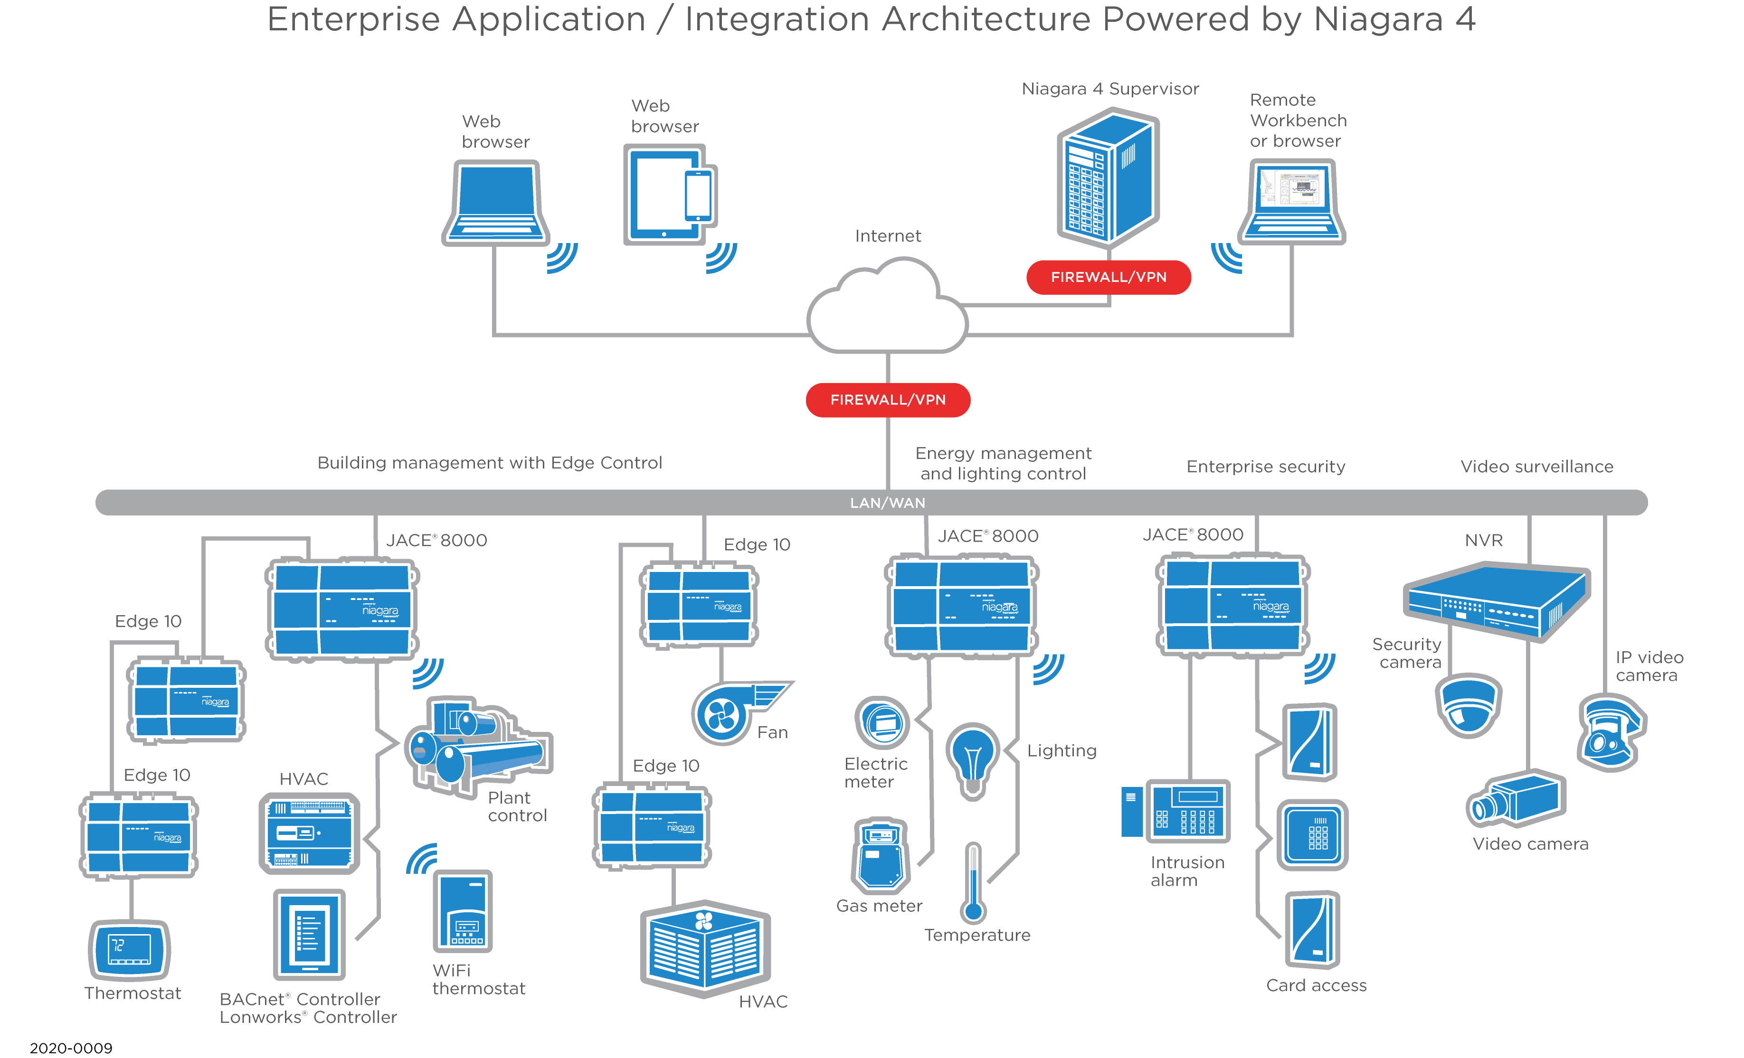
Discuss concerns these products may have
What does it look like?
Third party systems integration

Slide 25
Discuss concerns these products may have
Cyber Security
Robust Security Model built directly into the Framework
Customizable authentication schemes
Authentication of users with strong credentials by default
  For both data in motion and sensitive data
Role-Based Access Control (RBAC) for easy permissions configuration
  Manage user roles and permissions with tags
Configurable Authentication based on connection type
Enterprise identity and access management systems (LDAP, Kerberos, SAML) integration
Digital signatures to ensure application integrity
NIST-validated FIPS 140-2 Level 1 option
All user actions and security-related events recorded in Niagara’s audit log for traceability
Dedicated cybersecurity team focused on continuous security improvements
Security of Niagara
depends on:
Built-in capabilities
(Tridium)
Configuration
(Integrators and administrators)
Based on those factors, Tridium:
Provides strong security
capabilities in all products
Continually informs and educates
business partners and customers
Security of surrounding network
(IT departments)
Strives to make security
easier for integrators

Slide 26

Discuss concerns these products may have
Our “Secure by Default” principle
Make security easier: default to the most secure configurations
  All transmissions encrypted
  Users forced to have strong password strengths
  Users set up with the strongest authentication mechanism
  User lockouts upon consecutive bad log-ins
Force administrators to do the right thing
  Factory default password must be changed after commissioning
Do the right thing, regardless of configuration
  Encrypt sensitive information at rest
  Digitally Signed Code: validated at run-time
  JACE-8000/Portability Secure Boot: trusted software validated at boot-time
Provide stronger configuration options based on best practices
  Articles, documentation, TridiumTalks provide detailed guidance
We provide strong security capabilities – but it is important for
our partners and customers to configure and manage Niagara correctly!

Slide 27













































Discuss concerns these products may have
How can I get the Niagara Framework Installed in my Facility?

Slide 28
Discuss concerns these products may have
New ESG Pressures
High expectations for data services and data extensibility
Post-COVID HVAC changes: more air changes & filtration
New energy production and energy-saving assets being added (solar panels, occupancy-awareness devices, air quality sensors)
Regional differences in procurement and infrastructure management
Questions regarding data ownership being asked
A Niagara-Powered Building Automation Strategy enables transformation into a data-driven organization, supporting continuous optimization of operations and easier ESG reporting.

Slide 29
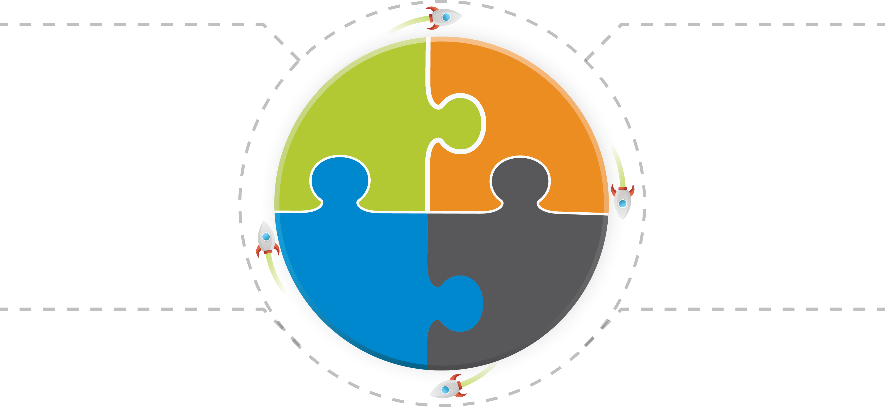


Discuss concerns these products may have
How Open-Protocol Niagara-Based BAS Supports ESG Strategy
Maintenance
Insights
Carbon
Reduction
OPERATIONS OPTIMIZATION
ESG REPORTING
Easy Extensibility to IoT
Occupant Safety & Health
O&M Staff More Productive
FACILITIES
BUSINESS
Energy Cost Savings
Quantitative Sustainability Goals
Measurement & Verification
ASHRAE, USGBC LEED, WELL, etc.
BAS
STANDARDS/COMPLIANCE
Data Normalization
FACILITIES, IT/CYBER & BUSINESS
IT
DIGITALIZATION
UL, ISO, ANSI etc.
Greater Operational Intelligence
5G, WiFi, & other connectivity standards
Improved Analytics
NIST, & other cyber
defense standards
Machine-Learning/ AI Recommendations
Digital Twin

Slide 30

Journey Williams –
How to apply products in a smart way
Integrations

Slide 31
Discuss an approach for building owners
The importance of getting all stakeholders involved
Get people to be excited about going to the office
Give them input and ownership
  This will drive sustainability goals
  Give understanding when things aren’t perfect
  Create a true collaborative comfortable workplace
This even applies to mixed-tenant buildings as it will draw and attract the highest quality tenants willing to pay more for a better environment
understanding security requirements is key to getting buy in from everyone's IT group

Slide 32
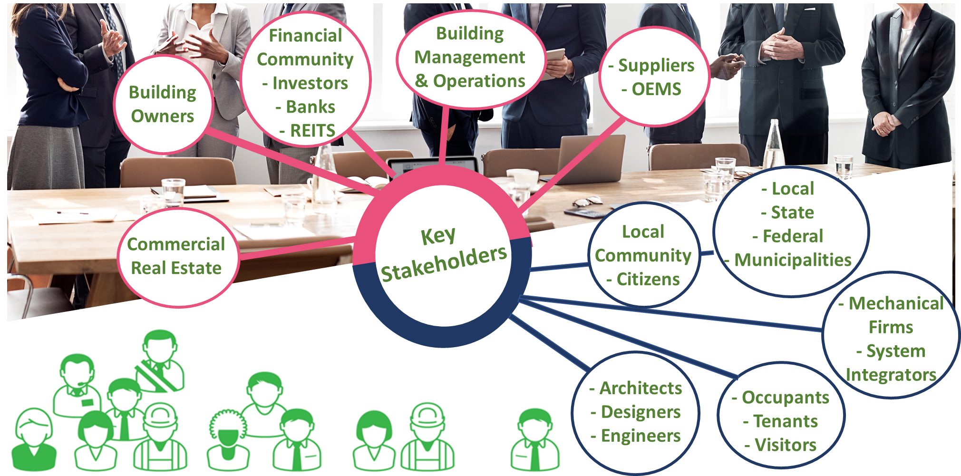
Stakeholders

Slide 33

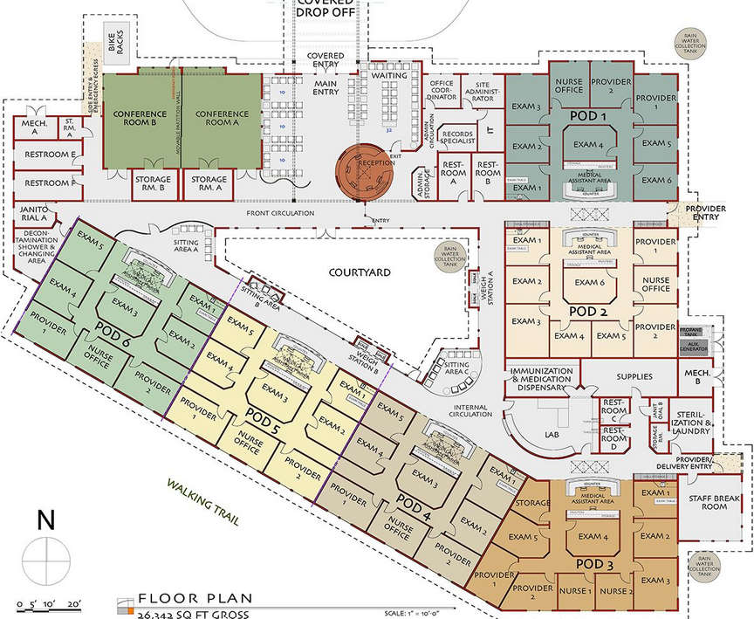








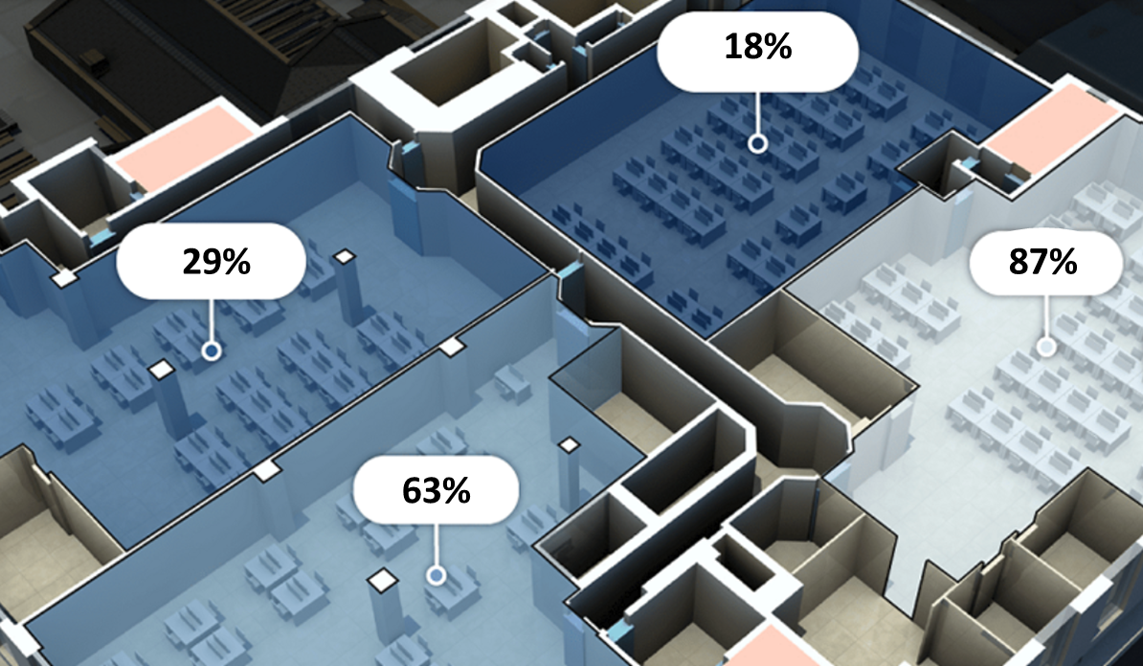









Way Finding and Occupancy
Occupancy Sensing
Asset Finder
Way Finding Path

Slide 34
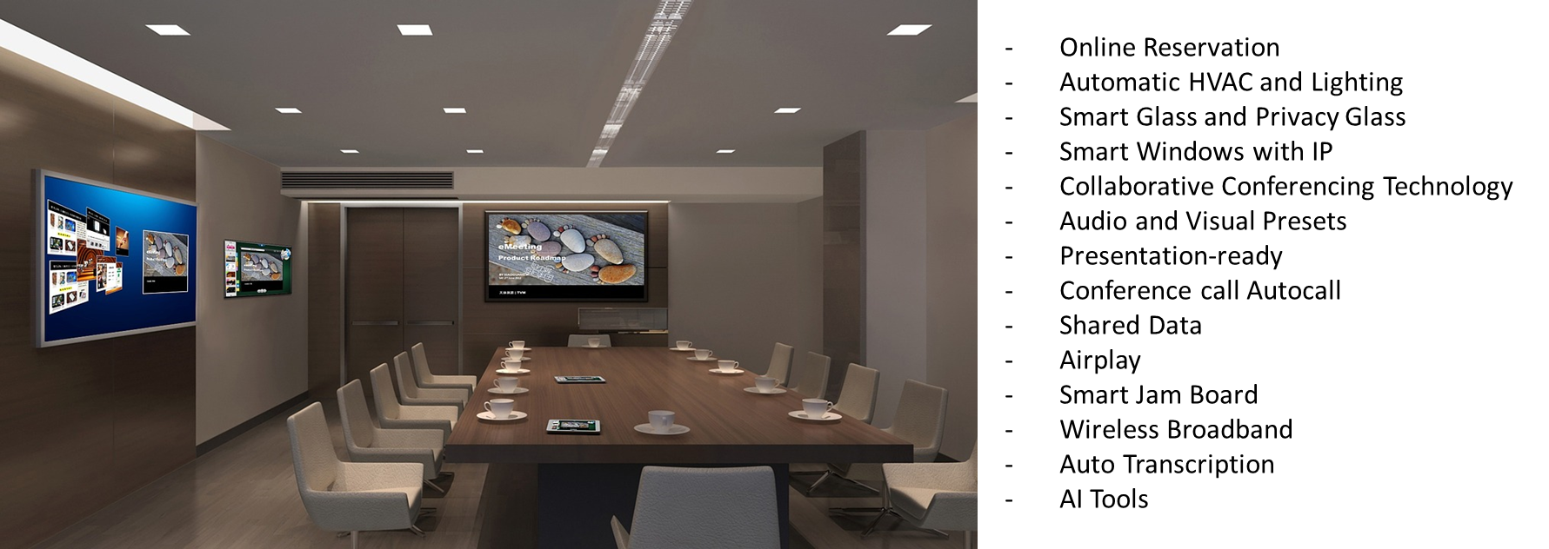
Smart Conference Room

Slide 35
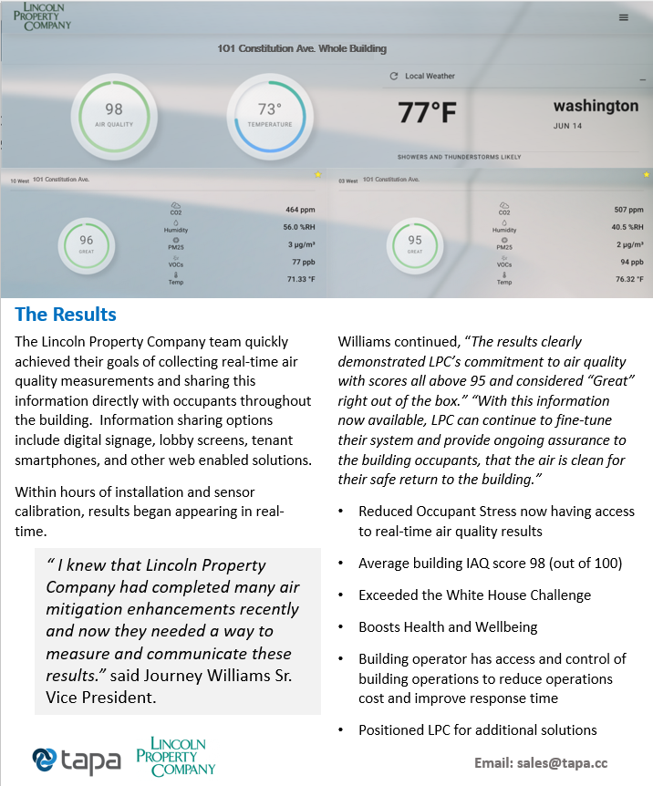
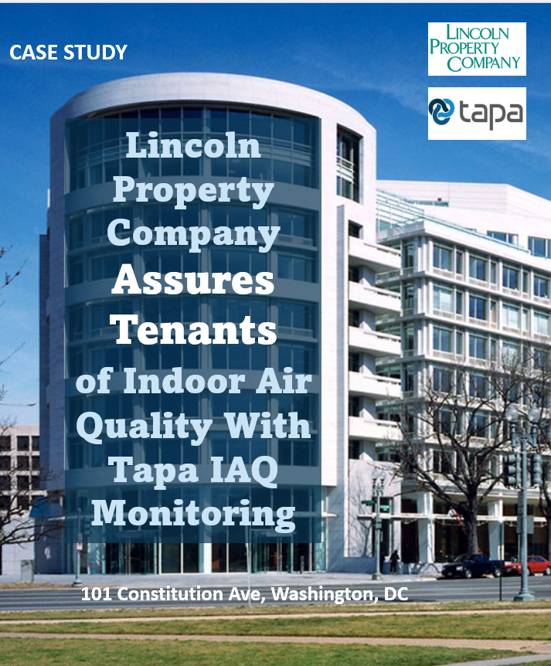
Case Study: Tapa IAQ
© Tapa Inc, Proprietary & Confidential 2022

Slide 36
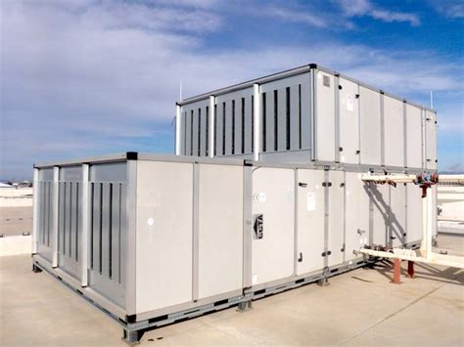
Added Benefit: Energy Efficiency
Tapa's Indoor Air Quality (IAQ) monitoring solution determined that a sequencing issue was causing an outside air fan to run longer than it should have, and it was filling the air handling rooms with warm moist air. With adjustments made, IAQ monitoring not only helped save energy costs but also prevented a potential mold build-up. Additionally, Tapa's IAQ monitoring solution determined that carbon dioxide (CO₂) levels never approached the threshold of 600 ppm. Therefore, the building was able to reduce the amount of fresh air and save additional energy costs.
Energy efficiency and IAQ are compatible
Energy savings of 10% to 20% possible and pays for IAQ monitoring system
ASHRAE recommends permanent IAQ Monitoring for demand-based ventilation
IAQ monitoring can help earn and keep certifications such as LEED
IAQ trending information drives adjustments

Slide 37
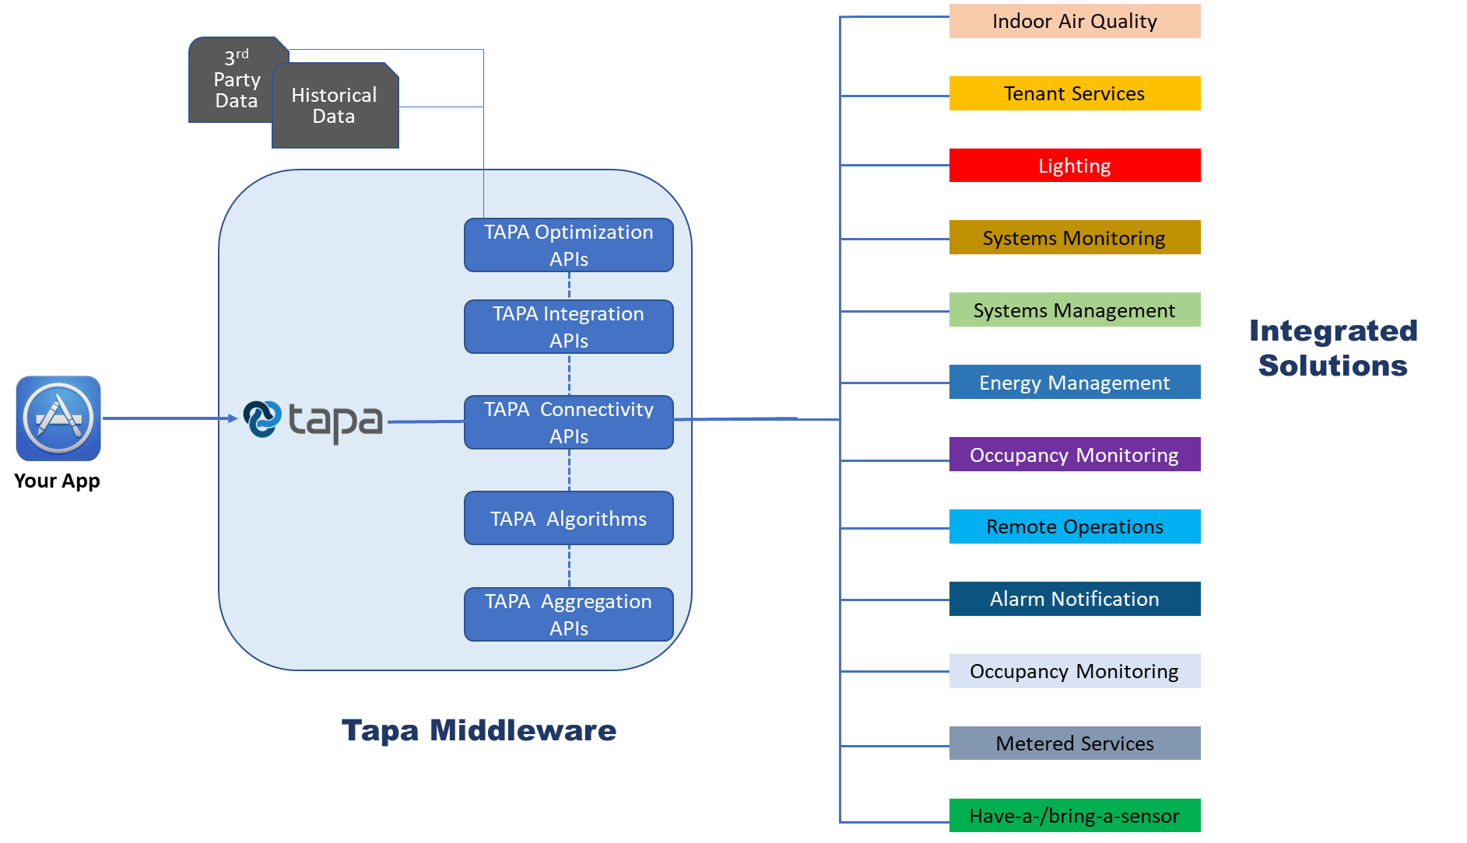
Tapa Solutions

Slide 38
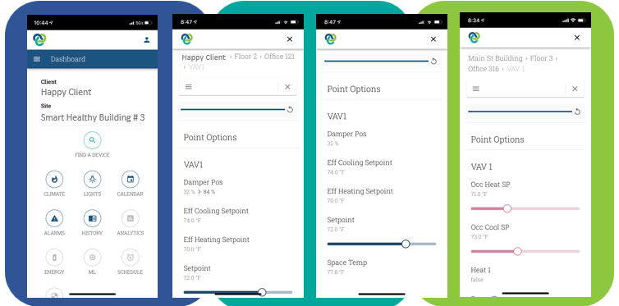
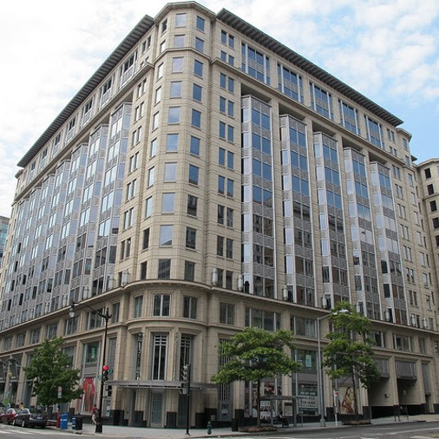





District Center 555
A Better Buildings showcase project, District Center is a first of its kind commercial office “Smart Building” with capability for smart tenant solutions, such as apps for personal control of lighting, HVAC, access control, and more.

Slide 39
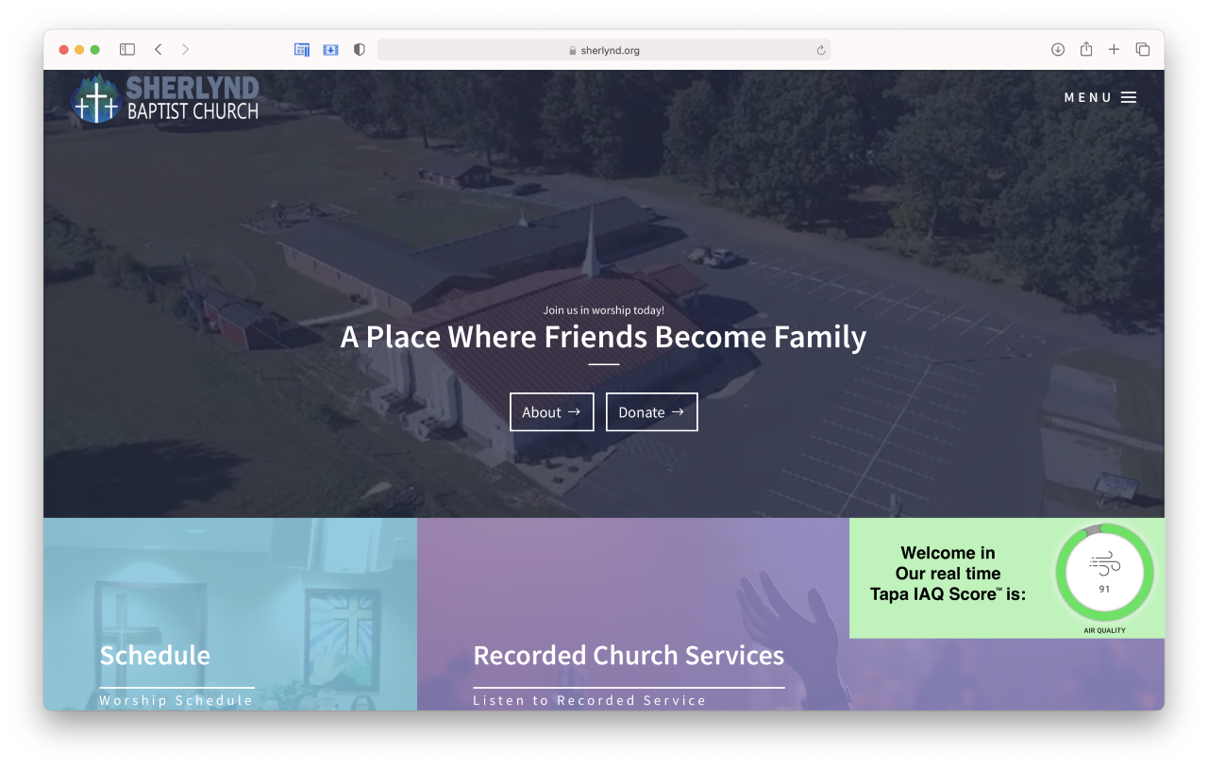
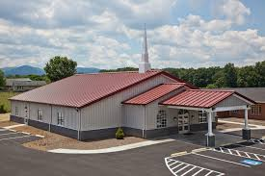
Sherlynd Baptist Church
Sherlynd Baptist Church
Lyndhurst VA

Slide 40
Review specific applications
District Center-
  Whole single pain of glass but what is in it for the tenants
101 Constitution
  Air quality install
  Found energy savings
Church
  Allows for more complex control at a fraction of the cost

Slide 41
Discuss conductivity and interoperability.
It is vital to partner with a team you trust and to engage the controls team ahead of the finalized design.
  You need to be able to trust them on technology and price
  They can usually save a significant cost by recommending systems that work better together or are more efficient at a lower cost.
  Think about life cycle costs when considering value engineering.
  not combining the lighting and HVAC may save you $20-$100K upfront, but how long would it take to make that up when DOE proved that you save at least 6% by connecting the two systems.
  Make sure the program is actually implemented and the system tuned over time
  MASTER SPECS ARE A MUST
    I have seen countless projects that were designed and implemented well on day one only to be undermined every time there it Tenant Improvement work

Slide 42
Questions & Thank you!
  J. Christopher Larry
  exp US Services, Inc.
  Director of Energy Engineering
  (724) 355-7636
  Christopher.larry@exp.com
  Journey Williams
  Tapa
  President
  (703) 717-1484
  Journey.williams@tapa.cc
  Stephen Holicky
  Tridium, Inc.
  Director of Product Management
  804.456.7053
  stephen.holicky@tridium.com

Slide 43
THANK YOU!
Questions?

Slide 44



7. White Paper Sub-Committee Update
Ken Wacks (Ken Wacks Associates)
All proposals and previously completed IBC White Papers can be downloaded at:
www.caba.org/whitepapers

Slide 45

8. New Business
Bob Allan (NAVCO, Inc.)
New IBC business?

Slide 46

9. Announcements
Harsha Chandrashekar (Honeywell International, Inc.)
9.1 Past Events Overview
The Buildings Show
Nov 30-Dec 2
Toronto, ON
BICSI
February 5-9
Tampa, FL
AHR Expo
February 6-8
Atlanta, GA
Distributech International
February 7-9
San Diego, CA
Buildex Vancouver
February 15-16
Vancouver, BC

Slide 47

9. Announcements
Harsha Chandrashekar (Honeywell International, Inc.)
9.2 Upcoming Events
ISH
March 13-17 | Germany
IFMA World Workplace
March 22-23 | Netherlands
IFMA Facility Fusion
April 11-13 | San Francisco, CA
Lightfair
May 21-25 | New York, NY
Realcomm Ibcon
June 14-15 | Las Vegas, NV
Shanghai Intelligent Building Technology
August 29-31 | Shanghai, China
BICSI
September 10-14 | Las Vegas, NV
Greenbuild
September 26-29 | Washington DC

Slide 48

10. Adjournment
Bob Allan (NAVCO, Inc.)
Next IBC Meeting: Tuesday, May 30, 2023
Continental Automated Buildings Association (CABA)
caba@caba.org
www.CABA.org
www.caba.org/ibc
Connect to what’s next™

