Slide 1
Intelligent Buildings Council (IBC) Webinar Meeting will commence 12:05pm ET Thursday, November 10, 2022, 12 NOON – 1:30 PM (ET)
IBC Chair: Bob Allan (NAVCO, Inc.)
Vice-Chair: Harsha Chandrashekar (Honeywell International Inc)
Vice-Chair: Robert Lane (Robert H. Lane and Associates Inc.)
Vice-Chair: Chris Larry (Exp US Services Inc.)

Slide 2
1. Agenda Greg Walker (CABA)
Agenda
Call to Order, Welcome, Introductions, About IBC
Appointment of New IBC Vice-Chair
Administrative
Research Update
CABA Podcast
Keynote: “Protecting buildings from cyberattacks – six important steps to take today” (30 min) Louis Parks (Veridify Security)
White Paper Sub-Committee Update
New Business
Announcements
Adjournment

Slide 3
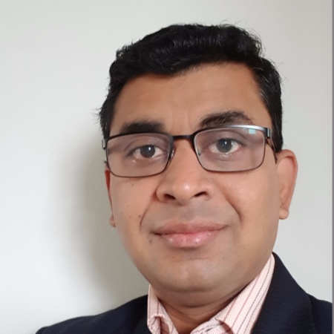
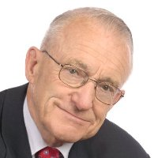
2. Call to Order, Welcome, Introductions, About the IBC Bob Allan (NAVCO, Inc.)
IBC Chair
Bob Allan
Bob Allan
Vice President of Sales
East Region
NAVCO, Inc.
IBC Vice-Chair
Harsha Chandrashekar
Product Approvals & Regulatory Leader
Honeywell International Inc
IBC Vice-Chair
Robert Lane
President & Managing Partner
Robert H. Lane and Associates Inc.
IBC Vice-Chair
Chris Larry
Director of Energy Engineering
Exp US Services Inc.
The CABA Intelligent Buildings Council works to strengthen the large building automation industry through innovative technology-driven research projects. The Council was established in 2001 by CABA to specifically review opportunities, take strategic action and monitor initiatives that relate to integrated systems and automation in the large building sector. The Council's projects promote the next generation of intelligent building technologies and incorporates a holistic approach that optimizes building performance and savings. www.caba.org/ibc

Slide 4
3. Appointment of New IBC Vice-Chair Bob Allan (NAVCO, Inc)
CABA Welcomes Newly Appointed IBC Vice-Chair
Chris Larry is Director of Energy Engineering for exp US Services Inc, a top 10 ranked full-service A&E firm headquartered in Toronto, Canada with US headquarters in Chicago, Illinois with multiple offices throughout the US. Chris has spent over 30 years working to minimize the building industry’s energy and environmental footprint through refining building design, building modeling, performance optimization, and intelligent controls. Chris has previous experience as Senior Energy Engineer for Siemens Building Technologies, Mid-Central District Performance Contracting Group, Consulting Engineer for Burt Hill Kosar Rittelmann Architects, and Flack + Kurtz Consulting Engineers. Chris is currently on the Zero Energy Commercial Buildings Consortium (CBC) with the DOE. Chris has held many positions within the ASHRAE Society (Chairman for Chapter Technology Transfer Committee, Chairman for Technical, Energy and Governmental Activities (TEGA), President of the ASHRAE Pittsburgh Chapter, Chairman of the Region III 2006 and 2014 CRC. Chris is also the past President of the Association of Energy Engineers (AEE) in Pittsburgh. Chris received the “Energy Engineer of the Year” from AEE in 2000 and currently instructs the Certified Energy Manager (CEM) certified training course for AEE.
IBC Vice-Chair
Chris Larry
Director of Energy Engineering
Exp US Services Inc.

Slide 5
4. Administrative Bob Allan (NAVCO, Inc.)
Motion to approve past IBC Minutes August 9, 2022
www.caba.org/ibc

Slide 6
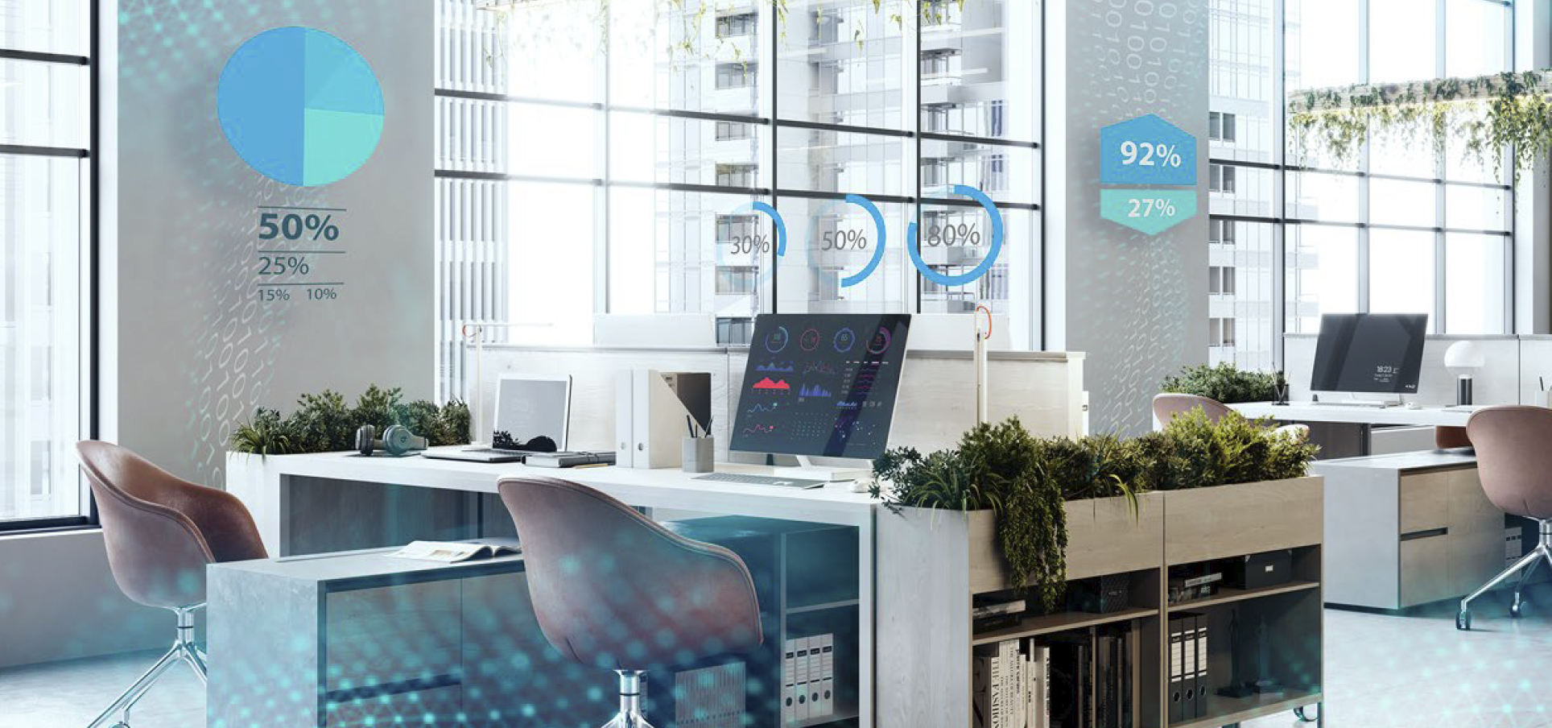
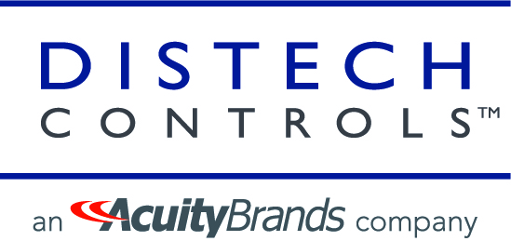
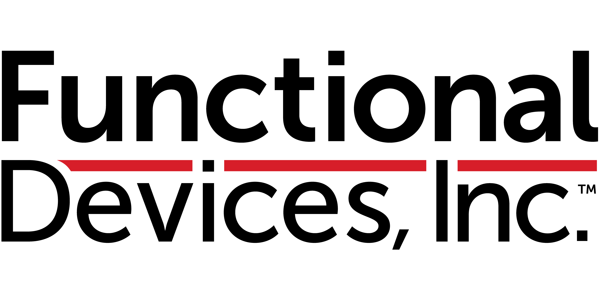
5. Research Update Chris Larry (Exp US Services Inc.)
5.1 2022 IBC Landmark Research
Healthy Buildings and Indoor Environmental Quality

Slide 7
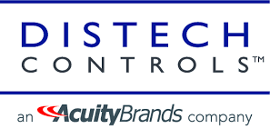
5. Research Update Greg Walker (CABA)
5.2 Annual BACS Market Sizing North America

Slide 8
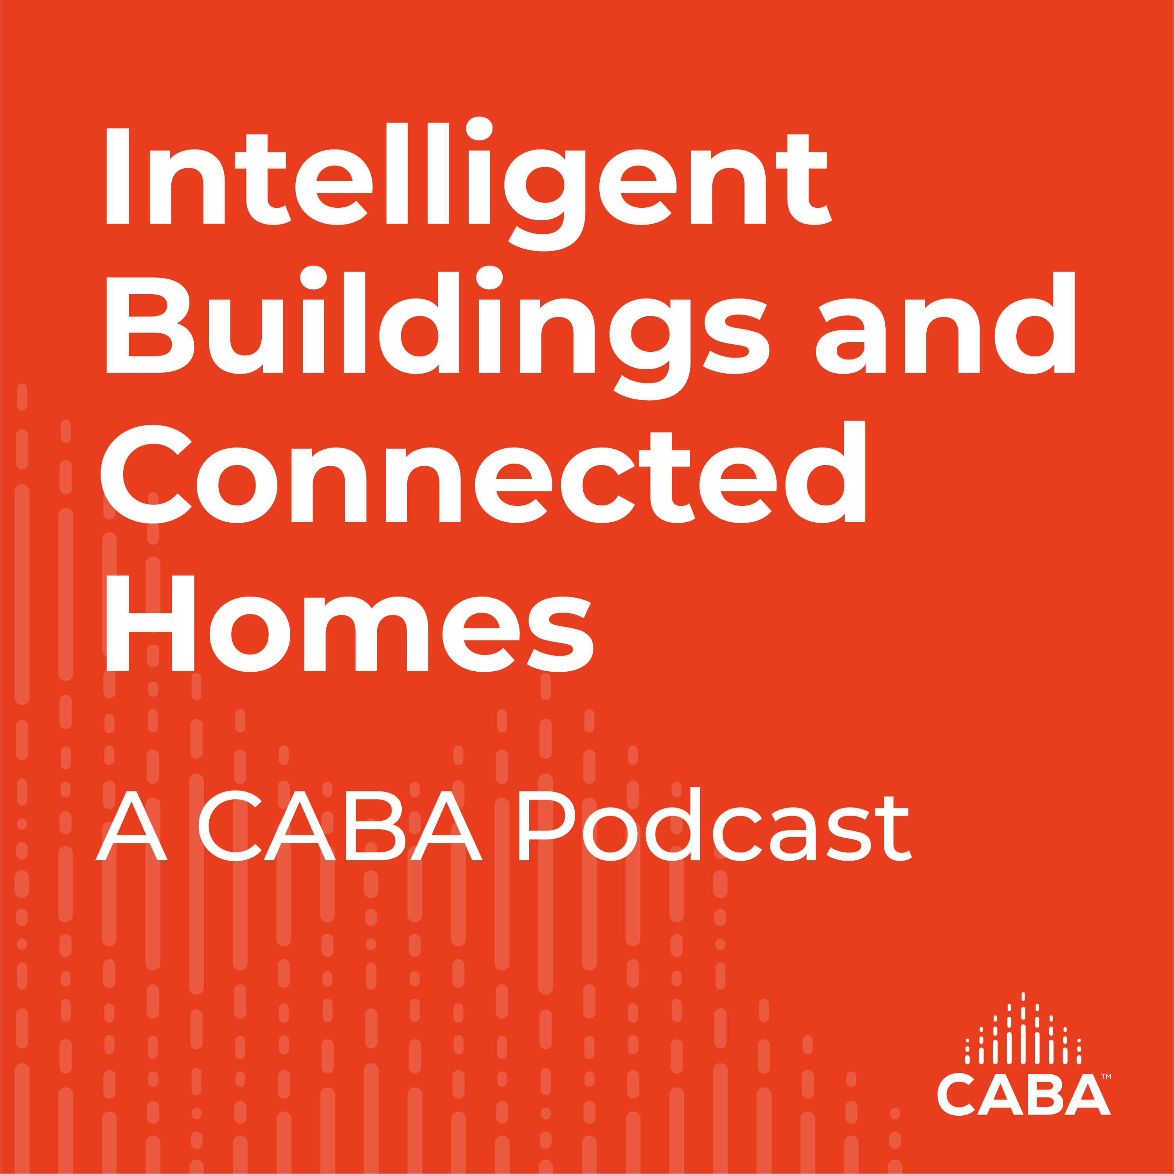
6. CABA Podcasts Marta Klopotowska (CABA)
Join industry experts and leaders from around the globe as they discuss everything smart home and intelligent buildings.
CABA is looking for guests and hosts for future pre-recorded episodes. Contact Marta Klopotowska (Klopotowska@caba.org) for more information.
July 2022 Intelligent Buildings Recording:
“Understanding the Language Around Today’s Intelligent Buildings”

Slide 9
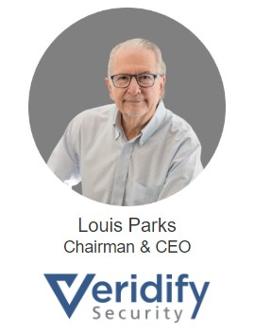
7. Keynote Harsha Chandrashekar (Honeywell International, Inc.)
Protecting buildings from cyberattacks – six important steps to take today

Slide 10
Protecting Buildings from Cyber Attacks
6 Steps
You Can Take Today

Slide 11
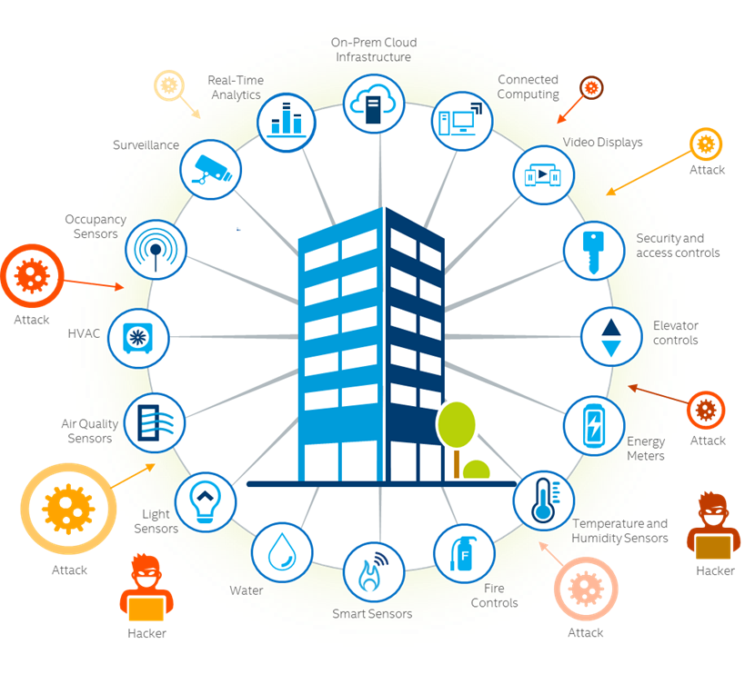
What is a Cyber Attack?
Intentional unauthorized access or control of a system/network by a third-party
Why attack a building?
Disrupt operations – possible Ransom
Access other systems
Collect data

Slide 12
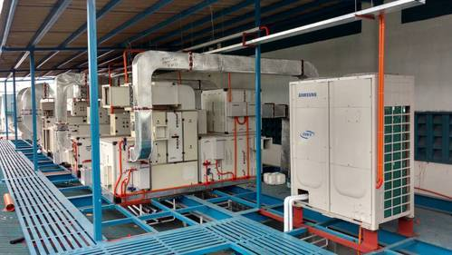
Information vs Operational Technology
Information Technology (IT) run your business:
HR, Payroll, Accounting, Websites, etc.
Computers, Cloud, Servers
Security Focus: Data and Confidentiality
Operational Technology (OT) run your infrastructure:
Controllers, Sensors, PLCs
Small, embedded devices
Security Focus: Function and Safety
Information
Technology
Operational
Technology

Slide 13
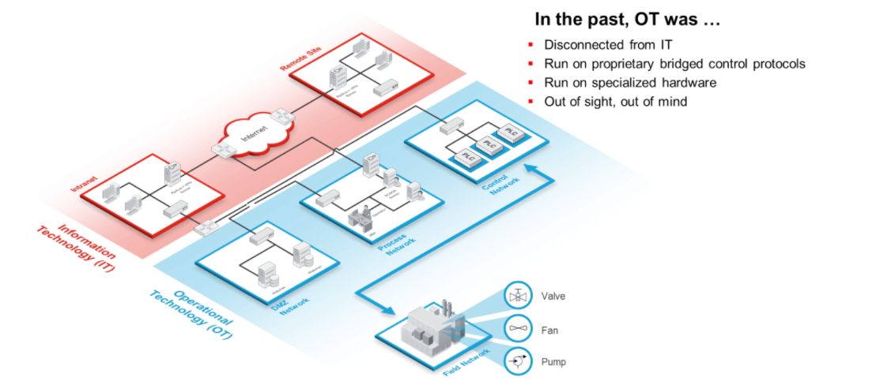
Why are Buildings so Vulnerable?
IT Networks are well protected by policies and tools designed to protect your data and access, like Firewalls, Virtual Private Networks (VPNs), Access Controls, Application Security, Anti-malware, Network Segmentation, and more…
IT Networks

Slide 14
OT Networks
Why are Buildings so Vulnerable?
OT Network security is minimal - consisting mostly of monitoring, detection, and segmentation tools
OT Security
Is 20 Years BEHIND
IT Security

Slide 15
Connected Buildings Today…
Why are Buildings so Vulnerable?
Buildings are becoming smarter and easier to manage through the connection of OT Networks to IoT/IT Networks
Connecting increases the Cyber Attack Surface Creating security exposures that threaten occupant safety and generating significant financial risks

Slide 16
Building/OT Network Challenges
Legacy Infrastructure
Proprietary Systems
Multiple Protocols
Screenless, no physical I/O
Limited Device Security at the edge
System/Device Location
Multiple Vendors
Siloed Facilities and IT Management

Slide 17
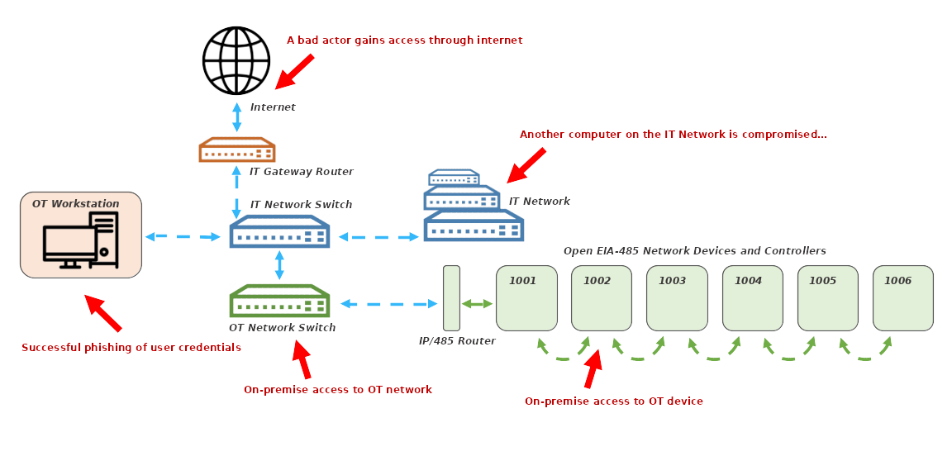
Cyber Attacks on a Building/OT Network

Slide 18
Typical Recommendations are IT-centric
Network visibility
Patch and Update
Network Segmentation
Firewalls
Antivirus
Monitor
Zero Trust
Good – but IT Network Focused

Slide 19
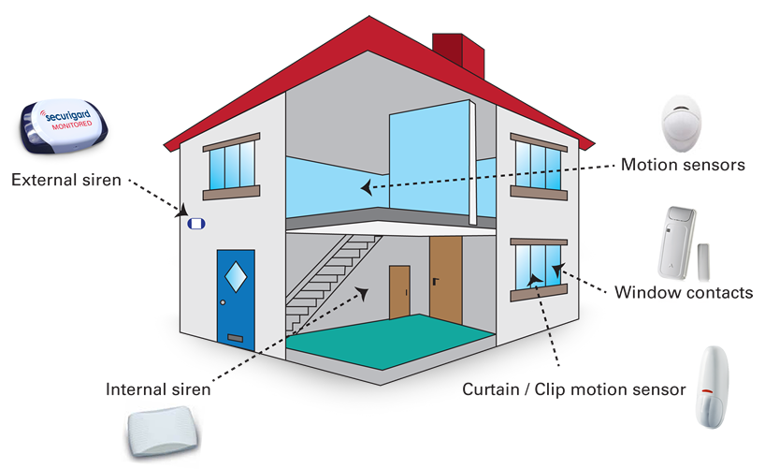
Monitoring vs. Protecting
Monitor, Detect, and Alert are important functions in keeping a building safe
To deliver Security, you need real-time protection – e.g., Access Controls/Locks

Slide 20
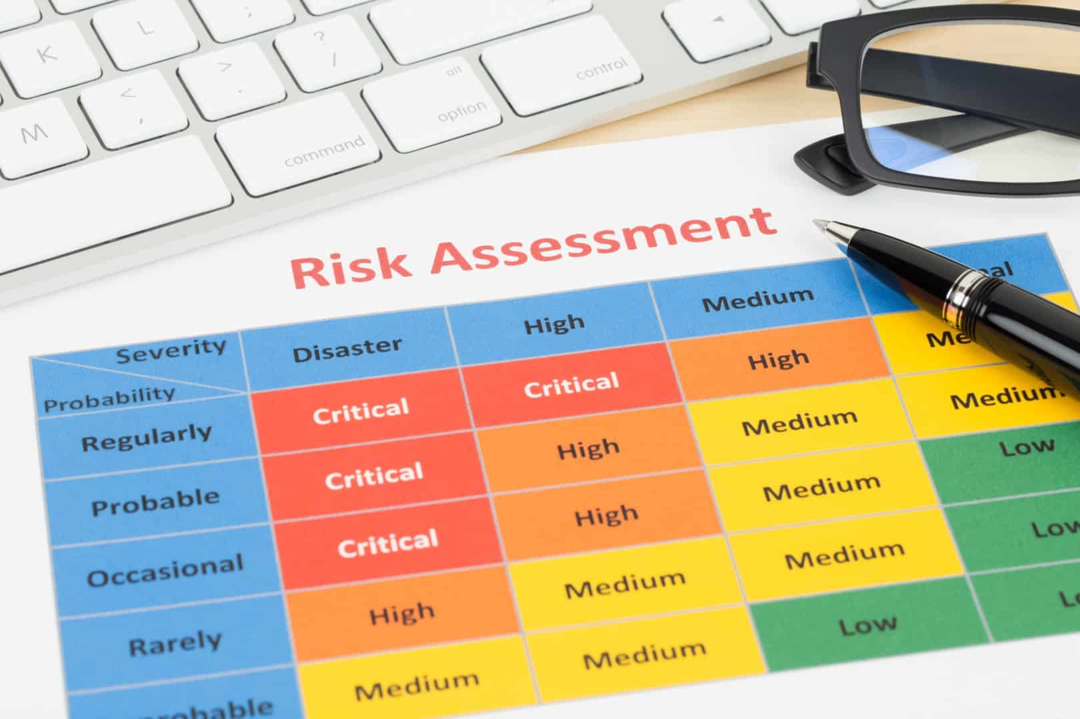
Six Steps you can take “Today”
1. Create a Building Inventory
E.g., Systems/networks, devices, software
2. Monitor Advisories – follow mitigation advice
E.g., ICS-CERT Advisories (CISA.gov/uscert/advisories)
3. Perform a Risk Assessment
E.g., Objectives, scope, threats, impact, prioritize, document
Device
Type

Slide 21
Six Steps you can take “Today”
4. Protect BMS
E.g., Physical security, access
5. Back up systems
Prepare for easier restoration or replacement
6. Seek OT “Device-Level” Security
E.g., Supports Zero Trust, Secure (authentication, encrypt)

Slide 22
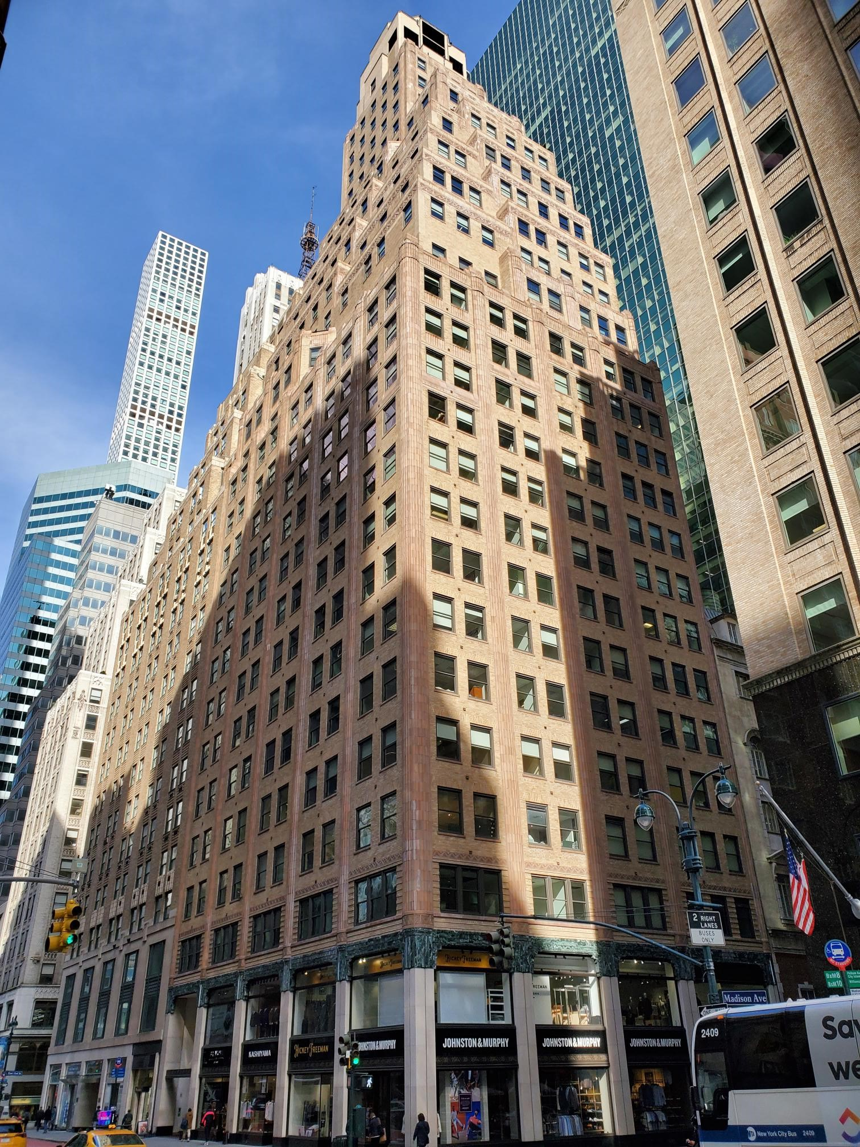
Making Building Cyber Safe adds Real Value
Protects tenants, revenue, and asset values
Increases building value - like LEED
Enhances lease offerings
Comply with Fed Cyber Laws – attract more tenants
May reduce insurance costs
Device-level solutions available for easy retro-fit

Slide 23
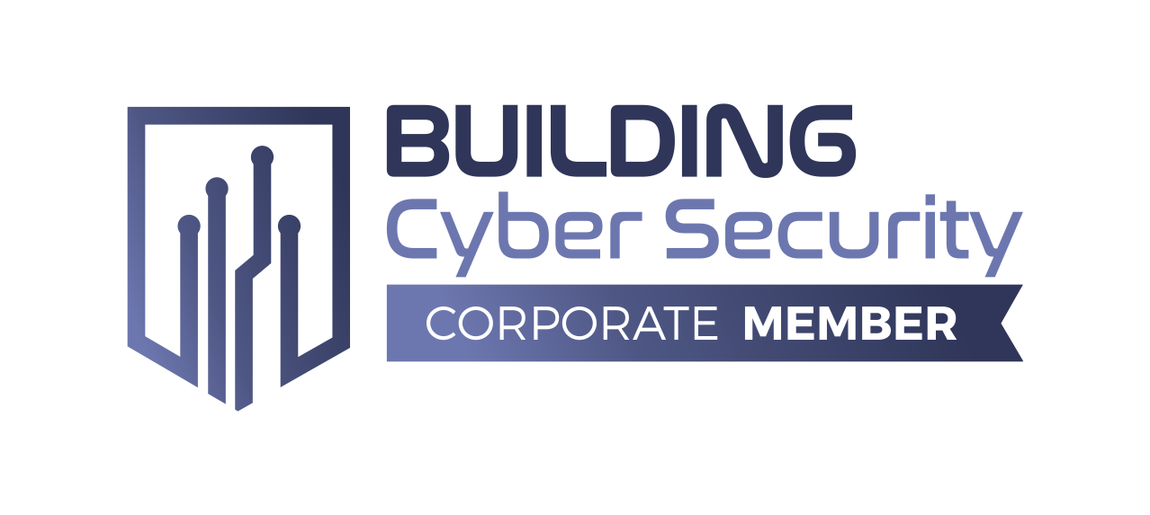
Your Partner in Making Smart Buildings Cybersafe
Louis Parks, CEO
LParks@veridify.com
M: +1.203.451.3920
Company Headquarters California Office Shelton, CT San Jose, CA

Slide 24
THANK YOU!
Questions?

Slide 25
8. White Paper Sub-Committee Update Ken Wacks (Ken Wacks Associates)
8.1 In Progress:
“Fire Alarm Systems in Buildings”
Canadian Fire Alarm Association (Chair)
AML Encore Corp./Canadian Fire Alarm Association
exp. US Services, Inc.
Honeywell International, Inc.

Slide 26
8. White Paper Sub-Committee Update Ken Wacks (Ken Wacks Associates)
8.2 Complete:
“OT Cybersecurity as applied to Building Automation Systems for Critical Systems”
Mission Critical Global Alliance (MCGA) (Chair)

Slide 27
8. White Paper Sub-Committee Update Ken Wacks (Ken Wacks Associates)
All proposals and previously completed IBC White Papers can be downloaded at:
www.caba.org/whitepapers

Slide 28
9. New Business Bob Allan (NAVCO, Inc.)
New IBC business?

Slide 29
10. Announcements Robert Lane (Robert H. Lane and Associates Inc.)
10.1 Past Events Overview
2022 IES Annual Conference
August 18-20, 2022 New Orleans, LA
Shanghai Intelligent Building Technology August 31 – September 2, 2022 Shanghai, China
BuildingsNY
September 14-15, 2022
New York, NY
Cable-Tec Expo 22 September 19-22, 2022
Philadelphia, PA
BICSI Fall Conference & Exhibition September 25-29, 2022 Las Vegas, NV
IFMA’s World Workplace
September 28-30, 2022
Nashville, TN
Light+Buildings
October 2-6, 2022
Frankfurt, Germany
CRE Tech New York
October 12-13, 2022
New York, NY
Greenbuild International Conference and Expo
November 1-3, 2022
San Francisco, CA
ISA Automation & Leadership Conference
November 7-9, 2022
Galveston, TX

Slide 30
10. Announcements Robert Lane (Robert H. Lane and Associates Inc.)
10.2 Upcoming Events
The Buildings Show Nov 30-Dec 2, 2022
Toronto, ON
BICSI
February 5-9, 2023
Tampa, FL
AHR Expo
February 6-8, 2023
Atlanta, GA
Distributech International
February 7-9, 2023 San Diego, CA
Buildex Vancouver
February 15-16, 2023
Vancouver, BC

Slide 31
11. Adjournment Bob Allan (NAVCO, Inc.)
Next IBC Meeting: Tuesday, February 28, 2023
Continental Automated Buildings Association (CABA) caba@caba.org www.CABA.org
www.caba.org/ibc
Connect to what’s next™

