Slide 1
Connected Home Council (CHC) Webinar Meeting will commence 12:05pm ET Tuesday, May 24, 2022, 12 NOON – 1:30 PM (ET)
Chair: Eric Harper (Snap One)
Vice-Chair: Jim Hunter (Delos Living LLC)
Vice-Chair: Byron BeMiller (Semtech Corporation)
Vice-Chair: Charles Hume (Southwire Company, LLC)

Slide 2
1. Agenda Greg Walker (CABA)
Agenda
Call to Order, Welcome, Introductions, About the CHC
Administrative
Research Update
Keynote: “Helium: Decentralizing Wireless Networks” (30 min)
Scott Kaplan (Nova Labs, Inc.)
White Paper Sub-Committee Update
New Business
Announcements
Adjournment

Slide 3
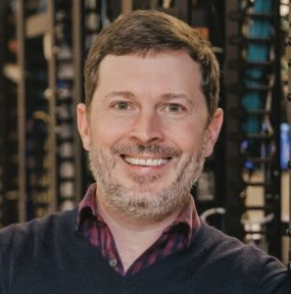
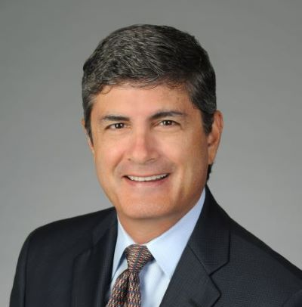
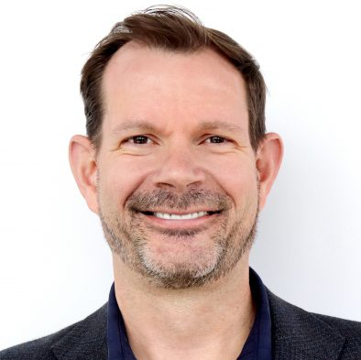
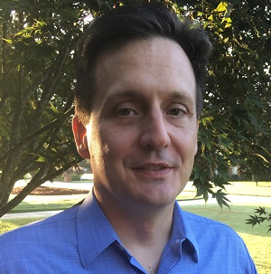
2. CHC Meeting Call to Order, Intros, About the CHC Greg Walker (CABA)
CHC Chair
Eric Harper
SVP, Product Marketing & Markets
Snap One
CHC Vice-Chair
Byron BeMiller
Director, Wireless Marketing
Semtech Corporation
CHC Vice-Chair
Jim Hunter
Chief Technology Officer
Delos Living LLC
CHC Vice-Chair
Charles Hume
Director of Digital Power Technologies
Southwire Company, LLC
Established in 2004, the CABA Connected Home Council initiates and reviews projects that relate to connected home and multiple dwelling unit technologies and applications. The Council also examines industry opportunities that can accelerate the adoption of new technologies, consumer electronics and broadband services within the burgeoning connected home market. www.caba.org/chc
3

Slide 4
3. Administrative Greg Walker (CABA)
Motion to approve past CHC Minutes February 15, 2022
www.caba.org/chc

Slide 5
4. Research Update Greg Walker (CABA)
4.1 2022 CHC Landmark Research
The Connected Home and Energy Management

Slide 6
4. Research Update Greg Walker (CABA)
4.2 2021 CHC Landmark Research
The Connected Home and AI

Slide 7
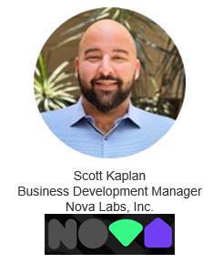
5. Keynote Jim Hunter (Delos Living LLC)
Helium: Decentralizing Networks

Slide 8
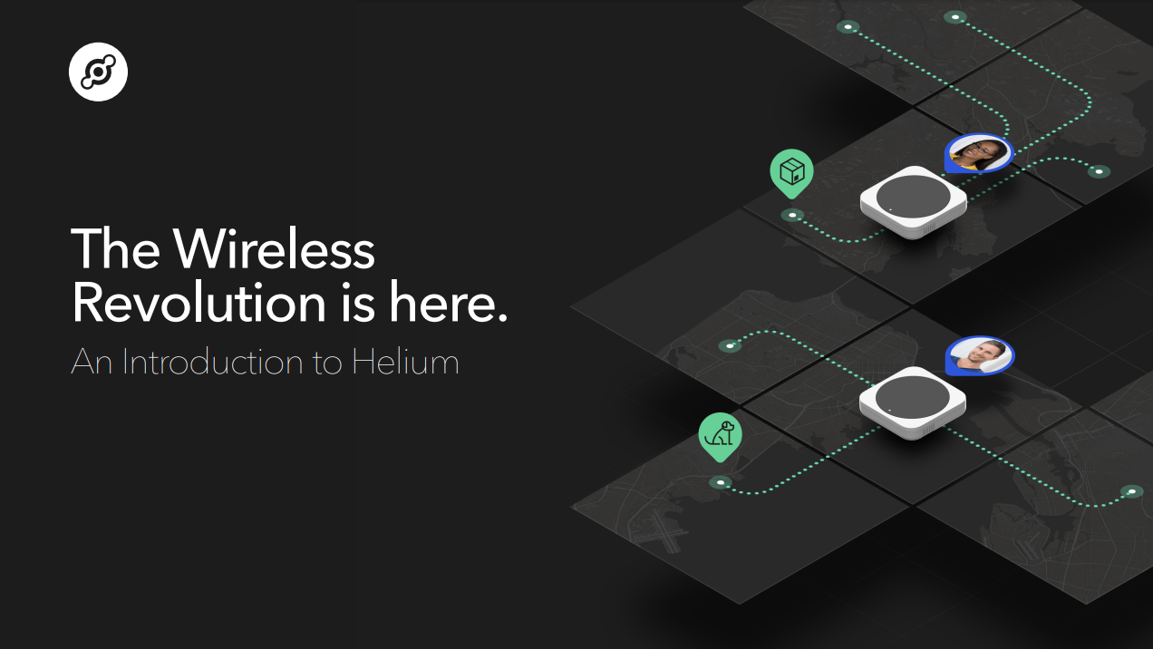

Slide 9
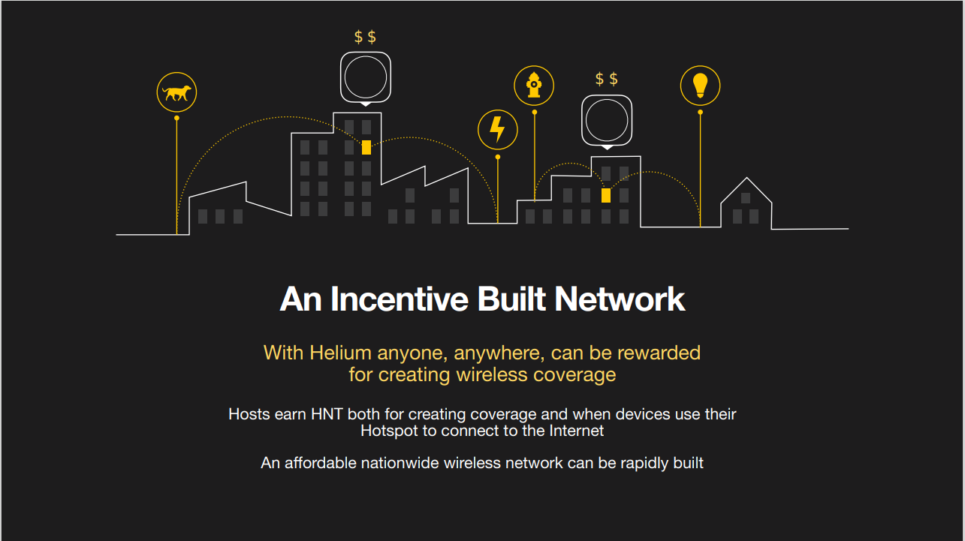

Slide 12
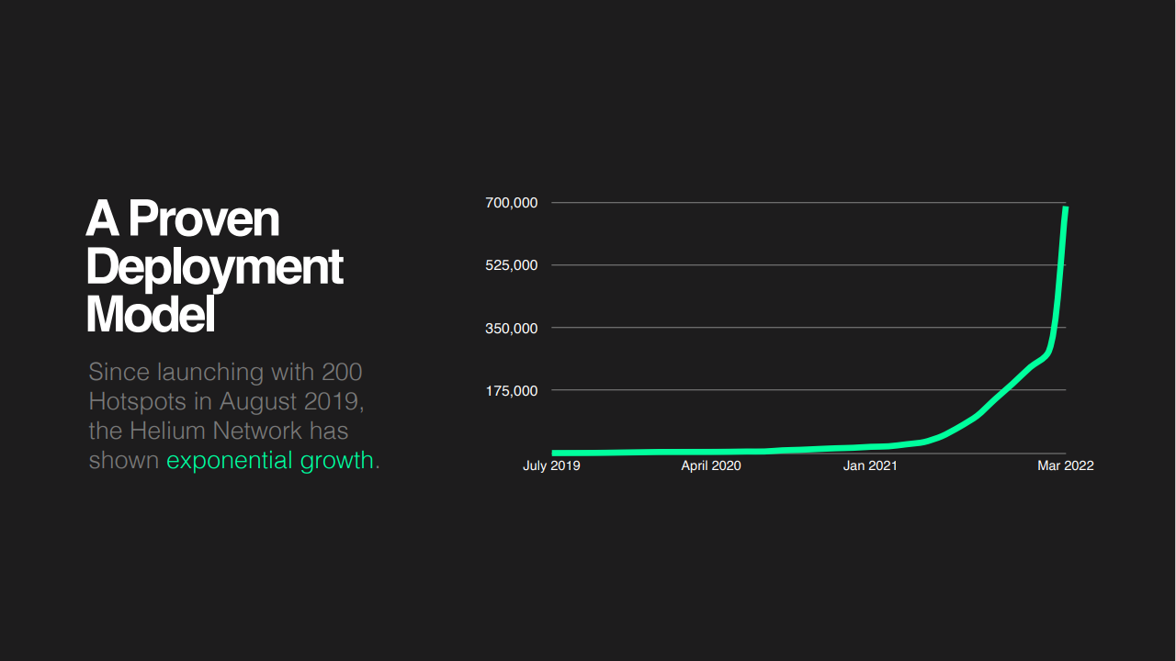

Slide 16
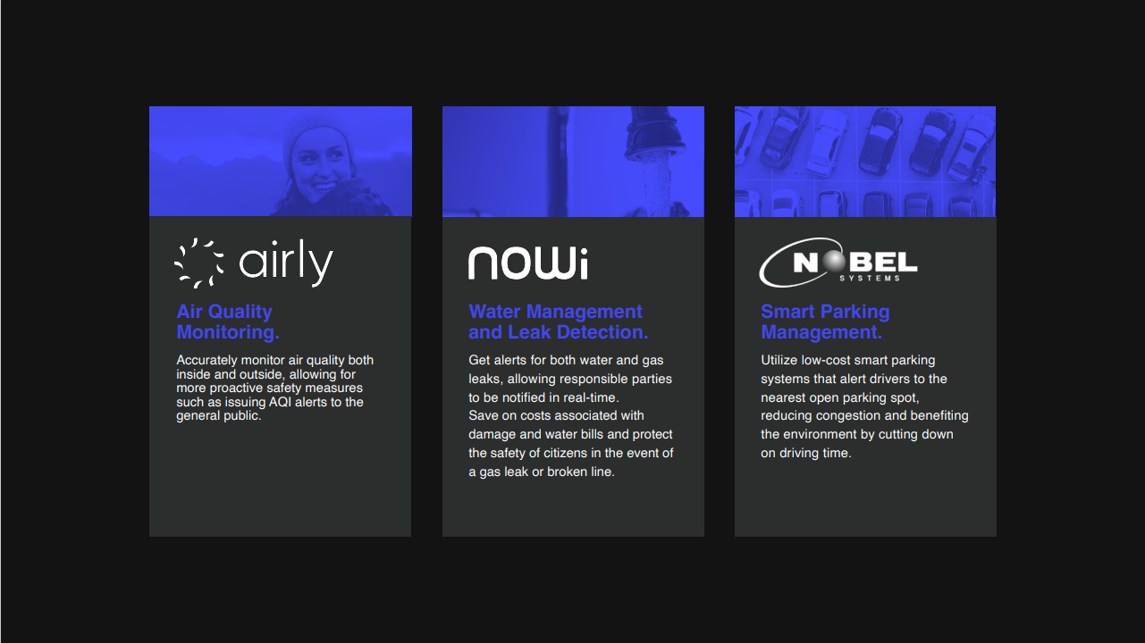

Slide 23
THANK YOU!
Questions?

Slide 24
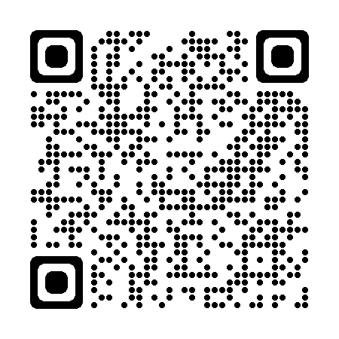
6. White Paper Sub-Committee Update Ken Wacks (Ken Wacks Associates)
Whitepaper proposals can be submitted to Marta Klopotowska at Klopotowska@caba.org
All proposals and previously completed CHC White Papers can be downloaded at:
www.caba.org/whitepapers
24

Slide 25
7. New Business Marta Klopotowska (CABA)
New CHC business?

Slide 26
8. Announcements Marta Klopotowska (CABA)
8.1 Past Events Overview
CONNECTIONS
May 17-19, 2022
Frisco, TX, USA

Slide 27
8. Announcements Marta Klopotowska (CABA)
8.2 Upcoming Events
CEDIA EXPO
September 29 - October 1, 2022
Dallas, TX, USA

Slide 28
9. Adjournment Marta Klopotowska (CABA)
Next CHC Meeting: Tuesday, August 16, 2022
Continental Automated Buildings Association (CABA) caba@caba.org www.CABA.org
www.caba.org/chc
Connect to what’s next™
28

