Slide 1
Intelligent Buildings Council (IBC) Webinar
Thursday, December 10, 2022, 12 NOON – 1:30 PM (ET)
Vice-Chair: Harsha Chandrashekar (Honeywell International Inc)
Vice-Chair: Robert Lane (Robert H. Lane and Associates Inc.)
Vice-Chair: Bob Allan (The Siemon Company)

Slide 2


1. Agenda
Greg Walker (CABA)
Agenda
Call to Order, Welcome, Introductions, About IBC
Administrative
Research Update
Keynote: “Environment, Social and Governance in buildings of less than 20,000 sq.ft” (30 min)
Rajendran Avadaiappan (Energy Metrics)
6. White Paper Sub-Committee Update
7. New Business
8. Announcements
9. Adjournment

Slide 3

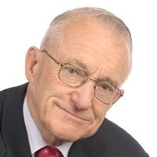
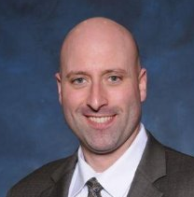



2. Call to Order, Welcome, Introductions, About the IBC
Bob Allan (The Siemon Company)
IBC Vice-Chair
Harsha Chandrashekar
Product Approvals & Regulatory Leader
Honeywell International Inc
IBC Vice-Chair
Robert Lane
President & Managing Partner
Robert H. Lane and Associates Inc.
IBC Vice-Chair
Bob Allan
Global Business Development Manager, Intelligent Buildings
The Siemon Company
The CABA Intelligent Buildings Council works to strengthen the large building automation industry through innovative technology-driven research projects. The Council was established in 2001 by CABA to specifically review opportunities, take strategic action and monitor initiatives that relate to integrated systems and automation in the large building sector. The Council's projects promote the next generation of intelligent building technologies and incorporates a holistic approach that optimizes building performance and savings. www.caba.org/ibc

Slide 4

3. Administrative
Bob Allan (The Siemon Company)
3.1 Motion to approve past IBC Minutes December 7, 2021: www.caba.org/ibc

Slide 5

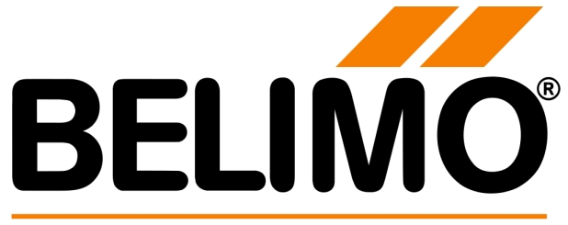



















4. Research Update
Robert Lane (Robert H. Lane and Associates Inc.)
4.1 2021 IBC Landmark Research “AI and Predictive Maintenance in Intelligent Buildings”

Slide 6

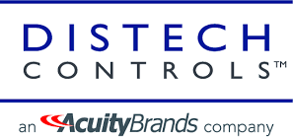

4. Research Update
Greg Walker (CABA)
4.2 Annual “BACS Market Sizing North America”

Slide 7
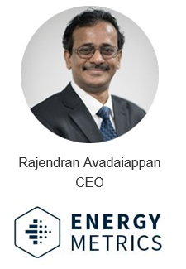
5. Keynote
Harsha Chandrashekar (Honeywell International, Inc.)
“Environment, Social and Governance in buildings of less than 20,000 sq.ft” (30 min)

Slide 8
Re-Open Better
ESG for Buildings < 20000 sqft
Minimizing Carbon Impact Further
10 Feb 2022

Slide 9
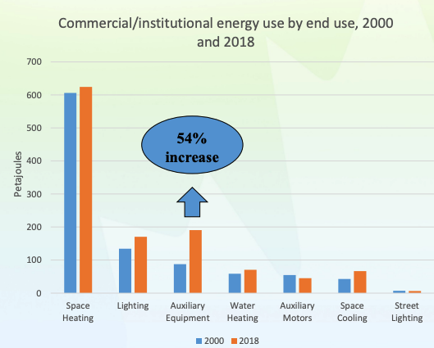
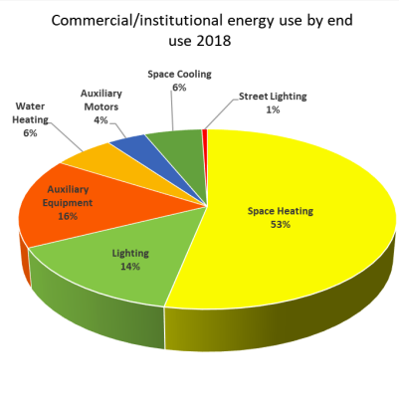
Setting the Energy Context
Small Commercial Buildings* (SCBs) in Canada comprise of 68% of commercial buildings stock and 18% of commercial building energy use.
For comparative context, in the US, almost up to 25% of energy is wasted in SCBs due to lack of intelligent controls. This leads up to a gigantic 750 trillion BTUs waste annually (just in the US).
Use of new technology and equipment has increased significantly over the past two decades. The need is to put intelligent controls to save energy in these buildings, including these new devices.
Things gets complex when we try to manage a portfolio of such SCBs with equipment from different manufacturers.
Creating a single layer of intelligence to apply a common set of rules to manage them is the challenge.
* Buildings < 20,000 sq ft area
Notes:
2. d. Why we are recommending this system? :
Future expansion to include more devices, integrate various sub-systems, and create a unified and intelligent building management experience.

Slide 10
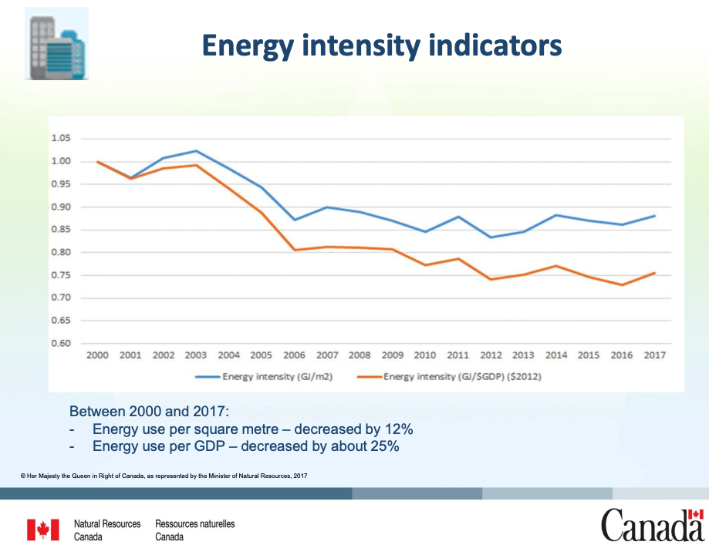
Past Strategy and Future Opportunity
Design & Construction interventions, with guiding BUILDING CODE, have been very effective.
We have seen 12% reduction in Energy Per SqM over the last two decades.
The need now is to implement adaptive controls to use energy just when needed, and more importantly AVOID WASTE.
As mentioned above, 25% of energy is typically wasted, and avoiding this will be a huge step forward.
Continuous Monitoring and Adaptive Controls are the way to go. They have been expensive traditionally for small spaces.
IoT and Cloud technologies have made it possible to implement low-cost solutions to achieve this across distributed building portfolios and drive unified program improvement.
Notes:
2. d. Why we are recommending this system? :
Future expansion to include more devices, integrate various sub-systems, and create a unified and intelligent building management experience.

Slide 11
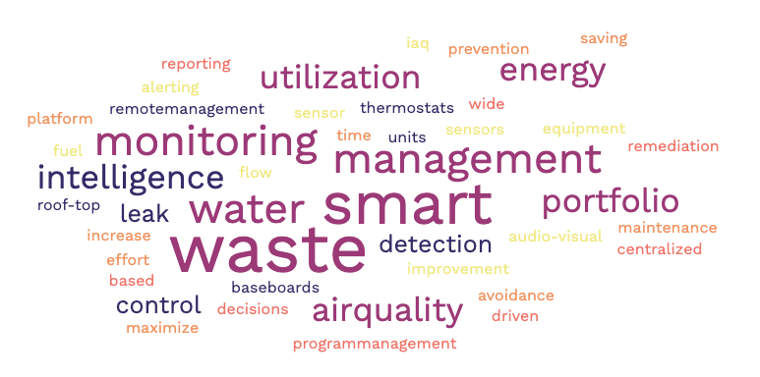
A Practical Approach to ESG with Faster Payback
Using Smart IoT Devices for monitoring and control of Energy usage, particularly Smart Thermostats for Heating and Cooling have led to tremendous savings.
In a study we did along with NRC, across 400+ SCBs, we have found savings of 19% and 16% in Electricity and Natural Gas respectively. (Published in ASHRAE and COBEE 2022).
Due to the low-cost involved in the Smart Sensors and a centralized intelligent control platform on Cloud, we have noticed a Payback of less than 3 years.
Adding Centralized & Remote Management of Setpoints with these devices has increased the savings due to avoided Truck-Rolls. This brought the payback to less than 1.5 years.
Air-Quality sensors, interconnected to the comfort management has ensured health as well, bringing additional value from the same platform.
Water Leak Detection & Flow Control, Fuel Leak Detection and Shutoff, are adding more savings to the same platform, avoiding repair costs.
Recent addition is AV equipment monitoring, allowing proactive maintenance and utilization
Since the platform supports various manufacturers and device types, it allows savings across all. This also mitigates the RISK of locking on to one supplier/manufacturer.
Notes:
2. d. Why we are recommending this system? :
Future expansion to include more devices, integrate various sub-systems, and create a unified and intelligent building management experience.

Slide 12
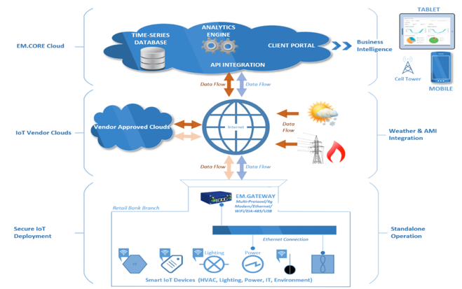
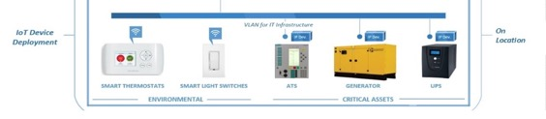
EM.Connect: BMS-LITE + CENTRAL INTELLIGENCE
An Example System
Monitor
  Smart-Devices and BMS Integration: Device Availability, Temperature, Relative Humidity, Air Quality (CO2, VOC, PM2.5), Ambient Sound, Ambient Light, Energy Storage, Generators, Energy Consumption, Water leak, Fuel Leak, etc.
Control & Alert
  HVAC & Heater ON/OFF & Setpoints
  Lights ON/OFF & Brightness
  Air-Flow (CFM) / Air Purifiers
  Water & Fuel shut off/control
  Scheduling of Devices – ON/OFF
Optimize & Save
  Maximize: Health, Comfort & Efficiency
  Optimize & Save: Energy & Operations Costs
Notes:
2.b. Overview of the connectivity. What does the installed data network look like

Slide 13
Multiple Practical Dimensions of E in ESG
Energy Use management and avoiding waste is just one of the many requirements of ESG
  Energy saving leads all ESG initiatives
  Finding ROI is the big challenge, and finance puts the breaks.
  Finding other savings with the same solution will make it attractive.
Water use and especially leak detection and management is another important dimension.
  Avoid Depleting Natural Water Resources
  Reduce Unwanted/Wasteful Damages to the structures requiring expensive repairs
Air-Quality is another imminent need along with Comfort, to ensure Health and Safety of occupants.
  Covid-19 related pure air-quality requirements
  Comfort of Temperature & Humidity along with Air-Quality
  Smart Flushing is the waste avoidance
Reducing Travel, particularly truck-rolls to do repairs
  Remote Monitoring and Management helps
  Reduces Wasteful Carbon / GHG
Increase Equipment Life – Increasing Uptime, Saving energy & money for the long-term
  Proactive Monitoring and timely repairs
  Reduce unwanted human effort to mend things when they fail
Smart Thermostats
Air Quality Sensors
Light Switches
Audio-Visual Devices
LoRa Gateways
WiFi Gateways
Cellular Gateways
BacNet Connectors
Modbus Connectors
Remote Management Apps
Alarms / Tickets
Reports and Analytics
Optimization Logic
Centralized Program Management
Continuous Savings
Notes:
2. d. Why we are recommending this system? :
Future expansion to include more devices, integrate various sub-systems, and create a unified and intelligent building management experience.

Slide 14
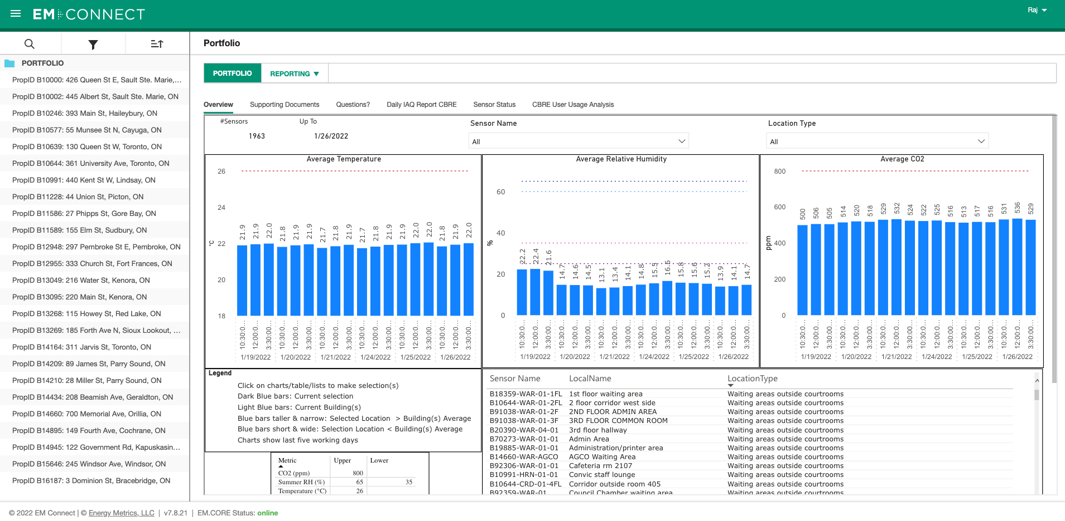
Integrated Portfolio Management
Portfolio Wide View
All Sensor readings are aggregated for Portfolio-wide view.
Notes:
2.b. Provide pictures of an existing installation of the various components of your equipment solution

Slide 15
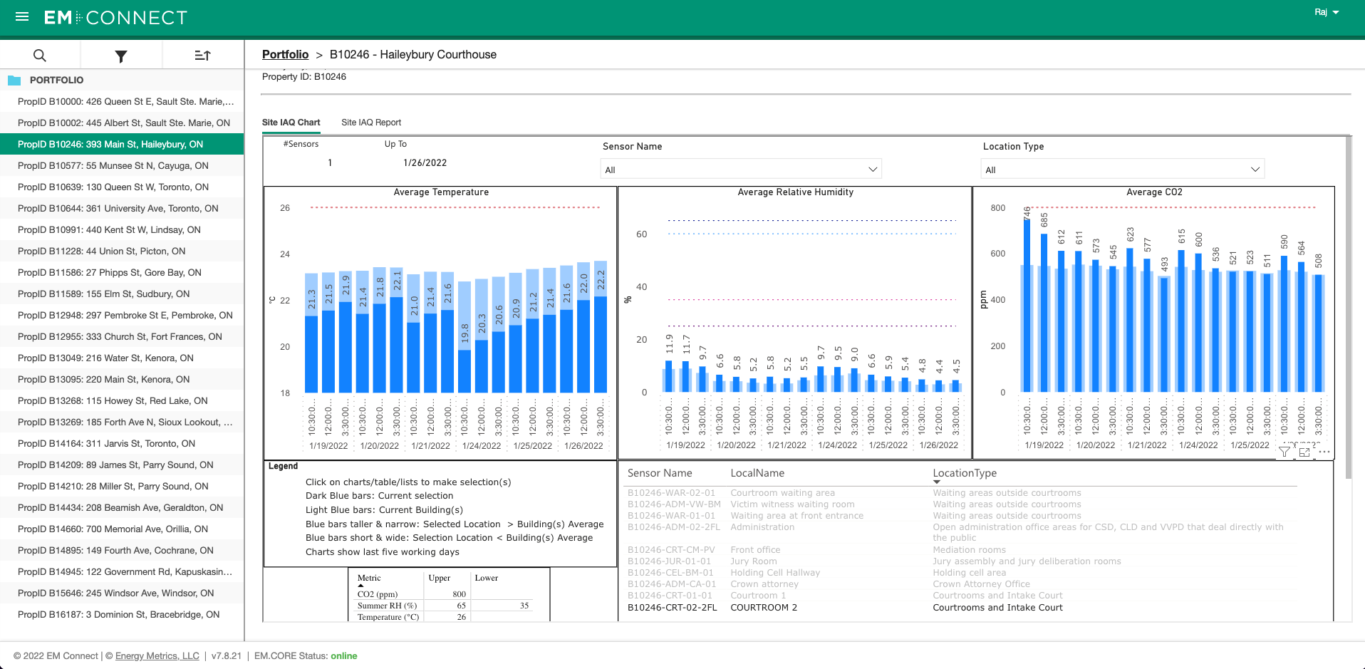
Integrated Infrastructure Management
Branch Level View
Specific Sensors can be compared to the Site-level performance to find issues
Notes:
2.b. Provide pictures of an existing installation of the various components of your equipment solution

Slide 16
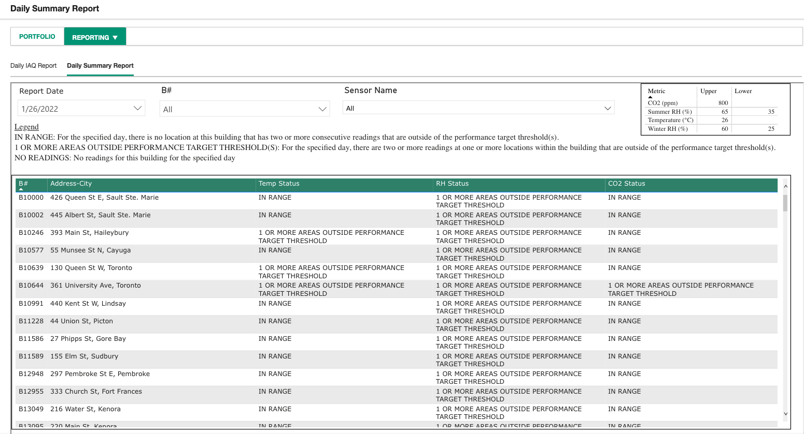
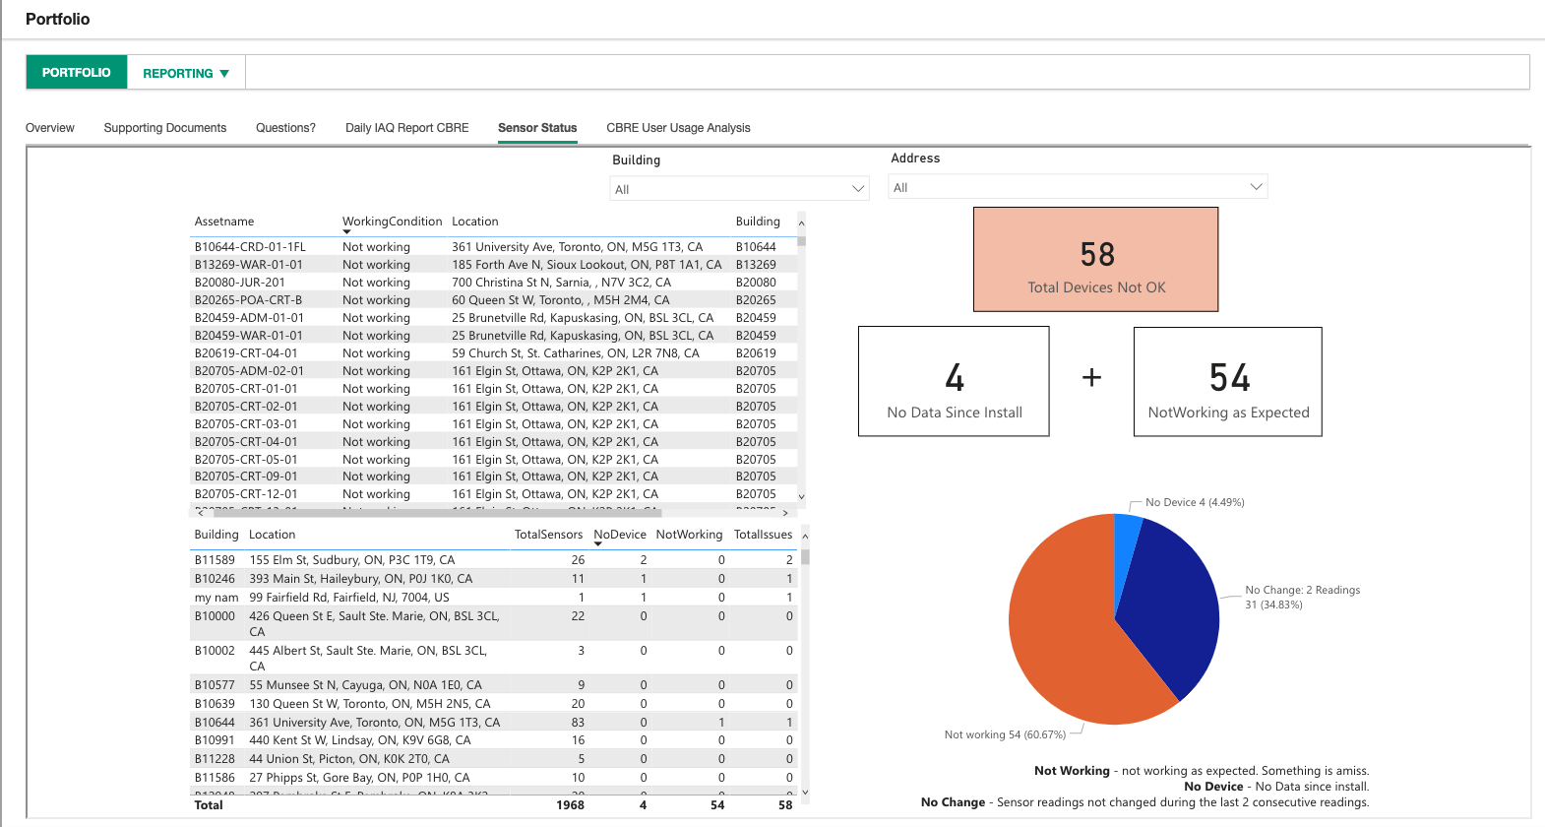
Integrated Maintenance Management
Portfolio-wide Issues Report and Dashboard for FMs/Program Managers
All sensors/devices with issues across the portfolio are reported continuously to take corrective action.
Notes:
2.b. Provide pictures of an existing installation of the various components of your equipment solution

Slide 17
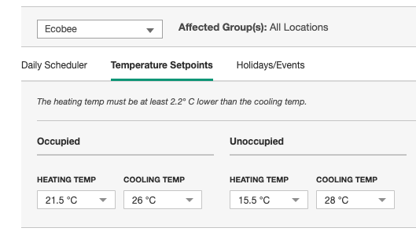
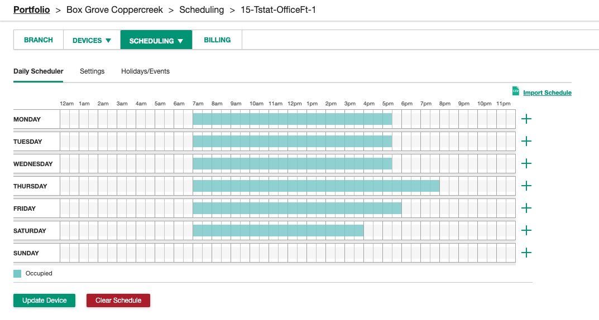
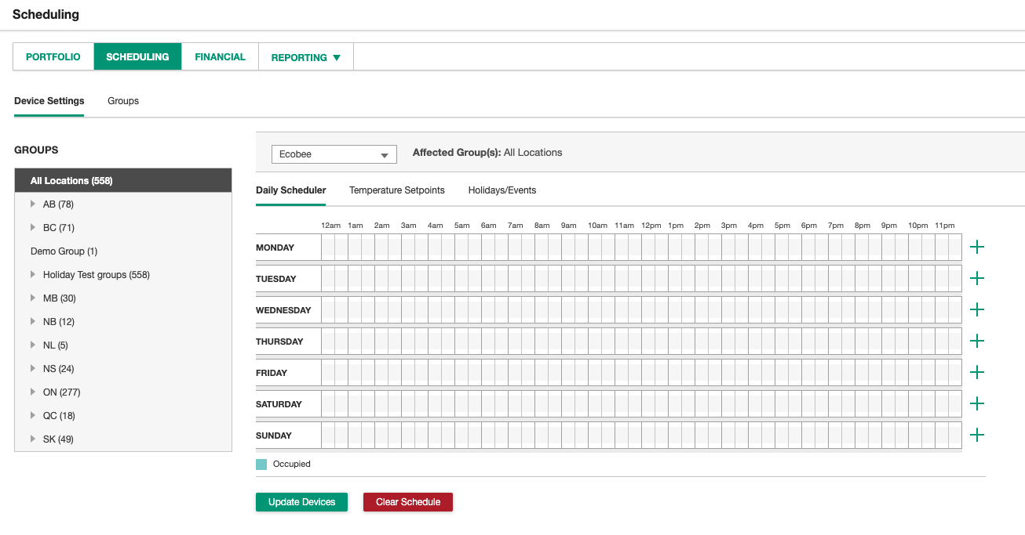
Integrated Device Management
Individual Device and Portfolio-Wide Scheduling
All sensors/devices across the portfolio can be set to scheduled On/Off / Setpoints
Notes:
2.b. Provide pictures of an existing installation of the various components of your equipment solution

Slide 18
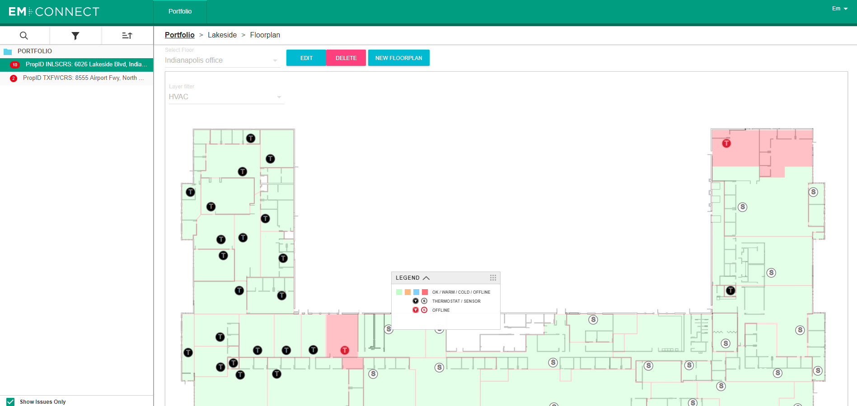
EM.CONNECT
Mapping for Success
Floor Plan
Spaces with Status
All sensors/devices with issues are reported with geographical context and performance indicators continuously to take corrective action.
Floor Plans Can be uploaded and mapped by Customer Self-service

Slide 19

Social Impact of These Initiatives
Everyone is responsible and is a part of change
Minimize waste: Build a culture of conscious use of natural resources – every-day
Commitment: Keep track of deteriorating performance conditions and ensure interventions are made to restore them to optimal state
Avoid Travel: Ensure all unwanted travel is avoided. Just traveling miles for something trivial as changing the setpoint by a few degrees should not be needed.
Crowd Source Comfort and Health: The occupants of a facility should be able to influence the comfort settings of a place, and the energy / portfolio managers should be able to set governing guidelines.
Making the world a better place is everyone’s responsibility. And everyone should take an active part and be in control of the collective destiny.
Notes:
2. d. Why we are recommending this system? :
Future expansion to include more devices, integrate various sub-systems, and create a unified and intelligent building management experience.

Slide 20
Healthy Governance
Meeting the needs – now & future
Air-Quality & Air-Flow
No Over-Flushing Air
Health +
Energy Efficiency + Savings
Weather / Comfort Management
Constantly Monitor Indoor Air-Quality (IAQ), Water and Energy
  Temp, Relative Humidity, CO2, PM (1/2.5/5/10) & Volatile Organic Compounds (VOCs)
Finds the Gap between actual and recommended Settings
  Air-Quality, Energy Usage, Temperature and Comfort
Smart Use/Flush
  Don’t constantly blow air, FLUSH to maintain healthy IAQ
  Can integrate with Air Purifiers, Smart Thermostats & BMS
  Update setpoints for Smart Flush (Fan/HVAC mode, etc.)
Dynamically calculate what needs to change:
  Optimum algorithm: ASHRAE+HEALTH (WELL, EACO & CCOHS)
  Use sensor network for target Temp, RH Setpoints and Air-Flow with integrated Air-Quality & HVAC equipment
  Identify waste – Schedule / Shutoff to minimize waste.
Keep recommended standards - Balanced with Comfort, Health, Energy, Water and Effort.
Minimize Waste.
Notes:
2. d. Why we are recommending this system? :
Future expansion to include more devices, integrate various sub-systems, and create a unified and intelligent building management experience.

Slide 21
Thank you for your Interest.
For Further Information and assistance, Please contact:
Rajendran Avadaiappan
(718) 755-9489
raj@energymetricsllc.com

Slide 22

5. Keynote - Questions?
Harsha Chandrashekar (Honeywell International, Inc.)

Slide 23

6. White Paper Sub-Committee Update
Ken Wacks (Ken Wacks Associates)
6.1 Completed:
“Bipolar Ionization and its Contribution to Smart and Safe Buildings”
Pure Air Control (Chair)

Slide 24
6. White Paper Sub-Committee Update
Ken Wacks (Ken Wacks Associates)
6.2 In Progress:
“Part 2: Impacts of Automated Shading in Building Projects”
TRC Energy Services (Chair)
Axis Lighting Inc.
Draper, Inc.
exp. US Services, Inc.
Ken Wacks Associates
Lawrence Berkeley National Laboratory (LBNL)
Legrand
Lutron Electronics Co., Inc.
Mecho
NYSERDA (New York State Energy Research and Development Authority)
PLC Multipoint, Inc.
Somfy Systems, Inc.
Sustainable Resources Management Inc.
Vistar Energy Consulting
Window Products Management

Slide 25
6. White Paper Sub-Committee Update
Ken Wacks (Ken Wacks Associates)
6.2 In Progress:
“Fire Alarm Systems in Buildings”
Canadian Fire Alarm Association (Chair)
AML Encore Corp./Canadian Fire Alarm Association
exp. US Services, Inc.

Slide 26
6. White Paper Sub-Committee Update
Ken Wacks (Ken Wacks Associates)
6.2 In Progress:
“Architecting Intelligent Self Learning Adaptive Smart Campus Framework for Smart Cities”
NAVTAT Solutions (Chair)

Slide 27
6. White Paper Sub-Committee Update
Ken Wacks (Ken Wacks Associates)
6.2 In Progress:
“Assuring Healthy Buildings using Smart Technologies”
D&M Engineering (Chair)
Delos Living LLC
International Corporate Expansion (ICE) / XME.digital
Johnson Controls, Inc.
NYSERDA
Parity, Inc.
Sustainable Resources Management Inc.
TIA Telecommunications Industry Association (TIA)
Yorkland Controls Ltd.

Slide 28



6. White Paper Sub-Committee Update
Ken Wacks (Ken Wacks Associates)
All proposals and previously completed IBC White Papers can be downloaded at:
www.caba.org/whitepapers

Slide 29

7. New Business
Bob Allan (The Siemon Company)
7.1 Other new IBC business?

Slide 30

8. Announcements
Robert Lane (Robert H. Lane and Associates Inc.)
8.1 Past Events Overview
BICSI
January 30 - February 3, 2022
Orlando, FL USA
AHR Expo
January 31 - February 2, 2022
Las Vegas, NV USA

Slide 31

8. Announcements
Robert Lane (Robert H. Lane and Associates Inc.)
8.2 Upcoming Events
CXEnergy
April 19-22, 2022
Orlando, FL USA
Distributech International
May 23-25, 2022
Dallas, TX USA

Slide 32

8. Adjournment
Bob Allan (The Siemon Company)
Next IBC Meeting: Tuesday, May 10, 2022
Continental Automated Buildings Association (CABA)
caba@caba.org
www.CABA.org
www.caba.org/ibc
Connect to what’s next™

