Slide 1
Connected Home Council (CHC) Webinar Meeting will commence 12:05pm ET Tuesday, February 15, 2022, 12 NOON – 1:30 PM (ET)
Chair: Eric Harper (Snap One)
Vice-Chair: Jim Hunter (Delos Living LLC)
Vice-Chair: Byron BeMiller (Semtech Corporation)
Vice-Chair: Charles Hume (Southwire Company, LLC)

Slide 2
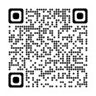
1. Agenda Greg Walker (CABA)
Agenda
Call to Order, Welcome, Introductions, About the CHC
Administrative
Research Update
Keynote: “Introduction to Texas State CIEDAR Consortium” (30 min)
Andres Carvallo (Texas State University)
White Paper Sub-Committee Update
New Business
Announcements
Adjournment
© 2022, Continental Automated Buildings Association
Connected Home Council

Slide 3
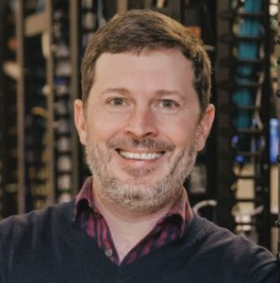
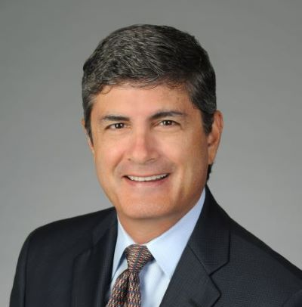
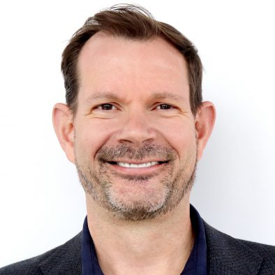
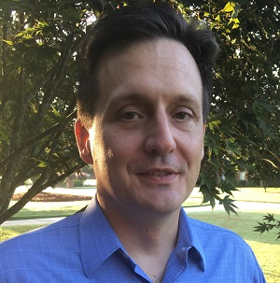
2. CHC Meeting Call to Order, Intros, About the CHC Eric Harper (Snap One)
CHC Chair
Eric Harper
SVP, Product Marketing & Markets
Snap One
CHC Vice-Chair
Byron BeMiller
Director, Wireless Marketing
Semtech Corporation
CHC Vice-Chair
Jim Hunter
Chief Technology Officer
Delos Living LLC
CHC Vice-Chair
Charles Hume
Director of Digital Power Technologies
Southwire Company, LLC
Established in 2004, the CABA Connected Home Council initiates and reviews projects that relate to connected home and multiple dwelling unit technologies and applications. The Council also examines industry opportunities that can accelerate the adoption of new technologies, consumer electronics and broadband services within the burgeoning connected home market. www.caba.org/chc
3
© 2022, Continental Automated Buildings Association
Connected Home Council

Slide 4
3. Administrative Eric Harper (Snap One)
3.1 Motion to approve past CHC Minutes from December 2, 2021: www.caba.org/chc
© 2022, Continental Automated Buildings Association
Connected Home Council

Slide 5
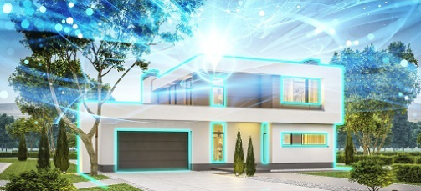
4. Research Update Charles Hume (Southwire Company, LLC)
4.1 “The Connected Home and AI” 2021 CHC Landmark Research
© 2022, Continental Automated Buildings Association
Connected Home Council

Slide 6
4. Research Update Greg Walker (CABA)
4.2 2022 CHC Landmark Research
“The Connected Home and Energy Management”
© 2022, Continental Automated Buildings Association
Connected Home Council

Slide 7
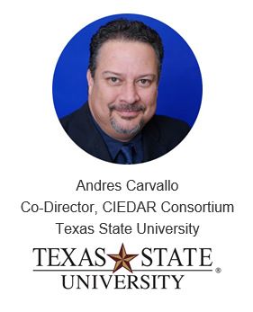
5. Keynote Jim Hunter (Delos Living LLC)
“Introduction to Texas State CIEDAR Consortium” (30 min)
© 2022, Continental Automated Buildings Association
Connected Home Council

Slide 8
Texas State University
CIEDAR Projects & Labs

Slide 9
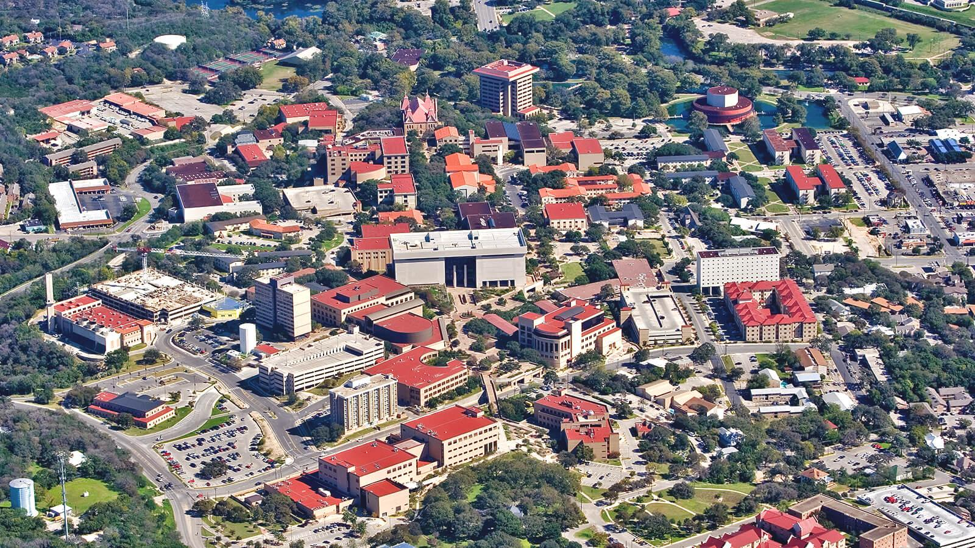
Texas State University
4th largest university in Texas, 1,800 faculty, 40,000 students, over 5,100 acres of land housing two campuses and multiple research labs.
50% of our students are ethnic minorities;
10-year Hispanic Serving Institution (HSI), 35% Hispanic population.
9

Slide 10
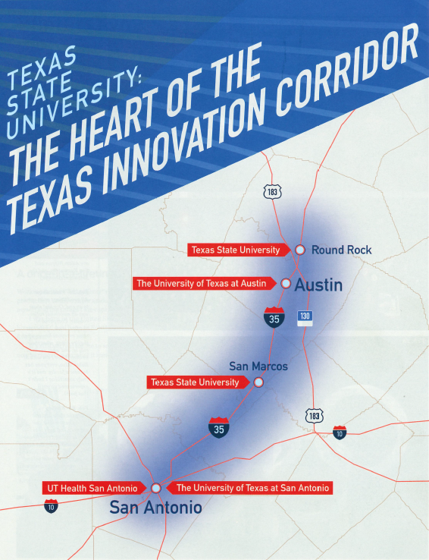

Slide 11
TXST CIEDAR Locations
Round Rock Campus – 100 acres
San Marcos Campus – 500 acres
STAR Park – 100 acres
Freeman Ranch – 4,200 acres
Muller Ranch – 160 acres
ALERRT Center – 65 acres
Grand Total 5,125 acres

Slide 12
TXST CIEDAR Vision
Connected Infrastructure for Education, Demonstration, and Applied Research (CIEDAR).
The creation of nine (9) living labs within smart neighborhoods in partnership with industry to accelerate digitalization, decentralization, and decarbonization of industry via our own Technology Enhanced Infrastructure vision.

Slide 13
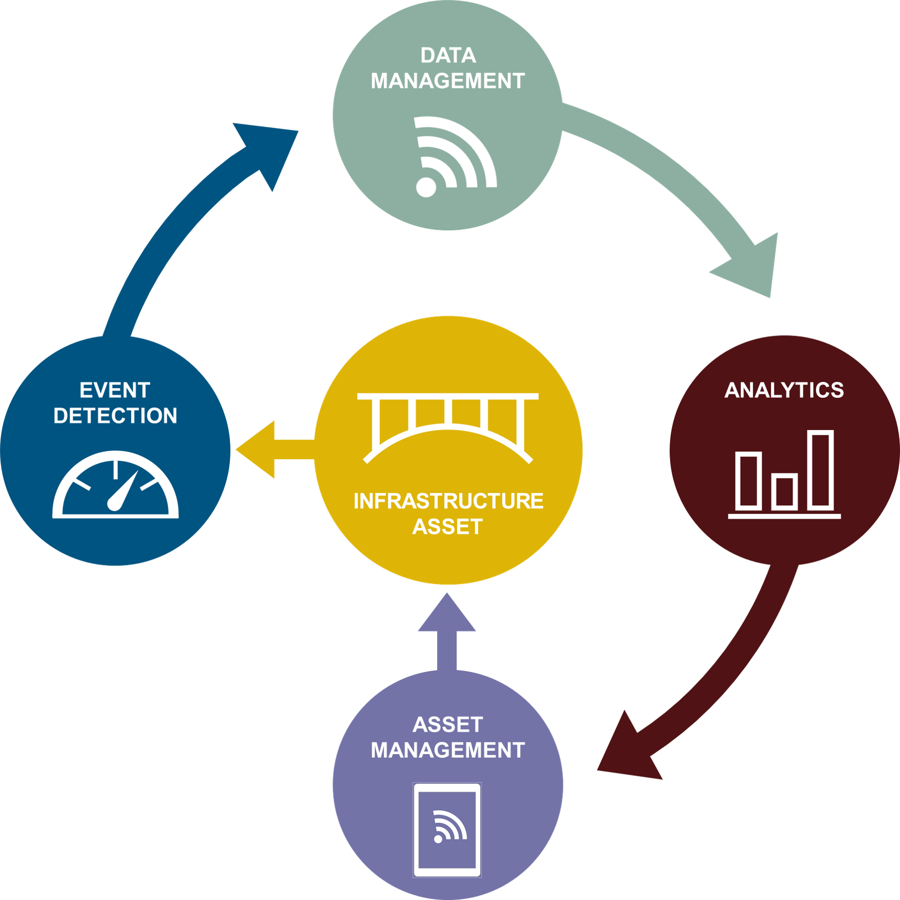
Technology Enhanced Infrastructure

Slide 14
TXST CIEDAR Mission
The study of technologies with application to the lifecycle monitoring of infrastructure assets.
Validation of existing technologies
Evaluation of emerging technologies
Development of new technologies
The multidisciplinary study of technologies with application to infrastructure.
project teams may include engineering (civil electrical, industrial, manufacturing, mechanical), physics, chemistry, geography, mathematics, computer science, business, design, biology, psychology, communications and many others.

Slide 15
TXST CIEDAR Key Benefits
Each lab is a R&D marketplace of solutions solving real life problems.
Our faculty and students deliver world-class solutions at a 50% less in labor cost. All Intellectual Property licensing have been pre-set at super affordable rates.
Buyers and Sellers get to work together quickly and efficiently to find practical and affordable answers to pressing challenges.
Deploying the solutions within TXST real state grounds and/or at any of the Cities and Utilities members.

Slide 16
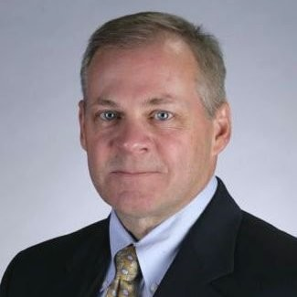
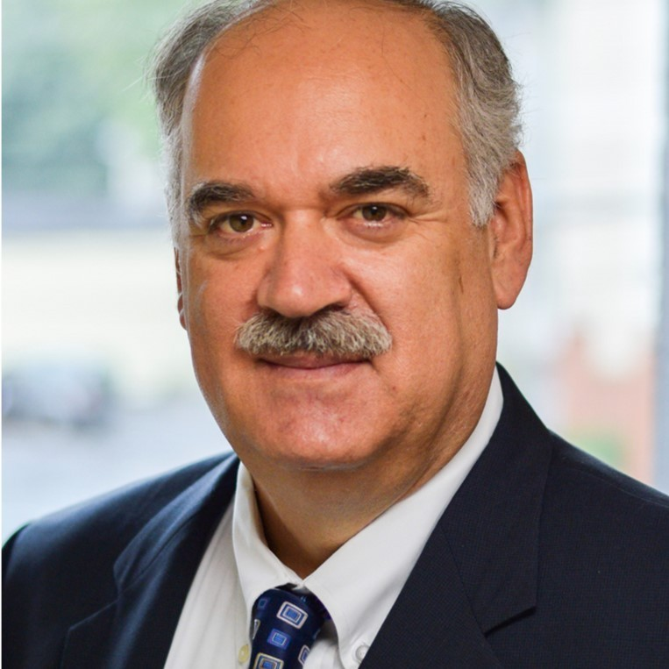
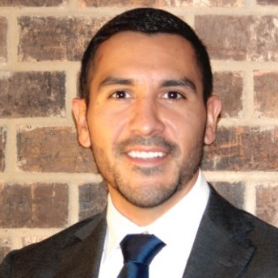
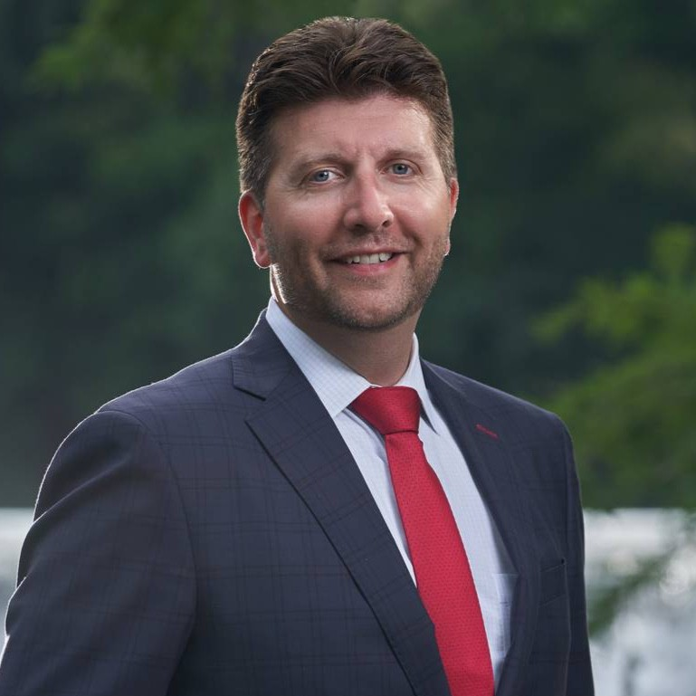
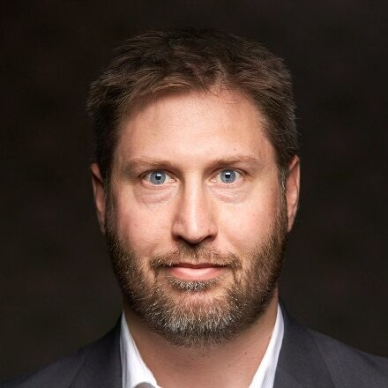
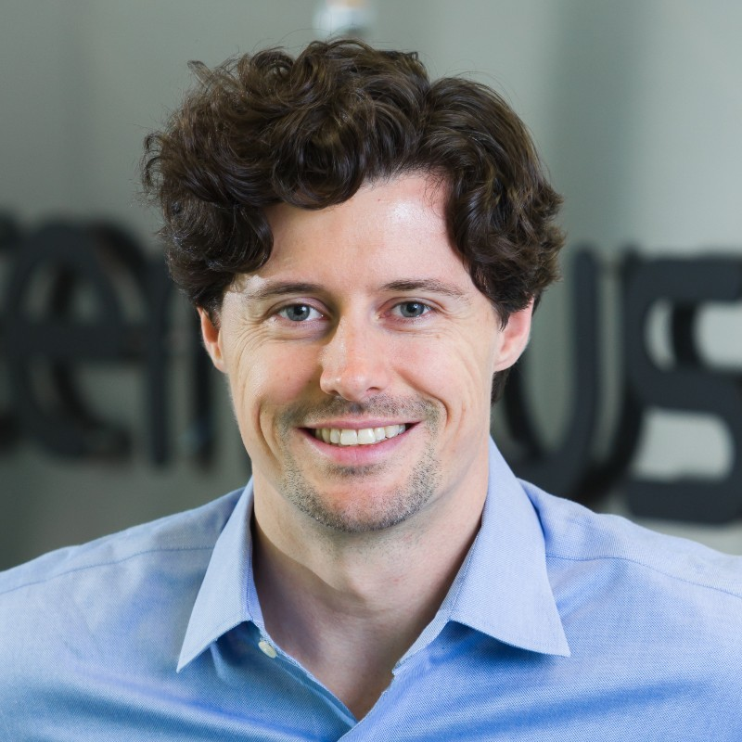
TXST CIEDAR Industry Advisory Board
Dave Anderson
President & CEO
Richard Soley Executive Director
Gabriel Reyna Managing Partner
Jason Giulietti
President
Greg Walker President & CEO
Curtis Rodgers Principal

Slide 17
TXST CIEDAR Members
Planning to onboard another 20 new members in the coming months. Cities, Utilities, Enterprises.

Slide 18
Digital 360 Summit 2019 Potential Member Relationships

Slide 19
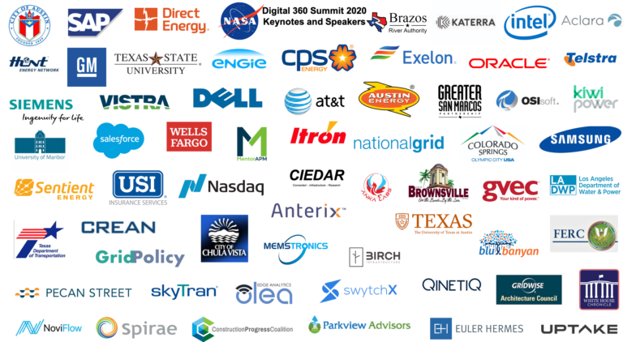
Digital 360 Summit 2020 Potential Member Relationships

Slide 20
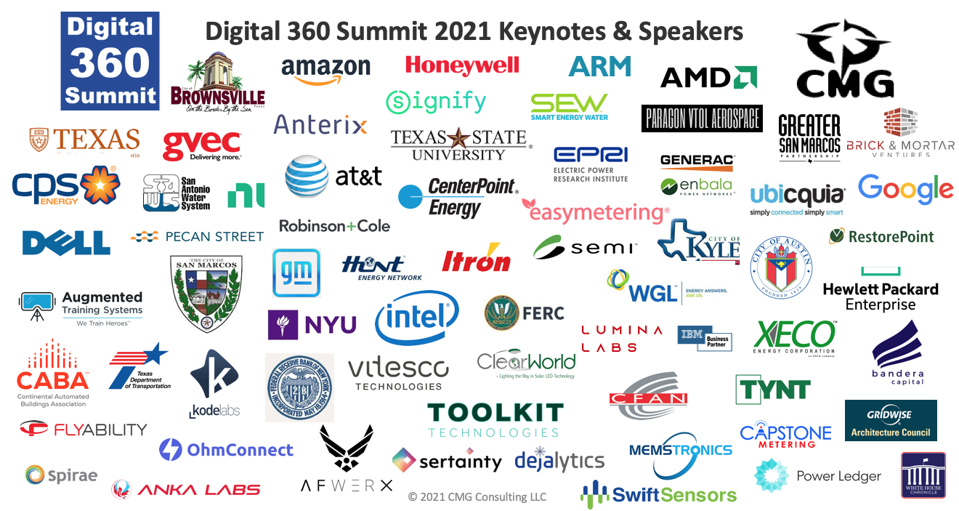
Digital 360 Summit 2021 Potential Member Relationships

Slide 21
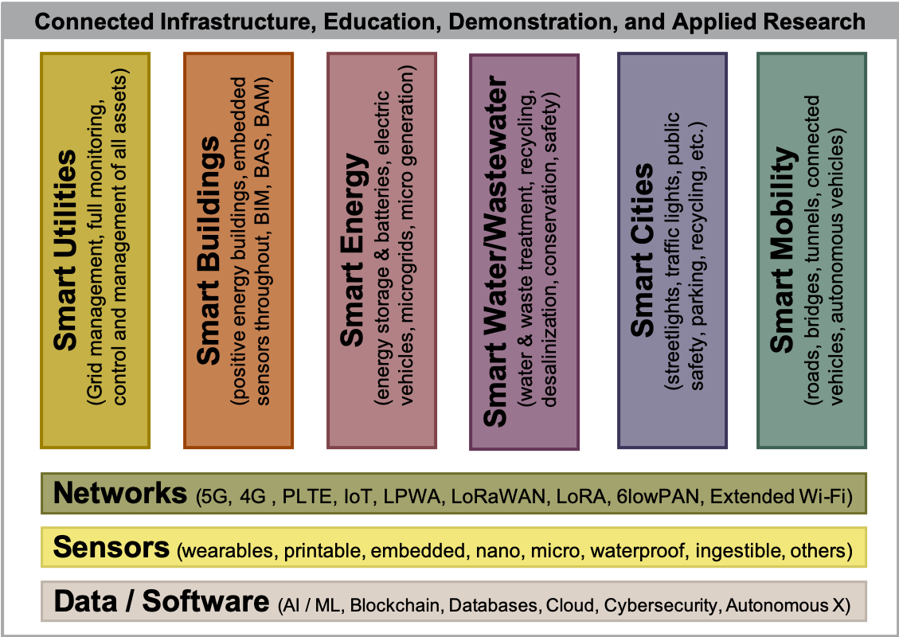
TXST CIEDAR Smart Living Labs
CIEDAR is exploring partnerships with industry to develop the following 9 smart living labs populated by its expert faculty and students:

Slide 22
TXST CIEDAR Key Projects
100-acre STAR Park for research partners to lease / build open
Smart Cities Lab - Smart LED / Solar Powered / Energy Storage Street Lights with 4G / 5G cells and Optical, Noise, Air, Humidity, Temperature, and Flood sensors by Q2 2022
NOC/SOC Training Lab at STAR One (173) by Dec 9, 2021
Smart Building & Infrastructure Lab ground break Aug 31, 2021 at STAR Park
127.5 MW and 510-acres Solar PV Farm testbed and Smart Energy Lab buildout by Q1 2023 at Freeman Center and Muller Ranch. Focus on solar PV, power electronics, fuel cells, energy storage, tracking systems, energy management, control systems, metering, and green hydrogen.
Stand up Smart Mobility Lab buildout by Q3 of 2022
100-acre smart mobility track testbed buildout by Q1 2023 at Muller Ranch
100 miles round trip CAV Shuttle System from RRTX <-> SMTX
Drone Power Line and tower Inspection testbed buildout by Q3 2022 at STAR Park
Drone Commercial Packages Delivery testbed buildout by Q3 2022 at STAR Park / SM Airport
Drone People Transport testbed buildout by Q3 2022 at STAR Park / SM Airport
Workforce Housing competition followed by testbed and Smart Homes Labs buildout by Q2 2022
1,000 square feet, 2 bedroom, 1 or 2 bath, net zero energy, net zero water, design and build cost at or less than $100 per square foot. 3 winners build at STAR Park models. Deploy region wide with local developers.
Digital Substation of the Future testbed and Smart Utilities Lab buildout by Q4 2023 at Muller Ranch.
Stand Up Smart Networks Lab by Aug 31, 2021 at STAR One. - DONE
Private LTE/5G 900 MHz licensed research network testbed buildout reaching all facilities
Wirepas 900 MHz unlicensed research network testbed buildout reaching all facilities
LoRAWAN 900 MHz / 2.4 GHz unlicensed research network testbed buildout reaching all facilities
Wi-SUN 900 MHz unlicensed research network testbed buildout reaching all facilities
CBRS 3.55 – 3.7 GHz research network testbed buildout reaching all facilities
10/100 Gbps fiber research network testbed buildout reaching all facilities
Smart public safety testbed + Smart XReality Lab by Q4 2022 at ALERRT Center

Slide 23
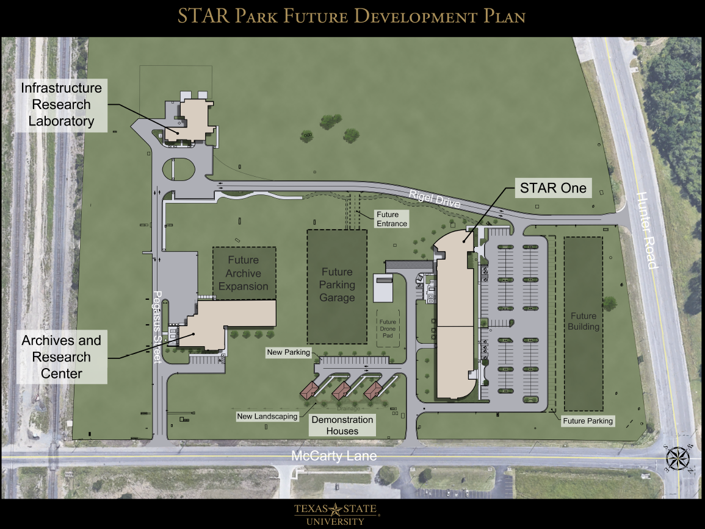
Smart Cities Lab

Slide 24
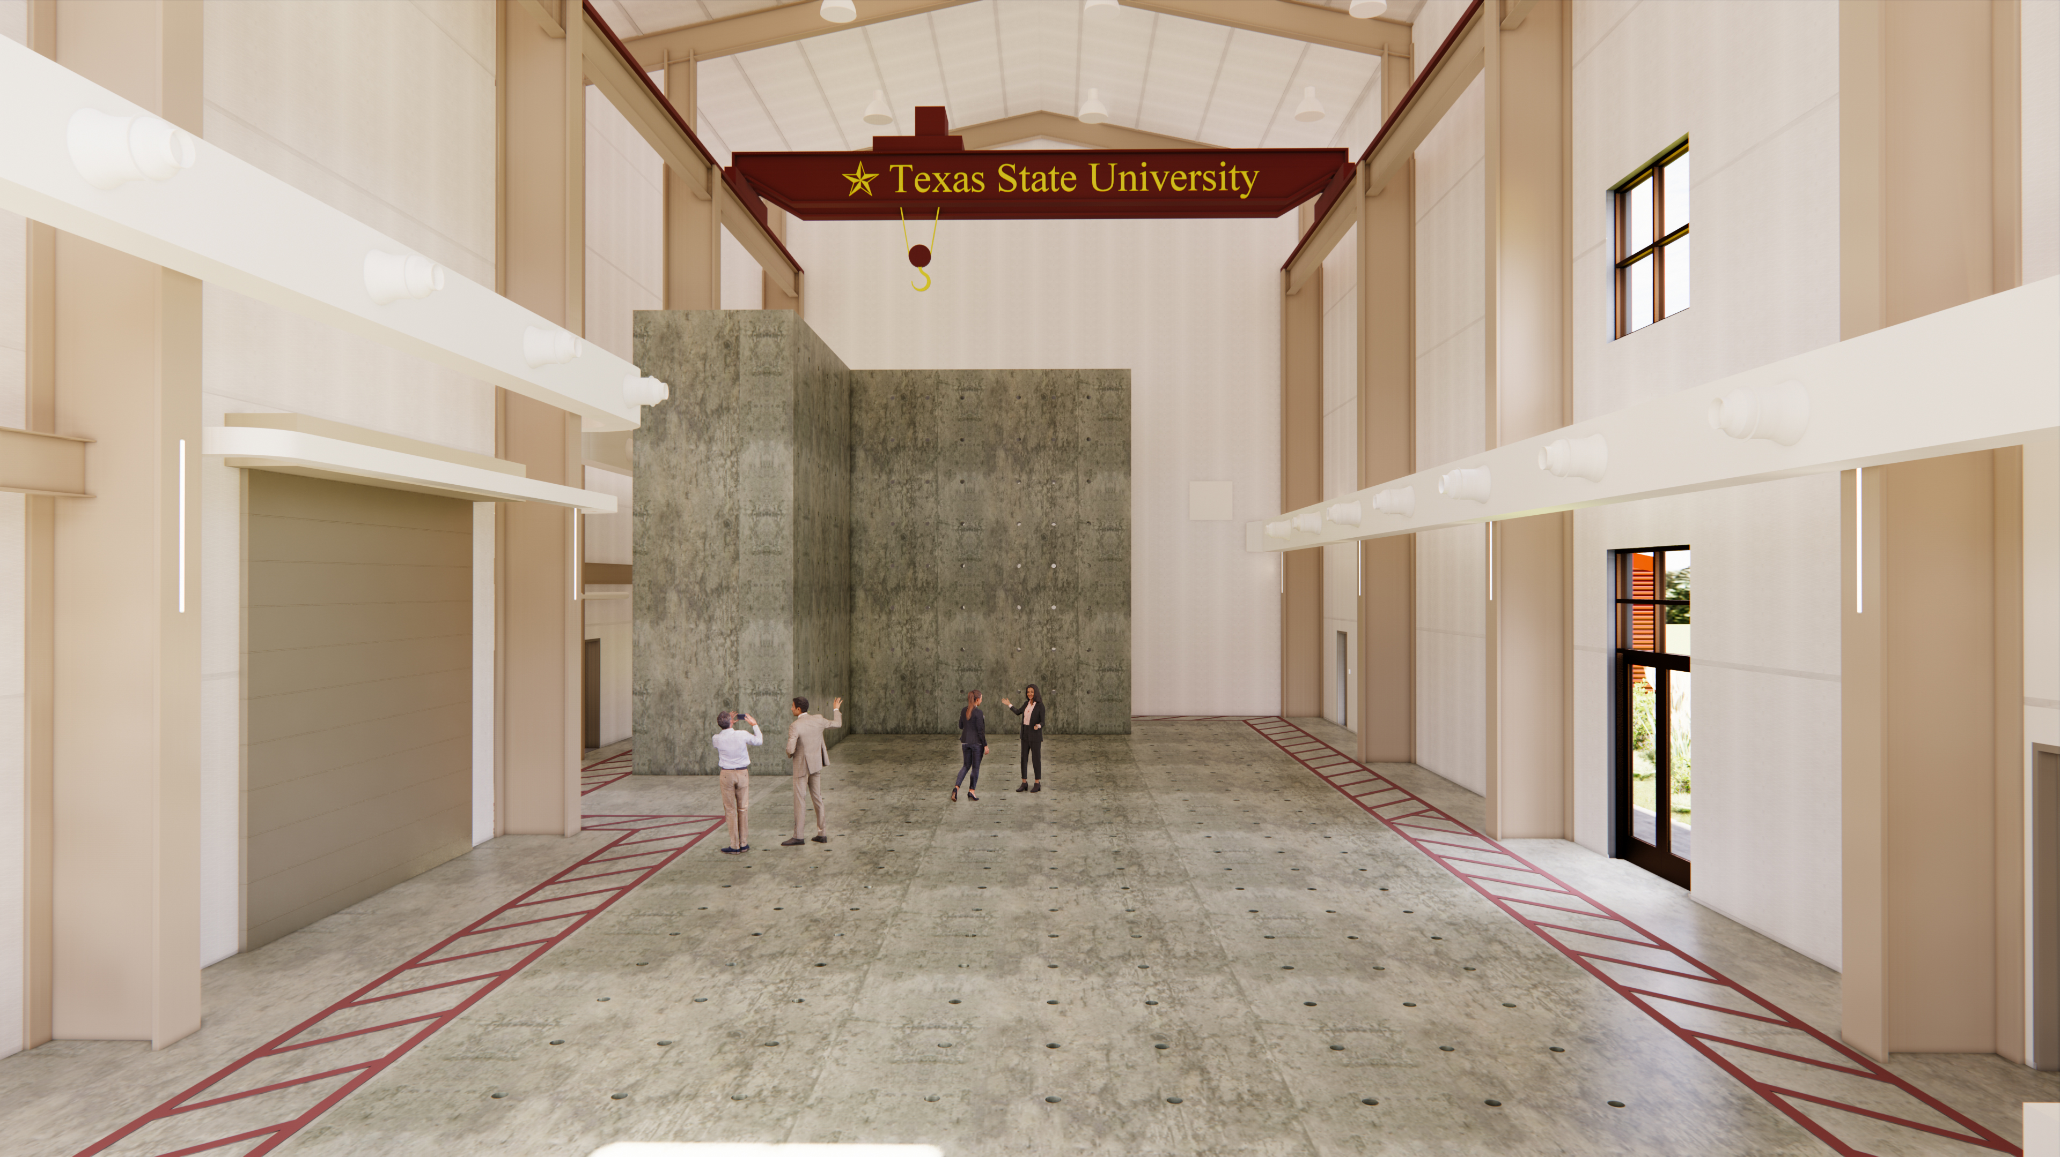
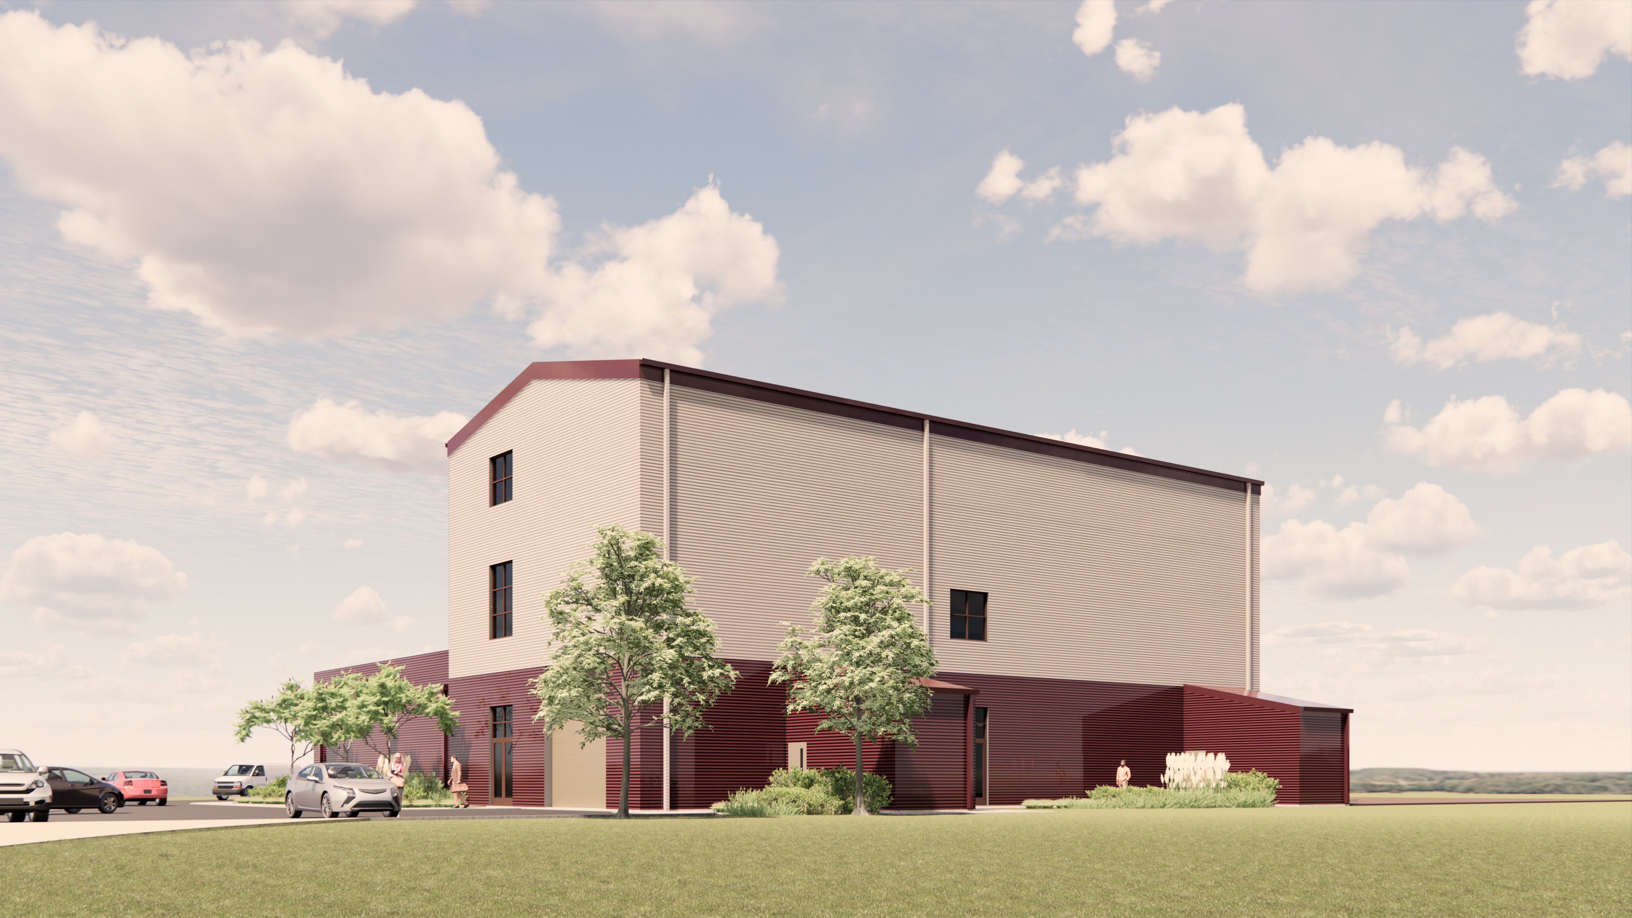
Smart Buildings & Infrastructure Lab

Slide 25
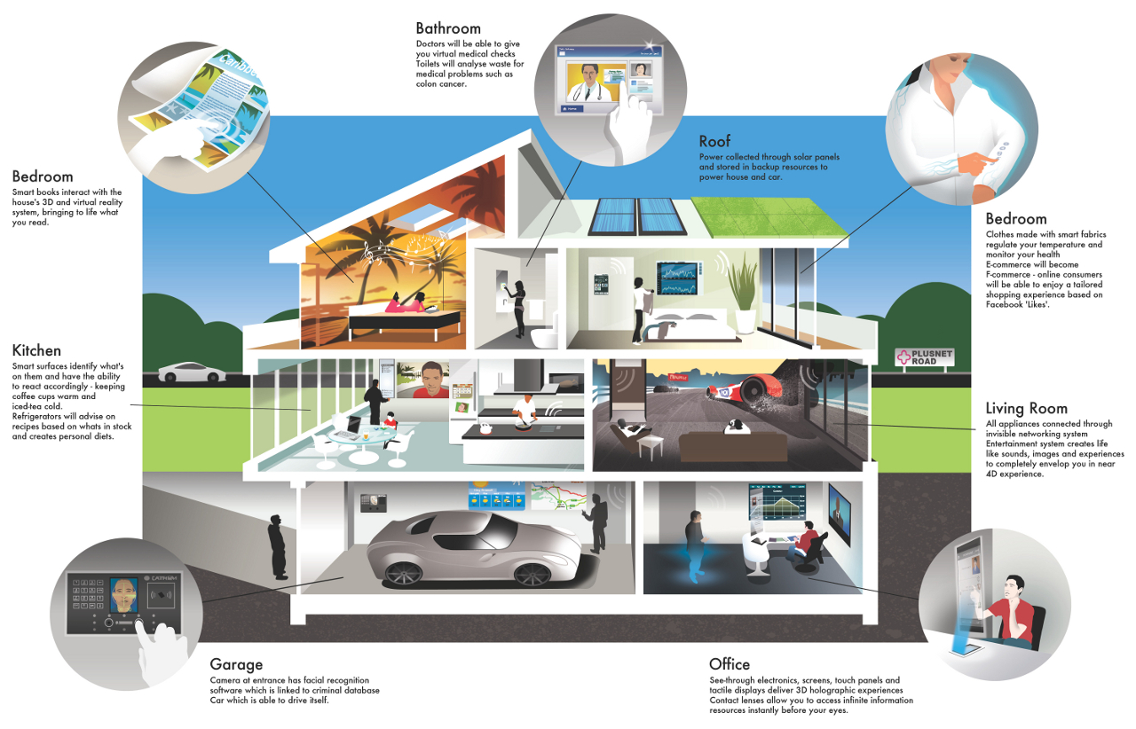
Smart Homes Lab
1,000 square feet, 2 bedroom, 1 or 2 bath, net zero energy, net zero water, design and build cost at or less than $100 per square foot. 3 winners build at STAR Park models. Deploy region wide with local developers.

Slide 26
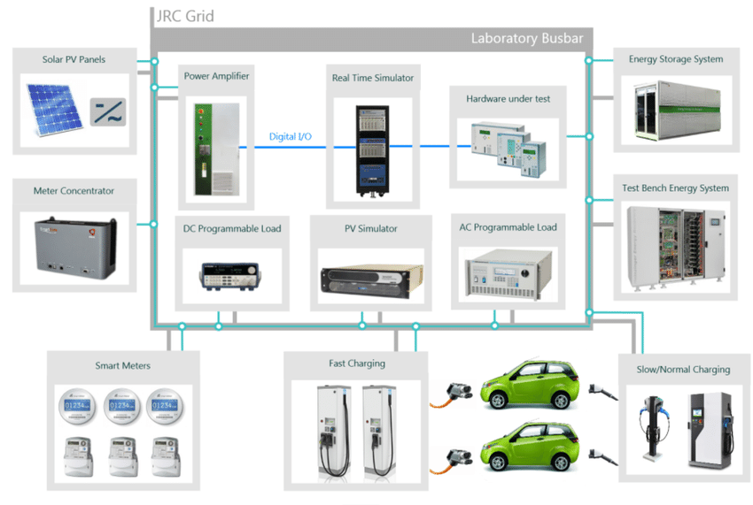
Smart Energy Lab
Solar PV, power electronics, fuel cells, energy storage, EV charging, tracking systems, energy management systems (CVR/VVO/DRMS/DERMS/VPP), control systems, metering, trading systems, blockchain, AI/ML/Analytics, and green hydrogen.

Slide 27
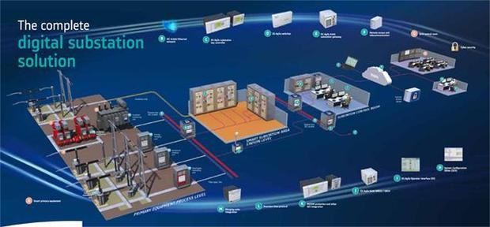
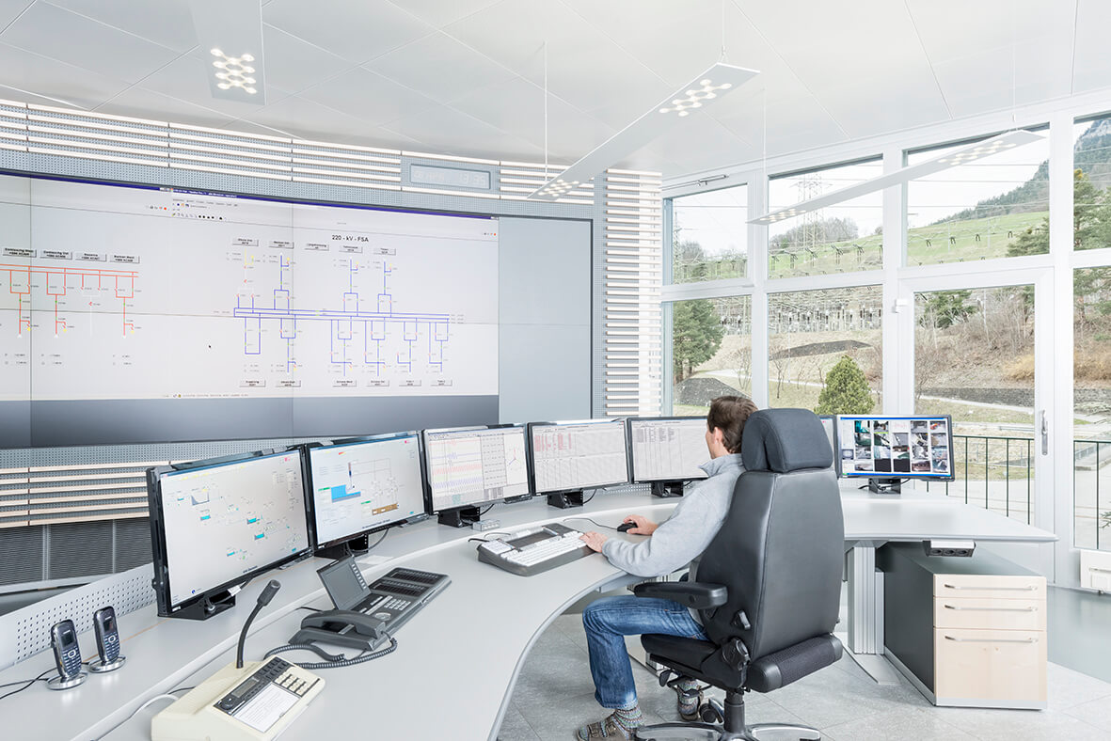
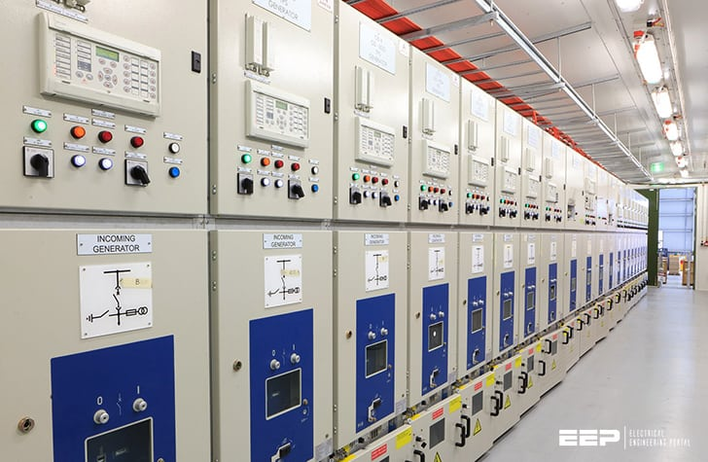
Smart Utilities Lab
Smart grid management (Sub/Transformers/Distribution-Wires, meters), energy management systems (V2G / CVR / VVO / DR / DER / VPP), control systems, energy storage, EV charging, metering, trading systems, blockchain, AI / ML / Analytics, communications networks, cybersecurity.

Slide 28
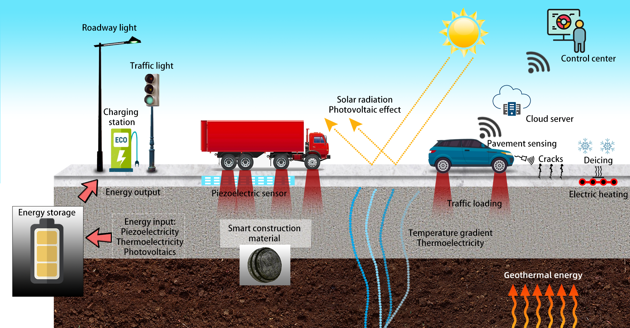
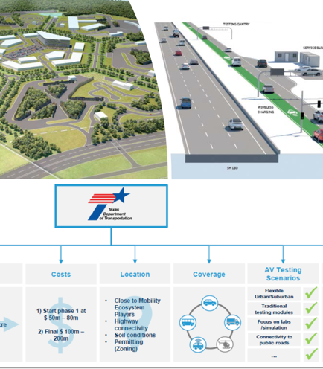
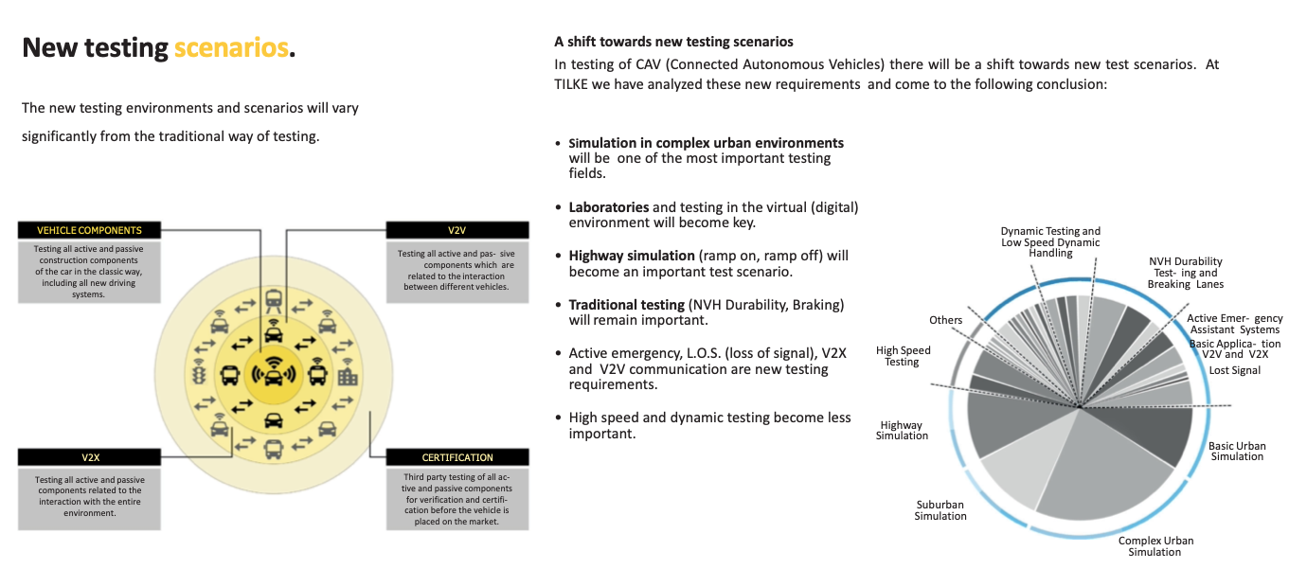
Smart CAV Lab

Slide 29
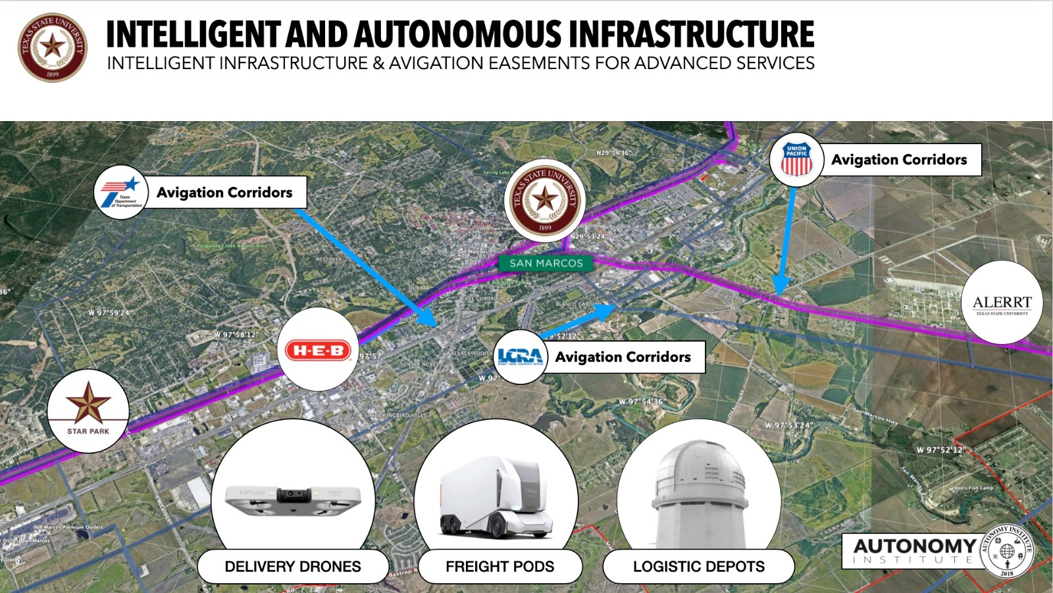
100 miles RR <-> SM CAV Lab

Slide 30
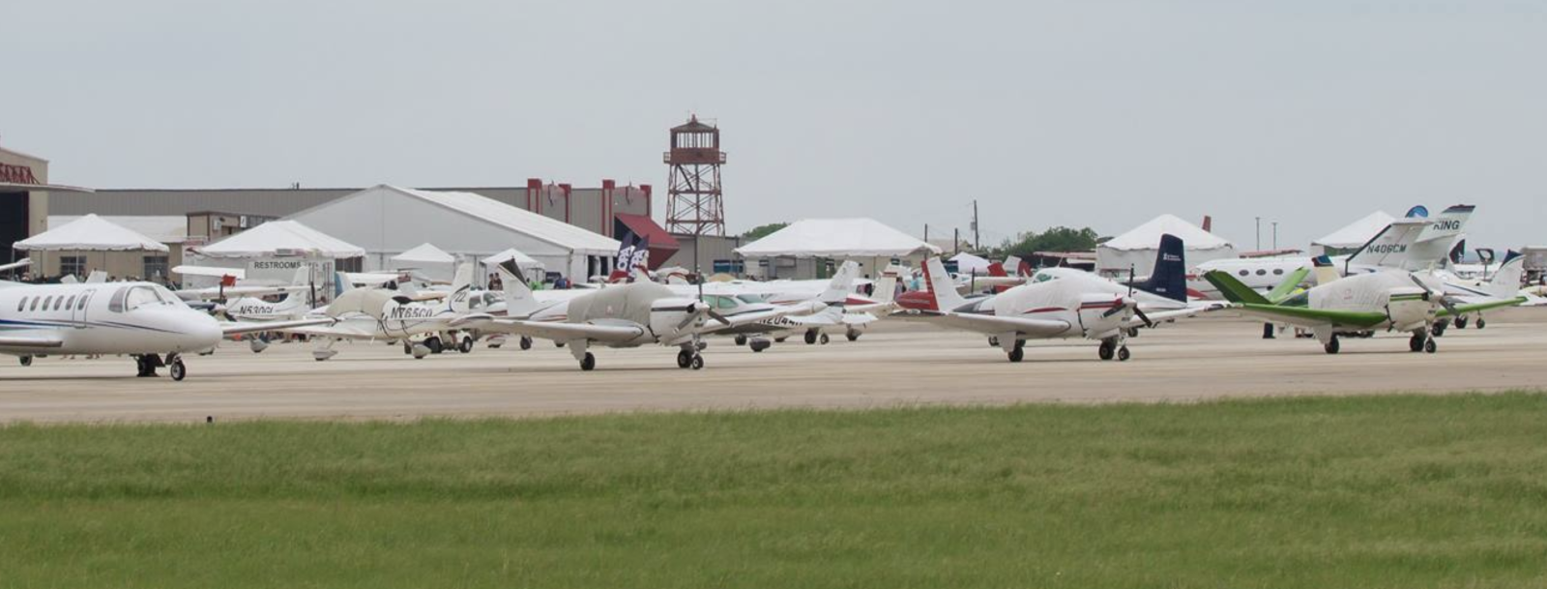
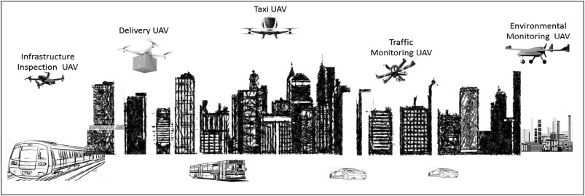
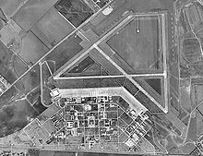
Smart DRONE/VTOL Lab
New runway and hangar materials, DRONE / VTOL pads and recharge microgrids, drones with sensors, solar PV and energy storage, LED lights and smart buildings.

Slide 31
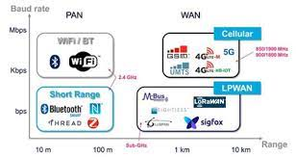
Smart Networks Lab
Private LTE/5G 900 MHz licensed research network testbed buildout reaching all facilities
Wirepas 900 MHz unlicensed research network testbed buildout reaching all facilities
LoRAWAN 900 MHz / 2.4 GHz unlicensed research network testbed buildout reaching all facilities
Wi-SUN 900 MHz unlicensed research network testbed buildout reaching all facilities
CBRS 3.55 – 3.7 GHz research network testbed buildout reaching all facilities
10/100 Gbps fiber research network testbed buildout reaching all facilities

Slide 32
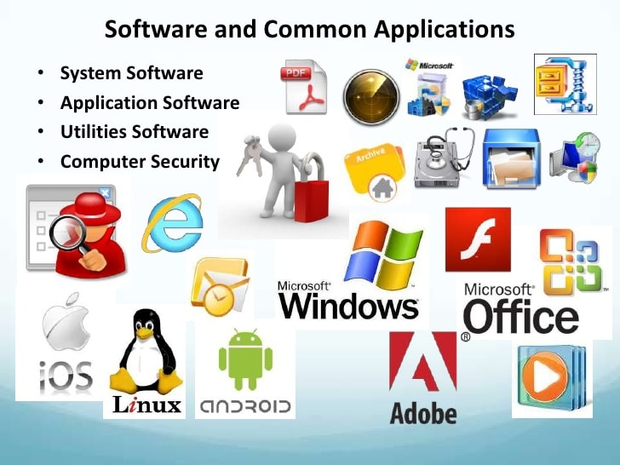
Big Data and Software Lab
AI/ML Blockchain Databases
Embedded Systems Cloud Computing Mobile Computing
Cybersecurity Autonomous Controls Voice Controls
UX platforms UI platforms Programming Languages
Social Media AR/VR/XR Digital Twins
GIS, Location Services Written Equations Visualization
Control Systems Energy Management Systems

Slide 33
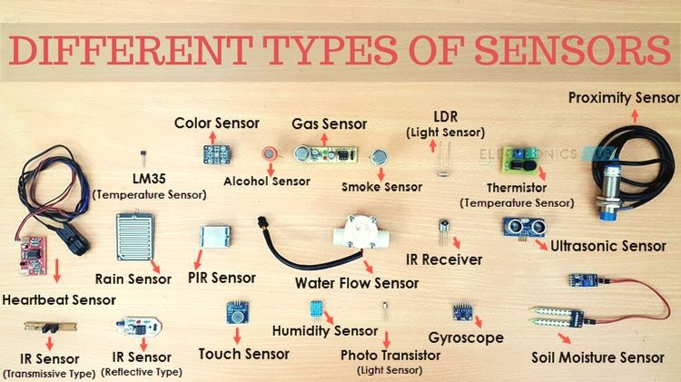
Smart Sensors Lab
Pressure Temperature Force
Vibration Motion Light
Ultrasonic Smoke Smell
Color Gas Alcohol
CO2 Fluid Altitude
Humidity Air Quality Wearables
Embedded Nano / Micro Gesture
Voice Water Proof Ingestible
Printable Location AI/ML

Slide 34
NOC/SOC Training Lab

Slide 35
Contacts
Andres Carvallo Co-Director, CIEDAR Professor of Innovation, College of Science and Engineering Fellow, Materials Applications Research Center
Phone: 512-968-8108 Email: andres.carvallo@txstate.edu
Stan McClellan Co-Director, CIEDAR Professor of Electrical and Computer Engineering Ingram School of Engineering
Phone: 512-245-4125 Email: stan.mcclellan@txstate.edu

Slide 36
THANK YOU!
Questions?

Slide 37
6. White Paper Sub-Committee Update Ken Wacks (Ken Wacks Associates)
6.1 Completed:
“Benefits of Advanced Lighting Systems on the human experience: Human Centric Lighting and Controls”
exp. US Services Inc. (Chair)
Ken Wacks Associates
Mecho-systems
Snap One LLC
© 2022, Continental Automated Buildings Association
Connected Home Council

Slide 38
6. White Paper Sub-Committee Update Ken Wacks (Ken Wacks Associates)
6.2 In Progress:
“Part 2: Power over Ethernet (PoE) & Digital Electricity (DE) in Commercial and Multiple Dwelling Residential Buildings”
Sinclair Digital Holdings (Chair)
Axis Lighting
Contemporary Controls Systems, Inc.
Ken Wacks Associates
LumenCache, Inc.
National Electrical Manufacturers Association (NEMA)
National Research Council Canada (NRC)
Public Services and Procurement Canada
Renesas Electronics America Inc.
Somfy Systems, Inc.
Southwire Company, LLC
Telecommunications Industry Association (TIA)
UL LLC
© 2022, Continental Automated Buildings Association
Connected Home Council

Slide 39
6. White Paper Sub-Committee Update Ken Wacks (Ken Wacks Associates)
6.2 In Progress:
“Connected Home Cybersecurity Regulations”
P.A.ID Strategies (Chair)
AgeLight LLC
BC Hydro
exp. US Services, Inc.
LonMark International
Mission Critical Global Alliance (MCGA)
National Research Council Canada (NRC)
Smart Buildings SuperCluster (SBSC)
Sustainable Resources Management Inc.
TwelveDot Inc.
UL LLC
© 2022, Continental Automated Buildings Association
Connected Home Council

Slide 40
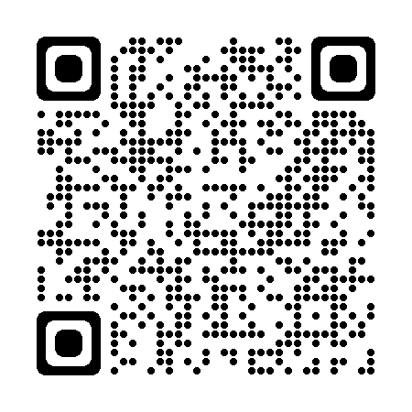
6. White Paper Sub-Committee Update Ken Wacks (Ken Wacks Associates)
All proposals and previously completed CHC White Papers can be downloaded at:
www.caba.org/whitepapers
40
© 2022, Continental Automated Buildings Association
Connected Home Council

Slide 41
7. New Business Eric Harper (Snap One)
7.1 Other new CHC business?
© 2022, Continental Automated Buildings Association
Connected Home Council

Slide 42
8. Announcements Byron BeMiller (Semtech Corporation)
8.1 Past Events Overview
CES 2022 - January 5-8, 2022 | Las Vegas, NV, USA
CONNECTIONS Summit at CES 2022 - January 5, 2022 | Las Vegas, NV, USA
© 2022, Continental Automated Buildings Association
Connected Home Council

Slide 43
8. Announcements Byron BeMiller (Semtech Corporation)
8.2 Upcoming Events
CEDIA EXPO
September 29 - October 1, 2022
Dallas, TX, USA
CONNECTIONS
May 17-19, 2022
Frisco, TX, USA
© 2022, Continental Automated Buildings Association
Connected Home Council

Slide 44
9. Adjournment Eric Harper (Snap One)
Next CHC Meeting: Tuesday, May 17, 2022
Continental Automated Buildings Association (CABA) caba@caba.org www.CABA.org
www.caba.org/chc
Connect to what’s next™
44
© 2022, Continental Automated Buildings Association
Connected Home Council

