Slide 1
Smart Building Management and the Rise of Predictive Maintenance
Harbor Research report commissioned by CABA
Conrad McCallum, CABA

Slide 2




About CABA
Vision: CABA advances the intelligent buildings
and connected home sector
Networking. Industry Presence. Research and Information
© 2021, Continental Automated Buildings Association

Slide 3












CABA Board of Directors
© 2021, Continental Automated Buildings Association

Slide 4
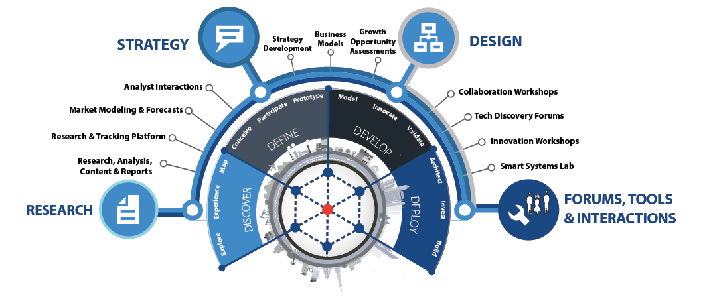
About Harbor Research
Strategy Consulting
Our strategy and business development consulting services deliver creative innovation tools, practical methods and applied problem solving.
Research and Content
Our research, tracking, and market intelligence services provide an accessible learning environment for those who are trying to wrap their arms and minds around emerging disruptive opportunities.
Smart Systems Lab
We are creating a real-world laboratory where organizations design, prototype, and test new models for delivering value and differentiation. The Lab’s mission is to enable business model, technology, and system-level innovation enabled by the Internet of Things.

Slide 5
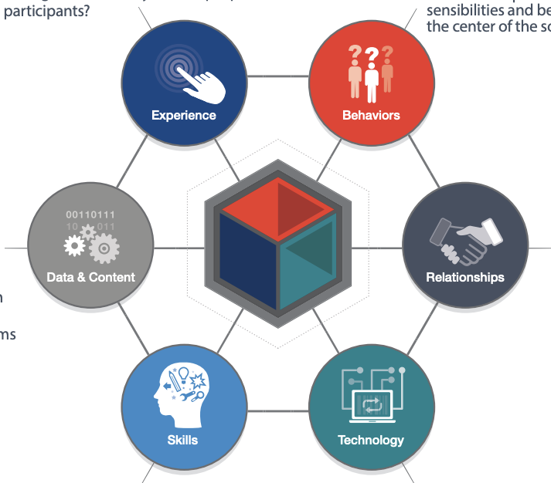
Proposed Research Questions and Topics
State & Evolution of the Market: Trends and Forces
Evolution of the Consumer and Supplier: Buying Behaviours and Trends
Evolution of the Opportunity: Future Considerations for Stakeholders
Competition
Notes:
Bueno Systems (bronze), Cushman & Wakefield (Bronze)

Slide 6
Trends & Forces Driving Predictive Maintenance in Buildings
Customer Demands
-decreased costs
-conditioning monitoring equipment
-ROI, process improvement?
Technology Evolution
-5G
-IoT + cloud
-integrating data sets
Competitor Positioning
-”comprehensive” PM a ways off
-startups and establish players
-business models from other sectors
Socioeconomic Aspects
-personnel hard to find
-standards/legislation
-the pandemic
Notes:
Bueno Systems (bronze), Cushman & Wakefield (Bronze)

Slide 7
Predictive Maintenance Provides Timeframe Estimates
Predictive:
ML-driven maintenance technique that leverages condition monitoring data to estimate when maintenance should be performed
Conditional:
Rules & Logic-based technique that alerts users when a condition measurement is outside its acceptable range
Preventative:
A strategy that relies on a consistent periodic maintenance of equipment and systems
Reactive:
Maintenance is only scheduled and conducted after system failure occurs
Notes:
Bueno Systems (bronze), Cushman & Wakefield (Bronze)

Slide 8
Conditioning Maintenance as a Base for Predictive Capabilities
Other Value-Added Application Services
Data Visualization / Interface
Diagnostics
Location & Tracking
Monitoring
Device Management & Connectivity
Cloud Infrastructure
Sensor and Communications Package, Data Gateway
Notes:
Bueno Systems (bronze), Cushman & Wakefield (Bronze)

Slide 9
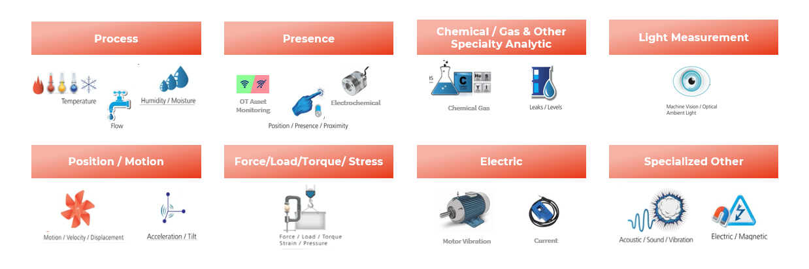
Condition Monitoring as a Base for Predictive Capabilities
Notes:
Bueno Systems (bronze), Cushman & Wakefield (Bronze)

Slide 10
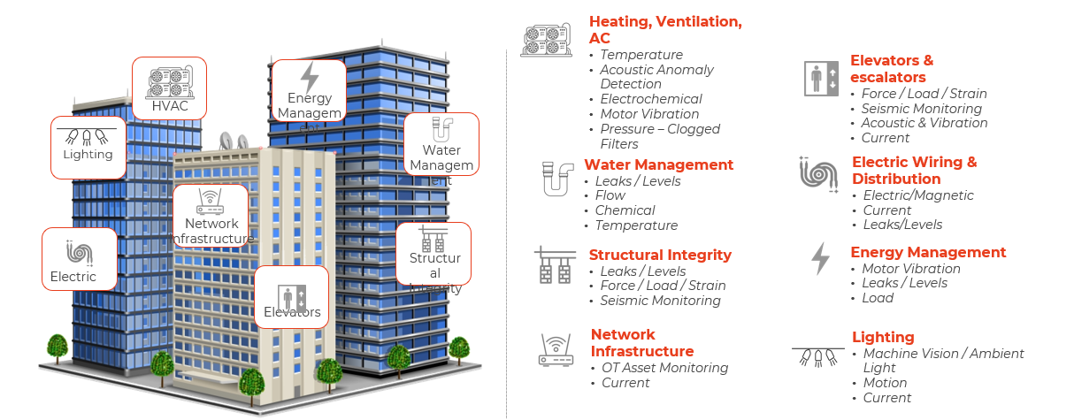
Conditioning Monitoring as a Base for Predictive Capabilities
Notes:
Bueno Systems (bronze), Cushman & Wakefield (Bronze)

Slide 11





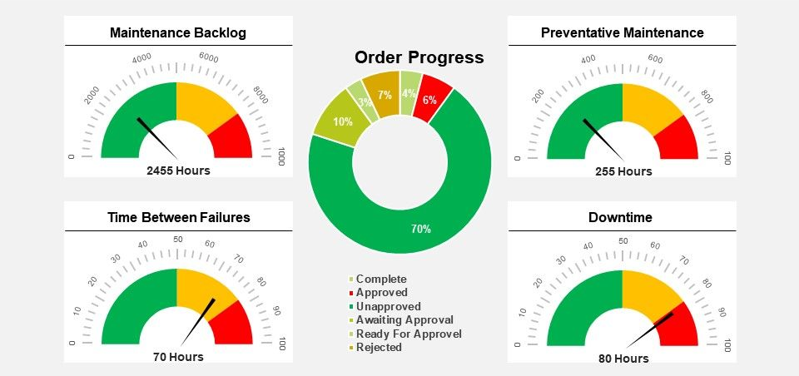

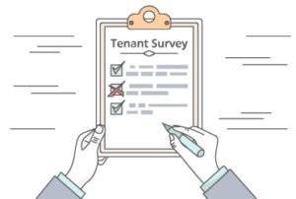


Predictive Maintenance Overview
Collect & Store Data
Develop & Deploy Model
Benefits
Data Processing & Unstructured Data Cleaning
Reduction in CAPEX
Sensors
Building
Management
Systems
Reduction in OPEX
Storage
Develop ,Train & Test Machine Learning Model
CMMS
Improved Visibility
System
Data
Deploy Machine Learning Model
OEM
Datasets
Reduced Downtime
External
Variables
Collect Feedback & Implement Model Improvements
Improved Predictability
Notes:
Bueno Systems (bronze), Cushman & Wakefield (Bronze)

Slide 12
AI is Progressing from Supervised to Unsupervised
Current technologies lead the market towards more complex machine learning
Classification
Regression
Convolutional Neural Networks
Recurrent Neural Networks
Deep Reinforcement Learning
1950—1980: Rules-Based Algorithms Emerge for Rudimentary Audio and Language Processing
1980—2000: Machine Learning Sets the Stage for Predictive Analytics
2000—2021: Deep Learning & Neural Networks Emerge
2021—?: The Unsupervised Future
Birth of Artificial Intelligence
Second Evolution of AI
Symbolic reasoning (Syntactic theories of language)
Regression and “business intelligence”
First Evolution of AI
Third Evolution of AI
Reasoning and classification
Deep reinforcement learning

Slide 13
AI is Progressing from Supervised to Unsupervised
The Evolution of Artificial Intelligence Applications in Intelligent Buildings
Complex Apps
Process & System Integration
Automated & Unsupervised Analytics
Deep Reinforcement Learning
Outputs are unknown; high workload requirements
Recurrent Neural Networks
Predictive Analytics
Convolutional Neural Networks
Compound Apps
Aggregation of Things
Technical Complexity
Reactive Analytics
Regression
Simple Apps
Thing
Outputs are known; low workload requirements
Classification
Simple Rules Engines
Usefulness of Analytics
Notes:
Bueno Systems (bronze), Cushman & Wakefield (Bronze)

Slide 14
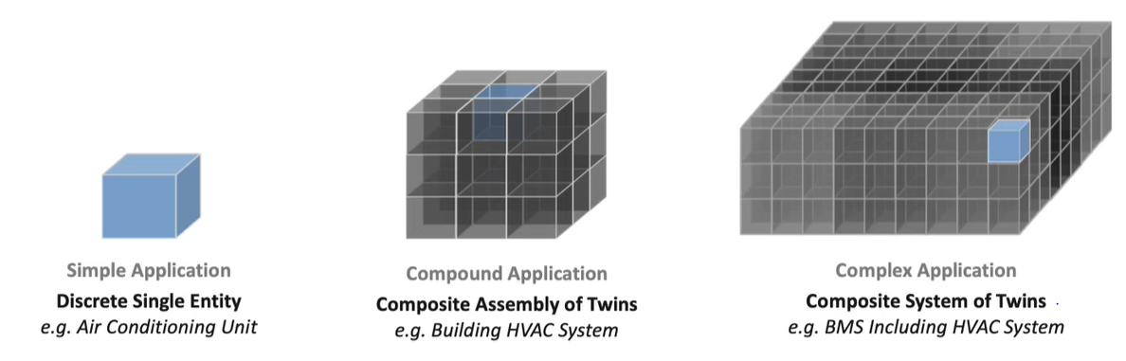
Simple, Compound & Complex Digital Twins
Notes:
Bueno Systems (bronze), Cushman & Wakefield (Bronze)

Slide 15
Various Building Models Shaping the Buildings Segment
Fully Outsourced Remote Monitoring
Single-System Focus
Part of a Larger Building Management System
BMS Agnostic Solution
Low-Code Model Development
Notes:
Bueno Systems (bronze), Cushman & Wakefield (Bronze)

Slide 16

Top Hurdles to Overcome with Prospective Building Clients
Fear Over Loss of Employment
Communication in ROI Terms
Integration Difficulties
Notes:
Bueno Systems (bronze), Cushman & Wakefield (Bronze)

Slide 17
Critical Ecosystem & Partnership-Related Hurdles
Classic Remote Service and Aftermarket Support
Multi-Vendor Systems & Services Interactions
Open Systems & Data Interoperability
Shared Risk and Outcome-based
Notes:
Bueno Systems (bronze), Cushman & Wakefield (Bronze)

Slide 18










Top Takeaways
Safety and compliance
Maintenance “guarantees”
Willingness to pay
Protocols and standards
Misgivings about AI
Communicating ROI
Wireless Technical Support
Comms / Sensing Package
Cloud Services
Design & Engineering
Comms Hardware
Sensor Hardware
WIFI / Bluetooth / LTE
Advanced Predictive Diagnostics & Root Cause Analysis
Remote Expert Support and Advanced Analytics
WIFI
Bluetooth
LTE
(Sensors vary based on equipment)
Basic Machine Data Visualization
Other Components
Secure Remote Access & Control
Battery
LED Indicators
Serial, USB, Ethernet Ports (Optional)
Hardware & Software Design Services
Sensing / Comms Package
(Embedded or Aftermarket)
Data
Gateway
Software
Backend
Machine Learning Algorithm
Predictive Maintenance Software

Slide 19




























The Current Ecosystem – AI and PM
Professional Service-Driven Analytics
Robust
Data Integration, App Dev & Data Management
Platforms
Equipment OEM Data & Analytics Solutions
App Development Tools/Platforms
Data Management & Applications Development
BI/Data Visualization Tools
Cloud & Infrastructure
Providers
Analytics
Tools
Simple
Custom
Configured
Packaged
Solution Delivery
Notes:
Bueno Systems (bronze), Cushman & Wakefield (Bronze)

Slide 20
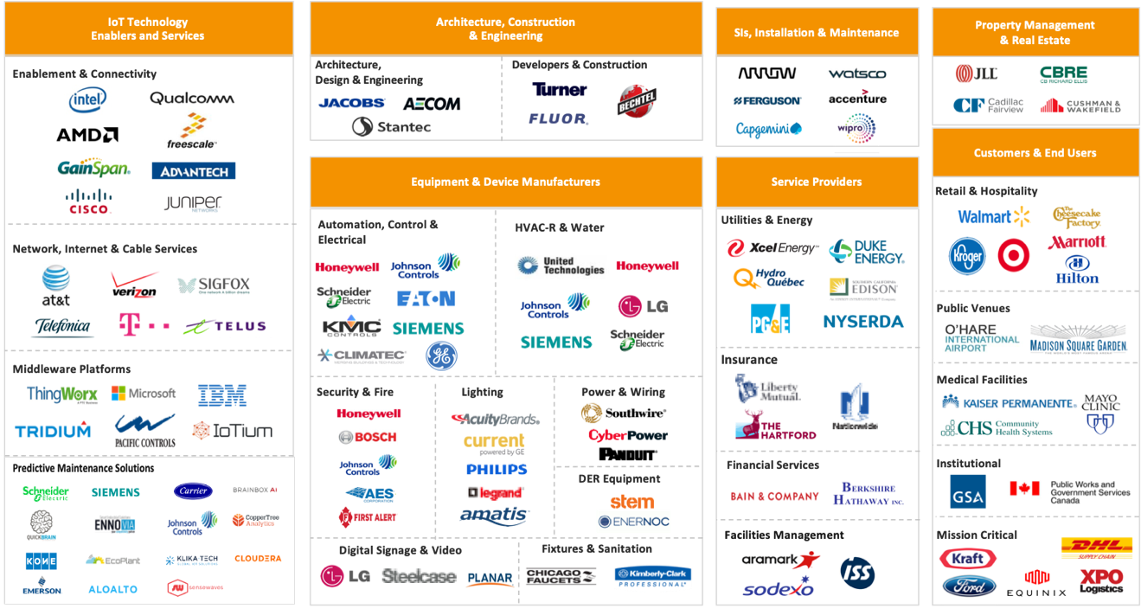




The Current Ecosystem – Building Automation
Notes:
Bueno Systems (bronze), Cushman & Wakefield (Bronze)

Slide 21
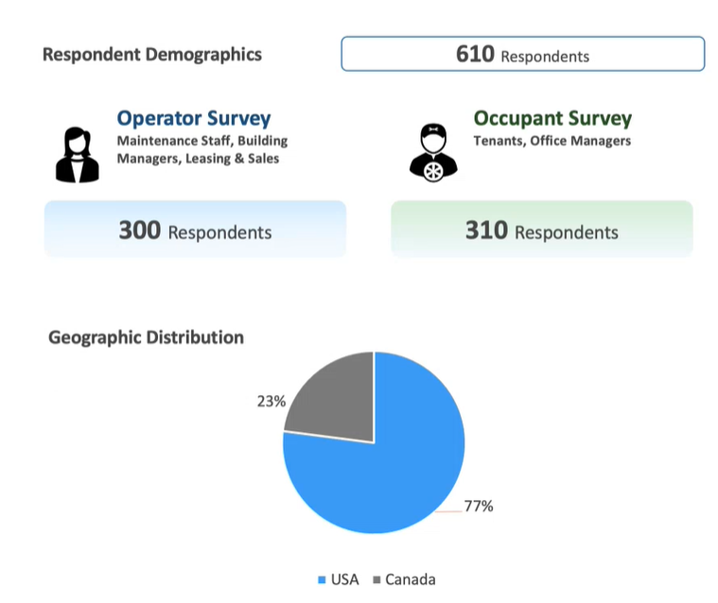
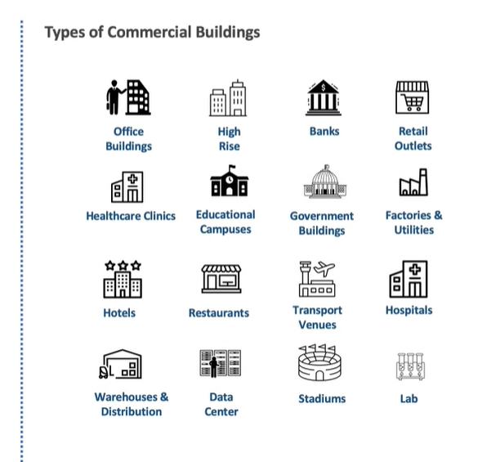
Survey Results – Final Respondent Demographics
Notes:
Bueno Systems (bronze), Cushman & Wakefield (Bronze)

Slide 22
Primary Research – Final Interview Participants
Experts
Anka Labs
Accenture Connected Buildings Lead
Asset & Maintenance Insights
CEDIA
Central Lille
Suppliers/Operators
Clockworks Analytics
CopperTree Analytics
Dewberry
EcoEnergy Insighjts
Facilio
Falkonry
Infor
Lutra
Silicon Labs
Stantec
Tolin Mechanical
Notes:
Bueno Systems (bronze), Cushman & Wakefield (Bronze)

Slide 23
Research Design – Key Pillars
Develop and Deploy a Market Survey Across the Identified Market Segments to Understand Buying Behaviours and Preferences
Conduct In-Depth Expert Interview with Market Participants to Understand the Evolution of Payment Preferences and Solution Delivery Opportunities
Validation of Results and Solidifying the Balance of Coverage Across the Identified Segments
Conduct an Analysis Associated with Technology, Customer, Competitive Forces Impacting the Evolution of Service Delivery
Notes:
Bueno Systems (bronze), Cushman & Wakefield (Bronze)

Slide 24
Research Design – Distribution of Buildings Types
Notes:
Bueno Systems (bronze), Cushman & Wakefield (Bronze)

Slide 25

Funder Acknowledgements
Notes:
Bueno Systems (bronze), Cushman & Wakefield (Bronze)

