Slide 1
Intelligent Buildings Council (IBC) Webinar Tuesday, December 7, 2021, 12 NOON – 1:30 PM (ET)
Chair: Brian Ensign (Superior Essex Communications)
Vice-Chair: Harsha Chandrashekar (Honeywell International Inc)
Vice-Chair: Robert Lane (Robert H. Lane and Associates Inc.)
Vice-Chair: Bob Allan (The Siemon Company)

Slide 2
1. Agenda Greg Walker (CABA)
Agenda
Call to Order, Welcome, Introductions, About IBC
Administrative
Research Update
Keynote: “Reducing Smart Building Complexity with a Smarter Stack” (30 min)
Anto Budiardjo (Padi, Inc.) & Tracy Markie (Engenuity Systems, Inc.)
Members of Monday Live!
6. White Paper Sub-Committee Update
7. New Business
8. Announcements
9. Adjournment

Slide 3
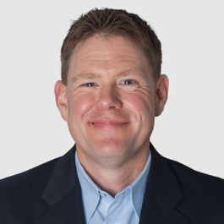
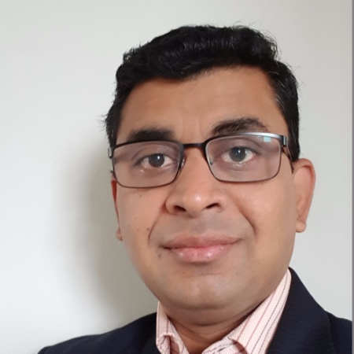
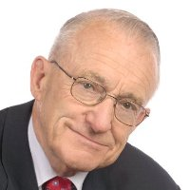
2. Call to Order, Welcome, Introductions, About the IBC Brian Ensign (Superior Essex Communications)
IBC Chair
Brian Ensign
Vice President, Marketing
Superior Essex Communications
IBC Vice-Chair
Harsha Chandrashekar
Product Approvals & Regulatory Leader
Honeywell International Inc
IBC Vice-Chair
Robert Lane
President & Managing Partner
Robert H. Lane and Associates Inc.
IBC Vice-Chair
Bob Allan
Global Business Development Manager, Intelligent Buildings
The Siemon Company
The CABA Intelligent Buildings Council works to strengthen the large building automation industry through innovative technology-driven research projects. The Council was established in 2001 by CABA to specifically review opportunities, take strategic action and monitor initiatives that relate to integrated systems and automation in the large building sector. The Council's projects promote the next generation of intelligent building technologies and incorporates a holistic approach that optimizes building performance and savings. www.caba.org/ibc

Slide 4
3. Administrative Brian Ensign (Superior Essex Communications)
3.1 Motion to approve past IBC Minutes October 12, 2021: www.caba.org/ibc

Slide 5
4. Research Update Greg Walker (CABA)
4.1 2021 IBC Landmark Research “AI and Predictive Maintenance in Intelligent Buildings”

Slide 6
4. Research Update Greg Walker (CABA)
4.2 Annual “BACS Market Sizing North America”

Slide 7
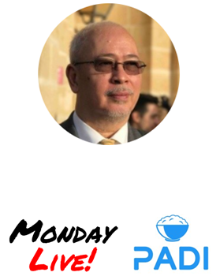
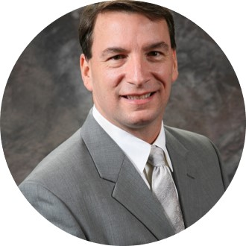
5. Keynote Harsha Chandrashekar (Honeywell International, Inc.)
“Reducing Smart Building Complexity with a Smarter Stack” (30 min)
Anto Budiardjo,
CEO, Padi, Inc.
Member of Monday Live!
Tracy Markie,
CEO/Founder, Engenuity Systems, Inc.
Member of Monday Live!

Slide 8
The Smarter Stack
Simplifying the complex landscape of Smarter Buildings
Learn About the Smarter Stack
See Examples
Get the Smarter Stack Template
Version 0.2
Join the conversation on Monday Live! Every Monday ay 3pm ET Register at mondaylive.org

Slide 9
The Smarts to Make Buildings Better
Users | All who occupy, operate, own, or otherwise consume the building
Smarts | The technology and services to make the building smarter.
Building | The building and its control and automation systems.

Slide 10
A Stack of Needs
Users |  | All those who occupy, operate, own, or otherwise consume the building. | Needs buildings to be operated to be safe, healthy and productive environments.
Smarts | Apps | The applications designed to make buildings smart. | Needs to deliver apps to users and access data about the building.
 | Data | The data about the building regardless where it is located. | Need to securely gather, store and make available for applications and users.
Building |  | The building and its control and automation systems. | Needs to be available 24/7.
Operations
Delivery
Exchange
Systems

Slide 11
Making the Smarts Smarter
Delivery | The delivery of smarts to the operations and other users
Apps | The smart digital applications designed to improve the building
Exchange | The exchange, integration & matching of apps, data, & services
Data | Storage, normalization, governance & management of data
Purpose The outcomes desired by owners, managers and occupants Operations The operations to manage the building on a daily basis
Purpose
The outcomes desired by owners, managers and occupants
Users
Operations
The operations to manage the building on a daily basis
Smarts
Systems The automation/control & devices to operate the building Physical The steel, concrete and equipment that makes the building
Systems
The automation/control & devices to operate the building
Building
Physical
The steel, concrete and equipment that makes the building

Slide 12
The Smarter Stack
Purpose
The outcomes desired by owners, managers and occupants
Why is this being done?
Operation
The operations to manage the building on a daily basis
How it is operated daily
Delivery
The delivery of smarts to the operations and other users
How the smarts is delivered
The smart digital applications designed to improve the building
Smarts
Apps
What makes it smart
The exchange, integration & matching of apps, data, & services
Exchange
What makes it work together
Data
The storage, normalization, governance & management of data
What makes it valuable
Systems
The automation/control & devices to operate the building
What makes it work 24/7
Physical
The steel, concrete and equipment that makes the building
What is being made smarter

Slide 13
The "Simon Sinek" View
Purpose
Why
Why is this being done?
Operation
How it is operated daily
How
Delivery
How the smarts is delivered
Smarts
Apps
What makes it smart
Exchange
What makes it work together
What
Data
What makes it valuable
Systems
What makes it work 24/7
Physical
What is being made smarter

Slide 14
A Tool Used As a Backdrop to Show Positioning
Purpose
Why is this being done?
Operation
How it is operated daily
Delivery
How the smarts is delivered
Smarts
Apps
Product X
What makes it smart
Exchange
What makes it work together
Data
Technology Y
What makes it valuable
Systems
What makes it work 24/7
Physical
What is being made smarter

Slide 15
Example Use: Traditional vs. Smarter Model
Purpose
Owner's Needs
Occupant App
Why is this being done?
In House
Operation
Facility Mgmt
Digital Twin
How it is operated daily
Delivery
Vertically Integrated BAS
Offering
SI/MSI/MSP
SPOG
How the smarts is delivered
Smarts
Apps
Analytics
IAQ
What makes it smart
Exchange
OpenADR
Middleware
What makes it work together
Data
Cloud
On-Prem
What makes it valuable
Systems
HVAC
Security, etc.
What makes it work 24/7
Physical
123 Main St
What is being made smarter

Slide 16
Some Examples of Uses...
CAVEAT: The following are subjective and not scientific!

Slide 17
Sample Business Categories
Purpose
Profit
Happy Students
Tennant Exp
Wellness
Safety
Why is this being done?
Operation
Facility Mgmt
Property Mgmt
Energy Mgmt
Maintenance
Janitorial
How it is operated daily
Delivery
Srv Providers
SPOG
MSI & MSP
Consultants
How the smarts is delivered
Smarts
Apps
Analytics
Energy Mgmt
AI/ML
FM & IWMS
Applications
What makes it smart
Vertically Integrated BAS/BMS
Providers
Exchange
Gateways
Middleware
Semantic Tagging
Integration
What makes it work together
Data
Cloud
Cybersecurity
Weather
Data Warehouse
What makes it valuable
Systems
Control Systems
Physical Security
IoT/BAS
Lighting Systems
What makes it work 24/7
Physical
Schools
Retail
Pharma
Elevators
Airports
What is being made smarter

Slide 18
On Connectivity & Communications
Purpose
Bandwidth Latency Reliability WiFi 5G Satelites
Economics
Availability
Why is this being done?
Operation
QR Codes
Humans
How it is operated daily
Delivery
Websites
Mobile
Digital Twin
VR & AR
Kiosks & Digital Signs
How the smarts is delivered
Smarts
Apps
Firewalls
SDN
Management Consoles
Monitoring
SIEM/SASE
What makes it smart
Exchange
Gateways
Middleware
Brokers
Protocol Converters
Internet
What makes it work together
Data
APIs
Data Security
Servers
Syslogs
Databases
What makes it valuable
Systems
Hub/Switch
VPN Devices
NAT
Routers
POTS
What makes it work 24/7
Physical
Antenas
Cat 5
Cable (TV)
Twisted Pair
Conduit
What is being made smarter

Slide 19
On Cybersecurity
Purpose
Defense in Depth
CIA/AIC Triad
Zero Trust
Security Policies
Nominal Operation
Why is this being done?
Operation
2FA/MFA
LDAP/SAML
Islanding
Penetration Testing
IAM
(Users/Devices)
Asset Mgmt Back/Restore
How it is operated daily
Delivery
SSO
Patches & SW Updates
Scorecards & Security Reports
How the smarts is delivered
Smarts
Apps
Next Gen Firewalls
SIEM/SASE
Management Consoles
Threat Intelligence
What makes it smart
Exchange
Firewalls
Data Diode
& Air Gap
Security Certificates
Trust Vectors
What makes it work together
Data
API Keys
Encryption
Syslogs
Backups
What makes it valuable
Systems
VPN/VLAN
TLS Encryption
Secure Config
Obscurity
What makes it work 24/7
Physical
Physical Access
Hardware
Conduit
Security Key
Protection
What is being made smarter

Slide 20
Use Case: High School Requirements
Purpose
 | Why is this being done? |  |  | Scheduling |  | Comfort |  | Social |  | Critical Safety
 | How it is operated daily |  |  | School Dashboard |  | HVAC Engineer |  | CCTV Monitoring |  | Energy Dashboard |  | Trouble Tickets
Smarts |  | How the smarts is delivered What makes it smart What makes it work together What makes it valuable |  | MSP |  | Local HVAC |  | Console
 |  |  |  | DER |  | WELL |  | FDD |  | IAQ |  | EMS
 |  |  |  | Configurator |  | Integration |  | DER Agg
 |  |  |  | Cloud |  | Weather |  | Video Storage
 | What makes it work 24/7 What is being made smarter |  |  | HVAC |  | Access |  | Lighting |  | Fire System
 |  |  |  | Elevators |  | 123 Main |  | Sport Stadium
Why is this being done?
Operation
How it is operated daily
Delivery
How the smarts is delivered
Smarts
Apps
What makes it smart
Exchange
What makes it work together
Data
What makes it valuable
Systems
What makes it work 24/7
Physical
What is being made smarter

Slide 21
Perspectives
Purpose
Consumer
Purpose
Building Owner
Why is this being done?
Why is this being done?
Operation
Operation
FM
How it is operated daily
How it is operated daily
Delivery
Delivery
Integrator
SPOG
How the smarts is delivered
How the smarts is delivered
Apps
Smarts
Apps
Smarts
What makes it smart
App
What makes it smart
Exchange
Exchange
Dev
Middleware
What makes it work together
BIM?
What makes it work together
Data
Data
Data Store
Cybersecurity
What makes it valuable
What makes it valuable
Systems
Systems
BAS
Vendor
What makes it work 24/7
What makes it work 24/7
Physical
Physical
A&E
What is being made smarter
Builders
What is being made smarter

Slide 22
Technologies, Standards & Protocols
Purpose
Purpose
ANSI/APPA 1000-1
LEED
WELL
ASHRAE 180
Why is this being done?
Why is this being done?
Operation
Operation
Safety Standards
ASHRAE 55
NFPA
Digital Twin
How it is operated daily
How it is operated daily
Delivery
Delivery
K8S
VR/AR
How the smarts is delivered
How the smarts is delivered
HTML
Apps
Smarts
Apps
Linux & Node.js
Smarts
What makes it smart
What makes it smart
Exchange
Exchange
Connection Profiles
IP
APIs
What makes it work together
What makes it work together
Haystack
MQTT?
Data
Data
DLT /
Blockchain
SQL & NoSQL
What makes it valuable
What makes it valuable
Systems
Systems
BACnet
Modbus
5G
What makes it work 24/7
What makes it work 24/7
Physical
Physical
Building Standards
Zoning
Building Code
What is being made smarter
What is being made smarter

Slide 23
Financial Aspects (input req)
Purpose
Purpose
Add Value Daily
Why is this being done?
Why is this being done?
Operation
Operation
Bid
$10k-1m/M
Contract or
How it is operated daily
How it is operated daily
Delivery
Delivery
Project
Relationship
$1-100k/M
How the smarts is delivered
Expense (Liability)
How the smarts is delivered
Apps
Smarts
Apps
Smarts
OpEx
App Store
$1-100k/M
What makes it smart
What makes it smart
SaaS (Monthly)
Exchange
Exchange
Tech Specs
$1k-$1m
What makes it work together
What makes it work together
Data
Data
Forever
Capture / Buy
Priceless!
What makes it valuable
What makes it valuable
Systems
Systems
Asset
20 Years
RFP or D-B
$10k-10m
What makes it work 24/7
What makes it work 24/7
CapEx
Physical
Physical
100 Years
Major Deal
$1m-100m
What is being made smarter
What is being made smarter

Slide 24
What is Your Smarter Stack
Purpose
Purpose
Why is this being done?
Why is this being done?
Operation
Operation
How it is operated daily
How it is operated daily
Delivery
Delivery
How the smarts is delivered
Put your stuff
here!
How the smarts is delivered
Apps
Smarts
Apps
Smarts
What makes it smart
What makes it smart
Exchange
Exchange
What makes it work together
What makes it work together
Data
Data
What makes it valuable
What makes it valuable
Systems
Systems
What makes it work 24/7
What makes it work 24/7
Physical
Physical
What is being made smarter
What is being made smarter

Slide 25
Experiments & Ideation...
Playing around - Internal Only

Slide 26
A Way to Explain Something
Purpose
Why is this being done?
Experience
Operation
This is a great way to think about what my customer wants. Blah blah..
How it is operated daily
Delivery
How the smarts is delivered
Smarts
Apps
What makes it smart
Exchange
What makes it work together
Information
Data
This technology is a way to make data secure and available. Blag blah blah...
What makes it valuable
Systems
What makes it work 24/7
Physical
What is being made smarter

Slide 27
Positioning a Product (or Service)

Slide 28
Building Lifecycle ???!
Purpose
Requirements
& Budgets
n/a
Move In
Consume
Disruptions!
n/a
Why is this being done?
Operation
n/a
n/a
Plan
FM
FM
How it is operated daily
Delivery
Drawings 3D Models
UI, Reports
& SPOG
Contractors
How the smarts is delivered
Smarts
Apps
Commissioning Tools
Operational Tools
Ticketing Systems
Design
Project Tools
Project Tools
What makes it smart
Exchange
Enable Info Flow
Enable Info Flow
BIM
BIM
What makes it work together
Data
Capture Intent
Proj Mgmt
Configuration
Performance
History
Learnings
What makes it valuable
Systems
Specify
Install
Cx
Runs
Adjust
Re-Install
What makes it work 24/7
Physical
Create Drawings
Build
Validate?
Use
Fix
Re-Build
What is being made smarter

Slide 29
SPOG (Single Pane of Glass)
Purpose
Single Sign On
All UI in One Place
Manage All Tools Used by Staff
Easy App Installation
Why is this being done?
Operation
Facility Mgmt
Prop Mgmt
Brokerage
Maintenance
How it is operated daily
Delivery
Integrators
Users in Multiple Locations
MSI & MSP
Consultants
How the smarts is delivered
Smarts
Apps
Analytics
Energy Mgmt
AI/ML
FM & IWMS
Applications
What makes it smart
Exchange
Connection Profiles
Middleware
Gateways
Custom Integration
What makes it work together
Data
All Locations Edge to Cloud
Cybersecurity
Public Data
e.g. Weather
Data for Sale/Hire
What makes it valuable
Systems
Control and Automation
Security, CCTV & Access Control
IoT/IIoT
Enterprise Systems
What makes it work 24/7
Physical
Commercial Buildings
Manufacturing
Schools & Public Buildings
Transportation
What is being made smarter

Slide 30
Vertically Integrated BAS
Purpose
Comfort
Energy Management
Why is this being done?
Operation
In-House FM
Maintenance Services
ESCO
How it is operated daily
Delivery
Corp Owned Branches
Resellers (SI/Contractors)
National Accounts
Supervisor Systems
Other Services
How the smarts is delivered
Smarts
Apps
Engineering Tools
Operation Tools, Graphics, etc.
Analytics, FDD
What makes it smart
Exchange
Gateways
Integration Partners
What makes it work together
Data
On Prem
Some Cloud
Client Data Systems
What makes it valuable
Systems
Controls & Automation
Lighting
Lighting
Vert Transport
Other Systems
What makes it work 24/7
Physical
Commercial Buildings
HVAC
Equipment
What is being made smarter

Slide 31
Independent Data Layer
Purpose
Why is this being done?
Operation
How it is operated daily
Delivery
How the smarts is delivered
Smarts
Apps
What makes it smart
Exchange
What makes it work together
Data
What makes it valuable
Systems
What makes it work 24/7
Physical
What is being made smarter

Slide 32
What Functions are Performed Where
Purpose
Owning, leasing, facilitating activity, and using/occupying the building
Why is this being done?
The daily operation of the building
Why is this being done?
Operation
How it is operated daily
The delivery of smart tech & services to operate and experience the building smarter
How it is operated daily
Delivery
How the smarts is delivered
How the smarts is delivered
Apps to manage, monitor, analyse, and make the building smarter
Smarts
Apps
What makes it smart
What makes it smart
Enabling products, services and vendors to be integrated to make everything smarter
Exchange
What makes it work together
What makes it work together
Storing, retrieving, securing, and serving data about the building
Data
What makes it valuable
Controlling mechanical equipment, network, and other physical aspects of the building
What makes it valuable
Systems
What makes it work 24/7
Physical
Keeping the elements out and safely sheltering people and things inside
What is being made smarter

Slide 33
5. Keynote - Questions? Harsha Chandrashekar (Honeywell International, Inc.)
Anto Budiardjo,
CEO, Padi, Inc.
Member of Monday Live!
Tracy Markie,
CEO/Founder, Engenuity Systems, Inc.
Member of Monday Live!

Slide 34
6. White Paper Sub-Committee Update Ken Wacks (Ken Wacks Associates)
6.1 Completed:
“Bipolar Ionization and its Contribution to Smart and Safe Buildings”
Pure Air Control (Chair)

Slide 35
6. White Paper Sub-Committee Update Ken Wacks (Ken Wacks Associates)
6.1 Completed:
“Part 2: The Commercialization of LiFi””
Wharton County Junior College (Chair)
Association (NEMA)
Association (TIA)
BKS Digital Connectivity Solutions
Control4
CRANTEC
sinilux
Du
GETAC
Li-Fi LED CI
Ken Wacks Associates
National Electrical Manufacturers
Nav Wireless Technologies Pvt. Ltd.
Nokia
Orange
PureLiFi
Quantum-Resistant Crypto (QRCrypto SA)
Telecommunications Industry
University of Strathclyde

Slide 36
6. White Paper Sub-Committee Update Ken Wacks (Ken Wacks Associates)
6.2 In Progress:
“Part 2: Impacts of Automated Shading in Building Projects”
TRC Energy Services (Chair)
Axis Lighting Inc.
Draper, Inc.
exp. US Services, Inc.
Ken Wacks Associates
Lawrence Berkeley National Laboratory (LBNL)
Legrand
Lutron Electronics Co., Inc.
Mecho
NYSERDA (New York State Energy Research and Development Authority)
PLC Multipoint, Inc.
Somfy Systems, Inc.
Sustainable Resources Management Inc.
Vistar Energy Consulting
Window Products Management

Slide 37
6. White Paper Sub-Committee Update Ken Wacks (Ken Wacks Associates)
6.2 In Progress:
“Fire Alarm Systems in Buildings”
Canadian Fire Alarm Association (Chair)
AML Encore Corp./Canadian Fire Alarm Association
exp. US Services, Inc.

Slide 38
6. White Paper Sub-Committee Update Ken Wacks (Ken Wacks Associates)
6.2 In Progress:
“Architecting Intelligent Self Learning Adaptive Smart Campus Framework for Smart Cities”
NAVTAT Solutions (Chair)

Slide 39
6. White Paper Sub-Committee Update Ken Wacks (Ken Wacks Associates)
6.2 In Progress:
“Assuring Healthy Buildings using Smart Technologies”
D&M Engineering (Chair)
Delos Living LLC
International Corporate Expansion (ICE) / XME.digital
Johnson Controls, Inc.
NYSERDA
Parity, Inc.
Sustainable Resources Management Inc.
TIA Telecommunications Industry Association (TIA)
Yorkland Controls Ltd.

Slide 40
6. White Paper Sub-Committee Update Ken Wacks (Ken Wacks Associates)
All proposals and previously completed IBC White Papers can be downloaded at:
www.caba.org/whitepapers

Slide 41
7. New Business Brian Ensign (Superior Essex Communications)
7.1 Other new IBC business?

Slide 42
8. Announcements Brian Ensign (Superior Essex Communications)
8.1 Past Events Overview
Greenbuild - September 21-23, 2021 | San Diego, CA USA
LightFair - October 25-29, 2021 | New York, NY USA
Realcomm | Ibcon - November 2-3, 2021 | Scottsdale, AZ USA The Buildings Show - December 1-3, 2021 | Toronto, ON Canada

Slide 43
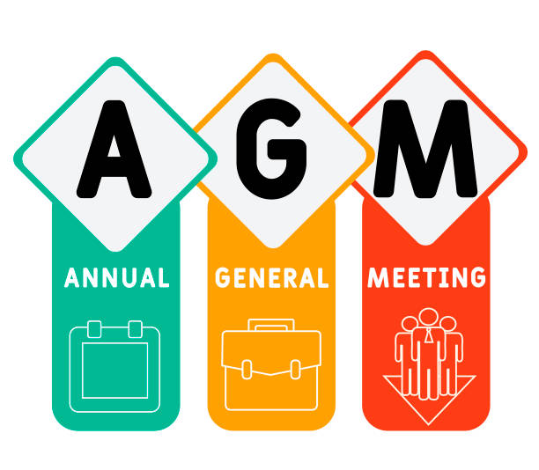
8. Announcements Brian Ensign (Superior Essex Communications)
8.2 Upcoming Events
CABA Annual General Meeting
Thursday, December 9, 2021
Virtual Event
Register

Slide 44
8. Announcements Brian Ensign (Superior Essex Communications)
8.2 Upcoming Events
AHR Expo
January 31 - February 2, 2022
Las Vegas, NV USA
BICSI
January 30 - February 3, 2022 Orlando, FL USA

Slide 45
8. Adjournment Brian Ensign (Superior Essex Communications)
Next IBC Meeting: Mid-February 2022
Continental Automated Buildings Association (CABA) caba@caba.org www.CABA.org
www.caba.org/ibc
Connect to what’s next™

