Slide 1
Connected Home Council (CHC) Webinar Thursday, December 2, 2021, 12 NOON – 1:30 PM (ET)
Chair: Eric Harper (Snap One)
Vice-Chair: Jim Hunter (Delos Living LLC)
Vice-Chair: Byron BeMiller (Semtech Corporation)
Vice-Chair: Charles Hume (Southwire Company, LLC)

Slide 2
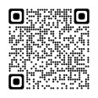
1. Agenda Greg Walker (CABA)
CHC Webinar
“Cybersecurity for the Smart Home – Using CTA Cybersecurity White Paper and Online Tool” (30 min)
- Jim Hunter (Delos Living LLC) – Moderator
- Dan Fulmer (Fultech Solutions, Inc.)
CHC Meeting
Agenda
White Paper Sub-Committee Update
Webinar
CHC Meeting: Call to Order, Welcome, Introductions, About the CHC
Administrative
Research Update
New Business
Announcements
Adjournment
© 2021, Continental Automated Buildings Association
Connected Home Council

Slide 3
2. White Paper Sub-Committee Update Ken Wacks (Ken Wacks Associates)
2.1 Completed:
“Benefits of Advanced Lighting Systems on the human experience: Human Centric Lighting and Controls”
exp. US Services Inc. (Chair)
Ken Wacks Associates
Mecho-systems
Snap One LLC
© 2021, Continental Automated Buildings Association
Connected Home Council

Slide 4
2. White Paper Sub-Committee Update Ken Wacks (Ken Wacks Associates)
2.1 Completed:
“Part 2: The Commercialization of LiFi”
Wharton County Junior College (Chair)
Association (NEMA)
Association (TIA)
BKS Digital Connectivity Solutions
Control4
CRANTEC
Dibangoup sinilux
Du
GETAC
Li-Fi LED CI
Ken Wacks Associates
National Electrical Manufacturers
Nav Wireless Technologies Pvt. Ltd.
Nokia
Orange
PureLiFi
Quantum-Resistant Crypto (QRCrypto SA)
Telecommunications Industry
University of Strathclyde
© 2021, Continental Automated Buildings Association
Connected Home Council

Slide 5
2. White Paper Sub-Committee Update Ken Wacks (Ken Wacks Associates)
2.2 In Progress:
“Part 2: Power over Ethernet (PoE) & Digital Electricity (DE) in Commercial and Multiple Dwelling Residential Buildings”
Sinclair Digital Holdings (Chair)
Axis Lighting
Contemporary Controls Systems, Inc.
Ken Wacks Associates
LumenCache, Inc.
National Electrical Manufacturers Association (NEMA)
National Research Council Canada (NRC)
Public Services and Procurement Canada
Renesas Electronics America Inc.
Somfy Systems, Inc.
Southwire Company, LLC
Telecommunications Industry Association (TIA)
UL LLC
© 2021, Continental Automated Buildings Association
Connected Home Council

Slide 6
2. White Paper Sub-Committee Update Ken Wacks (Ken Wacks Associates)
2.2 In Progress:
“Connected Home Cybersecurity Regulations”
P.A.ID Strategies (Chair)
AgeLight LLC
BC Hydro
exp. US Services, Inc.
LonMark International
Mission Critical Global Alliance (MCGA)
National Research Council Canada (NRC)
Smart Buildings SuperCluster (SBSC)
Sustainable Resources Management Inc.
TwelveDot Inc.
UL LLC
© 2021, Continental Automated Buildings Association
Connected Home Council

Slide 7
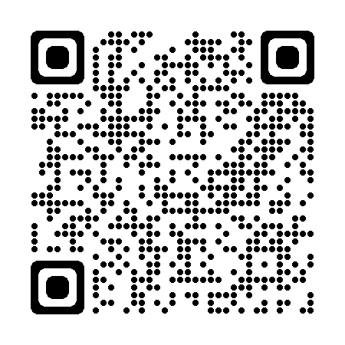
2. White Paper Sub-Committee Update Ken Wacks (Ken Wacks Associates)
All proposals and previously completed CHC White Papers can be downloaded at:
www.caba.org/whitepapers
© 2021, Continental Automated Buildings Association
Connected Home Council

Slide 8
CHC Webinar: “Cybersecurity for the Smart Home – Using CTA Cybersecurity White Paper and Online Tool” (30 min)
Jim Hunter (Delos Living LLC) – Moderator
Dan Fulmer(Fultech Solutions, Inc.)

Slide 9
Cybersecurity for the Smart Home
Using CTA Cybersecurity White Paper and Online Tool
By Dan Fulmer, Ex Officio,
CTA TechHome Division Board

Slide 10
Why Create the Cybersecurity White paper
Back in 2012, hacking and cyber attacks were starting to hit the news cycles more often. The TechHome Board was considering ways to help integrators and consumers.
CTA has a lobbying arm in Congress, and they were asking for input on laws and regulations to curb hacking, so CTA had to address it. The CTA suggested allowing the industry to self regulate, so as not to impose arbitrarily chosen winners and losers, to allow the open market to come up with solutions and industry to address shortcomings shy of more costly regulation.
We decided to start considering creating consumer and integrator facing solutions so we could help stave off regulation and hopefully stop some of the hacking, without adding cost.

Slide 11
About the Presenter
Dan Fulmer
Founder, FulTech Solutions, inc (1995), CTA Integrator of the Year 2011-12
CTA Board Member since 2000,
Presenter at Industry Events such as EHX, CTS, CEPro events.
Chairman of CTA TechHome Board 2013-2014
Holds multiple industry certifications, CTS, Crestron Certified Master Programmer, DMC-E, Zoom Room Certified Integrator, and more
Studied Computer Science and Engineering at UCF where he received his B.S. degree.

Slide 12
How does this help?
After much discussion it was decided that a whitepaper, showing what and how to do what is required, would help the industry in 3 major ways.
Reduce liability for integrators, as we can now show industry accepted standards for how we approach and apply countermeasures to hacking
Give Integrators an effective, industry accepted and easy to use tool to provide to customers to improve their cybersecurity and reduce likelihood of attacks on connected devices.
Give consumers a reliable, effective and score based, easy to understand system to reduce “built-in hacking” (default username and passwords) and protect their homes network and devices.

Slide 13
What Makes up the Cybersecurity System?
After committee reviews and discussions it was determined that we needed to bring in subject matter experts in the various disciplines covered by the areas we determined would be critical to reviewing in the average smart home system.
Experts were brought in from various large and small companies across the technology industry, including from Zwave consortium, anti-virus companies and manufacturers.
We devised a dynamic system based on multiple disciplines that would provide all that is needed to apply the essentials to help secure a smart home with multiple connected devices.

Slide 14
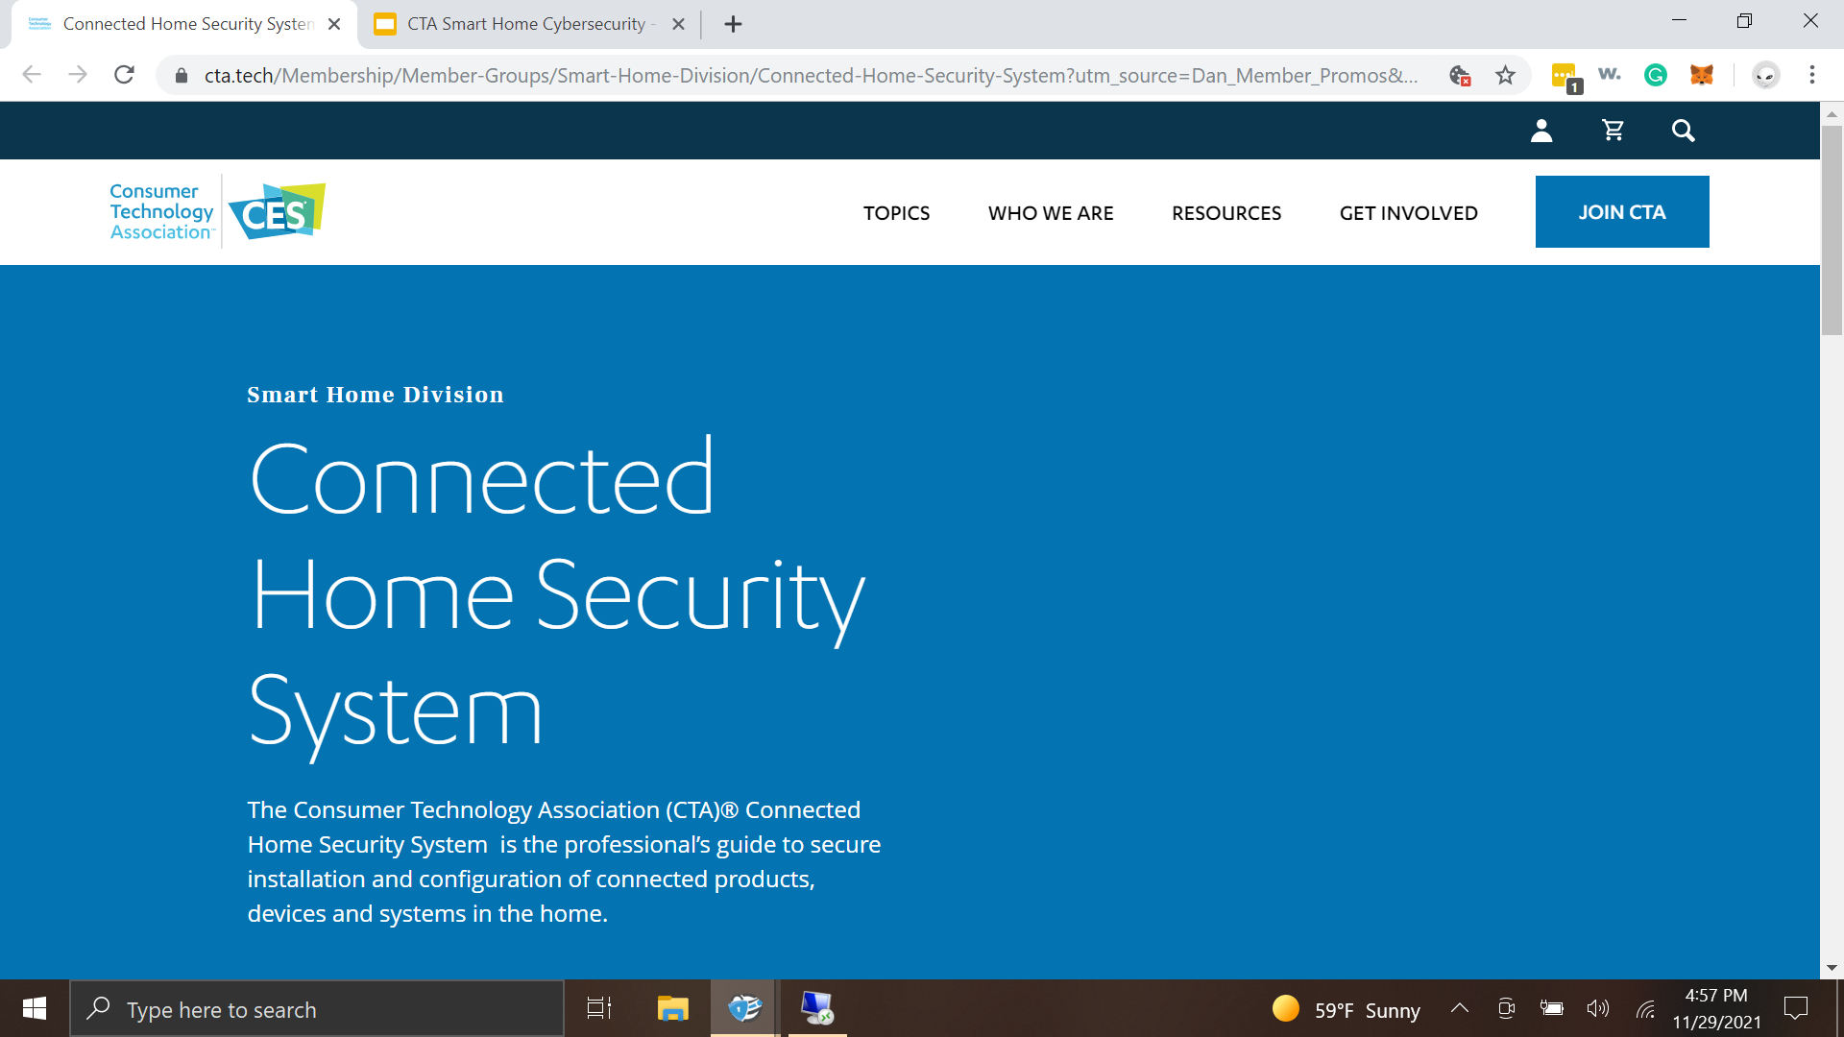

Slide 15
What is it comprised of?
The Complete CTA Cybersecurity for the Smart Home System consist of 3 major components.
The White Paper (downloadable PDF) which explains the how and why in details
The Checklist, a quick tool to apply the system to a home (offline use)
The Dynamic Online Tool - disciplines are determined by the integrators selections and the checklist is applied online by selecting what was done or not done and to what level. This then outputs a score based on what was applied.

Slide 16
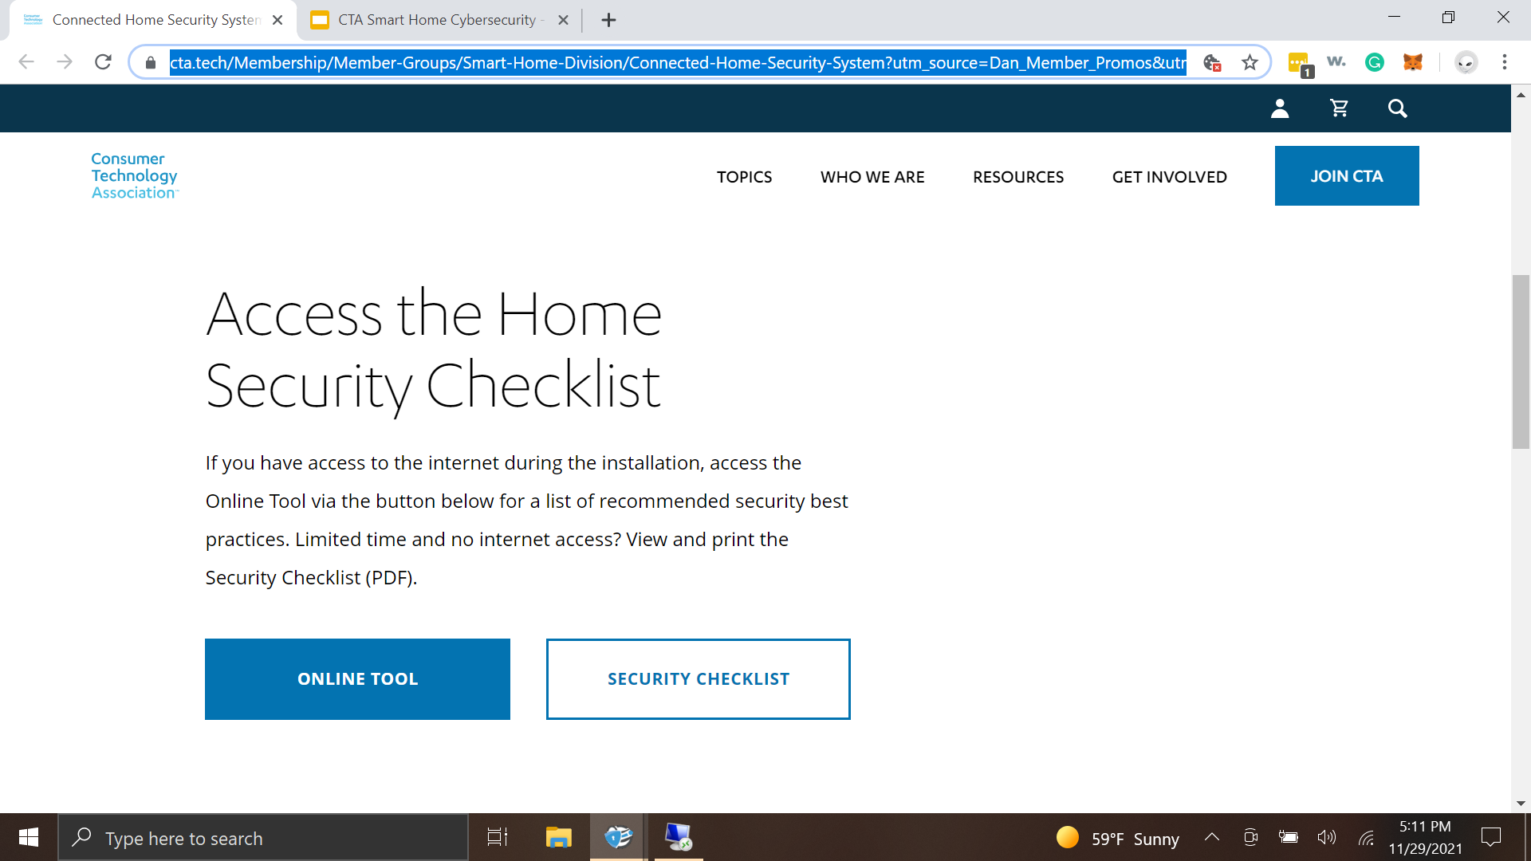

Slide 17
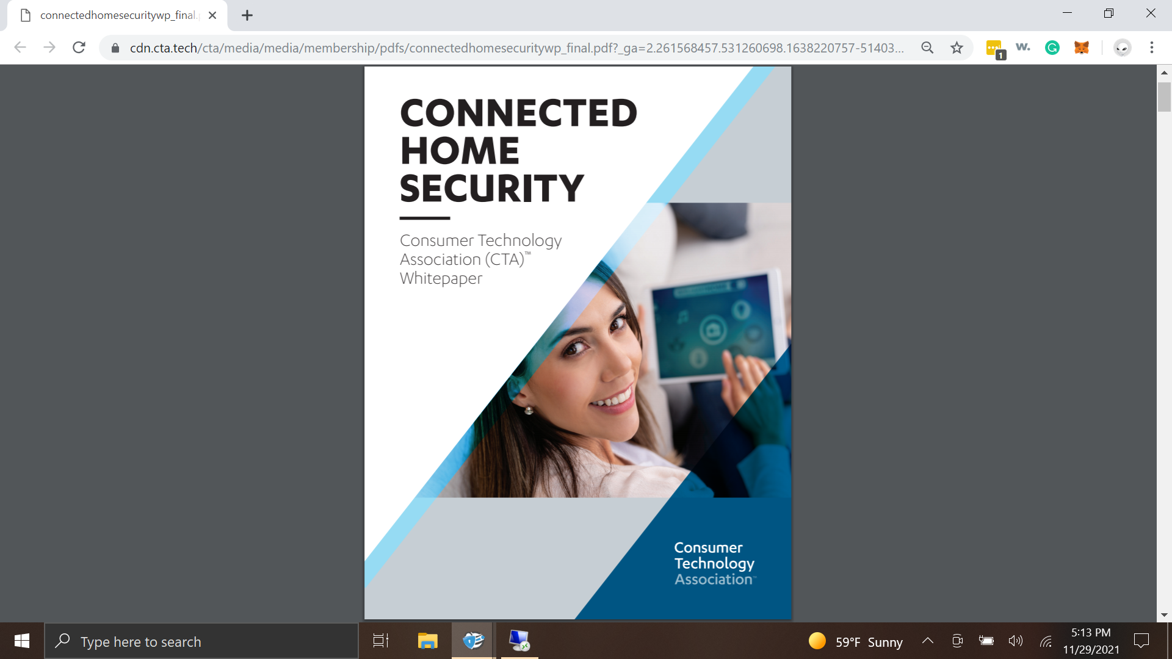

Slide 18
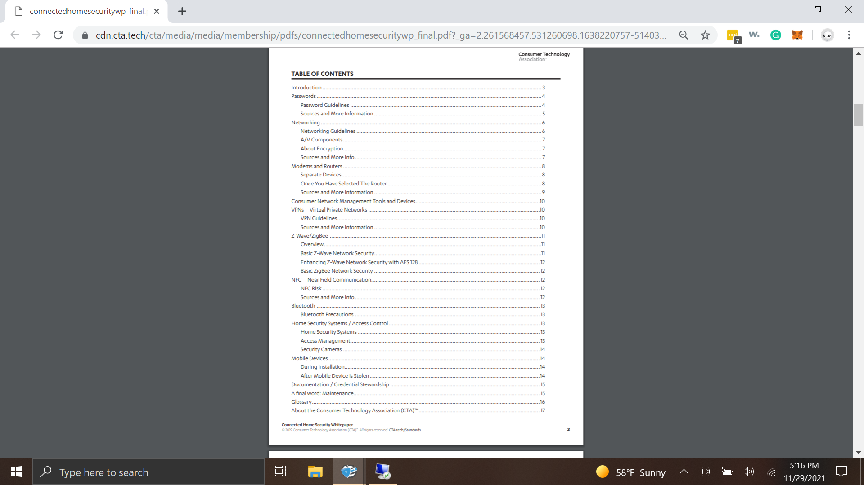
Extensive Coverage of How’s and Why’s

Slide 19
How do I use this system?
The system describes how to use it right on the main page. Simply scroll down and it explains in detail, each step required to utilize the system.
It is suggested that you are familiar with all disciplines in the white paper, understand the applications and how's and why’s before attempting to use the checklist or online tool.
Once you understand the White Paper you can use the Checklist as a quick way to check, test and implement the system at customers homes
Using the Online tool is a way to input what you have done and provide a score/record to the homeowners about what you did to secure the network.

Slide 20
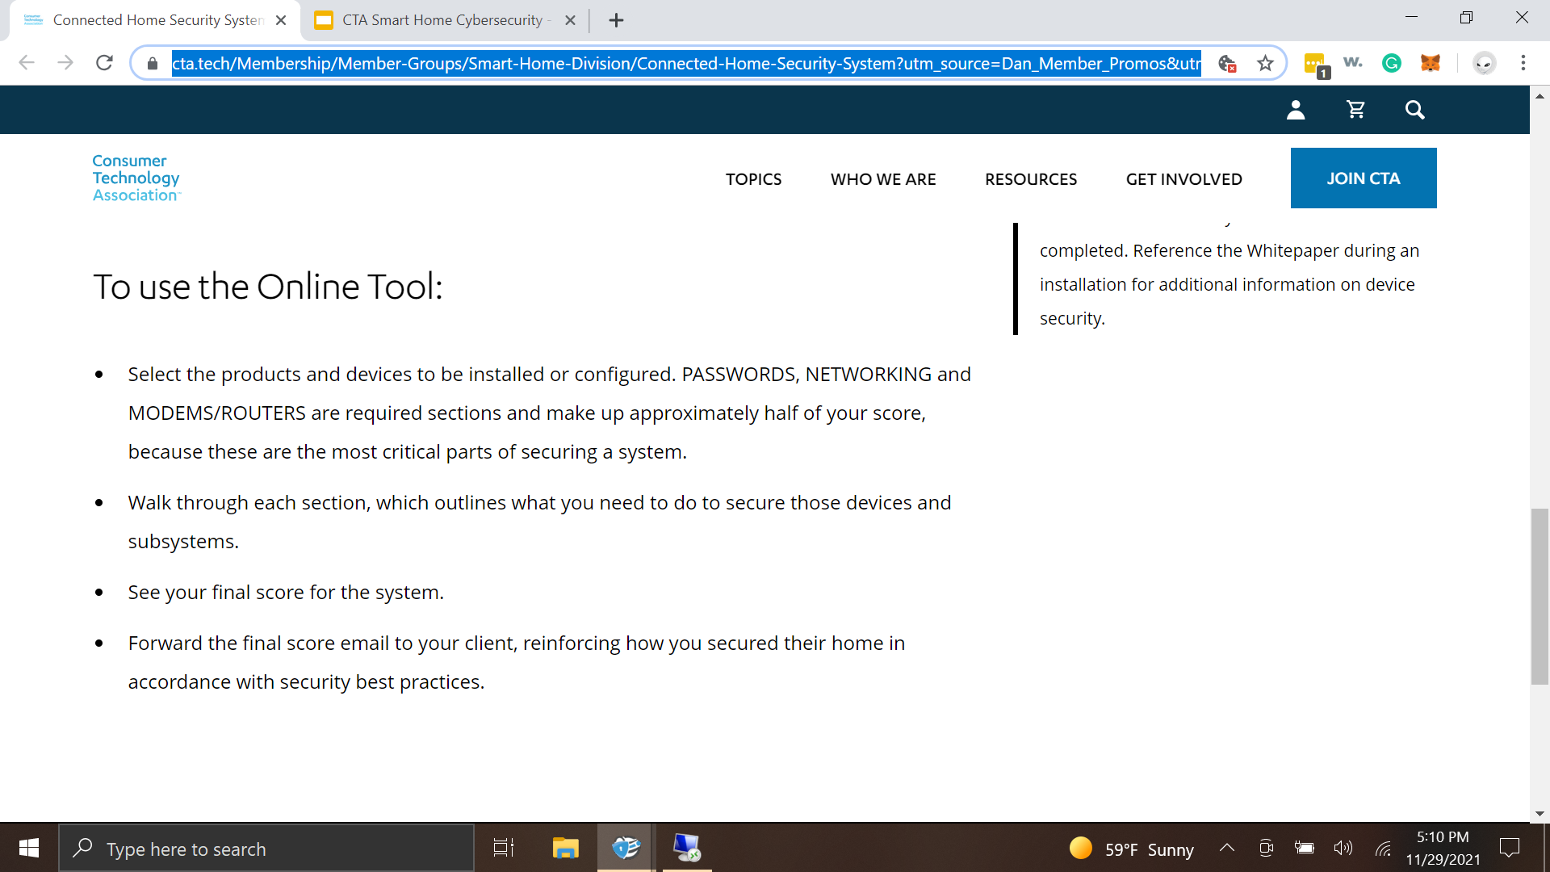

Slide 21
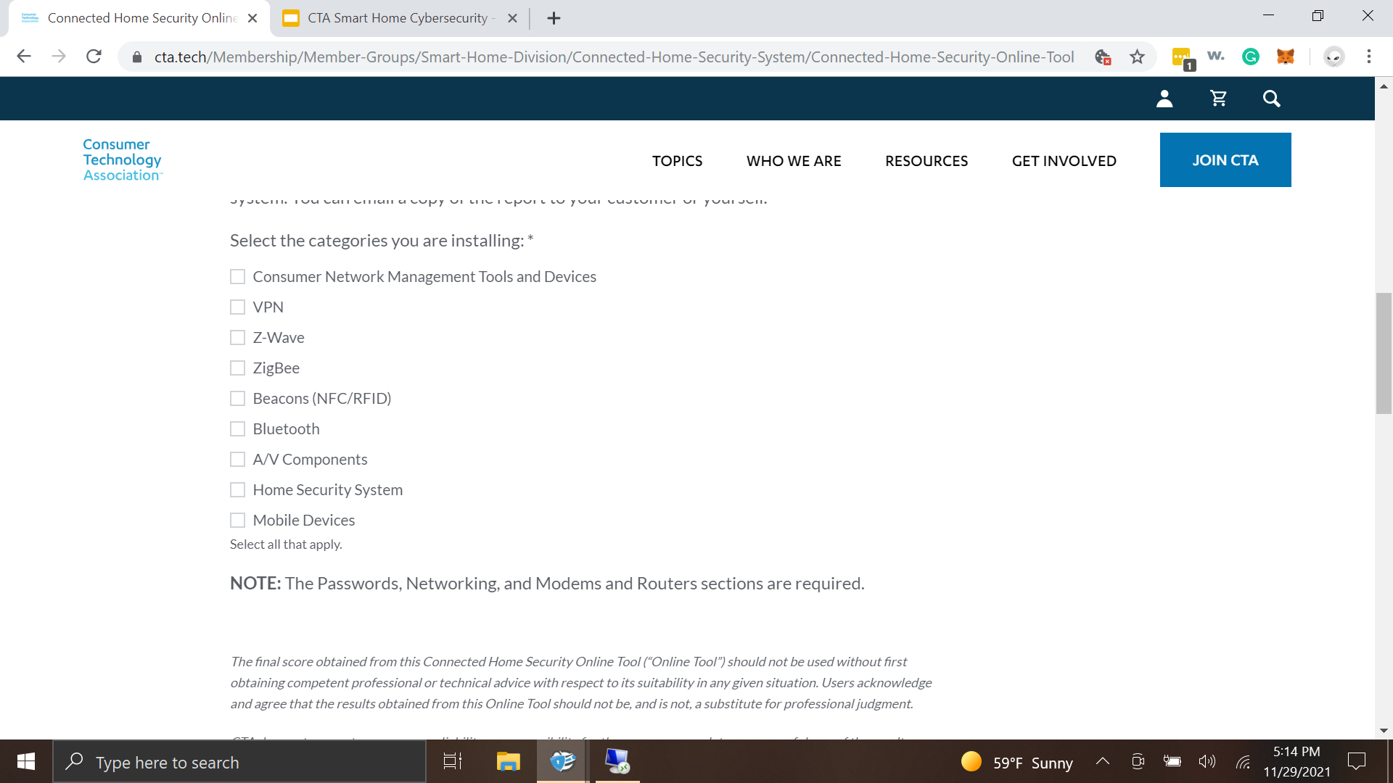
Online Tool Allows for Dynamic Selection

Slide 22
How do I get my customers to use this?
Most customers are aware of recent hacks, general cybersecurity issues and nanny cams getting hacked. Remind them of these incidents and offer to help secure their network.
This is a SERVICE you OFFER to your clients (some integrators mandate it is included).
This is NOT FREE. You should charge for the time it takes to implement the system. This varies based on the size of the home, network, number of components and connected devices. This could be from 1 hour to 8 hours or more.

Slide 23
Who can use this system?
The CTA TechHome Division Board decided to open this system to non-members and the general public in a way to help set standards and give the general public a tool to help them secure their own networks or at least understand the basics of network security.
Any dealer, integrator, end-user, network administrator or anyone else can access and use this system and online tool via the link provided.
https://cta.tech/Membership/Member-Groups/Smart-Home-Division/Connected-Home-Security-System?utm_source=Dan_Member_Promos&utm_medium=MemberWebsites

Slide 24
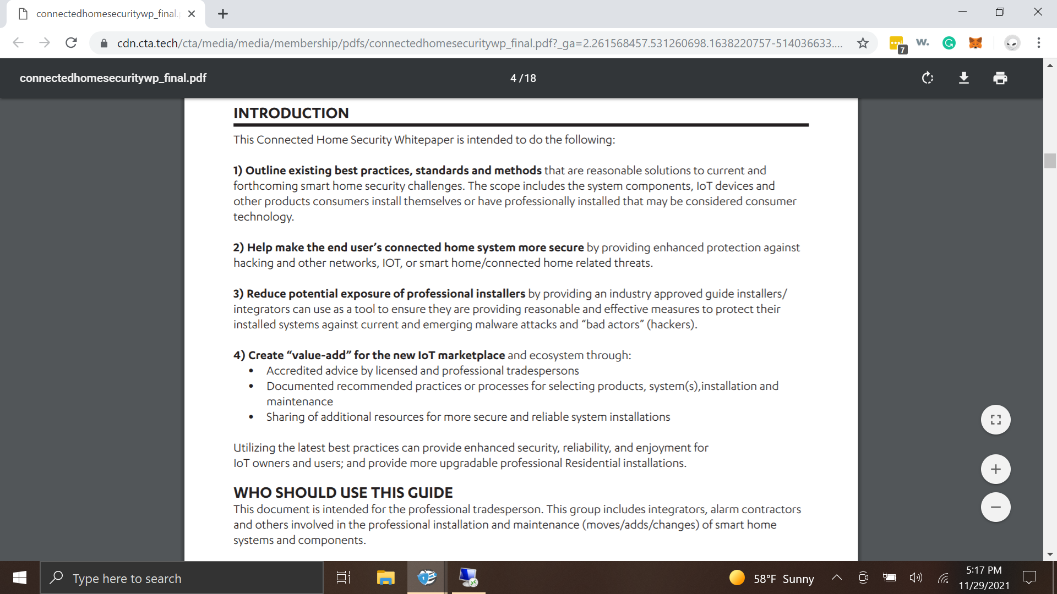

Slide 25
Walkthrough Presentation

Slide 26
THANK YOU!
Questions?

Slide 27
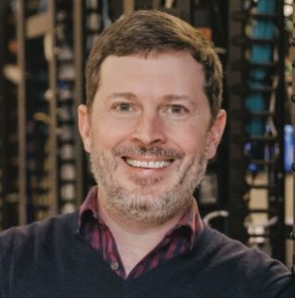
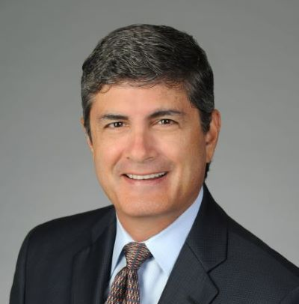
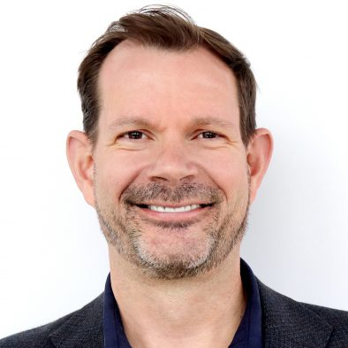
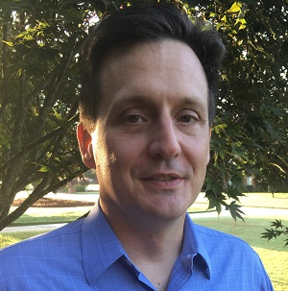
3. CHC Meeting Call to Order, Intros, About the CHC Eric Harper (Snap One)
CHC Chair
Eric Harper
SVP, Product Marketing & Markets
Snap One
CHC Vice-Chair
Byron BeMiller
Director, Wireless Marketing
Semtech Corporation
CHC Vice-Chair
Jim Hunter
Chief Technology Officer
Delos Living LLC
CHC Vice-Chair
Charles Hume
Director of Digital Power Technologies
Southwire Company, LLC
Established in 2004, the CABA Connected Home Council initiates and reviews projects that relate to connected home and multiple dwelling unit technologies and applications. The Council also examines industry opportunities that can accelerate the adoption of new technologies, consumer electronics and broadband services within the burgeoning connected home market. www.caba.org/chc
© 2021, Continental Automated Buildings Association
Connected Home Council

Slide 28
4. Administrative Eric Harper (Snap One)
4.1 Motion to approve past CHC Minutes from September 30, 2021: www.caba.org/chc
© 2021, Continental Automated Buildings Association
Connected Home Council

Slide 29
5. Research Update Charles Hume (Southwire Company, LLC)
“The Connected Home and AI” 2021 CHC Landmark Research
© 2021, Continental Automated Buildings Association
Connected Home Council

Slide 30
6. New Business Eric Harper (Snap One)
6.1 Other new CHC business?
© 2021, Continental Automated Buildings Association
Connected Home Council

Slide 31
7. Announcements Eric Harper (Snap One)
7.1 Past Events Overview
Greenbuild - September 21-23, 2021 | San Diego, CA USA
LightFair - October 25-29, 2021 | New York, NY USA
Realcomm | Ibcon - November 2-3, 2021 | Scottsdale, AZ USA

Slide 32
7. Announcements Eric Harper (Snap One)
7.2 Current Events
The Buildings Show
December 1-3, 2021
Toronto, ON Canada

Slide 33
7. Announcements Eric Harper (Snap One)
7.3 Upcoming Events
AHR Expo
January 31 - February 2, 2022 Las Vegas, NV USA
BICSI
January 30 - February 3, 2022 Orlando, FL USA

Slide 34
8. Adjournment Eric Harper (Snap One)
Next CHC Meeting: Mid-February 2022
Continental Automated Buildings Association (CABA) caba@caba.org www.CABA.org
www.caba.org/chc
Connect to what’s next™
© 2021, Continental Automated Buildings Association
Connected Home Council

