Slide 1
Intelligent Buildings Council (IBC) Webinar Tuesday, October 12, 2021, 12 NOON – 1:30 PM (ET)

Slide 2
1. Agenda Greg Walker (CABA)

Slide 3
2. Call to Order, Welcome, Introductions, About the IBC Brian Ensign (Superior Essex Communications)

Slide 4
3. Administrative Brian Ensign (Superior Essex Communications)

Slide 5
4. Research Update Harsha Chandrashekar (Honeywell International, Inc.)

Slide 6
4. Research Update Harsha Chandrashekar (Honeywell International, Inc.)

Slide 8
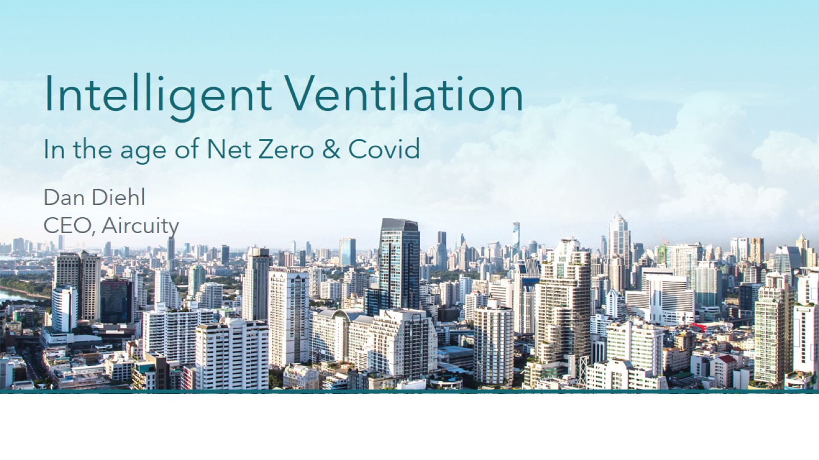
Intelligent Ventilation In the age of Net Zero & Covid

Slide 9
Agenda and Objectives

Slide 10
What is Happening?

Slide 11
Macro Trends ‘21 and Beyond

Slide 12
Macro Trends Driving Convergence - Demanding both Healthy & Sustainability Buildings

Slide 13
In Action

Slide 14
Getting to Net Zero

Slide 15
Facts

Slide 16
WSP: Many Carbon Neutral Program and Definitions

Slide 17
NBI: Energy efficiency is core component of NZE Buildings

Slide 18
Health & Cognitive Function Drivers

Slide 19
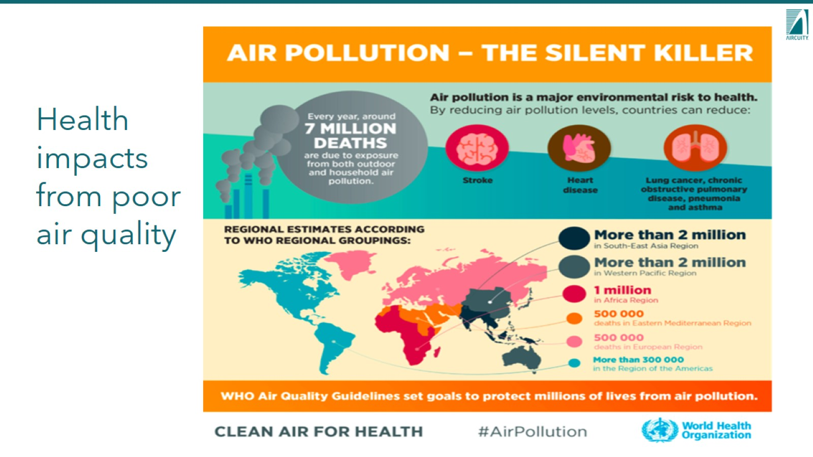
Health impacts from poor air quality

Slide 20
Recent Announcement for World Health Organization - WHO

Slide 23
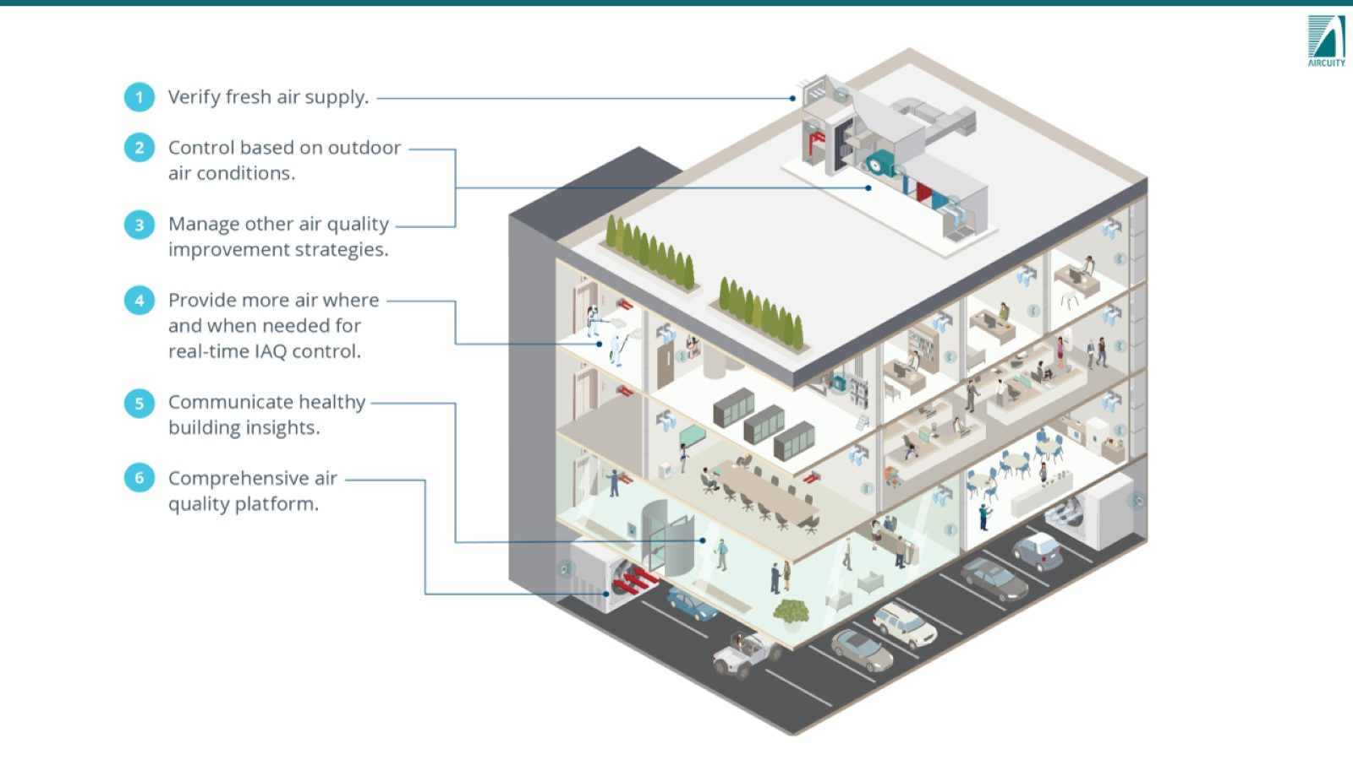

Slide 24
Accurate & Dynamic Ventilation

Slide 27
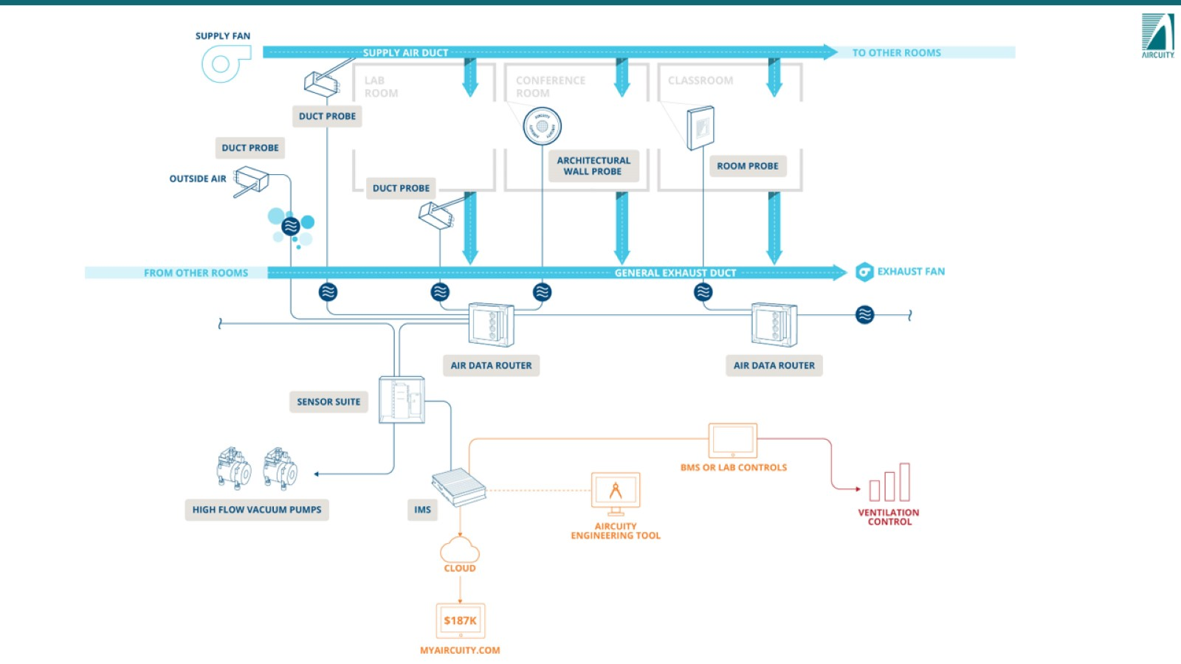

Slide 28
Detected Parameters

Slide 29
Sensor & Hardware Assurance

Slide 30
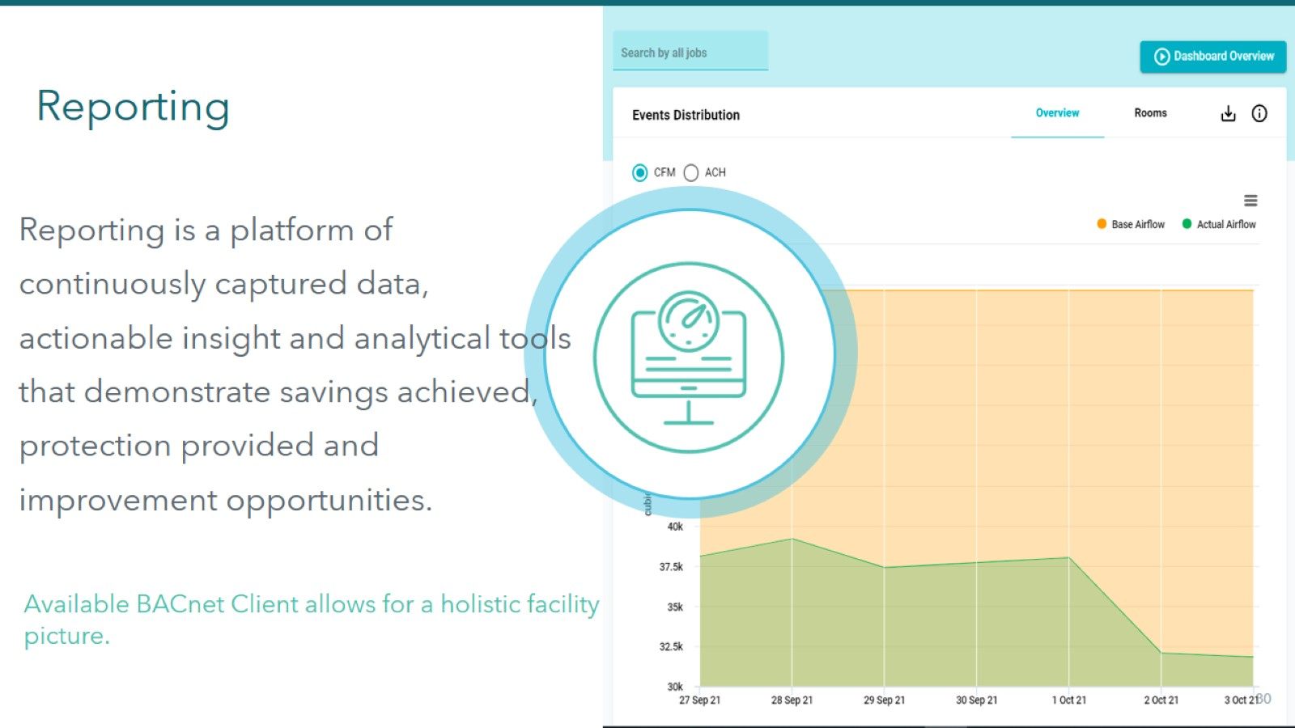
Reporting

Slide 31
Monitoring

Slide 33
Our Challenges Remain

Slide 34
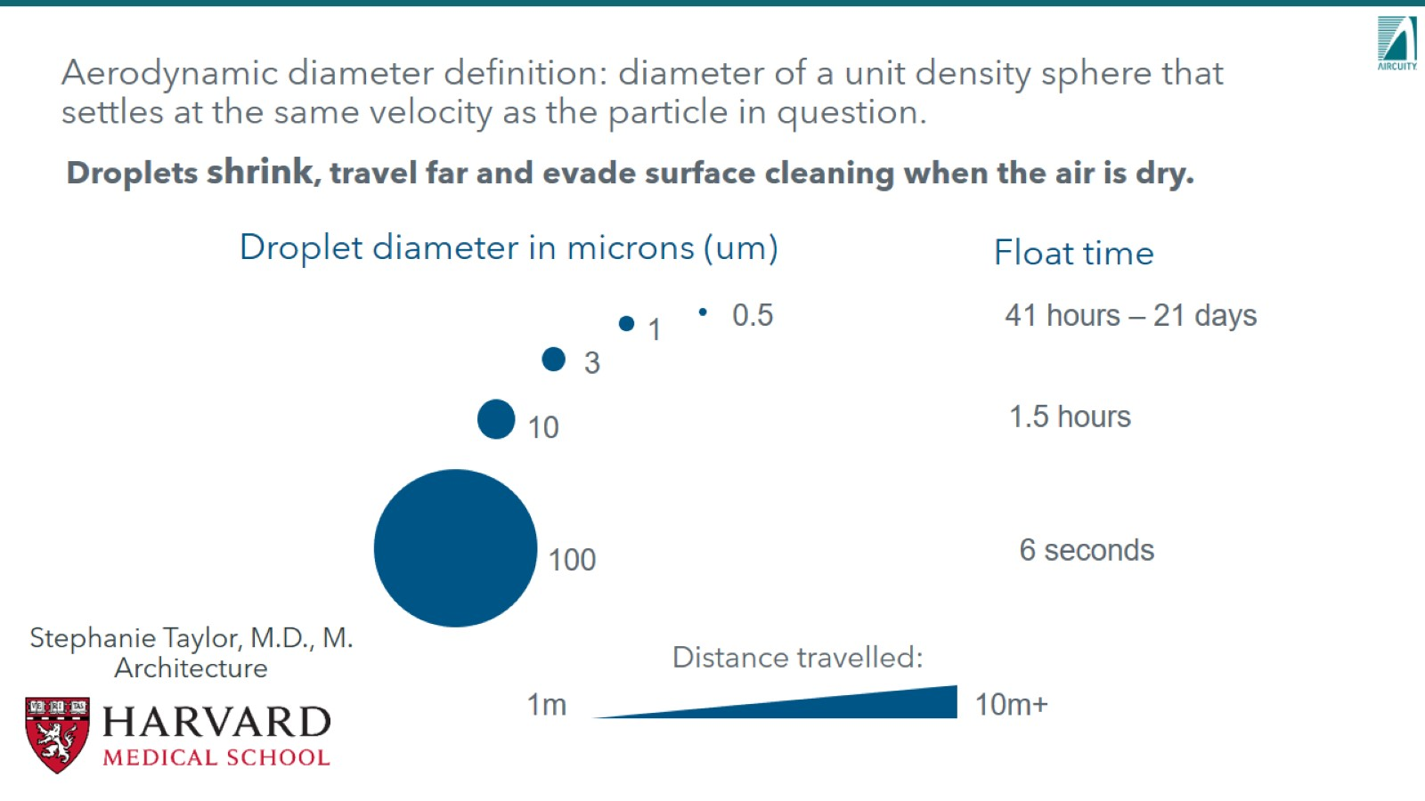

Slide 36
II. Filtration Effectiveness

Slide 37
Particulate Measurement & Response

Slide 40
7 UCI Smart Lab Essentials

Slide 41
7 Smart Lab Essentials: Aircuity Delivers!

Slide 43
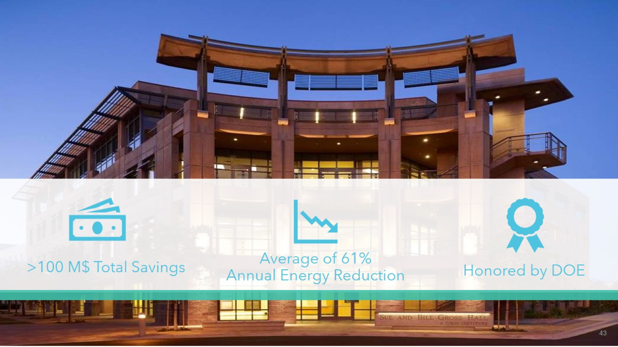

Slide 44
Do we continue to wait?

Slide 46
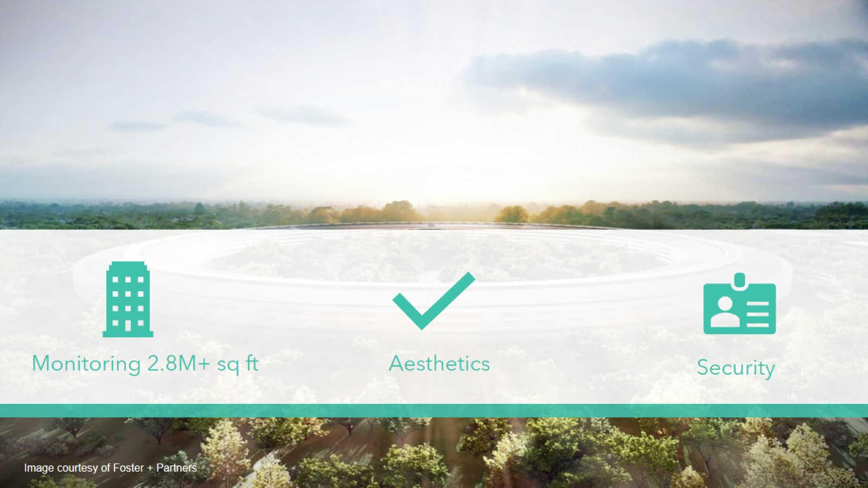

Slide 48
MSKCC Adoption

Slide 49
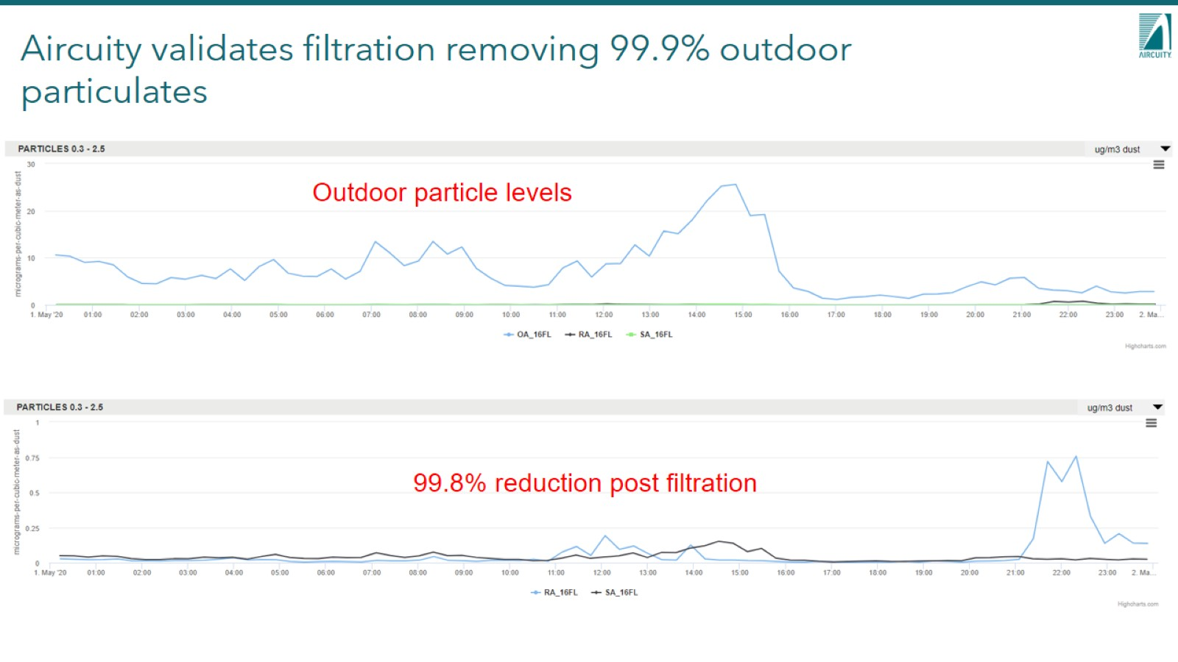
Aircuity validates filtration removing 99.9% outdoor particulates

Slide 51
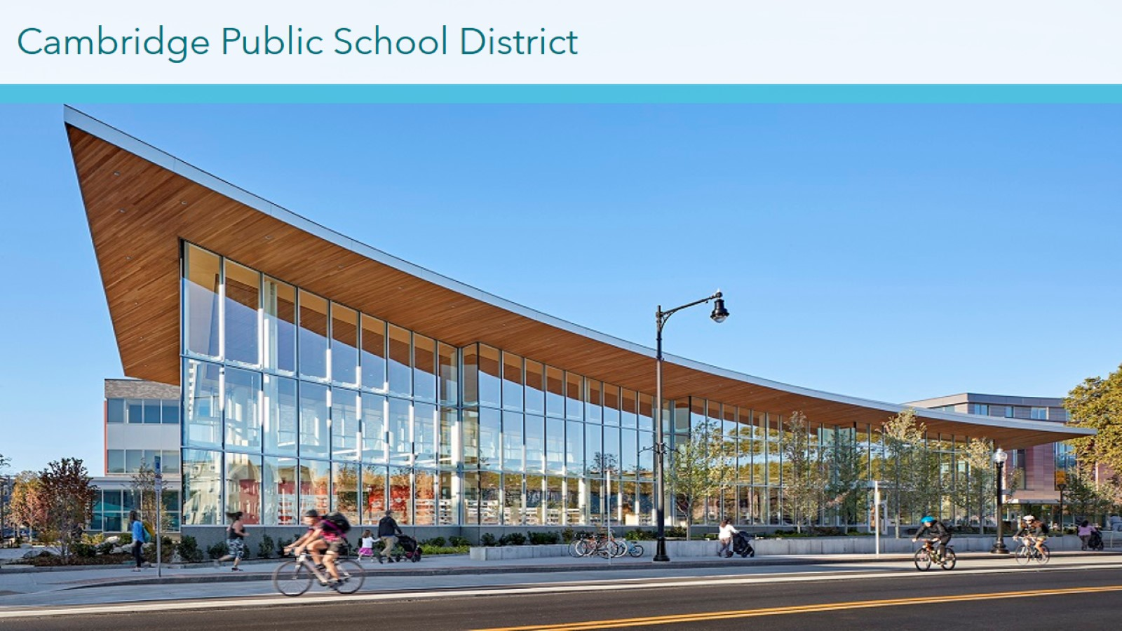

Slide 55
WSP: Path to Zero Carbon Starts with Energy Efficiency

Slide 56
Roadmap for the Future

Slide 58
5. Keynote - Questions? Bob Allan (The Siemon Company)

Slide 59
6. White Paper Sub-Committee Update Ken Wacks (Ken Wacks Associates)

Slide 60
6. White Paper Sub-Committee Update Ken Wacks (Ken Wacks Associates)

Slide 61
6. White Paper Sub-Committee Update Ken Wacks (Ken Wacks Associates)

Slide 62
6. White Paper Sub-Committee Update Ken Wacks (Ken Wacks Associates)

Slide 63
6. White Paper Sub-Committee Update Ken Wacks (Ken Wacks Associates)

Slide 64
6. White Paper Sub-Committee Update Ken Wacks (Ken Wacks Associates)

Slide 65
7. New Business Dan Isaacs & Mark Carvalho (D&M Engineering LLC, INGAGER)

Slide 66
Health Assurance

Slide 67
Technology Leader Drone Service Innovation

Slide 74
Contact

Slide 75
7. New Business Brian Ensign (Superior Essex Communications)

Slide 76
8. Announcements Robert Lane (Robert H. Lane and Associates Inc.)

Slide 77
8. Announcements Robert Lane (Robert H. Lane and Associates Inc.)

Slide 78
8. Adjournment Brian Ensign (Superior Essex Communications)

