Slide 1
Connected Home Council (CHC) Webinar
Thursday, September 30, 2021, 12 NOON – 1:30 PM (ET)
Chair: Eric Harper (Snap One)
Vice-Chair: Jim Hunter (Delos Living LLC)
Vice-Chair: Byron BeMiller (Semtech Corporation)
Vice-Chair: Charles Hume (Southwire Company, LLC)

Slide 2



1. Agenda
Greg Walker (CABA)
CHC Webinar
“AI and the Connected Home” (30 min)
- Jim Hunter (Delos Living LLC) – Moderator
- Harry Pascarella (Harbor Research) & Michael Levy (Harbor Research)
CHC Meeting
1. Agenda
2. CHC Meeting: Call to Order, Welcome, Introductions, About the CHC
3. Administrative
4. Research Update
5. White Paper Sub-Committee Update
6. New Business
7. Adjournment
© 2021, Continental Automated Buildings Association
Connected Home Council

Slide 3
CHC Webinar:
“AI and the Connected Home” (30 min)
Jim Hunter (Delos Living LLC) – Moderator
Harry Pascarella (Harbor Research) & Michael Levy (Harbor Research)

Slide 4
Evolution of Smart Home Products & Values

Slide 5
Consumer Considerations When Buying Connected Home Products
Customers select connected home appliances that will save money and improve their quality of life, while requiring little effort to do so.
Consumer Adoption Drivers of Connected Home Products (n – 500+)
"We market our smart home solutions based on increased comfort and convenience. We've had the most traction from this angle--needs and wants of consumers are a lot different than those of commercial customers”
Multifamily Solution Specialist, Carrier
"Installing these tools themselves doesn't create any value, you have to get end users to actually use them”
Executive, SafePlug (energy controllers/monitors)
Connected Home Roadmap Landmark Research, 2019

Slide 6
Connected Home Use Cases Are Still “Simple”
Today’s top use cases are still focused on relatively ”simple” applications. As interoperability improves, consumers will increasingly desire applications that involve more complex interactions between and among devices
Smoke and gas detection
Higher
Streaming audio and video content
Lack of device interoperability and data sharing capabilities inhibits more complex interactions
Fall and accident detection
Temperature automation and control
Person-specific routines / environment preferences
Lighting automation and control
Keyless entry
Real-time energy pricing monitoring
Smart home data management and central data storage
Robotic
cleaning
Device and appliance energy usage monitoring
Use Case Complexity
Simple
Water and distribution monitoring
Complex
Smart Energy management
Keyless garage access
Appliance control and notifications
Wellness monitoring
Home surveillance
Lower
Current Use Cases
Potential Future Use Cases
Current Relative Attractiveness

Slide 7
Connected Home Roadmap Summary (2019)

Slide 8
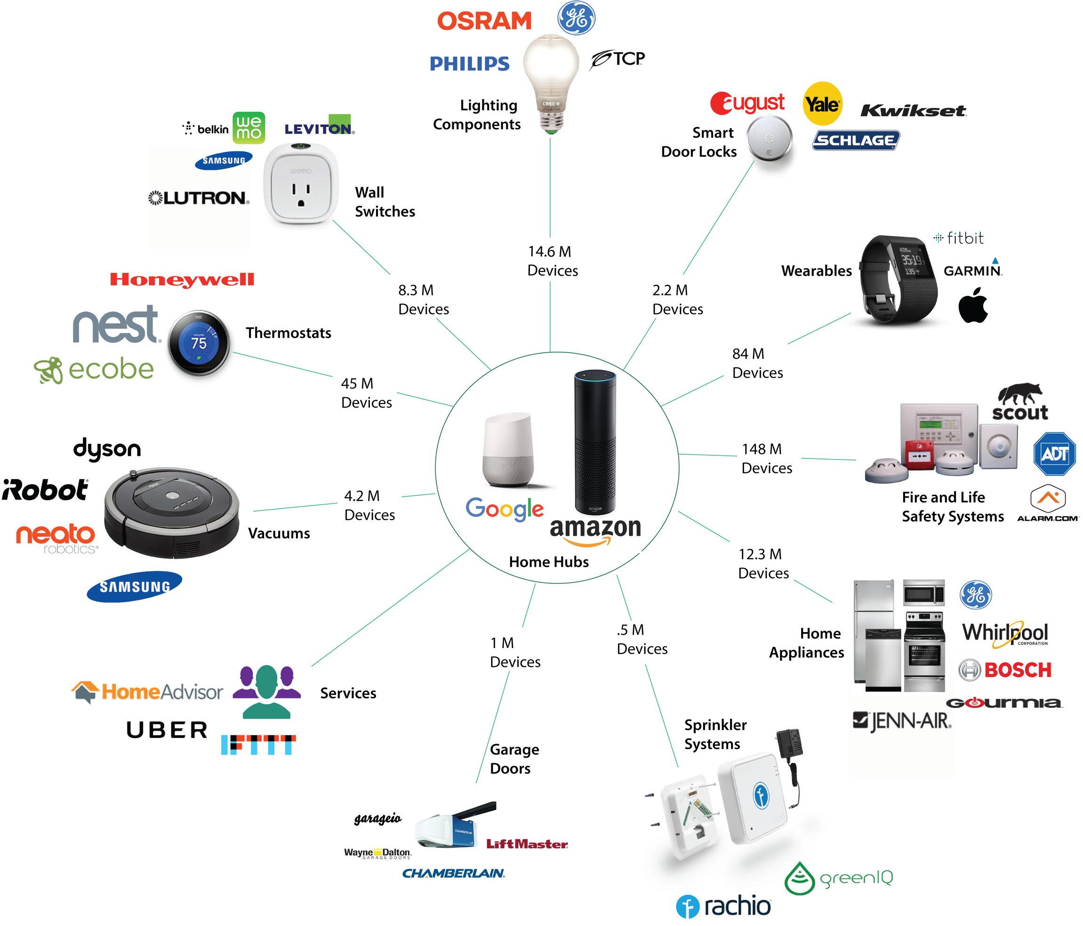
Device Ecosystems And Interoperability Are Paramount
Future connected home services and values will be increasingly dependent on device interoperability and vendor partnerships
Home hubs are acting as an entry portal to other connected devices
As a result, it requires device to leverage connectivity that will allow for interoperability
Diverse entrants including service providers, technology innovators, and traditional product manufacturers are taking claim in the space
Product manufacturers must embrace peer devices and leverage partnerships

Slide 9
Future Connected Home Ecosystem Architecture Evolution Towards Integration & Coordination

Slide 10
As Ecosystem Continues to Expand & Change, Artificial Intelligence Tech is Evolving
Simple classification and regression technologies that revolutionized business and machine intelligence in the late-20th century are evolving towards deeper, unsupervised learning
Birth of Artificial Intelligence
1952-1974
Cybernetics and early neural networks
Turing test
Symbolic reasoning
First Evolution of AI
1980-1987
Reasoning and classification
Data analytics
Second Evolution of AI
1993-2011
‘Business intelligence’
Regression and classification
Third Evolution of AI
2012 - Present
Convolutional and recurrent neural networks
Deep reinforcement learning

Slide 11
Artificial Intelligence Evolving towards Automated Learning & Action
Continued advancement in software technologies is pushing the market from where a bulk of players are developing today towards more complex unsupervised machine learning,
Traditional Machine Learning
Advanced Machine Learning
Output is known
Least workload requirements
Output is unknown
Highest workload requirements
2021 Market Average
2015
2018
2024
2027
Technology
Classification
Regression
Convolutional Neural Networks
Recurrent Neural Networks
Deep Reinforcement Learning
Description
Outputs have a discreet set of outcomes
Outputs follow a linear path as inputs change (continuous)
Class of deep ANNs designed specifically to analyze visual imagery
Class of deep ANNs that involves directed cycles in memory
Agent learns from experience
Example Use Case
Simple Image Recognition
Demand Forecasting
Advanced Image Recognition (i.e. behavior)
Natural Language Processing
Autonomous Vehicles
Illustrative Players
11

Slide 12
Advanced AI Can Enable more Complex Apps
The Evolution of Artificial Intelligence Applications
Complex Apps
Process & System Integration
Automated & Unsupervised Analytics
Deep Reinforcement Learning
Recurrent Neural Networks
Predictive Analytics
Convolutional Neural Networks
Compound Apps
Aggregation of Things
Technical Complexity
Reactive Analytics
Regression
Simple Apps
Thing
Classification
Simple Rules Engines
Usefulness of Analytics

Slide 13



AI Apps are Becoming More Accessible, Easier to Build
New educational, platform and open-source tools have come to market that make AI development easier for both data scientists and traditional developers
Enabled Dev Population
Tool Types
Who Can Help
No Code
(Creative & Knowledge Workers)
230 million
Plug & Play
Software Tools
Next Generation
Low Code
(Traditional Developers without AI experience)
Education/E-Learning Platforms
AI/ML Application
Development Tools
Software Frameworks
23 million
AI Tools
(AI Developers & Data Scientists)
Open Source AI Platform
Developer Workflow
Application Tools
AI Software Frameworks
11.4 million

Slide 14
Future Connected Home Roadmap and Implications: Artificial Intelligence has a Big Part to Play
Smart Home Roadmap
Hub-and-Spoke Ecosystems: Ecosystems are forming around popular home platforms with artificially intelligent “digital assistants”, most notably Amazon's Alexa among others
A La Carte Platforms and Assistants: Interestingly, developers are generally not motivated to use both the platform and voice assistant from the same brand
Competitive
Environment
No Interface is the Best Interface. Ultimately, home automation must focus on removing occupant interactions and moving device and system operational decisions to the background of users’ lives to create maximal value with minimal user effort
  In this vein, “intuitive interactions” are a stepping-stone to “no interactions”
Consumer
Impacts
True Interoperability. Device data will be shared among devices via peer-to-peer communications channels, enabling devices to locally coordinate actions to meet programmed or learned occupant preferences. Devices will filter and process relevant information internally, utilizing but not relying upon remote servers to reduce transmission costs and achieve a level of resiliency not feasible today
Technology
Considerations

Slide 15
Connected Home Artificial Intelligence:
Research Questions (1/2)
Harbor will work with the Steering Committee to finalize questions, scope, and goals during the kickoff process
Trends & Forces
Customer Needs, Adoption, and Buying Behavior
What artificial intelligence applications are currently being introduced and adopted in connected homes and why? What are the major barriers to full scale adoption of new artificial intelligence (“AI”) solutions in the home?
How will technologies such as predictive analytics and maintenance to reduce trips and human interaction impact the adoption of artificial intelligence in connected homes? And how are these same technologies enabling new applications and business opportunities in connected homes?
How does the connected home ecosystem look from installation to operation to updates and ownership?
How will the market evolve in the near-term and the long-term? What implications does this have for key stakeholders?
What key regulatory and socioeconomic forces are driving or slowing the adoption of artificial intelligence in connected homes?
What are the implications of wider adoption of artificial intelligence for data ownership, cybersecurity, and use privacy?
What artificial intelligence applications and use cases are driving the largest business opportunities in which market sub-segments today (sub-segments include single unit, multi-unit and other types of connected homes)?
What are the top pain points customers face when introducing new technology in connected homes? How do top applications and use cases address key customer needs and pain points? How do connected home constituents determine cost-benefit metrics of artificial intelligence technologies?
What value propositions and KPIs do customers consider most when adopting artificial intelligence solutions in connected homes? Are these customers well informed of the value provided by artificial intelligence solutions in connected homes? How will this evolve in the future?
What are the key differences in customer types? How should positioning, channel and sales tactics differ by customer personas?
How do customers most often interact with suppliers? What customer budgeting, investment and solution packaging and delivery considerations do suppliers need to take into account when selling solutions?

Slide 16
Connected Home Artificial Intelligence:
Research Questions (2/2)
Harbor will work with the Steering Committee to finalize questions, scope, and goals during the kickoff process
Supplier Dynamics and Best Practices
Future Considerations for Stakeholders
Who are the key established players across each of the following identified segments: hardware and software technology manufacturers and suppliers, OEMS, integrators and installers, service providers?
Who are the key hardware and software innovators creating disruption with artificial intelligence in the connected homes market? How are they differentiating themselves?
What new acquisitions, investments, partnerships and ecosystems are developing in the market for artificial intelligence in connected homes?
What are the strengths and weaknesses of the identified players in the market today? Which business and solution delivery models are the most successful today, and how will this change in the future?
How does channel to market and best practices differ across player type, solution, industry sub-segment, etc.?
What segments, technologies and software are being adopted for artificial intelligence in connected homes both today and in the future?
What are the key socioeconomic and regulatory barriers and opportunities in the market? How can stakeholders capitalize on these opportunities?
What are the best practices for mitigating customer concerns, communicating value propositions and delivering or integrating artificial intelligence solutions?
What major barriers and difficulties do suppliers have when delivering artificial intelligence solutions? How can stakeholders effectively prepare to address problems such as proprietary platform software solutions and differences in artificial intelligence hardware platforms?
What are the best practices for pricing and monetizing artificial intelligence solutions in connected homes? What ecosystem participants will stakeholders need to engage to have an effective market channel?
What Post-Covid opportunities e.g. air filtration, UV lighting, sensors, etc.) are presenting themselves as viable business opportunities?

Slide 17
Research Design for Connected Home Artificial Intelligence
Harbor Research will be facilitating a collaborative project to conduct a market analysis, survey research, industry expert/thought leader interviews and analysis process for CABA’s Steering Committee Members
SURVEY: Develop and deploy a market survey across the identified market segments to understand buying behaviors & preferences
INTERVIEWS: Conduct in-depth expert interviews with market participants to develop the evolution of preferences and solution delivery opportunities
CONFIRMATION: Validate of results and solidifying the balance of coverage across the identified segments
ANALYSIS: Analyze the technology and competitive forces impacting the evolution of Connected Home Artificial Intelligence
Harbor will design and administer an online survey of market participants along with supplemental conversations, the survey will include 500-750 tenants (rent and own, single and multi-tenant living quarters), distributed across agreed upon segments and demographics in the United States and Canada (this will allow us to establish a detailed data set and to provide a statistical summary and analysis of research findings). Additional breakouts of survey respondents among these groups to be determined by Harbor and the CABA Connected Home Council (CHC) Steering Committee).
Harbor will conduct this survey with the support of a reputable panel or multiple panels will allow us to quickly and effectively deploy this survey to the target audience.
Harbor will conduct parallel supplemental in-depth interviews (approximately 7-10) with marketplace stakeholders, including speaker manufacturers, service providers, software players, and home hubs (IoT platform providers), as well as related specialist artificial intelligence technology providers. Interviews will comprise of a mix of telephone and video interactions based on a discussion guide designed in cooperation with CABA.
These interviews will work to understand how technical requirements and user needs are shifting, along with how these marketplace stakeholders expect customers wish to interact with artificial intelligence applications in Connected Homes.
Harbor will then employ a “Delphi-like” methodology/approach, based on above survey, to conduct a review of research results with a balanced cross-section of thought leaders and industry specialists/experts (approximately 3-5 people) to further validate results and provide a balanced coverage and perspective.
The goal is to further validate the results and provide a balanced coverage and perspective of the survey research and interviews.
Harbor’s analysis will result in a series of recommendations and strategic alternatives that align stakeholders with opportunities, challenges and key considerations arising from Artificial Intelligence in Connected Homes.
This analysis will allow Harbor to articulate a clear set of recommendations for key industry participants focused on developing differentiated and valuable solution delivery strategies for both themselves and their customers.

Slide 18
Market feedback to inform recommendations to key stakeholders
Qualified End-Customer Survey
In-Depth Supplier and Expert Interviews
Approach
Harbor will work closely with the Steering Committee and CABA to develop and finalize a survey, including allowing the Steering Committee to review the draft survey and provide inputs. Harbor will conduct this survey with the support of a reputable panel or multiple panels will allow us to quickly and effectively deploy this survey to 500-750 qualified respondents. We will deploy a soft-launch of the survey to ~10% of participants to allow the Steering Committee to provide detailed feedback prior to a complete launch.
Approach
Harbor will conduct ~7-10 in-depth interviews to understand how technical requirements and user needs are shifting, and how market dynamics within the Connected Home space are evolving.
Industry Thought Leaders
Academics/ Researchers
Industry Associations
Interview Target
Mix
End-Customers
Connected Home Tenants
Connected Home Occupants
Stakeholders
Connected Home Owners
Connected Home Developers & Builders
Interview
target
Mix
Service Providers &
Users
Building Construction Firms
Maintenance Professionals
Building Owners and Operators
Integrators and Installers
Insurance Providers
Utilities
Government Orgs.
Technology Players
IoT Platform Providers
Hardware Providers
Infrastructure Providers
Software Application Providers
BMS/EMS System Providers
Carriers/Telcos
Data/Analytics Players
Illustrative Questions
1. In your connected home, how has Artificial Intelligence been deployed?
Connected Home professional B. Software-based platform
Service unit from retailer D. Manufacturer-linked
E. Independent electrician F. Self-installed / DIY
Equipment Manufacturers
HVAC Systems
Control Systems
Power Quality & Standby Systems
Lighting
Energy & Building Management Systems
Example Interviewees from Past CABA Work:
Senior Director of Subscriber IOT Solutions, Johnson Controls
Director of IT Operations/Infrastructure, Xcel Energy
Manager: Business Solutions & Operations, Comcast
2. What would you be willing to pay for an integrated Connected Home AI System?
One-time fee <$1,000 B. One-time fee $1,000-$50,000
One-time fee >$50,000 D. Recurring fee <$1,000 per month
E. Recurring fee >$1,000 per month F. Not willing to pay

Slide 19
Connected Home Artificial Intelligence Study Deliverables
Preparation and Framing
Introductory webinar for prospective funders
Research kick-off presentation and webinar to establish: the study purpose, scope, objectives, approach, and timelines
Output and Steering Committee Interactions During the Research
Bi-weekly conference call meetings with Steering Committee sponsors to communicate progress, preliminary findings, approvals of research methodologies, and next steps
Individual calls with Steering Committee members to understand their particular market and needs
Survey draft and final survey questions for respondents, draft and final interview questions for market participants/experts and thought leaders. Survey results packaged in PowerPoint and Excel format. Interview summaries and packaged results from stakeholder interviews
Upon completion of the research, there will be a presentation outlining the complete research findings via a webinar presentation to the research sponsors. Following this presentation, the sponsors can provide feedback and direction for the production of the final report
Final Deliverables and Follow Activities
Delivery of four documents: Full report (Microsoft Word Format), Executive Summary (Microsoft Word Format), Full Report Presentation (Microsoft PowerPoint Format), Executive Summary Presentation (Microsoft PowerPoint)
Final webinar (1.5 – 2 Hours) and Sponsor Webinars (1 Hour each) for each organization on the Steering Committee, unlimited attendance provided by Harbor Research
  Full list of attendees and contact information for each Sponsor Webinar
“Print-ready” electronic, full-color PDF report including executive summary, detailed findings, conclusions, and recommendations - each sponsor will also receive a complete hard copy of the research report (note, full report will include a 25-40 page written paper + summary presentation in PPT)
Think tank-like facilitated interaction between steering committee members facilitated by Harbor Research team to drive discussion about potential next steps and areas for further collaboration and interaction
Notes:
•

Slide 20
THANK YOU!
Questions?

Slide 21








2. CHC Meeting Call to Order, Intros, About the CHC
Eric Harper (Snap One)
CHC Chair
Eric Harper
SVP, Product Marketing & Markets
Snap One
CHC Vice-Chair
Byron BeMiller
Director, Wireless Marketing
Semtech Corporation
CHC Vice-Chair
Jim Hunter
Chief Technology Officer
Delos Living LLC
CHC Vice-Chair
Charles Hume
Director of Digital Power Technologies
Southwire Company, LLC
Established in 2004, the CABA Connected Home Council initiates and reviews projects that relate to connected home and multiple dwelling unit technologies and applications. The Council also examines industry opportunities that can accelerate the adoption of new technologies, consumer electronics and broadband services within the burgeoning connected home market. www.caba.org/chc
© 2021, Continental Automated Buildings Association
Connected Home Council

Slide 22

3. Administrative
Eric Harper (Snap One)
3.1 Motion to approve past CHC Minutes from July 8, 2021
© 2021, Continental Automated Buildings Association
Connected Home Council

Slide 23





4. Research Update
Greg Walker (CABA)
“The Connected Home and AI” 2021 CHC Landmark Research
© 2021, Continental Automated Buildings Association
Connected Home Council

Slide 24

5. White Paper Sub-Committee Update
Ken Wacks (Ken Wacks Associates)
5.1 In Progress:
“Part 2: Power over Ethernet (PoE) & Digital Electricity (DE) in Commercial and Multiple Dwelling Residential Buildings”
Sinclair Digital Holdings (Chair)
Axis Lighting
Contemporary Controls Systems, Inc.
Ken Wacks Associates
LumenCache, Inc.
National Electrical Manufacturers Association (NEMA)
National Research Council Canada (NRC)
Public Services and Procurement Canada
Renesas Electronics America Inc.
Somfy Systems, Inc.
Southwire Company, LLC
Telecommunications Industry Association (TIA)
UL LLC
© 2021, Continental Automated Buildings Association
Connected Home Council

Slide 25
5. White Paper Sub-Committee Update
Ken Wacks (Ken Wacks Associates)
5.1 In Progress:
“Benefits of Advanced Lighting Systems on the human experience: Human Centric Lighting and Controls”
exp. US Services Inc. (Chair)
Ken Wacks Associates
Mecho-systems
Snap One LLC
© 2021, Continental Automated Buildings Association
Connected Home Council

Slide 26
5. White Paper Sub-Committee Update
Ken Wacks (Ken Wacks Associates)
5.1 In Progress:
“Connected Home Cybersecurity Regulations”
P.A.ID Strategies (Chair)
AgeLight LLC
BC Hydro
exp. US Services, Inc.
LonMark International
Mission Critical Global Alliance (MCGA)
National Research Council Canada (NRC)
Smart Buildings SuperCluster (SBSC)
Sustainable Resources Management Inc.
TwelveDot Inc.
UL LLC
© 2021, Continental Automated Buildings Association
Connected Home Council

Slide 27
5. White Paper Sub-Committee Update
Ken Wacks (Ken Wacks Associates)
5.1 In Progress:
“Part 2: The Commercialization of LiFi”
Wharton County Junior College (Chair)
Association (NEMA)
Association (TIA)
BKS Digital Connectivity Solutions
Control4
CRANTEC
Dibangoup sinilux
Du
GETAC
Li-Fi LED CI
Ken Wacks Associates
National Electrical Manufacturers
Nav Wireless Technologies Pvt. Ltd.
Nokia
Orange
PureLiFi
Quantum-Resistant Crypto (QRCrypto SA)
Telecommunications Industry
University of Strathclyde
© 2021, Continental Automated Buildings Association
Connected Home Council

Slide 28



5. White Paper Sub-Committee Update
Ken Wacks (Ken Wacks Associates)
All proposals and previously completed CHC White Papers can be downloaded at:
www.caba.org/whitepapers
© 2021, Continental Automated Buildings Association
Connected Home Council

Slide 29

6. New Business
Byron BeMiller (Semtech Corporation)
6.1 Other new CHC business?
© 2021, Continental Automated Buildings Association
Connected Home Council

Slide 30
7. Adjournment
Eric Harper (Snap One)
Next CHC Meeting: November/December 2021
Continental Automated Buildings Association (CABA)
caba@caba.org
www.CABA.org
www.caba.org/chc
Connect to what’s next™
© 2021, Continental Automated Buildings Association
Connected Home Council

