Slide 1
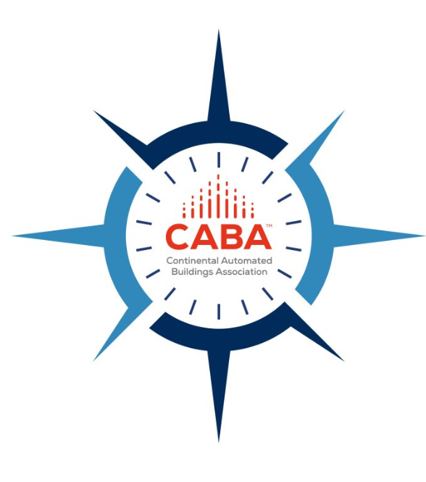
CABA Vision, Mission, Goals

Slide 2
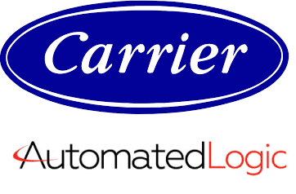
CABA Board of Directors
2

Slide 3
CABA Councils
The CABA Information Council identifies and review white papers and research for the CABA Information Series, the most authoritative source for technical information in the home and large building automation sectors. The Information Series populate the "world's largest" research library for "connected homes and intelligent buildings".
This Council examines industry opportunities that can accelerate the adoption of new technologies, consumer electronics and broadband services within the burgeoning connected home market.
This Council specifically reviews opportunities, strategizes, takes action and monitors initiatives that relate to integrated systems and automation in the "large building" sector. The Council is comprised of leading and visionary representation from all segments of the building industry including manufacturers, service providers, building owners and building professionals.
3
© 2020, Continental Automated Buildings Association

Slide 4
CABA Research
“The Connected Home and AI” 2021 CHC Landmark Research

Slide 5
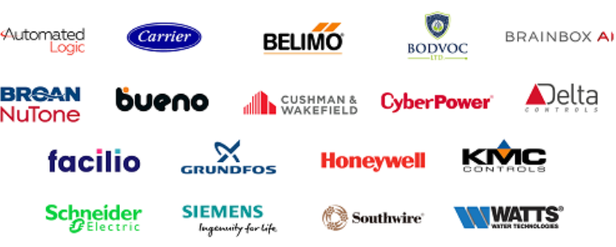
CABA Research
2021 IBC Landmark Research “AI and Predictive Maintenance in Intelligent Buildings”

Slide 6
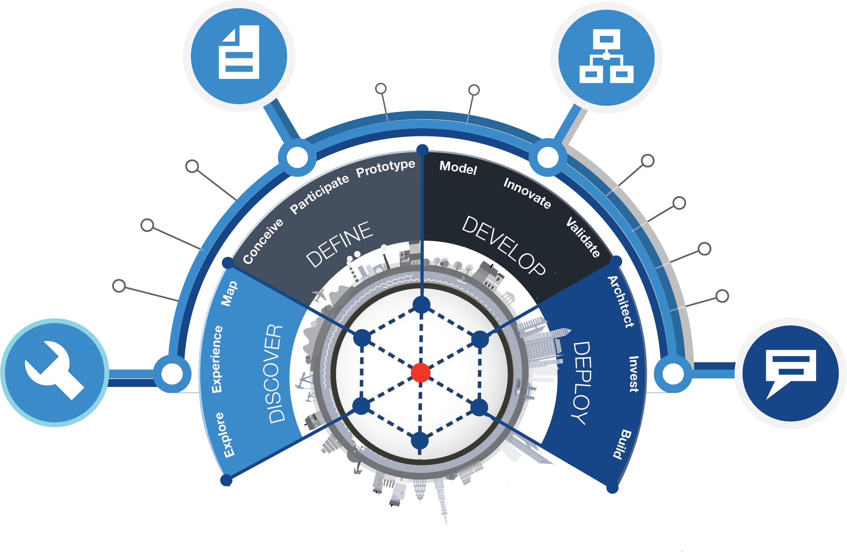
About Harbor Research & Our Services
Firm History
Harbor Research was the first firm to focus on Smart Systems, Services and the Internet of Things (IoT) and first to publish groundbreaking research on new business models in the Harvard Business Review in 2004 & 2005.
Overview of Harbor’s Services
Research Services
Our research, tracking, and market intelligence services provide an accessible learning environment for those who are trying to wrap their arms and minds around emerging disruptive opportunities.
Strategy Consulting
Our strategy and business development consulting services deliver creative innovation tools, practical methods and applied problem solving.
Smart Systems Lab
Our lab enables subscription-based clients to co-develop their business models, technologies, products and services in close collaboration with partners and peers, supported by our ability to design, prototype, and test new models for delivering value & differentiation.
Clients and Engagements
For over 30 years we have focused on identifying, analyzing and helping clients to develop or adopt emergent technologies. Every relationship we develop is enhanced by the range and depth of these experiences.
Growth
Strategy
Development
Business
Model
Design
Technology Developers & Suppliers
STRATEGY
DESIGN
100+
400+
clients
engagements
Analyst Interactions & Support
Collaboration Workshops
Scenario Planning,
Modeling & Forecasts
Tech Discovery Forums
OEMs and Service Providers
Innovation Workshops
150+
600+
Technology Research
& Market Analysis
Smart Systems Lab
clients
engagements
FORUMS
RESEARCH
Offices
Denver, Colorado - USA
Berlin, Germany - Europe

Slide 7
Maintenance Solutions are Evolving Towards Predictive With AI
The adoption of new monitoring, data management, and analytics technologies is enabling predictive maintenance strategies that coordinate OEMs, Service Providers, and end customer personnel in increasing asset uptime
Reactive Maintenance
OEM/SP
Services Enabled
Field Maintenance & Repair Services
Customer Support
Service Contract & Management
Reactive Maintenance
The traditional method of OEM repair & replacement services is still in use today, with end users reacting to service events (planned or unplanned) by contacting OEMs for assistance
Equipment Failure
OEM / Service Provider Investigates
Request Repair
Repair, replacement, or new product is offered
End User
Reactive with Regular Service Contract
Service Contract
OEM/SP
Services Enabled
Asset Management & Reliability
Supply Chain / Logistics Management
Some OEMs and end customers have evolved to reactive maintenance with a regular service contract, enabling end users and OEMs to collaborate live on device issues and troubleshoot before breakdowns
Regular repair services
Equipment Failure
Provides support within contract language
End User
Predictive Maintenance
Shared product ownership & full transparency
OEM/SP
Services Enabled
Predictive Maintenance
Supply Chain / Logistics Management
Uptime as a services
Through advancements in connectivity and the integration of historic part and failure data within predictive models as well as changes in end user preference, OEMs and End Users can effectively share product ownership and maximize uptime
Real-time evaluation
Anomaly detection
Failure prediction
Asset & location tracking
Predictive insights
End User
Close collaboration & data transparency enable:

Slide 8
Overview of Report Elements & Supporting Materials
Harbor will use a combination of secondary and primary research to support each section of the report. In addition, an AI&PMIB forecast model will augment our research with quantitative market sizing data and trends
The Evolution of AI & Predictive Maintenance in Intelligent Buildings
The Evolving Consumer: Realizing the Promised Value of Predictive Maintenance
The Role of Predictive Maintenance in Intelligent Buildings
Artificial Intelligence is Enabling a New Generation of Predictive Maintenance Apps
Conclusions & Recommendations
Introduction to the project, intelligent buildings, and predictive maintenance
Deep dive into the changing customer demographics and needs that are driving the need for AI&PM solutions
Technology, solution, and player landscape of AI&PM, and how it is evolving
Deep dive into AI’s role in augmenting predictive maintenance and enabling new services for Intelligent Buildings
Summary of key points and recommendations to ecosystem participants
Topics Covered
Introduction: Smart Systems and services in IBs
Trends and forces
Definition and evolution of predictive maintenance & its benefits
Introduction to AI
Overview of predictive maintenance requirements, components, and market size
Ecosystem analysis of PM players and stakeholders
Pain points with current maintenance solutions
Emerging considerations
Explanation of how AI can improve predictive services in Intelligent Buildings
Barriers to adoption (e.g. data quality, privacy)
Technical architecture and future applications
Overview of changing demographics, including analysis of survey results
Pain points that frustrate operators the most
Willingness to pay for AI&PM solutions and preferred prices and packages
Summary & call to action to improve AI&PMIB
Recommendations by player type (including short term, medium term, and long term)
Final remarks
Core Supporting Materials
Secondary research
IDI’s with experts
Secondary research
IDI’s with experts
IDI’s with suppliers
Secondary research
AI&PMIB forecast model
IDI’s with experts
IDI’s with suppliers
Secondary research
Customer survey
IDI’s with experts
IDI’s with suppliers
Secondary research
AI&PMIB forecast model
IDI’s with experts
IDI’s with suppliers
8
© 2021, Continental Automated Buildings Association

Slide 9
The Surveys Highlight Usage & Purchasing Behaviors
These surveys aim to understand maintenance management needs, pain points, and value drivers from the vantage point of purchasers and beneficiaries. This includes the variables affecting adoption of AI & predictive maintenance software
Building Operator Survey
Building Occupant Survey
~250-300 Total Respondents
~250-300 Total Respondents
Rationale & Key Goals
Understand how maintenance is currently managed, what the main pain points are that operators contend with, building’s technology maturity & buying behavior, predictive maintenance readiness and willingness to pay
Understand how maintenance is currently managed, what pain points occupants are facing, whether they would welcome a predictive maintenance system, and how much they would be willing to pay for the benefits these systems bring
Facility Managers
Facilities Staff
Building Managers
Operations Executives
IT Purchasing/Procurement Managers, Buyers, and Purchasing Agents
Commercial Property Managers
Target Roles & Titles
Tenants in Residential or Commercial Building
Office/Clinic/Outlet Managers
Tenants are willing to pay marginally more per month to ensure uninterrupted operation of vital systems, such as HVAC or elevators
Tenants would like increased predictability around maintenance scheduling and increased transparency around progress
Tenants are indifferent about the use of artificial intelligence in predicting system or equipment failure
Tenants do not believe that they should be responsible for any part of the maintenance management process, from reporting to scheduling and fixing
Others?
Key Hypotheses to Validate
Facilities managers welcome automation of basic tasks such as scheduling, but worry about automating more complicated tasks, like deciding on when to fix a leak during a busy period
Predictive maintenance systems on the market today are difficult to integrate with legacy buildings technologies and systems
Facilities managers often have little to no visibility into the purchasing of a maintenance management software
Buildings’ operators tend to prioritize mission-critical and safety-critical applications for technology investment
Others?

