Slide 1
Intelligent Buildings and COVID-19
Smart & Healthy Buildings Summit
Sydney, Australia
March 24-25, 2021
Ron Zimmer, CABA President & CEO

Slide 2
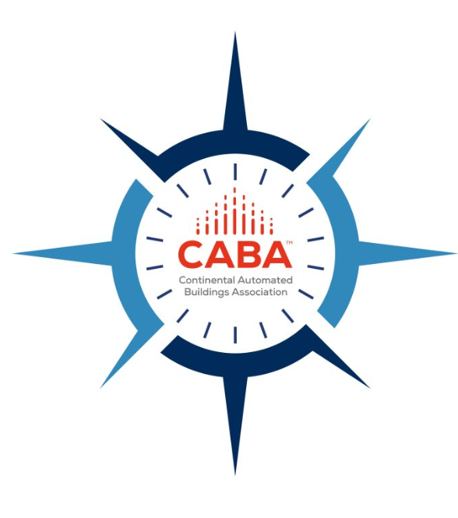
CABA Vision, Mission, Goals

Slide 3
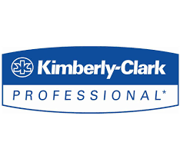
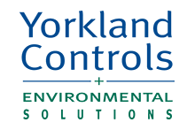
CABA Intelligent Buildings and COVID-19: Leverage Technology for Safer and Healthier Environments Research Report

Slide 4
Areas to Focus on to Mitigate COVID-19 Spread in Buildings
Federal, state, and local government regulations
Standalone, equipment-level technologies and services
Shared, transparent, and efficient communication
Optimizing a building’s sensor network
Healthy Building Standards
Top Eight Focus Areas for Workforce Re-Entry
Facilities management
Mechanical, Electrical and Plumbing (MEP) Safe-Start Strategies
Workforce Productivity
4

Slide 5
Mitigation Strategies for COVID-19 in Workplaces
High
Elimination of exposure
Stringent work-from-home policies
Selective Activity
Building access restricted to critical workforce
Effectiveness of Mitigation Strategies
Engineering Controls
9 foundations of a healthy building
Administrative Controls
Social distancing and reducing workplace density
Low
PPE
Masks and other protective gear
Source: CABA Intelligent Buildings and COVID-19 Report
Notes:
Presenter
2020-04-21 20:49:33
--------------------------------------------
- Thank 8 funders, without their financial support not happened.
- All the funders were on the Steering Committee
Also contributed with insights and direction to the research and shaped an guild the research.
------------------------------------------------------------------------------------------------

Slide 6
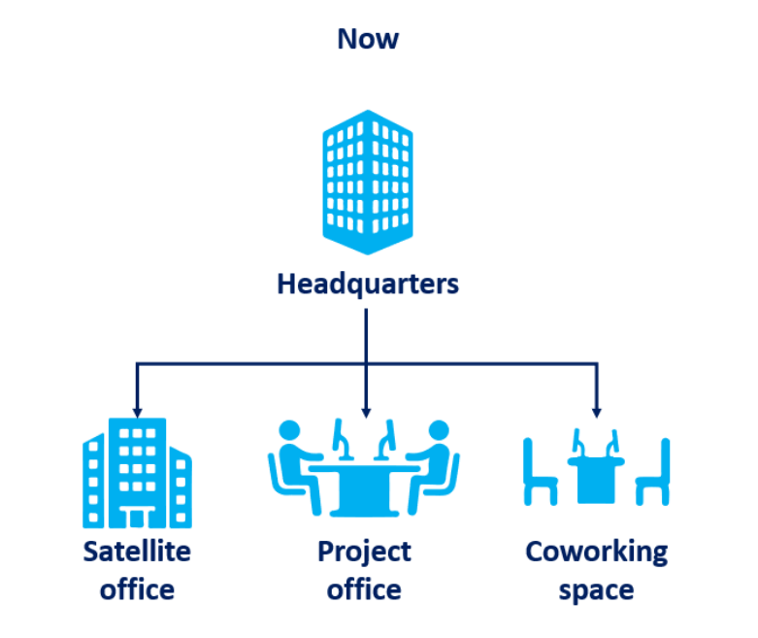
Future of Workplaces
Notes:
Presenter
2020-04-21 20:49:33
--------------------------------------------
- Thank 8 funders, without their financial support not happened.
- All the funders were on the Steering Committee
Also contributed with insights and direction to the research and shaped an guild the research.
------------------------------------------------------------------------------------------------

Slide 7
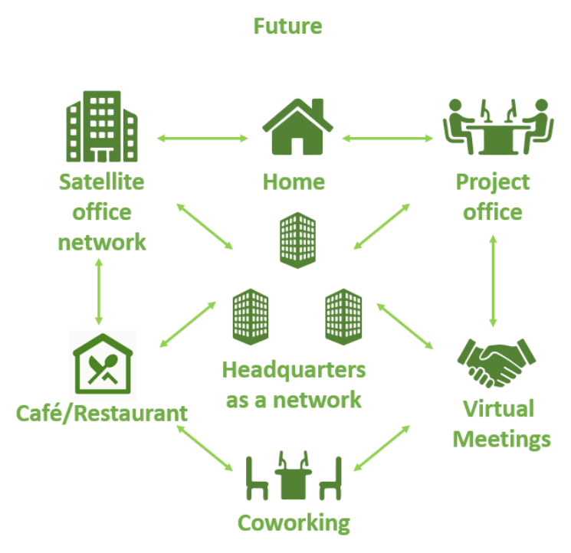
Future of Workplaces
Notes:
Presenter
2020-04-21 20:49:33
--------------------------------------------
- Thank 8 funders, without their financial support not happened.
- All the funders were on the Steering Committee
Also contributed with insights and direction to the research and shaped an guild the research.
------------------------------------------------------------------------------------------------

Slide 8
Implications for Technology and Resource Planning
Along with basic mitigation measures it is critical for building owners to adopt and develop technology-based MEP safe-start strategies prioritizing nice foundations of healthy buildings.
Foundations of a Healthy Building
The American Industrial Hygiene Association (AIHA) emphasize the importance of relative humidity control.
AIHA advises building managers to hire a certified industrial hygienist and other occupational health and safety professionals to review and assess the risks.
Building owners must adopt technology-based building controls involving AI-driven buildings, cloud-based remote services and IoT-enabled sensor networks to develop MEP safe-start strategies
Ventilation
Thermal Health
Indoor Air Quality (IAQ)
Moisture
Dust & Pests
Lighting & Views
Safety& Security
Acoustics
Water Quality
8

Slide 9
Technology Radar 2020-2025
50
ESTABLISHED
Cloud-based
Remote services
Predictive
maintenance
Workplace
analytics
Antimicrobial
paints in
wash rooms
Lighting & Control
Post-COVID Applications
Pathogen
scanner
HEPA
filters
UVGI
Occupancy detection (OD) based social distancing
Indoor positioning (IP) based contact tracing
AI-based face and mask detection
Antimicrobial paints in wash rooms
Foot operated elevator
Touch-free bathroom fixtures
Thermal imaging
AI-based access control
Building health performance benchmarking (BHPB)
Pathogen scanner
Nano technology (NT)-based self cleaning surfaces
Touch-free toilet seat cover cleaning
HVAC
optimization
Touch-free
bathroom
fixtures
AI-based lighting control
Voice enabled Lighting Control
Human-centric Lighting
BHPB
BEPO
IAQ-based
ventilation
IMPLEMENTATION
Cloud-based
Remote services
AI-based
lighting control
Automation & Energy
Optimization
HVAC
optimization
Antimicrobial
paints in
wash rooms
UVGI
BLE
Building energy performance optimization (BEPO)
Cloud-based remote services
Predictive maintenance
Digital twin
Workplace analytics
Human-centric
lighting
OD-based
social distancing
Technology Index Score
IP-based
contact tracing
Workplace
analytics
Touch-free
bathroom fixtures
Thermal imaging
Digital twin
AI-based
access control
HEPA filters
IAQ-based
ventilation
Touch-free toilet seat cover cleaning
Predictive
maintenance
Pathogen scanner
BEPO
Foot operated
elevators
AI-based face
and mask detection
NT-based self
cleaning surfaces
Narrowband communication
Voice-enabled
lighting control
HVAC & IAQ
HVAC optimization
Indoor air quality (IAQ)-based ventilation
Ultraviolet germicidal irradiation (UVGI)
High efficiency particulate air (HEPA) filters
UVGI
OD-based
Social distancing
Communication
AI-based access control
BHPB
Power over Ethernet (PoE)
Narrowband communication
Bluetooth Low Energy (BLE)
AI-based
lighting
control
Voice-enabled
lighting control
AI-based face
and mask detection
BLE
TRIAL
Antimicrobial
paints in
wash rooms
Thermal imaging
IAQ-based
ventilation
Narrowband communication
PoE
IP-based
contact tracing
Foot operated
elevators
Digital twin
0
9
2020
2025
Source: CABA Intelligent Buildings and COVID-19 Report

Slide 10
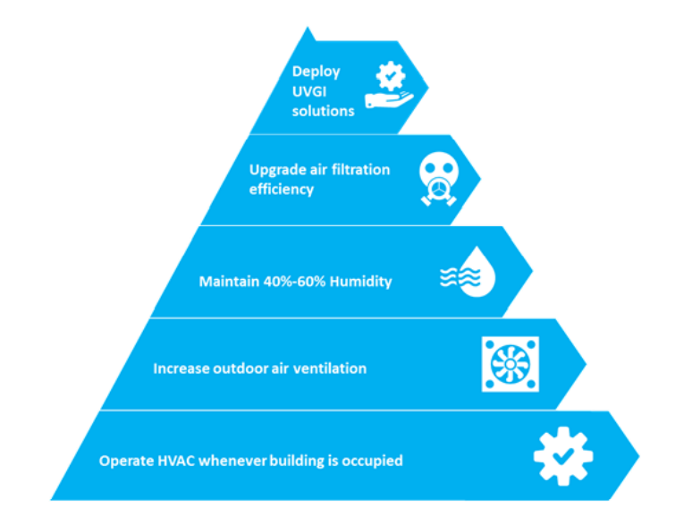
Optimizing HVAC Systems to Reduce COVID-19 Transmission and Improve Effectiveness
Notes:
Presenter
2020-04-21 20:49:33
--------------------------------------------
- Thank 8 funders, without their financial support not happened.
- All the funders were on the Steering Committee
Also contributed with insights and direction to the research and shaped an guild the research.
------------------------------------------------------------------------------------------------

Slide 11
Facility Managers’ Technology and Service Requirements During the Pandemic
Building health assessment
Indoor air quality (IAQ) solutions
Data driven services
Health and wellness standards
Notes:
Presenter
2020-04-21 20:49:33
--------------------------------------------
- Thank 8 funders, without their financial support not happened.
- All the funders were on the Steering Committee
Also contributed with insights and direction to the research and shaped an guild the research.
------------------------------------------------------------------------------------------------

Slide 12
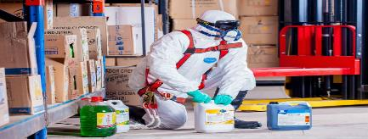
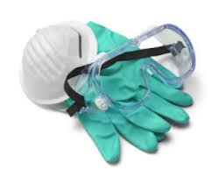
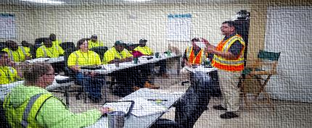
Intelligent Buildings Dictated by the “New Normal”
Reversing Open Offices
Deep cleaning and sanitation of facilities
Buildings & Systems Recalibration
Redesigning with adequate occupant distancing
Refurbishing office setups
Supporting hybrid workforce, WFH
Frequent cleaning with enhanced standards
Space usage measurement technology for occupant management and optimizing cleaning with pathogen detection capability offsite
Retuning, recalibration and augmentation of systems for reentry
Incremental checks, including re-certs
Touch-free & Contact-free Infrastructure
Air Management, Health and IEQ
Working Capital Shortage
Retrofitting to no-touch systems, including entry and access
Foot activated elevators (Toe-to-Go)®
Touch less fixtures and controls, faucets
Non-thermal, plasma technology to reduce cross-contaminant risks (AirPHX) ®
Quality ventilation to reduce pathogens
Anti-microbial paints
Non-contact infrared sensors with integration on mobile platforms
Clients delaying payments, projects, with wage liabilities
Existing pool of FM workers under-prepared
Impeded supplies against greater demand
12
Source: CABA Intelligent Buildings and COVID-19 Report
Notes:
https://economictimes.indiatimes.com/industry/services/property-/-cstruction/covid19-impact-facility-management-companies-ensure-workers-engagement-with-extra-incentives/articleshow/75118404.cms?from=mdr
https://blog.infraspeak.com/challenges-fm-2019/

Slide 13
Key Takeaways
Key Takeaways
Negative growth impact witnessed in lighting and controls , heating, ventilation and air conditioning equipment and controls, building automation systems controls, and facilities management markets.
Positive growth software service segments such as digital lighting services, building energy management systems, artificial intelligence (AI)-driven building solutions, building information modeling, and digital twins are set to play a critical role in providing data-driven insights to facility managers.
Key Takeaways
Facility managers to follow occupational safety and health administration COVID-19 planning guidance for effective control measures as well as American society for heating, refrigeration and air conditioning engineers guided mechanical, electrical and plumbing (MEP) safe-start strategies for in-depth engineering controls in workplaces.
Facility managers need to adapt to some of the key changes that are required in the comprehensive building health assessment, prioritizing indoor air quality, adoption of data-driven services and compliance with building health standards to evaluate the right balance between maintaining health and wellbeing as well as maximize productivity of occupants
WELL and RESET healthy building standards will have a crucial role to play in creating a framework for healthy building performance index to assess the health performance of buildings. Accredited professionals of those standards will assess and certify health performance of buildings.
13

Slide 14
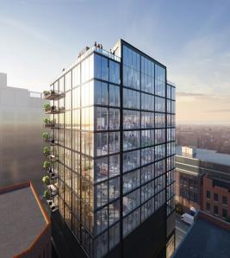
CREATING RESILIENT SMART BUILDINGS: AN ILLUSTRATION
Creating Resilient Smart Buildings: An Illustration
A Toe-To-Go elevator system provided by MAD Elevator Inc. with foot-operated call buttons to reduce the spread of virus.
An airPHX purification system that uses atmospheric cold plasma technology to convert some oxygen molecules into oxidizing molecules to kill pathogens in the air and on surfaces.
Touch-free thermal scanning in the lobby to measure body temperature.
A touch-free access control system with mobile access.
Paint Shield, a microbicidal interior latex paint from Sherwin-Williams, on washroom walls to kill pathogens such as Staphylococcus aureus, methicillin-resistant Staphylococcus aureus (MRSA), Escherichia coli (E. coli), vancomycin-resistant Enterococcus faecalis (VRE), and Enterobacter aerogens.
Sloan touch-free faucets, soap dispensers, and flush valves, and SloanTec hydrophobic glaze on washroom fixtures.
Fulton East, a 12-story, 90,000-square-foot office and retail building in Chicago’s Fulton Market district, is the first commercial building to be designed, constructed, and commissioned for a post-COVID-19 environment.
14

Slide 15
Contact CABA
Continental Automated Buildings Association (CABA)
T: 613.686.1814
TF: 888.798.CABA |2222|
Email: caba@caba.org | Website: www.caba.org
Twitter: http://www.twitter.com/caba_news
LinkedIn: https://www.linkedin.com/groups/2121884/
Connect to what’s next™

