Slide 1
Smart Cities and Intelligent Buildings
5th Annual Smart Cities International Virtual Symposium 2021
February 23-24, 2021
Ron Zimmer, CABA President & CEO

Slide 2
About CABA
CABA (Continental Automated Buildings Association)
The Continental Automated Buildings Association (CABA) is an international not-for-profit industry association, founded in 1988, dedicated to the advancement of connected home and building technologies. The organization is supported by an international membership of over 375 organizations involved in the design, manufacture, installation and retailing of products relating to home automation and building automation. Public organizations, including utilities and government are also members. CABA's mandate includes providing its members with networking and market research opportunities. CABA also encourages the development of industry standards and protocols and leads cross-industry initiatives.
Please visit http://www.caba.org for more information.
Vision
CABA advances the connected home and intelligent buildings sectors.
2

Slide 3
CABA Board of Directors
3

Slide 4
What are Major Smart City Drivers
Growing urbanization. People are moving to cities at an unprecedented rate. Over 700 million people will be added to urban populations over the next 10 years.
Growing stress. Today’s cities face significant challenges – increasing populations, environmental and regulatory requirements, declining tax bases and budgets and increased costs
Inadequate infrastructure. Urbanization is putting significant strain on city infrastructures that were, in most cases, built for populations a fraction of their current size.
Growing economic competition. The world has seen a rapid rise in competition between cities to secure the investments, jobs, businesses and talent for economic success. Increasingly, both businesses and individuals evaluate a city’s “technology quotient” in deciding where to locate.
4

Slide 5
What are Major Smart City Drivers
Growing environmental challenges. Cities house half of the world’s population but use two-thirds of the world’s energy and generate three-fourths of the world’s CO2 emissions. If we are going to mitigate climate change, it will have to happen in cities.
Growing expectations. Citizens are increasingly getting instant, anywhere, anytime, personalized access to information and services via mobile devices and computers. And they increasingly expect that same kind of access to city services
Rapidly improving technology capabilities. Many of the smart city drivers listed above are negatives – problems that demand solutions. Positive drivers do exist, especially the rapid progress in technology. The costs of solutions are dramatically declining. Additionally, in some areas, a substantial amount of the infrastructure is already installed.
5

Slide 6
Technological Factors
automation
Internet of Things
sensors and data
smart infrastructure
intelligent transportation systems
technology leapfrogging
energy efficiency
integration
autonomous vehicles
microgeneration
e-mobility
data connectivity
additive mfg
artificial intelligence
the quantified self
intelligent buildings
cybersecurity
small-scale solutions
remote services
digital modeling
6

Slide 7
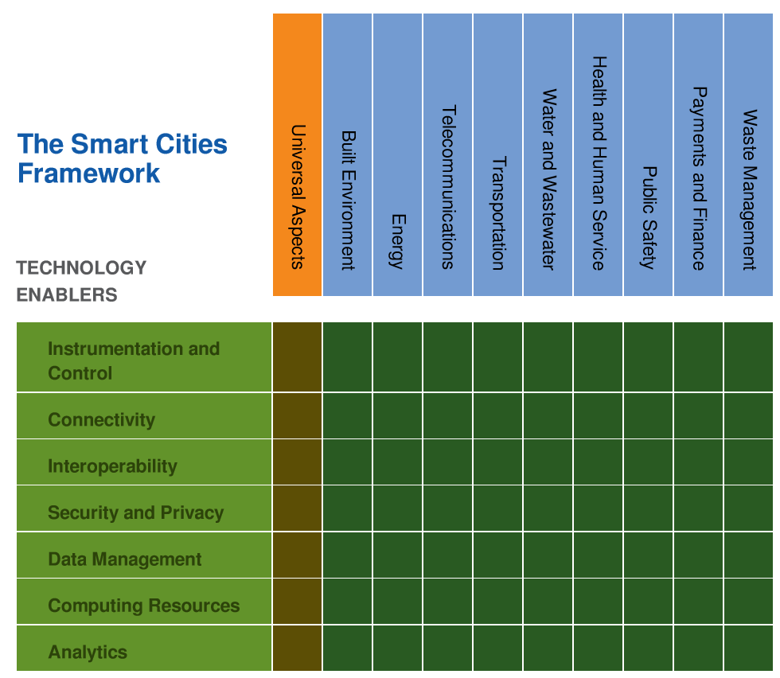
The Nine Smart City Vertical Applications
Buildings
Energy
Telecommunications
Transportation
Water and Wastewater
Health and Human
Services
Public Safety
Payments and Finance
Waste Management
7

Slide 8
The Seven Technologies of a Smart City
Instrumentation and Control
Connectivity
Interoperability
Security and Privacy
Data Management
Computing Resources
Analytics
8

Slide 9
Developing your Smart City Strategy
Examine use of the IEEE P2784 Smart City Planning and Technology Guide in
envisioning, deploying and managing
your Smart City Project
9

Slide 10
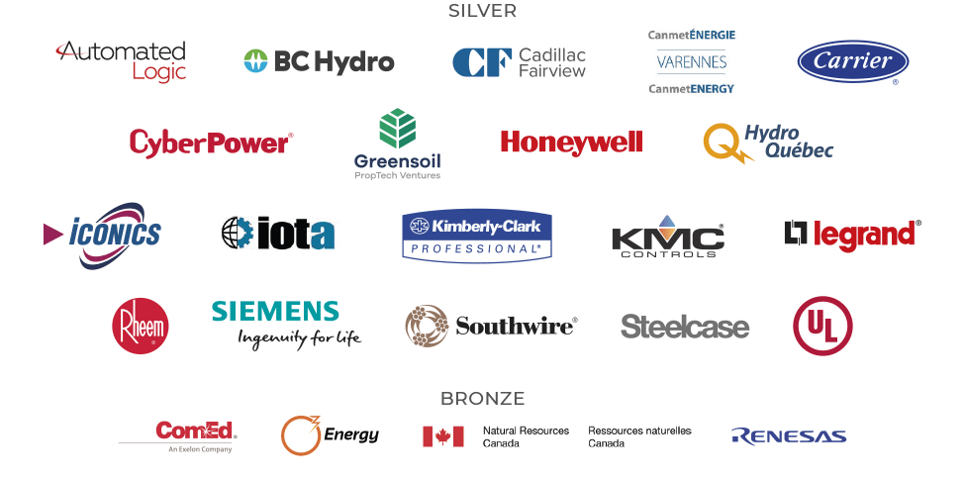
CABA Intelligent Building Energy Management System
Project Steering Committee and Funders
10
Source: CABA Intelligent Building Energy Management System 2020 Report

Slide 11
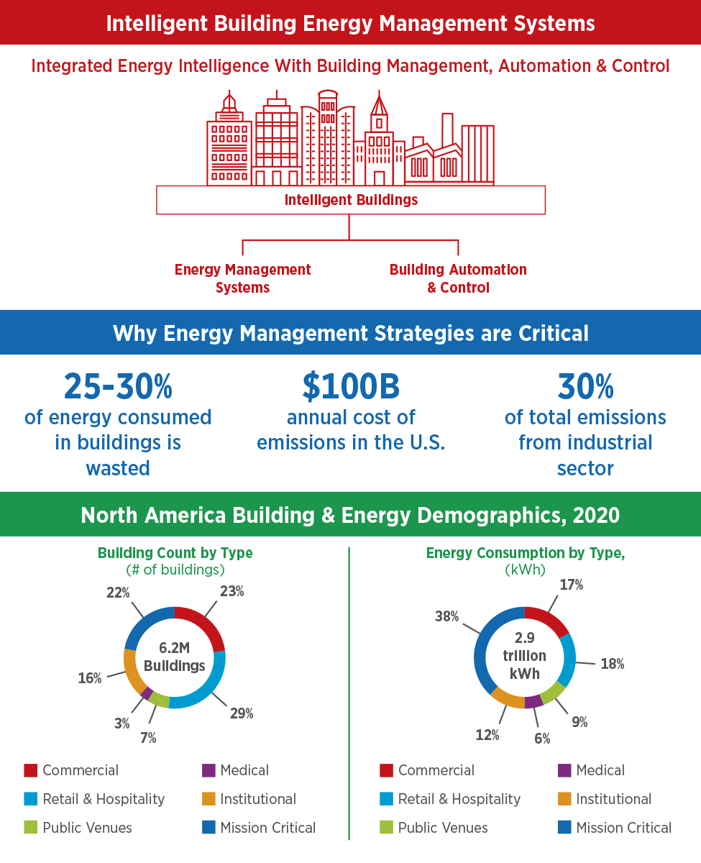
As Intelligent Buildings Mature, Energy Management Becomes Increasingly Critical
Figure ES3 Buildings Across Industries Need to Prioritize Energy Management
11
Source: CABA Intelligent Building Energy Management System 2020 Report

Slide 12
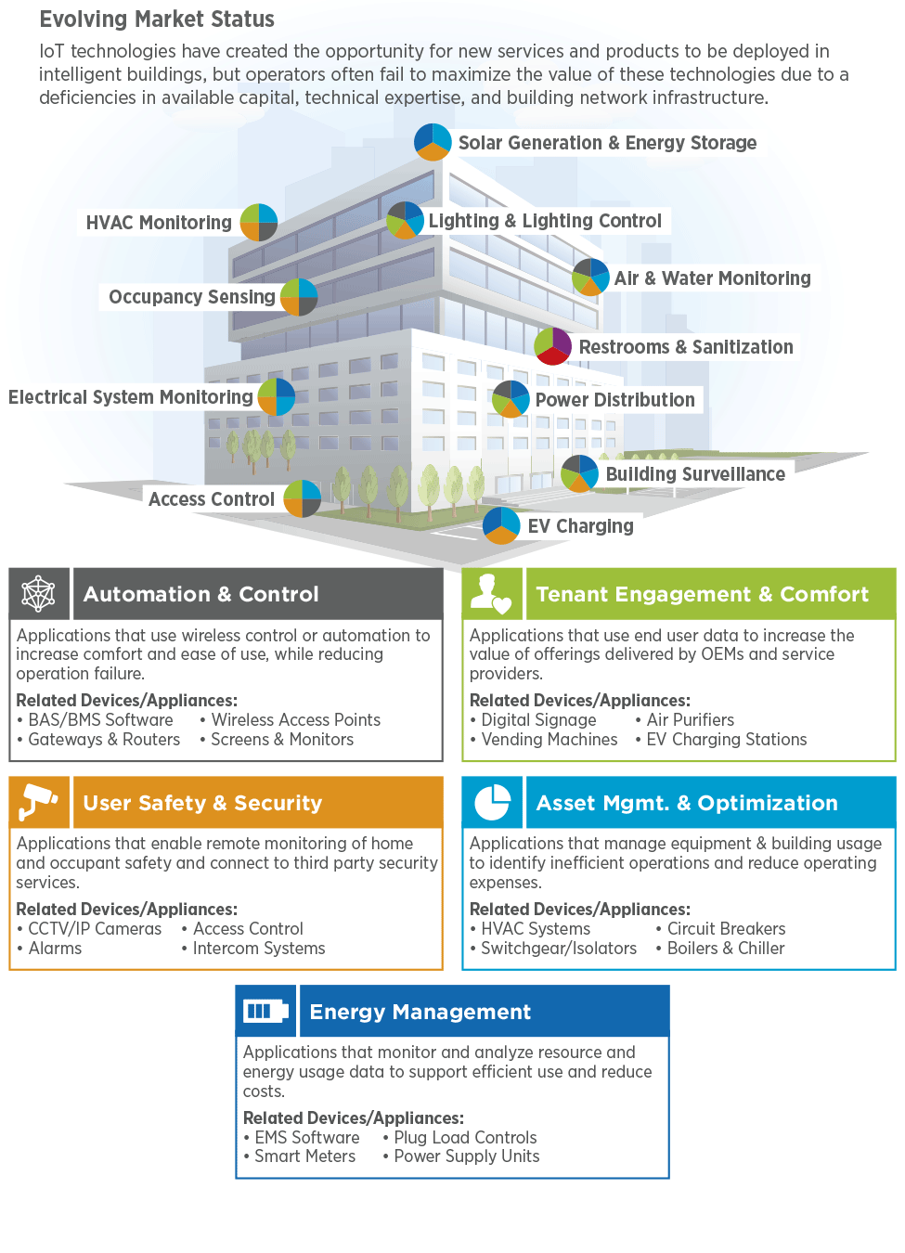
Intelligent Buildings Beget Complex Technologies Ecosystem
12
Source: CABA Intelligent Building Energy Management System 2020 Report

Slide 13
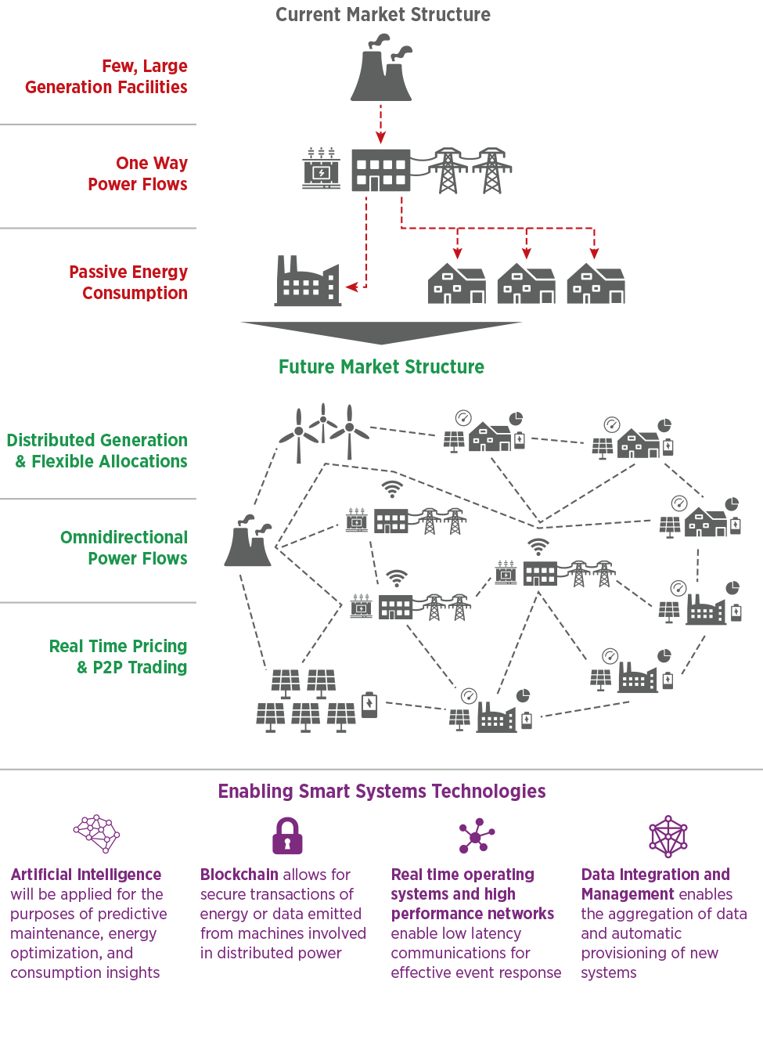
Driven by Technology, a Distributed Energy Future has Nearly Arrived
13
Source: CABA Intelligent Building Energy Management System 2020 Report

Slide 14
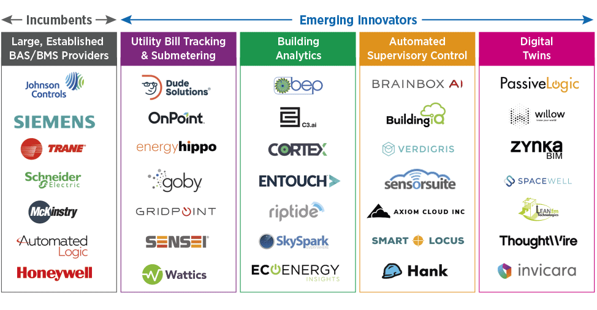
Incumbent IBEMS Suppliers are Threatened by Innovators
Figure 3.3 Innovators are Approaching the IBEMS Market From Different Angles
14
Source: CABA Intelligent Building Energy Management System 2020 Report

Slide 15
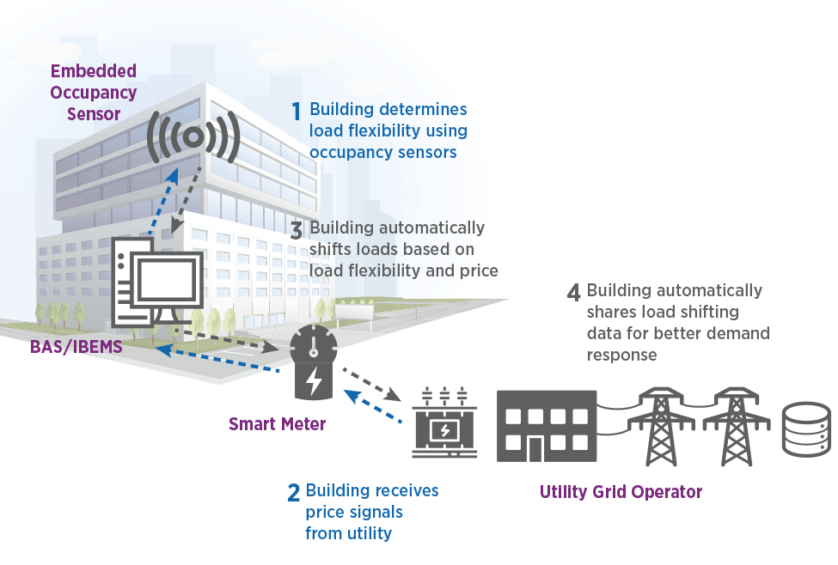
Occupancy Sensing and API’s Automate Grid Interactivity
Figure 4.6 An Example Use-Case of GEB
15
Source: CABA Intelligent Building Energy Management System 2020 Report

Slide 16
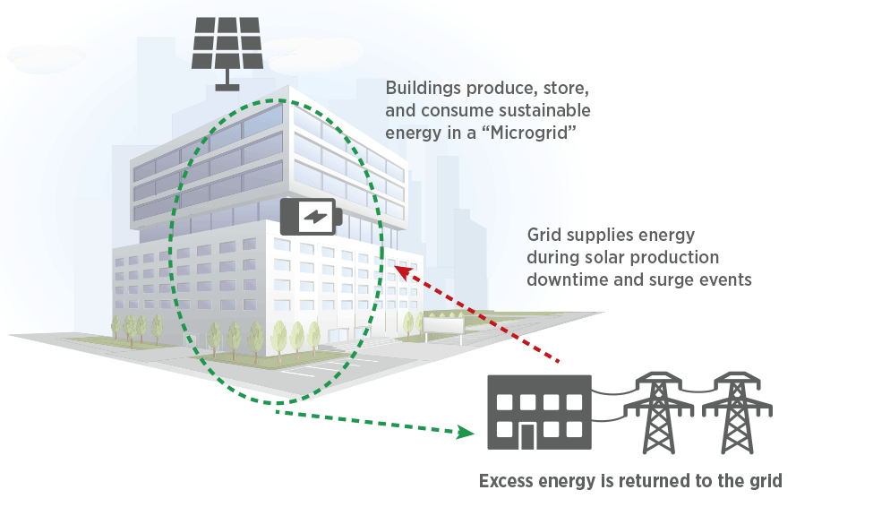
Grid Interactivity Augments Onsite Generation and Storage
Figure 4.8 Grid Interactivity Can Optimize In-Building Energy Production
16
Source: CABA Intelligent Building Energy Management System 2020 Report

Slide 17
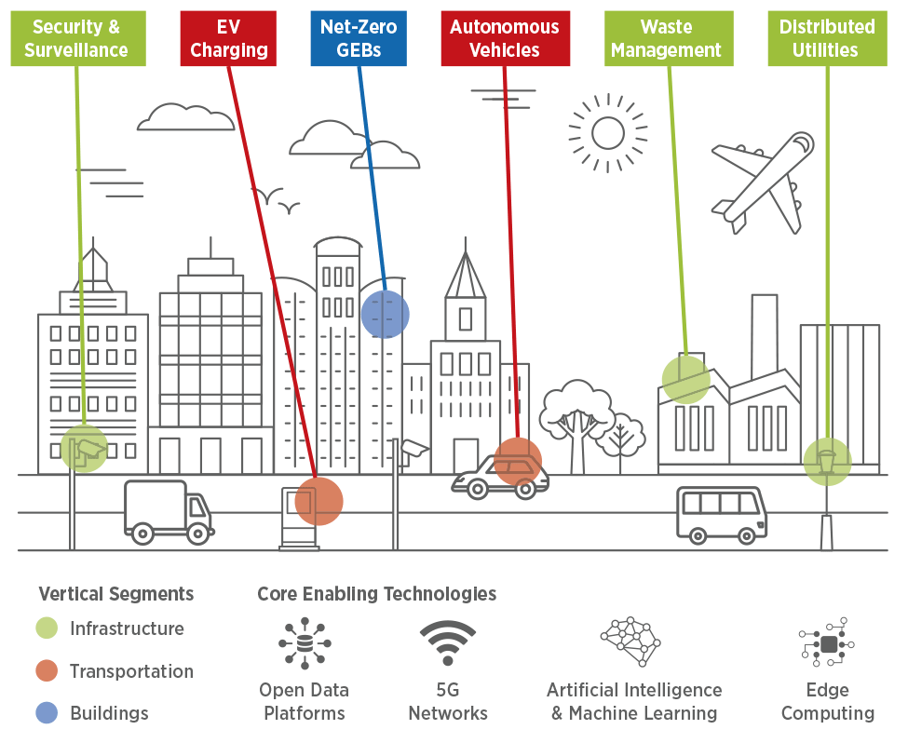
GEBs Allow Buildings to Optimize Energy Consumption and Produce Energy to Enable Smart Cities Applications
Figure 4.9 Building-to-Grid Communication Will Enable Sustainable Smart Cities
17
Source: CABA Intelligent Building Energy Management System 2020 Report

Slide 18
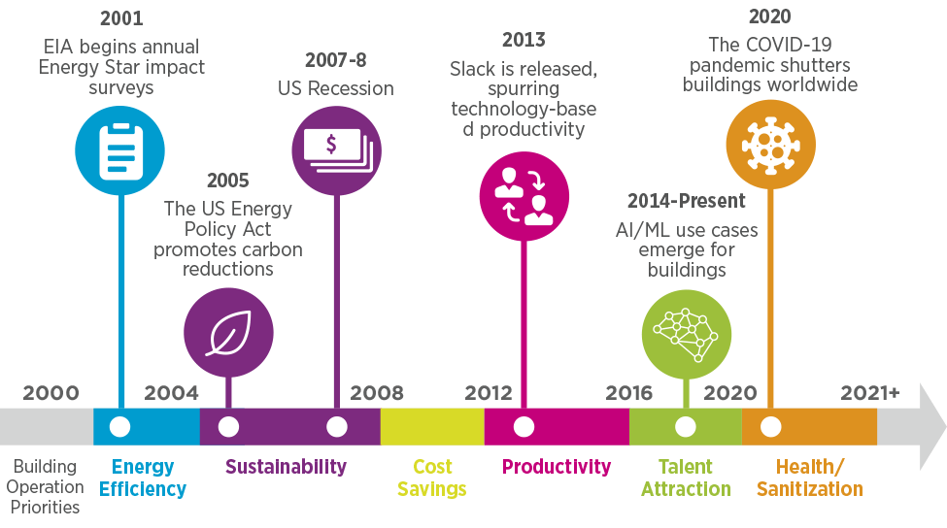
Over Time, Intelligent Building Priorities Have Shifted
Figure 1.2 Building Technology Adoption Priorities are Mercurial
18
Source: CABA Intelligent Building Energy Management System 2020 Report

Slide 19
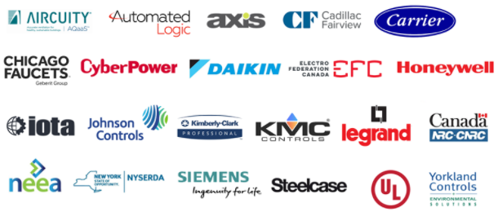
CABA Intelligent Buildings and COVID-19
Project Steering Committee and Funders
19
Source: CABA Intelligent Buildings and COVID-19 Report 2021

Slide 20
Evaluation of Technologies and Applications for Value Creation
Frost & Sullivan predicts nearly 12 technologies and applications to have accelerated deployments at mainstream level by the end of 2024 and 2025.
Technology Radar 2020-2025
50
ESTABLISHED
Cloud-based
Remote services
Predictive
maintenance
Workplace
analytics
Antimicrobial
paints in
wash rooms
Lighting & Control
Post-COVID Applications
Pathogen
scanner
HEPA
filters
UVGI
AI-based lighting control
Voice enabled lighting control
Human-centric lighting
HVAC
optimization
Touch-free
bathroom
fixtures
Occupancy detection (OD) based social distancing
Indoor positioning (IP) based contact tracing
AI-based face and mask detection
Antimicrobial paints in washrooms
Foot operated elevator
Touch-free bathroom fixtures
Thermal imaging
AI-based access control
Building health performance benchmarking (BHPB)
Pathogen scanner
Nano technology (NT)-based self cleaning surfaces
Touch-free toilet seat cover cleaning
BHPB
BEPO
IAQ-based
ventilation
IMPLEMENTATION
Cloud-based
Remote services
AI-based
lighting control
HVAC
optimization
Antimicrobial
paints in
wash rooms
UVGI
BLE
Automation & Energy
Optimization
Human-centric
lighting
OD-based
social distancing
Technology Index Score
IP-based
contact tracing
Workplace
analytics
Touch-free
bathroom fixtures
Thermal imaging
Digital twin
AI-based
access control
Building energy performance optimization (BEPO)
Cloud-based remote services
Predictive maintenance
Digital twin
Workplace analytics
Predictive
maintenance
HEPA filters
IAQ-based
ventilation
Touch-free toilet seat cover cleaning
Pathogen scanner
Foot operated
elevators
AI-based face
and mask detection
BEPO
NT-based self
cleaning surfaces
Narrowband communication
Voice-enabled
lighting control
UVGI
OD-based
Social distancing
HVAC & IAQ
Communication
AI-based
lighting
control
AI-based access control
BHPB
Voice-enabled
lighting control
AI-based face
and mask detection
TRIAL
HVAC optimization
Indoor air quality (IAQ)-based ventilation
Ultraviolet germicidal irradiation (UVGI)
High efficiency particulate air (HEPA) filters
Power over Ethernet (PoE)
Narrowband communication
Bluetooth Low Energy (BLE)
BLE
Thermal imaging
IAQ-based
ventilation
Antimicrobial
paints in
wash rooms
Narrowband communication
PoE
IP-based
contact tracing
Foot operated
elevators
Digital twin
0
2020
2025
20
Source: CABA Intelligent Buildings and COVID-19 Report 2021

Slide 21
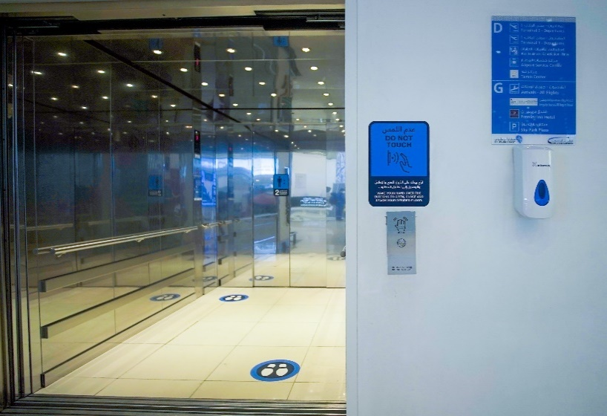
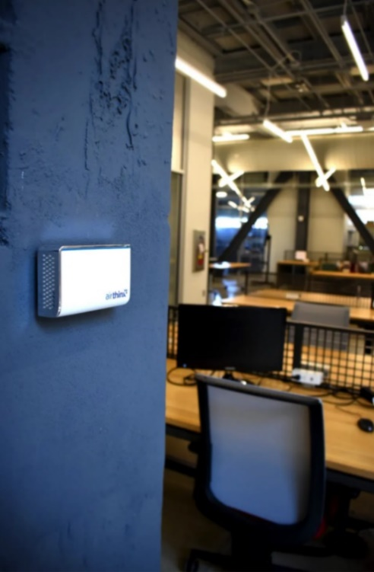
Use Cases and Best Practices Implementation
Best practices examples involving cutting-edge technologies and applications for post-COVID-19 environment are discussed below.
1
2
1. Digital Twin for Future Workplaces: Microsoft in collaboration with Bentley Systems and Schneider Electric rolled out a digital twin of its new regional headquarters at Frasers Tower in Singapore in March 2020. The sensor network collected data from 179 Bluetooth beacons in meeting rooms and 900 sensors for lighting, air quality and temperature by Schneider Electric. The platform generates nearly 2,100 data points that are connected to the cloud on Microsoft Azure, enabling the holistic management of the environment.
2. Post-COVID-19 Applications: A UAE-based start-up company, Meta Touch has developed a touch-less gesture recognition technology known as touch-less Keypad. In June 2020, Abu Dhabi International Airport deployed this solution in 53 elevators. Other measures to contain COVID-19 include thermal imaging, facial recognition and motion sensors to track movement of people.
3. IAQ-based Ventilation: Air quality monitoring company, Airthinx and facilities management company Gilbane partnered to provide air quality solution to one of its clients. Airthinx sensors installed in office buildings monitor CO2, VOCs, CH2O, and particulate matter that affects employee productivity. Gilbane recommended an increase in airflow in areas where the particulate matter spikes were found.
4. IAQ-based Ventilation: An international architect-engineering firm with office space of 50,000 square foot headquartered in the New York city is pursuing WELL platinum standard certification prioritizing health and well-being of employees. IAQ-based ventilation control provider, Aircuity collaborated with the occupants, project engineers, and sustainability consultants to pioneer a ventilation strategy that provided 9 WELL points and attained platinum certification. The solution included a multi-parameter demand control ventilation sequence that is integrated with the building management system to control ventilation not only based on CO₂, but also VOCs and particulate matter.
3
4
21
Source: CABA Intelligent Buildings and COVID-19 Report 2021

Slide 22
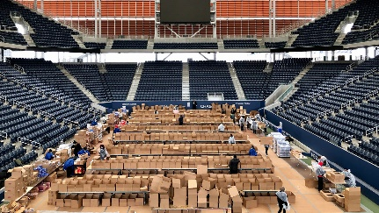
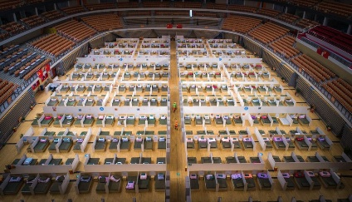
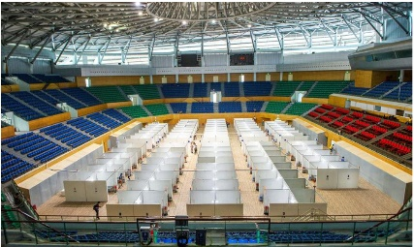
Exploring Alternate Uses of Intelligent Buildings
Several buildings across the world were repurposed to hospitals to meet the growing demand for beds for infected patients.
Examples of stadiums converted to healthcare facilities during the pandemic
Buildings | Locations | Details
Maracana football stadium | Rio de Janeiro, Brazil | Converted to a field hospital with 1,800 beds
Billie Jean King National Tennis Center | New York, USA | Tennis courts converted to 350-bed hospital facility
Watford Football Club Stadium | Watford, UK | Executive Box, studios and meeting rooms used for accommodation of healthcare personal and for counselling rooms
Indira Gandhi Athletic Stadium | Assam, India | Makeshift hospitals with a capacity of at least 1000 people
Commonwealth Games Village Indoor Stadium | New Delhi, India | 500 beds to treat COVI-19 patients
National Stadium | Warsaw, Poland | Accommodation for 500 patients, equipped with oxygen therapy9
Wuhan Sports Center | Wuhan, China | Converted into a 1,100-bed temporary hospital for COVID-19 patients
Tien Son Sport Center | Danang, Vietnam | 1000-bed field hospital to cater to infected patients, should the hospitals become full
22
Source: CABA Intelligent Buildings and COVID-19 Report 2021

Slide 23
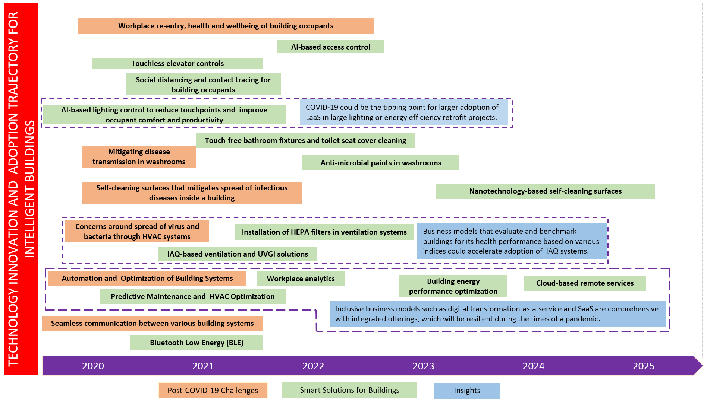
Recommendations
Based on the extensive research over three interrelated modules, this research illustrates a technology innovation and adoption trajectory. This chart highlights the solutions that can address new challenges for intelligent buildings.
This trajectory depicts the solutions that can help address post-COVID-19 challenges, and assigns a tentative timeline by which such solutions could see more mainstream adoption.
While some solutions have already gained prominence before COVID-19, their widespread adoption is expected to accelerate in 2021.
In order to eliminate the spread of pathogens and health concerns inside buildings, touchless systems need to be implemented at the earliest.
23
Source: CABA Intelligent Buildings and COVID-19 Report 2021

Slide 24
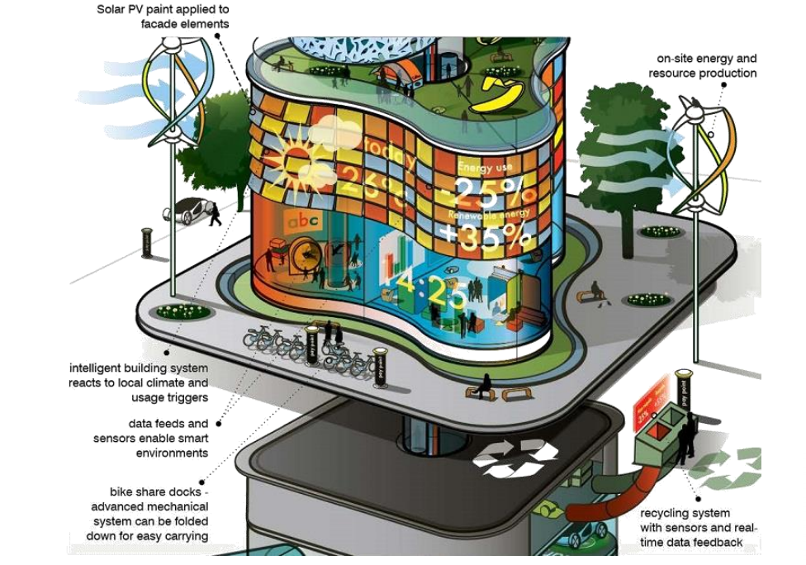
Smart Cities Include Smart Buildings
24
Source: Arup Foresight

Slide 25
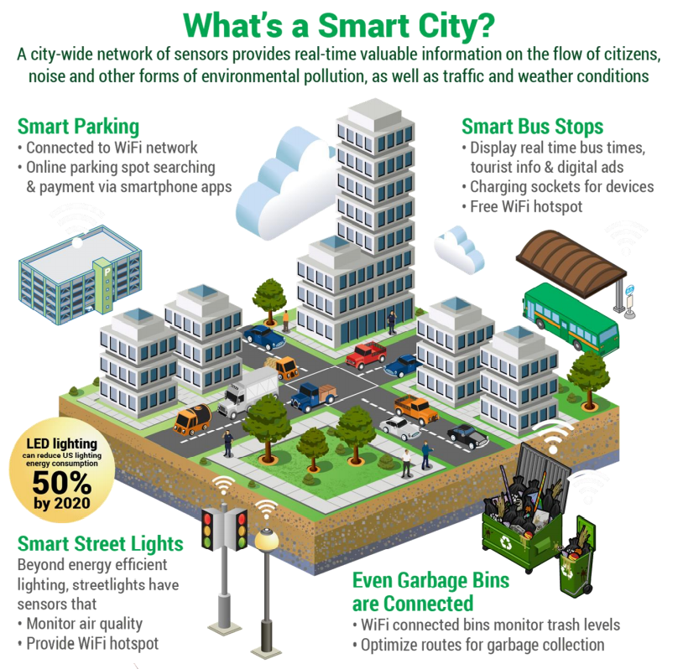
Smart Cities
25
Source: Arup Foresight

Slide 26
Contact CABA
Continental Automated Buildings Association (CABA)
T: 613.686.1814
TF: 888.798.CABA |2222|
Email: caba@caba.org | Website: www.caba.org
Twitter: http://www.twitter.com/caba_news
LinkedIn: https://www.linkedin.com/groups/2121884/
Connect to what’s next™

