Slide 1
CABA Intelligent Buildings Council (IBC) Report

Slide 2


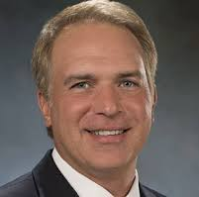
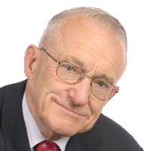
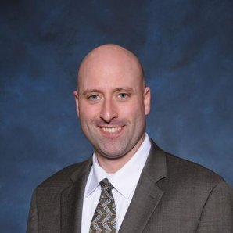





About the IBC
IBC Chair
Trevor Nightingale
Director General
National Research Council
IBC Vice-Chair
Harsha Chandrashekar
Product Approvals & Regulatory Leader
Honeywell International
Inc
IBC Vice-Chair
Terrence DeFranco
President and Chief Financial Officer
Iota Communications, Inc.
IBC Vice-Chair
Robert Lane
President & Managing Partner
Robert H. Lane and Associates Inc.
IBC Vice-Chair
Bob Allan
Global Business Development Manager, Intelligent Buildings
The Siemon Company
The CABA Intelligent Buildings Council works to strengthen the large building automation industry through innovative technology-driven research projects. The Council was established in 2001 by CABA to specifically review opportunities, take strategic action and monitor initiatives that relate to integrated systems and automation in the large building sector. The Council's projects promote the next generation of intelligent building technologies and incorporates a holistic approach that optimizes building performance and savings.
2
© 2021, Continental Automated Buildings Association

Slide 3


IBC Membership
288 Members
All meetings are recorded:
www.caba.org/ibc
3
© 2021, Continental Automated Buildings Association

Slide 4

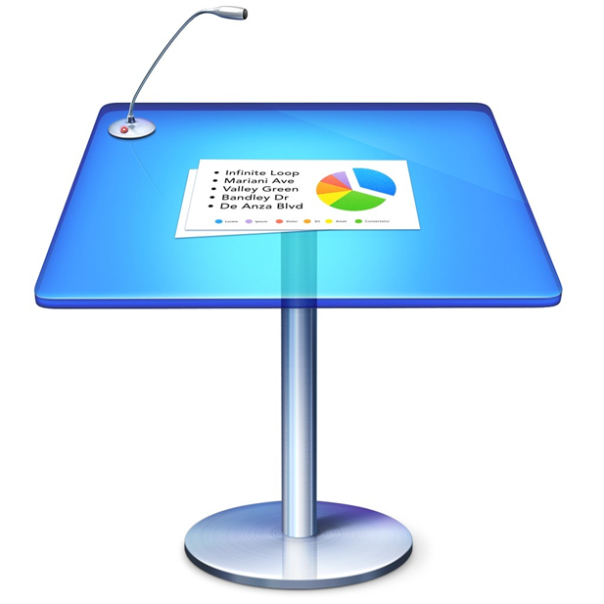
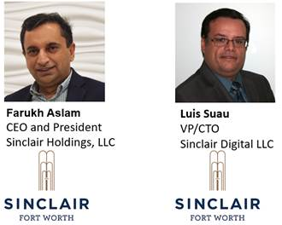
Recent IBC Meetings and Keynotes
August 24, 2020
“Smart Buildings: BEMS, EMIS, FDD, M&V, DCV and COVID”
November 18, 2020
“Digital Building Implementation and Automation at the Marriott Sinclair Hotel”
4
© 2021, Continental Automated Buildings Association
Notes:
Fleet Complete
Approximately 30-40 percent of all commercial vehicles in North America are connected to the world outside and vide versa through telematics technologies, a figure that is expected to double by 2025. These vehicles are reshaping smart mobility business models and not only driving efficiencies in freight and passenger mobility but also creating new opportunities for smart buildings and related infrastructure. Sandeep Kar, Chief Strategy Officer at Fleet Complete will share his views on digitization and its impact on connected vehicle eco-systems and discuss emerging business models that will drive connected vehicles’ interactions with smart buildings and vice-versa. Location based data, autonomous driving, freight digitization, smart parking, and several other emerging technologies and applications will be focal points of his presentation.

Slide 5
Upcoming IBC Meetings and Keynotes
Feb 17, 2021
“Look for the WELL seal: Evidence-based strategies for health & safety in commercial real estate”
Description: From stadiums and hotels to corporate offices and coworking spaces, organizations and facilities all around the world are getting back to business with the support of evidence-based standards, programs and solutions. Founder of IWBI and Founder, CEO of Delos, Paul Scialla, will share how the WELL Health-Safety Rating for Facility Operations and Management is leading the charge in helping buildings and organizations address the health, safety, and well-being of their most valuable asset—people.
5
© 2021, Continental Automated Buildings Association
Notes:
Fleet Complete
Approximately 30-40 percent of all commercial vehicles in North America are connected to the world outside and vide versa through telematics technologies, a figure that is expected to double by 2025. These vehicles are reshaping smart mobility business models and not only driving efficiencies in freight and passenger mobility but also creating new opportunities for smart buildings and related infrastructure. Sandeep Kar, Chief Strategy Officer at Fleet Complete will share his views on digitization and its impact on connected vehicle eco-systems and discuss emerging business models that will drive connected vehicles’ interactions with smart buildings and vice-versa. Location based data, autonomous driving, freight digitization, smart parking, and several other emerging technologies and applications will be focal points of his presentation.

Slide 6
White Paper Sub-Committee Update
In Progress:
“Fire Alarm Systems in Buildings”
Canadian Fire Alarm Association (Chair)
“Part 2: Impacts of Automated Shading in Building Projects”
TRC Energy Services (Chair)
“Architecting Intelligent Self Learning Adaptive Smart Campus Framework for Smart Cities”
NAVTAT Solutions (Chair)
“Needlepoint Bipolar Ionization and its Contribution to Smart and Safe Buildings”
Pure Air Control Services, Inc. (Chair)
“Part 2: The Evolution of Integrating LiFi Technology into Smart Lighting and Control Systems for the Intelligent Building”
Wharton County Junior College (Chair)
All proposals and previously completed CHC White Papers can be downloaded at: caba.org/whitepapers
6
© 2021, Continental Automated Buildings Association
Notes:
6.1 Recently Complete:
“Human Skin Cells: A Potential Source of Building Contaminants"
Author and Chair is Rajiv Sahay (Pure Air Control Services, Inc.)
Paper posted on www.CABA.org/whitepapers

Slide 7
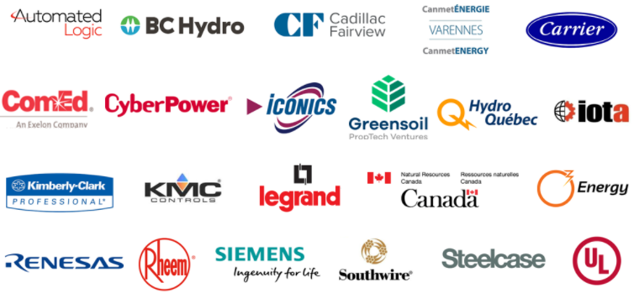

Research Update
“Intelligent Building Energy Management Systems” 2020 IBC Research
© 2021, Continental Automated Buildings Association

Slide 8
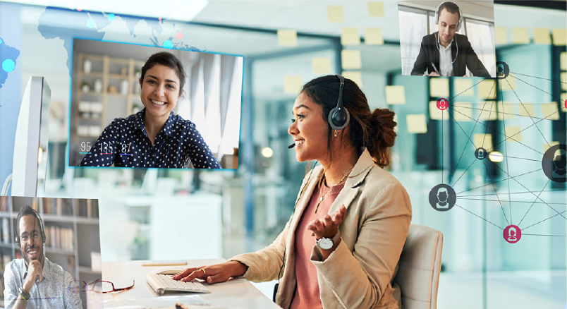
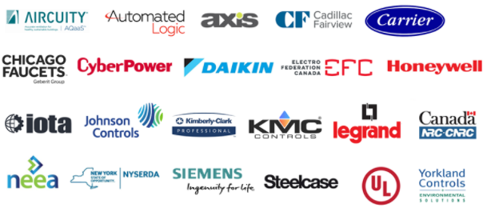
Research Update
“Intelligent Buildings and COVID-19” 2020 IBC Research
© 2021, Continental Automated Buildings Association

Slide 9

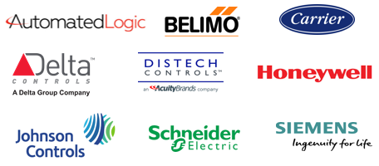
Research Update
New CABA “BACS Market Sizing North America” Annual Research

Slide 10


New IBC Business and Questions?
Next IBC Meeting, Feb 17, 2021
10
© 2021, Continental Automated Buildings Association

