Slide 1
Intelligent Buildings Council (IBC)
Chair: Trevor Nightingale (National Research Council)
Vice-Chair: Harsha Chandrashekar (Honeywell International Inc)
Vice-Chair: Robert Lane (Robert H. Lane and Associates Inc.)
Vice-Chair: Bob Allan (The Siemon Company)
Vice-Chair: Terrence DeFranco (Iota Communications, Inc.)

Slide 2
1. Agenda Greg Walker (CABA)
1. Agenda
2. Call to Order, Welcome, Introductions, about IBC
Administrative
White Paper Sub-Committee Update
5. “Look for the WELL seal: Evidence-based strategies for health & safety in commercial real estate” (30 min)
Paul Scialla (Delos)
6. Research Update
7. New Business
8. Adjournment

Slide 3
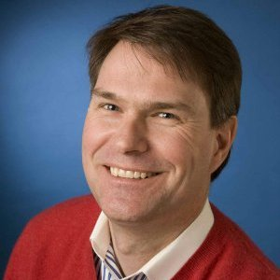
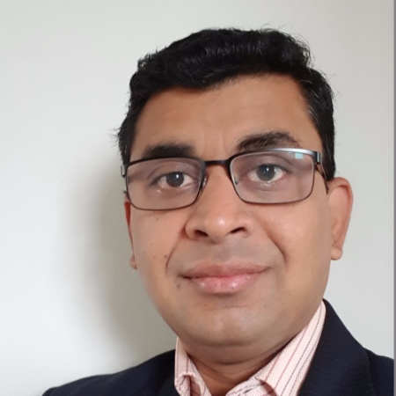
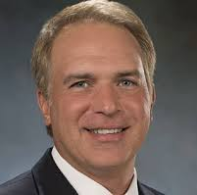
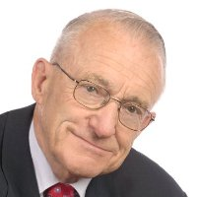
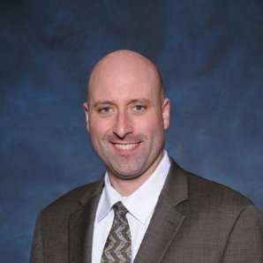
2. Call to Order, Welcome, Introductions, About the IBC Trevor Nightingale (National Research Council)
IBC Chair
Trevor Nightingale
Director General
National Research Council
IBC Vice-Chair
Harsha Chandrashekar
Product Approvals & Regulatory Leader
Honeywell International
Inc
IBC Vice-Chair
Terrence DeFranco
President and Chief Financial Officer
Iota Communications, Inc.
IBC Vice-Chair
Robert Lane
President & Managing Partner
Robert H. Lane and Associates Inc.
IBC Vice-Chair
Bob Allan
Global Business Development Manager, Intelligent Buildings
The Siemon Company
The CABA Intelligent Buildings Council works to strengthen the large building automation industry through innovative technology-driven research projects. The Council was established in 2001 by CABA to specifically review opportunities, take strategic action and monitor initiatives that relate to integrated systems and automation in the large building sector. The Council's projects promote the next generation of intelligent building technologies and incorporates a holistic approach that optimizes building performance and savings.
www.caba.org/ibc

Slide 4
3. Administrative Trevor Nightingale (National Research Council)
3.1 Motion to approve past IBC Minutes (Nov 18): www.caba.org/ibc

Slide 5
3. Administrative Trevor Nightingale (National Research Council)
3.2 Motion to Approve Terrence DeFranco (Iota Communications, Inc.) as the new IBC Chair

Slide 6
4. White Paper Sub-Committee Update Ken Wacks (Ken Wacks Associates)
4.1 In Progress:
Part 2: “Impacts of Automated Shading in Building Projects”
TRC Energy Services (Chair)
Axis Lighting Inc.
Draper, Inc.
Ecotay Inc.
Ken Wacks Associates
Lawrence Berkeley National Laboratory (LBNL)
Lutron Electronics Co., Inc.
Mecho
NYSERDA (New York State Energy Research and Development Authority)
PLC-Multipoint, Inc.
Screen Innovations
Somfy Systems, Inc.
Sustainable Resources Management Inc.
Vistar Energy Consulting
Window Products Management

Slide 7
4. White Paper Sub-Committee Update Ken Wacks (Ken Wacks Associates)
4.1 In Progress:
“Fire Alarm Systems in Buildings”
Canadian Fire Alarm Association (Chair)
exp. US Services, Inc.

Slide 8
4. White Paper Sub-Committee Update Ken Wacks (Ken Wacks Associates)
4.1 In Progress:
“Architecting Intelligent Self Learning Adaptive Smart Campus Framework for Smart Cities”
NAVTAT Solutions (Chair)

Slide 9
4. White Paper Sub-Committee Update Ken Wacks (Ken Wacks Associates)
4.1 In Progress:
“Needlepoint Bipolar Ionization and its Contribution to Smart and Safe Buildings”
Pure Air Control Services, Inc. (Chair)

Slide 10
4. White Paper Sub-Committee Update Ken Wacks (Ken Wacks Associates)
4.1 In Progress:
“Part 2: The Evolution of Integrating LiFi Technology into Smart Lighting and Control Systems for the Intelligent Building”
Wharton County Junior College (Chair)
Acuity Brands, Inc.
ArcoLogix LLC
SnapAV
Ken Wacks Associates
National Electrical Manufacturers Association
Telecommunications Industry Association (TIA)

Slide 11
4. White Paper Sub-Committee Update Ken Wacks (Ken Wacks Associates)
All proposals and previously completed IBC White Papers can be downloaded at:
www.caba.org/whitepapers

Slide 12
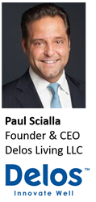
5. Keynote Terrence DeFranco (Iota Communications, Inc.)
“Look for the WELL seal: Evidence-based strategies for health & safety in commercial real estate” (30 min)

Slide 13
5. Keynote - Questions? Terrence DeFranco (Iota Communications, Inc.)

Slide 14
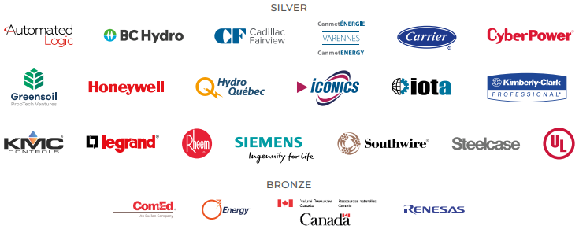
6. Research Update Bob Allan (The Siemon Company)
6.1 2020 IBC Landmark Research “Intelligent Building Energy Management Systems”

Slide 15
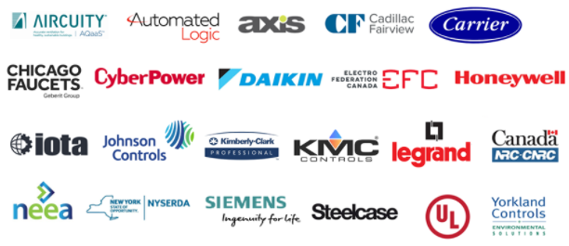
6. Research Update Greg Walker (CABA)
6.2 2019-2020 IBC Landmark Research “Intelligent Buildings and COVID-19”

Slide 16
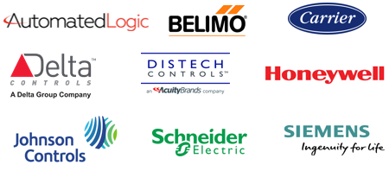
6. Research Update Harsha Chandrashekar (Honeywell International Inc)
6.3 Annual “BACS Market Sizing North America”

Slide 17
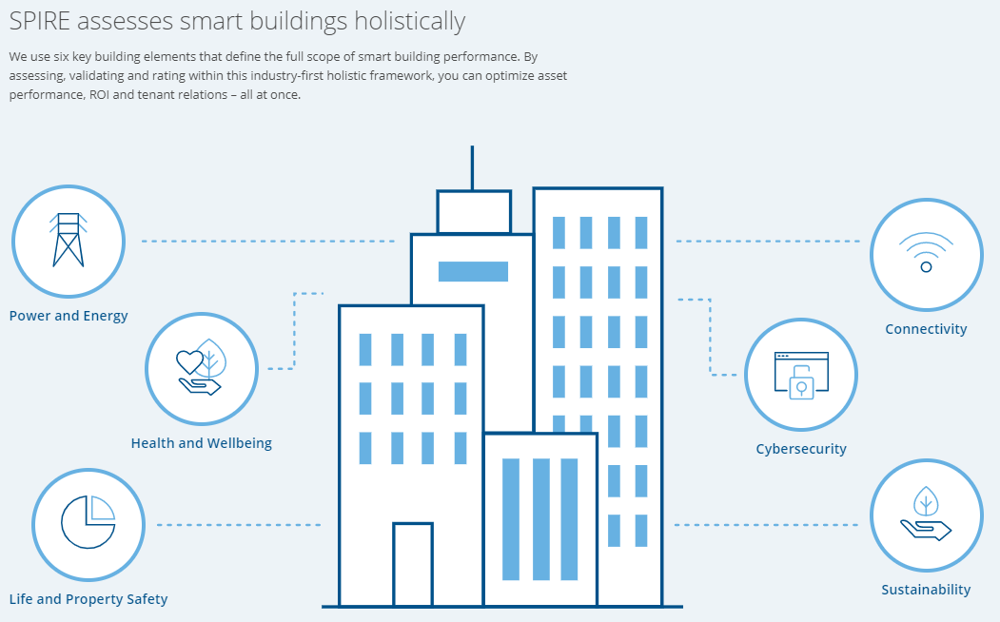
7. New Business Greg Walker (CABA)
7.1 SPIRE Smart Building Program

Slide 18
7. New Business Robert Lane (Robert H. Lane & Associates Inc.)
7.2 Other new IBC business?

Slide 19
8. Adjournment Trevor Nightingale (National Research Council)
Next IBC Meeting, May-June 2021
Continental Automated Buildings Association (CABA) caba@caba.org www.CABA.org
www.caba.org/ibc
Connect to what’s next™

