Slide 1
Connected Home Council (CHC) Webinar
Monday, February 22, 2021, 12 NOON – 1:30 PM (ET)
Chair: Roy Perry (Alarm.com, Inc.)
Vice-Chair: Jim Hunter (Delos Living LLC)
Vice-Chair: Byron BeMiller (Semtech Corporation)
Vice-Chair: Charles Hume (Southwire Company, LLC)

Slide 2


1. MeetingAgenda
Greg Walker (CABA)
CHC Webinar
“McKechnie Family LIFE Home at The University of Illinois Urbana Champaign” (30 min)
- Jim Hunter (Delos Living LLC) – Moderator
- Wendy Rogers (University of Illinois Urbana-Champaign)
- Harshal Mahajan (University of Illinois Urbana-Champaign)
- Brian Pastor (University of Illinois Urbana-Champaign)
CHC Meeting
1. Agenda
2. CHC Meeting: Call to Order, Welcome, Introductions, about the CHC
3. Administrative
4. Research Update
5. White Paper Sub-Committee Update
6. New Business
7. Adjournment

Slide 3
CHC Webinar: “McKechnie Family LIFE Home at The University of Illinois Urbana-Champaign” (30 min)
Jim Hunter (Delos Living LLC) – Moderator
Wendy Rogers (University of Illinois Urbana-Champaign)
Harshal Mahajan (University of Illinois Urbana-Champaign)
Brian Pastor (University of Illinois Urbana-Champaign)

Slide 4


Introduction
Jim Hunter (Delos Living LLC)

Slide 5
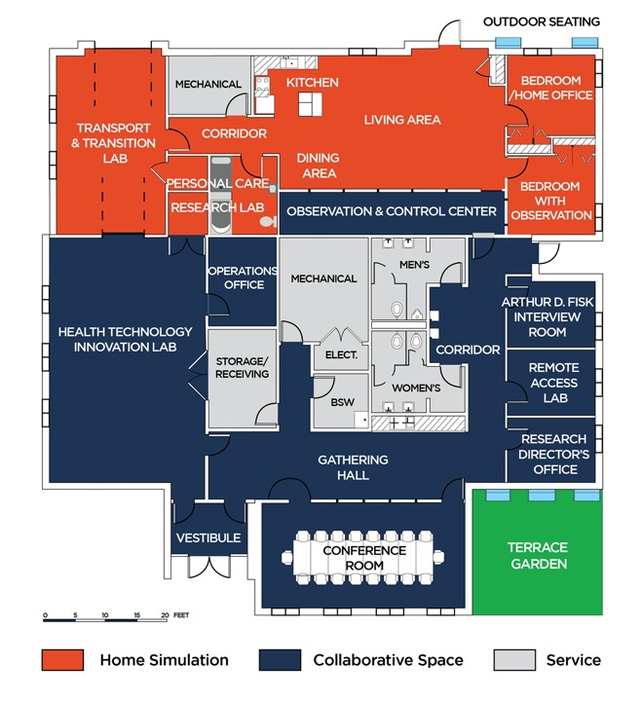
McKechnie Family LIFE Home
Living in Interactive Future Environments
Newly-Completed Cutting Edge Research Space on the University of Illinois Campus
Multi-Purpose Research and Community Space
Research on topics for the complete life-span
Event and Community Space
Development space for next generation technologies
Research space for beta testing technologies
Includes outdoor spaces, allowing research to extend beyond the four walls

Slide 6
Q&A
Jim Hunter (Delos Living LLC)

Slide 7
1. CHC Meeting Agenda
Greg Walker (CABA)
CHC Webinar
“McKechnie Family LIFE Home at The University of Illinois Urbana Champaign” (30 min)
- Jim Hunter (Delos Living LLC) – Moderator
- Wendy Rogers (University of Illinois Urbana-Champaign)
- Harshal Mahajan (University of Illinois Urbana-Champaign)
- Brian Pastor (University of Illinois Urbana-Champaign)
CHC Meeting
1. Agenda
2. CHC Meeting: Call to Order, Welcome, Introductions, about the CHC
3. Administrative
4. Research Update
5. White Paper Sub-Committee Update
6. New Business
7. Adjournment

Slide 8
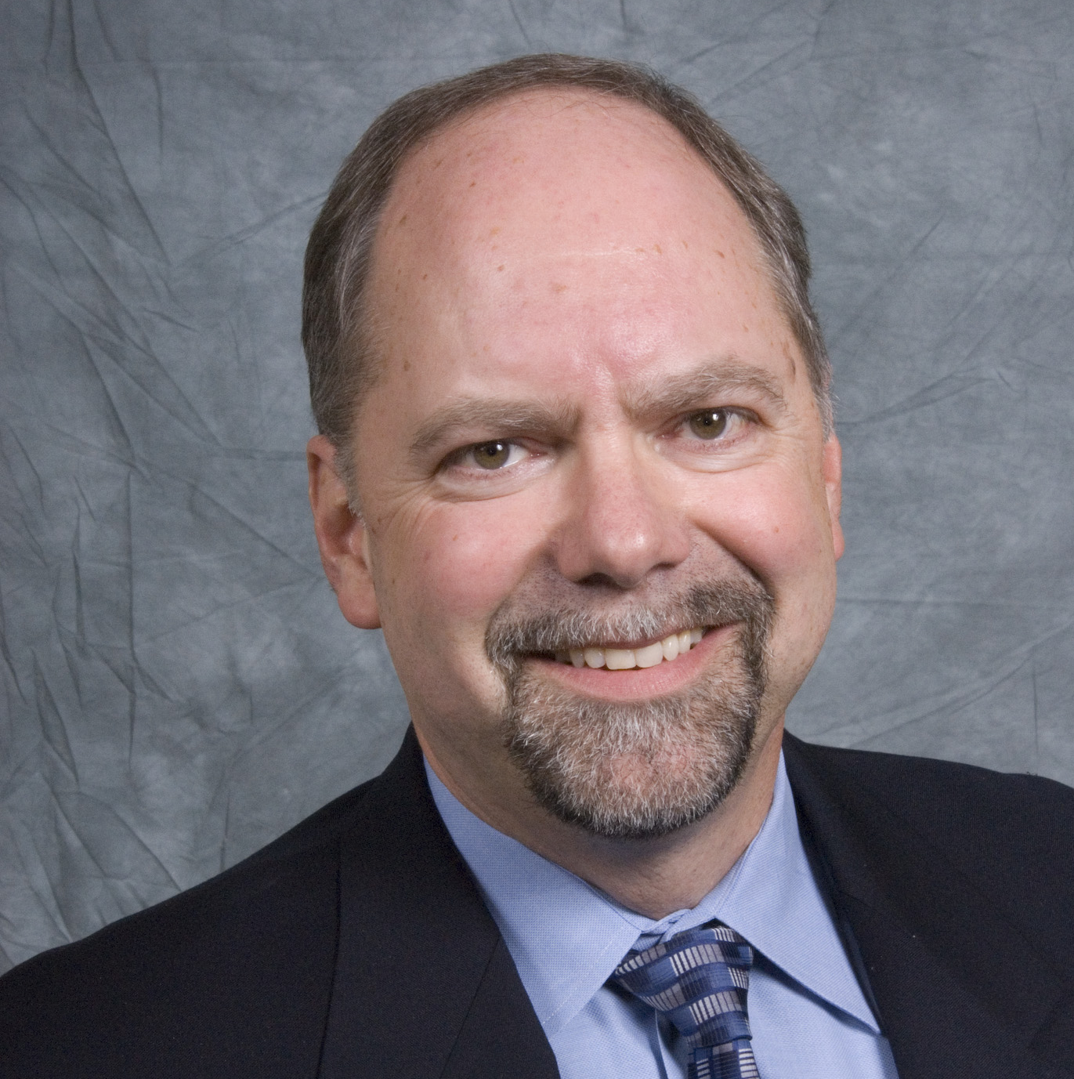
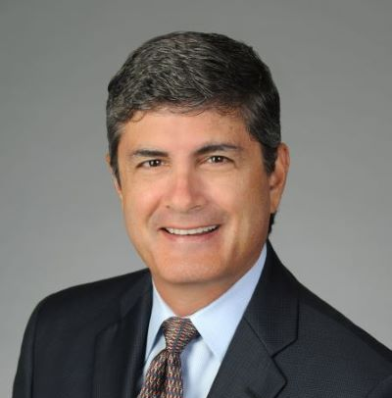
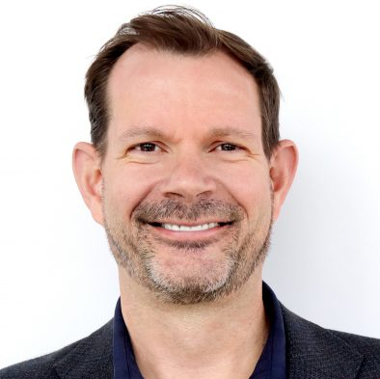
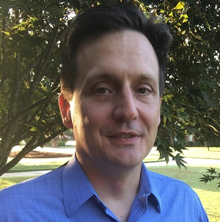




2. CHC Meeting Call to Order, Introductions, About the CHC
Roy Perry (Alarm.com)
CHC Chair
Roy Perry
VP Ecosystem Alliances
Alarm.com
CHC Vice-Chair
Byron BeMiller
Director, Wireless Marketing
Semtech Corporation
CHC Vice-Chair
Jim Hunter
Chief Technology Officer
Delos Living LLC
CHC Vice-Chair
Charles Hume
Director of Digital Power Technologies
Southwire Company, LLC
Established in 2004, the CABA Connected Home Council initiates and reviews projects that relate to connected home and multiple dwelling unit technologies and applications. The Council also examines industry opportunities that can accelerate the adoption of new technologies, consumer electronics and broadband services within the burgeoning connected home market. www.caba.org/chc

Slide 9

3. Administrative
Roy Perry (Alarm.com)
3.1 Motion to approve past CHC Minutes from November 16, 2020:

Slide 10
3. Administrative
Roy Perry (Alarm.com)
3.2 CHC Steering Committee Update
CHC Steering Committee:
- This Steering Committee will be led by the CHC Chair and will be made up of approximately 10 individuals selected by the CHC Executive Committee.
- The Steering Committee will meet quarterly to discuss and select topics and speakers upcoming CHC Webinars. The Steering Committee would arrange the speakers for the CHC quarterly webinars.
- Official terms of reference for this Steering Committee is under development.

Slide 11


4. Research Update
Charles Hume (Southwire Company, LLC)
(CABA)
“Privacy and Cybersecurity in the Connected Home” 2020 CHC Landmark Research

Slide 12

5. White Paper Sub-Committee Update
Ken Wacks (Ken Wacks Associates)
5.1 In Progress:
“Part 2: Power over Ethernet (PoE) & Digital Electricity (DE) in Commercial and Multiple Dwelling Residential Buildings”
Sinclair Digital Holdings (Chair)
Axis Lighting
Contemporary Controls Systems, Inc.
Ken Wacks Associates
LumenCache, Inc.
National Electrical Manufacturers Association (NEMA)
National Research Council Canada (NRC)
Public Services and Procurement Canada
Renesas Electronics America Inc.
Somfy Systems, Inc.
Southwire Company, LLC
Telecommunications Industry Association (TIA)
UL LLC

Slide 13
5. White Paper Sub-Committee Update
Ken Wacks (Ken Wacks Associates)
5.1 In Progress:
“Human Centric Lighting: Non-Energy Benefits of Lighting and its Smart Controls”
ArcoLogix LLC
Human Centric Lighting Society
Ken Wacks Associates
Legrand
Mecho
National Electrical Manufacturers Association (NEMA)
SnapAV
Syska Hennessy
UL LLC

Slide 14
5. White Paper Sub-Committee Update
Ken Wacks (Ken Wacks Associates)
5.1 In Progress:
“Connected Home Cybersecurity Regulations”
P.A.ID Strategies (Chair)
AgeLight LLC
BC Hydro
exp. US Services, Inc.
LonMark International
Mission Critical Global Alliance (MCGA)
National Research Council Canada (NRC)
Smart Buildings SuperCluster (SBSC)
Sustainable Resources Management Inc.
TwelveDot Inc.
UL LLC

Slide 15
5. White Paper Sub-Committee Update
Ken Wacks (Ken Wacks Associates)
5.1 In Progress:
“Part 2: The Evolution of Integrating LiFi Technology into Smart Lighting and Control Systems for the Intelligent Building”
Wharton County Junior College (Chair)
Acuity Brands, Inc.
ArcoLogix LLC
SnapAV
Ken Wacks Associates
National Electrical Manufacturers Association (NEMA)
Telecommunications Industry Association (TIA)

Slide 16


5. White Paper Sub-Committee Update
Ken Wacks (Ken Wacks Associates)
All proposals and previously completed CHC White Papers can be downloaded at:
www.caba.org/whitepapers

Slide 17

6. New Business
Byron BeMiller (Semtech Corporation)
6.1 Other new CHC business?

Slide 18
7. Adjournment
Roy Perry (Alarm.com)
Next CHC Meeting: May or June 2021
Continental Automated Buildings Association (CABA)
caba@caba.org
www.CABA.org
www.caba.org/chc
Connect to what’s next™

