Slide 1
CABA “Intelligent Building Energy Management System” Executive Summary
Harbor Research
Harry Pascarella Daniel Intolubbe-Chmil
Jamil Muna Michael Levy

Slide 2




Overview of CABA
CABA (Continential Automated Buildings Association)
Vision
CABA advances the connected home and intelligent buildings sectors.
Mission
CABA enables organizations and individuals to make informed decisions about the integration of technology, ecosystems and connected lifestyles in homes and buildings.
2
Source: Continental Automated Buildings Association

Slide 3






















CABA Board of Directors
3
Source: Continental Automated Buildings Association

Slide 4
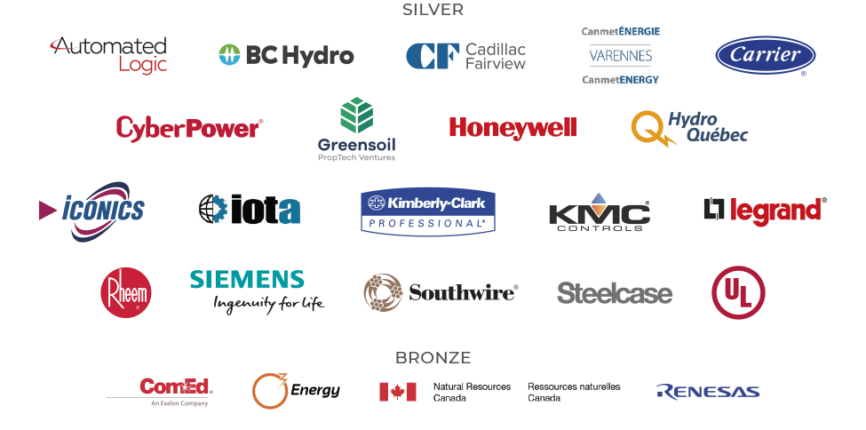
CABA All Funders
Figure ES1 Landmark Study Funders
Source: CABA Intelligent Building Energy Management Systems 2020 Report

Slide 5
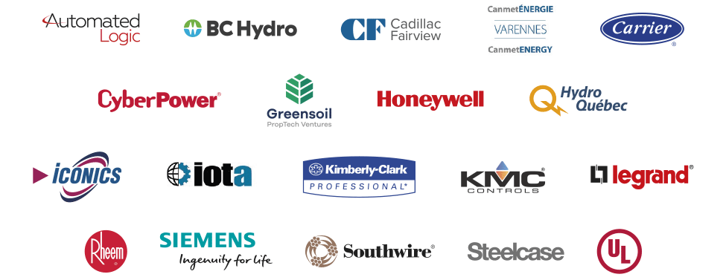
Project Steering Committee
Figure ES2 Steering Committee Members
Source: CABA Intelligent Building Energy Management Systems 2020 Report

Slide 6
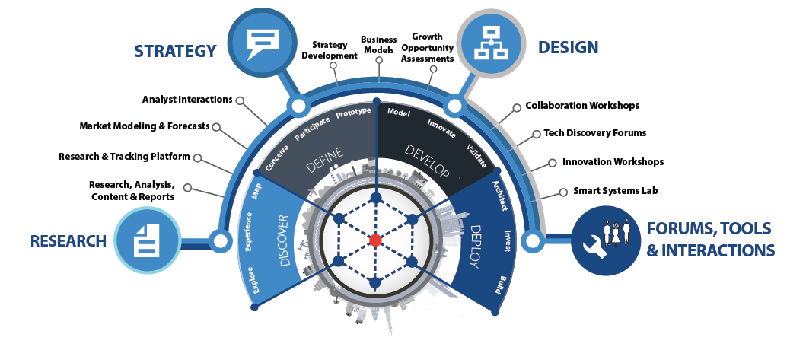
About Harbor Research
Strategy Consulting
Our strategy and business development consulting services deliver creative innovation tools, practical methods and applied problem solving.
Research and Content
Our research, tracking, and market intelligence services provide an accessible learning environment for those who are trying to wrap their arms and minds around emerging disruptive opportunities.
Smart Systems Lab
We are creating a real-world laboratory where organizations design, prototype, and test new models for delivering value and differentiation. The Lab’s mission is to enable business model, technology, and system-level innovation enabled by the Internet of Things.

Slide 7
Research Goals
1
Examine various aspects of energy management systems as they relate to the intelligent building industry.
  Define IBEMS and describe the current state of energy management capabilities in intelligent buildings, including analyzing the current market structure and the position of key players
  Contextualize IBEMS in the evolving distributed energy future, exploring new business models that better integrate DER and onsite generation to more efficiently consume energy
  Understand how key intelligent buildings stakeholders—architects, operators, and occupants—prioritize energy management and which features and/or pain points influence adoption
Illuminate how the IBEMS opportunity will change as distributed energy and intelligent buildings evolve, providing actionable insights for how ecosystem participants can address new opportunities.
  Examine new go-to-market channels, player ecosystems, and innovator case studies related to IBEMS that are arising as the intelligent buildings market continues to evolve
  Develop recommendations for how firms should structure their organization and offerings to capture new value from IBEMS, from the perspectives of different ecosystem participants
2
Source: CABA Intelligent Building Energy Management Systems 2020 Report

Slide 8
Key Takeaways (1/2)
As Intelligent Building Technologies Evolve and Sustainability Becomes Prioritized, IBEMS Need to Evolve Beyond Simple Applications: Over the past decade, the technological capabilities of IBEMS have grown exponentially and new ways of incorporating sustainable power have emerged. However, most operators still struggle to gain value of their IBEMS products beyond simple scheduling and root-cause analysis functions
Suppliers develop IBEMS solutions without understanding a building’s DER capabilities, data structure, and occupant needs
Operators are mostly focused on near-term ROI, rather than longer-term energy savings or occupant satisfaction
Buildings lack historical and predictive data, and often fail to have advanced metering infrastructure in place
1
2
The IBEMS Market is Dominated by Outdated BAS/BMS Solutions from Large Suppliers: Large BAS/BMS suppliers have a high adoption base of buildings who are locked-in to their brand. They have little incentive to innovate, given that further automation and efficiencies would cannibalize their lucrative service contracts
Energy-focused suppliers are pushing focused applications for energy-related uses like submetering and billing
Horizontal innovators are seeking to apply analytics or control-based technologies to achieve energy efficiency
Recently, innovators are applying digital twin technologies to holistically manage energy alongside other building functions
3
While BACnet Adoption is Increasing, Further Protocol Consolidation and Data Labeling Standardization Need to Occur: Though BACnet use is increasing, buildings have trouble adopting a standard data labeling or naming convention, though organization like Brick and Project Haystack seek to address this issue
Greater technology-based standardization during construction can solve interoperability and data sharing issues
Building data, KPIs, and functions are labeled differently according to region, BMS provider, and occupant demographics
Source: CABA Intelligent Building Energy Management Systems 2020 Report

Slide 9
Key Takeaways (2/2)
GEBs Can Help Operators Achieve Massive Cost and Energy Savings, but Utilities and Governments Must Support This Evolution: The emerging model of a grid-interactive efficient building (GEB) can automatically respond to utility price signals and allow for load flexibility. However, regulators and utilities need to offer buildings the right incentives and financing to meet the technical requirements that GEBs demand
Most buildings lack GEB capabilities due to outdated technology infrastructure and utility time-of-use pricing maturity
Buildings need both DER integration and on-site energy storage for automated load shifting and sustainable energy use
Occupancy sensing, full lighting controls, and advanced metering infrastructure are other technologies to enable GEBs
Grid interactivity will intensify utility-related cybersecurity concerns, at both the network and device/field levels
4
The COVID-19 Pandemic’s Impact on IBEMS Remains Unclear: While the pandemic will increase the overall costs to operate and construct buildings, as operators implement social distancing and expand sanitization, it remains unclear how the pandemic will ultimately affect energy management in buildings
Most occupants, operators, and constructors believe that COVID-19 will impact the prioritization of energy management and sustainability in buildings, but they are almost evenly divided on whether their importance will increase or decrease
Most constructors believe that COVID-19 will increase building construction costs by more than 10 percent
Generally, it is likely that decreased/staggered occupancy schedules and the energy needs of COVID-19 response technologies will offset in terms of overall energy needs, but this calculation will likely differ by each individual building
5
Source: CABA Intelligent Building Energy Management Systems 2020 Report

Slide 10
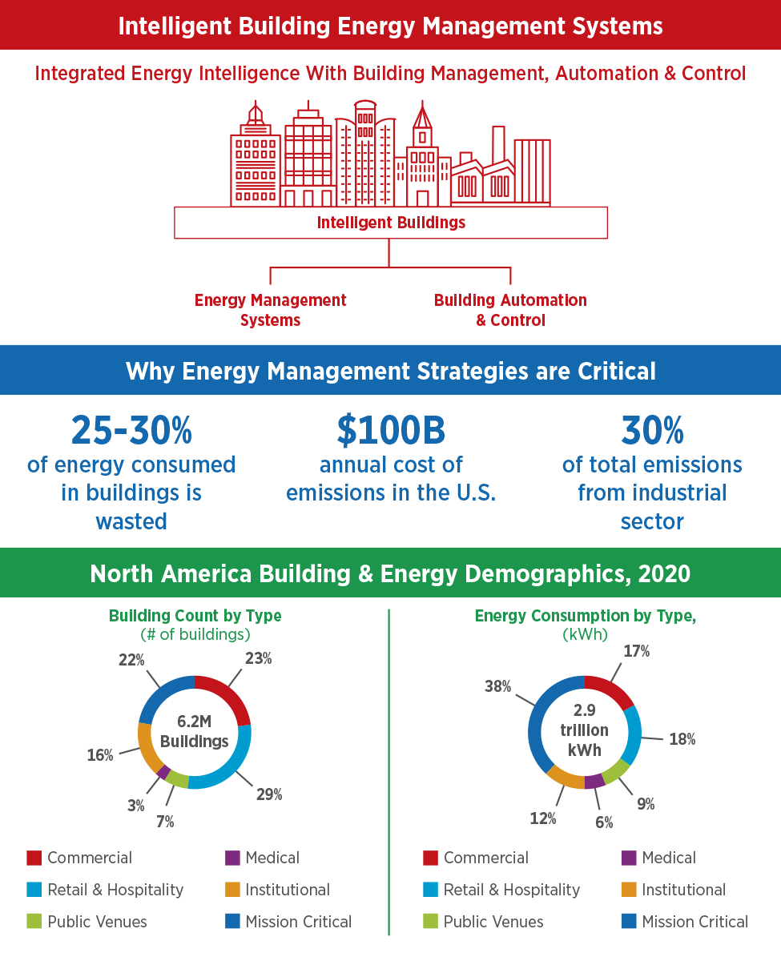
As Intelligent Buildings Mature, Energy Management Becomes Increasingly Critical
Source: CABA Intelligent Building Energy Management Systems 2020 Report
Figure ES3 Buildings Across Industries Need to Prioritize Energy Management

Slide 11
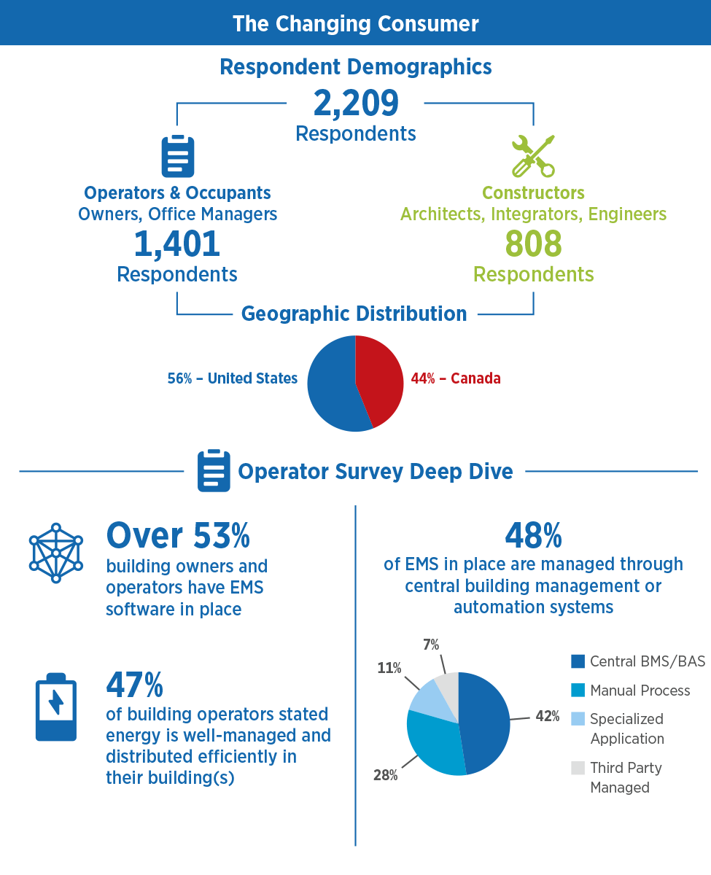
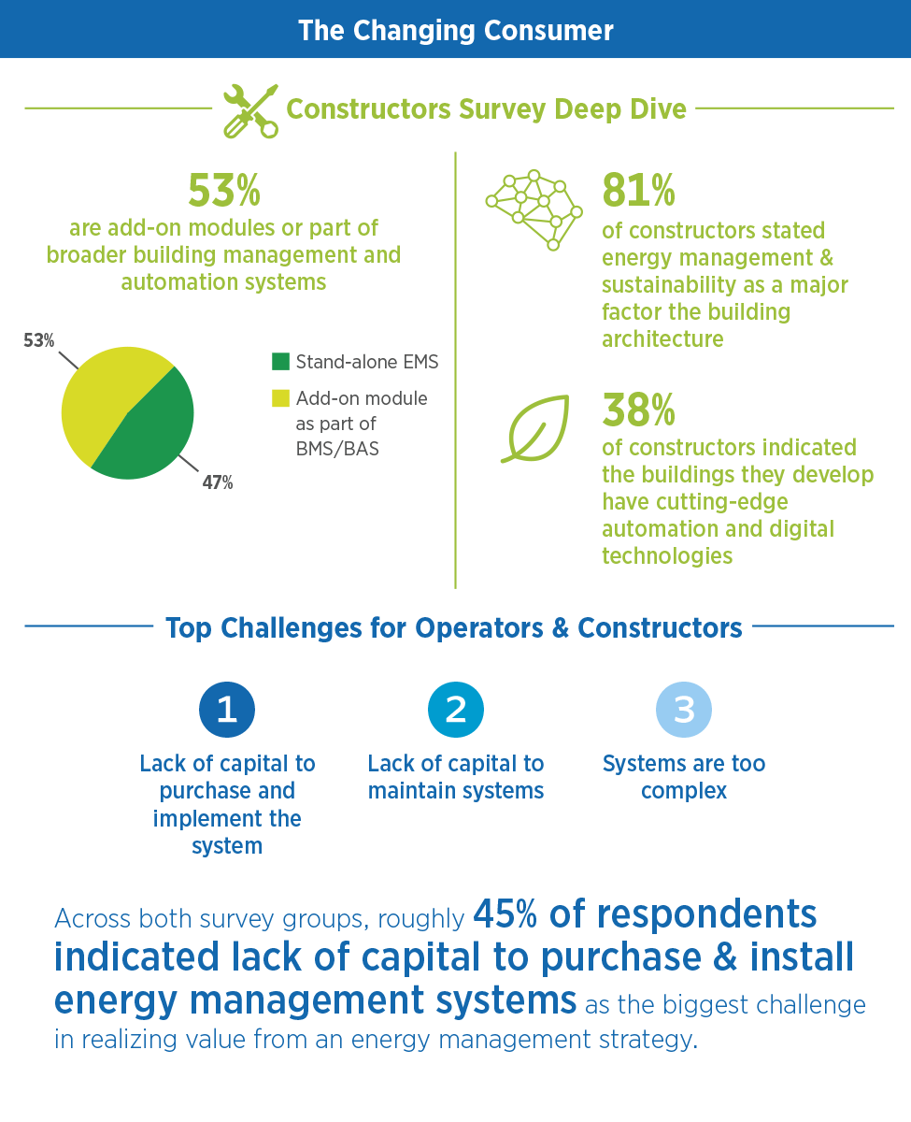
Buildings Stakeholders Struggle to Gain Value from IBEMS
Figure ES4 Operators and Architects Struggle to Maximize the Value of IBEMS
Source: CABA Intelligent Building Energy Management Systems 2020 Report

Slide 12
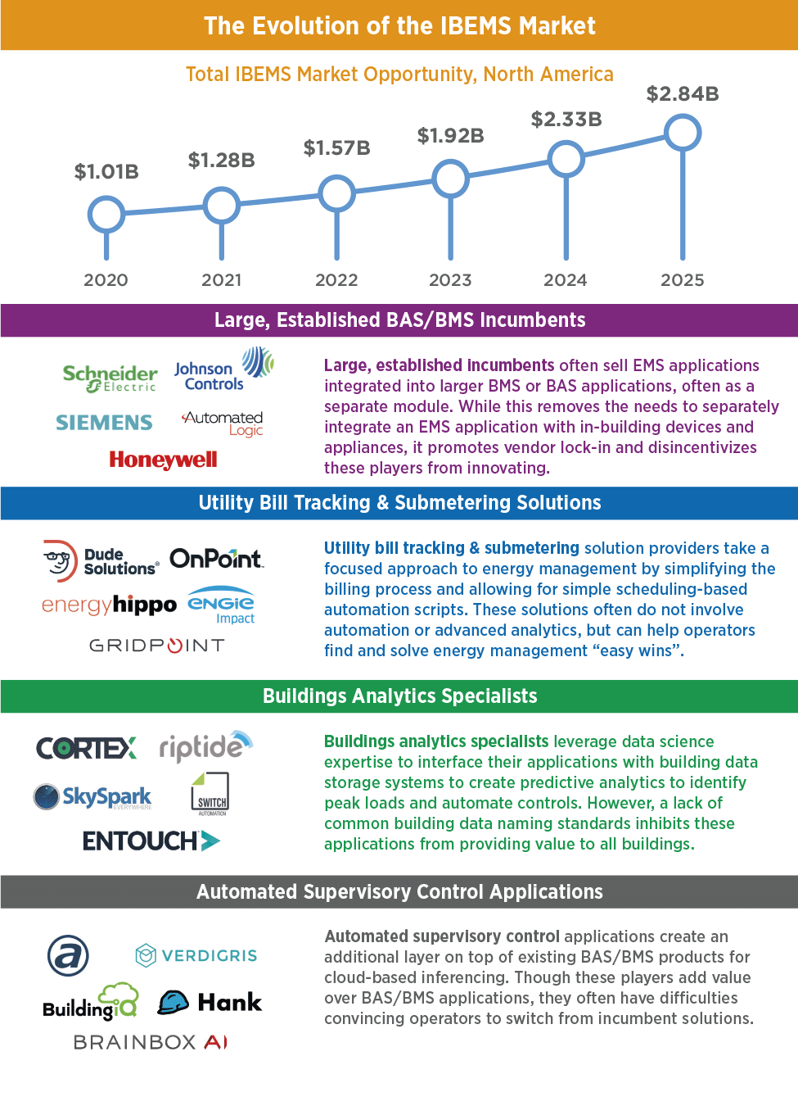
Despite Growth, the IBEMS Market Remains Fragmented
Figure ES5 Players are Taking Different Approaches to Win the IBEMS Opportunity
Source: CABA Intelligent Building Energy Management Systems 2020 Report

Slide 13
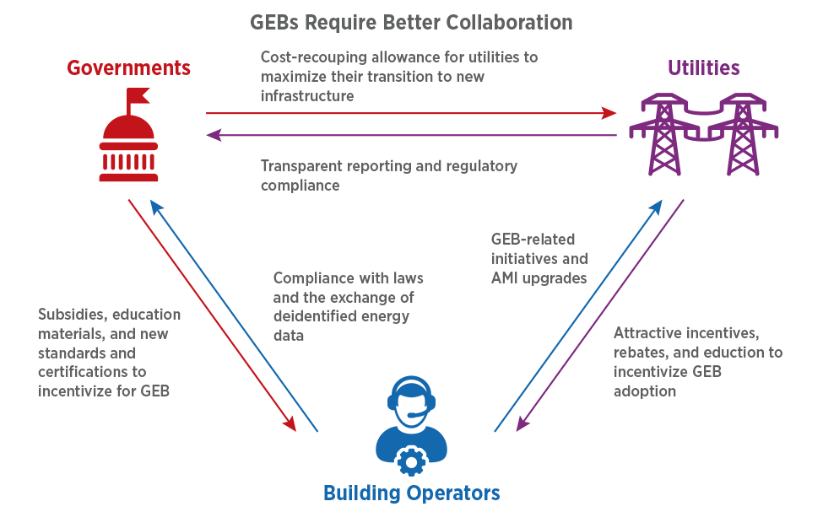
GEB Adoption Hinges Upon Stakeholder Collaboration
Figure ES6 Collaboration is Required to Enable GEBs
Source: CABA Intelligent Building Energy Management Systems 2020 Report

Slide 14
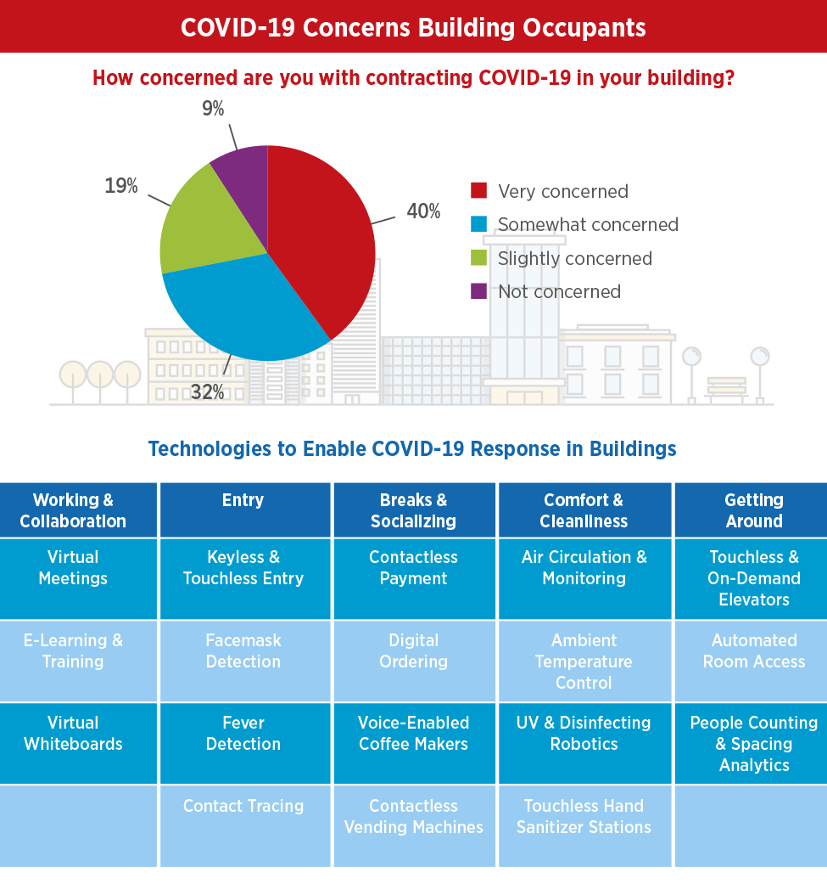
Buildings Turn to Technology to Address COVID-19 Concerns
Figure ES7 The COVID-19 Pandemic Concerns Occupants
Source: CABA Intelligent Building Energy Management Systems 2020 Report

Slide 15
CONTACT CABA
Continental Automated Buildings Association (CABA)
613.686.1814
Toll free: 888.798.CABA (2222)
caba@caba.org
www.CABA.org
www.twitter.com/caba_news
www.linkedin.com/groups?gid=2121884
Connect to what’s next™
15

