Slide 1
Intelligent Buildings and COVID-19: Leverage Technology for Safer and Healthier Environments
Buildings Week
November 30 - December 4, 2020
Ron Zimmer, CABA President & CEO

Slide 2
CABA Vision, Mission, Goals

Slide 3
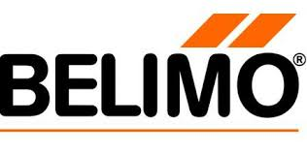
CABA Board of Directors

Slide 4
Smart Buildings – Networked, Intelligent, Adaptable…

Slide 5
Intelligent Building Solutions Market Lifecycle Analysis

Slide 6
Enterprise Convergence Platform and Cloud Technology

Slide 7
The Forgotten 90%

Slide 8
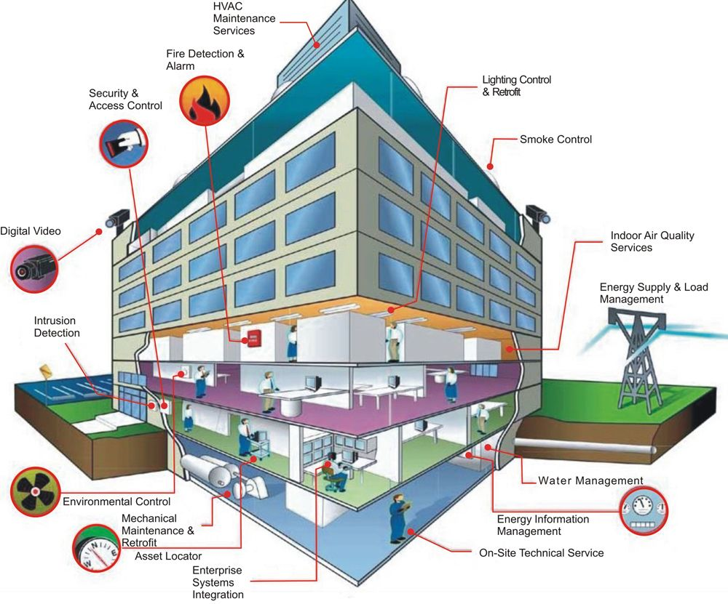
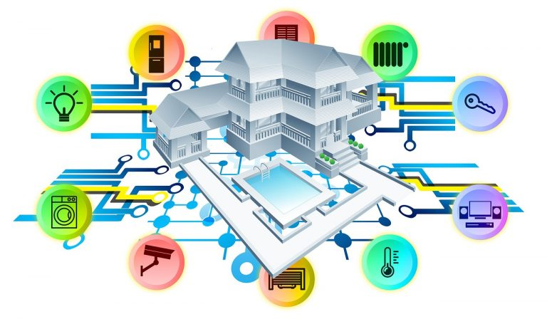
What is a Connected Home or Intelligent Building?
8

Slide 9
What is a Connected Home or Intelligent Building?
Siemens Smart Buildings
8

Slide 10
Impact on Key Industries
ICT and eCommerce
Agriculture
Tourism and Leisure
Personal Care
Energy
Aerospace
Materials and Food
Net Positive Impact
Net Negative Impact
Transport and Mobility
Education
Chemicals
Banking and Financial Services
Construction and Real Estate
Healthcare
Building Services
Manufacturing and
Process Control
10
Source: Frost & Sullivan

Slide 11
CABA Intelligent Buildings and COVID-19: Leverage Technology for Safer and Healthier Environments Research Report

Slide 12
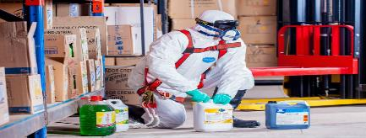
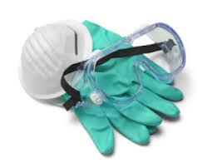
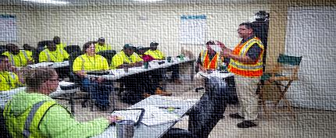
Intelligent Buildings Dictated by the “New Normal”
Reversing Open Offices
Deep cleaning and sanitation of facilities
Buildings & Systems Recalibration
Redesigning with adequate occupant distancing
Refurbishing office setups
Supporting hybrid workforce, WFH
Frequent cleaning with enhanced standards
Space usage measurement technology for occupant management and optimizing cleaning with pathogen detection capability offsite
Retuning, recalibration and augmentation of systems for reentry
Incremental checks, including re-certs
Touch-free & Contact-free Infrastructure
Air Management, Health and IEQ
Working Capital Shortage
Retrofitting to no-touch systems, including entry and access
Foot activated elevators (Toe-to-Go)®
Touch less fixtures and controls, faucets
Non-thermal, plasma technology to reduce cross-contaminant risks (AirPHX) ®
Quality ventilation to reduce pathogens
Anti-microbial paints
Non-contact infrared sensors with integration on mobile platforms
Clients delaying payments, projects, with wage liabilities
Existing pool of FM workers under-prepared
Impeded supplies against greater demand
12
Source: Frost & Sullivan
Notes:
https://economictimes.indiatimes.com/industry/services/property-/-cstruction/covid19-impact-facility-management-companies-ensure-workers-engagement-with-extra-incentives/articleshow/75118404.cms?from=mdr
https://blog.infraspeak.com/challenges-fm-2019/

Slide 13
Industry Environment: Key Predictions
Building EMS’ Expanding Role, Beyond Efficiency & Comfort
Connected Security & Safety Preparedness Plugs into EMS
Pandemic-ready Use Case Mandatory for Real Estate Developments
Building managers will look for EMS solutions that are powered by AI and completely leverage the full potential of IoT devices to optimize building performance. Beyond occupant comfort and sustainability, synchronization with emergency response support and ability to recalibrate environmental quality is critical from the EMS to support “pandemic-ready” needs.
Frost & Sullivan predicts the implementation of stringent safety standards and increased penetration of IoT-enabled cybersecurity and compliance detection systems to improve emergency response and reduce risks during pandemics. City surveillance projects will increasingly link with the built environment for input sharing and planning response strategies.
Buildings will feature new use cases driven by government mandates. The ability to support pandemic-ready “pop up” medical infrastructure, either as a dedicated wing or a standalone unit in the campus, complete with environmental calibration, will be necessary to maintain their accreditations. Suppliers will tailor solutions to meet these changing requirements.
Keeping 5-G Rollout on Track for Broader Benefits
AI-powered Smart Buildings Delivered by A Digitally Mature Ecosystem
Integrated Vertical Building Solution Bundled with Disaster Response
Frost & Sullivan predicts, while economic headwinds will delay enterprise 5G rollout, its larger benefits will keep 5G implementation on track. Trends in favor include the spike in bandwidth demand due to growth in teleworking and remote operations, post COVID-19, including 5G’s support in Singapore’s and China’s monitoring and controlling efforts to triage the pandemic.
Leading building technology companies such as IBM and Siemens will integrate disparate building automation and management systems under one AI powered platform. Operating and maintaining buildings with such solutions will be further supported by a digitally advanced ecosystem that can integrate disaster mitigation and rebound services in a non human supported environment.
Lighting solution providers like Acuity and Signify will lead on the momentum for connected lighting and push for integrated vertical building solutions, including integrated LED luminaires, building energy management, and digital lighting services. Bundling disaster response capabilities in their solution portfolio will characterize value propositions and branding.
13
Source: Frost & Sullivan

Slide 14
COVID-19 Aftermath: Transformations Ahead
NAVIGATING THE AFTERMATH OF COVID-19 CALLS FOR DRASTIC TRANSFORMATIONS AND ADOPTING A “CULTURE OF SHARING”
BUILDINGS
Alternate workplace: the overnight reality
Prerequisite infrastructure for pandemics
Rise in micro waste-to-energy & packaged onsite remediation options
Greater versatility of Energy Management Systems (EMS): synchronization with environment quality and safety
Rise in new use cases for buildings driven by government mandates
RENEWABLES
Longer investment cycles will keep renewables’ growth immune
Short and mid term delays are inevitable in new capacity building
Supply chain issues expected from China’s Solar PV production decline
Demand increase for packaged installations from buildings for emergency response
Overarching Goals:
Self-sufficiency; Self-correction and Collective healing
FUEL SUPPLY
Supply chain innovation will focus on cost reduction technologies
With less Capex available, Opex-based business models will thrive
Increased investor scrutiny for efficient capital deployment and better risk management
Balancing investment priorities across hydrocarbon & non-hydrocarbon business
ENERGY
Reforms to ensure affordability, reliability and grid security
System transitions to lower emissions and to support distributed generation
Price transparency from producers will ensure increase bargaining power for consumers
Workforce shortages & health issues will escalate automation and digitalization
CURATIVE CITIES
Respond:
Leverage technology for predictive detection: Beyond facial recognition; detect temperature & environment
Proactively segregate risk & vulnerability zones; link to wearables and data from buildings and occupants
Reset:
Auto activation of management and mitigation processes, e.g., thermal sensors, containment monitoring
Pandemic-ready medical infrastructure “pop ups” in real time with environmental recalibration
Rebound:
Advantages of an agile connected business ecosystem kicks in to support recovery & rebound
Leveraging of data and digital delivery to rebuild customers, employees, supply chain and community initiatives
14
Source: Frost & Sullivan

Slide 15
Impact of COVID-19 on the North American LED Lighting Market
Notes:
Presenter
2020-04-21 20:49:33
--------------------------------------------
- Thank 8 funders, without their financial support not happened.
- All the funders were on the Steering Committee
Also contributed with insights and direction to the research and shaped an guild the research.
------------------------------------------------------------------------------------------------

Slide 16
Impact of COVID-19 on the North American HVAC & BAS Markets
Notes:
Presenter
2020-04-21 20:49:33
--------------------------------------------
- Thank 8 funders, without their financial support not happened.
- All the funders were on the Steering Committee
Also contributed with insights and direction to the research and shaped an guild the research.
------------------------------------------------------------------------------------------------

Slide 17
Impact of COVID-19 on the North American Facilities Management Market
Notes:
Presenter
2020-04-21 20:49:33
--------------------------------------------
- Thank 8 funders, without their financial support not happened.
- All the funders were on the Steering Committee
Also contributed with insights and direction to the research and shaped an guild the research.
------------------------------------------------------------------------------------------------

Slide 18
Impact of COVID-19 on the Global AI-Driven Building Technologies Industry & North American BEMS Market
Notes:
Presenter
2020-04-21 20:49:33
--------------------------------------------
- Thank 8 funders, without their financial support not happened.
- All the funders were on the Steering Committee
Also contributed with insights and direction to the research and shaped an guild the research.
------------------------------------------------------------------------------------------------

Slide 19
Impact of COVID-19 on the North American BIM & Digital Twin Solutions Market
Notes:
Presenter
2020-04-21 20:49:33
--------------------------------------------
- Thank 8 funders, without their financial support not happened.
- All the funders were on the Steering Committee
Also contributed with insights and direction to the research and shaped an guild the research.
------------------------------------------------------------------------------------------------

Slide 20
Impact of 21st – Century Events on the CRE Sector
Key Index | Recession and 9/11 Attack (Q1 2001 to Q4 2001) | Severe Acute Respiratory Syndrome (SARS, Q4 2002 to Q2 2003) | Swine Flu and the Great Recession (Q1 2008 to Q1 2010)
Pre-Event (4 Quarters)
GDP7 | Increasing | Increasing | Increasing
CRE Price Index8 | Increasing | Negative | Declining but positive
Real Estate Investment Trust (REIT) Index9 | Increasing | Declining but positive | Declining but positive
During the Event
GDP | Declining but positive | Increasing | Contracting
CRE Price Index | Declining but positive | Increasing | Negative
REIT Index | Declining but positive | Data not available | Negative
Post-Event (4 Quarters)
GDP | Increasing | Increasing | Increasing
CRE Price Index | Negative | Declining but positive | Increasing
REIT Index | Declining but positive | Increasing | Increasing
Notes:
Presenter
2020-04-21 20:49:33
--------------------------------------------
- Thank 8 funders, without their financial support not happened.
- All the funders were on the Steering Committee
Also contributed with insights and direction to the research and shaped an guild the research.
------------------------------------------------------------------------------------------------

Slide 21
Implications for Technology and Resource Planning
Along with basic mitigation measures it is critical for building owners to adopt and develop technology-based MEP safe-start strategies prioritizing nice foundations of healthy buildings.
Foundations of a Healthy Building
The American Industrial Hygiene Association (AIHA) emphasize the importance of relative humidity control.
AIHA advises building managers to hire a certified industrial hygienist and other occupational health and safety professionals to review and assess the risks.
Building owners must adopt technology-based building controls involving AI-driven buildings, cloud-based remote services and IoT-enabled sensor networks to develop MEP safe-start strategies
Ventilation
Thermal Health
Indoor Air Quality (IAQ)
Moisture
Dust & Pests
Lighting & Views
Safety& Security
Acoustics
Water Quality
21
Source: Frost & Sullivan

Slide 22
Facility Managers’ Technology and Service Requirements During the Pandemic
Building health assessment
Indoor air quality (IAQ) solutions
Data driven services
Health and wellness standards
Notes:
Presenter
2020-04-21 20:49:33
--------------------------------------------
- Thank 8 funders, without their financial support not happened.
- All the funders were on the Steering Committee
Also contributed with insights and direction to the research and shaped an guild the research.
------------------------------------------------------------------------------------------------

Slide 23
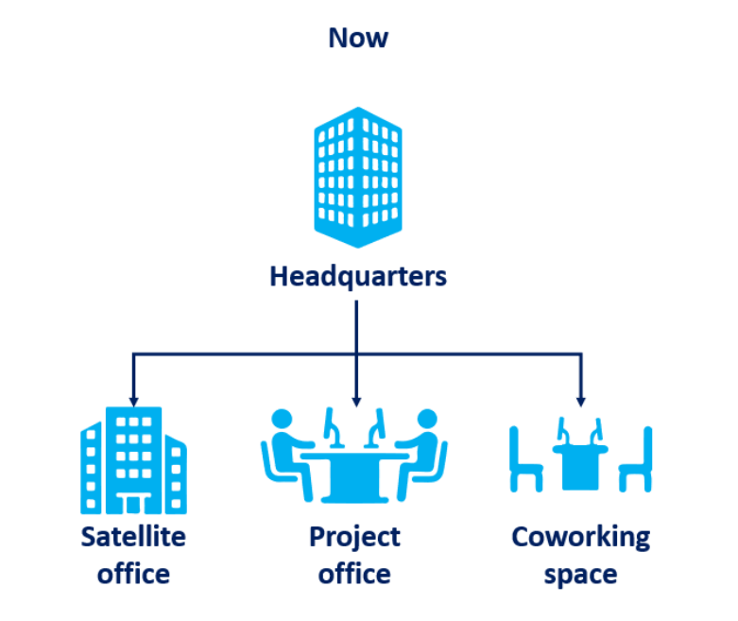
Future of Workplaces
Notes:
Presenter
2020-04-21 20:49:33
--------------------------------------------
- Thank 8 funders, without their financial support not happened.
- All the funders were on the Steering Committee
Also contributed with insights and direction to the research and shaped an guild the research.
------------------------------------------------------------------------------------------------

Slide 24
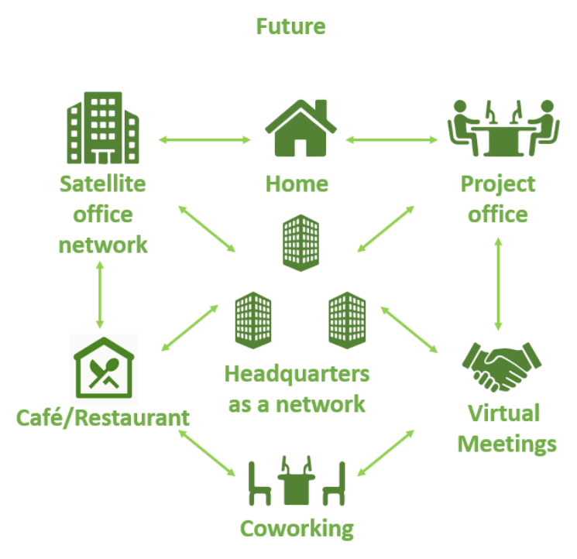
Future of Workplaces
Notes:
Presenter
2020-04-21 20:49:33
--------------------------------------------
- Thank 8 funders, without their financial support not happened.
- All the funders were on the Steering Committee
Also contributed with insights and direction to the research and shaped an guild the research.
------------------------------------------------------------------------------------------------

Slide 25
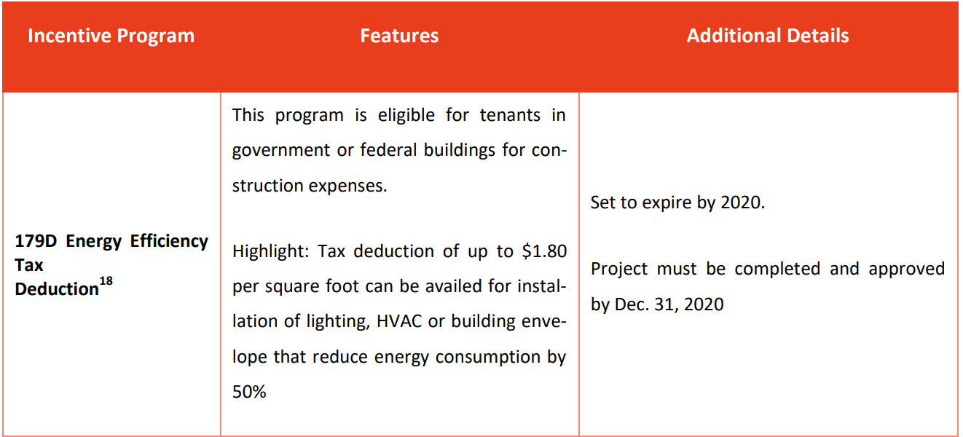
Incentive Programs for Improving Building Energy Efficiency
Notes:
Presenter
2020-04-21 20:49:33
--------------------------------------------
- Thank 8 funders, without their financial support not happened.
- All the funders were on the Steering Committee
Also contributed with insights and direction to the research and shaped an guild the research.
------------------------------------------------------------------------------------------------

Slide 26
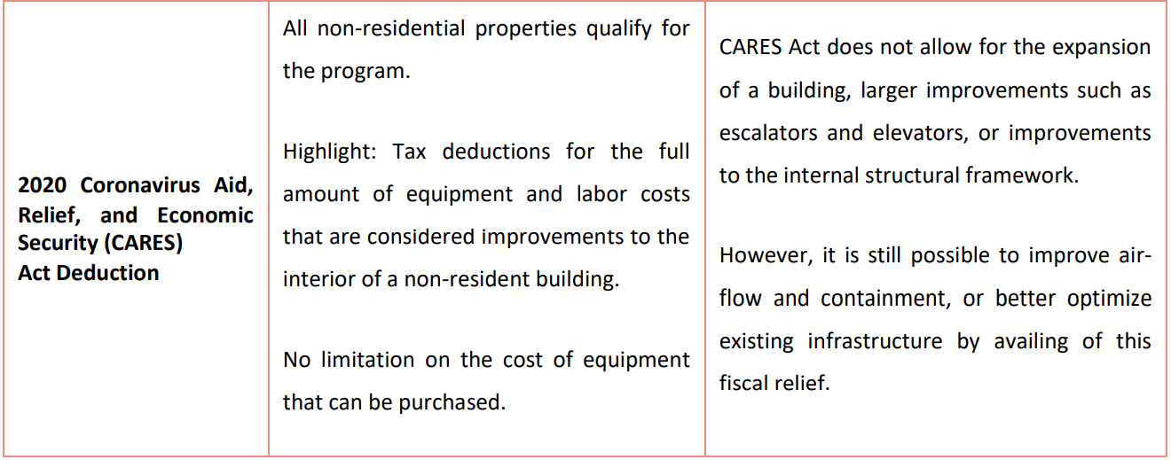
Incentive Programs for Improving Building Energy Efficiency
Notes:
Presenter
2020-04-21 20:49:33
--------------------------------------------
- Thank 8 funders, without their financial support not happened.
- All the funders were on the Steering Committee
Also contributed with insights and direction to the research and shaped an guild the research.
------------------------------------------------------------------------------------------------

Slide 27
Incentive Programs for Improving Building Energy Efficiency
Notes:
Presenter
2020-04-21 20:49:33
--------------------------------------------
- Thank 8 funders, without their financial support not happened.
- All the funders were on the Steering Committee
Also contributed with insights and direction to the research and shaped an guild the research.
------------------------------------------------------------------------------------------------

Slide 28
Areas to Focus on to Mitigate COVID-19 Spread in Buildings
Federal, state, and local government regulations
Standalone, equipment-level technologies and services
Shared, transparent, and efficient communication
Optimizing a building’s sensor network
Healthy Building Standards
Top Eight Focus Areas for Workforce Re-Entry
Facilities management
Mechanical, Electrical and Plumbing (MEP) Safe-Start Strategies
Workforce Productivity
28
Source: Frost & Sullivan

Slide 29
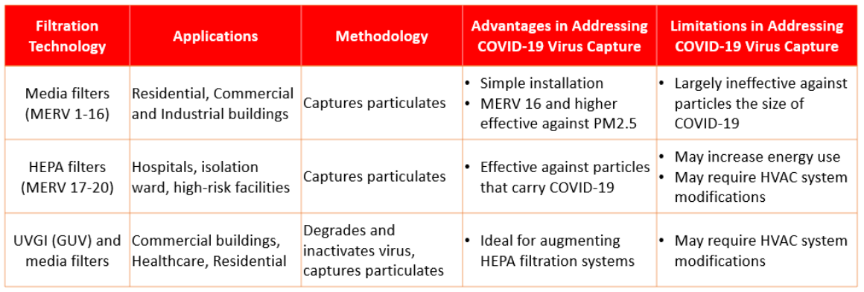
HVAC Filtration Technologies to Capture COVID-19
Notes:
Presenter
2020-04-21 20:49:33
--------------------------------------------
- Thank 8 funders, without their financial support not happened.
- All the funders were on the Steering Committee
Also contributed with insights and direction to the research and shaped an guild the research.
------------------------------------------------------------------------------------------------

Slide 30
Mitigation Strategies for COVID-19 in Workplaces
High
Elimination of exposure
Stringent work-from-home policies
Selective Activity
Building access restricted to critical workforce
Effectiveness of Mitigation Strategies
Engineering Controls
9 foundations of a healthy building
Administrative Controls
Social distancing and reducing workplace density
Low
PPE
Masks and other protective gear
Source: CABA Intelligent Buildings and COVID-19 Report
Notes:
Presenter
2020-04-21 20:49:33
--------------------------------------------
- Thank 8 funders, without their financial support not happened.
- All the funders were on the Steering Committee
Also contributed with insights and direction to the research and shaped an guild the research.
------------------------------------------------------------------------------------------------

Slide 31
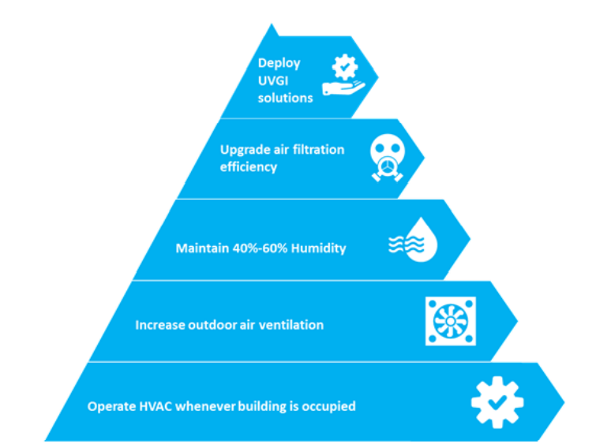
Optimizing HVAC Systems to Reduce COVID-19 Transmission and Improve Effectiveness
Notes:
Presenter
2020-04-21 20:49:33
--------------------------------------------
- Thank 8 funders, without their financial support not happened.
- All the funders were on the Steering Committee
Also contributed with insights and direction to the research and shaped an guild the research.
------------------------------------------------------------------------------------------------

Slide 32
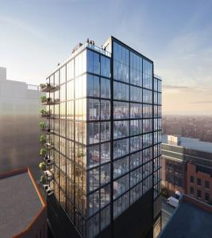
CREATING RESILIENT SMART BUILDINGS: AN ILLUSTRATION
Creating Resilient Smart Buildings: An Illustration
A Toe-To-Go elevator system provided by MAD Elevator Inc. with foot-operated call buttons to reduce the spread of virus.
An airPHX purification system that uses atmospheric cold plasma technology to convert some oxygen molecules into oxidizing molecules to kill pathogens in the air and on surfaces.
Touch-free thermal scanning in the lobby to measure body temperature.
A touch-free access control system with mobile access.
Paint Shield, a microbicidal interior latex paint from Sherwin-Williams, on washroom walls to kill pathogens such as Staphylococcus aureus, methicillin-resistant Staphylococcus aureus (MRSA), Escherichia coli (E. coli), vancomycin-resistant Enterococcus faecalis (VRE), and Enterobacter aerogens.
Sloan touch-free faucets, soap dispensers, and flush valves, and SloanTec hydrophobic glaze on washroom fixtures.
Fulton East, a 12-story, 90,000-square-foot office and retail building in Chicago’s Fulton Market district, is the first commercial building to be designed, constructed, and commissioned for a post-COVID-19 environment.
32
Source: Frost & Sullivan

Slide 33
Technology Radar 2020-2025
50
ESTABLISHED
Cloud-based
Remote services
Predictive
maintenance
Workplace
analytics
Antimicrobial
paints in
wash rooms
Lighting & Control
Post-COVID Applications
Pathogen
scanner
HEPA
filters
UVGI
Occupancy detection (OD) based social distancing
Indoor positioning (IP) based contact tracing
AI-based face and mask detection
Antimicrobial paints in wash rooms
Foot operated elevator
Touch-free bathroom fixtures
Thermal imaging
AI-based access control
Building health performance benchmarking (BHPB)
Pathogen scanner
Nano technology (NT)-based self cleaning surfaces
Touch-free toilet seat cover cleaning
HVAC
optimization
Touch-free
bathroom
fixtures
AI-based lighting control
Voice enabled Lighting Control
Human-centric Lighting
BHPB
BEPO
IAQ-based
ventilation
IMPLEMENTATION
Cloud-based
Remote services
AI-based
lighting control
Automation & Energy
Optimization
HVAC
optimization
Antimicrobial
paints in
wash rooms
UVGI
BLE
Building energy performance optimization (BEPO)
Cloud-based remote services
Predictive maintenance
Digital twin
Workplace analytics
Human-centric
lighting
OD-based
social distancing
Technology Index Score
IP-based
contact tracing
Workplace
analytics
Touch-free
bathroom fixtures
Thermal imaging
Digital twin
AI-based
access control
HEPA filters
IAQ-based
ventilation
Touch-free toilet seat cover cleaning
Predictive
maintenance
Pathogen scanner
BEPO
Foot operated
elevators
AI-based face
and mask detection
NT-based self
cleaning surfaces
Narrowband communication
Voice-enabled
lighting control
HVAC & IAQ
HVAC optimization
Indoor air quality (IAQ)-based ventilation
Ultraviolet germicidal irradiation (UVGI)
High efficiency particulate air (HEPA) filters
UVGI
OD-based
Social distancing
Communication
AI-based access control
BHPB
Power over Ethernet (PoE)
Narrowband communication
Bluetooth Low Energy (BLE)
AI-based
lighting
control
Voice-enabled
lighting control
AI-based face
and mask detection
BLE
TRIAL
Antimicrobial
paints in
wash rooms
Thermal imaging
IAQ-based
ventilation
Narrowband communication
PoE
IP-based
contact tracing
Foot operated
elevators
Digital twin
0
33
2020
2025
Source: CABA Intelligent Buildings and COVID-19 Report

Slide 34
Key Takeaways
Key Takeaways
Negative growth impact witnessed in lighting and controls , heating, ventilation and air conditioning equipment and controls, building automation systems controls, and facilities management markets.
Positive growth software service segments such as digital lighting services, building energy management systems, artificial intelligence (AI)-driven building solutions, building information modeling, and digital twins are set to play a critical role in providing data-driven insights to facility managers.
Key Takeaways
Facility managers to follow occupational safety and health administration COVID-19 planning guidance for effective control measures as well as American society for heating, refrigeration and air conditioning engineers guided mechanical, electrical and plumbing (MEP) safe-start strategies for in-depth engineering controls in workplaces.
Facility managers need to adapt to some of the key changes that are required in the comprehensive building health assessment, prioritizing indoor air quality, adoption of data-driven services and compliance with building health standards to evaluate the right balance between maintaining health and wellbeing as well as maximize productivity of occupants
WELL and RESET healthy building standards will have a crucial role to play in creating a framework for healthy building performance index to assess the health performance of buildings. Accredited professionals of those standards will assess and certify health performance of buildings.
34
Source: Frost & Sullivan

Slide 35
Recent IBC Meetings and Keynotes
May 13, 2020
“The Impacts of COVID-19 on Intelligent Buildings”
August 24, 2020
“Smart Buildings: BEMS, EMIS, FDD, M&V, DCV and COVID”
35
Notes:
Fleet Complete
Approximately 30-40 percent of all commercial vehicles in North America are connected to the world outside and vide versa through telematics technologies, a figure that is expected to double by 2025. These vehicles are reshaping smart mobility business models and not only driving efficiencies in freight and passenger mobility but also creating new opportunities for smart buildings and related infrastructure. Sandeep Kar, Chief Strategy Officer at Fleet Complete will share his views on digitization and its impact on connected vehicle eco-systems and discuss emerging business models that will drive connected vehicles’ interactions with smart buildings and vice-versa. Location based data, autonomous driving, freight digitization, smart parking, and several other emerging technologies and applications will be focal points of his presentation.

Slide 36
Research Update
“Privacy and Cybersecurity in the Connected Home”
2020 CHC Landmark Research
36

Slide 37
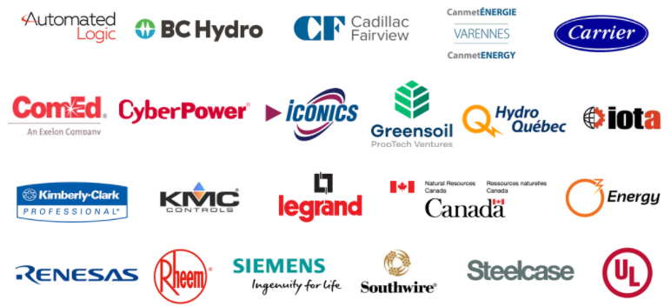
Research Update
“Intelligent Building Energy Management Systems”
2020 IBC Research
37

Slide 38
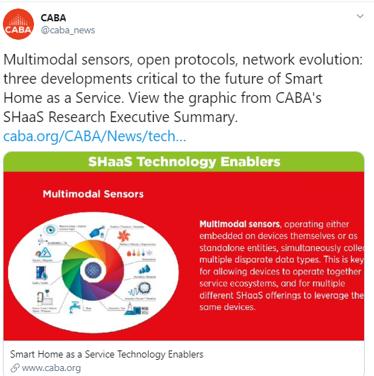
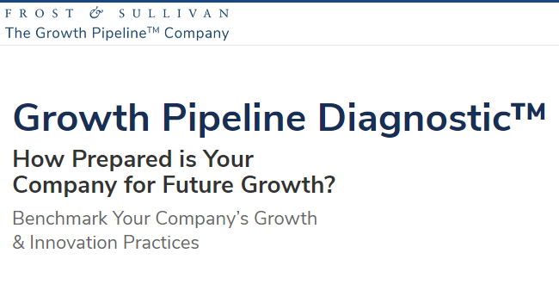
CABA provides members with 24 member benefits related to research, marketing and news and information
Marketing of CABA
Research
Intelligent Building and COVID-19 Webinar - Promotion
38

Slide 39
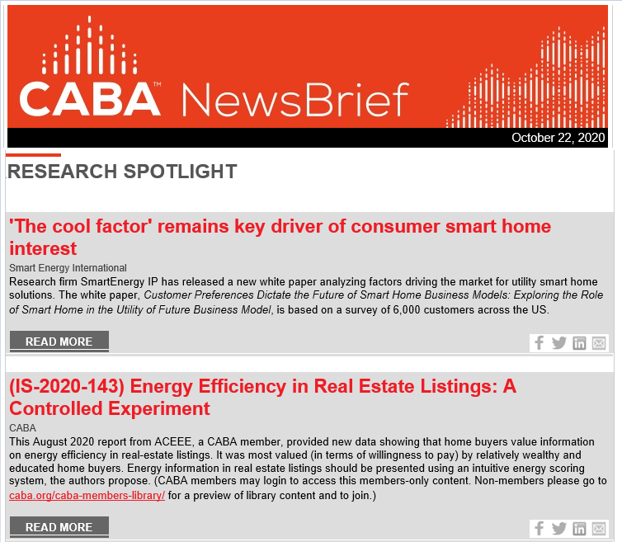
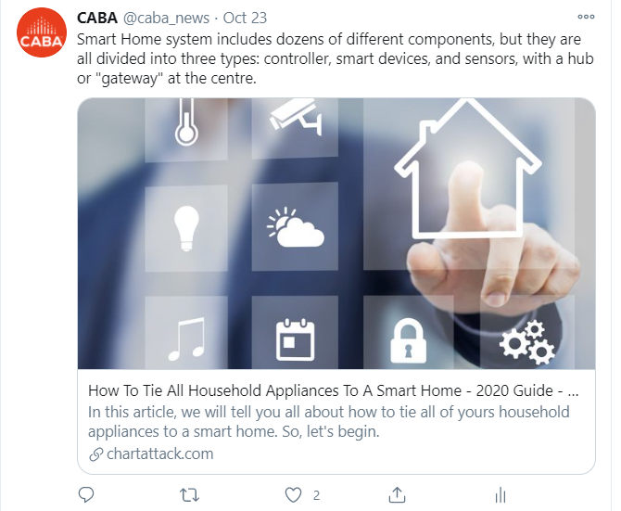
Reminder: Industry news can be found in the CABA NewsBrief and on CABA social media
CABA LinkedIn and LinkedIn Group
CABA Twitter Feed
CABA
NewsBrief
39

Slide 40
Contact CABA
Continental Automated Buildings Association (CABA)
T: 613.686.1814
TF: 888.798.CABA |2222|
Email: caba@caba.org | Website: www.caba.org
Twitter: http://www.twitter.com/caba_news
LinkedIn: https://www.linkedin.com/groups/2121884/
Connect to what’s next™

