Slide 1
Intelligent Buildings Council (IBC)
Chair: Trevor Nightingale (National Research Council)
Vice-Chair: Harsha Chandrashekar (Honeywell International Inc)
Vice-Chair: Robert Lane (Robert H. Lane and Associates Inc.)
Vice-Chair: Bob Allan (The Siemon Company)
Vice-Chair: Terrence DeFranco (Iota Communications, Inc.)

Slide 2
1. Agenda Greg Walker (CABA)
1. Agenda
2. Call to Order, Welcome, Introductions, about IBC
Administrative
White Paper Sub-Committee Update
5. “Digital Building Implementation and Automation at the Marriott Sinclair Hotel” (30-40 min)
Farukh Aslam (Sinclair Holdings, LLC)
Luis Suau (Sinclair Holdings, LLC)
6. Research Update
7. New Business
8. Adjournment

Slide 3
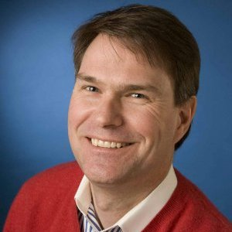
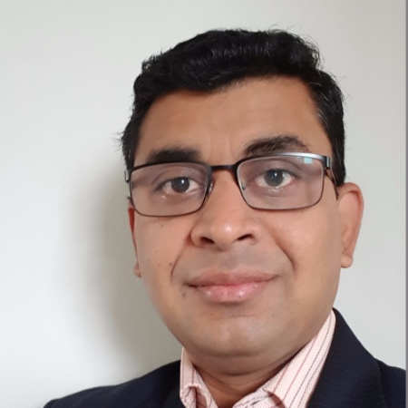
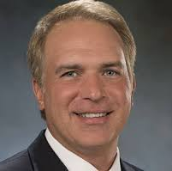
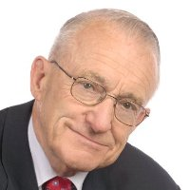
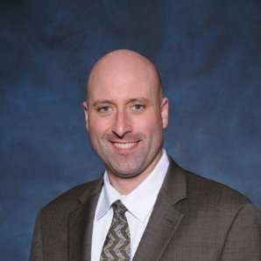
2. Call to Order, Welcome, Introductions, About the IBC Trevor Nightingale (National Research Council)
IBC Chair
Trevor Nightingale
Director General
National Research Council
IBC Vice-Chair
Harsha Chandrashekar
Product Approvals & Regulatory Leader
Honeywell International
Inc
IBC Vice-Chair
Terrence DeFranco
President and Chief Financial Officer
Iota Communications, Inc.
IBC Vice-Chair
Robert Lane
President & Managing Partner
Robert H. Lane and Associates Inc.
IBC Vice-Chair
Bob Allan
Global Business Development Manager, Intelligent Buildings
The Siemon Company
The CABA Intelligent Buildings Council works to strengthen the large building automation industry through innovative technology-driven research projects. The Council was established in 2001 by CABA to specifically review opportunities, take strategic action and monitor initiatives that relate to integrated systems and automation in the large building sector. The Council's projects promote the next generation of intelligent building technologies and incorporates a holistic approach that optimizes building performance and savings.
www.caba.org/ibc

Slide 4
3. Administrative Trevor Nightingale (National Research Council)
3.1 Motion to approve past IBC Minutes (Nov 18): www.caba.org/ibc

Slide 5
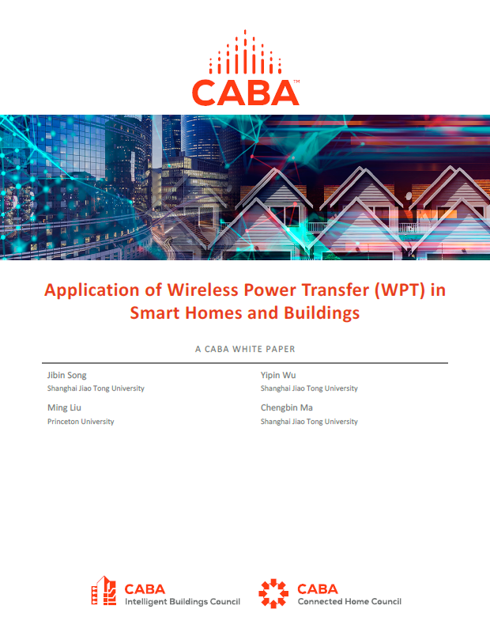
4. White Paper Sub-Committee Update Ken Wacks (Ken Wacks Associates)
4.1 Recently Completed:
“Application of Wireless Power Transfer (WPT) in Smart Homes and Buildings”
Shanghai Jiao Tong University (Chair)
Princeton University (Chair)
AirFuel Alliance
Ken Wacks Associates

Slide 6
4. White Paper Sub-Committee Update Ken Wacks (Ken Wacks Associates)
4.2 In Progress:
Part 2: “Impacts of Automated Shading in Building Projects”
TRC Energy Services (Chair)
Axis Lighting Inc.
Draper, Inc.
Ecotay Inc.
Ken Wacks Associates
Lawrence Berkeley National Laboratory (LBNL)
Lutron Electronics Co., Inc.
Mecho
NYSERDA (New York State Energy Research and Development Authority)
PLC-Multipoint, Inc.
Screen Innovations
Somfy Systems, Inc.
Sustainable Resources Management Inc.
Vistar Energy Consulting
Window Products Management

Slide 7
4. White Paper Sub-Committee Update Ken Wacks (Ken Wacks Associates)
4.2 In Progress:
“Fire Alarm Systems in Buildings”
Canadian Fire Alarm Association (Chair)

Slide 8
4. White Paper Sub-Committee Update Ken Wacks (Ken Wacks Associates)
4.2 In Progress:
“Architecting Intelligent Self Learning Adaptive Smart Campus Framework for Smart Cities”
NAVTAT Solutions (Chair)

Slide 9
4. White Paper Sub-Committee Update Ken Wacks (Ken Wacks Associates)
4.2 In Progress:
“Needlepoint Bipolar Ionization and its Contribution to Smart and Safe Buildings”
Pure Air Control Services, Inc. (Chair)

Slide 10
4. White Paper Sub-Committee Update Ken Wacks (Ken Wacks Associates)
4.2 In Progress:
“Part 2: The Evolution of Integrating LiFi Technology into Smart Lighting and Control Systems for the Intelligent Building”
Wharton County Junior College (Chair)
Acuity Brands, Inc.
ArcoLogix LLC
SnapAV
Ken Wacks Associates
National Electrical Manufacturers Association
Telecommunications Industry Association (TIA)

Slide 11
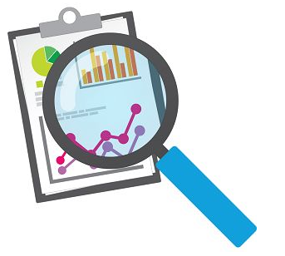
4. White Paper Sub-Committee Update Ken Wacks (Ken Wacks Associates)
All proposals and previously completed IBC White Papers can be downloaded at:
www.caba.org/whitepapers

Slide 12
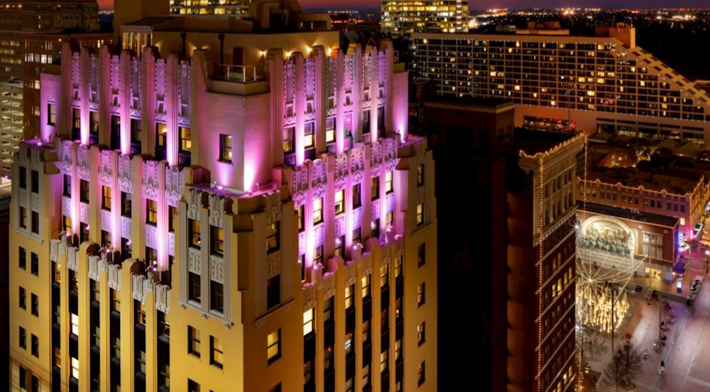
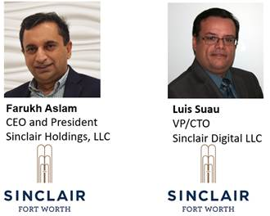
5. Keynote Terrence DeFranco (Iota Communications, Inc.)
“Digital Building implementation and Automation at the Marriott Sinclair Hotel” (30 min)

Slide 13
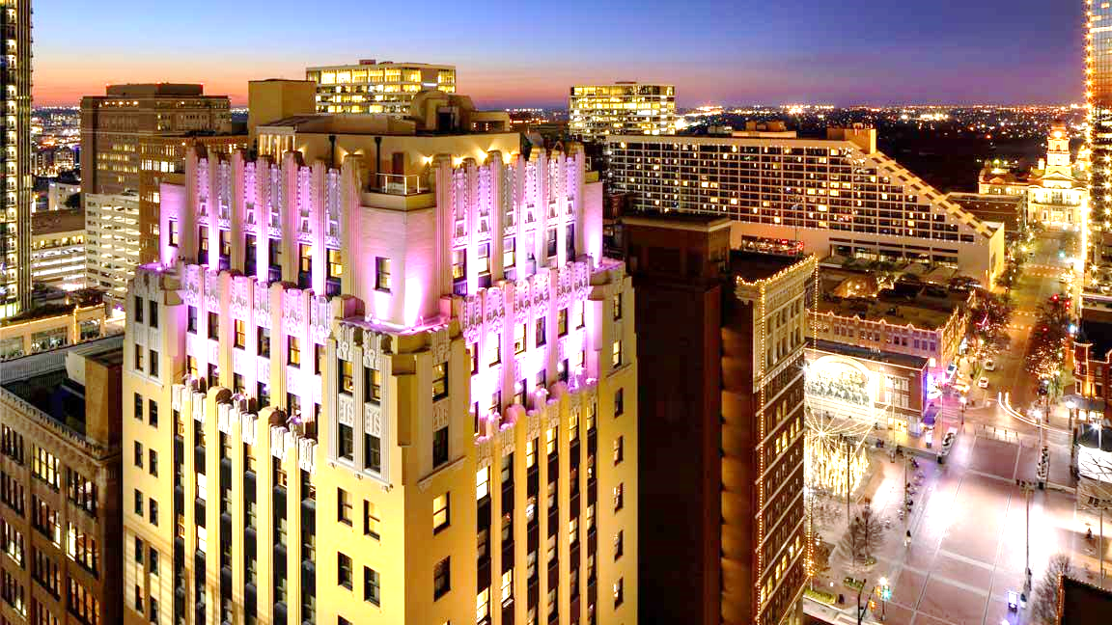
Developing the Connected Building
The Sinclair Hotel
Farukh Aslam
Luis Suau

Slide 15
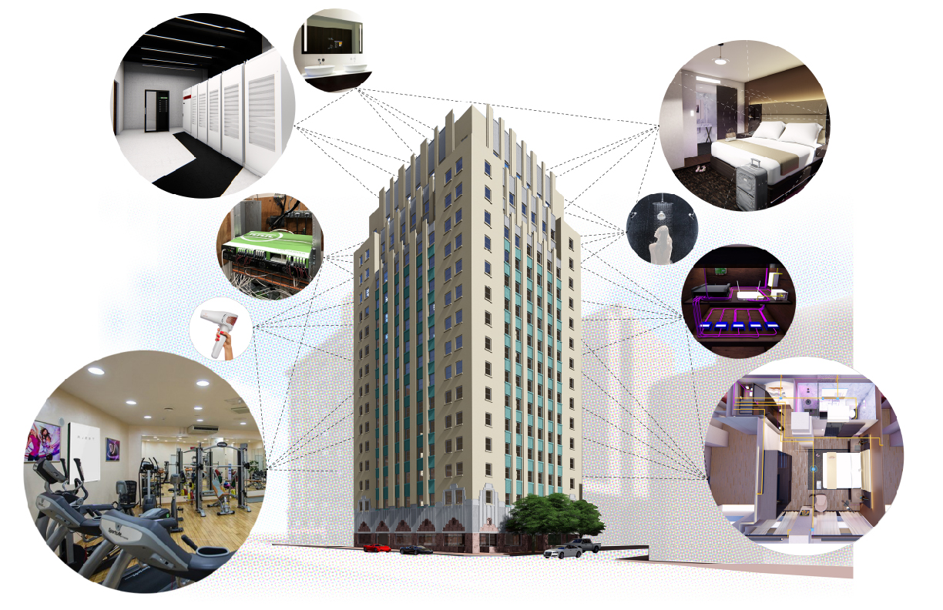
Marriott Sinclair Hotel
An Autograph Collection Property
"The Connected Building”

Slide 16
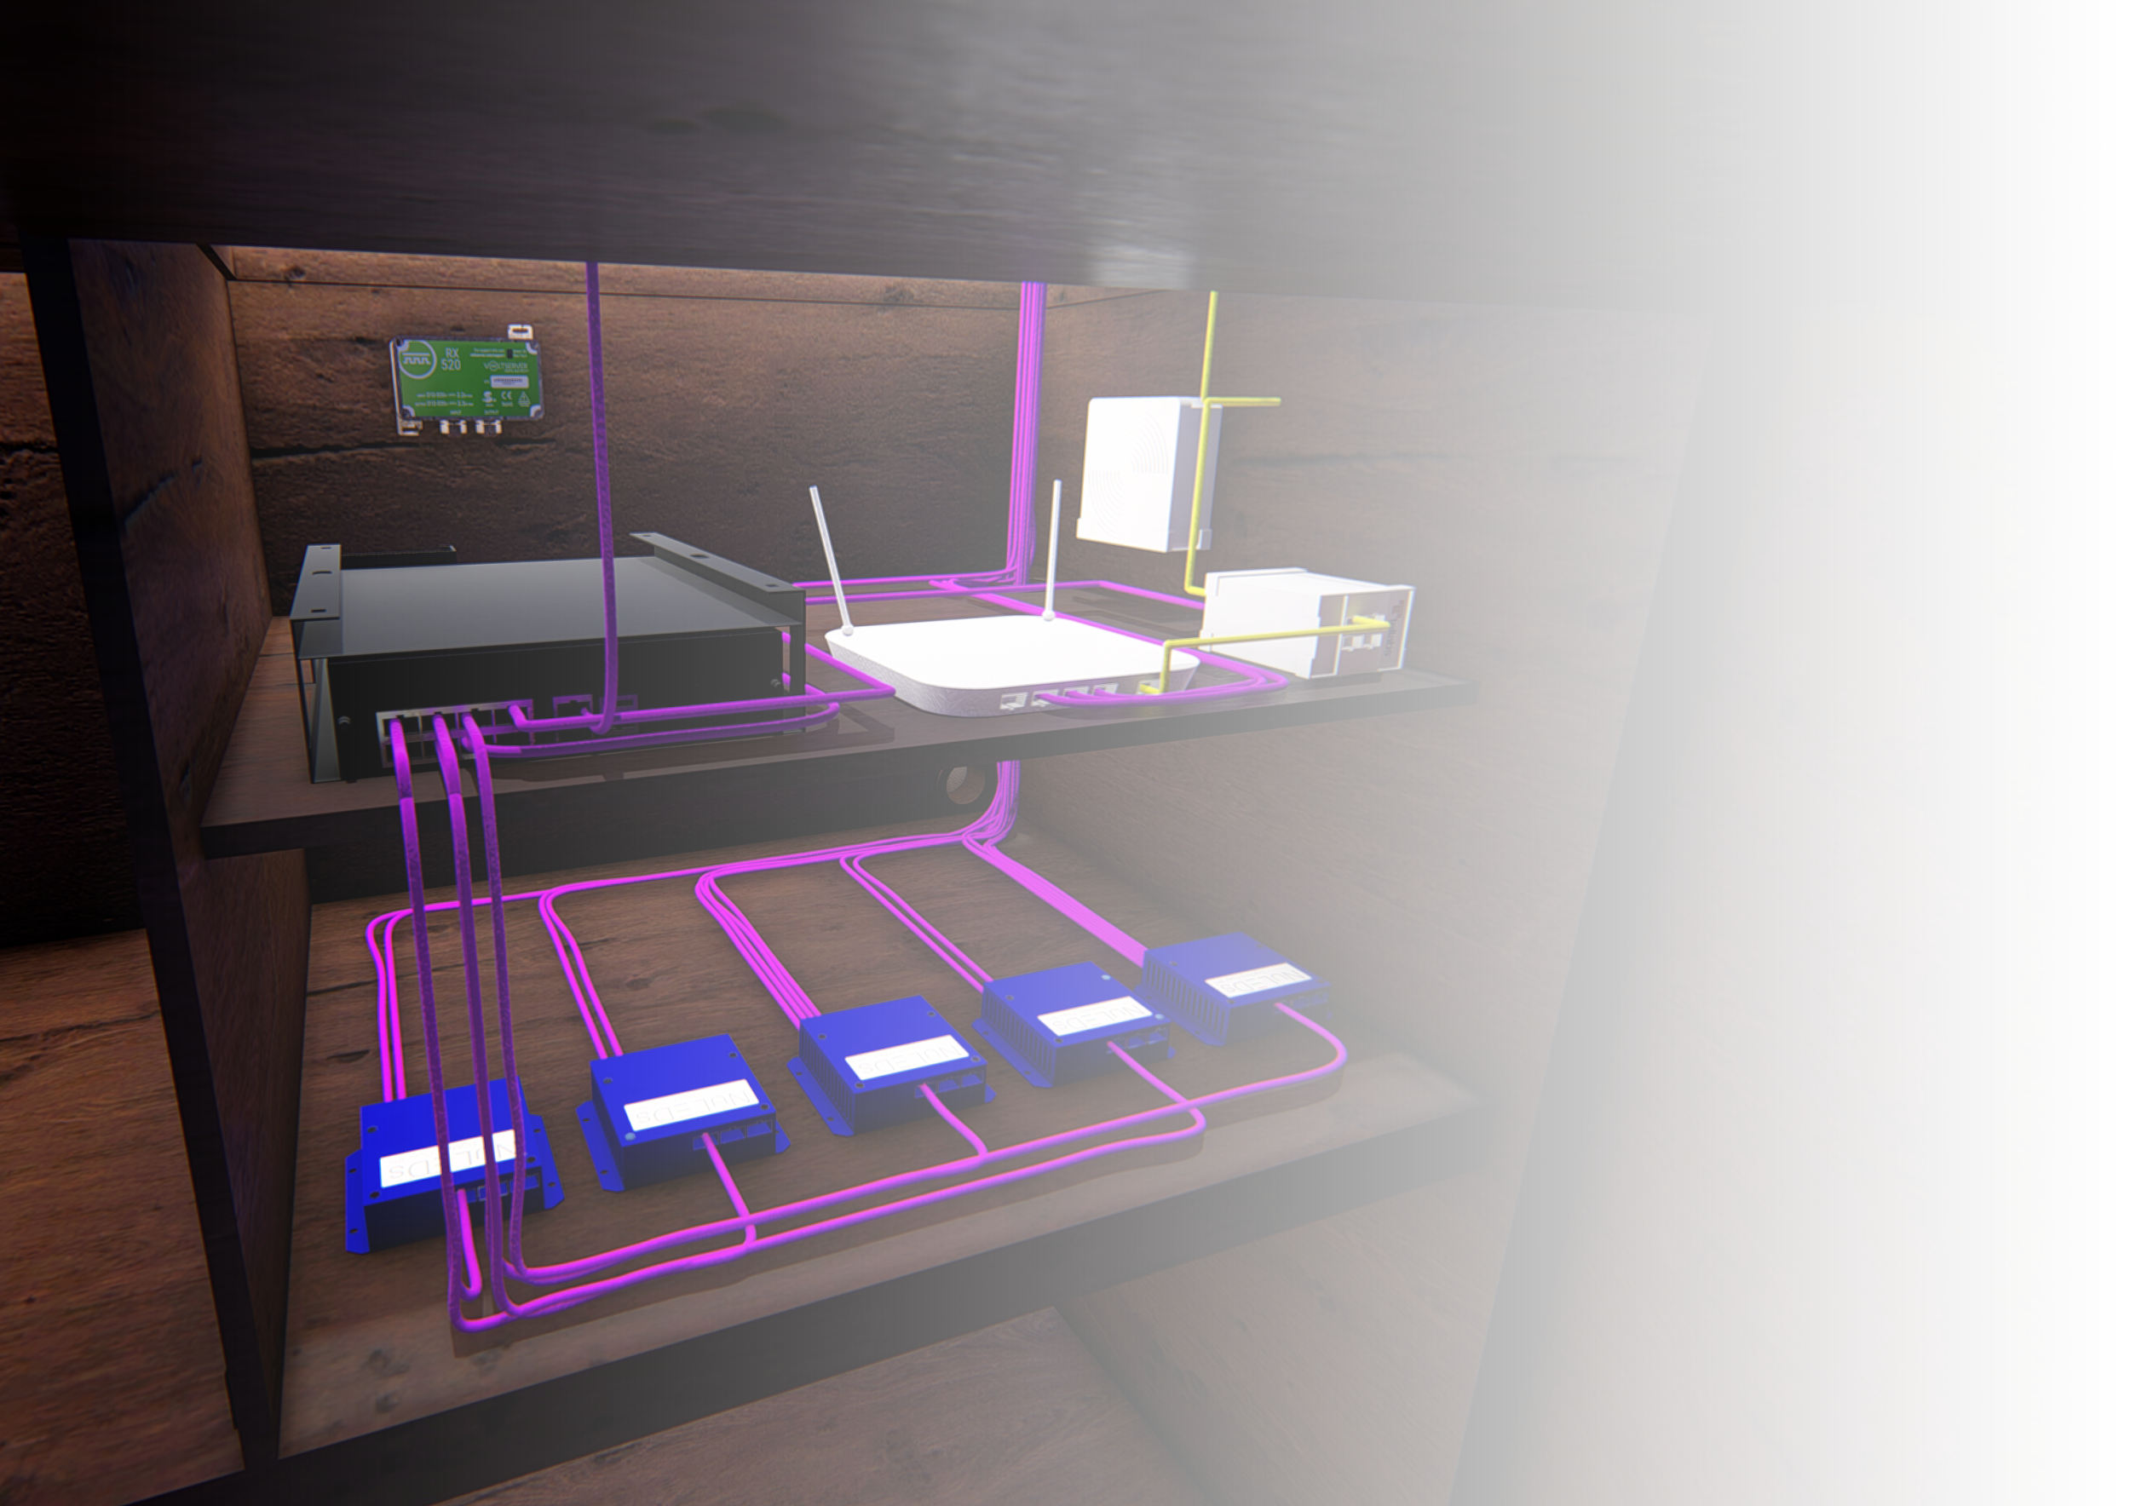
What drove you to POE technology?
PoE Lighting
By removing the driver from the light, you’re able to power multiple lights with a single driver.
This allows you to then communicate with each of those lights on a network, getting notifications when maintenance is required.
The Cisco Digital Building Switch can power all the lights in the room, and can similarly power other low-voltage devices

Slide 17
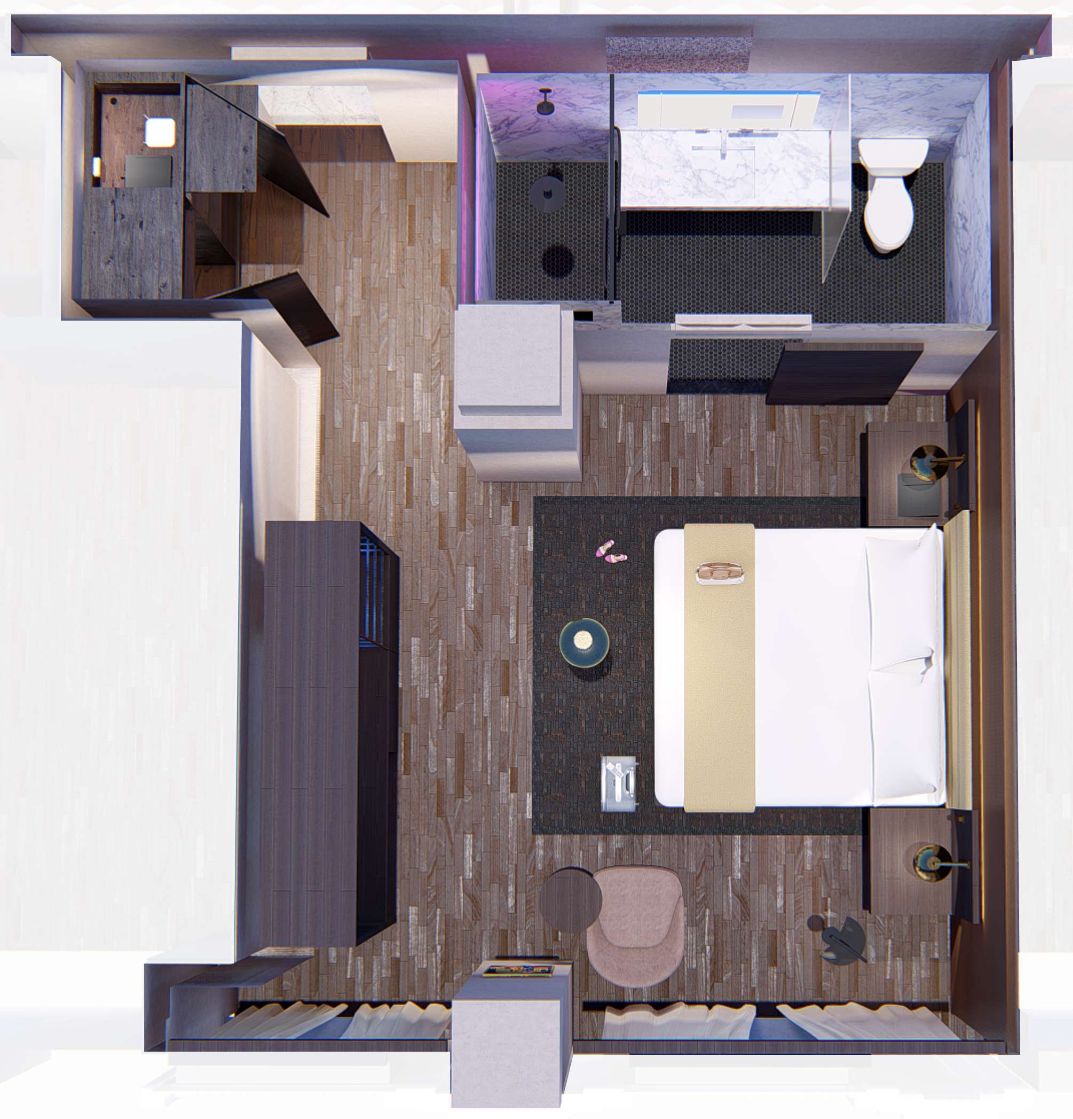
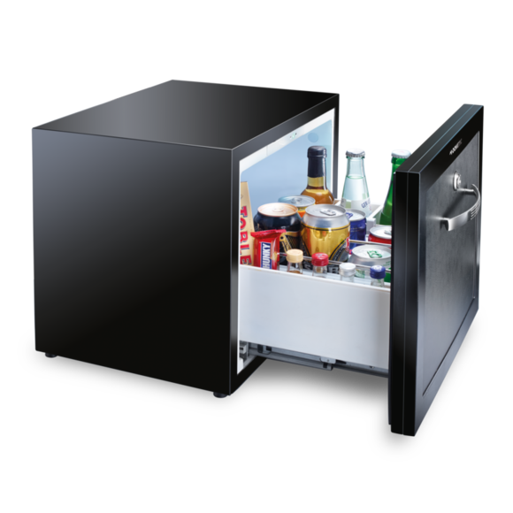
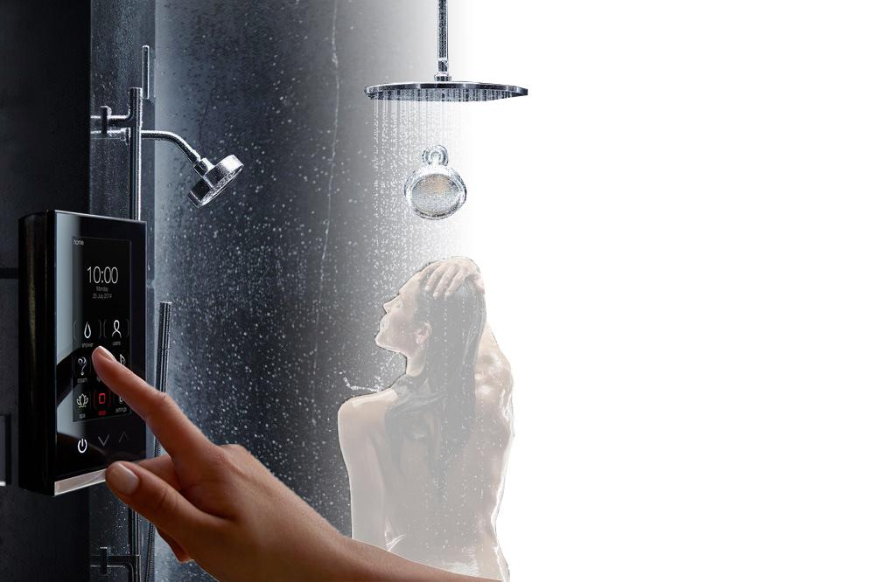
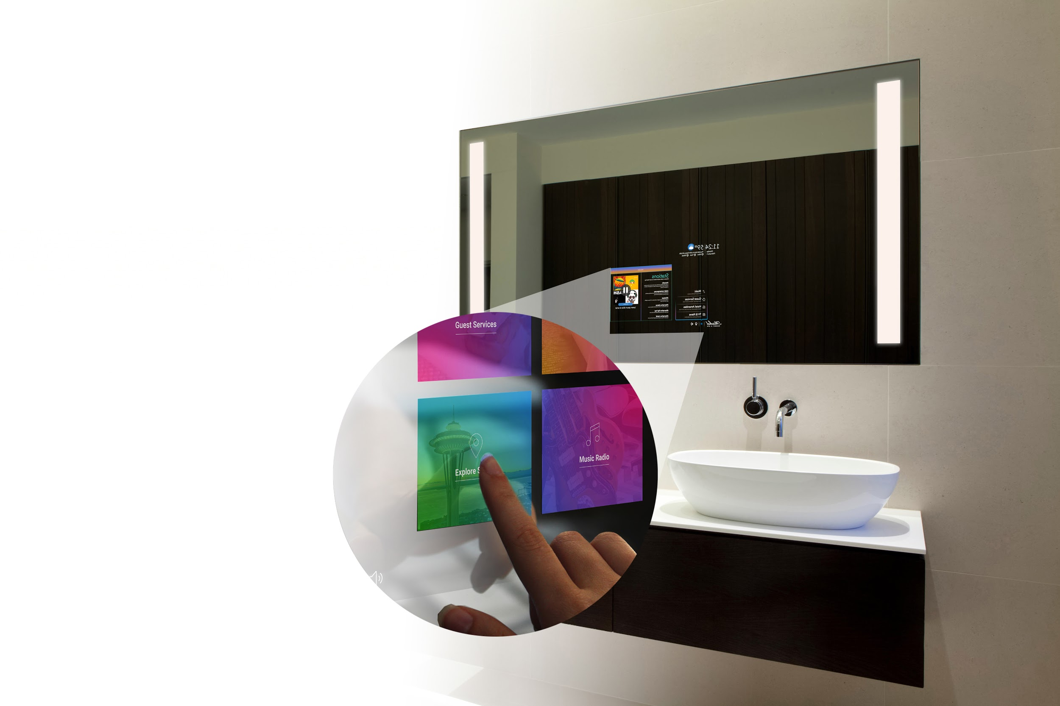
What devices are POE?
In-Room Deployment
Sinclair Autograph Hotel Deployment
Cisco Digital Building Switch in Every Room
Provides power for lighting, mini bar, window shades, ONT, electric mirror, wall controllers
“Cookie-Cutter” approach
Fiber to every guestroom
Advanced Technologies: Digital Showers, OLED televisions, Electric Mirrors, Touch Screen Wall Controllers

Slide 18
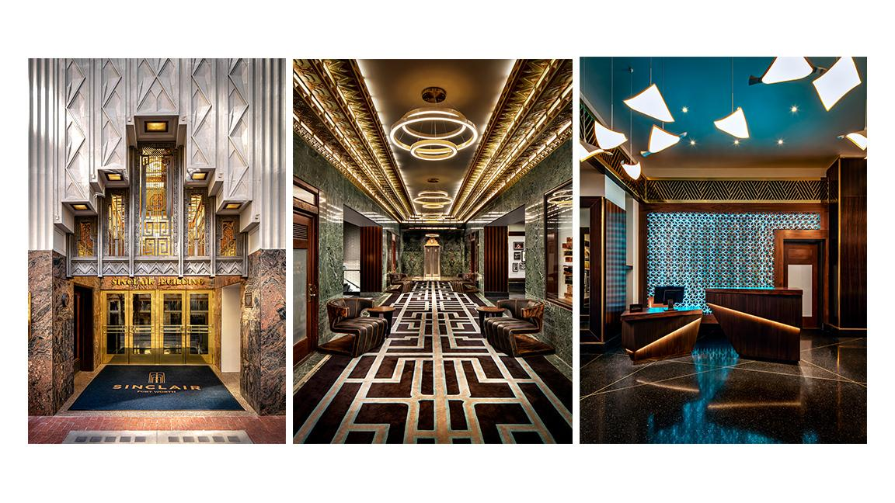

Slide 19
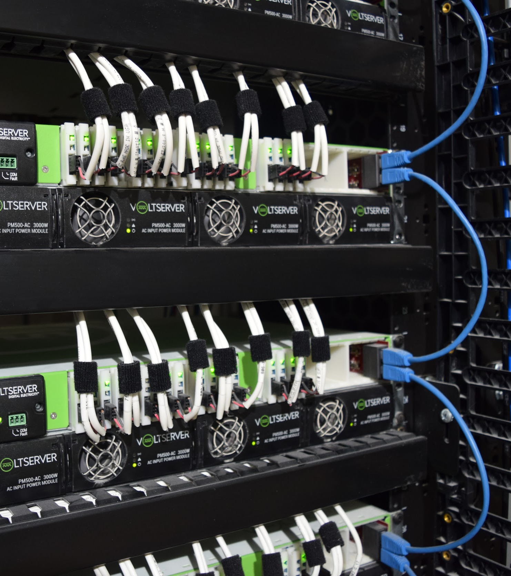
Digital Electricity
What drove the use of Digital Electricity?
Sending large amounts of electricity over 18/2 cables in packets.
Class 2 power that is safe to handle, eliminating the need for an electrician to install.
Intelligent load shedding capabilities to distribute power based on priority in the event of a power outage.
Allows for the removal of traditional A/C power

Slide 20
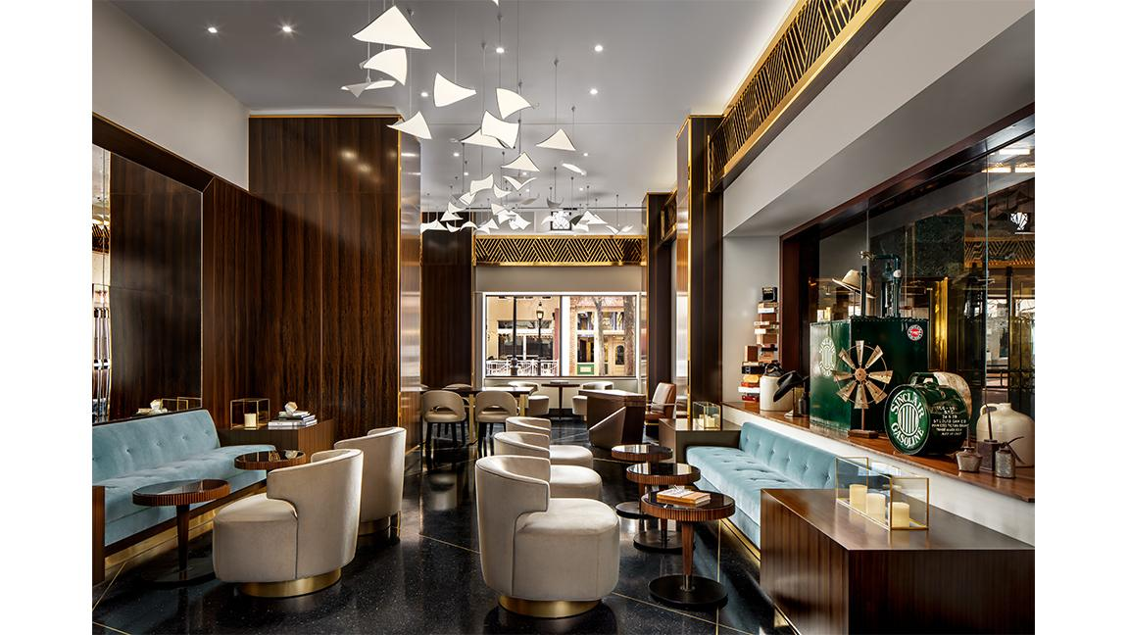

Slide 21
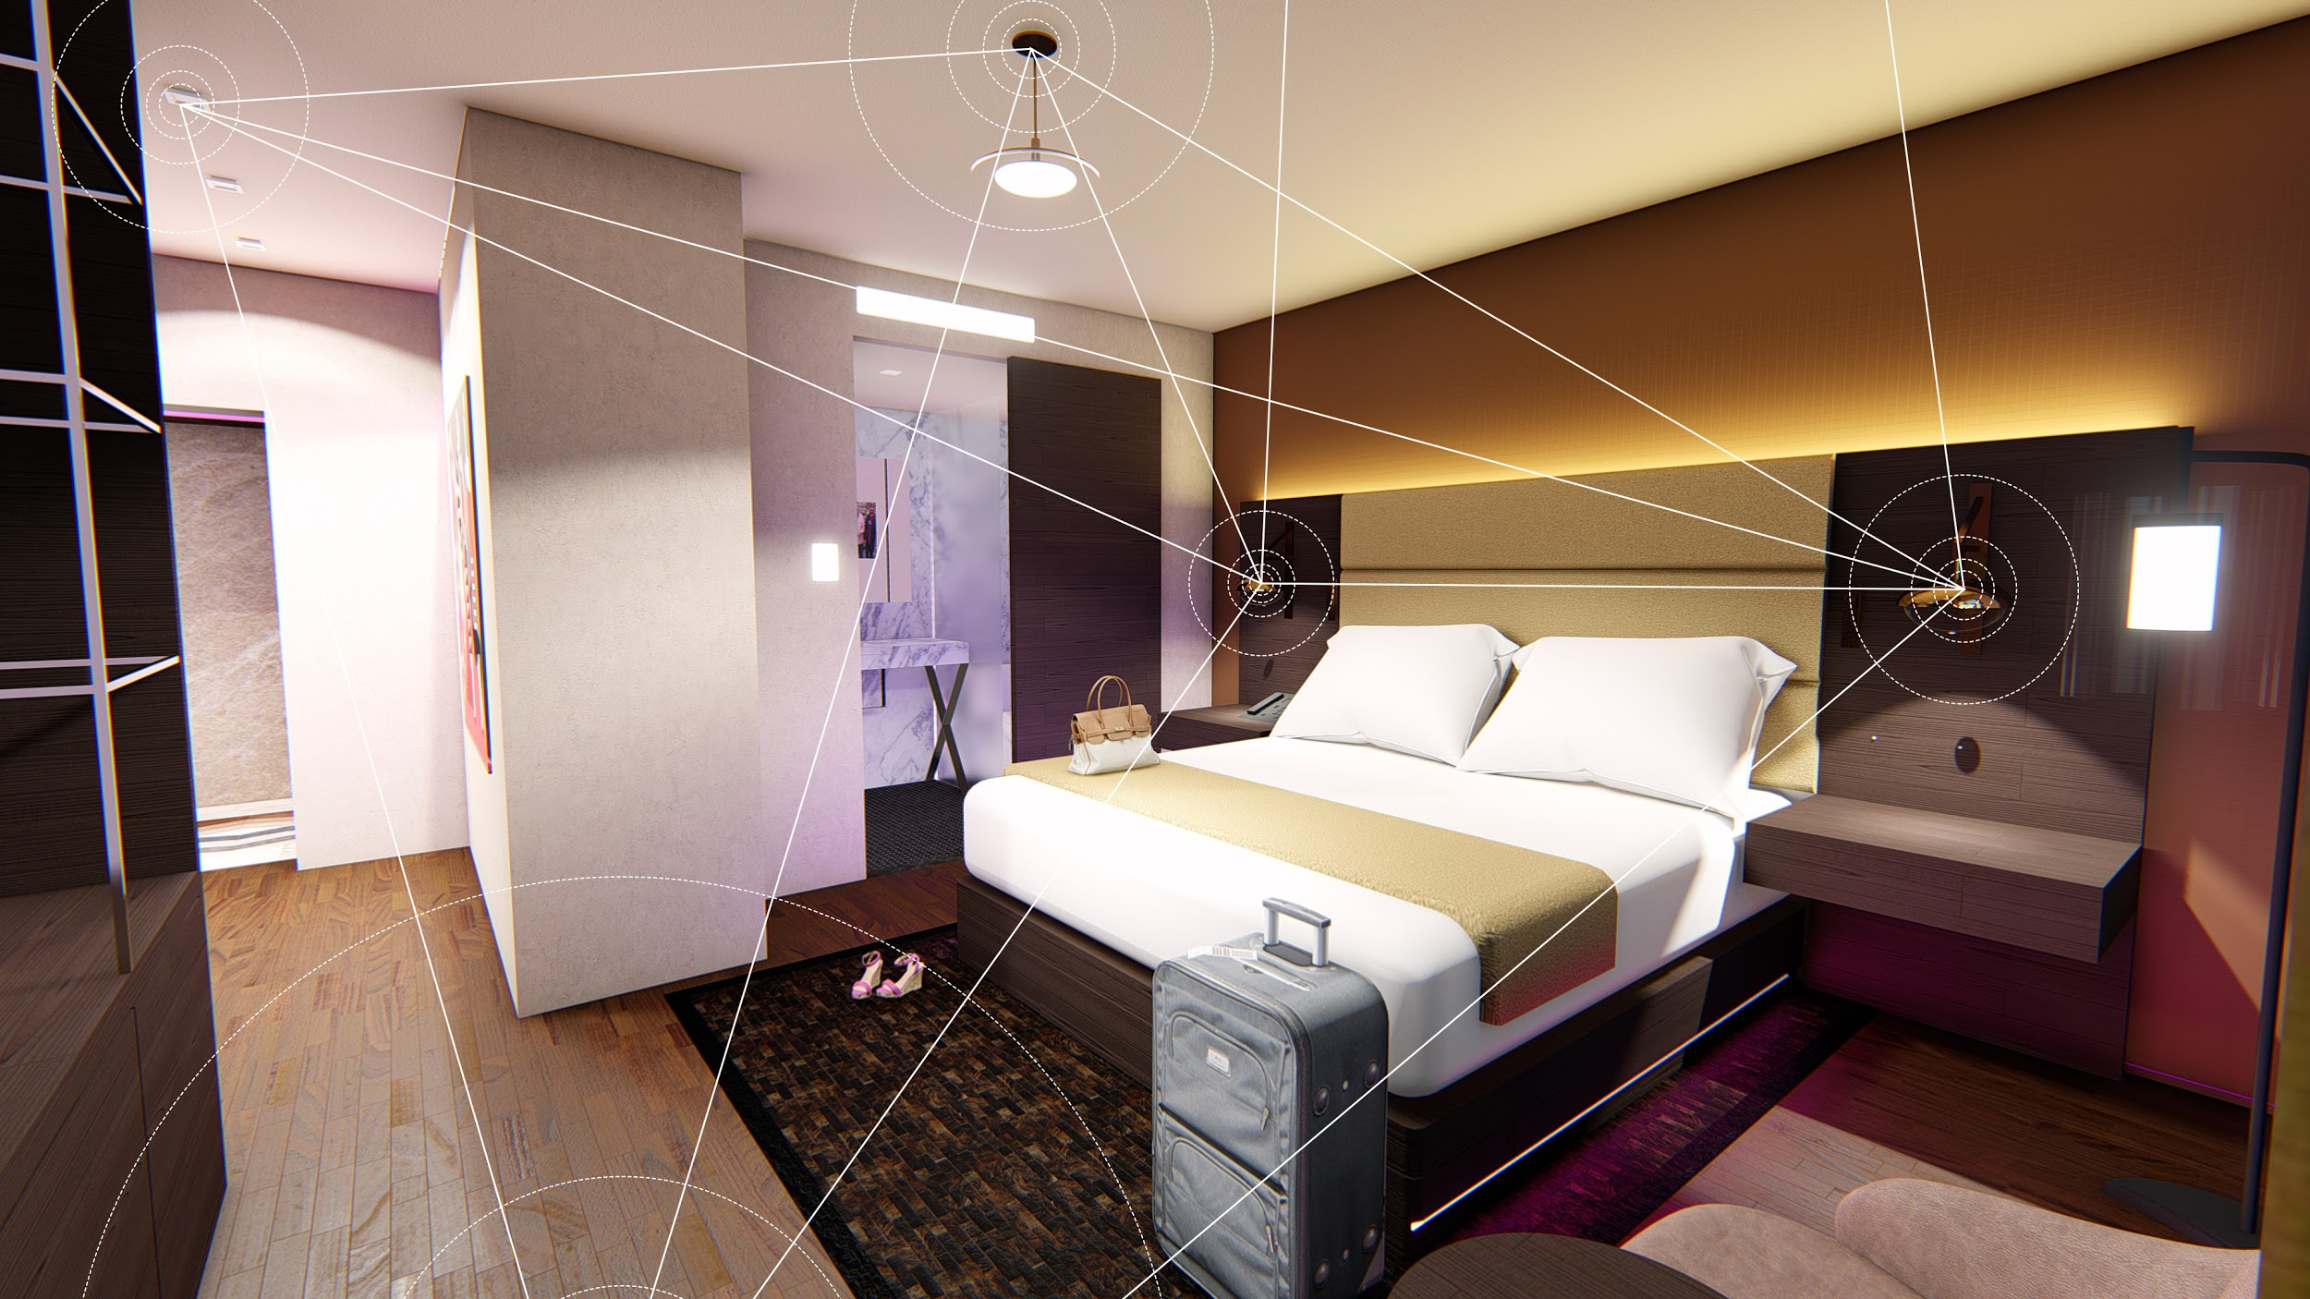
What other automation technology exists?
Ivani Bluetooth Mesh Technology
By using a bluetooth mesh we can communicate among different products to create efficient and intelligent spaces.
Features include:
Occupancy Detection
Geo-Fencing
Asset Tracking
People Counting
Spaces can be tuned to optimal settings for Air conditioning, window shade placement for solar gain, and disconnection of power to lights.

Slide 22
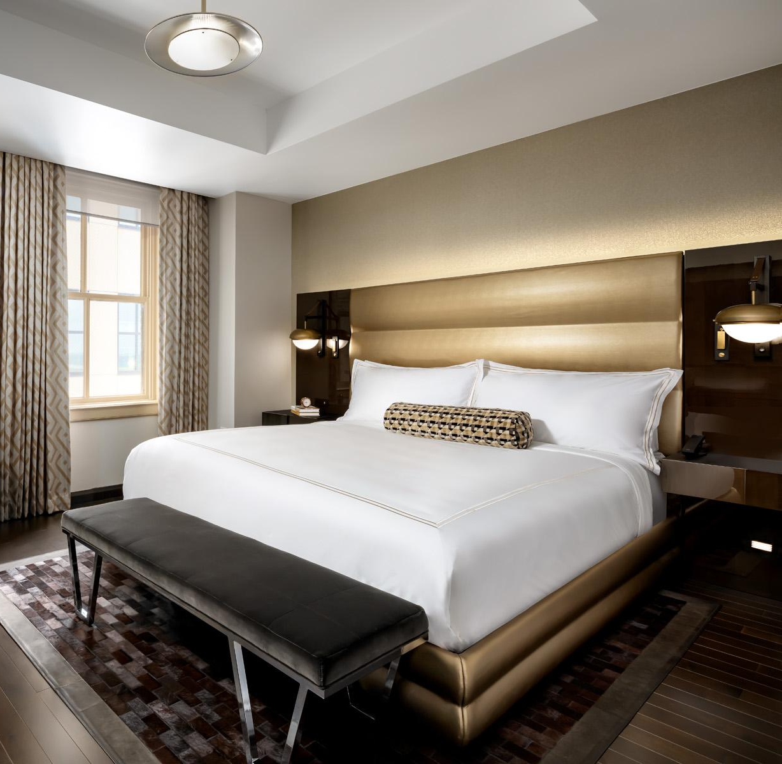
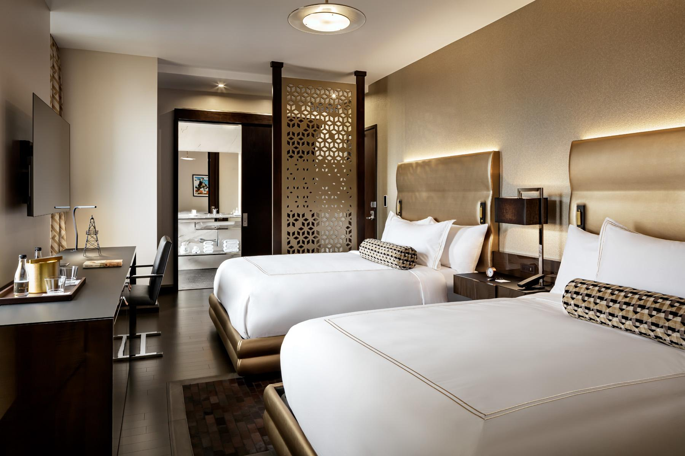
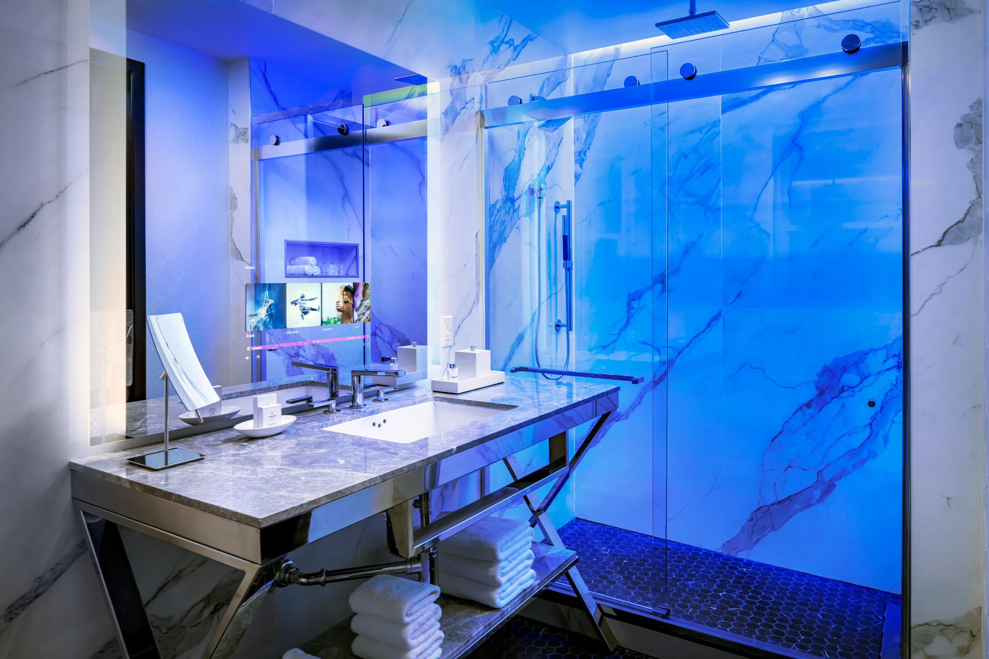

Slide 23
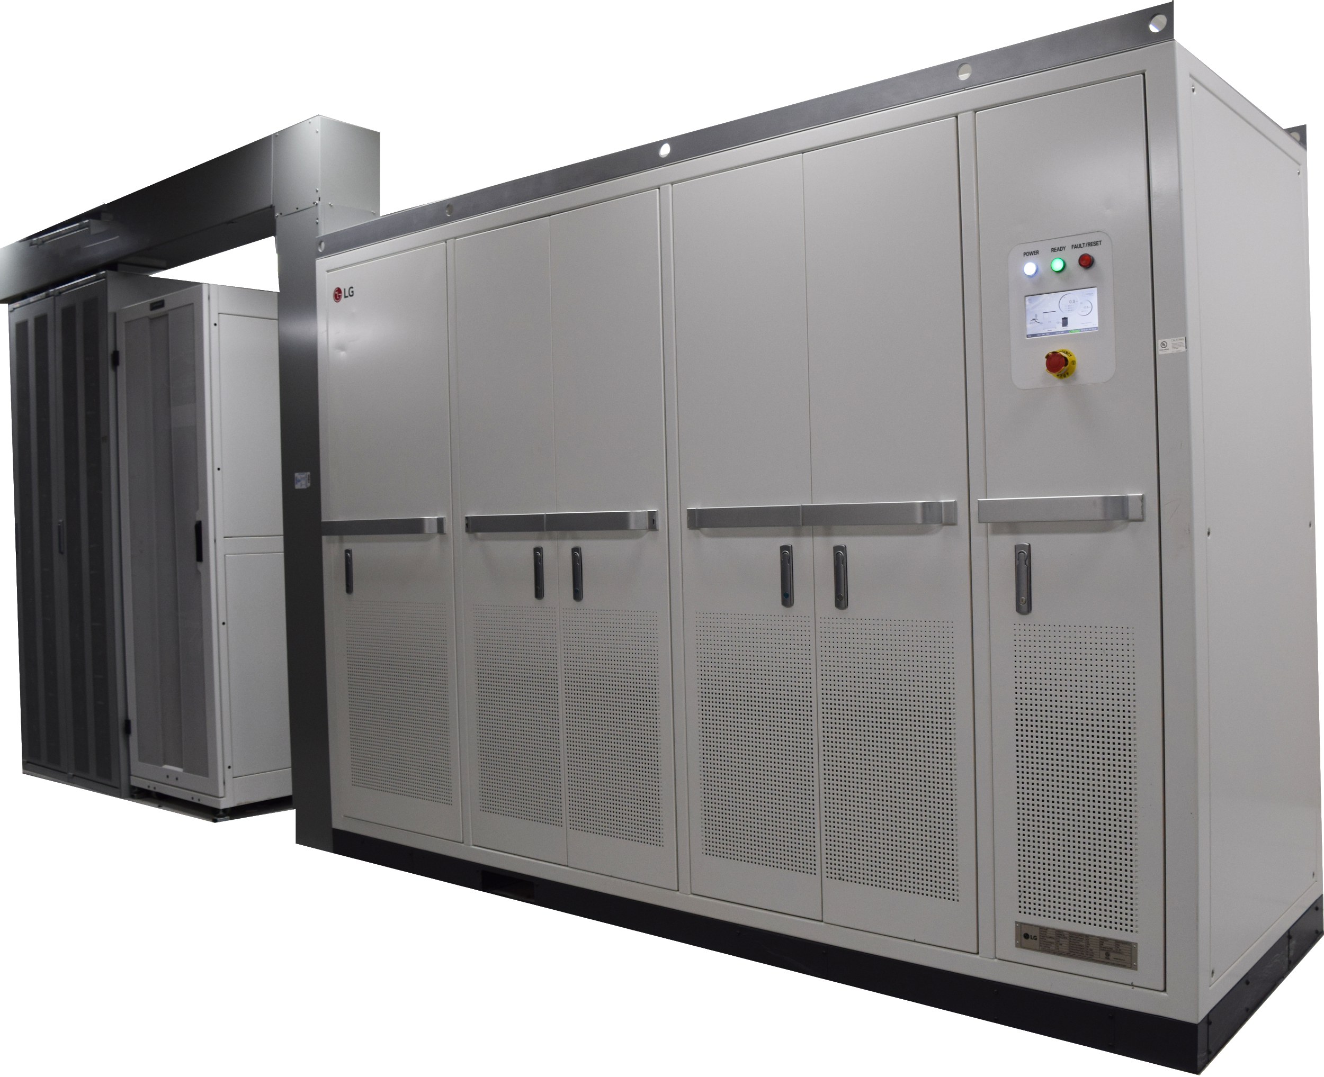
How did an ESS get replace your GenSet?
Centralized
Energy Storage System (ESS)
For the first time in the world, Lithium Ion Battery Pack has a UL924 rating which allows it to be used for Emergency backup power
Diesel generators are loud, unsafe, and require frequent maintenance
Energy Storage Systems are already being used in Korea to shave peak loads, integrate with renewable energy solutions, and backup power for different applications.

Slide 24
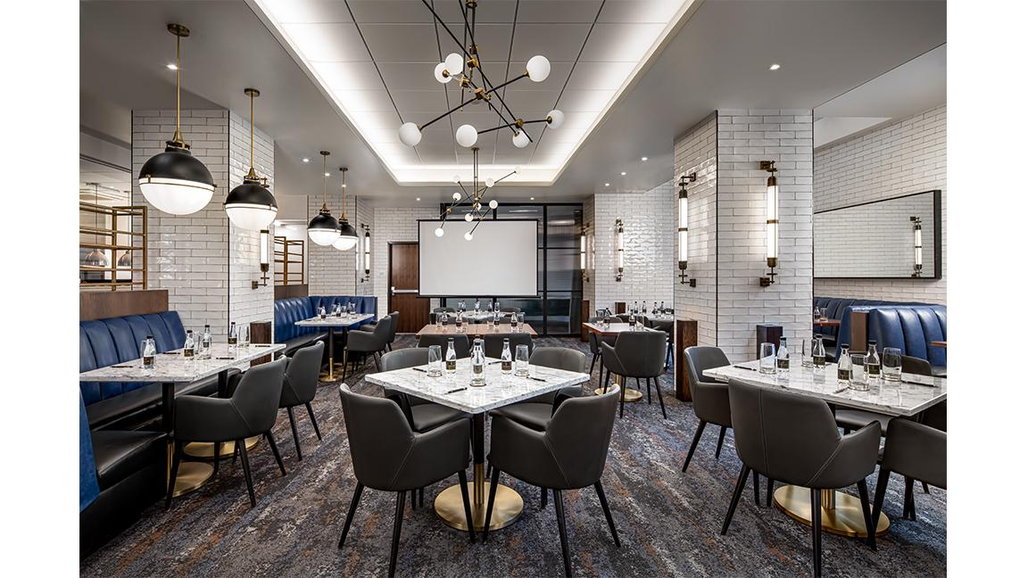

Slide 25
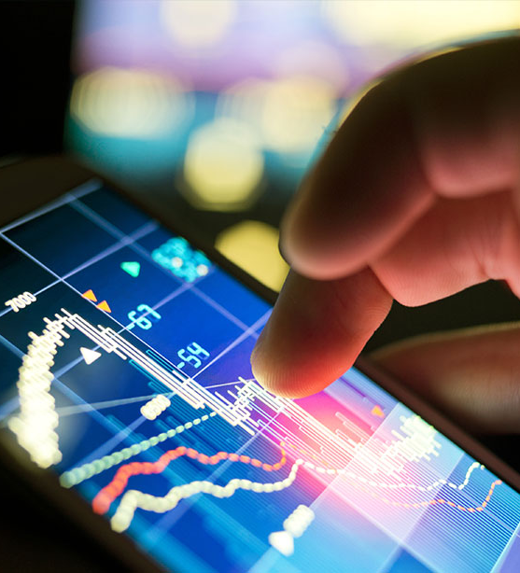
What will Sinclair Digital be doing next?
Evangelize Digital Building Technologies
Develop Buildings as DC Microgrids
Design, Install, and Maintain Digital Infrastructure in Buildings: Lighting, Shading, Controls, Automation
Use safe and new digital technologies:
Power over Ethernet (PoE)
Digital Electricity (DE)
Energy Storage Systems (ESS)
Super Capacitors
Lower customer costs (CapEx and OpEx) while creating a safer and more valuable property
Design our own products and Intellectual Property to fill gaps that exist today

Slide 26
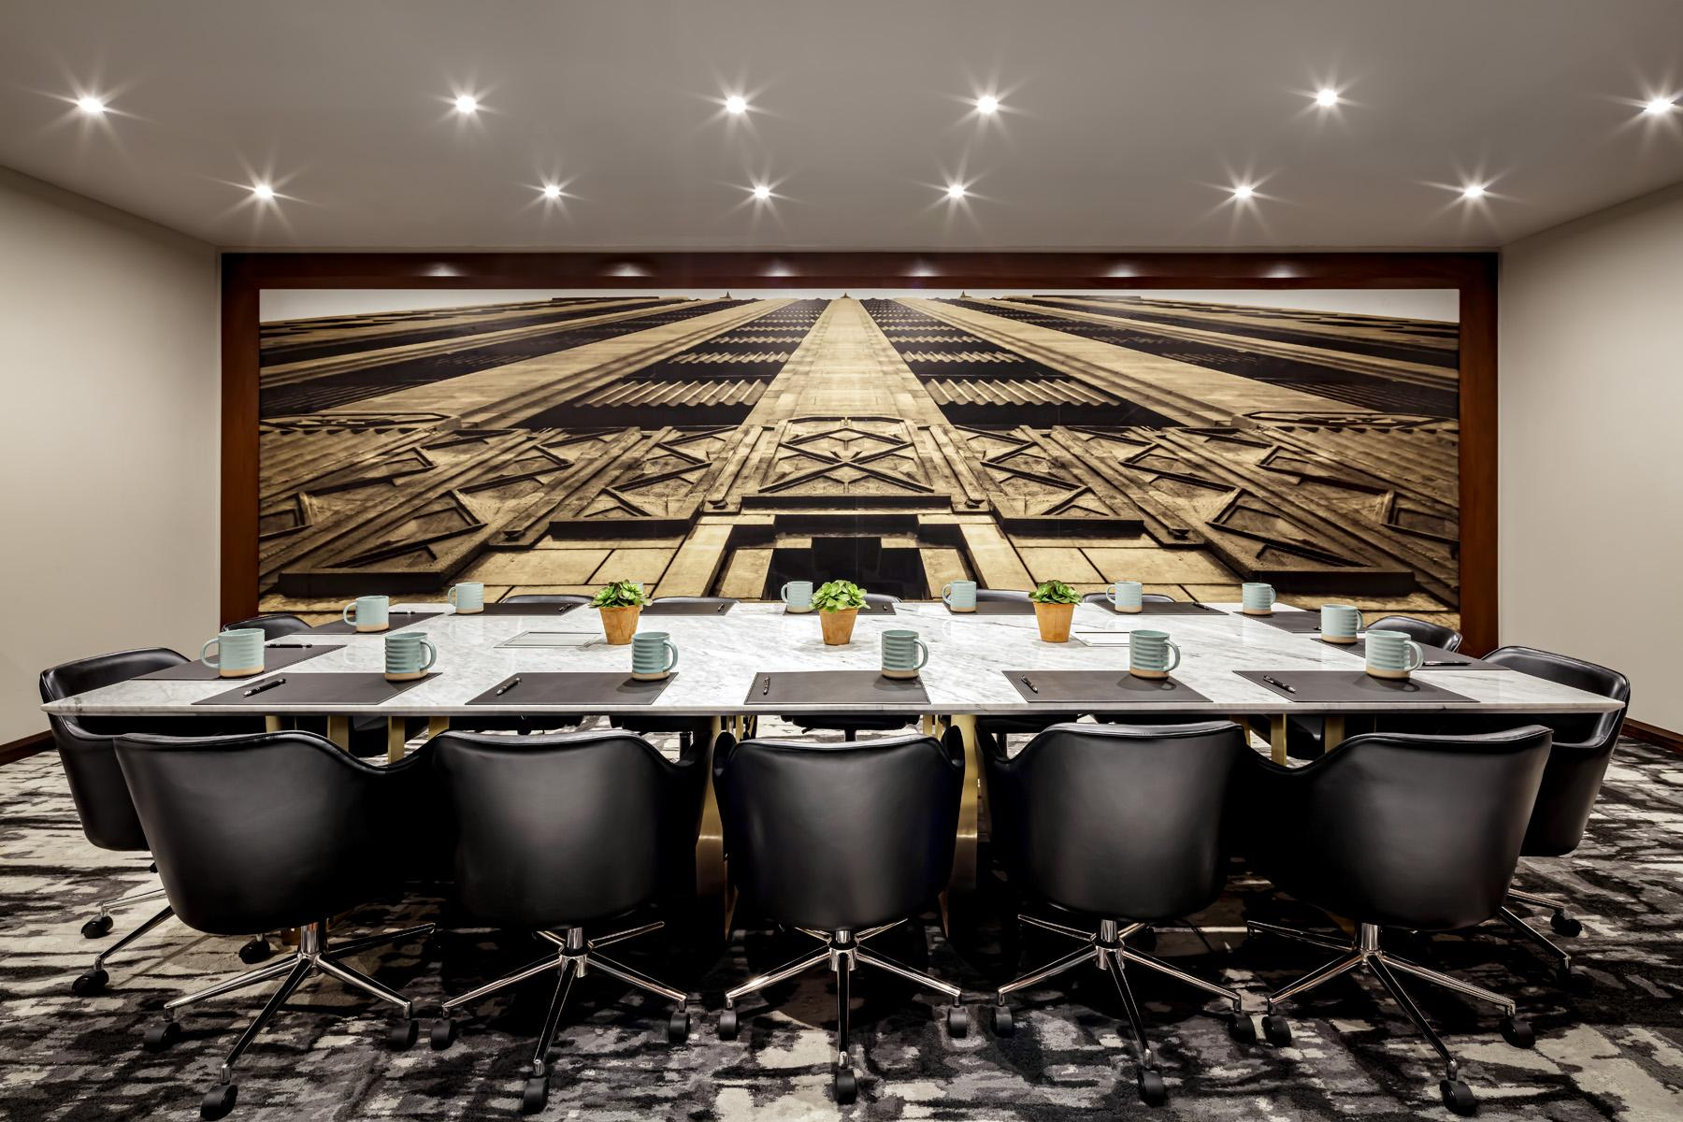

Slide 27
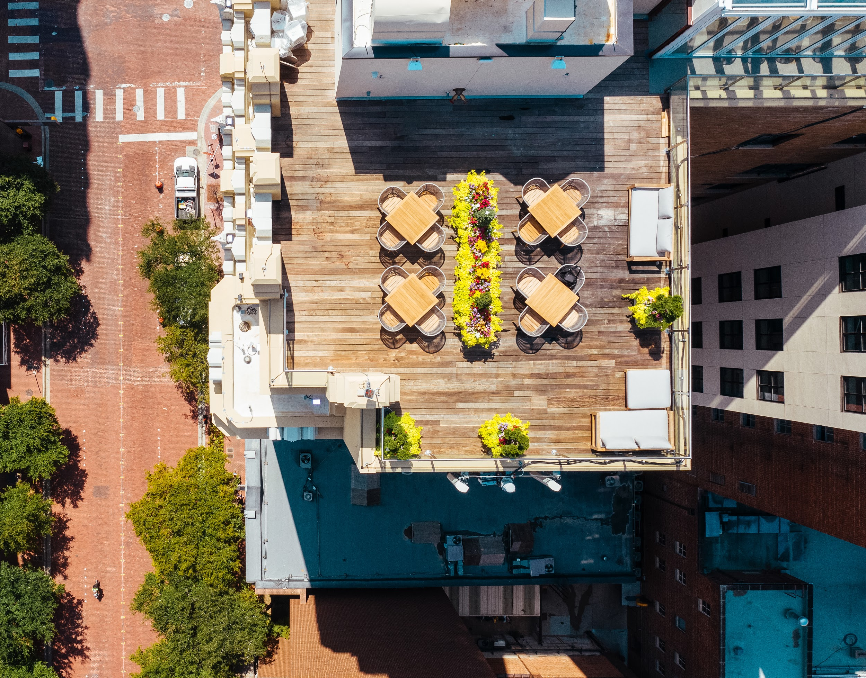
Thank you.

Slide 28
connected. verb
joined or linked together

Slide 29
5. Keynote - Questions? Terrence DeFranco (Iota Communications, Inc.)

Slide 30
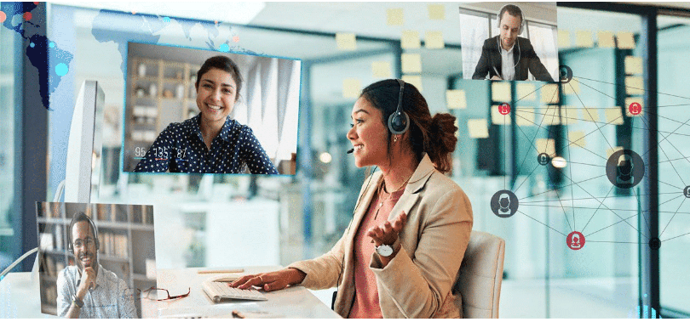
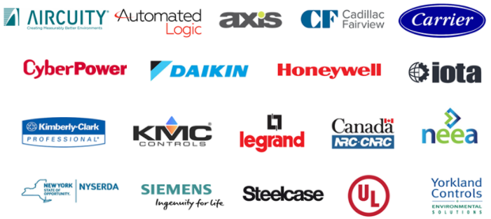
6. Research Update Greg Walker (CABA)
6.1 2019-2020 IBC Landmark Research “Intelligent Buildings and COVID-19”
www.caba.org/research

Slide 31
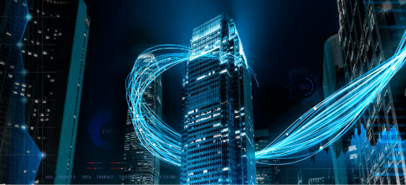
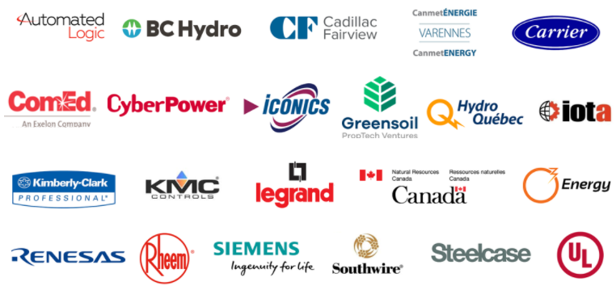
6. Research Update Michael Levy (Harbor Research, Inc.)
6.2 2020 IBC Landmark Research “Intelligent Building Energy Management Systems”
www.caba.org/research

Slide 32
6. Research Update Harsha Chandrashekar (Honeywell International Inc)
6.3 Annual “BACS Market Sizing North America”

Slide 33
7. New Business Trevor Nightingale (National Research Council)
7.1 Other new IBC business?

Slide 34
8. Adjournment Trevor Nightingale (National Research Council)
Next IBC Meeting, January 2021
Continental Automated Buildings Association (CABA) caba@caba.org www.CABA.org
www.caba.org/ibc
Connect to what’s next™

