Slide 1
Connected Home Council (CHC) Webinar
Monday, November 16, 2020, 12 NOON – 1:30 PM (ET)
Chair: Roy Perry (Alarm.com, Inc.)
Vice-Chair: Jim Hunter (Delos Living LLC)
Vice-Chair: Byron BeMiller (Semtech Corporation)
Vice-Chair: Charles Hume (Southwire Company, LLC)

Slide 2


1. Agenda
Greg Walker (CABA)
Agenda
2. CHC Webinar: “Smart Load-Shift Strategies for Electrically Heated Homes” (30 min)
- Jim Hunter (Delos Living LLC) – Moderator
- Ajit Pardasani (National Research Council)
3. CHC Meeting: Call to Order, Welcome, Introductions, about the CHC
4. Administrative
5. Research Update
6. White Paper Sub-Committee Update
7. New Business
8. Adjournment

Slide 3
2. CHC Webinar: “Smart Load-Shift Strategies for Electrically Heated Homes” (30 min)
Jim Hunter (Delos Living LLC) – Moderator
Ajit Pardasani (National Research Council)

Slide 4
2. Speaker Introduction
Jim Hunter (Delos Living LLC)
Ajit Pardasani (National Research Council)

Slide 5
Smart Load-Shift Strategies for Electrically Heated Homes
Ajit Pardasani, B.Eng., M.Sc.
Senior Research Officer, Building Technology Optimization
NRC-Constrution

Slide 6


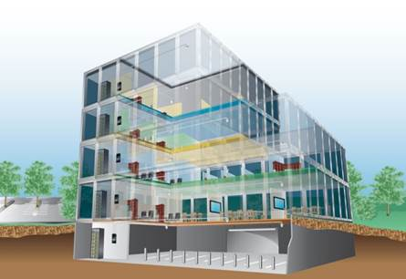
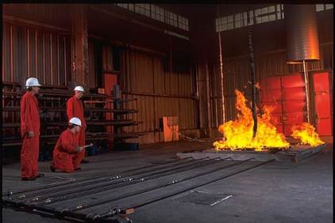

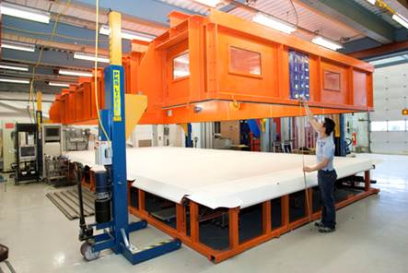
Building and Infrastructure research
– since 1947
Building Envelope & Materials
Civil Engineering & Infrastructure
Intelligent Building Operations
Fire Safety
Building Regulations
Technical & Testing Services
Notes:
Here is what we are known for
Develop, validate and de-risk technologies
Decrease time to market for innovative technologies
Looked to as an Independent third party to measure, validate and authenticate

Slide 7

Lower Energy
Costs
Lower Emissions
Building Physics
Smart Energy
Grid
Lower
O&M
IT Systems
& Analytics
Human
Factors
Collateral Benefits Org. Productivity
HPB also require multi-disciplinary approach to buildings and broader set of competencies

Slide 8
Acknowledgements
Jennifer Veitch, Guy Newsham, Vera Hu, Anca Galasiu, Sandra Mancini, Steve Kruithof, Trevor Nightingale (NRC);
Jill Rogers, Norma McCarthy, Nurul Abser, Sara Mudge, Trupti Abhang, and the Customer Care team (NB Power);
Brody Hanson, Greg Robart, Sonya Hull and Terrance Cormier, and the DRMS team at the Smart Grid Centre of Competence, Siemens Canada;
Elias Puurunen (Northern HCI Solutions Inc.);

Slide 9
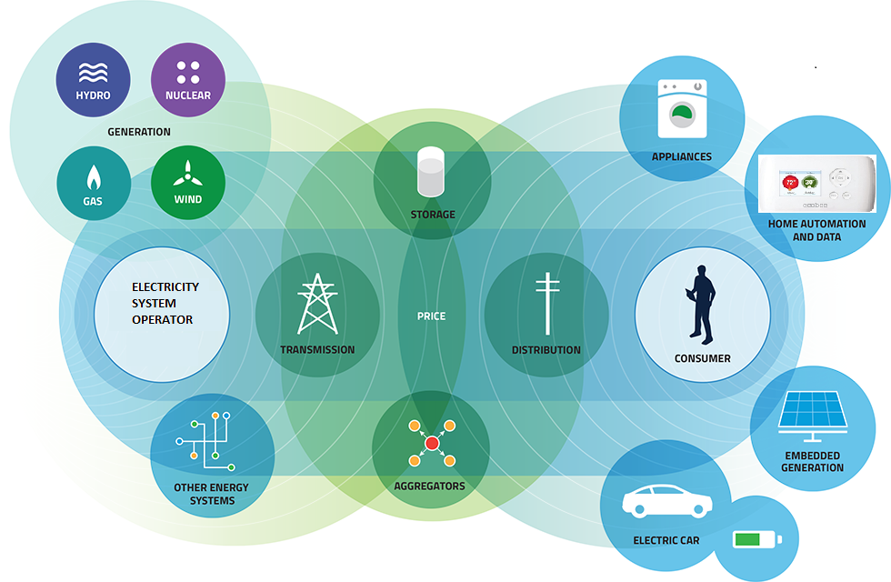

Changing Electricity Landscape and Internet of Things (IoT)
Generation
Smart/ Distributed
Energy Resources
Transmission
Distribution
Buildings use more than 70% of electricity
By 2040, 33% of all vehicles to be electric
Source: IESO
Notes:
The traditional electricity grid is undergoing a major transformation. In the traditional grid the electrons move only in one direction- from generating stations to be used in in buildings, city and transport infrastructure, mines, and factories, etc. The current trend of increasing penetration of embedded generation from renewable resources like wind and solar and connected loads enabled by smart thermostats are posing new challenges for utilities companies causing them to seek new technological solutions and economic models for the future. The advances in communication technologies and falling prices have made now possible for utility companies to access and control connected loads in buildings through smart thermostats. This presentation provides an overview of smart grid pilot studies …. .

Slide 10


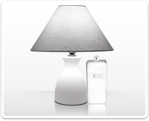
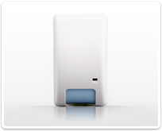
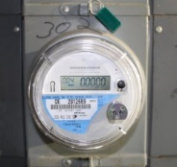
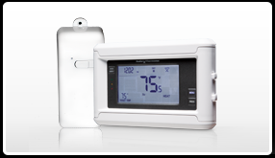
Smart Energy Home Infrastructure
security
sensors
Time of Use rate structures are designed to spread out the electricity usage more evenly over the day
light
control
Plug Loads
Lighting
Appliances
Refrigeration
occupancy
sensors
Controls operate buildings for rate structures to reduce energy bills
HVAC System
Space Cooling
Space Heating
Smart Meter
smart
thermostat
Water Heating
Notes:
Smart controls can reduce demand charges and energy bills
Smart Controls have the potential to save energy costs by reducing energy use during the peak hours
In certain regions utilities provide incentives for peak demand reduction
Potential to design and operate buildings for rate structures to reduce energy bills (e.g. thermal storage, thermostat setpoint adjustment, etc.)

Slide 11
Smart Home Infrastructure Applications
Smart Home
Thermostat Set-point Control
Demand
Energy Use
Smart Device Data
Benchmarking
Fault Detection
Energy Use Habits
Energy Retrofit Advice
Energy Waste

Slide 12
Demand Response Pilot Studies in Canada – Electric Heating Focus
Utility | Type of Electric Heating | Sample Size | Peak Reduction
Quebec Hydro | 50% central heating, and 50% baseboard heating | 50 homes of Hydro- Quebec employees
 | Smart Thermostat Pilot with ASE Energy and Sinope | 30 homes of Hydro- Quebec employees | 2kW of load shift for homes with 10 SLVT and 1 kW with 4 SLVT
BC Hydro Vancouver Island | Baseboard heaters | 22 homes (2016-17) | 500 W – 1 kW 5 SLVT
Fortis, BC | Electric HP and furnaces | 100
Manitoba Hydro | Electric heating | 88 homes | energy efficiency focus
NB Power | Baseboard Heaters Mini-split HP with b/b Baseboard with secondary heat | 50 homes (2015-16) 600 homes (2016-17) | 2 kW for b/b heated homes 1 kW for mini-split HP 4-6 SLVT

Slide 13
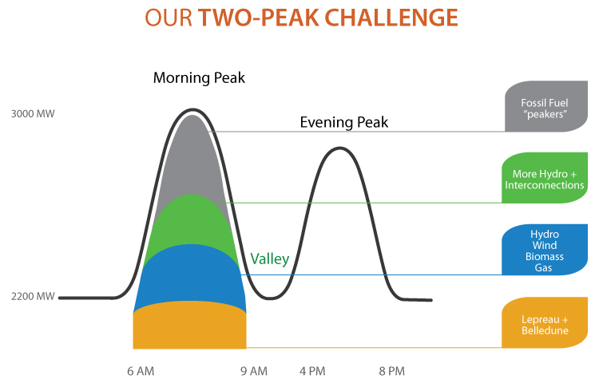
Twin Peaks – New Brunswick
Peak Reduction Program:
System peaks a few times a year during winter
61% electricity is space heating
Peaking generation units (Fossil Fuel)
Imminent EOL of major gen. assets
Graphics Credit: NB Power

Slide 14
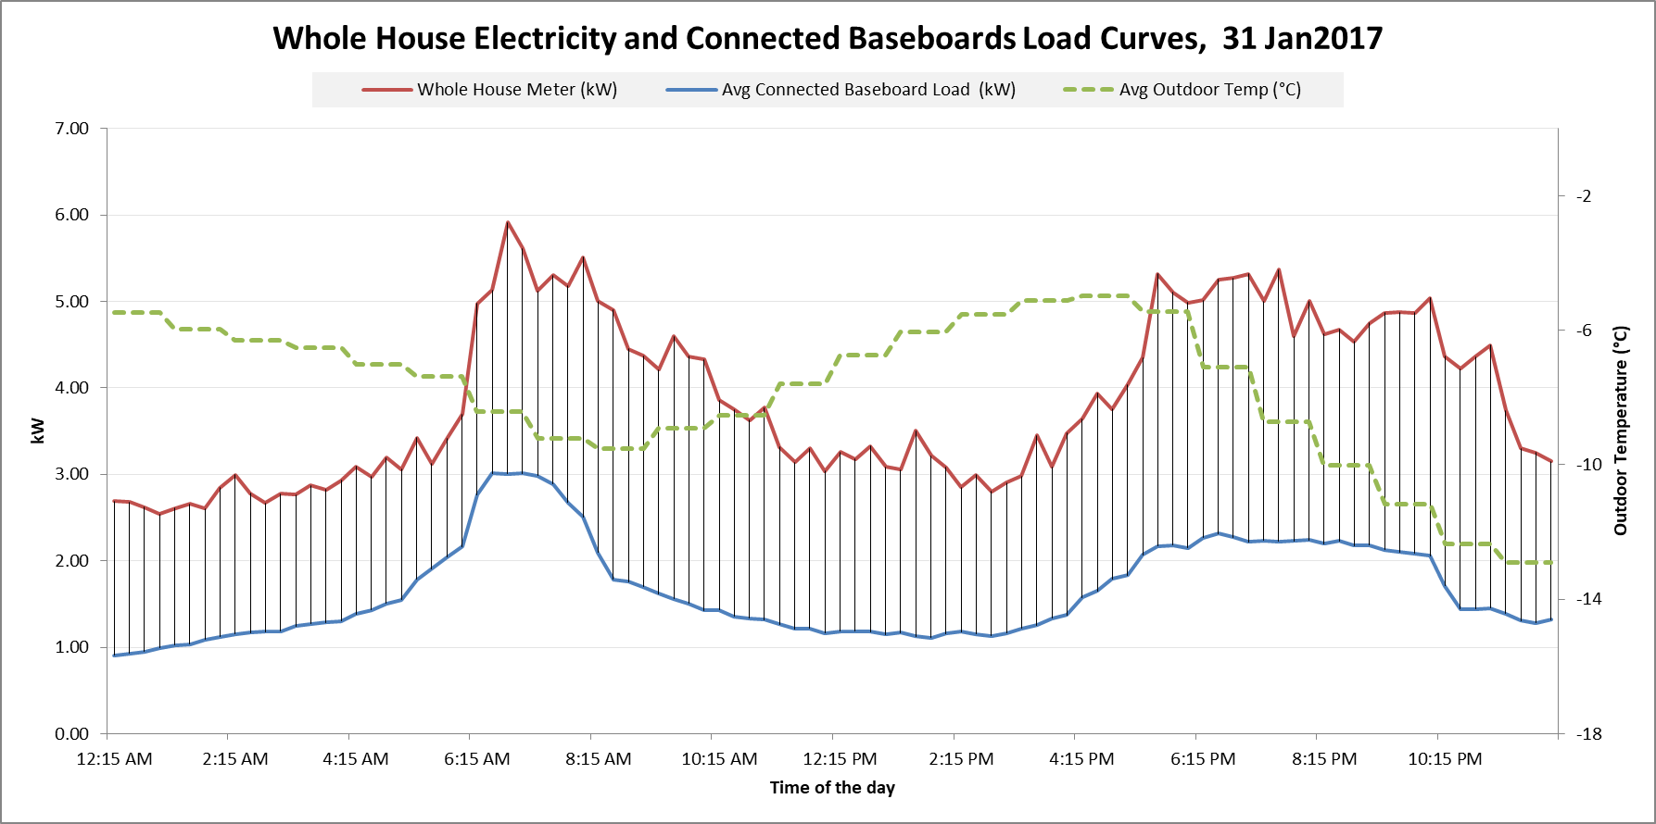
Winter Residential Load Profile
N_{dewellings} =224
N_{WholeHouseMeters} = 29

Slide 15
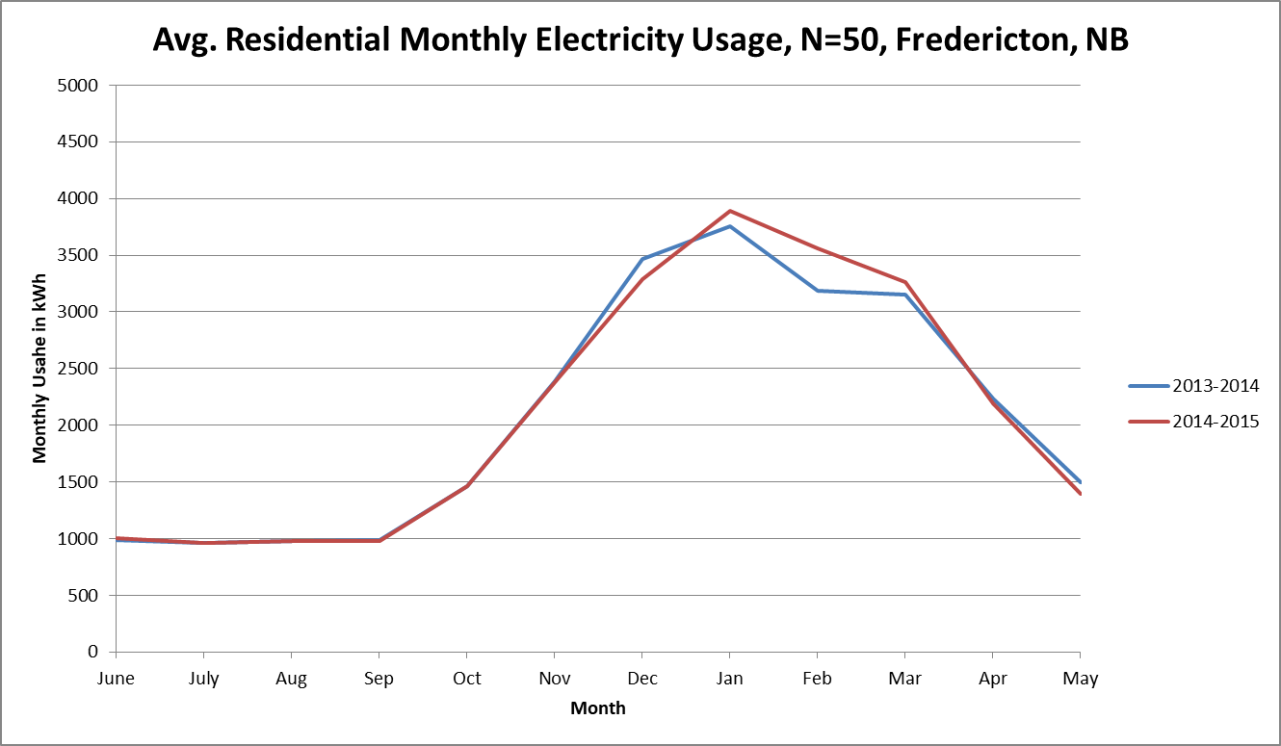
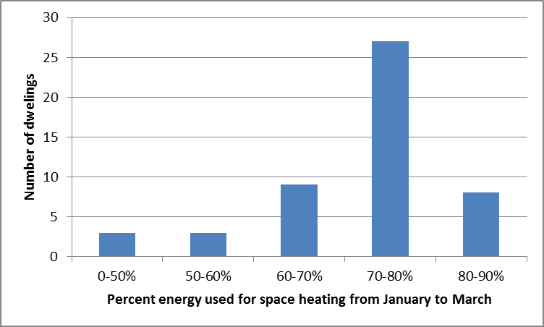
Usage for Electrically Heated Homes (N=50)

Slide 16
Demand Control Strategy: Electrical Thermal Storage Enabled by Connected Thermostats
The Solution: Thermal storage of electrical energy
(Treating building fabric similar to a thermal battery)
  Store electricity as thermal energy by pre-heating the building by 1° or 2 ° Celsius above the pre-programmed temperature set point before the onset of system peak
  Discharge the stored energy during the peak period

Slide 17
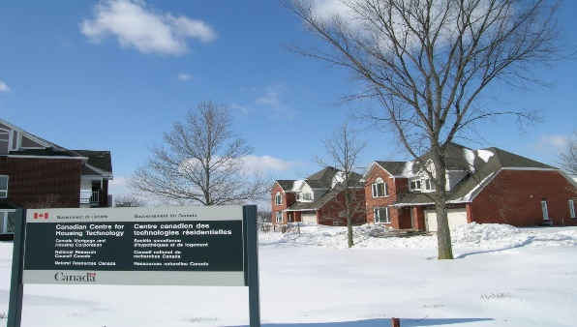

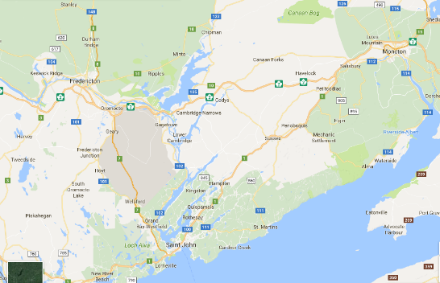

Pilot Evolution - 3 years (2014-17)
50
Homes
2
Homes
Twin Test Houses
50-Home Pilot Study
567-Home Program Pilot
Research
Demonstration
Scale up
2014-15
Evaluated shift potential
Canadian Centre for Housing Technologies, Ottawa, Ontario
.
2015-16
Evaluated load shift and occupant comfort in detached homes
Fredericton, N.B..
2016-17
Evaluated load shift and comfort for a variety of heating systems
Three Cities: Fredericton, Moncton and Saint John, N.B.
Study Partners: NB Power, NRC, Siemens Canada

Slide 18
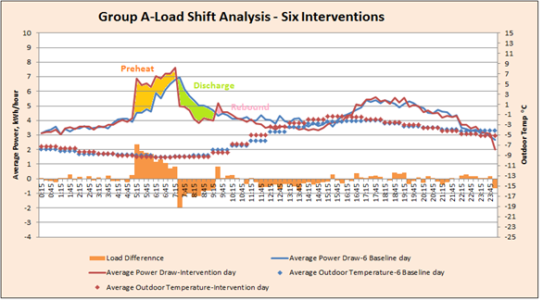
50-Home Study: Comparing Intervention to Baseline Load Profile
50-home study
Fredericton, NB
2015-2016
Group A, N=25
Group B, N=25
Notes:
Comparing the average load on the equivalent baseline days to that of the intervention days for Group A. The solid red line represents the load for an average of six intervention days for Group A and the blue line represents the equivalent baseline day which is the average of six days (12-Jan, 18-Jan, 9-Feb, 10-Feb, 16-Feb, 19-Feb)

Slide 19



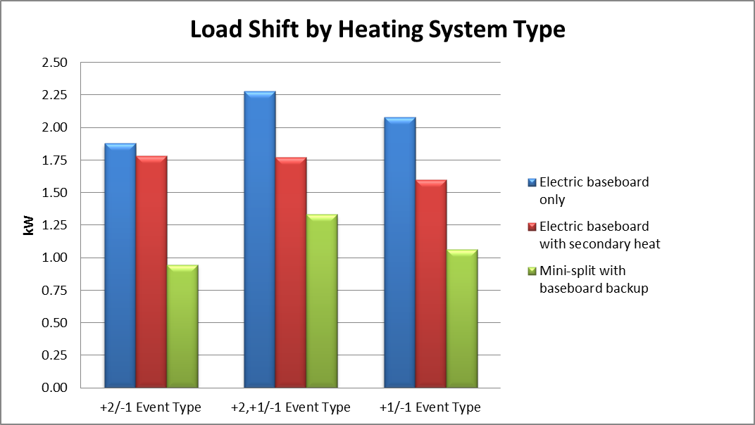
567-Home Demand Control Study (2016-17)
Dwellings: 193
Electric Baseboards: 120
Baseboard with secondary heat: 22
Mini-split HP with baseboard backup: 51
8.6 kW
Average Connected Load
Dwellings: 199
Electric Baseboards:119
Baseboard with secondary heat: 50
Mini-split HP with baseboard backup: 30
57%
15 kW
Average Total Capacity
Dwellings: 175
Baseboards Only: 90
Baseboard with secondary heat: 70
Mini-split HP with baseboard backup: 15
Study Partners: NB Power, NRC, Siemens Canada
Notes:
Population in three regions
KV 29,886
Fredericton 56,224
Moncton 64,128
The distribution of homes in three regions was intented to balance the electrician’s load and was not proportion to the population
The pilot received 300 mini-split applications! Which makes sense given that 1:3 homes in NB have mini-splits.
133 Sequentric devices were available at the start of the project
City of Fredericton: Fredericton CDA CS (45°55'13.000" N 66°36'32.010" W)
Moncton: MONCTON INTL A (46°06'44.000" N, 64°40'43.000" W)
Kennebecasis: SAINT JOHN A (45°18'58.000" N 65°53'24.000" W)

Slide 20
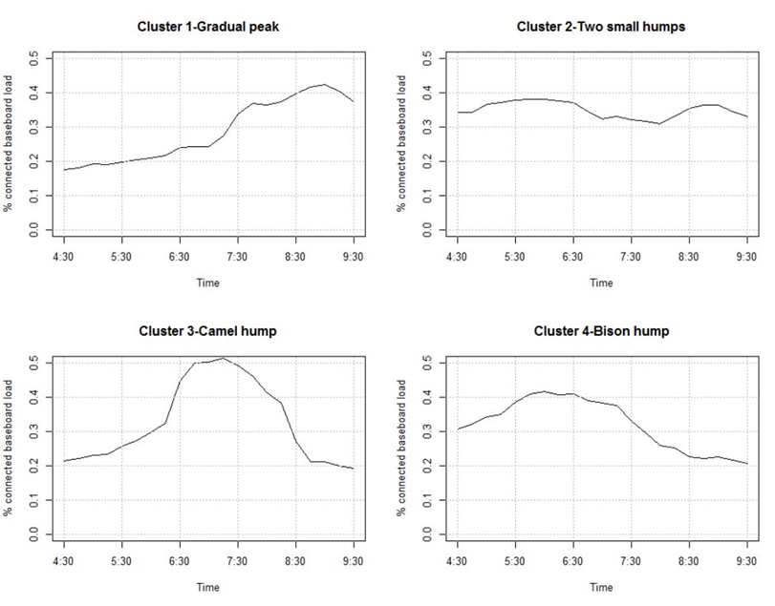
Electric Baseboard Heater Load Profiles based on Thermostats Data from 471 Homes in NB
Shape of Load Profile | Number of Homes
Gradual Peak | 63
Two small humps | 89
Camel hump | 246
Bison hump | 73
Total Homes | 471

Slide 21
Key Findings from 567-home Demand Control Pilot
Load shift not dependent on: vintage, house type,
# occupants, age of occupants, window orientation, income
Preheating curtails peak electrical heating load without adverse effects on occupant thermal comfort
Load shift dependent on pre-existing thermostat
set point profile
No significant rebound effect
No evidence of energy penalty
Very high satisfaction with thermostats and program
2 kW
Load Shift Opportunity
50%
Required Minimum
Connected Capacity

Slide 22
Actionable insights from smart home data
Evaluation of energy performance of a building
On-site audits | Data-based energy audit for retrofits
Requires on-site visit by a professional energy auditor | Conducted from a remote site by processing data through algorithms
On-site data collection | Uses data remotely from smart home devices, smart meters, and public datasets
Relatively accurate | Good enough to identify energy performance issues
Relatively expensive ($300 to $500) per home | Inexpensive when done on a large scale

Slide 23
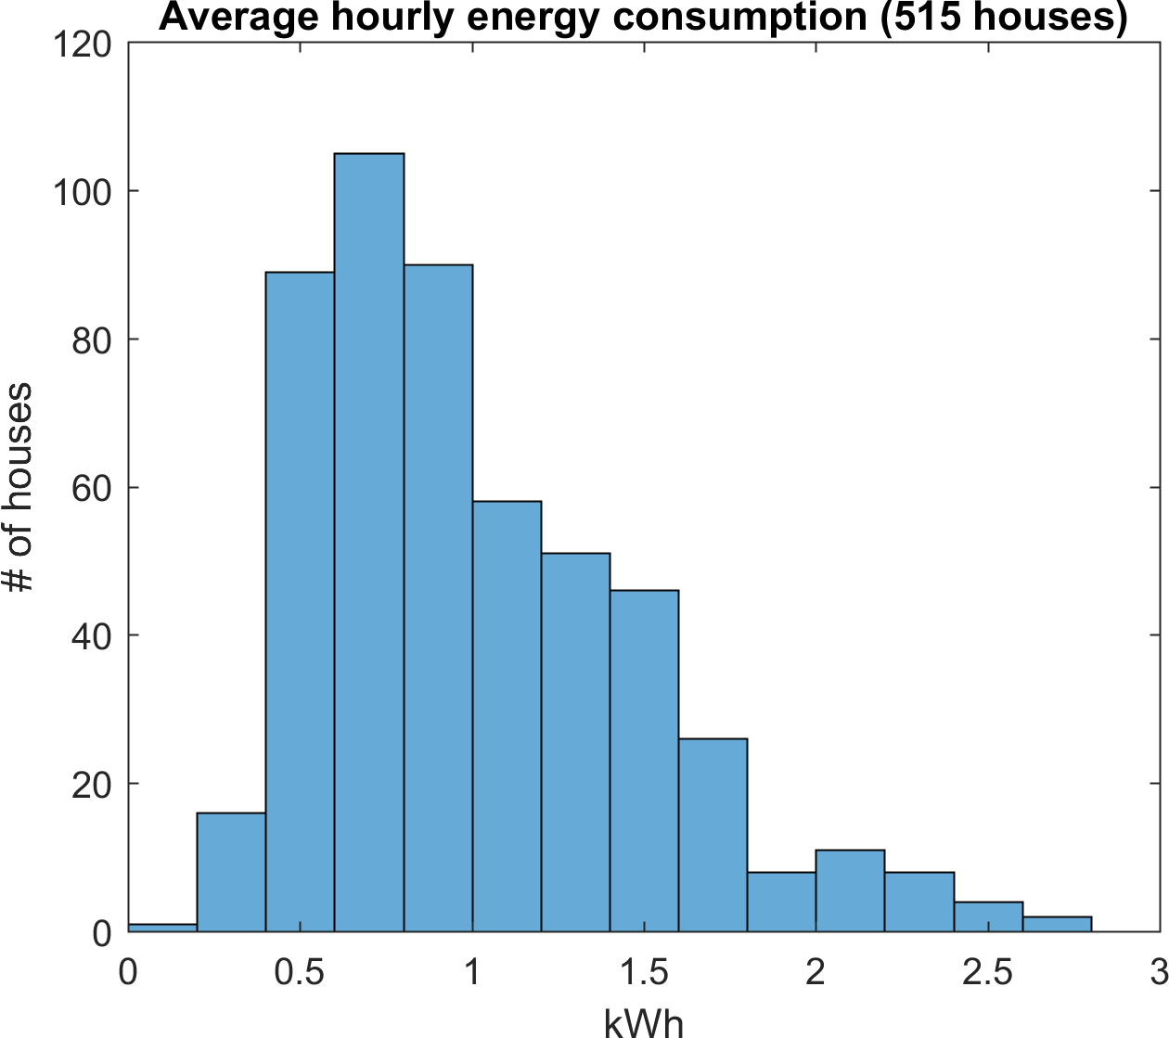
Household Electricity Use based on Smart Meter Data from 515 houses in GTA
Mean = 1.05 kWh,
Median = 0.90 kWh,
SD = 0.56 kWh
# of occupants | Mean (kWh)
1 | 0.52
2 | 0.94
3 | 0.98
4 | 1.16
5 | 1.38

Slide 24
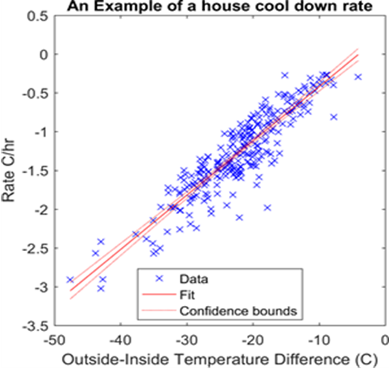
Relative House Structure and Thermal Characteristics
Rate of cooling of house as an indicator of envelope performance
  Change in indoor air temperature, ∆T = mx + c
A relatively high value of slope, indicates relatively high heat loss:
  a relatively poorly insulated envelope
  an envelope with relatively high air leakage
  a relatively large envelope area
  or a combination of all above three.
An example house
Y = 0.07*X + 0.28

Slide 25
The Future: Smart Energy Devices are the key to a secure, resilient, decarbonised new energy future.
Image Credit: Ontario 2017 Long Term Energy Plan: Delivering Fairness and Choice
Notes:
The image shows a person standing in front of a stylized home energy management console that allows her to see and control how electrical devices in the home are being used, such as solar photovoltaic panels, electric vehicles, energy storage, and appliances. The home energy management console also shows the amount of power being used throughout the day. Figure 12 depicts a future scenario where electricity customers have greater choice and control over how they use power.

Slide 26



THANK YOU ajit.pardasani@nrc-cnrc.gc.ca

Slide 27
2. Q&A
Jim Hunter (Delos Living LLC)
Ajit Pardasani (National Research Council)

Slide 28








3. CHC Meeting Call to Order, Introductions, About the CHC
Roy Perry (Alarm.com)
CHC Chair
Roy Perry
VP Ecosystem Alliances
Alarm.com
CHC Vice-Chair
Byron BeMiller
Director, Wireless Marketing
Semtech Corporation
CHC Vice-Chair
Jim Hunter
Chief Technology Officer
Delos Living LLC
CHC Vice-Chair
Charles Hume
Director of Digital Power Technologies
Southwire Company, LLC
Established in 2004, the CABA Connected Home Council initiates and reviews projects that relate to connected home and multiple dwelling unit technologies and applications. The Council also examines industry opportunities that can accelerate the adoption of new technologies, consumer electronics and broadband services within the burgeoning connected home market.
www.caba.org/chc

Slide 29

4. Administrative
Roy Perry (Alarm.com)
4.1 Motion to approve past CHC Minutes from May 20, 2020:
Motion to approve was made by:
- Maurice Okawaki (Frost & Sullivan)
Motion was seconded by:
- Ken Wacks (Ken Wacks Associates)

Slide 30
4. Administrative
Roy Perry (Alarm.com)
4.2 Discussion of the new proposed CHC Steering Committee:
New CHC Steering Committee Proposed:
- The proposed Steering Committee would be made up of approximately 10 individuals
- The CHC Executive Committee would select the members of the Steering Committee
- It is proposed that the Steering Committee meet quarterly to discuss and select topics and speakers upcoming CHC Webinars. The Steering Committee would arrange the speakers for the CHC quarterly webinars. (other functions???)
- The Steering Committee would be organized and led by the CHC Chair and not CABA staff (as requested by Ron Zimmer).

Slide 31


5. Research Update
Greg Walker (CABA)
(CABA)
“Privacy and Cybersecurity in the Connected Home” 2020 CHC Landmark Research

Slide 32
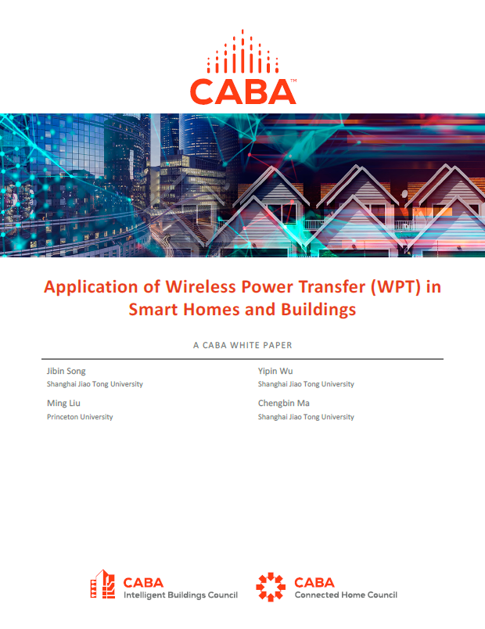
6. White Paper Sub-Committee Update
Ken Wacks (Ken Wacks Associates)
6.1 Recently Completed:
“Application of Wireless Power Transfer (WPT) in Smart Homes and Buildings”
Shanghai Jiao Tong University (Chair)
Princeton University (Chair)
AirFuel Alliance
Ken Wacks Associates

Slide 33

6. White Paper Sub-Committee Update
Ken Wacks (Ken Wacks Associates)
6.2 In Progress:
“Part 2: Power over Ethernet (PoE) & Digital Electricity (DE) in Commercial and Multiple Dwelling Residential Buildings”
Sinclair Digital Holdings (Chair)
Axis Lighting
Contemporary Controls Systems, Inc.
Ken Wacks Associates
LumenCache, Inc.
National Electrical Manufacturers Association (NEMA)
National Research Council Canada (NRC)
Public Services and Procurement Canada
Renesas Electronics America Inc.
Somfy Systems, Inc.
Southwire Company, LLC
Telecommunications Industry Association (TIA)
UL LLC

Slide 34
6. White Paper Sub-Committee Update
Ken Wacks (Ken Wacks Associates)
6.2 In Progress:
“Human Centric Lighting: Non-Energy Benefits of Lighting and its Smart Controls”
Human Centric Lighting Society (Chair)
ArcoLogix LLC
Ken Wacks Associates
Legrand
Mecho
National Electrical Manufacturers Association (NEMA)
SnapAV
Syska Hennessy
UL LLC

Slide 35
6. White Paper Sub-Committee Update
Ken Wacks (Ken Wacks Associates)
6.2 In Progress:
“Connected Home Cybersecurity Regulations”
P.A.ID Strategies (Chair)

Slide 36
6. White Paper Sub-Committee Update
Ken Wacks (Ken Wacks Associates)
6.2 In Progress:
“Part 2: The Evolution of Integrating LiFi Technology into Smart Lighting and Control Systems for the Intelligent Building”
Wharton County Junior College (Chair)
Acuity Brands, Inc.
ArcoLogix LLC
SnapAV
Ken Wacks Associates
National Electrical Manufacturers Association (NEMA)
Telecommunications Industry Association (TIA)

Slide 37


6. White Paper Sub-Committee Update
Ken Wacks (Ken Wacks Associates)
All proposals and previously completed CHC White Papers can be downloaded at:
www.caba.org/whitepapers

Slide 38

7. New Business
Byron BeMiller (Semtech Corporation)
7.1 Other new CHC business?

Slide 39

7. New Business
Greg Walker (CABA)
7.2 McKechnie Family LIFE Home – University of Illinois Urbana-Champaign
Director: Wendy A. Rogers, Ph.D.
Assistant Director of Research: Harshal Mahajan, Ph.D.
Operations: Brian Pastor, M.S.

Slide 40
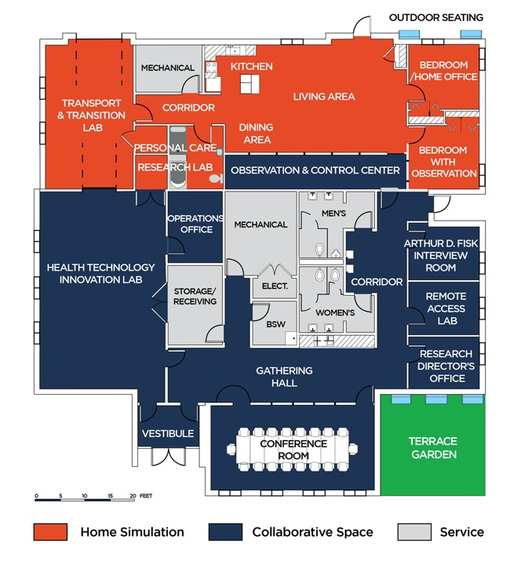
McKechnie Family LIFE Home
Living in Interactive Future Environments
Newly-Completed Cutting Edge Research Space on the University of Illinois Campus
Multi-Purpose Research and Community Space
Research on topics for the complete life-span
Event and Community Space
Development space for next generation technologies
Research space for beta testing technologies
Includes outdoor spaces, allowing research to extend beyond the four walls

Slide 41
8. Adjournment
Roy Perry (Alarm.com)
Next CHC Meeting: January 2021
Continental Automated Buildings Association (CABA)
caba@caba.org
www.CABA.org
www.caba.org/chc
Connect to what’s next™

