Slide 1
Connected Home Council (CHC) Webinar Wednesday, September 2, 2020, 12 NOON – 1:30 PM (ET)
Chair: Roy Perry (Alarm.com, Inc.)
Vice-Chair: Jim Hunter (Delos Living LLC)

Slide 2
1. Agenda Greg Walker (CABA)
1. Agenda
2. Call to Order, Welcome, Introductions, about the CHC
Administrative
“Connected Home IoT Cybersecurity Guidelines, Standards and Verification Systems”
Panel Discussion (30 min)
Jim Hunter (Delos Living LLC)
Gonda Lamberink (UL LLC)
Andre Ristaino (The International Society of Automation)
Chris Larry (exp. US Services, Inc.)
5. Research Update
6. White Paper Sub-Committee Update
7. New Business
8. Adjournment

Slide 3
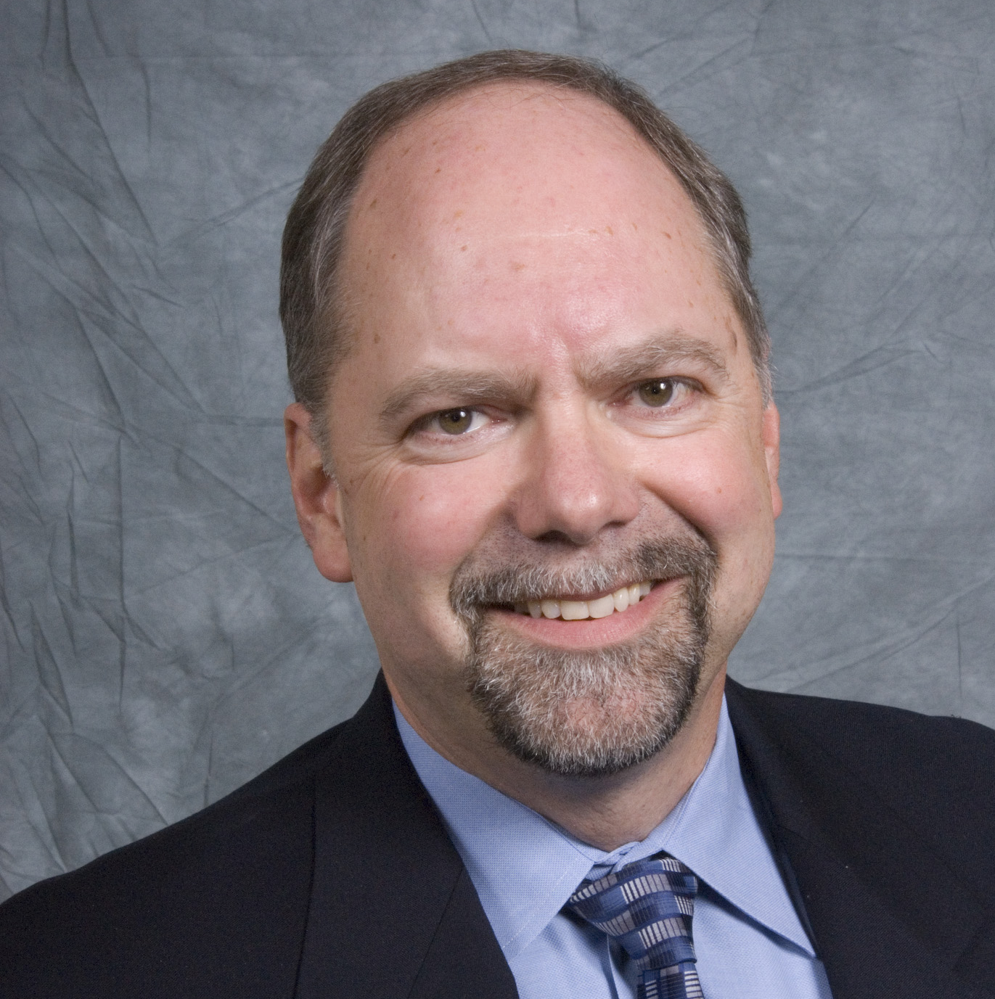
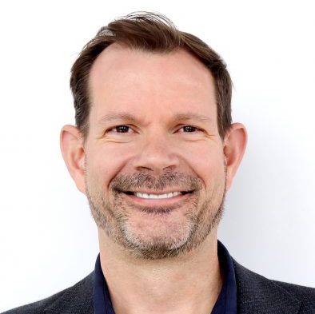
2. Call to Order, Welcome, Introductions, About the CHC Roy Perry (Alarm.com)
CHC Chair
Roy Perry
VP Ecosystem Alliances
Alarm.com
CHC Vice-Chair
Jim Hunter
Chief Technology Officer
Delos Living LLC
Established in 2004, the CABA Connected Home Council initiates and reviews projects that relate to connected home and multiple dwelling unit technologies and applications. The Council also examines industry opportunities that can accelerate the adoption of new technologies, consumer electronics and broadband services within the burgeoning connected home market.
www.caba.org/chc

Slide 4
3. Administrative Roy Perry (Alarm.com)
3.1 Motion to approve past CHC Minutes from May 20, 2020:
Motion to approve was made by:
- Maurice Okawaki (Frost & Sullivan)
Motion was seconded by:
- Ken Wacks (Ken Wacks Associates)

Slide 5
3. Administrative Roy Perry (Alarm.com)
3.2 Motion to approve Byron BeMiller (Semtech Corporation) and Charles Hume (Southwire Company, LLC) as new CHC Vice-Chairs:

Slide 6
3. Administrative Roy Perry (Alarm.com)
3.3 Discussion and Motion to approve CHC Changes:
Name change from “Connected Home Council (CHC)” to “Connected Home Consortium (CHC)”?
CHC Executive Committee (Chair and Vice-Chairs) will meet quarterly with formal minutes and Roberts Rules etc.
New CHC Webinars will be held quarterly (30min – 1hr).
New CHC Steering Committee.
- Made up of approximately 10 individuals
- The CHC Executive Committee will select the member on the Steering Committee
- Will meet quarterly to discuss and select topics and speakers upcoming CHC Webinars. The Steering Committee will arrange the speakers for the CHC quarterly webinars.
- CHC Steering Committee will be organized and led by the CHC Chair and not CABA Staff.
5. New CHC Meeting format will no longer have keynote speakers (30min – 1hr)?

Slide 7
4. CHC White Paper Panel
“Connected Home IoT Cybersecurity Guidelines, Standards and Verification Systems”

Slide 8
5. Research Update Greg Walker (CABA) (CABA)
“Privacy and Cybersecurity in the Connected Home” 2020 CHC Landmark Research

Slide 9
6. White Paper Sub-Committee Update Ken Wacks (Ken Wacks Associates)
6.1 Recently Completed:
“Power over Ethernet (PoE) & Digital Electricity (DE) in Commercial and Multiple Dwelling Residential Buildings”
Somfy Systems, Inc. (Chair)
Contemporary Controls Systems, Inc.
LumenCache, Inc.
National Electrical Manufacturers Association (NEMA)
Public Services and Procurement Canada
Renesas Electronics America Inc.
Southwire Company, LLC
UL LLC

Slide 10
6. White Paper Sub-Committee Update Ken Wacks (Ken Wacks Associates)
6.2 In Progress:
“Human Centric Lighting: Non-Energy Benefits of Lighting and its Smart Controls”
Human Centric Lighting Society (Chair)
ArcoLogix LLC
Control4
National Electrical Manufacturers Association
Syska Hennessy
UL LLC

Slide 11
6. White Paper Sub-Committee Update Ken Wacks (Ken Wacks Associates)
6.2 In Progress:
“Connected Home Cybersecurity Regulations”
P.A.ID Strategies (Chair)

Slide 12
6. White Paper Sub-Committee Update Ken Wacks (Ken Wacks Associates)
6.2 In Progress:
“Part 2: The Evolution of Integrating LiFi Technology into Smart Lighting and Control Systems for the Intelligent Building”
Wharton County Junior College
Acuity Brands, Inc.
ArcoLogix LLC
SnapAV
Ken Wacks Associates
National Electrical Manufacturers Association
Telecommunications Industry Association (TIA)

Slide 13
6. White Paper Sub-Committee Update Ken Wacks (Ken Wacks Associates)
All proposals and previously completed CHC White Papers can be downloaded at:
www.caba.org/whitepapers

Slide 14
7. New Business Roy Perry (Alarm.com)
Other new CHC business?

Slide 15
8. Adjournment Roy Perry (Alarm.com)
Next CHC Meeting: November 2020
Continental Automated Buildings Association (CABA) caba@caba.org www.CABA.org
www.caba.org/chc
Connect to what’s next™

