Slide 1
Intelligent Buildings Council (IBC)
Chair: Trevor Nightingale (National Research Council)
Vice-Chair: Harsha Chandrashekar (Honeywell International Inc)
Vice-Chair: Robert Lane (Robert H. Lane and Associates Inc.)
Vice-Chair: Bob Allan (The Siemon Company)
Vice-Chair: Terrence DeFranco (Iota Communications, Inc.)

Slide 2
1. Agenda Greg Walker (CABA)
1. Agenda
2. Call to Order, Welcome, Introductions, about IBC
3. Administrative
“Smart Buildings: BEMS, EMIS, FDD, M&V, DCV and COVID” (30 min)
Guy Newsham (National Research Council)
5. Research Update
6. White Paper Sub-Committee Update
7. New Business
8. Adjournment

Slide 3
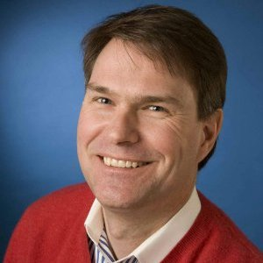
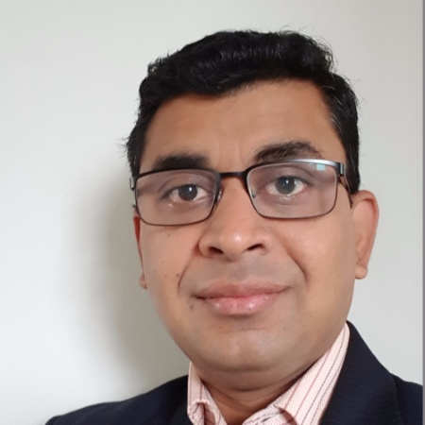
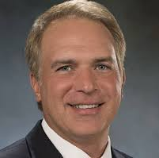
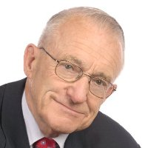
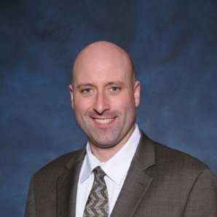
2. Call to Order, Welcome, Introductions, About the IBC Bob Allan (The Siemon Company)
IBC Chair
Trevor Nightingale
Director General
National Research Council
IBC Vice-Chair
Harsha Chandrashekar
Product Approvals & Regulatory Leader
Honeywell International
Inc
IBC Vice-Chair
Terrence DeFranco
President and Chief Financial Officer
Iota Communications, Inc.
IBC Vice-Chair
Robert Lane
President & Managing Partner
Robert H. Lane and Associates Inc.
IBC Vice-Chair
Bob Allan
Global Business Development Manager, Intelligent Buildings
The Siemon Company
The CABA Intelligent Buildings Council works to strengthen the large building automation industry through innovative technology-driven research projects. The Council was established in 2001 by CABA to specifically review opportunities, take strategic action and monitor initiatives that relate to integrated systems and automation in the large building sector. The Council's projects promote the next generation of intelligent building technologies and incorporates a holistic approach that optimizes building performance and savings.
www.caba.org/ibc

Slide 4
3. Administrative Bob Allan (The Siemon Company)
3.1 Motion to approve past IBC Minutes (May 13): www.caba.org/ibc
Motion to approve was made by:
- Ken Wacks (Ken Wacks Associates)
Motion was seconded by:
- Michael Levy (Harbor Research)

Slide 5
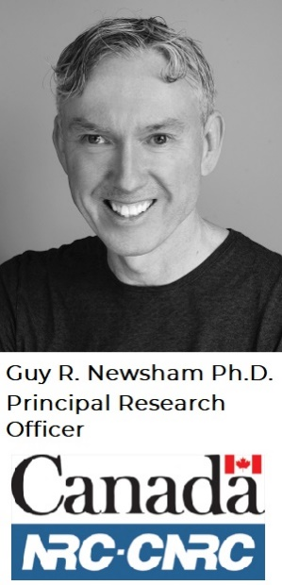
4. Keynote Terrence DeFranco (Iota Communications, Inc.)
“Smart Buildings: BEMS, EMIS, FDD, M&V, DCV and COVID” (30 min)

Slide 6
Smart Buildings: BEMS, EMIS, FDD, M&V, DCV and COVID
Guy Newsham, PhD
Team Lead, Building Technology Optimization
NRC-Constrution

Slide 7
GoC Smart Buildings
What is a BEMS?
Started as a one-building pilot (Building J) with PSPC in 2014 …
Now working with:
~100 PSPC buildings (implemented by a NMSO)
Multiple DND bases
CNL campus
7.5% annual energy savings with 1-2 yr payback

Slide 8
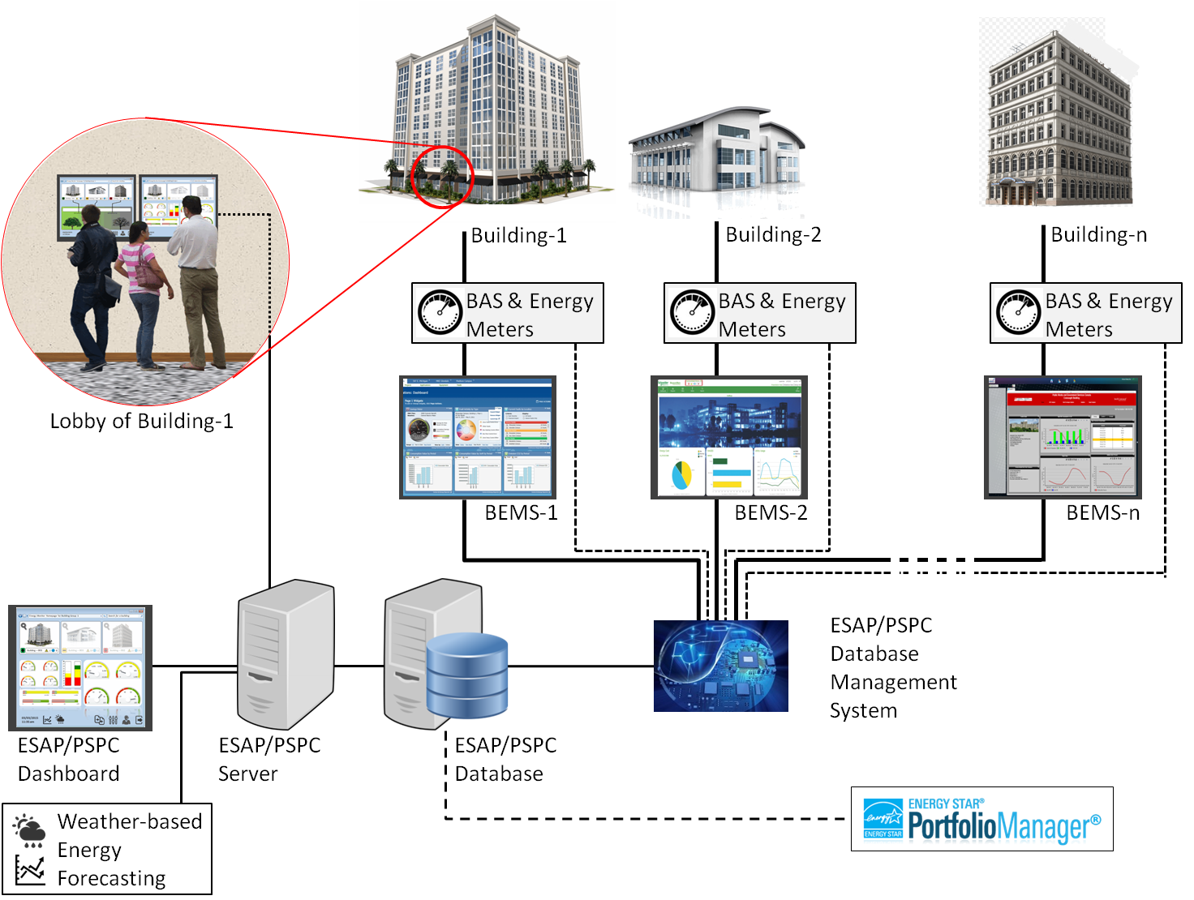
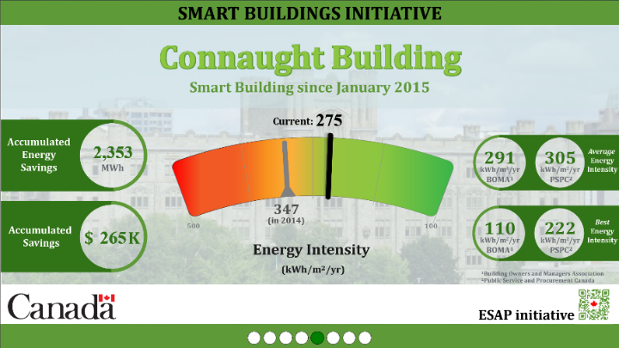
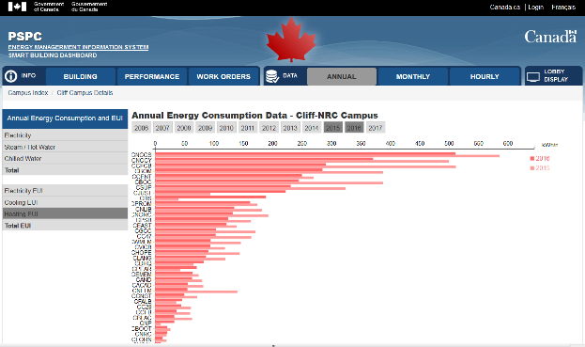
PSPC EMIS
Building J
Remote Auditing
8

Slide 9
The M&V Challenge
Baseline period
Implementation date
Reporting period
Transition
period?
Weather effects
Energy Use
In addition …
Operator behaviour
Changes in occupancy
Changes in tenants/use
Data quality
Additional ECM(s)?
Time

Slide 10
M&V Methodology
Read data
Apply exclusions
where:
y is chilled water consumption in MJ
HDD is heating degree days, base temp. 18°C
CDD is cooling degree days, base temp. 18°C
WD is the number of working days in the month
Define baseline and reporting periods
Baseline period
Reporting period
Create baseline regression model
(Building J)
Visualize and report
Compute savings

Slide 11
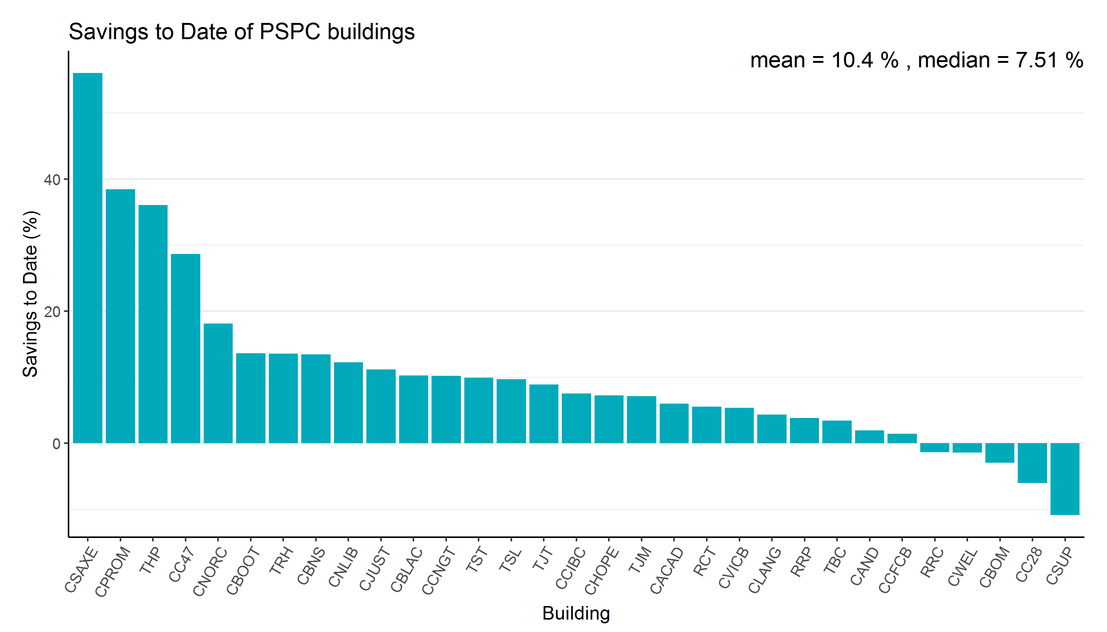
Energy Savings
Savings to Date:
Energy Savings (MWh) | Cost Savings ($)
> 29,000 | > $3.8M
A B C D E F G H I J K L M N O P Q R S T U V W X Y Z AA BB CCDD EE

Slide 12
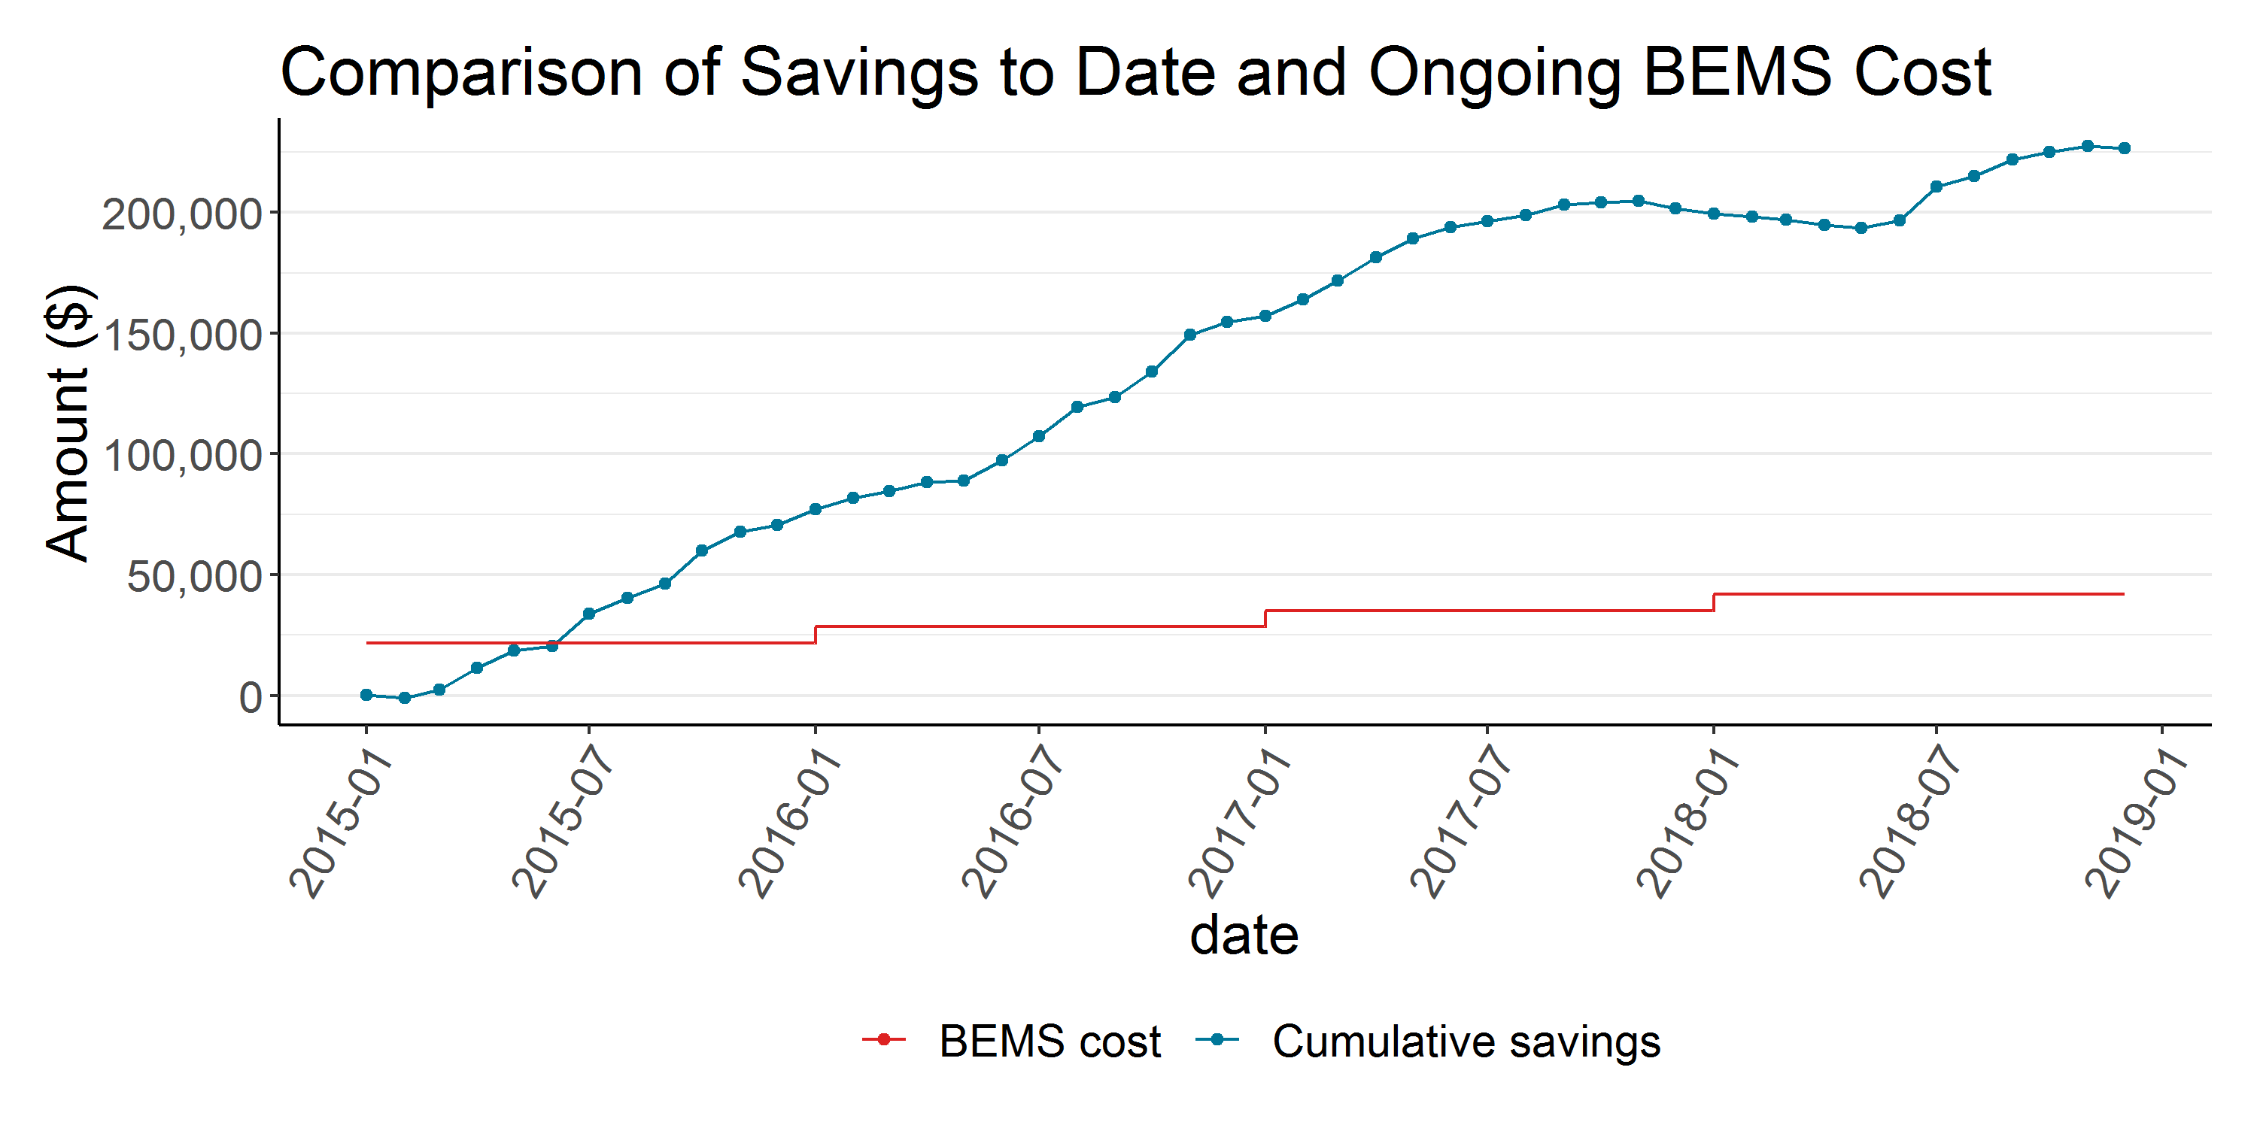
Payback
(Building J)

Slide 13
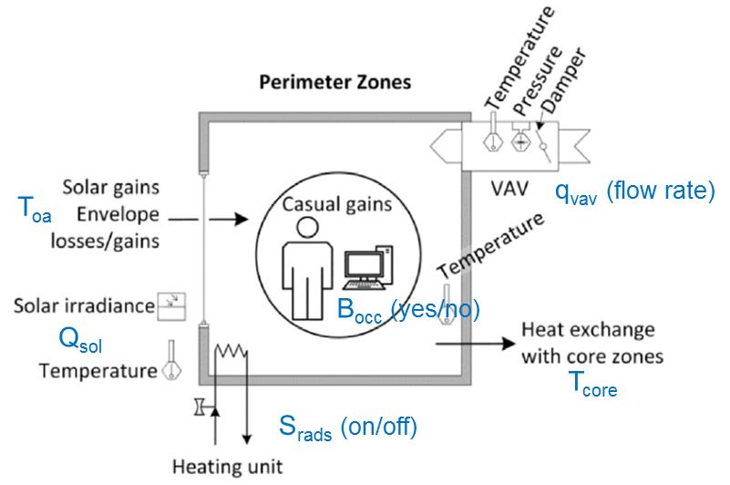
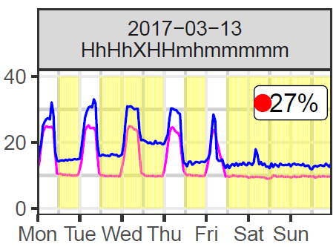
Additional Analytics
>20 Research papers
Data cleaning
BAS point detection
Energy forecasting
Anomaly detection
Faulty heater valves?

Slide 14
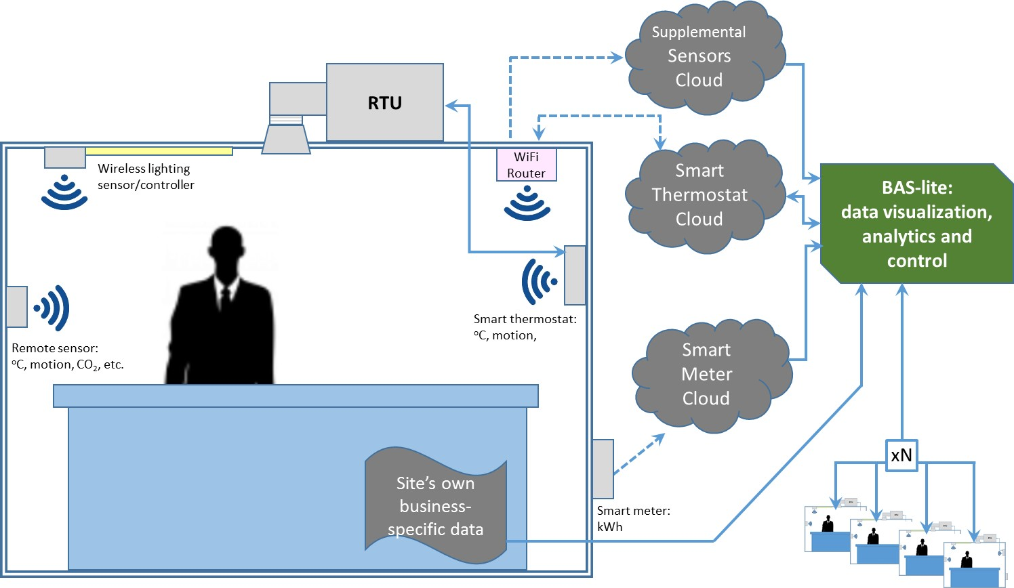
BAS-Lite

Slide 15
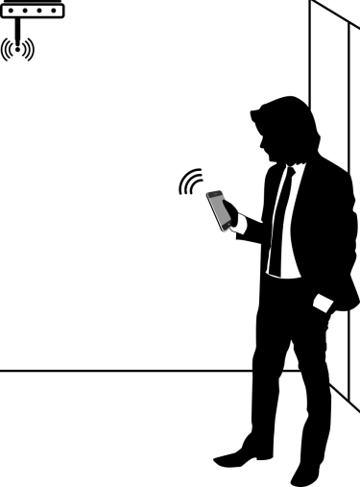
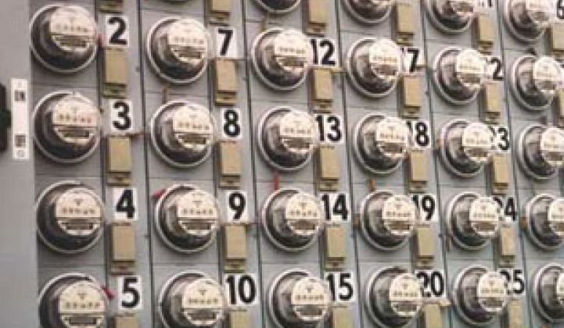
Occupancy counts
Original use case: DCV
10% heating savings, 38% cooling savings
New use case: COVID
Real-time monitoring of 20-50% occupancy targets

Slide 16
THANK YOU guy.newsham@nrc-cnrc.gc.ca

Slide 17
4. Keynote - Questions? Terrence DeFranco (Iota Communications, Inc.)

Slide 18
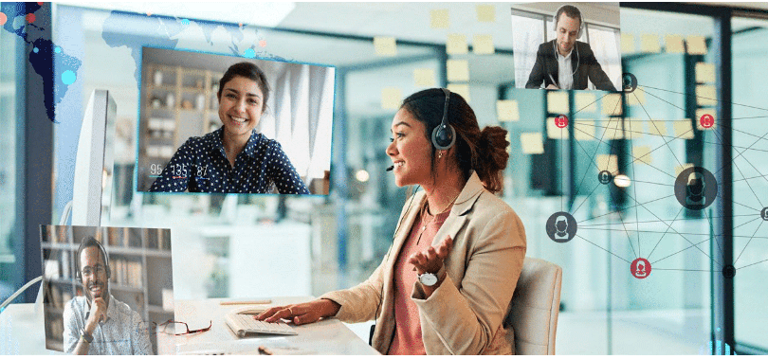
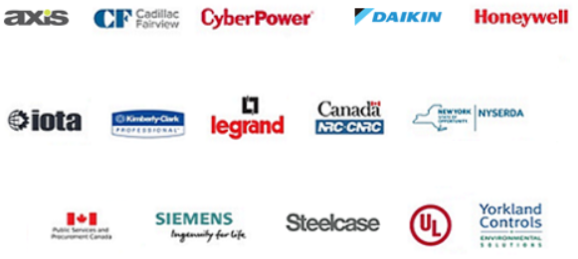
5. Research Update Greg Walker (CABA)
5.1 2019-2020 IBC Landmark Research “Intelligent Buildings and COVID-19”
www.caba.org/research

Slide 19
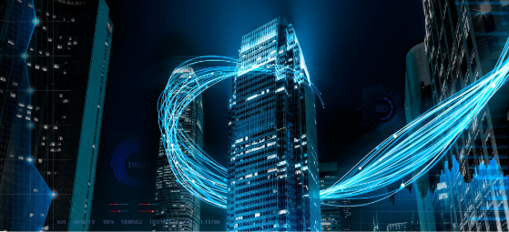
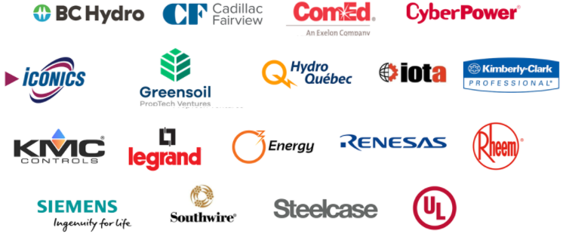
5. Research Update Michael Levy (Harbor Research, Inc.)
5.2 2020 IBC Landmark Research “Intelligent Building Energy Management Systems”
www.caba.org/research

Slide 20
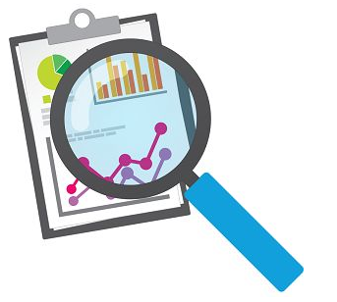
5. Research Update Ron Zimmer (CABA)
5.3 Potential New IBC Research “BACS”

Slide 21
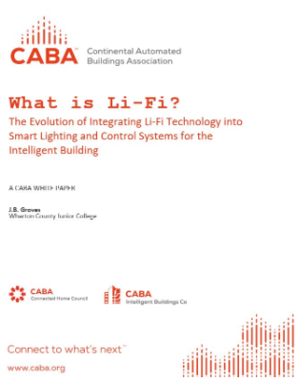
6. White Paper Sub-Committee Update Ken Wacks (Ken Wacks Associates)
6.1 Recently Completed:
“The Evolution of Integrating LiFi Technology into Smart Lighting and Control Systems for the Intelligent Building”
Wharton County Junior College (Chair)
Acuity Brands, Inc.
ArcoLogix LLC
Control4
National Electrical Manufacturers Association
Telecommunications Industry Association (TIA)
www.caba.org/WhitePapers

Slide 22
6. White Paper Sub-Committee Update Ken Wacks (Ken Wacks Associates)
6.2 In Progress:
“Multi-MHz Wireless Power Transfer and Its Commercial Applications”
Airfuel Alliance (Chair)
University of Michigan - Shanghai Jiao Tong University Joint Institute
Princeton University
www.caba.org/WhitePapers

Slide 23
6. White Paper Sub-Committee Update Ken Wacks (Ken Wacks Associates)
6.2 In Progress:
Part 2: “Impacts of Automated Shading in Building Projects”
TRC Energy Services (Chair)
Axis Lighting Inc.
Draper, Inc.
Ecotay Inc.
Ken Wacks Associates
Lawrence Berkeley National Laboratory (LBNL)
Lutron Electronics Co., Inc.
Mecho
NYSERDA (New York State Energy Research and Development Authority)
PLC-Multipoint, Inc.
Screen Innovations
Somfy Systems, Inc.
Sustainable Resources Management Inc.
Vistar Energy Consulting
Window Products Management
www.caba.org/WhitePapers

Slide 24
6. White Paper Sub-Committee Update Ken Wacks (Ken Wacks Associates)
6.2 In Progress:
“Fire Alarm Systems in Buildings”
Canadian Fire Alarm Association
www.caba.org/WhitePapers

Slide 25
6. White Paper Sub-Committee Update Ken Wacks (Ken Wacks Associates)
6.2 In Progress:
“Part 2: The Evolution of Integrating LiFi Technology into Smart Lighting and Control Systems for the Intelligent Building”
Wharton County Junior College
Acuity Brands, Inc.
ArcoLogix LLC
SnapAV
SnapAV
Ken Wacks Associates
National Electrical Manufacturers Association
Telecommunications Industry Association (TIA)
www.caba.org/WhitePapers

Slide 26
6. White Paper Sub-Committee Update Ken Wacks (Ken Wacks Associates)
All proposals and previously completed IBC White Papers can be downloaded at:
www.caba.org/whitepapers

Slide 27
7. New Business Robert Lane (Robert H. Lane and Associates Inc.)
7.1 Other new IBC business?

Slide 28
8. Adjournment Bob Allan (The Siemon Company)
Next IBC Meeting, November 2020
Continental Automated Buildings Association (CABA) caba@caba.org www.CABA.org
www.caba.org/ibc
Connect to what’s next™

