Slide 1
Connected Home Council (CHC) Webinar Wednesday, May 20, 2020, 12 NOON – 1:30 PM (ET)
Chair: Roy Perry (Alarm.com, Inc.)
Vice-Chair: Danny Sran (TELUS)

Slide 2
1. Agenda Greg Walker (CABA)
1. Agenda
2. Call to Order, Welcome, Introductions, about the CHC
Administrative
4. “Evidence-Based Ways To Make Homes Safer and Healthier Post COVID-19” (30 min)
Paul Scialla (Delos Living LLC)
5. Research Update
6. White Paper Sub-Committee Update
7. New Business
8. Adjournment

Slide 3
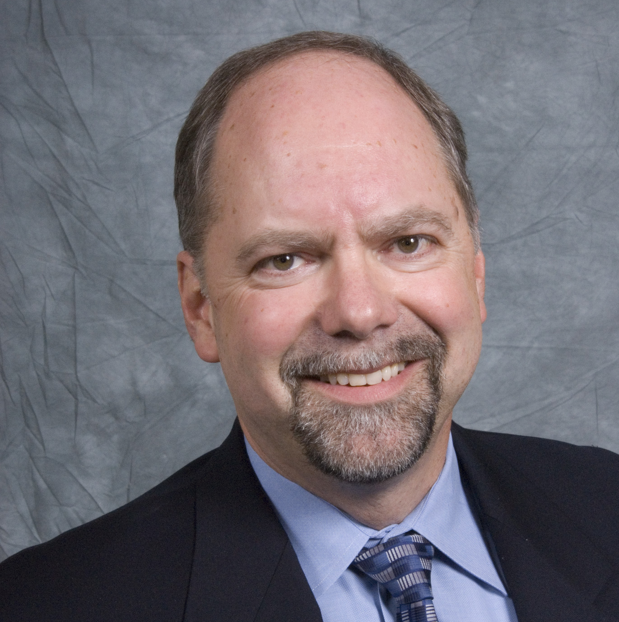
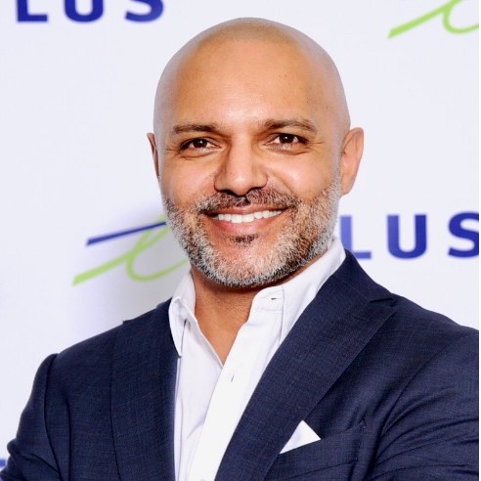
2. Call to Order, Welcome, Introductions, About the CHC Roy Perry (Alarm.com)
CHC Chair
Roy Perry
VP Ecosystem Alliances
Alarm.com
CHC Vice-Chair
Danny Sran
Mgr. Construction - New Growth Markets TELUS
Established in 2004, the CABA Connected Home Council initiates and reviews projects that relate to connected home and multiple dwelling unit technologies and applications. The Council also examines industry opportunities that can accelerate the adoption of new technologies, consumer electronics and broadband services within the burgeoning connected home market.
www.caba.org/chc

Slide 4
3. Administrative Roy Perry (Alarm.com)
3.1 Motion to approve past CHC Minutes from February 26, 2020:
Motion to approve was made by:
- Maurice Okawaki (Frost & Sullivan)
Motion was seconded by:
- Ken Wacks (Ken Wacks Associates)

Slide 5
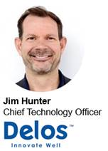
3. Administrative Roy Perry (Alarm.com)
3.2 Motion to approve Jim Hunter (Delos Living LLC) as a new CHC Vice-Chair
Motion to approve was made by:
- Maurice Okawaki (Frost & Sullivan)
Motion was seconded by:
- David Katz (Sustainable Resources Management Inc.)

Slide 6
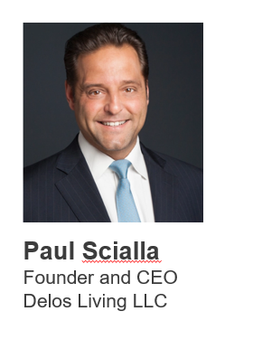
4. Keynote Jim Hunter (Delos Living LLC), Paul Scialla (Delos Living LLC)
“Evidence-Based Ways To Make Homes Safer and Healthier Post COVID-19”
Biography : After 18 years on Wall Street, including 10 at Goldman Sachs as a Partner, Paul Scialla’s interest in sustainability and altruistic capitalism led him to found Delos, which is merging the world’s largest asset class – real estate – with the world’s fastest growing industry – wellness. Since the company’s inception, Paul has become a leading voice in the sustainability movement, serving as a keynote speaker at prominent green building, real estate, and technology forums and conferences around the world. Paul is also the Founder of the International WELL Building Institute (IWBI), which administers the WELL Building Standard® globally to improve human health and wellbeing through the built environment, a member of the Board of Directors for the Chopra Foundation, and a founding board member of the JUST Capital Foundation.

Slide 7
4. Keynote Jim Hunter (Delos Living LLC), Paul Scialla (Delos Living LLC)
“Evidence-Based Ways To Make Homes Safer and Healthier Post COVID-19”
Questions?

Slide 8
5. Research Update Danny Sran (TELUS) (CABA)
“Privacy and Cybersecurity in the Connected Home” 2020 CHC Landmark Research

Slide 9
6. White Paper Sub-Committee Update Ken Wacks (Ken Wacks Associates)
6.1 Recently Completed:
“The Evolution of Integrating LiFi Technology into Smart Lighting and Control Systems for the Intelligent Building”
Wharton County Junior College (Chair)
Acuity Brands, Inc.
ArcoLogix LLC
Control4
National Electrical Manufacturers Association
Telecommunications Industry Association (TIA)

Slide 10
6. White Paper Sub-Committee Update Ken Wacks (Ken Wacks Associates)
6.2 In Progress:
“Power over Ethernet (PoE) & Digital Electricity (DE) in Commercial and Multiple Dwelling Residential Buildings”
Somfy Systems, Inc. (Chair)
Contemporary Controls Systems, Inc.
LumenCache, Inc.
National Electrical Manufacturers Association (NEMA)
Public Services and Procurement Canada
Renesas Electronics America Inc.
Southwire Company, LLC
UL LLC

Slide 11
6. White Paper Sub-Committee Update Ken Wacks (Ken Wacks Associates)
6.2 In Progress:
“Human Centric Lighting: Non-Energy Benefits of Lighting and its Smart Controls”
Human Centric Lighting Society (Chair)
ArcoLogix LLC
Control4
National Electrical Manufacturers Association
Syska Hennessy
UL LLC

Slide 12
6. White Paper Sub-Committee Update Ken Wacks (Ken Wacks Associates)
6.2 In Progress:
“Connected Home Cybersecurity Regulations”
P.A.ID Strategies (Chair)

Slide 13
6. White Paper Sub-Committee Update Ken Wacks (Ken Wacks Associates)
All proposals and previously completed CHC White Papers can be downloaded at:
www.caba.org/whitepapers

Slide 14
7. New Business Lauren Taylor (Frost & Sullivan)
7.1 Growth Opportunity Trends and Diagnostic Session with Frost & Sullivan

Slide 15
GROWTH OPPORTUNITIES AND THE GROWTH PIPELINE DIAGNOSTIC
Exclusive Session for
CABA Members
The Growth Pipeline™ Company
Preparing clients for a future shaped by growth

Slide 16
CABA GROWTH PIPELINE SESSION AGENDA
Introductions (3 min)
Purpose of call, introductions from Frost & Sullivan
Lauren Taylor and Konkana Khaund
Trends Driving Growth and Innovation for the Built Environment (15 min)
Opportunities to support rebound and reentry strategy
Delivering to future opportunities: Launching the Frost & Sullivan Post COVID-19 Opportunity Response Framework
Speaker: Konkana Khaund
Growth Pipeline DiagnosticTM (30 min)
Live walk through and member completion
Live viewing of aggregated results
Speaker: Lauren Taylor
Post-Session:
Individual assessment follow-up

Slide 17
THE GROWTH PIPELINE DIAGNOSTIC™
What is it?
Ten guided questions focused on the top issues and best practices by the world’s best growth companies
Provides a first-level diagnosis of your strengths and weaknesses regarding core aspects of growth
How do you use it?
Where does your score align?
To provide alignment among your team and drive an urgency to act on growth initiatives where they are most needed
Your Score as a Benchmark
How your Two Section Scores Compare
2.2
2.4
2
Total Growth PipelineTM Score Identify your Position
Growth Score Identify your Position
Innovation Score Identify your Position
Your score will be benchmarked against companies past and present to give you clear context
5
5
5
Apple (2007))
Google (2018)
Amazon (2016)
Microsoft (2019))
Netflix (2016)
Netflix (2018)
4
GE(2005)
Amazon (2018)
4
Tesla (2018)
4
IBM (2010)
Salesforce (2018)
What is next?
Fuji Film (2018)
Boston Scientific (2018)
AMD (2016)
Adobe (2018)
Pan AM (1970)
AMD (2018)
Boston Scientific (2016)
Kodak (1980)
Grubhub (2018)
3
3
IBM (2018)
3
Toys R US (1999)
Sony (2018)
Blockbuster (2000)
Nokia (2016)
Discuss your findings with a Growth Pipeline™ consultant and identify ways to act
Apple (2018)
Snapchat (2018)
2
Apple (2018)
2
GE (2018)
2
Sony (2018)
Fuji Film (2010)
GeneralMills (2018)
Mapquest (2007)
Microsoft (2012)
GE (2012)
Adobe (2009)
Mylan (2018)
1
Yahoo (2012)
1
Pam Am (1985)
1
GE (2018)
Blackberry (2010)
Blockbuster (2010)
Sears (2018)
Palm (2005)
Kodak (2002)
Toys R US (2016)

Slide 18
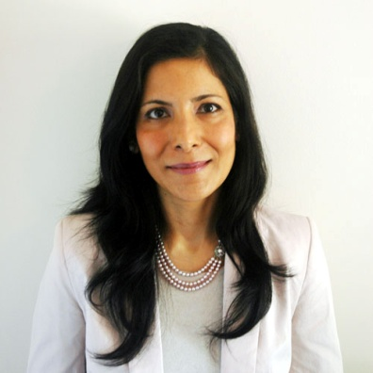
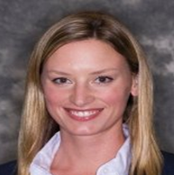
KEY PRESENTERS
Konkana Khaund
Consulting Director
Lauren Taylor
Principal Consultant
Practice: Energy, Environment & Smart Infrastructure
Discussion Topic: Trends Driving Growth and Innovation for the Built Environment
Background:
Over 20 years of experience working in smart infrastructure, energy and environmental industries
Skilled in strategic business planning, go-to-market strategy development, process implementation and industry though leadership proliferation
Lead client engagements globally for a wide spectrum of organizations including Fortune 1000 companies, governments and academia
Hold a Master's degree in Economics, Delhi University, India.
Practice: Visionary Innovation
Discussion Topic: Growth Pipeline Diagnostic
Background:
6 years in the Visionary Innovation Practice, over 15 years in client consulting
Expertise in growth strategies, mega trends, industry disruption, innovation processes, long-term scenario planning
Cross-industry strategies, insights, and best practices
Lead custom client consultation engagements across industries and drive mega trends thought leadership
MBA from the University of Texas at Austin

Slide 19
GROWTH DIAGNOSTIC SESSION
Date: Thursday, May 28th
Time: 11:00 am Eastern
Next Steps: Invitation with access link to be shared with all CABA members

Slide 20
MAURICE OKAWAKI
Director of Client Services
Mobile: 210.247.3813
Email: maurice.okawaki@frost.com
LAUREN TAYLOR
Principal Consultant
Mobile: 832.506.8384
Email: lauren.taylor@frost.com
The Growth Pipeline™ Company
Preparing clients for a future shaped by growth

Slide 21
7. New Business Roy Perry (Alarm.com)
7.2 Other new CHC business?

Slide 22
8. Adjournment Roy Perry (Alarm.com)
Next CHC Meeting: Early August 2020
Continental Automated Buildings Association (CABA) caba@caba.org www.CABA.org
www.caba.org/chc
Connect to what’s next™

