Slide 1
Intelligent Buildings and COVID-19 Informational Webinar
Thursday, July 16, 2020, 1PM – 2PM ET (ET)
Konkana Khaund, Frost & Sullivan

Slide 2




Overview of CABA
CABA (Continential Automated Buildings Association)
Vision
Empowers connectivity among people, spaces and technology for a better tomorrow.
Mission
CABA fosters informed thought leadership and collaboration within intelligent built environments to deliver a more livable, sustainable and efficient connected world.
2
Notes:
- 390 members
- 27,000 contacts
Marketing, networking-councils & liaison,
Events (SBS)-100 companies
Library, WP, collaborative
----------------------------------------------------------------------------------------------------

Slide 3




















CABA Board of Directors
3
© 2020, Continental Automated Buildings Association

Slide 4

CABA Project Funders “Intelligent Buildings and COVID-19”

Slide 5

COVID-19 & INTELLIGENT BUILDINGS
INFORMATION WEBINAR
Presented to:
Continental Automated Buildings Association
16 July 2020
The Growth Pipeline™ Company
Powering clients to a future shaped by growth

Slide 6
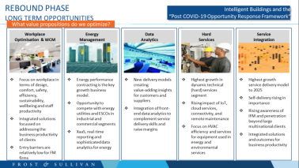
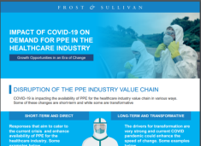
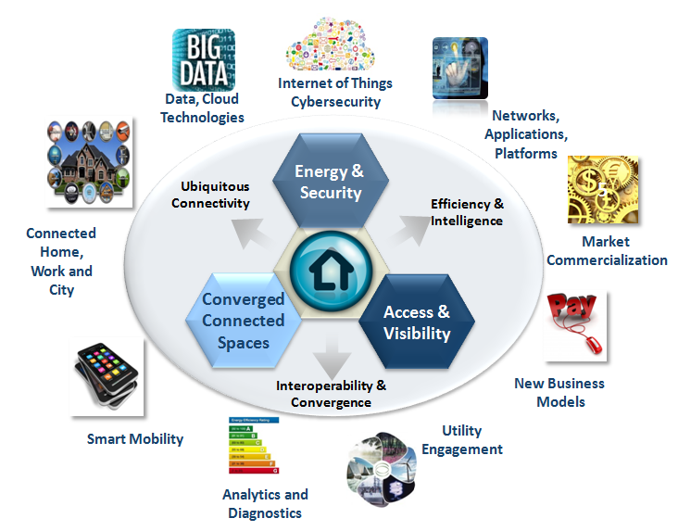
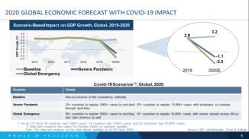
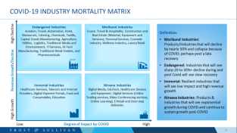
A Quick Snapshot of Frost & Sullivan's Proactive Engagement with Industry to Support Post CoVID-19 Rebound Strategies
Our active research, scenario projections, opportunity framework development exercises
Our Domain Expertise in Intelligent Building

Slide 7
2020 GLOBAL ECONOMIC FORECAST WITH COVID-19 IMPACT
Scenario-Based Impact on GDP Growth, Global, 2015-2020
Covid-19 Scenarios¹ ², Global, 2020
Scenario | Details
Baseline | Non-occurrence of the coronavirus outbreak.
Severe Pandemic | 35+ countries to register 3000+ cases by mid-April, 20+ countries to register 10,000+ cases, with lockdowns to continue through April-May.
Global Emergency | 80+ countries to register 5000+ cases by mid-May, 35+ countries to register 10,000+ cases, with severe spread across Africa and Latin America as well.
1. As on 13th April, 42 countries had 3,000+ cases, 33 countries had 5,000+ cases, and 20 countriess had 10,000+ cases.
2. Data and scenarios are subject to changes based on real-time updates.
Note: The data and analysis on this slide stands updated as of 16th April, 2020. .
Source: IMF; Worldometer; Frost & Sullivan

Slide 8

IMPACT ON KEY INDUSTRIES
ICT and eCommerce
Agriculture
Tourism and Leisure
Personal Care
Energy
Aerospace
Materials and Food
Net Positive Impact
Net Negative Impact
Transport and Mobility
Education
Chemicals
Banking and Financial Services
Construction and Real Estate
Healthcare
Building Services
Manufacturing and
Process Control

Slide 9
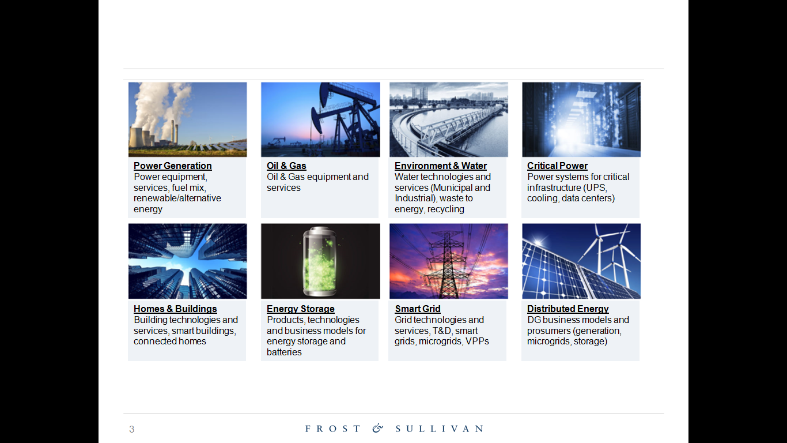
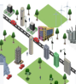
COVID-19 AFTERMATH: TRANSFORMATIONS AHEAD
NAVIGATING THE AFTERMATH OF COVID-19 CALLS FOR DRASTIC TRANSFORMATIONS AND ADOPTING A “CULTURE OF SHARING”
BUILDINGS
Alternate workplace: the overnight reality
Prerequisite infrastructure for pandemics
Rise in micro waste-to-energy & packaged onsite remediation options
Greater versatility of Energy Management Systems (EMS): synchronization with environment quality and safety
Rise in new use cases for buildings driven by government mandates
RENEWABLES
Longer investment cycles will keep renewables’ growth immune
Short and mid term delays are inevitable in new capacity building
Supply chain issues expected from China’s Solar PV production decline
Demand increase for packaged installations from buildings for emergency response
Overarching Goals:
Self-sufficiency; Self-correction and Collective healing
ENERGY
Reforms to ensure affordability, reliability and grid security
System transitions to lower emissions and to support distributed generation
Price transparency from producers will ensure increase bargaining power for consumers
Workforce shortages & health issues will escalate automation and digitalization
FUEL SUPPLY
Supply chain innovation will focus on cost reduction technologies
With less Capex available, Opex-based business models will thrive
Increased investor scrutiny for efficient capital deployment and better risk management
Balancing investment priorities across hydrocarbon & non-hydrocarbon business
CURATIVE CITIES
Respond:
Leverage technology for predictive detection: Beyond facial recognition; detect temperature & environment
Proactively segregate risk & vulnerability zones; link to wearables and data from buildings and occupants
Reset:
Auto activation of management and mitigation processes, e.g., thermal sensors, containment monitoring
Pandemic-ready medical infrastructure “pop ups” in real time with environmental recalibration
Rebound:
Advantages of an agile connected business ecosystem kicks in to support recovery & rebound
Leveraging of data and digital delivery to rebuild customers, employees, supply chain and community initiatives

Slide 10
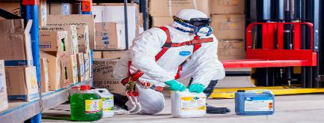


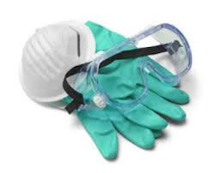
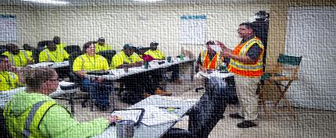

INTELLIGENT BUILDINGS DICTATED BY THE “NEW NORMAL”
Reversing Open Offices
Deep cleaning and sanitation of facilities
Buildings & Systems Recalibration
Redesigning with adequate occupant distancing
Refurbishing office setups
Supporting hybrid workforce, WFH
Frequent cleaning with enhanced standards
Space usage measurement technology for occupant management and optimizing cleaning with pathogen detection capability offsite
Retuning, recalibration and augmentation of systems for reentry
Incremental checks, including re-certs
Touch-free & Contact-free Infrastructure
Air Management, Health and IEQ
Working Capital Shortage
Retrofitting to no-touch systems, including entry and access
Foot activated elevators (Toe-to-Go)®
Touch less fixtures and controls, faucets
Non-thermal, plasma technology to reduce cross-contaminant risks (AirPHX) ®
Quality ventilation to reduce pathogens
Anti-microbial paints
Non-contact infrared sensors with integration on mobile platforms
Clients delaying payments, projects, with wage liabilities
Existing pool of FM workers under-prepared
Impeded supplies against greater demand
Notes:
https://economictimes.indiatimes.com/industry/services/property-/-cstruction/covid19-impact-facility-management-companies-ensure-workers-engagement-with-extra-incentives/articleshow/75118404.cms?from=mdr
https://blog.infraspeak.com/challenges-fm-2019/

Slide 11






INDUSTRY ENVIRONMENT: KEY PREDICTIONS
Building EMS’ Expanding Role, Beyond Efficiency & Comfort
Connected Security & Safety Preparedness Plugs into EMS
Pandemic-ready Use Case Mandatory for Real Estate Developments
Building managers will look for EMS solutions that are powered by AI and completely leverage the full potential of IoT devices to optimize building performance. Beyond occupant comfort and sustainability, synchronization with emergency response support and ability to recalibrate environmental quality is critical from the EMS to support “pandemic-ready” needs.
Frost & Sullivan predicts the implementation of stringent safety standards and increased penetration of IoT-enabled cybersecurity and compliance detection systems to improve emergency response and reduce risks during pandemics. City surveillance projects will increasingly link with the built environment for input sharing and planning response strategies.
Buildings will feature new use cases driven by government mandates. The ability to support pandemic-ready “pop up” medical infrastructure, either as a dedicated wing or a standalone unit in the campus, complete with environmental calibration, will be necessary to maintain their accreditations. Suppliers will tailor solutions to meet these changing requirements.
Keeping 5-G Rollout on Track for Broader Benefits
AI-powered Smart Buildings Delivered by A Digitally Mature Ecosystem
Integrated Vertical Building Solution Bundled with Disaster Response
Frost & Sullivan predicts, while economic headwinds will delay enterprise 5G rollout, its larger benefits will keep 5G implementation on track. Trends in favor include the spike in bandwidth demand due to growth in teleworking and remote operations, post COVID-19, including 5G’s support in Singapore’s and China’s monitoring and controlling efforts to triage the pandemic.
Leading building technology companies such as IBM and Siemens will integrate disparate building automation and management systems under one AI powered platform. Operating and maintaining buildings with such solutions will be further supported by a digitally advanced ecosystem that can integrate disaster mitigation and rebound services in a non human supported environment.
Lighting solution providers like Acuity and Signify will lead on the momentum for connected lighting and push for integrated vertical building solutions, including integrated LED luminaires, building energy management, and digital lighting services. Bundling disaster response capabilities in their solution portfolio will characterize value propositions and branding.

Slide 12






Remote working: POTENTIAL IMPLICATIONS for ORGANIZATIONS work from home is expected to have far reaching consequences leading to tectonic shifts in organizational policies, investments, technology adoption, and operational efficiency
Workplace
Workforce
Technology
Expat employees who are well positioned for a remote role could be relocated to home country
Decline in real estate requirement – New offices could be set up in suburbs
Reduction in mobility (commuting, general travel) requirements for employees
Adoption of new technologies that enable remote working
Onsite Vs. Offsite Employee split to be more skewed towards offsite
Shift towards automating operational processes
Understanding the 2 “W’s” of Remote Working – “Who” & “What” will be impacted?
Source: Frost & Sullivan
Notes:
https://economictimes.indiatimes.com/jobs/world-economy-working-from-home-gets-a-glimpse-of-the-virtual-future/articleshow/75155607.cms?from=mdr
https://voxeu.org/article/working-home-estimating-worldwide-potential

Slide 13




EMERGENCE OF A NEW WORKFORCE POST COVID
Connectivity is driving emerging employment models that offer greater flexibility to both employers and employees
Workplace
Workforce
Technology
EMERGING EMPLOYMENT MODELS
FREELANCE BROKERING
(e.g., Upwork (Elance))
MICROTASKING
(e.g., Amazon’s Mechanical Turk)
DISPERSED NETWORKS
(e.g., Citibank)
“UN”COLLARED
(e.g., Uber)
3rd party connects skilled labor/knowledge workers with one-time contracts
3rd party uses remote, unskilled labor to divide and conquer complex tasks
Organization relies on full-time, remote employees with flexible working arrangements
3rd party assembles a collective of workers to perform a function, usually an offline service
Key Influencers
Proliferation of new employment models (e.g., zero-hour contracts)
Rise of enabling technologies (Increase mobile connectivity and internet penetration)
P2P & Invisible payments (cardless, cashless, hidden in an online platform)
Source: Frost & Sullivan

Slide 14
Emerging WORK Scenarios pre & post covid
By 2030, the FUTURE workplace will be highly Flexible and personalized. THE KEY TAKEAWAYS HERE ARE WORK, WORKPLACE, MEDIUM, & EMPLOYEES
Workplace
Workforce
Technology
Pre Covid
Post Covid
Ethos
Fixed working hours, demarcation between home and work
Flexible Work Hours – anytime anywhere. Home is my (work) castle)
Nature of Work
Rigid structure – 8 to 12 hours of work per day
Flexible structure
Focus Point
Organization driven
Employee driven- Change of work styles attitudes and preferences
Structures
Stand alone buildings & offices
Remote, eco-friendly work structures, personalized, cubicle based offices
Employees
Restricted
Mobile dispersed and easily accessible- smart working solutions
Medium
Computer, laptops, tablets
Smart systems- Virtual and interactive wall technology
Chain of command
Top-down organizational structure
Networked, open, agile and transparent structures
Workplace
Human based
Human-machine collaboration- Mobile robots replacing labor in few areas
Source: Frost & Sullivan

Slide 15
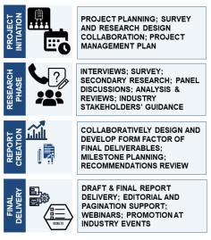
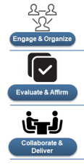




PROJECT DESIGN & APPROACH
The fundamental shifts brought about by COVID-19 will result in both, challenges, and opportunities for the IB industry.
The project vision will deliver:
Tangible and descriptive profiles of opportunities
A prescriptive timeline prioritizing response strategies
Implementation guidelines through time horizons: immediate, 3-5 years, long term perspective
The goal of this project is to help CABA members
Optimize their present and redefined value propositions
Extract organizational competencies
Create incremental value for the market
Chart future growth plans
PROJECT FULFILLMENT PLAN ACROSS 3 MODULES
PRIMARY RESEARCH
Virtual Round Tables with Visionaries
2 VRs of 6-8 members each, comprising thought leaders, regulators and industry influencers
IB Technology, Service & Solution Leaders; value chain partners
~25-30 representatives
Voice-of-customer
Research across North America
~N=150; use case development; IB customer perceptions and pain points
Module 1, 2 &3
Module 2 &3
Module 1 &3
SECONDARY RESEARCH

Slide 16
PROJECT DESIGN & OUTCOMES: MODULE 1
Scope
COVID-19 and Intelligent Buildings: Impact Overview
Regulatory Environment & Guidelines Review
Deliverables
IB Impact overview : buildings of the future dictated by the “new normal”: technology, service and occupant changes
CRE and asset management changing trends and impact review: IEQ, health and sanitation, reentry implications, change requirements to CRE services , system recalibration needs, worker safety, capital shortages, XaaS needs, service models
Scientific literature review for COVID-19 and associated transmission vectors , scientific research and opinions on dealing with COVID-19 aftermath, influence on new building solutions
Overview of knowledge and recommendations of other authorities such as Centers for Disease Control and Prevention (CDC), ASHRAE, and global though leaders
Analysis of the above components, implications and top takeaways for IB industry participants
Assimilation into a report to submit to the steering committee; Presentation of findings
Top Takeaways:
Which areas need prioritizing for response?
What does the science tell us?
What combined intelligence can we leverage?
Methodology & Report Layout
Research output will be largely secondary based, supplemented with detailed discussion with steering committee members, regulators, and industry influencer bodies to develop final report and recommendations
Report layout: ~30-35 page deliverable in word with PowerPoint supplement for presentation of findings
Timeline
5 working weeks from commencement of Module 1 to report delivery and presentation

Slide 17
PROJECT DESIGN & OUTCOMES: MODULE 2
Scope
IB technology impact assessment of COVID-19
Technology innovation and potential evaluation to support post COVID-19 opportunities
Deliverables
Technology landscape review and impact mitigation potential assessment: ultraviolet light sources, thermal imaging, sensors, touchless devices for calling, elevators, operating lights and doors, faucets, hand dyers, others; in-home preemptive temperature and health detection technologies to regulate building entry, occupant behavior management, facial recognition and people flow management, crowd analytics technology solutions, contact tracing and contactless maintenance, among others; cybersecurity concerns and mitigation measures to consider
Service innovations to support post COVID-19 building needs: building & workspace technology and design; XaaS needs, staff augmentation as a service, COVID-19 response as a service, comfort as a service
Technology and data analytics to support post COVID-19 mitigation measures: incorporate solutions to monetize data
Analysis of the above components, implications and top takeaways for IB industry participants
Assimilation into a report to submit to the steering committee; Creation of a technology implementation radar over a 5 year horizon; Presentation of findings
Top Takeaways:
Which innovations hold the key?
Which technologies offer maximum potential?
Where can we add incremental value?
Methodology & Report Layout
Research output will based on structured primary discussions with industry participants, technology innovators and incubators, supplemented with desk research and interactions with steering committee members to develop final report and recommendations
Report layout: ~40-50 page deliverable in word with PowerPoint supplement for presentation of findings
Timeline
8 working weeks from commencement of Module 2 to report delivery and presentation

Slide 18
PROJECT DESIGN & OUTCOMES: MODULE 3
Scope
Future readiness of the IB industry after COVID-19
Resiliency Requirements & Recommendations
Deliverables
New technology implications on the IB environment and occupants
Future of work and integration of work-from-home (WFH) in designing and planning for IB infrastructure
Planning for pandemic preparedness: considerations for future indoor environmental: HVAC systems, advanced air and IEQ management, monitoring, crowd management, occupant monitoring and security planning
Use cases of the future - recalibration and augmentation of systems and buildings for post-pandemic use such as:
  IB with alternative built in usages for “pop-up” hospitals; Design simulation to facilitate ”open office” reversals
  Emergency health, safety and sanitation scenario simulations
  EMS synchronization with emergency response support, IEQ resets to support “pandemic-ready” needs
  Disaster mitigation and rebound services in a non human supported environment
Analysis of the above components, implications and top takeaways for IB industry participants
Assimilation into a report summarizing the future ready roadmap for IBs to submit to the steering committee; Presentation of findings
Top Takeaways:
How do we plan for future IB infrastructure?
What will dictate our customer engagement process?
Which innovations are best suited for our organizations to respond to?
Methodology & Report Layout
Research output will be largely secondary based, supplemented with detailed discussion with steering committee members, regulators, and industry influencer bodies to develop final report and recommendations
Report layout: ~30-35 page deliverable in word with PowerPoint supplement for presentation of findings
Timeline
5 working weeks from project commencement to report delivery and presentation

Slide 19
Timeline: Activity Schedule
Milestones | Activity | Timeframe: 20 to 24 working weeks
Project Kickoff and Steering Committee (SC) Launch | Kickoff Meeting; Set goals and objectives; establish update schedule; Set dates for completions of Module 1 | Week 1
Module 1
Introductory meeting and Module 1 planning session | SC discussions Research Launch Literature review launch Primary research and analysis Report development | Week 2, 3, 4, 5
Module 1 Submission | Report submission | Week 6
Module 1 report review by SC | Report review Feedback and questions from SC Incorporation of feedback and submission of updated Module 1 report to SC | Week 7, 8
Module 1 presentation | Presentation of Module 1 report to SC | End of Week 8
Module 2 | Detailed work plans for Modules 2 and 3 will follow the above process as shown for Module 1 | Week 9-16
Module 3 |  | Week 17-24

Slide 20







PROJECT TEAM
Project Supervision, Management and Fulfillment
Team Credentials: Key Highlights
Recognized Subject Matter Experts in Intelligent Buildings, Technology Roadmaps, Industry Framework Developments
Customer Behavior Experts
Strategic Implementation Experts
COVID-19 reset and rebound strategies
Mark Simoncelli, Partner and Global VP of Consulting
Project Advisor, Frost & Sullivan’s Global COVID-19 Response Framework Leader
Lucrecia Gomez, Principal Consultant, Energy & Environment
Team Member, Industry Research
Konkana Khaund, Director of Consulting
Project Manager and Team Lead
Dr Romualdo Rodrigues, Director of Consulting,
Team Member, Voice-of-customer Research
SMEs & Fulfillment Team Members
Other SMEs will be added as required
Maria Benintende,
Sr Consultant
Dennis Marcel Victor,
Sr Consultant
Pratik Paul,
Sr Consultant

Slide 21

Questions?
Konkana Khaund
Director of Consulting, Energy & Environment

Slide 22
Contact Information
Greg Walker
walker@caba.org
Continental Automated Buildings Association (CABA)
caba@caba.org
www.CABA.org
www.caba.org/chc
Connect to what’s next™

