Slide 1
Intelligent Buildings Council (IBC)
Chair: Trevor Nightingale (National Research Council)
Vice-Chair: Robert Lane (Robert H. Lane and Associates Inc.)
Vice-Chair: Bob Allan (The Siemon Company)
Vice-Chair: Harsha Chandrashekar (Honeywell International Inc)

Slide 2
1. Agenda Greg Walker (CABA)
1. Agenda
2. Call to Order, Welcome, Introductions, about IBC
3. Administrative
“Growth Opportunities Enabled by Connected Vehicle’s Interaction With Smart Infrastructure” (30 min)
Sandeep Kar (Fleet Complete)
5. Research Update
6. White Paper Sub-Committee Update
7. New Business
8. Announcements
9. Adjournment

Slide 3
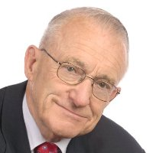
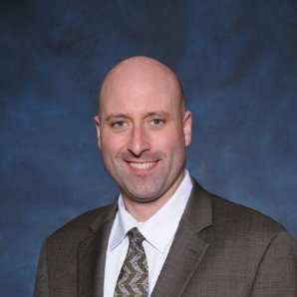
2. Call to Order, Welcome, Introductions, About the IBC Trevor Nightingale (National Research Council)
IBC Vice-Chair
Trevor Nightingale
Director
National Research Council
IBC Vice-Chair
Robert Lane
President & Managing Partner
Robert H. Lane and Associates Inc.
IBC Vice-Chair
Bob Allan
Global Business Development Manager, Intelligent Buildings
The Siemon Company
IBC Vice-Chair
Harsha Chandrashekar
Product Approvals & Regulatory Leader
Honeywell International Inc
The CABA Intelligent Buildings Council works to strengthen the large building automation industry through innovative technology-driven research projects. The Council was established in 2001 by CABA to specifically review opportunities, take strategic action and monitor initiatives that relate to integrated systems and automation in the large building sector. The Council's projects promote the next generation of intelligent building technologies and incorporates a holistic approach that optimizes building performance and savings.
http://www.caba.org/IBC

Slide 4
3. Administrative Trevor Nightingale (National Research Council)
3.1 Motion to approve past IBC Minutes: www.caba.org/ibc

Slide 5
3. Keynote Speaker Robert Lane (Robert H. Lane and Associates Inc.)
“Growth Opportunities Enabled by Connected Vehicle’s Interaction With Smart Infrastructure” (30 min)

Slide 6
Growth Opportunities Enabled by Connected Vehicle’s Interaction With Smart Infrastructure
Sandeep Kar
CSO, Fleet Complete

Slide 7
Top 5 Potentially Disruptive Business Models Cited by Global Survey of CEOs

Slide 8
Digital Transformation in Trucking: Big Data Analytics Enabling Both Panoramic and Granular Insights
Social Media Analytics Integration
2025
ITS
2020
Sensors and Terrain/Weather Mapping
2015
Traffic Predicting Software
2010
Telematics
Reactive
Proactive

Slide 9
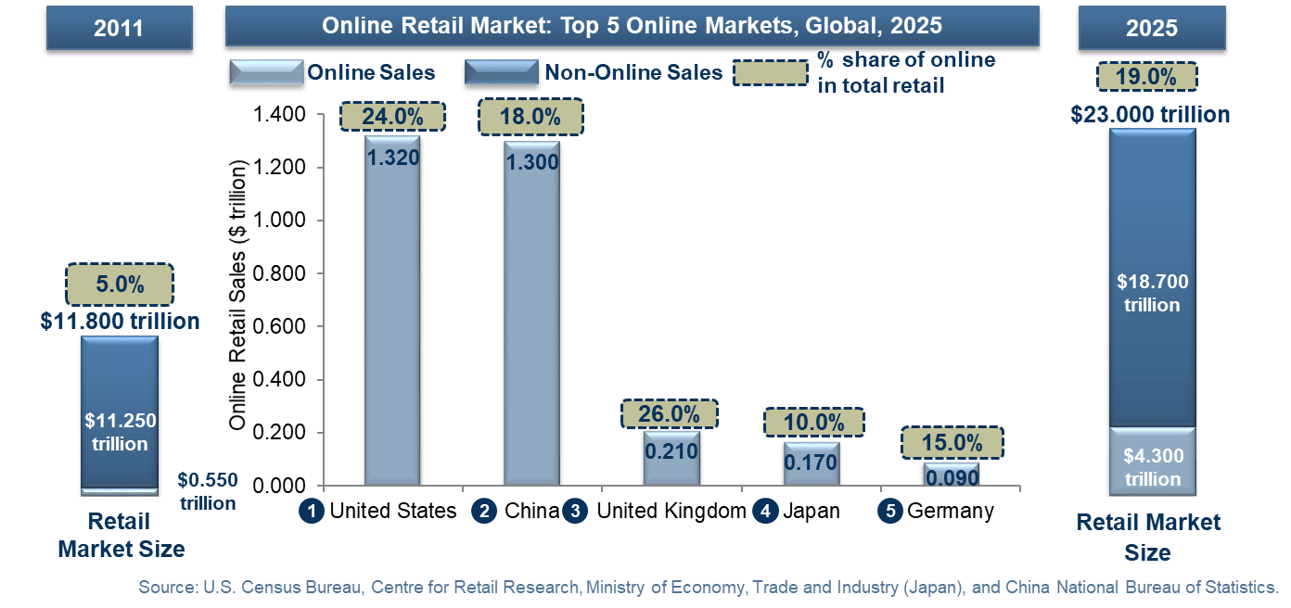
Rise of E-Retailing- Requiring Cost Optimization Solutions

Slide 10
Flow of Freight: Tremendous Volumes of Data Derived from Freight Flow Powering New Business Models
Shipping/Rail
Freight Movers
Intermodal Freight Processors
Warehouse Handlers
Truck Fleets
End-User
Customers
Data Aggregators
Container/trailer tracking
Mobile intermodal workforce management
Tethered/ untethered trailer monitoring
Document management
Fleet Tracker, Asset Tracker, BB Radar
Loading/ unloading
Quality management
Inventory management
Warehouse-vehicle networking
Track-and-trace
Prognostics
Safety and ADAS
Geo-fencing
Navigation
Usage-based-insurance
Vehicle and driver management
Last mile freight delivery visibility
Predictable e-commerce deliveries
Global sourcing
Freight aggregation
Uber for trucking
Digital freight brokerage
Autonomous driving
Driver and technician training
Freight Mobility Activities

Slide 11
Future Connected Vehicles Services
Over 100 connected vehicle features and services can be digitalized, many of which can be monetized
Fleet management
Immobilizer
Taxi service
Carsharing
E-hailing
Ride sharing
Trip planner
Booking service
Mobility payment
Corporate carsharing
Concierge service
Trunk opening
Vehicle location
Personal assistant
Connected home
Domotic link
Tolling
Congestion charge
Geo fencing/restriction
Parking service
Traffic management
Vehicle charging
Fuel payment
Fuel management
Product development
Customer loyalty program
Vehicle surveillance
Vehicle tracking
Theft recovery
Breakdown service
Emergency call
Roadsign monitoring
Regulation enforcement
Road maintenance
Infrastructure condition
Driver conditions
Insurance PAYD
Media streaming
Navigation services
Social media driving
Driving practice contest
Digital driving training
Usage monitoring
Driver scoring
Advertising
Targeted offers
Warranty management
Infotainment
Cost Optimization
Dealers
Distributors
Consumer
Mobility
Operators
UBI
Suppliers
Feature On Demand
OEMs
AM Embedded
Garages
OBDII Dongle
Convenience & Access
Vehicle Info
OE Embedded
Driver Behavior
Mobility Services
Infrastructure
Fleets
Break-in detection

Slide 12
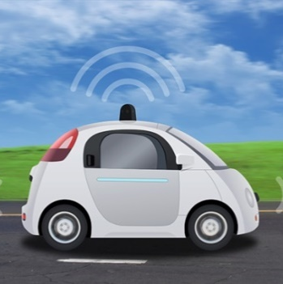
Autonomous Vehicles: Disruptive to industries beyond automotive
Public transport
Fast food
Connected Living ecosystem
Parking garages
Automotive ecosystem
Real estate
Trucking
Insurance
Energy/fuel
Hotels
Car repair and parts
Media and entertainment
Ride-hailing companies
Notes:
This evolution of cars from self driving to self learning will also open up to a new age of connected living solutions that are interrelated. The future holds many opportunities where the elements of living outside the car will be related to the travel behaviour and preferences inside the car. A good example for that is the Eleanor concept from Rolls Royce who took a new spin to personal assistance based on advanced machine learning linking the users priorities and data nodes (email, home settings, preferred travel routes etc. ) into the self driving system.
https://www.rolls-roycemotorcars.com/en-GB/103ex.html
http://www.telegraph.co.uk/business/2016/06/16/rolls-royce-unveils-the-ultimate-self-driving-20ft-luxury-concep/

Slide 13
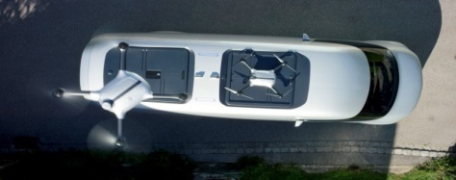
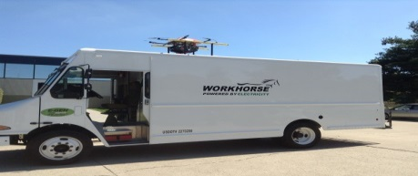
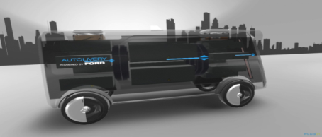
Implication: Truck-drone delivery opportunity New last-mile delivery models will explore building drones right into trucks, and launching them at various points along their route to smart buildings and homes
How It Works
Drones built and launched from the trucks
Drone will be used for the very last mile deliveries
Truck can be used to surpass no fly zones
Van used is automated or electric or both in most proof of concept
Proof of Concept
Mercedes Benz & Matternet drones
Workhorse Group
Ford Autolivery
Notes:
Global Urban Logistics Spending expected to grow from 2.55 tr to be $5.9 Trillion in spending in 2020, transportation accounting for 55%

Slide 14
Carsharing Market Forecasts
Industry expected to grow from 9mn members in 2016 to over 36mn members by 2025
Carsharing Market: Members and Vehicles, Global, 2016 and 2025
2016 Global Members
Carsharing Market: Number of Vehicles, Global, 2016 and 2025
2025 Global Members
~ 36 mn
~ 9 mn
Note: All figures are rounded. The base year is 2015. Source: Frost & Sullivan

Slide 15
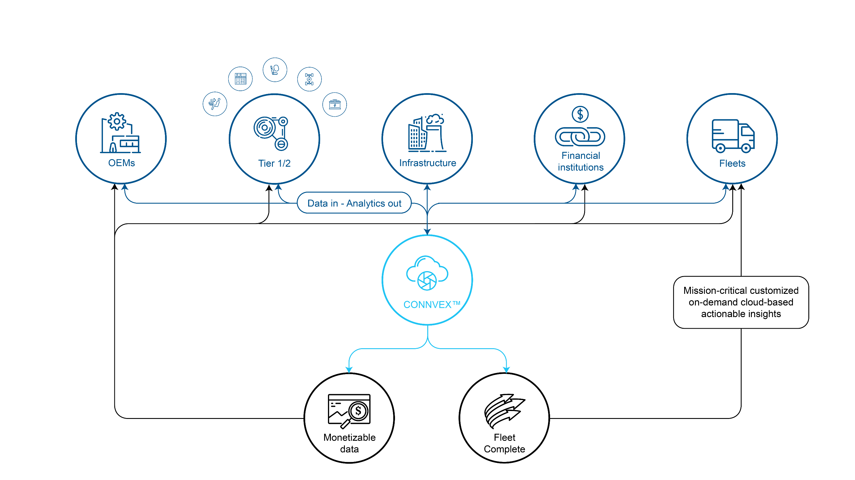
CONNVEX: A Purpose Built Big Data Analytics Platform for Connected Vehicle Eco-System Stakeholders

Slide 16
CONNVEX ™ Is Gaining Momentum: Get Ready

Slide 17
The Real Change CONNVEX is Enabling
Owning Assets
Owning Transactions
Owning Interactions

Slide 18
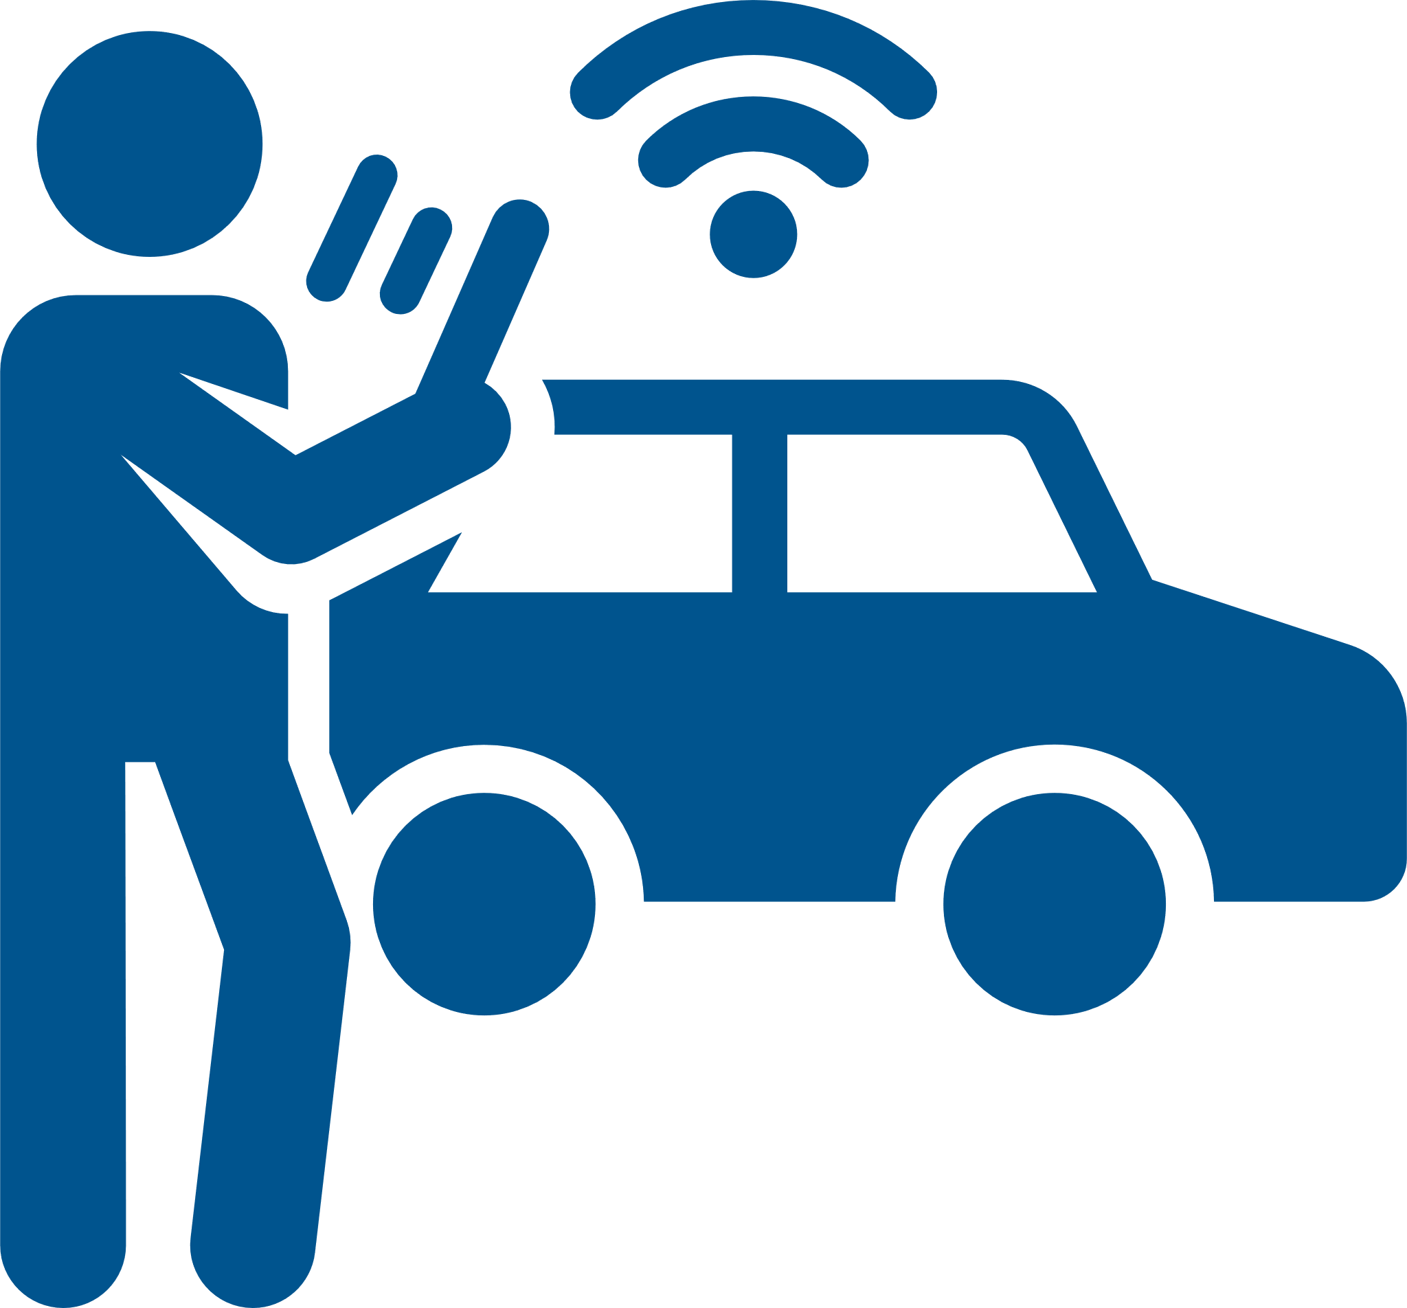
Connecting Buildings, Infrastructure and Mobility
SMART PERSONNEL
Effective and efficient maintenance
SMART VEHICLE
Smart mobility and carsharing support
SMART ADS
Targeted advertising
SMART DELIVERIES
E-commerce support for Just-In-Time (JIT) logistics
SMART POWER
Building generating power for the power grid
SMART PARKING
Reduced land requirements
REDUCED CARBON FOOTPRINT & OPEX

Slide 19
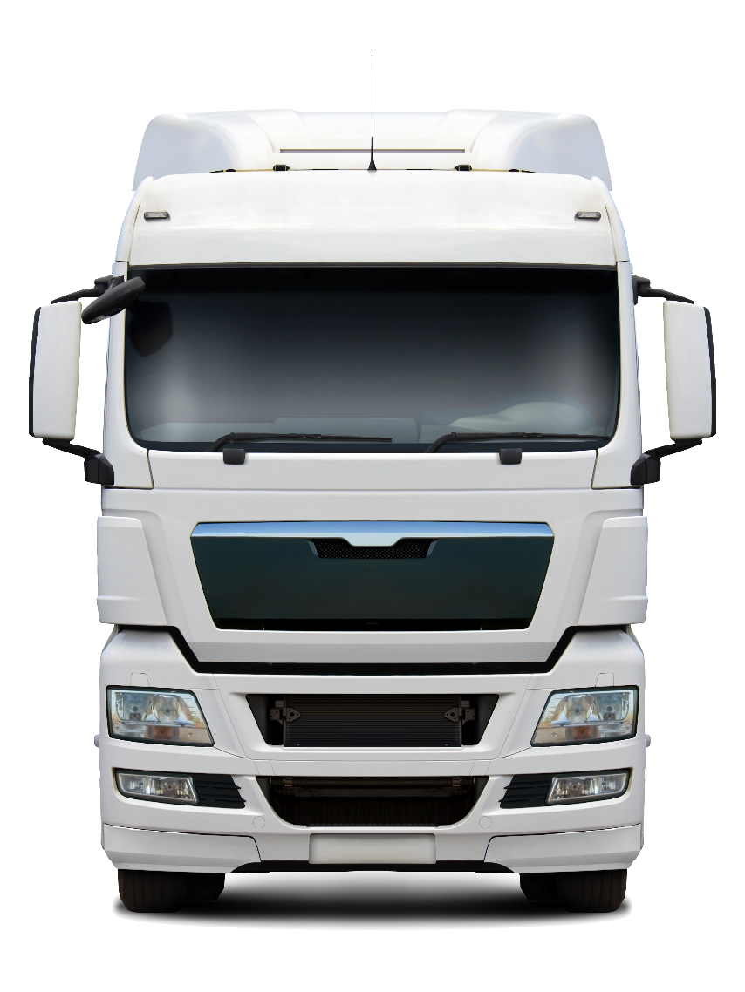
GREEN TRUCK
SMART TRUCK
SAFE TRUCK
CONNECTED TRUCK

Slide 20
Contact Details
Sandeep Kar
Chief Strategy Officer
Fleet Complete
(416) 333-5498
Sandeep.Kar@fleetcomplete.com

Slide 21
4. Keynote Robert Lane (Robert H. Lane and Associates Inc.)
Questions?

Slide 22
5. Research Update Trevor Nightingale (National Research Council)
5.1 “Improving Organizational Productivity with Building Automation Systems – Phase 2” 2018 IBC Multi-Client Boutique Research
Free Download of Phase 1: www.caba.org/productivity
www.caba.org/research

Slide 23
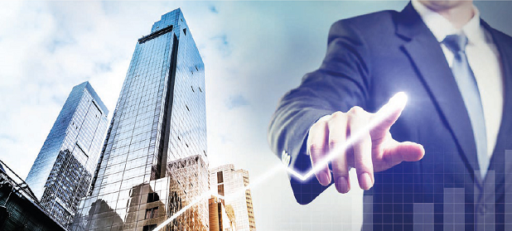
5. Research Update Harsha Chandrashekar (Honeywell International Inc.)
5.2 “Monetization of Intelligent Buildings” IBC Research
www.caba.org/research

Slide 24
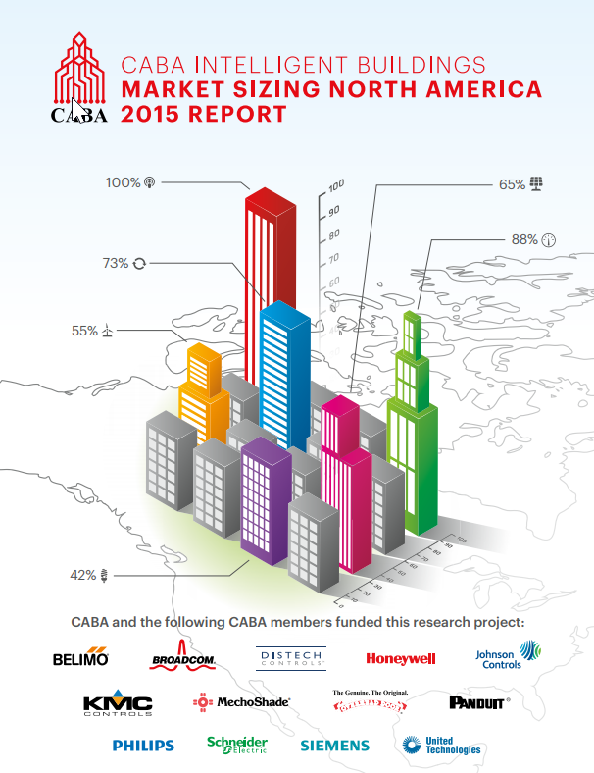
5. Research Update Bob Allan (The Siemon Company)
5.3 2019 IBC Landmark Research Topic?
“Intelligent Buildings and Market Sizing North America 2019”?
Topics?
Forecast time frame?
Geographic location?

Slide 25
6. White Paper Sub-Committee Update Ken Wacks (Ken Wacks Associates)
6.1 Recently Completed:
“Human Skin Cells: A Potential Source of Building Contaminants”
Environmental Diagnostic Laboratory (EDLab) at Pure Air Control Services, Inc.
www.caba.org/WhitePapers

Slide 26
6. White Paper Sub-Committee Update Ken Wacks (Ken Wacks Associates)
6.2 In Progress:
“Impacts of Automated Shading in Building Projects”
Axis
Ecotay Inc.
HunterDouglas
Ken Wacks Associates
Lawrence Berkeley National Laboratory
Legrand
Lutron
MechoSystems, Inc.
NYSERDA
PLC Multipoint, Inc.
Savant
Screen Innovations
Siemens Industry, Inc.
Somfy
Sustainable Resources Management
TRC Energy Services
Vistar Energy Consulting
Window Products Management
www.caba.org/WhitePapers

Slide 27
6. White Paper Sub-Committee Update Ken Wacks (Ken Wacks Associates)
6.2 In Progress:
“Energy Metering and Power Quality Metering in North America”
ArcoLogix LLC
Asian Institute of Intelligent Buildings
Brainwave Research Corp.
CMG
Convergint Technologies
CopperTree Analytics Inc.
Current, powered by GE
Cyber Power Systems, Inc.
Domotz
Enercare Connections Inc.
EZ Meter Technologies
Honeywell International Inc.
Ken Wacks Associates
Public Works and Government Services Canada
Renesas Electronics America Inc.
Robert H Lane and Associates Inc.
Schneider Electric
Sustainable Resources Management
Triacta Power Solutions
Zinwave
www.caba.org/WhitePapers

Slide 28
6. White Paper Sub-Committee Update Ken Wacks (Ken Wacks Associates)
6.2 In Progress:
“Automated Control Systems for Zero Emission Buildings”
Ecotay Inc.
www.caba.org/WhitePapers

Slide 29
6. White Paper Sub-Committee Update Ken Wacks (Ken Wacks Associates)
6.2 In Progress:
“IOT cyber security guidelines, standards and verification systems”
Agelight Digital Trust Advisory Group
ARC Advisory Group
ArcoLogix LLC
Automation Standards Compliance Institute
BC Hydro
CANASA (Canadian Security Association)
Compass Intelligence, LLC
Consultant
Control4
CopperTree Analytics Inc.
CSA Group
Domotz
eMcRey
EXP
George Brown College
Honeywell International Inc.
Johnson Controls Inc.
Ken Wacks Associates
LonMark International
National Electrical Manufacturers Association (NEMA)
RYCOM Corporation
Sustainable Resources Management Inc.
Syska Hennessy Group
TC9, Inc
The Siemon Company
www.caba.org/WhitePapers

Slide 30
6. White Paper Sub-Committee Update Ken Wacks (Ken Wacks Associates)
All proposals and previously completed IBC White Papers can be downloaded at:
www.caba.org/WhitePapers

Slide 31
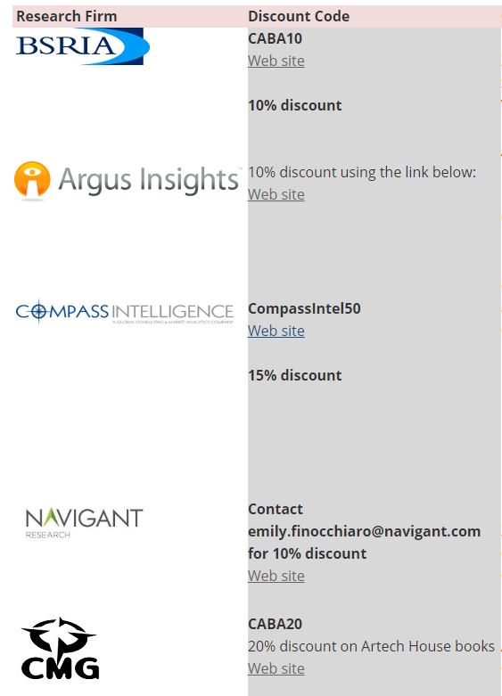
7. New Business Andrew Glennie (CABA)
7.1 Featured CABA Member Benefit
CABA Affinity Program
The CABA Affinity Program allows CABA member research firms to offer discounts to CABA members. Participating CABA member research firms provide CABA members with a promotional code for a set percent discount off their research. CABA has a wide range of research firms as members.
www.caba.org/Affinity

Slide 32
7. New Business Trevor Nightingale (National Research Council)
7.2 Other new IBC business?

Slide 33
8. Announcements Ron Zimmer (CABA)
8.1 Past Event Overview:
IBcon 2018 – Realcomm, June 6-7, Las Vegas, NV
InfoComm 2018, June 6-8, Las Vegas, NV
BICSI Fall Conference & Exhibition, Sept 29 – Oct 3, Las Vegas, NV
8.2 Upcoming events:
Greenbuild International Conference & Expo, Nov 14-16, Boston, MA
AHR EXPO HVACR Trade Show, Jan 14 – 16, Chicago, IL
DistribuTECH, Feb 5 – 7, San Antonio, TX
CABA Smart Building Summit, June, Palm Beach, FL

Slide 34
9. Adjournment Trevor Nightingale (National Research Council)
Next IBC Meeting, Jan 2019
Continental Automated Buildings Association (CABA) caba@caba.org www.CABA.org
www.caba.org/ibc
Connect to what’s next™

