Slide 1
Intelligent Buildings Council (IBC)
Chair: Trevor Nightingale (National Research Council)
Vice-Chair: Robert Lane (Robert H. Lane and Associates Inc.)
Vice-Chair: Bob Allan (The Siemon Company)
Vice-Chair: Harsha Chandrashekar (Honeywell International Inc)
Feb 13, 2018

Slide 2
Agenda Greg Walker (CABA)
1. Agenda
2. Call to Order, Welcome, Introductions
3. Administrative
“Tax Incentives for Green Buildings” (30 min)
5. Research Update
White Paper Sub-Committee Update
Intelligent vs Conventional Building Cost Calculator Task Force
New Business
Announcements
Adjournment

Slide 3
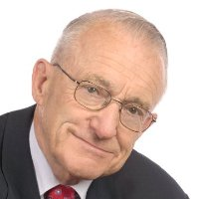
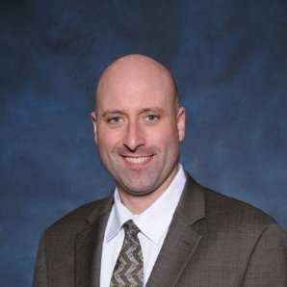
2. Call to Order, Welcome, Introductions – About the IBC Trevor Nightingale (National Research Council)
IBC Vice-Chair
Trevor Nightingale
Director
National Research Council
IBC Vice-Chair
Robert Lane
President & Managing Partner
Robert H. Lane and Associates Inc.
IBC Vice-Chair
Bob Allan
Product Marketing Manager
The Siemon Company
IBC Vice-Chair
Harsha Chandrashekar
Product Approvals & Regulatory Leader
Honeywell International Inc
The CABA Intelligent Buildings Council works to strengthen the large building automation industry through innovative technology-driven research projects. The Council was established in 2001 by CABA to specifically review opportunities, take strategic action and monitor initiatives that relate to integrated systems and automation in the large building sector. The Council's projects promote the next generation of intelligent building technologies and incorporates a holistic approach that optimizes building performance and savings.
http://www.caba.org/IBC

Slide 4
3. Administrative Trevor Nightingale (National Research Council)
3.1 Motion to approve past IBC Minutes: www.caba.org/IBC

Slide 5
4. “Tax Incentives for Green Buildings” (30 min)

Slide 6
Tax Incentives for Green Buildings

Slide 7
What is §179D?
Energy Efficiency Tax Incentives
A tax deduction for energy-efficient expenditures made to depreciable commercial, government/municipal, or large (3+ stories) residential buildings that reduce energy use by 50% compared with similar structure built to ASHRAE/IES Standard 90.1-2001.
NOTE: Beginning in 2016 a taxpayer must utilize ASHRAE/IES Standard 90.1-2007.
Maximum deduction: $1.80/SF
Partial deductions allowable of $0.60/SF for buildings that do not meet overall threshold but have systems which are individually energy efficient

Slide 8
§179D – A Brief History
Energy Efficiency Tax Incentives
The Energy Policy Act of 2005 (EPAct) established §179D
Notice 2006-52 established the ground rules:
methods of modeling, simulation, and calculation of savings
Requirements for certification and certifiers
Notice 2008-40 refined rules, introduced alternative percentages for partial calculations, and introduced special rule for government buildings
Notice 2012-22 established further changes to partial qualifications

Slide 9
What qualifies under §179D?
Energy Efficiency Tax Incentives
Buildings constructed or improved between January 1, 2006 and December 31, 2016 are eligible for deductions – Tax Extender is in legislation currently, watch for a February 2018 passage for projects completed in 2017 and 2018
Owner of a building, or lessee who installs energy-efficient systems
If multiple taxpayers install energy-efficient systems in the same building, the deduction may be split between them, as long as the total deduction does not exceed the maximum $1.80/SF

Slide 10
Who is eligible for the deduction?
Energy Efficiency Tax Incentives
For government-owned buildings, the deduction may be taken by the designer of the building or system qualifying for the deduction
NOTE-IRS Code Section 501(C)(3) organizations are not eligible. This means tax-exempt or non-profits do not qualify.

Slide 11
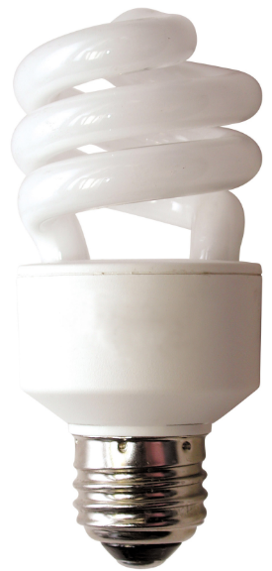
Energy Efficient Systems
Energy Efficiency Tax Incentives
Three building systems are scrutinized under §179D:
Building envelope (exterior walls, insulation, roof, windows, doors, foundation, slab, and more)
Building HVAC (heating, venting, and air conditioning) and hot water systems
Building interior lighting systems

Slide 12
Certification Process
Energy Efficiency Tax Incentives
Plans and technical documentation are examined, and a site visit must be conducted to verify accuracy
Models are created using IRS-approved software:
The actual building, including full details on construction, mechanical systems, and lighting
A similar reference building built to ASHRAE/IES Standard 90.1-2007
If the overall building does not meet the 50% energy reduction threshold, three more models are created isolating the building envelope, HVAC systems, and lighting systems respectively, and compared against the reference building to determine partial qualification

Slide 13
Certification Process
Energy Efficiency Tax Incentives
Once the models are created, full-year simulations are run to test the design, the installed systems, and the resultant energy use
The simulations include climate variations, hourly variations in occupancy (and corresponding variations in lighting and HVAC energy use), thermal mass effects, and more

Slide 14
Partially Qualifying Systems
Energy Efficiency Tax Incentives
If the overall 50% target is not met, the three individual systems are tested against different percentages depending on when the building was constructed or improved
The IRS has adjusted the individual percentages based on feedback—for instance, over time it has lowered the target for building envelope (as that has been the most difficult to qualify) while raising the target for lighting (as that has been the easiest)

Slide 15
So many options
Energy Efficiency Tax Incentives
There are eleven different ways to take advantage of §179D:
1: Fully-qualifying property with 50% energy efficiency
2-10: Nine different ways to achieve partial qualifications by systems (depending on efficiency and year placed in service)
11: Interim lighting rule – allows for measurement of lighting power density (watts/SF)

Slide 16
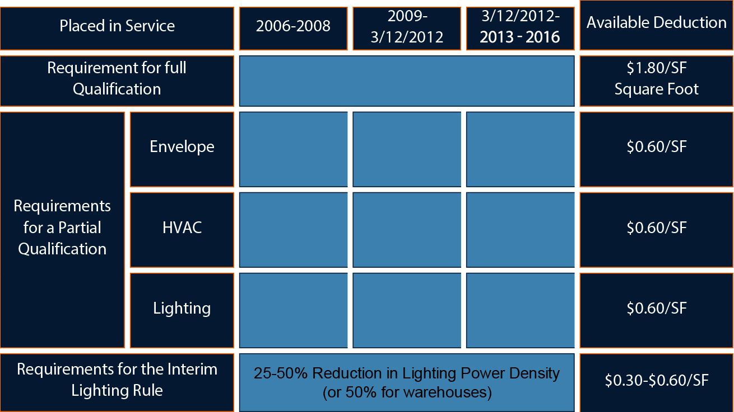
Partially Qualifying Systems
Energy Efficiency Tax Incentives
50%
16⅔ %
10 %
10 %
16⅔ %
20 %
15 %
16⅔ %
20 %
25 %

Slide 17
Maximum Deductions - Example
Energy Efficiency Tax Incentives
Example: 100,000 square foot building:
Full Qualification 100,000 SF
. x$1.80/SF .
$180,000 Deduction
Partial Qualification 100,000 SF
. x$0.60/SF .
$60,000 Deduction

Slide 18
§179D for Architects & Designers
Energy Efficiency Tax Incentives
With Notice 2008-40, the IRS solidified its rules allowing architects, designers, and builders to take advantage of §179D for government-owned buildings. Because of this, we’ve seen a large influx of these projects.
Any project built since 2006 could potentially qualify, and most modern buildings qualify for at least one of the three systems

Slide 19
§45L: Energy Efficient Residences
Energy Efficiency Tax Incentives
Established under the Energy Policy Act (EPAct) of 2005
Extended four times, most recently through the PATH Act of 2015 – with a sunset of 12/31/16 but watch for the extender through 12/31/18
While §179D is a deduction, §45L offers a credit
Available for any dwelling (residential unit) of 3 stories or less – houses, duplexes, apartment buildings, senior housing, etc.
Applicable for open tax years – unfortunately cannot use a form 3115 to go further back

Slide 20
Energy Efficiency Tax Incentives
§45L: Energy Efficient Residences
Like §179D, §45L requires units to achieve 50% energy savings.
However, savings are compared against 2006 IECC standards rather than 2007 ASHRAE/IES (2012 change, previously 2003 IECC standards)
Additionally, §45L requires 10% savings from the building shell as well—having super-efficient lighting and HVAC systems alone are not enough
Notes:
IECC – International Energy Conservation Code

Slide 21
Expansion of §179 Expensing
Tax Cuts & Jobs Act
The new tax law increases the maximum amount a taxpayer may expense under §179 to $1 million and increases the phase-out threshold amount to $2.5 million (previously was $500,000 with a phase-out at $2.0 million)
The $1 million and $2.5 million amounts will be indexed for inflation for taxable years beginning after 2018
Starting in 2018, §179 can be used for qualified property including HVAC systems

Slide 22
Bonus Depreciation
Tax Cuts & Jobs Act
Taxpayers are able to expense 100% of the cost of qualified property acquired and placed in service after September 27, 2017 and before January 1, 2023.
After that it decreases by 20% per year resulting in no bonus in 2027…Or at least not yet
Provision expands the property eligible for immediate expensing to include used property
Like the prior law, asset class life must be 20 years or less

Slide 23
Bonus Depreciation
Tax Cuts & Jobs Act
Acquired property:
No Bonus allowed prior to 9/27/17
Bonus allowed after 9/27/17
Bonus can be taken at 50% or 100% between 9/28/17 and 12/31/17

Slide 24
Bonus Depreciation
Tax Cuts & Jobs Act
Why is this important to you?
Let’s go through an example of a building acquired in 2017 with a depreciable basis of $5,000,000

Slide 25
Example: Office Building – June 2017 Acquisition (No Bonus)
Cost Segregation Studies
100,000
500,000
750,000
3,650,000
$5,000,000
$110,172
$273,625
$69,550
$179,722
$110,172
$49,577

Slide 26
Example: Office Building – November 2017 Acquisition (50% Bonus)
Cost Segregation Studies
100,000
500,000
750,000
3,650,000
100,000
500,000
750,000
3,650,000
$5,000,000
$5,000,000
$686,779
$403,535
$16,050
$702,829
$686,779
$309,051

Slide 27
Example: Office Building – November 2017 Acquisition (100% Bonus)
Cost Segregation Studies
100,000
500,000
750,000
3,650,000
$5,000,000
$1,345,667
$543,245
$16,050
$1,361,717
$1,345,667
$605,550

Slide 28
Thank you for listening!
Questions?
Philip A. Mann
Managing Director MS Consultants LLC
pmann@costsegs.com
Office: 716-580-1553
Cell : 716-308-4868
David A. Fabian
MS Consultants LLC
dfabian@costsegs.com
Office: 716-580-1561
Cell: 716-573-9378
Kyle R. Young
MS Consultants LLC
kyoung@costsegs.com
Office: 716-580-1592
Cell: 716-560-8235

Slide 29
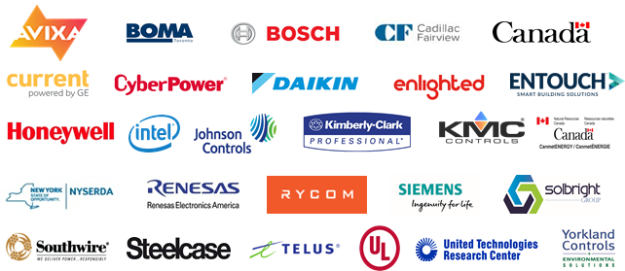
5. Research Update Harsha Chandrashekar (Honeywell International Inc.)
5.1 “Intelligent Building Design & Implementation”
www.caba.org/Research

Slide 30
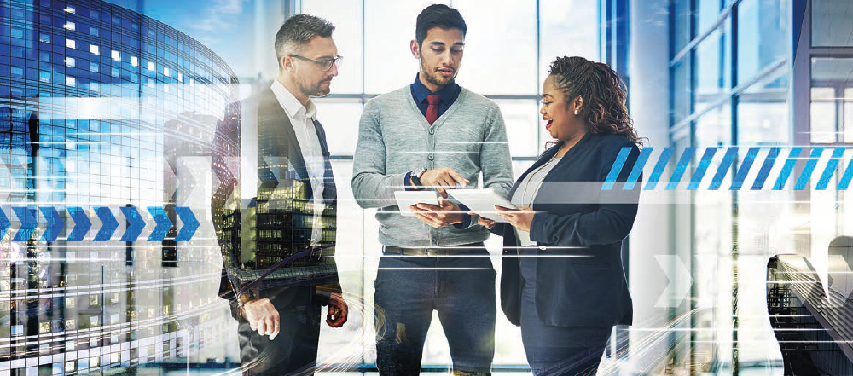
5. Research Update Trevor Nightingale (National Research Council)
5.2 “Phase 2: Improving Organizational Productivity with Building Automation Systems”
www.caba.org/Research

Slide 31
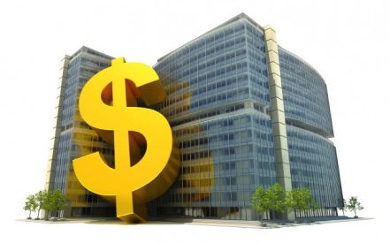
5. Research Update Bob Allan (The Siemon Company)
5.3 “Monetization of Intelligent Buildings” ”
www.caba.org/Research

Slide 32
6. White Paper Sub-Committee Update Ken Wacks (Ken Wacks Associates)
6.1 Recently Completed:
“The Road to Smart Cities”
Electro-Federation Canada
Frost & Sullivan
ABB
AHAM (Association of Home Appliance Manufacturers)
Bristol City Council
Canadian Advanced Technology Alliance (CATA)
Canadian Automated Vehicles Centre of Excellence (CAVCOE)
Canadian Chamber of Commerce
Canadian Electricity Association
Canadian Open Data Exchange (ODX)
Canadian Urban Institute
Canadian Water Quality Association
City of Atlanta
City of Edmonton
City of Toronto
City of Vaughan
Consultant (Former Manitoba Hydro)
Consumer Technology Association (CTA)
CSA Group
Ernst & Young LLP
Etron Energy Corp.
Information Technology Association of Canada
JLL
National Research Council of Canada
Navigant Research
Ontario Ministry of Research and Innovation
Retail Council of Canada
Robert H. Lane and Associates Inc.
Smart Cities Council
Smart Cities Management Consultant
Sustainable Resources Management Inc.
TM Forum
Unmanned Systems Canada

Slide 33
6. White Paper Sub-Committee Update Ken Wacks (Ken Wacks Associates)
6.2 Recently Completed:
“Development and Training of a Knowledge-based Workforce for the Intelligent Buildings and Connected Home Industries”
Bedrock Learning, Inc.
ESPA (The Electronic Systems Professional Alliance)
Texas A&M University
Wharton County Junior College
Algonquin College
Automation Federation
British Columbia Institute of Technology
CEES-Advisors
College of DuPage
Complete Learning Solutions
ETA International
George Brown College
Heartland Community College
Irvine Valley College
Lambton College
Laney College - BEST Center
LonMark International
QUEST
Rio Hondo Community College District
Robert H. Lane and Associates Inc.
Seneca College
Siemens Industry, Inc.
Sustainable Resources Management

Slide 34
6. White Paper Sub-Committee Update Ken Wacks (Ken Wacks Associates)
6.3 Recently Completed:
“A New Deal for Buildings”Modelling Bandwidth Demand Generated by Intelligent Buildings”
Cimetrics, Inc.
Fulham
Honeywell International Inc.
Johnson Controls Inc.
Johnson Controls Inc.
LonMark International
SkyFoundry, LLC
Sustainable Resources Management Inc.
Yorkland Controls Limited

Slide 35
6. White Paper Sub-Committee Update Ken Wacks (Ken Wacks Associates)
6.4 In Progress:
“Elevator Systems for Future Intelligent Buildings - Part 1, 2, and 3” – 3 papers
International Association of Elevator Engineers
The University of Northampton

Slide 36
6. White Paper Sub-Committee Update Ken Wacks (Ken Wacks Associates)
6.5 In Progress:
“Modelling Bandwidth Demand Generated by Intelligent Buildings”
Nordicity Group Limited
BetaRover Inc
Brookfield Global Integrated Solutions
MechoSystems, Inc.
Mircom
Open Connectivity Foundation
Paremus
PLC Multipoint, Inc.
Sustainable Resources Management Inc.
Syska Hennessy Group, Inc.
Texas A&M University
The Siemon Company
Western University

Slide 37
6. White Paper Sub-Committee Update Ken Wacks (Ken Wacks Associates)
6.3 In Progress:
“Impacts of Automated Shading in Building Projects”
Somfy Systems, Inc.
Lawrence Berkeley National Laboratory
MechoSystems, Inc.
NYSERDA
PLC Multipoint, Inc.
Siemens Industry, Inc.
Sustainable Resources Management
TRC Energy Services
Vistar Energy Consulting
Window Products Management

Slide 38
6. White Paper Sub-Committee Update Ken Wacks (Ken Wacks Associates)
All proposals and previously completed IBC White Papers can be downloaded at:
www.caba.org/White-Papers

Slide 39
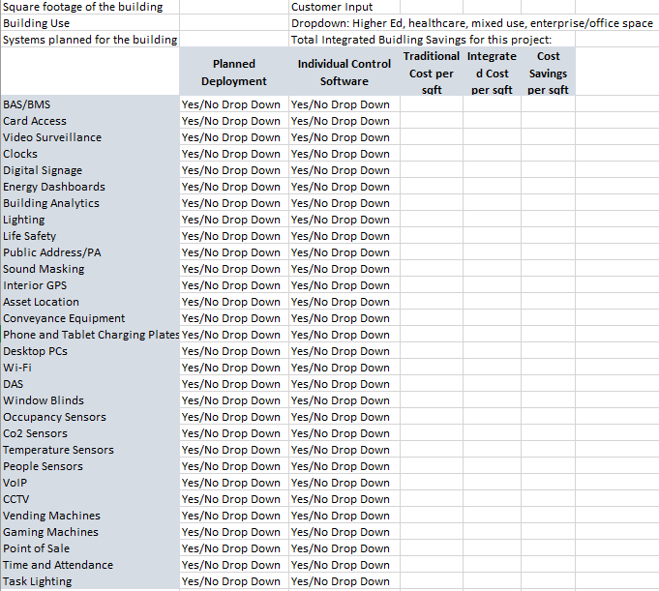
7. Intelligent vs Conventional Building Cost Calculator Task Force Bob Allan (The Siemon Company)

Slide 40
8. New Business Trevor Nightingale (National Research Council)
8.1 CABA decision on BIQ
8.2 New IBC business?

Slide 41
9. Announcements Ron Zimmer (CABA), Greg Walker (CABA)
9.1 Past Event Overview:
AHR EXPO, Jan 22-24, 2018, Chicago, IL
DistribuTECH, Jan 23-25, 2018, San Antonio, TX

Slide 42
9. Announcements Ron Zimmer (CABA), Greg Walker (CABA)
9.2 Upcoming events:
Strategies in Light / The LED Show, Feb 13-15, Long Beach, CA
LIGHTFAIR International, May 6-7, Chicago, IL
Innovative Cities Summit 2018, May 9-10, Riyadh, Kingdom of Saudi Arabia
TM FORUM LIVE!, May 14-16, Nice, France
IBcon 2018 – Realcomm, June 6-7, Las Vegas, NV
Light + Building, March 18-23, 2018, Frankfurt, Germany
Next IBC Meeting, May 2018

Slide 43
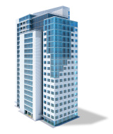
10. Adjournment Trevor Nightingale (National Research Council)
Continental Automated Buildings Association (CABA) 613.686.1814 Toll free: 888.798.CABA (2222)
caba@caba.org www.CABA.org
www.caba.org/IBC
Connect to what’s next™

