Slide 1
Connected Home Council (CHC) Webinar
Chair: Jay McLellan (Leviton Manufacturing Co., Inc.)
Vice-Chair: Obiorah Ike (ABB, Inc.)
Vice-Chair: Roy Perry (Alarm.com, Inc.)

Slide 2
1. Agenda Greg Walker (CABA)
1. Agenda
2. Call to Order, Welcome, Introductions, about CHC
3. Administrative
“Make Every Space a Smart Space” (30 min),
Greg Rhoades (Leviton Manufacturing Co., Inc.)
5. Research Update
6. White Paper Sub-Committee Update
7. New Business
8. Announcements
9. Adjournment

Slide 3
2. Call to Order, Welcome, Introductions, About the CHC Jay McLellan (Leviton Manufacturing Co., Inc.)
CHC Vice-Chair
Jay McLellan
VP, Energy Management, Controls and Automation Leviton Manufacturing Co., Inc.
CHC Vice-Chair
Obiorah Ike
Product Marketing Manager
ABB Inc.
CHC Vice-Chair
Roy Perry
VP Ecosystem Alliances
Alarm.com
Past CHC Chair
Yann Kulp
Director Strategy & Biz Dev North America
Schneider Electric
Established in 2004, the CABA Connected Home Council initiates and reviews projects that relate to connected home and multiple dwelling unit technologies and applications. The Council also examines industry opportunities that can accelerate the adoption of new technologies, consumer electronics and broadband services within the burgeoning connected home market.
http://www.caba.org/CHC

Slide 4
3. Administrative Jay McLellan (Leviton Manufacturing Co., Inc.)
3.1 Motion to approve past CHC Minutes:
www.caba.org/chc

Slide 5
4. “Make Every Space a Smart Space” (30 min) Greg Rhoades (Leviton Manufacturing Co., Inc.)

Slide 6
Make Every Space a Smart Space
CABA CHC Webinar
Notes:
Understand the different technologies
Understand when/why to use each
Know where to go for assistance
Ensure Happy Customers

Slide 7
Our industry continues to evolve
Customers demand product with greater functionality and built-in intelligence.
Smart structures whether homes, offices, hospitals or theaters - require innovative power, data and wireless solutions, all while consuming less energy and taking less time to install
Many trends begin in RESI and move to commercial
Changing markets demanding energy code requirements and advancing technologies present unlimited opportunities
Cutting-edge innovations combined with outstanding service and support position Leviton for success

Slide 8
Builder Landscape
Wi-Fi has become the “4th Utility” mapped on floorplans alongside gas, electrical and water
Wi-Fi Alliance Certified Home Plans
No dead zones – smart device adoption
Structured media still part of equation
What used to be 10-12 drops is now 2-4
4K TV in Living, high-performance to den
Builders peppering into select homes with 2-6 devices per home
Yesterday: $10,000+ for panel, switches, installation, maintenance,.
Today: 10x smart switches = $500; 2x smart switches = $100; free app/firmware upgrades

Slide 9
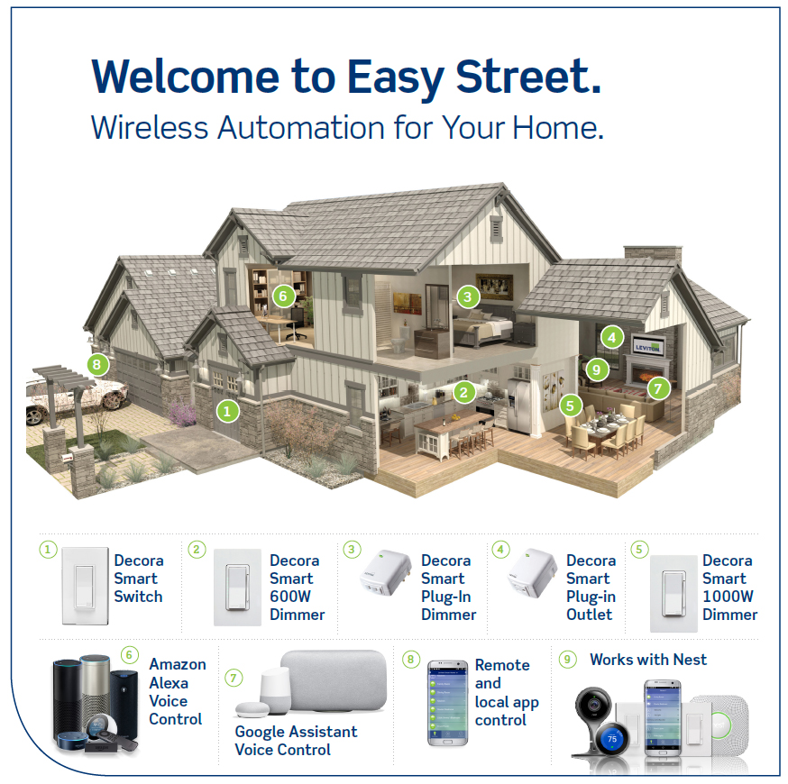
The Whole House Experience
Smart Dimmers & Switches
In-Wall and Plug-In
Extension of Decora® family, capitalizing on adoption
Control from anywhere, schedule lights to turn on when you want them
Amazon Echo / Google Home as Home Hub
Becoming the aggregator
Leveraging Voice partnerships
Notes:
#1 device application: Porch Light
#1 schedule: All Off
Majority utilizing voice control
Alexa is #1 Decora Smart Wi-Fi partner

Slide 10
Smart Use Cases
Wi-Fi Wake up Call
Kitchen of the Year
Happy Homebodies
3 AM Pranks
Dimmers and schedules to wake children
Automatically turn off floor fans each AM
Run movie time in man cave to adjust all lights
House Beautiful magazine
Specialized fixtures and crucial dimming scenarios
Used dimmers, iPad and Apple Watch to create “party mode”
Playroom + Nursery feature plug-in devices + Alexa
Dimmers + Switches in master bedroom
YouTube sensations, viral video (2.5m+ views)
Plug-ins on TV’s and computers to prank kids
Dimmers and Alexa to prank kids at night

Slide 11
Smart Product Overview
Technology Overview + Purpose

Slide 12
A New Day in Home Automation
Apps + Cloud
Explosion of Products
My Home
Overtaking high-end professionally installed systems
Selecting a technology can be confusing - no one true standard has yet emerged
New smart devices match existing devices in homes and feature a familiar appearance. Aesthetics matter.

Slide 13
Why Multiple Technologies?
Home Improvement Options
Computers in 1983
Today’s Smart Home
There are many hammers, screwdrivers, faucets, windows, locksets and hardware. The same is true with automation – variety and choice to meet customer preference.
Many companies that accomplished similar results using different technology (IBM, Tandy, Commodore…). One size still does not fit all (Apple, Microsoft, Android).
Pure, dedicated solutions to meet the customer’s unique application.

Slide 14
They Meet Specific Consumer Needs and Desires
Bluetooth
Z-Wave Plus
Wi-Fi
HomeKit
Timer replacement with app
Hub market industry leader
Hubless technology with an architecture to allow integration with popular IoT products and services
Tightly integrated with iOS to simplify installation and user experience

Slide 15
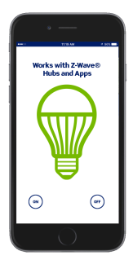
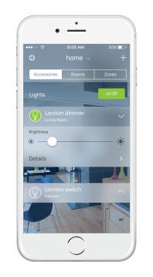
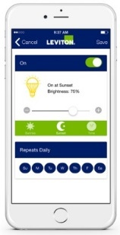
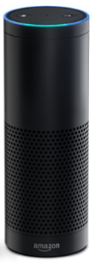
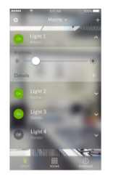
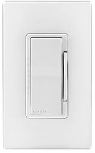
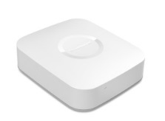
Platforms and Communication Pathways

Slide 16
Decora® Digital with Bluetooth
Benefits + Value Propositions:
Perfect retrofit option
With no need for a hub, gateway or internet connection, Bluetooth bridges the gap between traditional dimmers and whole-home automation systems
Combines universal compatibility, premium digital dimming, 24-hour programmable timing and a countdown timer in one smart device
Choose from dimmers, switches, a fan speed control and compatible remotes

Slide 17
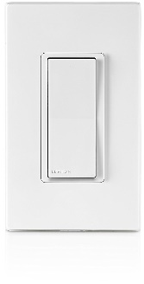
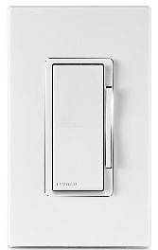
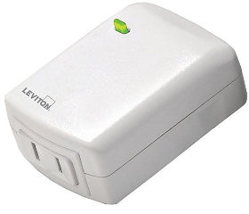
Decora Smart™ with Z-Wave Plus Technology
Leading residential home automation technology for hub applications
Compatible with prominent hubs and security systems
SmartThings, Wink...
Major in-roads with electrical contractors and builders; many systems installed over decade +
15 Amp Switch, DZ15S
600 Watt Dimmer, DZ6HD
1000 Watt Dimmer, DZ1KD
Plug-In Outlet, DZPA1
Plug-In Dimmer, DZPD3
Outlet, DZR15 *Z-Wave

Slide 18
Decora Smart™ with Wi-Fi Technology
Hubless automation
Schedules, remote access, voice activation
All you need is a device, Wi-Fi, internet, and mobile device
Partners: Alexa, Google Assistant, SmartThings, Nest, IFTTT
Devices are truly smart
Schedules and clocks reside in the device
Schedules run even when internet is down
Devices work manually as long as there is power
Minimal bandwidth usage
Per month, less than sending a single cell phone picture
Highly reliable and utilizes electronic banking security tech
Will not affect network performance
My Leviton runs on Amazon Web Services
15 Amp Switch, DW15S
600 Watt Dimmer, DW6HD
1000 Watt Dimmer, DW1KD
Plug-In Outlet, DW15A
Plug-In Dimmer, DW3HL
Voice Control

Slide 19
Decora Smart™ with HomeKit
Benefits + Value Propositions:
Direct involvement with Apple, no intermediary cloud or “new” accounts
Ease of installation and enrollment
All setup done via app + camera
No need for Wi-Fi password if iOS device is on the Wi-Fi network
Apple controls interoperability and user experience via HomeKit tech/Home app
Siri Voice Control on iPhone or iPad - turn on/off and dim/brighten
Scenes for common lifestyle activities

Slide 20
Platforms and Communication Pathways
Technology
Application Focus | Single Family | Single Family, MDU | Single Family, MDU | Single Family, MDU, Small Commercial
Driving Adoption | Simplicity | Interoperability | Apple cache | Voice control
3rd Party Integration | n/a | Hub dependent | Apple Home app | IFTTT, Samsung, Google, Amazon
Primary Benefits | Simplicity - single device control | Hub-based wireless technology allows products to interoperate | iOS home automation platform for a common user experience | Remote access, scheduling, voice control, cloud integration

Slide 21
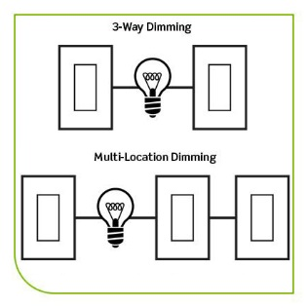
Multi-Location Control
3-Way Explanation:
Two devices control the same light fixture(s)
Staircase, hallway, or great room
Affordability and Ease:
Multi-location control achieved with low-cost universal 3-way+ remotes that work with all protocols
DD00R (Dimmer)
DD0SR (Switch)

Slide 22
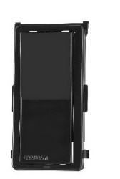
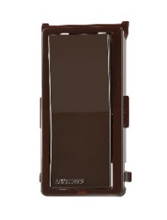
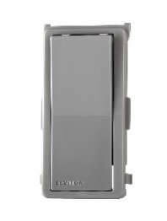
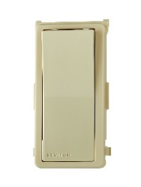
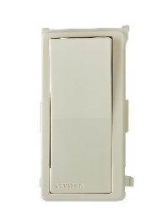
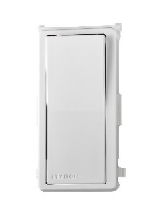
A Common Aesthetic Platform – Match Every Device
Look for smart products that function like regular devices and match common “non-intelligent” devices
Easily turn on lights in the dark
Ensure true color matching, smart/non-intelligent ganging, multiple colors and a wide array of wallplate and accessory selections
Black, Gray, Ivory, Brown, Light Almond, White
Mix/match with screwless wallplates for a designer look

Slide 23
Wi-Fi App: Enroll, Schedule, Control
App Setup Process – basic and advanced

Slide 24
Wi-Fi App Setup
Control 20 residences; 99 devices per residence
Simple wizard-based solution
iOS and Android
Phone or Tablet
Create an Account / Residence:
Download the “My Leviton” App
Create account
Create residence
Verify email account

Slide 25
Add a Device to App
Press “+” then “Add Device”
Device will have a quickly flashing green LED
If not, reset (hold down top paddle or button)
Find Device in Wi-Fi Settings (Leviton XXXX)
Connect to Wi-Fi Network
Name the Leviton device – example: “Lamp”
Now can control Leviton device from anywhere
Notes:
T

Slide 26
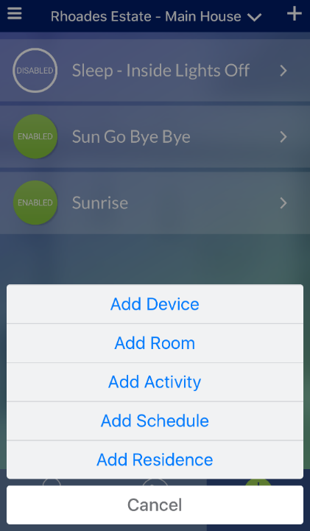
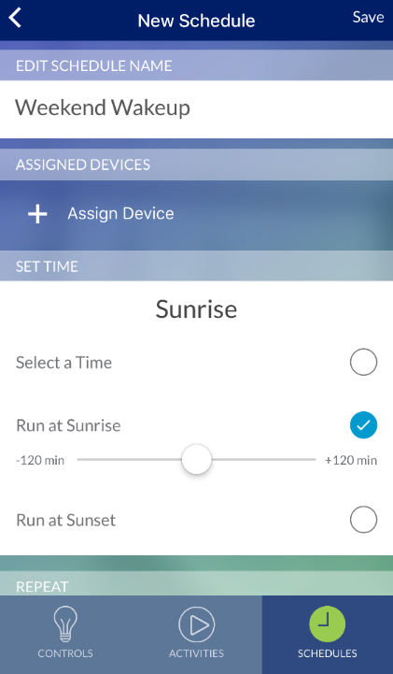
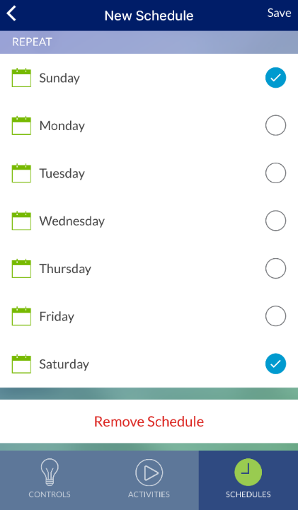
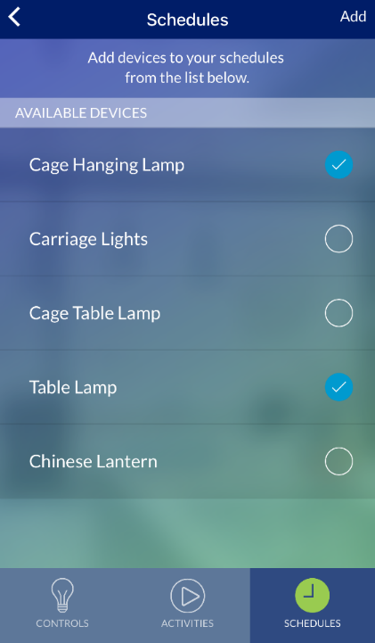
Create a Time (or Sun) Based Schedule
Schedule lights and connected loads to turn on/off
Specific times or based on sunrise/sunset (with adjustable times)
<
<
<
<
<
Notes:
T

Slide 27
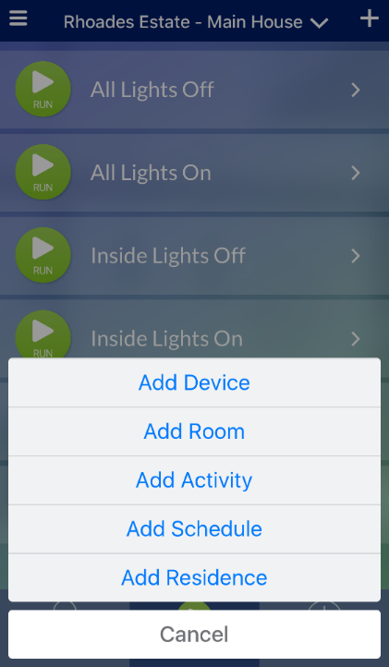
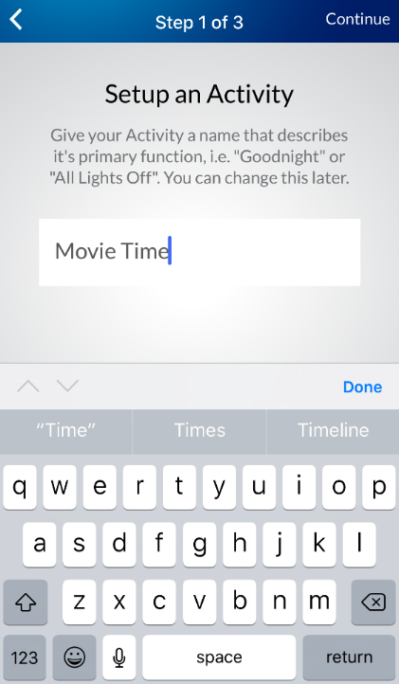
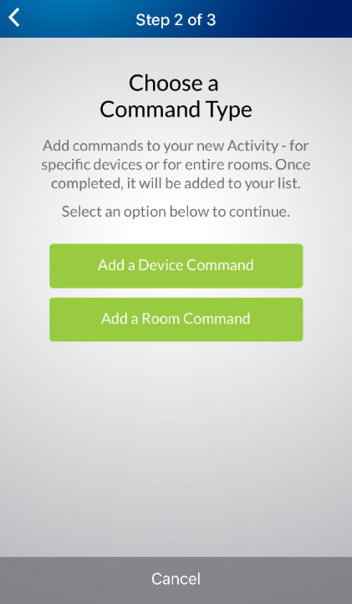
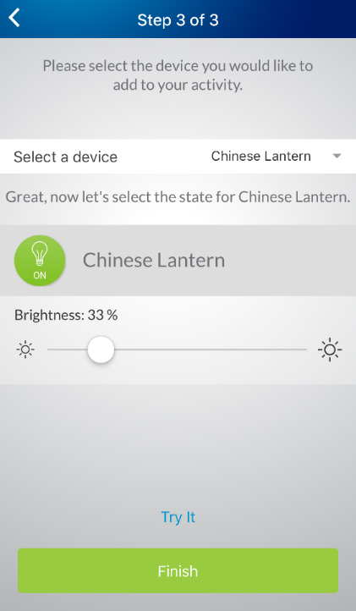
Create On-Demand Activities
Trigger multiple lights and loads at once for movie time, party mode, or goodnight.
<
<
<
Notes:
T

Slide 28
Wi-Fi App Custom Settings
If desired, devices can be customized!
Dim/Bright Bar LEDs: On, Off, Vanish 1-25s
Status LED: Off, Indicator, Locator
Bulb Type Selection: LED, CFL, Inc, etc.
Fade On/Off Rate: 0-25s
Preset Level: Previous value or specified
Min/Max Level: bright light, top out
Auto-Shutoff Timer: 1 min to 12 hours
Notes:
T

Slide 29
Wi-Fi: Integrations + Partners
Direct Integrations and Using Alexa Routines + App For Automation + Visual Control
Notes:
G

Slide 30
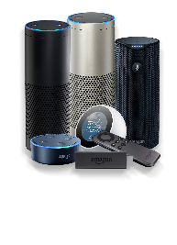
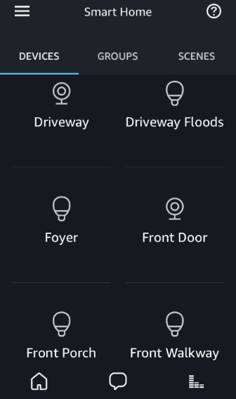
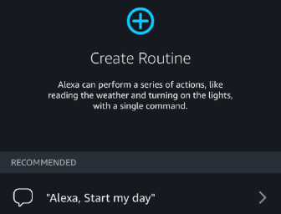
Voice is Getting Smarter + Becoming the Hub
Leviton partners with leading smart providers to leverage growing eco-systems:
Alexa, Google Assistant, Nest, Samsung SmartThings, IFTTT & More
Amazon Alexa and Google Assistant are positioning to be center of the smart home – not just voice.
Alexa visual interface provides 1 single location for controlling lights, locks, cams…
In-app control of smart devices including Leviton (on/off/bright/dim)
“Scenes”, “routines” integrate all products & services, not just smart home
Good Morning Routine Example: Weather, Turn on Lights, Read News, etc.
New products being introduced via Alexa Voice Services can control Decora Smart with Wi-Fi – cars, TV’s, watches, speakers, etc.
Notes:
G

Slide 31
Driving the Sale
Training + Marketing Information to Assist Your Sales Consulting Process
Notes:
G

Slide 32
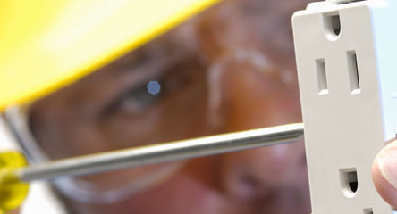
Leviton Educational Content – Webinars + Videos
How-to Videos, 3-5 min
EZ-Learn Training
In-Person Training
Hardware Install – Single Pole, 3-Way
Wi-Fi App - Setup + Advanced
Integration videos - Alexa, Google, Nest, etc.
Contractor Trainings around the country
Leviton LIVE New Orleans
Wireless 101 + 201 Sessions
On-Demand In-Depth Learning
Notes:
G

Slide 33
Step-by-Step App + Quick Start Guides
Wi-Fi
HomeKit
SmartThings/Z-Wave
Step-By-Step PDF of setup and programming process
Step-By-Step PDF of setup and programming process
Quick Start Guide – hardware install and app
Page 2 includes all Leviton compatible products for ease of purchase
Notes:
G

Slide 34
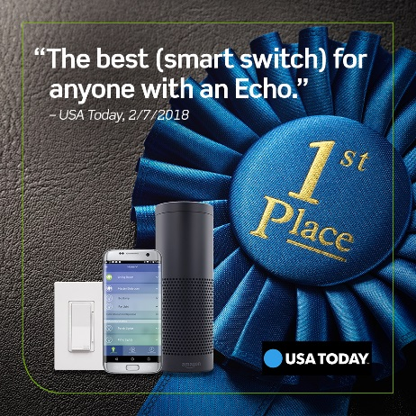
Leviton Decora Smart “In the News”
CNet
USA
Good Housekeeping
House Beautiful
“We loved how simple it was to set up and connect to Wi-Fi.”
Fast, Easy Makeovers to Try this Weekend
“Still, Leviton’s switches cost notably less than competitors.”
Leviton Decora Smart switches sync up with Nest
Interior designer promotes Wi-Fi and USB devices
How to Choose the Best Fixtures for your Home
“A light switch that makes your house feel like it’s from the future.”
Best Smart Switch!
Notes:
G

Slide 35
We Can Make Every Home a Smart Home
You and Leviton Together!
Thank you!
Notes:
T

Slide 36
4. “Make Every Space a Smart Space” (30 min) Greg Rhoades (Leviton Manufacturing Co., Inc.)
Questions?

Slide 37
5. Research Update Obiorah Ike (ABB, Inc)
5.1 “Connected Home Roadmap” CHC Research
www.caba.org/research

Slide 38
5. Research Update Jay McLellan (Leviton Manufacturing Co., Inc.)
5.2 2019 CHC Landmark Research Topic?

Slide 39
6. White Paper Sub-Committee Update Derek Cowburn (Lumen Cache, Inc.)
6.1 Recently Completed:
“The future delivery/business models for Smart Home services and infrastructure”
Asian Institute of Intelligent Buildings (AIIB)
BC Hydro
Bedrock Learning, Inc.
BeHome247, Inc.
CaSA Connected Appliances Ltd
Frost & Sullivan
Independent Consultant
Intermatic Inc.
Northeast Energy Efficient Partnerships (NEEP)
Paremus
Schneider Electric
Sustainable Resources Management Inc.
Sykes Assistance Services Corporation
The Chamberlain Group Inc.
Z-Wave Alliance
www.caba.org/WhitePapers

Slide 40
6. White Paper Sub-Committee Update Derek Cowburn (Lumen Cache, Inc.)
6.2 In Progress:
“IOT cyber security guidelines, standards and verification systems”
Agelight Digital Trust Advisory Group
ARC Advisory Group
ArcoLogix LLC
Automation Standards Compliance Institute
BC Hydro
CANASA (Canadian Security Association)
Compass Intelligence, LLC
Consultant
Control4
CopperTree Analytics Inc.
CSA Group
Domotz
eMcRey
EXP
George Brown College
Honeywell International Inc.
Johnson Controls Inc.
Ken Wacks Associates
LonMark International
National Electrical Manufacturers Association (NEMA)
RYCOM Corporation
Sustainable Resources Management Inc.
Syska Hennessy Group
TC9, Inc
The Siemon Company
www.caba.org/WhitePapers

Slide 41
6. White Paper Sub-Committee Update Derek Cowburn (Lumen Cache, Inc.)
All proposals and previously completed CHC White Papers can be downloaded at:
www.caba.org/WhitePapers

Slide 42
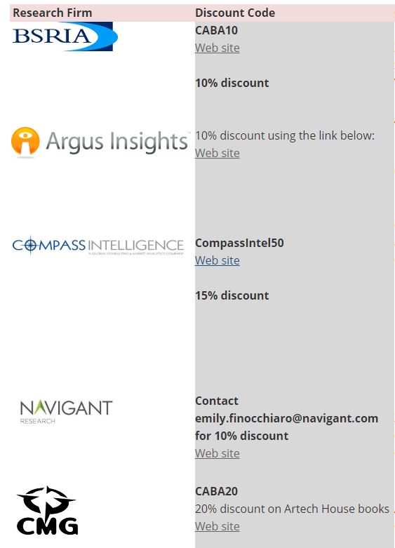
7. New Business Andrew Glennie (CABA)
7.1 Featured CABA Member Benefit
CABA Affinity Program
The CABA Affinity Program allows CABA member research firms to offer discounts to CABA members. Participating CABA member research firms provide CABA members with a promotional code for a set percent discount off their research. CABA has a wide range of research firms as members.
www.caba.org/Affinity

Slide 43
7. New Business Jay McLellan (Leviton Manufacturing Co., Inc.)
7.2 Other new CHC business?

Slide 44
8. Announcements Ron Zimmer (CABA)
8.1 Past Event Overview:
Shanghai Smart Home Technology, Sept 3-5, 2018, Shanghai, China
CEDIA Expo, Sept 4-8, San Diego, CA
8.2 Upcoming events:
CES International 2019, Jan 8-11, Las Vegas, NV
The NAHB International Builders' Show (IBS), Feb 19-21, Las Vegas, NV
The Kitchen & Bath Industry Show (KBIS), Feb 19-21, Las Vegas, NV

Slide 45
9. Adjournment Jay McLellan (Leviton Manufacturing Co., Inc.)
Next CHC Meeting, Jan 2019
Continental Automated Buildings Association (CABA) caba@caba.org www.CABA.org
www.caba.org/chc
Connect to what’s next™

