Slide 1
Connected Home Council (CHC)
Chair: Yann Kulp (Schneider Electric)
Vice-Chair: Obiorah Ike (ABB, Inc.)
Vice-Chair: Roy Perry (Alarm.com, Inc.)
Vice-Chair: Jay McLellan (Leviton Manufacturing Co., Inc.)

Slide 2
1. Agenda
Greg Walker (CABA)

Slide 3
1. Agenda Greg Walker (CABA)
1. Agenda
2. Call to Order, Welcome, Introductions, about CHC
3. Administrative
4. “Artificial Intelligence and the Connected Home” (30 min)
Research Update
6. White Paper Sub-Committee Update
7. New Business
8. Announcements
9. Adjournment

Slide 4
2. Call to Order, Welcome, Introductions
Yann Kulp (Schneider Electric)

Slide 5
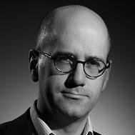
2. Call to Order, Welcome, Introductions, About the CHC Yann Kulp (Schneider Electric)
CHC Chair
Yann Kulp
VP of Strategy
Schneider Electric
CHC Vice-Chair
Obiorah Ike
Product Marketing Manager
ABB Inc.
CHC Vice-Chair
Roy Perry
VP Ecosystem Alliances
Alarm.com
CHC Vice-Chair
Jay McLellan
VP, Energy Management, Controls and Automation Leviton Manufacturing Co., Inc.
Established in 2004, the CABA Connected Home Council initiates and reviews projects that relate to connected home and multiple dwelling unit technologies and applications. The Council also examines industry opportunities that can accelerate the adoption of new technologies, consumer electronics and broadband services within the burgeoning connected home market.
http://www.caba.org/CHC

Slide 6
3. Administrative
Yann Kulp (Schneider Electric)
Jay McLellan (Leviton Manufacturing Co., Inc.)

Slide 7
3. Administrative Yann Kulp (Schneider Electric) Jay McLellan (Leviton Manufacturing Co., Inc.)
3.1 Motion to approve past CHC Minutes:
www.caba.org/chc
3.2 Introduction of the newly appointed CHC Vice- Chair, Jay McLellan (Leviton Manufacturing Co., Inc.)

Slide 8
4. “Artificial Intelligence and the Connected Home” (30 min)
Anne Breene (ArcoLogix, LLC)

Slide 9
ARTIFICIAL INTELLIGENCE AND THE IOT CONNECTED HOME
Preview of Caba white paper
Connected home Council
February 22, 2018
© 2018 L. A. Breene - All Rights Reserved

Slide 10
Agenda
Definitions:
Internet of Things (IoT) & Connected Home
Including a brief technical overview
Artificial Intelligence (AI)
Discussion of AI and XAI
AI Subfields & Methods
AI Planning & Decision Making
XAI – Explainable AI, DARPA
Regulation
Ethical AI
Conclusions

Slide 11
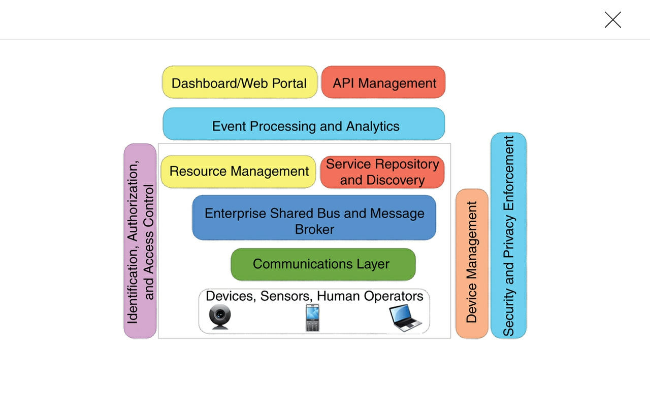
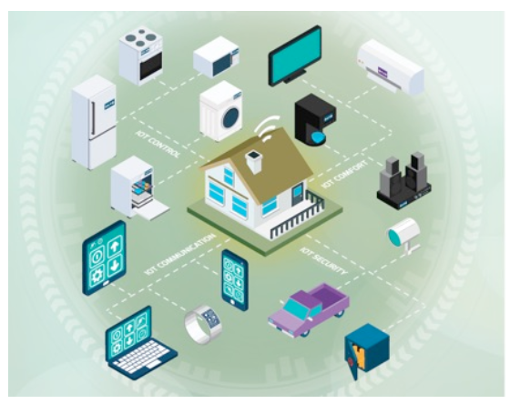
Internet of things (IoT/e) & Connected Home Definition
“the Internet of Things quite literally means ‘things’ or ‘objects’ that connect to the Internet — and each other. This could be almost anything — a computer, … smartphone, … door lock … to name a few.
Communication typically takes place in three different ways : machine to machine (M2M), human to machine (H2M), and machine to smartphone (M2S) or other device… The sum of all this is the Internet of Everything (IoE).”
Internet of Things: Principles and Paradigms.
Buyya, R. and Dastjerdi, A.V. Eds. Elsevier. 2017.
A Connected Home is one that is a part of the IoT.
-- The Internet of Things, Greengard, Samuel,
The MIT Press, 2015, k.loc. 275.

Slide 12
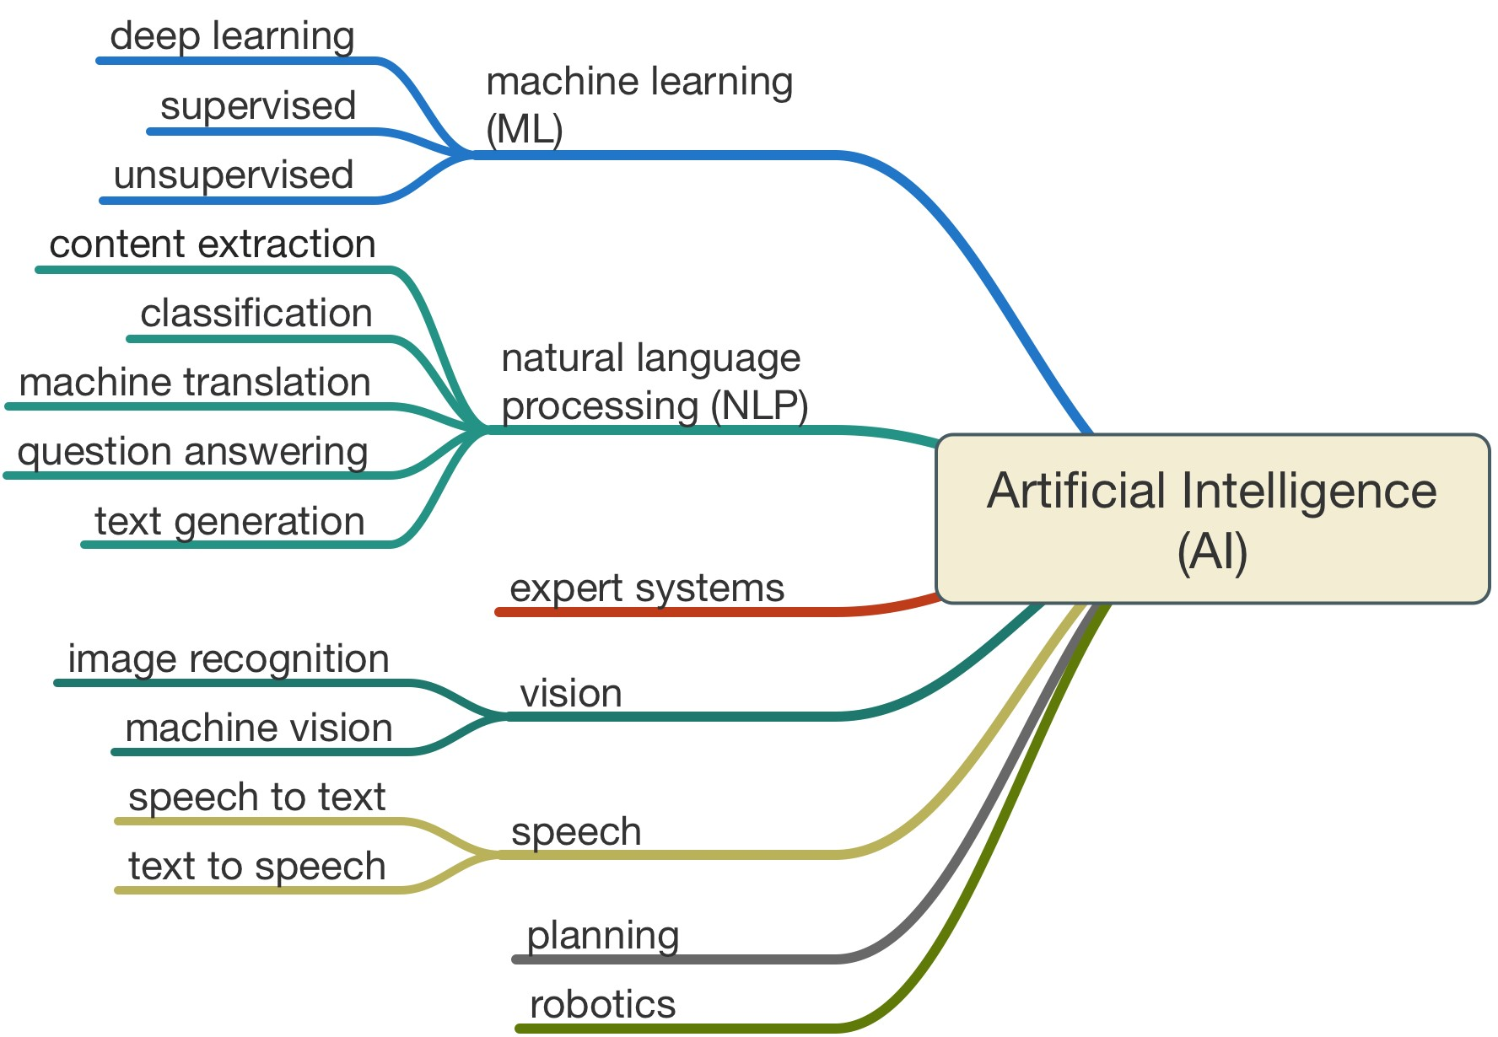
Artificial Intelligence definition
Artificial intelligence, or AI, is the field that studies the synthesis and analysis of computational agents that act intelligently.
A computational agent is an agent whose decisions about its actions can be explained in terms of computation.
An agent acts intelligently when
what it does is appropriate for its circumstances and its goals,
it is flexible to changing environments & goals,
it learns from experience,
and it makes appropriate choices given its perceptual and computational limitations.
An agent typically cannot observe the state of the world directly;
it has only a finite memory
and it does not have unlimited time to act.
Poole, David L. , Artificial Intelligence, Cambridge University Press, 2010, (kindle location 257).
Stock image appearing widely on the web.
Many ML researchers would prefer to replace AI with ML.
Artificial - humanly contrived often on a natural model - Merriam Webster
Intelligence – not understood

Slide 13
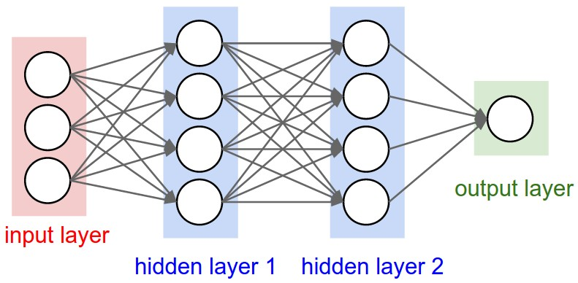
Machine learning
“In the past decade, machine learning has given us self-driving cars, practical speech recognition, effective web search, and a vastly improved understanding of the human genome. Machine learning is so pervasive today that you probably use it dozens of times a day without knowing it. Many researchers also think it is the best way to make progress towards human-level AI.
Topics include:
Supervised learning (parametric/non-parametric algorithms, support vector machines, kernels, neural networks).
Unsupervised learning (clustering, dimensionality reduction, recommender systems, deep learning).
Best practices in machine learning (bias/variance theory; innovation process in machine learning and AI).
The course will also draw from numerous case studies and applications, so that you'll also learn how to apply learning algorithms to building smart robots (perception, control), text understanding (web search, anti-spam), computer vision, medical informatics, audio, database mining, and other areas.” – Dr. Andrew Ng, Stanford and Coursera, Machine Learning Course Introduction, 2018.
Neural Network Example
“Machine learning systems … are extensions of expert systems in decision making in two ways: first, they need not be programmed but can learn from examples, and second, because they use probability theory, they are better in representing real - world settings with all the concomitant noise, exceptions, ambiguities, and resulting uncertainty.”
From: Machine Learning: The New AI, Alpaydin, Ethem, MIT Press, 2016, (kindle location 738).

Slide 14
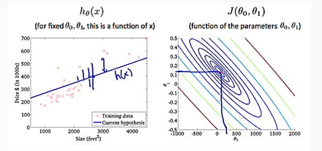
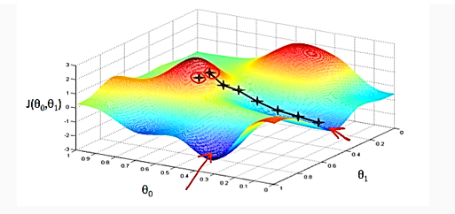
Linear Regression - Supervised
So we have our hypothesis function and we have a way of measuring how well it fits into the data. Now we need to estimate the parameters in the hypothesis function. That's where gradient descent comes in.
Imagine that we graph our hypothesis function based on its fields θ0 and θ1 (actually we are graphing the cost function as a function of the parameter estimates). We are not graphing x and y itself, but the parameter range of our hypothesis function and the cost resulting from selecting a particular set of parameters.
Dr. Andrew Ng – Stanford & Coursera, Machine Learning, excerpt.

Slide 15
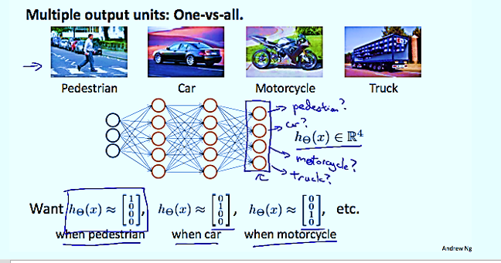
Neural network example - unsupervised

Slide 16
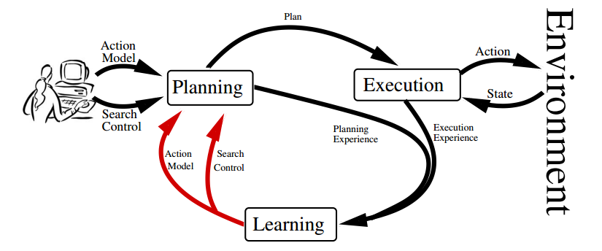
Planning and Decision Making
“In order to successfully complete tasks, autonomous agents require the capacity to reason about their environment and the consequences of their actions, as well as the desirability of those consequences. The field of decision theory uses probabilistic models of the environment, called decision problems, to formalize the tasks about which such agents reason. Furthermore, the desirability of actions and their effects are modeled as numerical feedback signals. These feedback signals are typically referred to as reward, utility, payoff, or cost functions. Solving a decision problem consists of finding a policy, i.e., rules for how to behave in each state, that is optimal in some sense with respect to these feedback signals.”
A Review of Machine Learning for Automated Planning, Sergio Jimenez,
et al, The Knowledge Engineering Review, Vol. 00:0, 1–24. c 2009, Cambridge University Press, p. 3.
Multi-Objective Decision Making, Roijers, D. and Whiteson, S., Synthesis Lectures on Artificial Intelligence and Machine Learning, 2017, p.1.

Slide 17
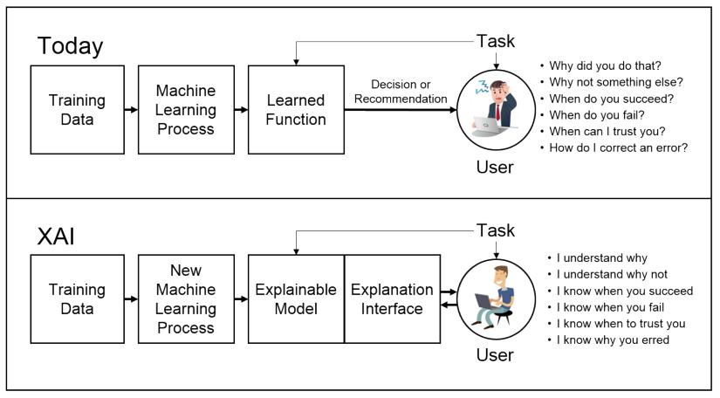
Explainable AI (XAI) defense advanced research projects agency
“DARPA is soliciting innovative research proposals in the areas of machine learning and human computer interaction. The goal of Explainable Artificial Intelligence (XAI) is to create a suite of new or modified machine learning techniques that produce explainable models that, when combined with effective explanation techniques, enable end users to understand, appropriately trust, and effectively manage the emerging generation of Artificial Intelligence (AI) systems. Proposed research should investigate innovative approaches that enable revolutionary advances in science, or systems.”
Broad Agency Announcement
Explainable Artificial Intelligence (XAI)
DARPA-BAA-16-53, August 10, 2016

Slide 18
European Union’s General data protection regulations (gdpr)
Goes into effect on May 25, 2018
The bulk of the language deals with how data is collected and stored, the regulation contains Article 22: Automated individual decision making, including profiling, potentially prohibiting a wide swath of algorithms currently in use in recommendation systems, credit and insurance risk assessments, computational advertising, and social networks, for example.
Citizens have the right to receive an explanation for algorithmic decisions.
ML depends upon data that has been collected from society, and to the extent that society contains inequality, exclusion, or other traces of discrimination, so too will the data.
Goodman, B. and Flaxman, S. 2017. European Union Regulations on Algorithmic Decision Making and a “Right to Explanation”. AI Magazine 38(3): 50-57, Association for the Advancement of Artificial Intelligence.

Slide 19
Ethical artificial intelligence
IEEE TechEthics Program launched in 2016
Goal: To ensure ethical and societal implications are considered in AI design, regulation and deployment
Implications of GDPR
Concerns expressed at first conference:
Who should be held responsible for the harm an application causes by its actions.
Researchers placed 4 black and white stickers on stop sign. A self-driving car interpreted the sign to be a speed limit sign and sped up. How
A Microsoft bot named Tay began learning to engage in pleasant and playful conversations on Twitter and within 24 hours was tweeting misogynist and racist comments it picked up from other Twitter users.
A Facebook research project, in which bots where tasked to learn to negotiate with other bots, the bots developed a language to use to replace English since they deemed it too inefficient. The project was terminated.
A researcher trained a commonly used AI ML technique using public Facebook data to identify Homosexual individuals. Its accuracy was better than a human's and the learning was unsupervised and therefore not understood.

Slide 20
Conclusions and questions
Research is needed in the following areas to aid adoption of AI in the Connected Home:
Network Security and Privacy
IoT Infrastructure
Hybrid Cloud Development – Fog Computing
User Interface
Understanding of Unsupervised Machine Learning
QUESTIONS?

Slide 21
Working group
COMPANY | NAME | TITLE
ArcoLogix | L. Anne Breene | CTO
ArcoLogix | Lawrence Silverman | CEO
Argus Insights, Inc. | John Feland | President
BC Hydro | David Rogers | Senior Engineer
Frost and Sullivan | Konkana Khaund | Consultant
Ken Wacks Associates | Ken Wacks | President
Lumen Cache, Inc. | Derek Cowburn | President
Sustainable Resources Management | David Katz | President and CEO
Thanks to you all for the valuable comments, help, and time.

Slide 22
5. Research Update
Obiorah Ike (ABB, Inc)
Roy Perry (Alarm.com)

Slide 23
5.1 2017 CHC Landmark Research
Obiorah Ike (ABB, Inc)
“Connected Home IoT Energy Roadmap”
www.caba.org/research
CABA Connected Home Council (CHC)

Slide 24
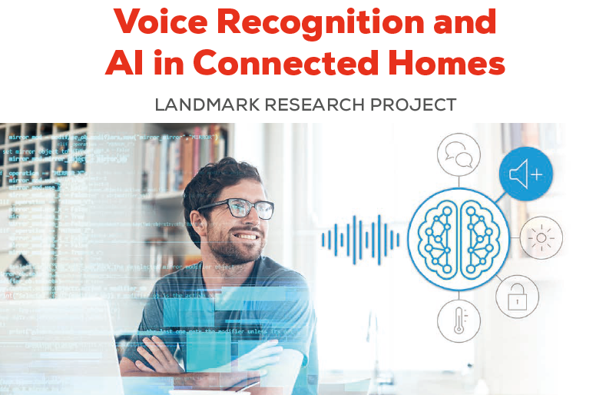
5.2 New 2018 CHC Landmark Research
Roy Perry (Alarm.com)
www.caba.org/research
CABA Connected Home Council (CHC)

Slide 25
6. White Paper Sub-Committee Update
Derek Cowburn (Lumen Cache, Inc.)

Slide 26
CHC White Paper Sub-Committee 6.1 Recently Completed Derek Cowburn (Lumen Cache, Inc.)
“Distribution Trends on the Home Automation Market”
BC Hydro
CSA Group
Independent Consultan
Intel Corporation
Intermatic Inc.
NEEP
Strategy Analytics
Trifecta Research
Z-Wave Alliance
zigbee alliance

Slide 27
CHC White Paper Sub-Committee 6.1 Recently Completed Derek Cowburn (Lumen Cache, Inc.)
“Academic Training for the Connected Home and Intelligent Buildings Industries”
Algonquin College
Automation Federation
Bedrock Learning, Inc.
British Columbia Institute of Technology
CEES-Advisors
College of DuPage
Complete Learning Solutions
ESPA (The Electronic Systems Professional Alliance)
ETA International
George Brown College
Heartland Community College
Irvine Valley College
Lambton College
Laney College - BEST Center
LonMark International
QUEST
Rio Hondo Community College District
Robert H. Lane and Associates Inc.
Seneca College
Siemens Industry, Inc.
Sustainable Resources Management
Texas A&M University
Wharton County Junior College

Slide 28
CHC White Paper Sub-Committee 6.2 In Progress Derek Cowburn (Lumen Cache, Inc.)
“Enabling Homes with Optical Fiber Solutions”
OFS, a Furukawa Company
Frost & Sullivan

Slide 29
CHC White Paper Sub-Committee 6.2 In Progress Derek Cowburn (Lumen Cache, Inc.)
“The future delivery/business models for Smart Home services and infrastructure"
Asian Institute of Intelligent Buildings
BC Hydro
Bedrock Learning, Inc.
Behome247
CaSA
Chamberlain Group, Inc.
Frost & Sullivan
Independent Consultant
Intermatic Inc.
NEEP
Paremus
Schneider Electric
Sustainable Resources Management Inc.
Sykes Assistance Services Corporation
Z-Wave Alliance

Slide 30
CHC White Paper Sub-Committee 6.2 In Progress Derek Cowburn (Lumen Cache, Inc.)
“Artificial Intelligence and the IoT Connected Home”
ArcoLogix LLC
Argus Insights, Inc.
BC Hydro
Frost and Sullivan
Ken Wacks Associates
Lumen Cache Inc.
Sustainable Resources Management

Slide 31
CHC White Paper Sub-Committee 6.2 In Progress Derek Cowburn (Lumen Cache, Inc.)
“Connected Home Use Case Audit”
Argus Insights, Inc.
Core Brands
Agelight Advisory Group / Online Trust & Integrity Working Community
Panasonic Corporation
TELUS
Trifecta Research
Z-Wave Alliance
Schneider Electric

Slide 32
7. New Business
Yann Kulp (Schneider Electric)
Andrew Glennie (CABA)

Slide 33
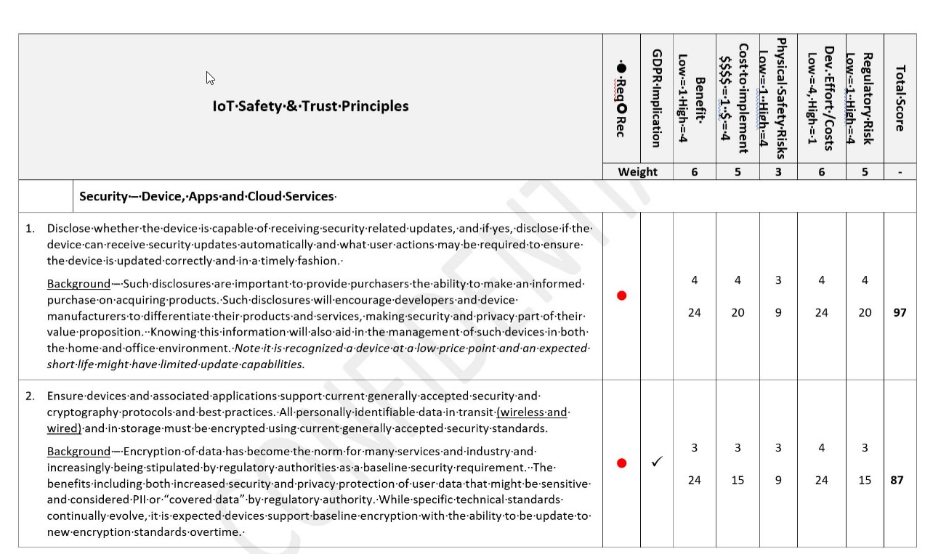
7. New Business Craig Spiezle (Agelight Advisory Group)
7.1 A conceptual scoring model for developers

Slide 34
7. New Business Yann Kulp (Schneider Electric) Andrew Glennie (CABA)
7.2 New CABA Member Benefit: Dealers, Distributors and Integrators access to CABA Member Research Library
7.3 Other new CHC business

Slide 35
8. Announcements
Ron Zimmer (CABA)

Slide 36
8. Announcements Ron Zimmer (CABA)
8.1 Past Event:
CES International 2018
Jan 9-12, Las Vegas, NV
The NAHB International Builders' Show (IBS)
Jan 9 - 11, Orlando, FL
The Kitchen & Bath Industry Show (KBIS)
Jan 9-11, Orlando, FL

Slide 37
8. Announcements Ron Zimmer (CABA)
8.2 Upcoming Event:
CONNECTIONS 2018
May 22-24, San Francisco, CA
CEDIA Expo
Sept 4-8, San Diego, CA
Next CHC Meeting
April 2018

Slide 38
9. Adjournment
Yann Kulp (Schneider Electric)

Slide 39
9. Adjournment Yann Kulp (Schneider Electric)
Continental Automated Buildings Association (CABA) 613.686.1814 Toll free: 888.798.CABA (2222)
caba@caba.org www.CABA.org www.twitter.com/caba_news www.linkedin.com/groups?gid=2121884
www.caba.org/chc
Connect to what’s next™

