Slide 1
Smart Home Summit
“CONNECTED HOME ROADMAP 2019”
November 20, 2019
Ron Zimmer
CABA President & CEO
Connect to what’s nextTM
www.CABA.org

Slide 2





About CABA
CABA (Continental Automated Buildings Association)
Vision
CABA advances the connected home and intelligent buildings sectors.

Slide 3
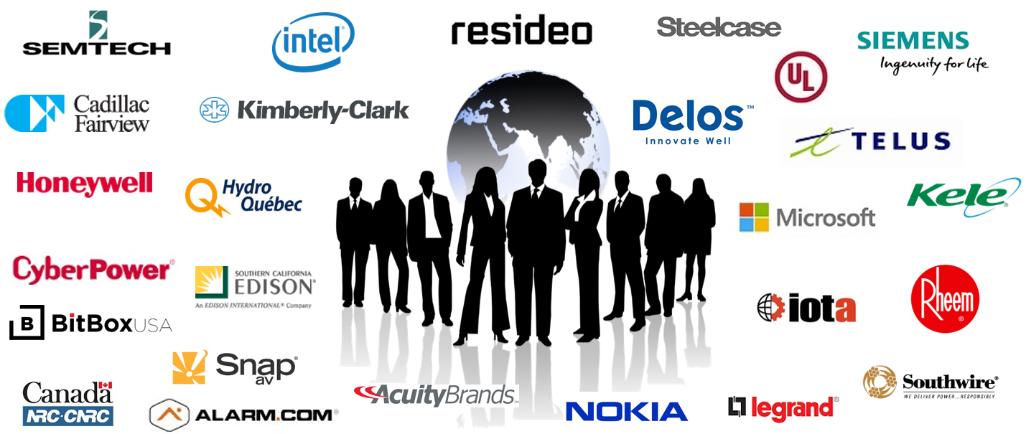
CABA Board of Directors
Notes:
Our BoD feel this could be the most significant piece of research we can create
Different types of organizations
focusing on real ROI
True value of the building
2 spots left: share knowledge and network with key companies and individuals in this space.
---------------------------------------------------------------------------------------------------------------

Slide 4

CABA Connected Home Roadmap
CABA MEMBER FUNDERS:

Slide 5
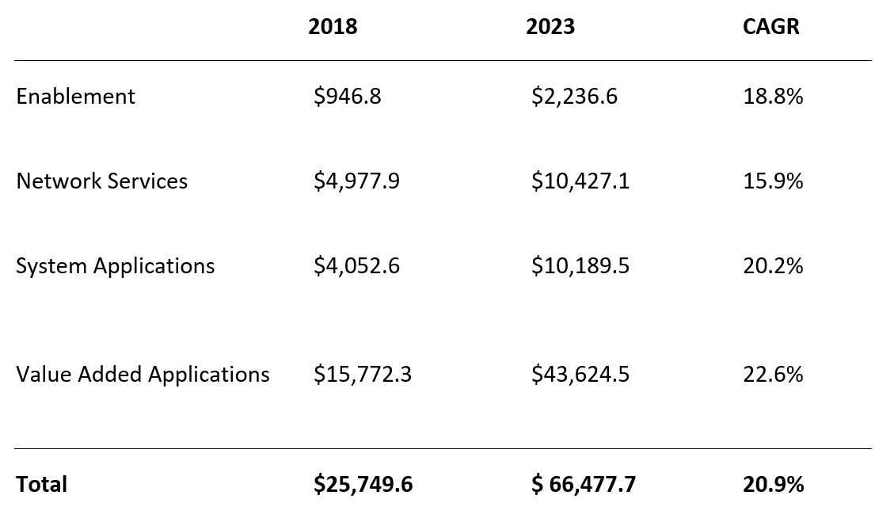
Smart Systems Revenue For Connected Home Will Reach $66.5B In 2023
CHR Report Figure 3-7

Slide 6
Smart Home User Profile Demographic & Behavioral Traits
CHR Report Figure 2-3

Slide 7
Diverse Device Networks Poses Significant Challenges
CHR Report Figure 1-2

Slide 8
Cost & Data Privacy Are Top Reported Pain Points
CHR Report Figure 2-4

Slide 9
Market Development Constrained By Hub-centric Collaboration
CHR Report Figure 1-4

Slide 10
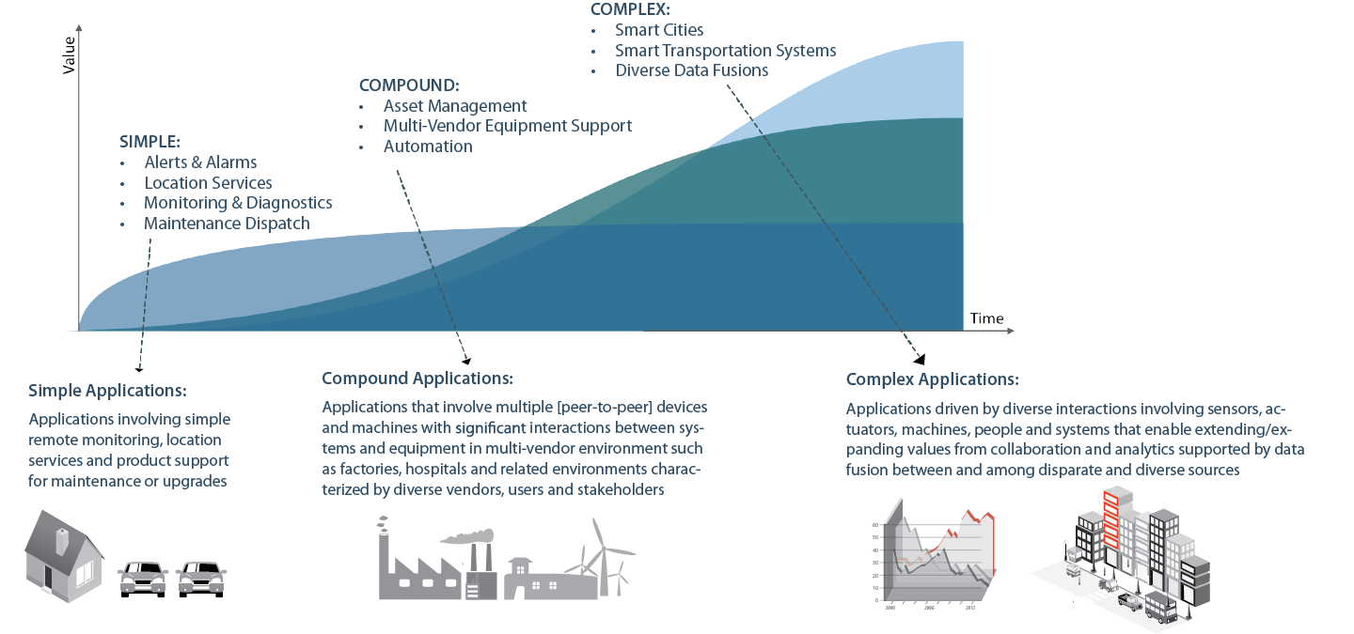





But It’s Still Early In The Game…….
COMPLEX
Supply Chains
Smart Cities
10
Source: CABA Connected Home Roadmap. 2019

Slide 11
Suppliers Can Frame Future Scenarios Around Four Key Trend Areas
CHR Report Figure 3-4

Slide 12
New Technologies Will Enable Complex, Interrelated Applications
Application Evolution
Simple
Apps that involve single devices or narrow values that are based on basic network connectivity and monitoring
(e.g. energy management)
Compound
Apps that involve multiple collaborating, peer-peer devices or significant interactions between and among devices, systems and people
(e.g. ML-enabled energy management for comfort and convenience)
Complex
Apps that drive interactions between and among devices, device sub-systems and people
(e.g. interconnected, personalized energy management for an individual’s health & wellness)
Enabling Technologies
Time
“Currently, energy management is the biggest focus for us – understanding consumption info, improved savings and home management. But this will naturally evolve to a more holistic view of appliance health and monitoring over time... You can leverage data for a lot of different use cases, and this is only expected to expand in the future where we’re currently just scratching the surface in terms of application potential.”
-Director – Product Management & Marketing, Powerley
“We are basically working on scenarios, the ability to learn a sequence of actions by pressing one button. When I wake up in the morning, it turns on the lights, the radio, the heater, etc. We want to integrate AI to understand your habits and suggest a scenario.”
-Program Manager, Sevenhugs

Slide 13








How to Rescue Crumbling UX: Integrated Hardware, Software, & Ecosystem Strategy
Hardware
Ecosystem
Network providers (Zigbee, Z-Wave, Wi-Fi) should align on standardized protocols to ease challenges for tech suppliers and improve user experience.
Tech suppliers should strive for multiprotocol strategies to build devices compatible with several network types.
Suppliers must develop edge computing machines.
Software
OEMs and tech suppliers should partner with software and service providers to drive indirect device sales and interoperability. This will allow suppliers to leverage devices as Smart Home control points.
Service providers should foster complex systems of local mesh networks.
Service providers should partner with real estate developers for long standing contracts and to install devices in new homes.
Software providers should build a platform of platforms to simplify user experience and improve security. OEMs should strive to create localized ecosystems.
Suppliers must future proof products as much as possible by removing contingencies on hardware, where over-the-air updates to software can be the core foundation for maintaining relevance of a product’s capabilities.
Given advancement of user maturity, suppliers must refine consumer data insights and solution R&D to best respond and predict behavior.
Players must invest in blockchain and security to instill confidence in consumers.

Slide 14
Connected Home Roadmap: Improve UX, Open Ecosystems & Build Trust
CHR Report Figure 4-1

Slide 15
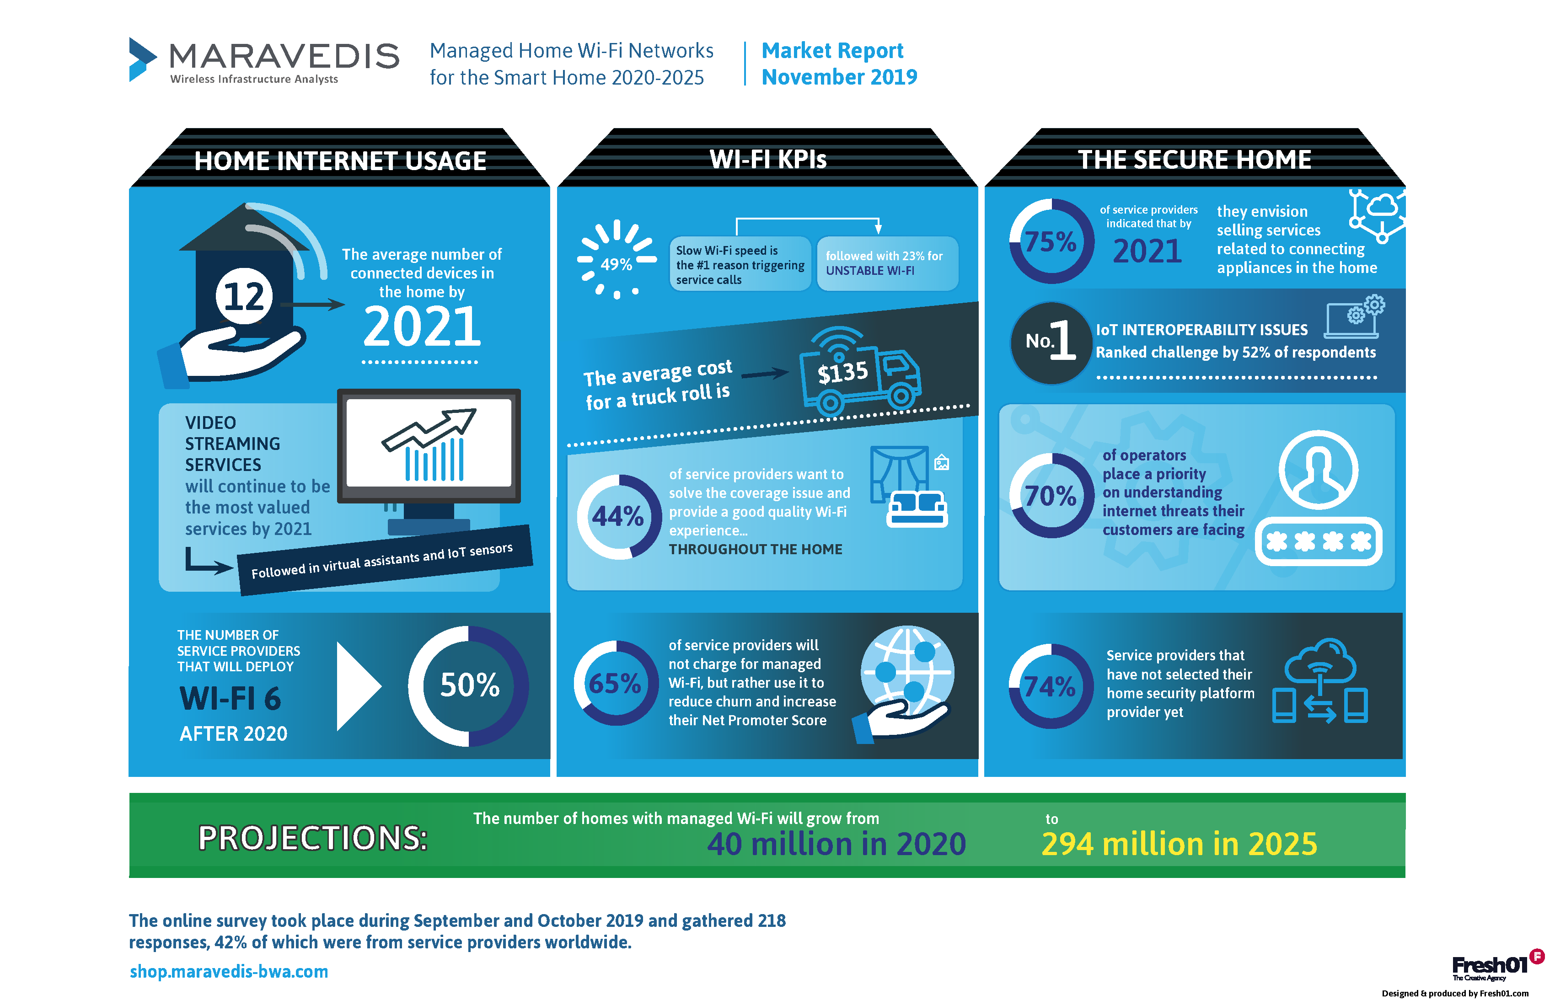
Key Ingredient for Smart Home Growth: Managed Wi-Fi Networks
Source: Maravedis, LLC, 2019

Slide 16










Final State: Mesh Ecosystems That Promote UX & Supplier Innovation
Kitchen
Living Room
    Impacts on
    Device Suppliers
Impacts on
User Experience
Barriers to Entry
Hardware Costs
Developer Costs
Innovation
Specification Autonomy
Prices
Functionality
Adoption
Outage Risk
Bathroom
Garage & Outdoors
A Mesh Ecosystem involves hubs in different systems (e.g. the bathroom vs. the kitchen) and/or from different providers that are able to communicate with each other and with associated Smart Home devices.
“We think smart home devices should enable greater insight for consumers beyond the walls of the home… We want to orchestrate the habits, preferences and other consumer data to simplify daily planning and tasks that might occur in a vehicle or at a supermarket.”
– CTO and CO-Founder, Aira

Slide 17
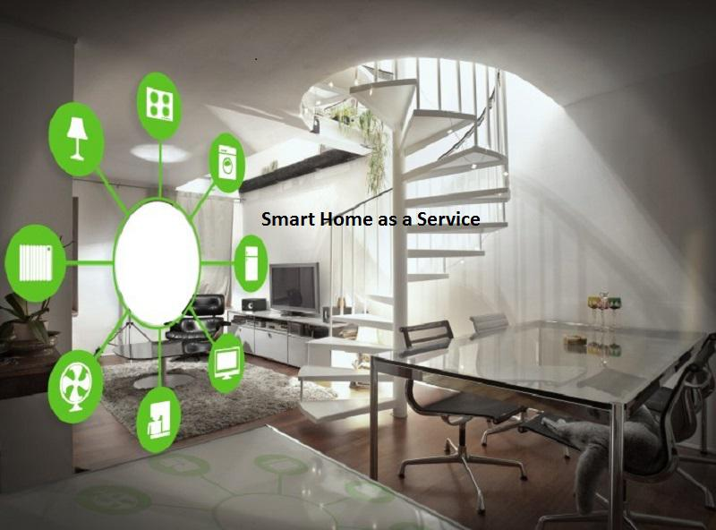
Next CABA Residential Research
“Smart Home as a Service” (SHaaS) – caba.org/shaas

Slide 18

Thank You, Questions and Contact Info
Continental Automated Buildings Association
(CABA)
613.686.1814
Toll free: 888.798.CABA (2222)
caba@caba.org
www.CABA.org
www.twitter.com/caba_news
www.linkedin/groups/gid=2121884
Connect to what’s nextTM

