Slide 1
Realcomm and IBcon 2019 DisruptCRE TRACK “MAKING MONEY WITH SMART BUILDINGS” June 13, 2019 Ron Zimmer CABA President & CEO
Connect to what’s nextTM
www.CABA.org

Slide 2
CABA Board of Directors

Slide 3
How Big is the Market?
1. Focusing on optimizing monetization can help suppliers unlock the $32.4 billion intelligent buildings opportunity.
2. Emerging buildings technologies expand the potential opportunities for suppliers to monetise their products and solutions.
3. Users’ payment preferences and coordination with other ecosystem players shape tech suppliers’ monetization opportunities.
Source: CABA Monetization of Intelligent Buildings 2019.

Slide 4
Combination of Trends Influences Outcomes of Monetization Strategies
Source: CABA Monetization of Intelligent Buildings 2019.

Slide 5
Combination of Trends Influences Outcomes of Monetization Strategies
Source: CABA Monetization of Intelligent Buildings 2019

Slide 6
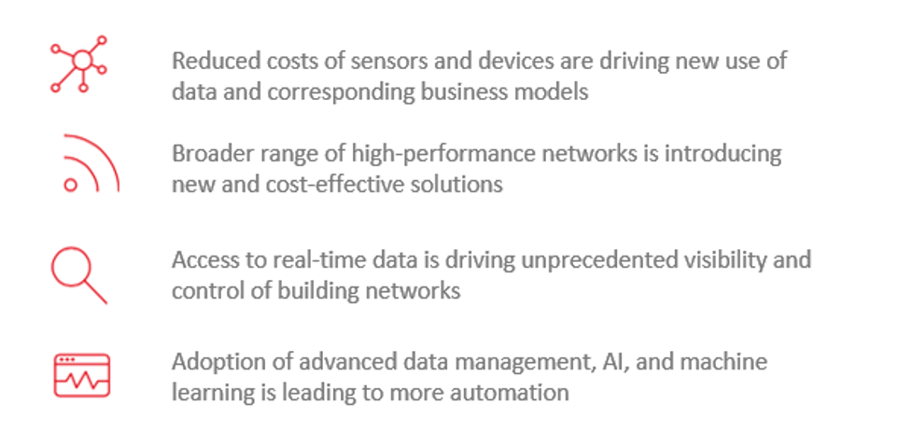
Combination of Trends Influences Outcomes of Monetization Strategies
Source: CABA Monetization of Intelligent Buildings 2019.

Slide 7
Decision Makers Face Challenges of Costly and Complex Implementation of Technology
1. Top Application Opportunities Across Commercial Building Segments
Energy Efficiency | 25 percent of respondents noted energy efficiency verification and measurement as the number one-use case that operators would be most willing to adopt and would make a positive impact on operations.
Building Occupancy Sensing | Detecting lighting and other means of converting energy efficiency garnered the vote for top use case from 20 percent of respondents.
Asset and Predictive Maintenance | 19 percent of votes for the top use case among operators.
2. Top Buildings Tech Pain Points Across Commercial Building Segments
Complex and Costly Set-Up and Implementation | 38 percent of respondents noted the selection and price, both upfront and through services is a key inhibitor for adoption.
Complexity of Integration with Current Systems | 47 percent of respondents noted implementing or retrofitting new modern, connected devices into existing systems leads to problems with interoperability.
Source: CABA Monetization of Intelligent Buildings 2019.

Slide 8
Tenants Value Comfort and Experience, While Owners Want Efficiency
Top Use Cases Across Commercial Building Segments
Higher
Tenants | Retail Consumers | Hospitality Consumers | Restaurant Consumers | Building Decision-Makers
Occupancy Sensing | Identity Management to Prevent Financial Data Fraud | Smart Signs | Building Energy Efficiency and Use of Renewable Energy | Energy Efficiency
Temperature Optimization | Smart Parking to Guide Shoppers to Open Parking Spots | Occupancy Sensing to support automatic lighting | AR and VR Applications for Food Before Ordering | Occupancy Sensing
Smart Sensors for Automated Lighting Control | Interactive Smart Signs to Guide Shoppers | Voice-Controlled Heating and Air Conditioning | Smart Reservation System | Predictive and Preventative Maintenance
Convenience Services | Interactive Customer Engagement Kiosks and Digital Signage | Smart Phone App for Maintenance and Housekeeping | Interactive Smart Menus | Air Quality
Rank of Priority
Lower
Source: CABA Monetization of Intelligent Buildings 2019

Slide 9
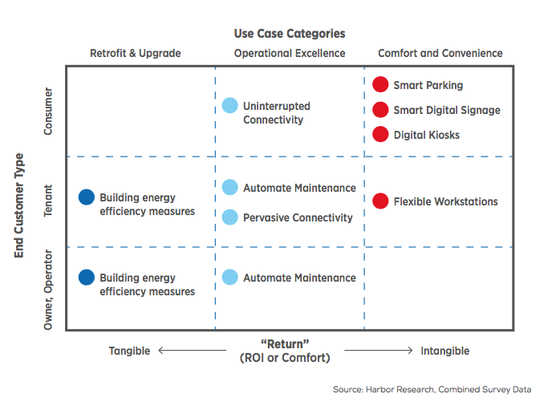
Use Case Categories Impact Owner/Operator Decision Making
Retrofit & Upgrade: Use cases included in this category include those that are predominately energy management related and that have very tangible metrics for measuring the expected return on investment
Operational Excellence: Use cases that still have quantifiable returns but are less tangible than retrofit and upgrade use cases.
Comfort and Convenience: Use cases that don’t have objective or clear measures of return for the stakeholder
Example: Retail store customers desire interactive digital signage to enhance their user experience, pushing retail store owners/operators to choose less tangible ROI solutions in hopes that ROI is made up in customer loyalty or other qualitative metrics
Source: CABA Monetization of Intelligent Buildings 2019.

Slide 10
Thank You, Questions and Contact Info
Continental Automated Buildings Association
(CABA)
613-686-1814
Toll free: 888.798.CABA (2222)
caba@caba.org
www.CABA.org
www.twitter.com/caba_news
www.linkedin/groups/gid=2121884
Connect to what’s nextTM

