Slide 1
Digital 360 Summit
Smart Buildings and Microgrid Panel
11:15-12:00 (45min)
Moderator: Ron Zimmer – CABA
Panel: Acuity Brands, Anka Labs, Texas State University, Edison Energy, Spirae

Slide 2
Smart Buildings and Microgrid Panel
Ronald J. Zimmer – CABA President & CEO - (Moderator)
Greg Carter - SVP Software Business Unit at Acuity Brands
Sunil Cherian - CEO of Spirae, Inc.
John Schemmel - Professor/Coordinator of Civil Engineering Program at Texas State University Ingram School of Engineering
Alper Üzmezler - CTO at Anka Labs, Inc. | Managing Partner at BASSG, LLC
Jay Zoellner - CEO of Edison Energy

Slide 3
CABA Board of Directors
3
Notes:
Our BoD feel this could be the most significant piece of research we can create
Different types of organizations
focusing on real ROI
True value of the building
2 spots left: share knowledge and network with key companies and individuals in this space.
---------------------------------------------------------------------------------------------------------------

Slide 4
Definition of Microgrid
“A microgrid is an autonomous power grid that can operate both in tandem with and when “islanded” from a utility grid. At minimum, a microgrid combines onsite energy generation and storage with system controls that allow the microgrid to connect/disconnect from the main grid and to operate independently. Microgrids may also include responsive battery deployment and tiered load-shedding.”
Source: Schatz Energy Research Center

Slide 5
Smart Microgrids are an evolution from traditional microgrids in the following three ways:
Variable generation. Traditional microgrid generation is dispatchable, typically diesel generation. Modern Smart Microgrids incorporate variable generation such as wind and photovoltaic solar, so that electricity must be either be used or stored when available.
Islandability. Traditional microgrids have been built in off-grid areas, and so are permanently islanded. Smart Microgrids may be built in remote, campus and urban areas, and so must be able to connect and disconnect from the larger ‘macro’ grid without negative impact.
Demand response. In traditional microgrids, generation follows the load. Modern Smart Microgrids use forecasting, modern sensing and communication technology to manage demand and more closely match available generation.
Source: NSERC Smart Microgrid Network (NSMG-Net)

Slide 6
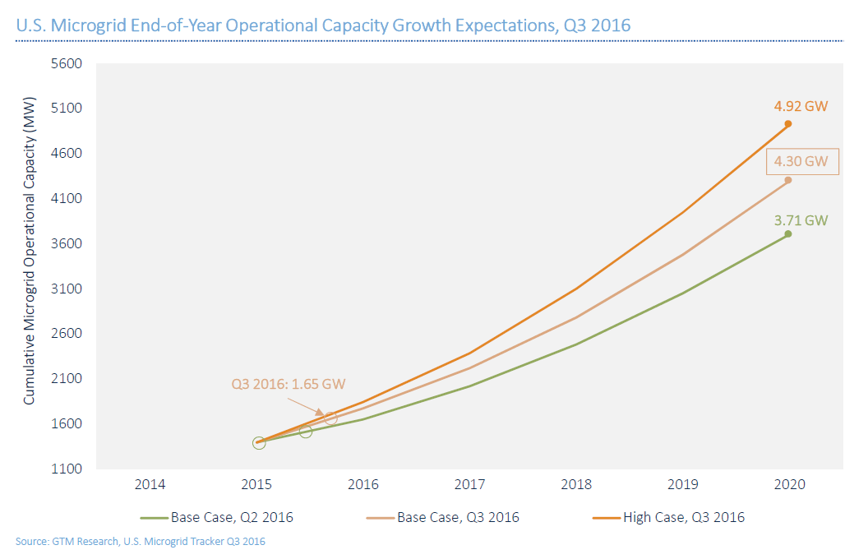

Slide 7
Global Microgrid Controller Outlook Market
In 2017 - $4.67 Billion
By 2026 - $18.8 Billion
CAGR of 16.7
Source: RESEARCH AND MARKETS

Slide 8
Smart Systems – The Building of the Future

Slide 9
Thank you and contact CABA
Continental Automated Buildings Association (CABA) 1173 Cyrville Road, Suite 210 Ottawa, ON K1J 7S6 613.686.1814 Toll free: 888.798.CABA (2222) Fax: 613.744.7833 caba@caba.org www.CABA.org www.twitter.com/caba_news www.linkedin.com/groups?gid=2121884
Connect to what’s next™

