Slide 1








Introducing the 2019 Connected Home Roadmap
CEDIA Expo 2019 · Denver, CO
© 2019, Continental Automated Buildings Association

Slide 2
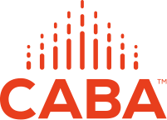

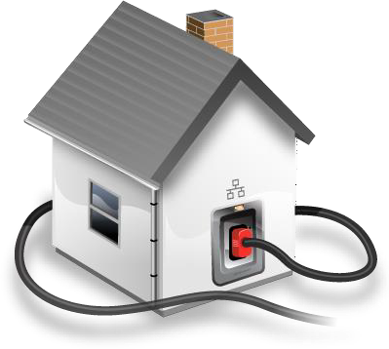


About CABA
CABA (Continental Automated Buildings Association)
Vision
CABA advances the connected home and intelligent buildings sectors.

Slide 3


CABA 30th Anniversary

Slide 4












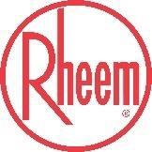








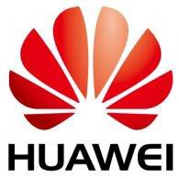

CABA Board of Directors

Slide 5

CABA Steering Committee

Slide 6

CABA All Funders

Slide 7
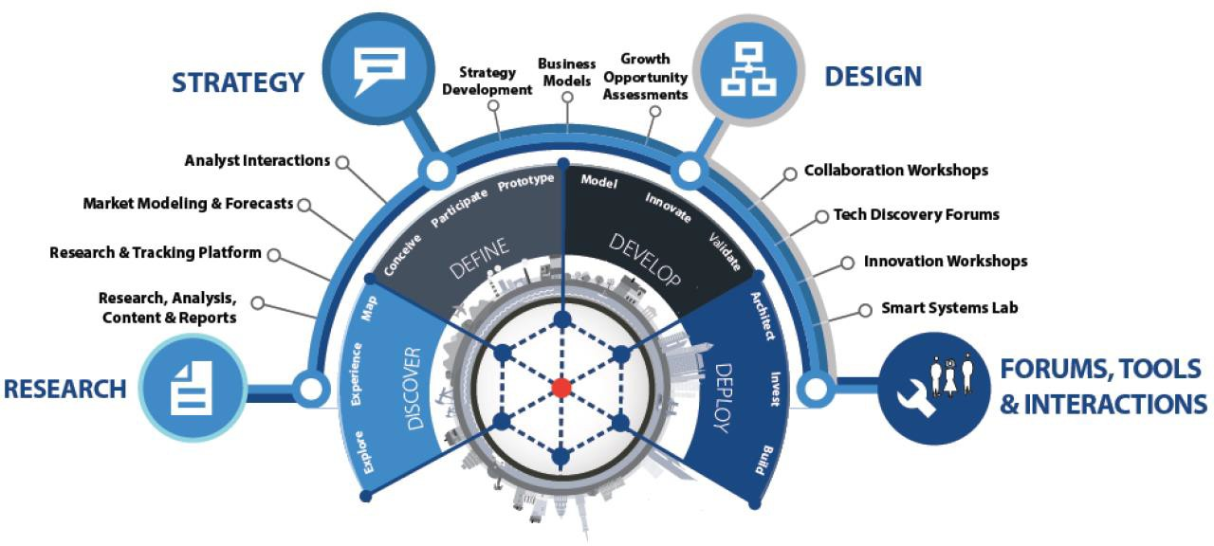
About Harbor Research
Strategy Consulting
Our strategy and business development consulting services deliver creative innovation tools, practical methods and applied problem solving.
Research and Content
Our research, tracking, and market intelligence services provide an accessible learning environment for those who are trying to wrap their arms and minds around emerging disruptive opportunities.
Smart Systems Lab
We are creating a real-world laboratory where organizations design, prototype, and test new models for delivering value and
differentiation. The Lab’s mission is to enable business model, technology, and system-level innovation enabled by the Internet of Things.

Slide 8
Research Goals
1
Examine in depth the current and future development considerations that the “Internet of Things” (IoT)
technologies and the services that these technologies enable will have in the connected home market.
Conduct a detailed analysis about the current and future state of the connected home marketplace, including key trends, buying behaviors, technology challenges and opportunities.
Identify and expand on the top current and future applications of IoT technologies in the context of plausible future connected home outcomes, outlining the technical makeup of solutions and value propositions for various market participants.
Provide actionable insights as it relates to he current and future market opportunities and development considerations that influence the trajectory of the connected home.
2
Develop product / technology, ecosystem, customer and application roadmaps context of each stakeholder to outline strategic priorities.
Make recommendations for how firms should structure their organization and offerings to capture new value from
smart, connected offerings.

Slide 9
Key Takeaways (1/2)
1
The growth of the Smart Home market is being stifled by a messy aggregation of network protocols, software incompatibility, and winner-take-all strategies across the supplier landscape
Poor user experience, a lack of privacy and security standards and the high costs of products and services are leaving smart home consumers frustrated—exacerbating the disconnect between suppliers and user preferences
2
3
The future market trajectory of the smart home is dependent on the following:
A
Progress around networking, security and computing protocol standardization
B
Collaborative engagement across supplier landscape to improve user experience
Technology advancements around AI, voice recognition, edge computing, cybersecurity, blockchain and networks that enable more advanced, complex smart home use cases / applications
C
D
The evolution of the player landscape towards mesh ecosystem architectures

Slide 10
Key Takeaways (2/2)
4
Future potential outcomes are illustrated by the following three scenarios:
Stagnant Smart Home: players continue to operate in isolated ecosystems, leaving the technology protocol landscape fragmented and reinforcing pain points around user experience, privacy and security, and cost
Scenario 1
Middle of the Road: while more complex use cases are introduced, player collaboration remains constrained to smart home hub ecosystems. This convergence on smart home ecosystems improves the disarray of technology protocols to a degree; however, challenges around user experience will limit mass adoption
Scenario 2
Smart Home Euphoria: open ecosystem architectures alleviate the protocol mess with collaborative product development that also addresses user experience issues. Technology advances around AI, edge computing, security and voice recognition catalyze use case complexity and contribute to increased consumer trust
Scenario 3
5
To unlock future Smart Home value of $66.5B, players need to:
A
B
Increase attention to driving network protocol standardization
Increase priority placed on software interoperability by tech suppliers
C D
Move from a dictator model ecosystem architecture to a more localized ecosystem
Increase distributed edge computing to increase reliability and user experience satisfaction

Slide 11
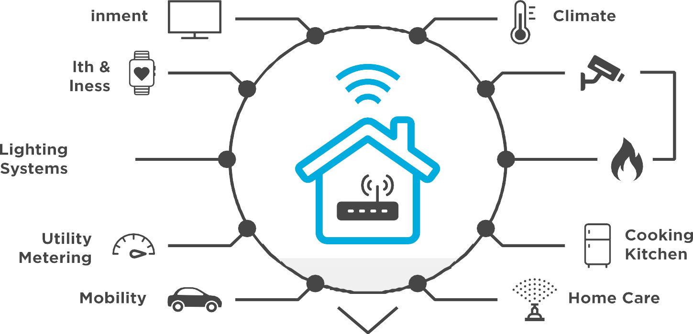


Diverse Device Networks Poses Significant Challenges
CHR Report Figure 1-2

Slide 12






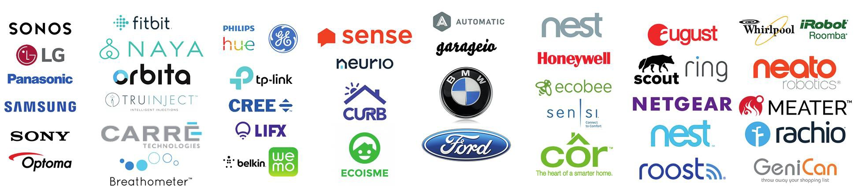
Market Development Constrained By Hub- centric Collaboration
CHR Report Figure 1-4

Slide 13
The growth of the Smart Home market is being stifled by the messy aggregation of network protocols, software incompatibility, and winner- take-all attitudes by the main players
© 2019, Continental Automated Buildings Association

Slide 14
Cost & Data Privacy Are Top Reported Pain Points
Key Pain Points and Challenges
Cost of device
Cost of recurring service
5 - Very Painful / Challenging
Privacy/safety concerns
Difficult to install
4 - Somewhat Painful /
Challenging
Lack of interoperability
Reliability
3 - Neutral / Negligible Pain
Customer support and
service
2 - Less Painful / Challenging
Interface/app control
Product design
1 - Least Pain, Least
Challenging
Lack of intelligence
Ease of use
0%
10%
20%
30%
40%
50%
CHR Report Figure 2-4

Slide 15
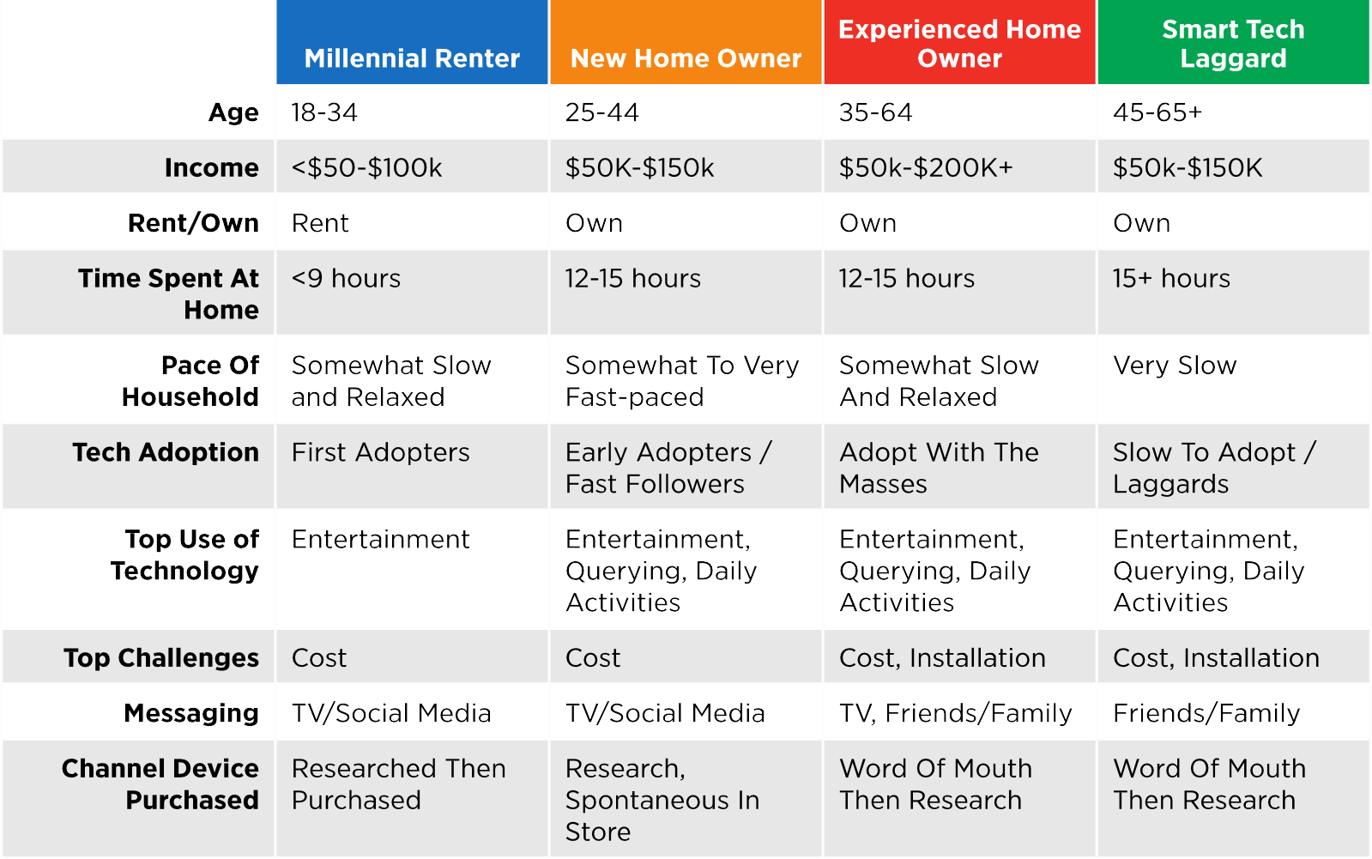
Smart Home User Profile Demographic & Behavioral Traits
CHR Report Figure 2-3

Slide 16
Poor user experience, a lack of privacy and security standards and high costs of products and services are leaving smart home
consumers frustrated—exacerbating a disconnect between suppliers and user preferences
© 2019, Continental Automated Buildings Association

Slide 17

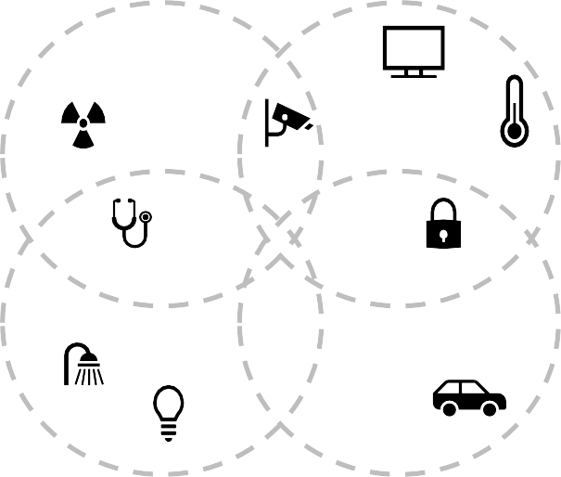














Final State: Mesh Ecosystems That Promote UX & Supplier Innovation
Kitchen
Living Room
Impacts on Device Suppliers
Impacts on
User Experience
Barriers to Entry
Prices
Hardware Costs
Functionality
Developer Costs
Adoption
Innovation
Outage Risk
Specification Autonomy
Bathroom
Garage & Outdoors
A Mesh Ecosystem involves hubs in different systems (e.g. the bathroom vs. the kitchen) and/or from different providers that are able to communicate with each other and with associated Smart Home devices.
“We think smart home devices should enable greater insight for consumers beyond the walls of the home… We want to orchestrate the habits, preferences and other consumer data to simplify daily planning and tasks that might occur in a vehicle or at a supermarket.”
– CTO and CO-Founder, Aira

Slide 18
New Technologies Will Enable Complex, Interrelated Applications
Application Evolution
Simple
Apps that involve single devices or narrow values that are based on basic network connectivity and monitoring
(e.g. energy management)
Compound
Apps that involve multiple collaborating, peer-peer devices or significant interactions between and among devices, systems and people (e.g. ML-enabled energy management for comfort and convenience)
Complex
Apps that drive interactions between and among devices, device sub-systems and people
(e.g. interconnected, personalized energy management for an individual’s health & wellness)
Enabling Technologies
Time
“Currently, energy management is the biggest focus for us – understanding consumption info, improved savings and home management. But this will naturally evolve to a more holistic view of appliance health and monitoring over time... You can leverage data for a lot of different use cases, and this is only
expected to expand in the future where we’re currently just scratching the surface in terms of application potential.”
“We are basically working on scenarios, the ability to learn a sequence of actions by pressing one button. When I wake up in the morning, it turns on the lights, the radio, the heater, etc. We want to integrate AI to understand your habits and suggest a scenario.”
-Director – Product Management & Marketing, Powerley
-Program Manager, Sevenhugs

Slide 19
Suppliers need to develop user-centric strategies to inform hardware, software and ecosystem roadmaps that address current market inefficiencies
© 2019, Continental Automated Buildings Association

Slide 20
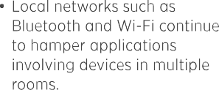
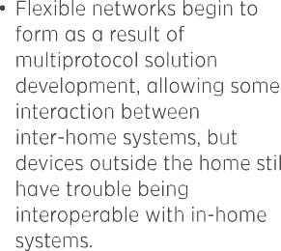
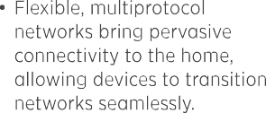




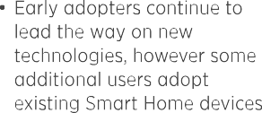
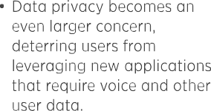
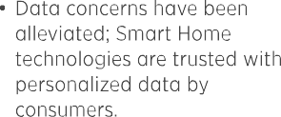


Suppliers Can Frame Future Scenarios Around The Four Key Trend Areas
CHR Report Figure 3-4

Slide 21
Smart Systems Revenue For Connected Home Will Reach
$66.5B In 2023
2018 |  | 2023 | CAGR
Enablement | $946.8 | $2,236.6 | 18.8%
Network Services | $4,977.9 | $10,427.1 | 15.9%
System Applications | $4,052.6 | $10,189.5 | 20.2%
Value Added Applications | $15,772.3 | $43,624.5 | 22.6%
Total | $25,749.6 | $ 66,477.7 | 20.9%
CHR Report Figure 3-7

Slide 22
Future potential outcomes for the connected home are illustrated by the three distinct scenarios that entail the varying impact of certain competitive, customer, technology and socioeconomic trends and forces and suppliers ability to respond to those impacts
© 2019, Continental Automated Buildings Association

Slide 23

How to Rescue Crumbling UX: Integrated HW, SW & Eco Strategy
Hardware
Ecosystem
Network providers (Zigbee, Z- Wave, Wi-Fi) should align on standardized protocols to ease challenges for tech suppliers and improve user experience.
OEMs and tech suppliers should partner with software and service providers to drive indirect device sales and interoperability. This will allow suppliers to leverage devices as Smart Home control points.
Software
Suppliers must future proof products as much as possible by removing contingencies on hardware, where over-the-air updates to software can be the core foundation for
maintaining relevance of a product’s
capabilities.
Tech suppliers should strive for multiprotocol strategies to build devices compatible with several network types.
•
Service providers should foster complex systems of local mesh networks.
Service providers should partner with real estate developers for long standing contracts and to install devices in new homes.
Software providers should build a platform of platforms to simplify user experience and improve security.
OEMs should strive to create localized ecosystems.
Suppliers must develop edge computing machines.
Given advancement of user maturity, suppliers must refine consumer data insights and solution R&D to best respond and predict behavior.
•
Players must invest in blockchain and security to instill confidence in consumers.

Slide 24
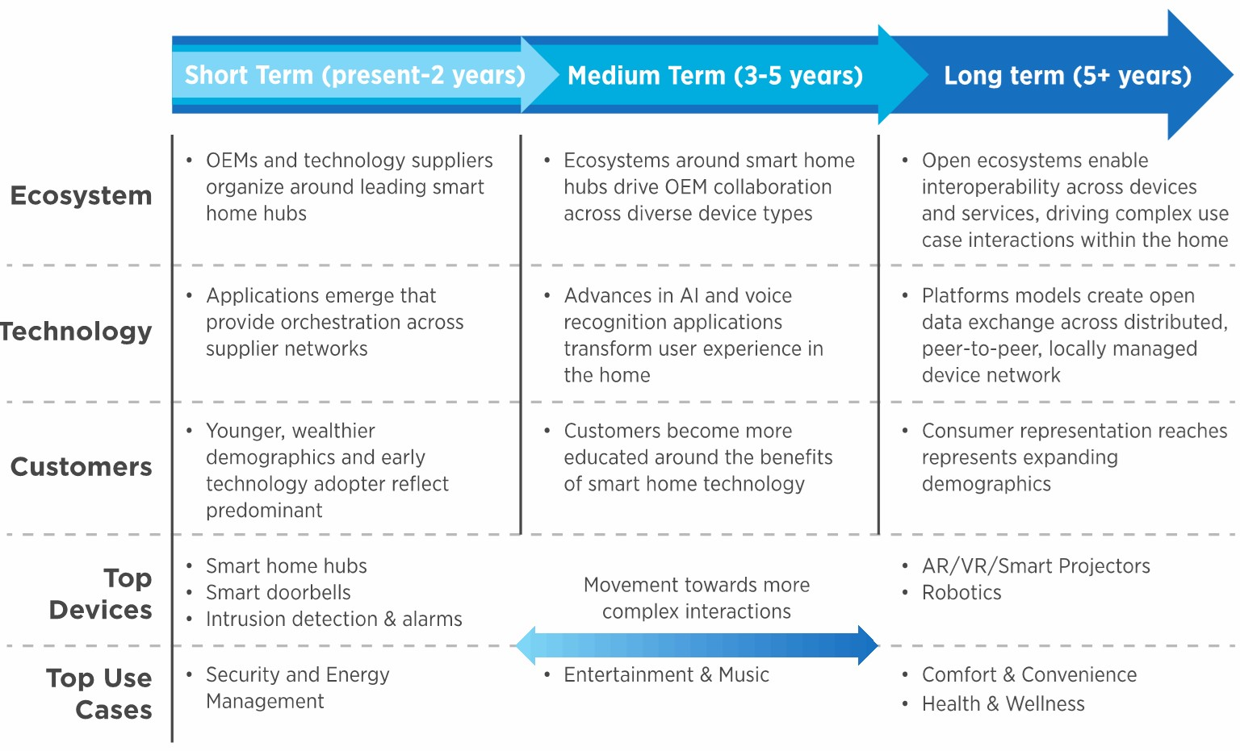
Connected Home Roadmap: Improve UX, Open Ecosystems & Build Trust
CHR Report Figure 4-1

Slide 25
To effectively tap into the $66.5 billion future connected home opportunity, players will need to develop distinct short-, medium- and long-term strategies around ecosystems, technology, customers, use cases / applications and devices
© 2019, Continental Automated Buildings Association

Slide 26
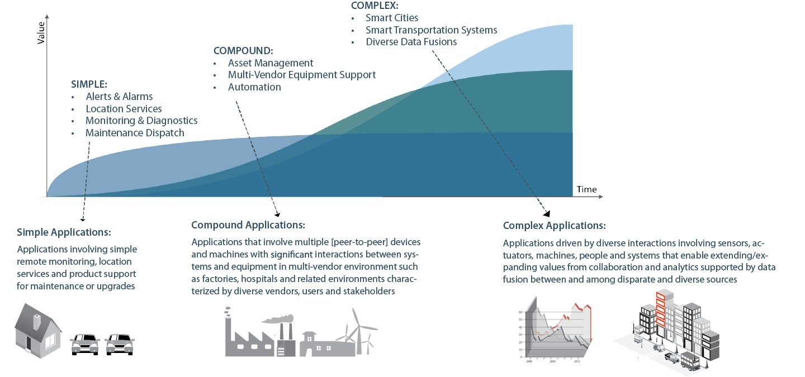









But It’s Still Early In The Game…….
COMPLEX
Supply Chains
Smart Cities

Slide 27
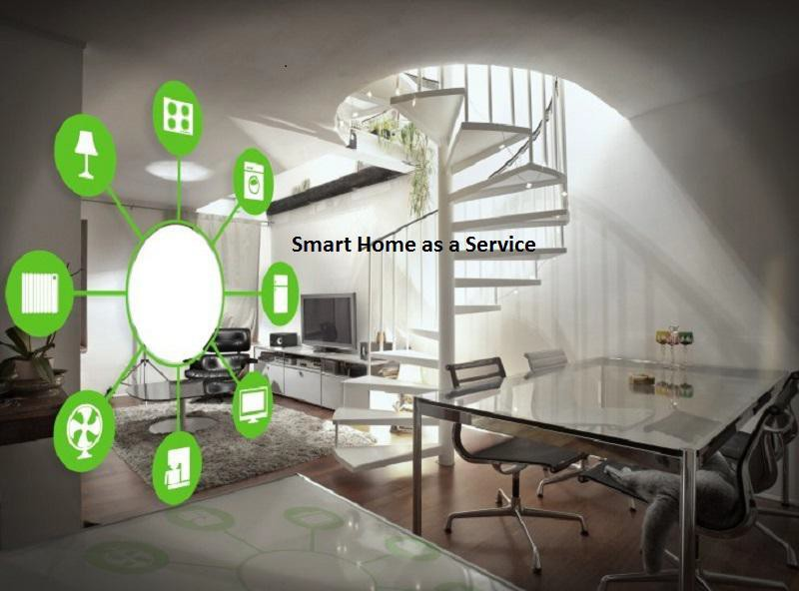
Next CABA Residential Research
“Smart Home as a Service” (SHaaS)
27
© 2019, Continental Automated Buildings Association

Slide 28
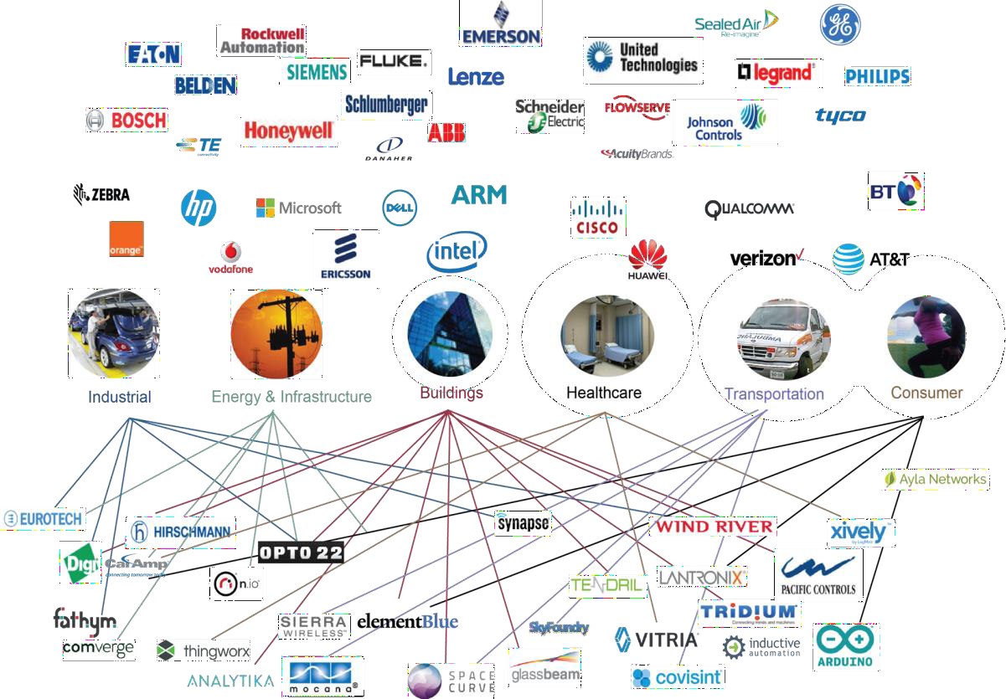

Harbor Research Community and Capabilities
Founded in 1984, Harbor Research helps companies develop new growth strategies for emerging technologies
Harbor Research is a strategy consulting and technology research firm focused on Smart Systems
Technology Research
Our research, tracking, and market intelligence services provide an accessible learning environment for those who are trying to wrap their arms and minds around emerging disruptive opportunities.
Strategy Consulting
Our strategy and business development consulting services deliver creative innovation tools, practical methods and applied problem solving.
Smart Systems Lab
We are creating a real- world laboratory where organizations design, prototype, and test new models for delivering value and differentiation.

Slide 29

CABA
CABA (Continential Automated Buildings Association)
Vision
CABA advances the connected home and intelligent buildings
sectors.
Mission
CABA enables organizations and individuals to make informed decisions about the integration of technology, ecosystems and connected lifestyles in homes and buildings.
29
© 2019, Continental Automated Buildings Association

