Slide 1
Digital Twins Bring Smart Building Benefits
David Katz – Ambassador Speaker
President - Sustainable Resources Management

Slide 2
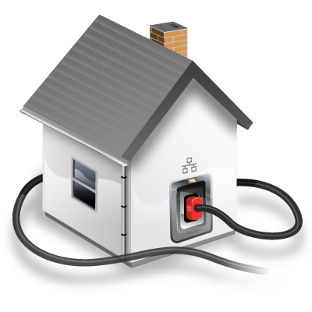
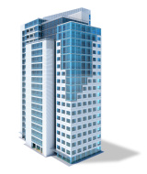
About CABA
CABA (Continental Automated Buildings Association)
Vision
CABA advances the connected home and intelligent buildings sectors.

Slide 3
CABA Board of Directors
Notes:
Our BoD feel this could be the most significant piece of research we can create
Different types of organizations
focusing on real ROI
True value of the building
2 spots left: share knowledge and network with key companies and individuals in this space.
---------------------------------------------------------------------------------------------------------------

Slide 4
Overview
Digital Twins are emerging in the industrial world as software can provide the digitalization of new products and plant layout before they are built. However amongst the smart building thought leaders, while there are some common themes emerging about digital twins, there are still areas of disagreement are lingering. Well organized data is essential and digital twins have a huge role in keeping people safe in buildings. The speaker will address the what, where, why, how of digital twining that has the potential to provide benefits to the occupants, property managers and building owners.

Slide 5
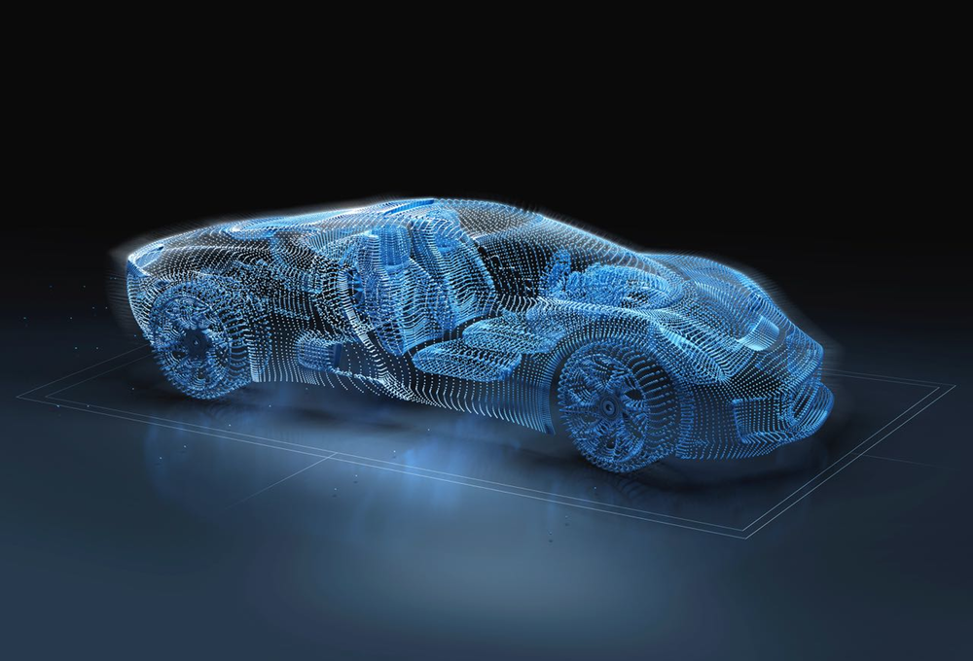
Overview
As digital twins grow in complexity and move from being digital representations of single items to models of systems of interconnected things like our buildings, more businesses are seeing the technology as an opportunity to orchestrate people, processes, and things in a sophisticated way -- resulting in better business outcomes, as well as benefits for everyone.

Slide 6
Overview - Agenda
Although digital twins have been around for several decades, it’s only been since the rapid rise of IoT that they’ve become more widely considered as a tool of the future. Digital twins are getting attention because they also integrate things like artificial intelligence (AI) and machine learning (ML) to bring data, algorithms, and context together, enabling organizations to test new ideas, uncover problems before they happen, get new answers to new questions, and monitor items remotely.

Slide 7
Overview - Agenda
Agenda:
What is a Digital Win;
Who are the emerging Digital Twin Technology Service Providers (TPS) ;
How can it be used to test the outcomes;
How will it maximize the performance and energy efficiency;
How will it improve tenant experience and productivity;
How can it provide building operators, service providers and first responders with the most appropriate real time data for their tasks.
Questions and Discussion.

Slide 8
What is a Digital Twin of a Building?
DIGITAL TWINS act as a bridge between physical and digital worlds by using sensors to collect real-time data about a physical item. This data is then used to create a digital duplicate of the item, allowing it to be understood, analyzed, manipulated, or optimized. Other terms used to describe digital twin technology over the years have included virtual prototyping, hybrid twin technology, virtual twin, and digital asset management.

Slide 9
What is the Digital Twin Definition

Slide 10
What is the Digital Twin Challenge
The pains of the digital twin
• Hype and oversell: The top of the Gartner hype curve
• “Everybody” is offering digital twin.
• Concepts driven by aerospace and automotive.
• Fragmented systems, siloed perspectives and overload of data.
• Systems are difficult to configure, maintain and scale.
• Challenges in work practices, security and alignment to business.
#PIWorld ©2018 OSIsoft, LLC

Slide 11
Who are using Digital Twins
Enterprises are increasingly developing and building digital twins to meet targeted business outcomes, ranging from maintenance optimization to process analysis to customer engagement.
Gartner ’s 2019 CIO Survey indicates that 6% of enterprises have already deployed digital twins, and another 38% are engaged in one- to three-year planning stages to deploy digital twins (see “2019 CIO Survey: CIOs Have Awoken to the Importance of AI”).
Even more strikingly, Gartner ’s 2018 survey of enterprises implementing IoT projects indicated 13% of enterprises have already implemented digital twins and 62% had digital twin implementations in process or planned for the next year (see “Survey Analysis: Digital Twins Are Poised for Proliferation”).

Slide 12
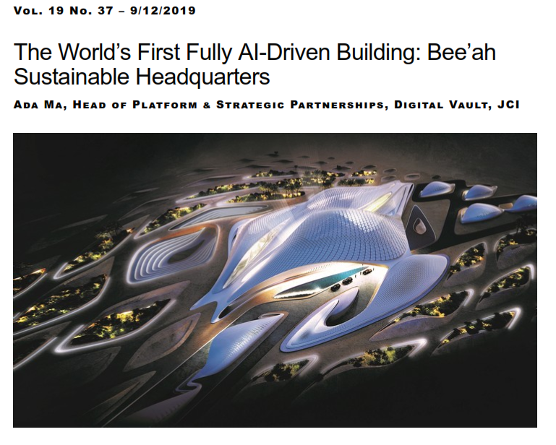
What is a Digital Twin of a Building?
Realcomm-Digital Twin AI building

Slide 13
What is a Digital Twin of a Building?
One interesting technology aspect is the development of a digital twin; this digital twin is unlike most others in that it interacts and communicates with the various subsystems, with standard operating procedures that allow the building to flow and work better. In keeping with the goal of the frictionless experience, the digital twin serves similarly to a human nervous system, uniting all components to help control the entire building. It is constantly learning about the people and assets within. With data gathered over time, it can make better and smarter decisions—from team communication protocols to remembering exactly what beverage a guest usually orders—and exactly when they usually order it.
Realcomm-Digital Twin AI building

Slide 14
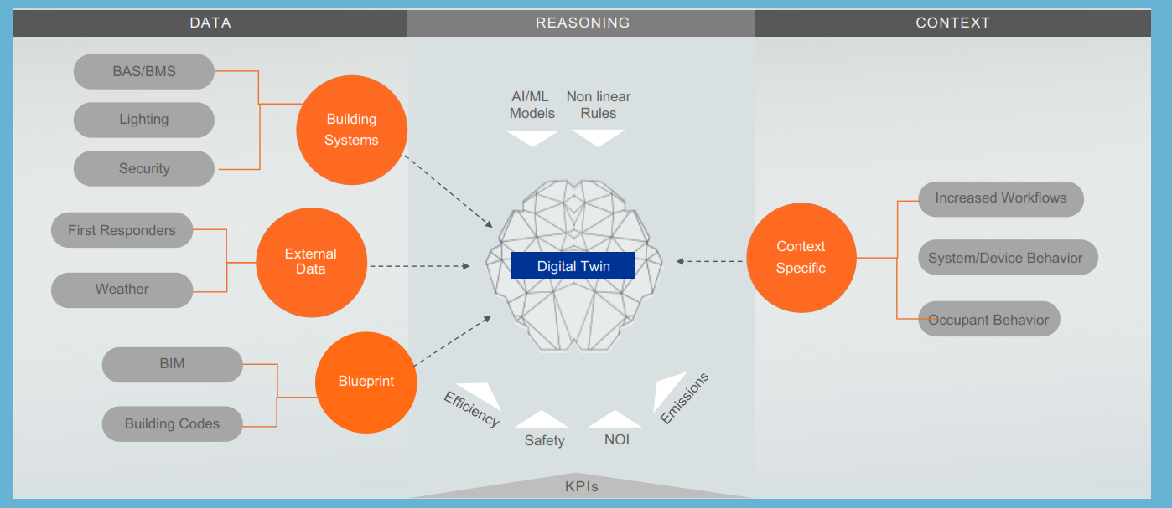
What is a Digital Twin of a Building?

Slide 15
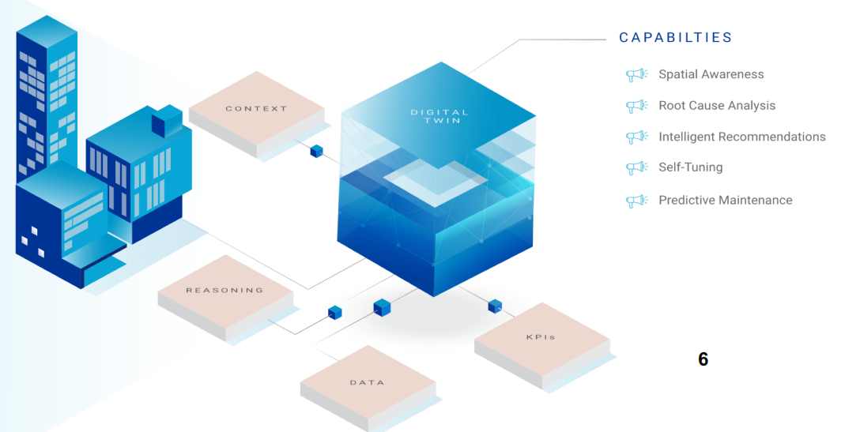
How Are Digital Twins Being Used?

Slide 16
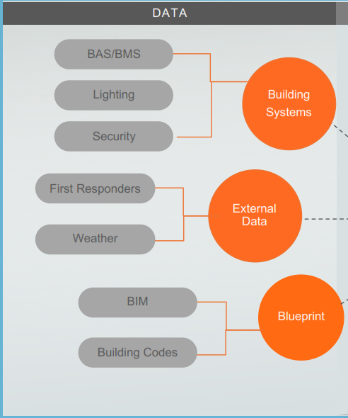
Where do we get the data needed for the digital twin
Building Automation systems generate data logs. And alarms as they control the HVAC, lighting and security systems. BACnet and other protocols allow for the systems to exchange information is control sequences and record the results from the sensors.
External Date from First responders as to what actions mitigate damage and enhance safety can be valuable input and the exchange of information when incidents occur is improved for better outcomes. Historical weather data is used in building modeling and advanced weather warnings are now available to be part of the responding control sequences for energy savings.
Digital CAD and BIM software is used now in most new building designs to meet the building code and existing buildings and can be replicated from past blueprints and operating and maintenance manuals.

Slide 17
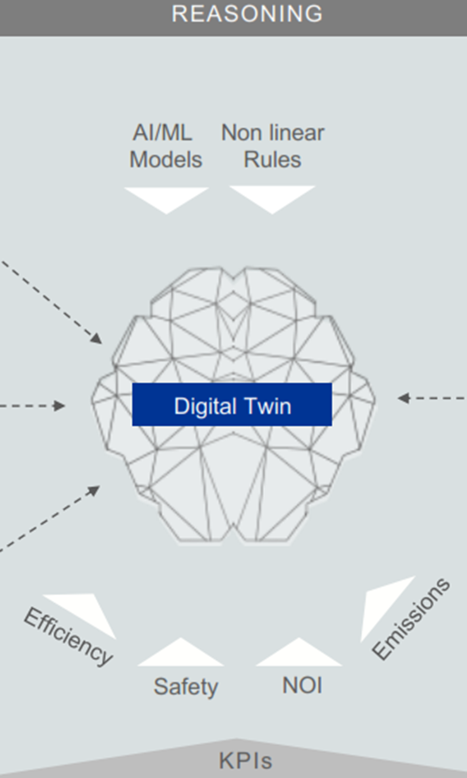
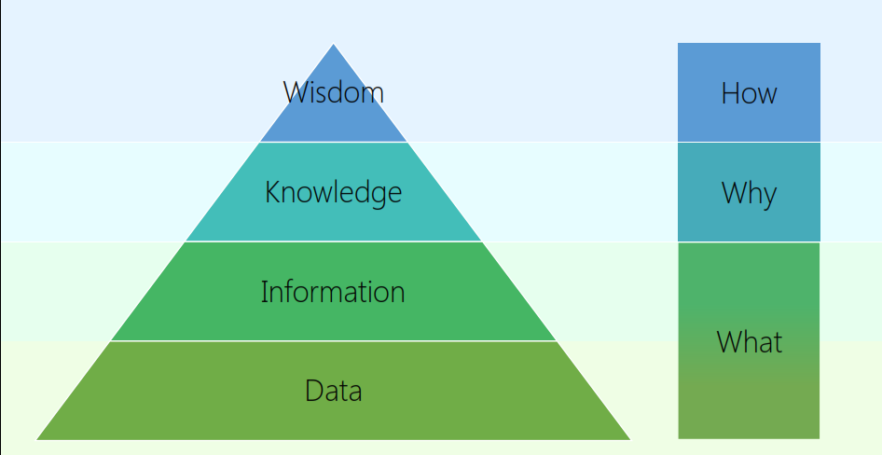
What do we do with the data in the digital twin
Seek wisdom from the digital model using data analysis with AI/ML and other nonlinear rules to gain knowledge and simulate situations to see the energy, safety, net operating Income and emissions trade-offs and resulting KPI’s.

Slide 18
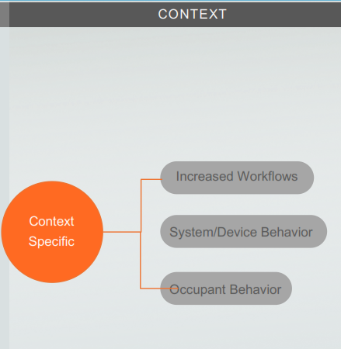
Who are the recipients and what benefits do they receive?
With better information on potential bottlenecks and waste of time, traditional workflows can be improved, and productivity increased. Space for work, meetings and relaxation can be planned better and real time data on occupancy can be used to reduce wasted time.
Building Automation system programs can be simulated to see the synergies when they talk to each other and optimized when they use this data to control the HVAC, lighting and security systems under different scenarios rather than the traditional simple scheduling that is disabled when someone complains. Equipment can be monitored in real time and fault detection and predictive maintenance can be employed.
Digital twins show how occupants having a mobile device can have applications that allow them to tailor their work environment to meet the tasks they are doing and having the feedback on the energy and emission reductions they contributed to also reinforces the benefits and can be used as financial incentives.

Slide 19
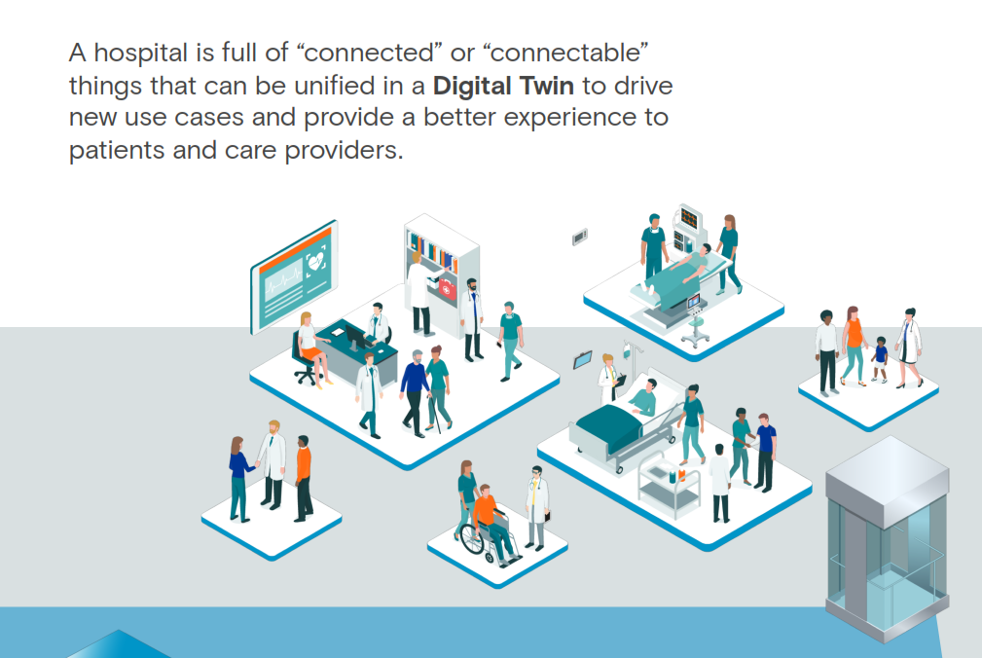
ThoughtWire Hospital Application

Slide 20
ThoughtWire Hospital Application
By creating a digital twin of a hospital, hospital administrators, doctors, and
nurses can get powerful, real-time insight into patient health and workflows. Using sensors to monitor patients and coordinate equipment and staff, digital twins offer a better way of analyzing processes and alerting the right people at the right time when immediate action is needed.
As a result, emergency room wait times can be reduced and patient flow can be improved, decreasing operational costs and enhancing the patient experience. One hospital measured a 900 percent improvement in cost savings after implementing digital twin technology to remove bottlenecks in patient flow.
Moreover, digital twins can predict and prevent patient emergencies like cardiopulmonary or respiratory arrest, known as code blues emergencies, resulting in more lives saved. In fact, one health care network that implemented digital twin technology in their hospitals saw a 61 percent reduction in code blue events.
© 2019, ThoughtWire Digital Twin eBook

Slide 21
ThoughtWire UBER Office Application

Slide 22
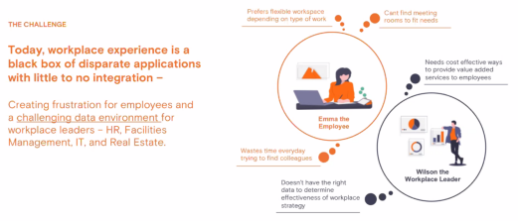
ThoughtWire UBER Office Application

Slide 23
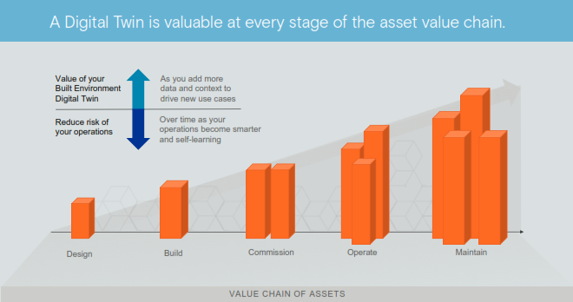
ThoughtWire UBER Office Application

Slide 24
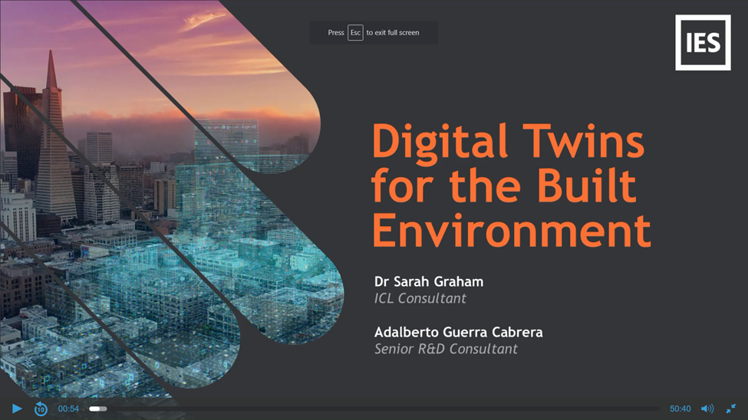
IES Digital Twins

Slide 25
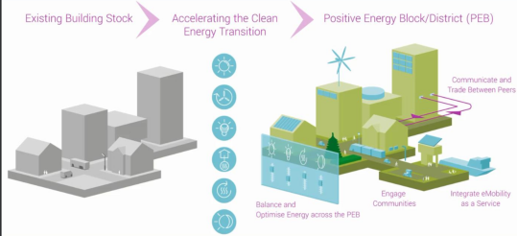
IES Digital Twins

Slide 26
IES Digital Twins in B1M video.

Slide 27
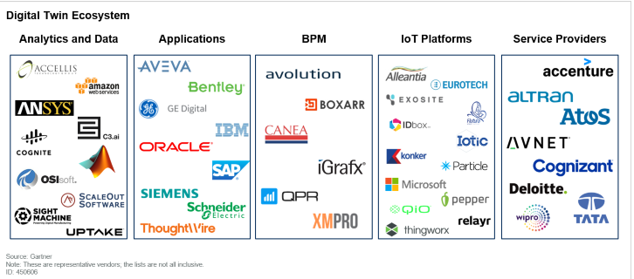
Gartner Summary of Digital Twin Market

Slide 28
Gartner Summary of Digital Twin Market Explained
This figure shows digital twin TSPs organized based on their historical technology and market strength in five core arenas: analytics and data, applications, business process management (BPM), IoT platforms and service providers:
Analytics and data: These providers develop digital twins leveraging their analytics capabilities, including artificial intelligence (AI) and high-fidelity physics capabilities.
Applications: These providers develop digital twins leveraging their business applications, often driving vertical-market-oriented solutions for their customers. This strategy includes using APM,
logistics or PLM applications to develop their digital twin models and portfolios.
BPM: These providers develop digital twins leveraging their BPM expertise and usually focus on process management, although some have demonstrated IoT-based capabilities.
IoT platforms: These providers develop digital twins leveraging their IoT capabilities, with a focus on asset monitoring and performance.
Service providers: These providers develop digital twins on a custom basis leveraging their vertical market expertise and a portfolio of analytics and application capabilities.

Slide 29
Questions and Discussion
David Katz Office: 416.493.9232 Cell: 416.618.4651
dkatz@sustainable.on.ca www.sustainable.on.,ca www.twitter.com/SRM_Onartio www.linkedin.com/groups?gid=2121884
Connect to what’s next™

Slide 30
CONTACT CABA
Continental Automated Buildings Association (CABA) 613.686.1814 Toll free: 888.798.CABA (2222)
caba@caba.org www.CABA.org www.twitter.com/caba_news www.linkedin.com/groups?gid=2121884
Connect to what’s next™

