Slide 1
The Buildings Show
Connected Home Roadmap: Learn from the Research
December 5, 2019 | 2:30 PM-4 PM
Ron Zimmer
CABA President & CEO
Connect to what’s nextTM
www.CABA.org

Slide 2
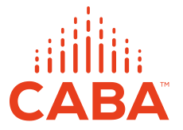

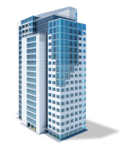


About CABA
CABA (Continental Automated Buildings Association)
Vision
CABA advances the connected home and intelligent buildings sectors.

Slide 3
CABA
CABA (Continential Automated Buildings Association)
Vision
CABA advances the connected home and intelligent buildings sectors.
Mission
CABA enables organizations and individuals to make informed decisions about the integration of technology, ecosystems and connected lifestyles in homes and buildings.
3
Notes:
- 390 members
- 27,000 contacts
Marketing, networking-councils & liaison,
Events (SBS)-100 companies
Library, WP, collaborative
----------------------------------------------------------------------------------------------------

Slide 4
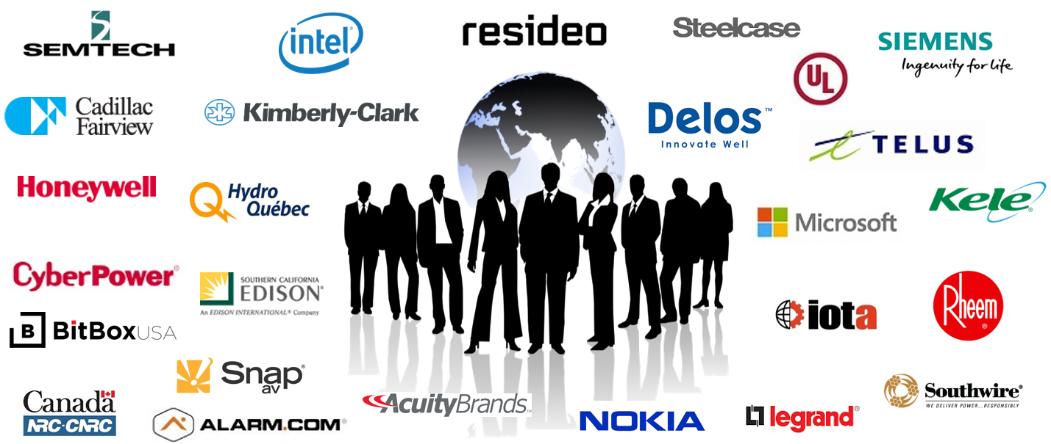
CABA Board of Directors
Notes:
Our BoD feel this could be the most significant piece of research we can create
Different types of organizations
focusing on real ROI
True value of the building
2 spots left: share knowledge and network with key companies and individuals in this space.
---------------------------------------------------------------------------------------------------------------

Slide 5

CABA Connected Home Roadmap
CABA MEMBER FUNDERS:

Slide 6
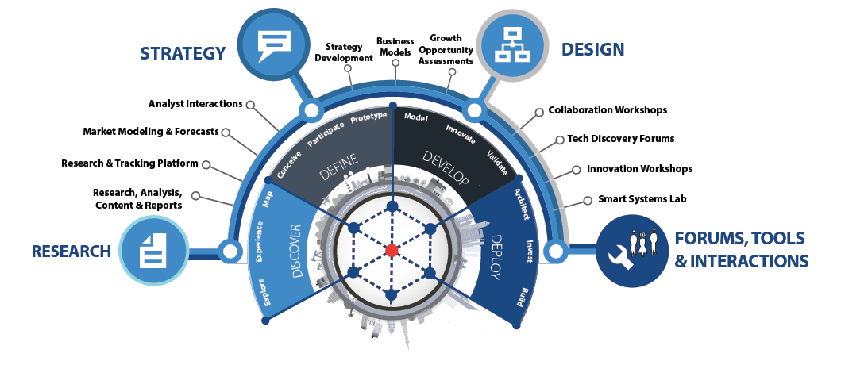
About Harbor Research
Strategy Consulting
Our strategy and business development consulting services deliver creative innovation tools, practical methods and applied problem solving.
Research and Content
Our research, tracking, and market intelligence services provide an accessible learning environment for those who are trying to wrap their arms and minds around emerging disruptive opportunities.
Smart Systems Lab
We are creating a real-world laboratory where organizations design, prototype, and test new models for delivering value and differentiation. The Lab’s mission is to enable business model, technology, and system-level innovation enabled by the Internet of Things.

Slide 7
Research Goals
1
Examine in depth the current and future development considerations that the “Internet of Things” (IoT) technologies and the services that these technologies enable will have in the connected home market.
  Conduct a detailed analysis about the current and future state of the connected home marketplace, including key trends, buying behaviors, technology challenges and opportunities.
  Identify and expand on the top current and future applications of IoT technologies in the context of plausible future connected home outcomes, outlining the technical makeup of solutions and value propositions for various market participants.
Provide actionable insights as it relates to he current and future market opportunities and development considerations that influence the trajectory of the connected home.
  Develop product / technology, ecosystem, customer and application roadmaps context of each stakeholder to outline strategic priorities.
  Make recommendations for how firms should structure their organization and offerings to capture new value from smart, connected offerings.
2

Slide 8
Key Takeaways (1/2)
1
The growth of the Smart Home market is being stifled by a messy aggregation of network protocols, software incompatibility, and winner-take-all strategies across the supplier landscape
2
Poor user experience, a lack of privacy and security standards and the high costs of products and services are leaving smart home consumers frustrated—exacerbating the disconnect between suppliers and user preferences
3
The future market trajectory of the smart home is dependent on the following:
A
Progress around networking, security and computing protocol standardization
B
Collaborative engagement across supplier landscape to improve user experience
C
Technology advancements around AI, voice recognition, edge computing, cybersecurity, blockchain and networks that enable more advanced, complex smart home use cases / applications
D
The evolution of the player landscape towards mesh ecosystem architectures

Slide 9
Key Takeaways (2/2)
4
Future potential outcomes are illustrated by the following three scenarios:
Stagnant Smart Home: players continue to operate in isolated ecosystems, leaving the technology protocol landscape fragmented and reinforcing pain points around user experience, privacy and security, and cost
Scenario 1
Middle of the Road: while more complex use cases are introduced, player collaboration remains constrained to smart home hub ecosystems. This convergence on smart home ecosystems improves the disarray of technology protocols to a degree; however, challenges around user experience will limit mass adoption
Scenario 2
Smart Home Euphoria: open ecosystem architectures alleviate the protocol mess with collaborative product development that also addresses user experience issues. Technology advances around AI, edge computing, security and voice recognition catalyze use case complexity and contribute to increased consumer trust
Scenario 3
5
To unlock future Smart Home value of $66.5B, players need to:
A
Increase attention to driving network protocol standardization
B
Increase priority placed on software interoperability by tech suppliers
C
Move from a dictator model ecosystem architecture to a more localized ecosystem
D
Increase distributed edge computing to increase reliability and user experience satisfaction

Slide 10
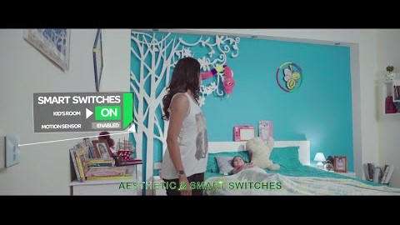
But Home Automation Continues to make Strides in 2019

Slide 11
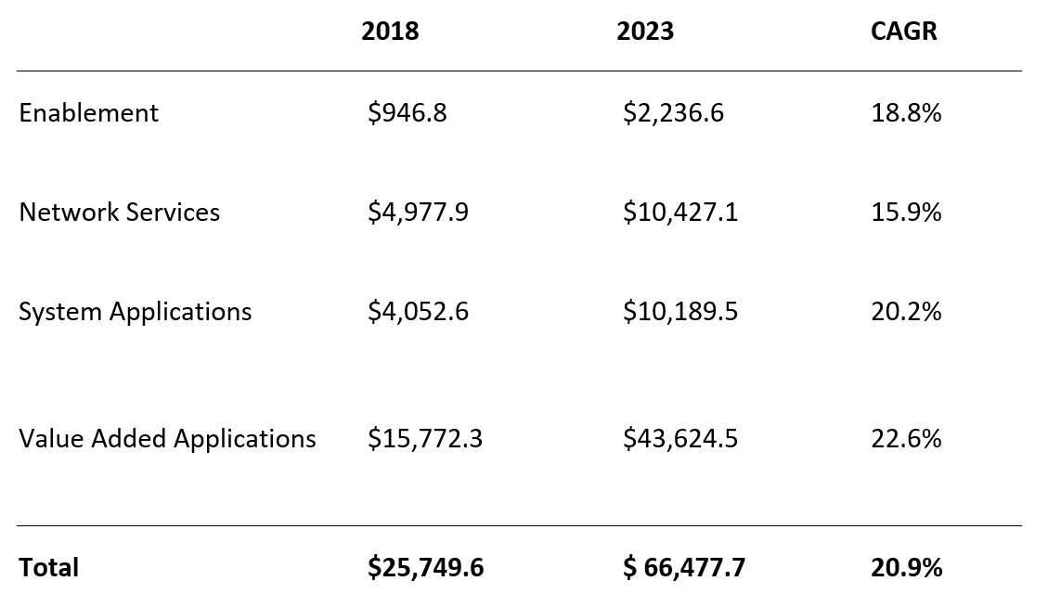
Smart Systems Revenue For Connected Home Will Reach $66.5B In 2023
CHR Report Figure 3-7

Slide 12
Poor user experience, a lack of privacy and security standards and high costs of products and services are leaving smart home consumers frustrated—exacerbating a disconnect between suppliers and user preferences

Slide 13
Market Development Constrained By Hub-centric Collaboration
CHR Report Figure 1-4

Slide 14
Diverse Device Networks Poses Significant Challenges
CHR Report Figure 1-2

Slide 15
The growth of the Smart Home market is being stifled by the messy aggregation of network protocols, software incompatibility, and winner-take-all attitudes by the main players

Slide 16
Cost & Data Privacy Are Top Reported Pain Points
CHR Report Figure 2-4

Slide 17
Smart Home User Profile Demographic & Behavioral Traits
CHR Report Figure 2-3

Slide 18
Poor user experience, a lack of privacy and security standards and high costs of products and services are leaving smart home consumers frustrated—exacerbating a disconnect between suppliers and user preferences

Slide 19
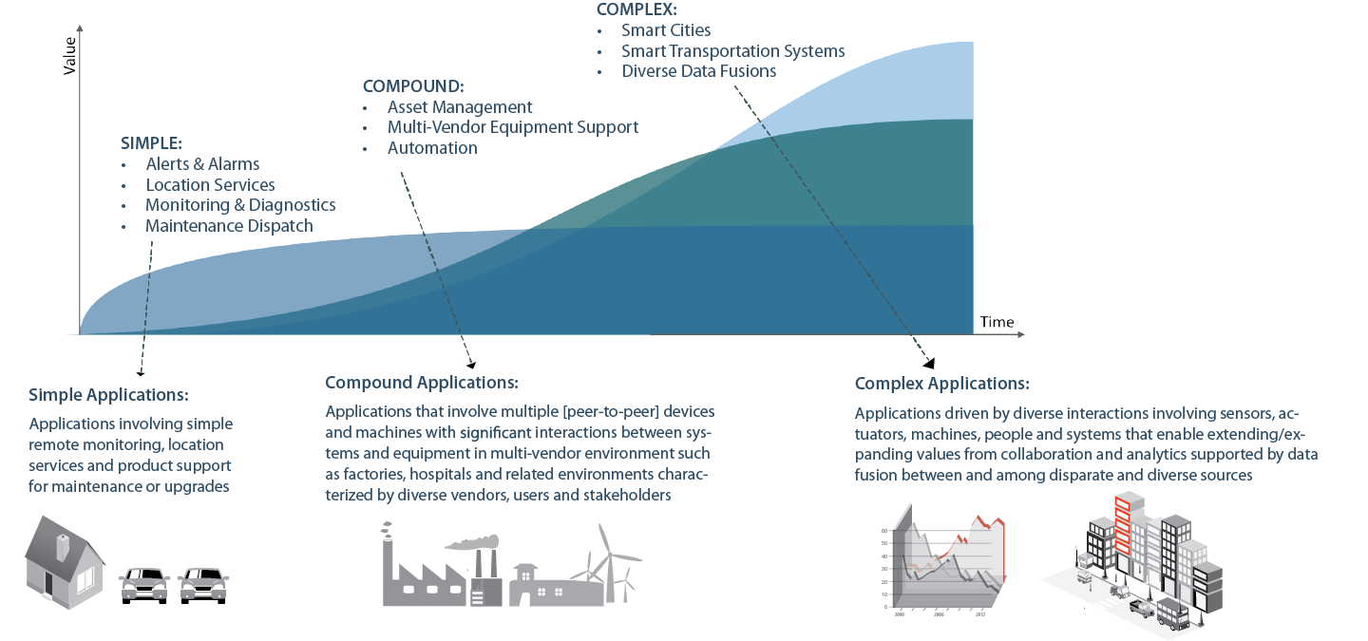





But It’s Still Early In The Game…….
COMPLEX
Supply Chains
Smart Cities
19
Source: CABA Connected Home Roadmap. 2019

Slide 20
Suppliers Can Frame Future Scenarios Around Four Key Trend Areas
CHR Report Figure 3-4

Slide 21
New Technologies Will Enable Complex, Interrelated Applications
Application Evolution
Simple
Apps that involve single devices or narrow values that are based on basic network connectivity and monitoring
(e.g. energy management)
Compound
Apps that involve multiple collaborating, peer-peer devices or significant interactions between and among devices, systems and people
(e.g. ML-enabled energy management for comfort and convenience)
Complex
Apps that drive interactions between and among devices, device sub-systems and people
(e.g. interconnected, personalized energy management for an individual’s health & wellness)
Enabling Technologies
Time
“Currently, energy management is the biggest focus for us – understanding consumption info, improved savings and home management. But this will naturally evolve to a more holistic view of appliance health and monitoring over time... You can leverage data for a lot of different use cases, and this is only expected to expand in the future where we’re currently just scratching the surface in terms of application potential.”
-Director – Product Management & Marketing, Powerley
“We are basically working on scenarios, the ability to learn a sequence of actions by pressing one button. When I wake up in the morning, it turns on the lights, the radio, the heater, etc. We want to integrate AI to understand your habits and suggest a scenario.”
-Program Manager, Sevenhugs

Slide 22
To effectively tap into the $66.5 billion future connected home opportunity, players will need to develop distinct short-, medium- and long-term strategies around ecosystems, technology, customers, use cases / applications and devices

Slide 23








How to Rescue Crumbling UX: Integrated Hardware, Software, & Ecosystem Strategy
Hardware
Ecosystem
Network providers (Zigbee, Z-Wave, Wi-Fi) should align on standardized protocols to ease challenges for tech suppliers and improve user experience.
Tech suppliers should strive for multiprotocol strategies to build devices compatible with several network types.
Suppliers must develop edge computing machines.
Software
OEMs and tech suppliers should partner with software and service providers to drive indirect device sales and interoperability. This will allow suppliers to leverage devices as Smart Home control points.
Service providers should foster complex systems of local mesh networks.
Service providers should partner with real estate developers for long standing contracts and to install devices in new homes.
Software providers should build a platform of platforms to simplify user experience and improve security. OEMs should strive to create localized ecosystems.
Suppliers must future proof products as much as possible by removing contingencies on hardware, where over-the-air updates to software can be the core foundation for maintaining relevance of a product’s capabilities.
Given advancement of user maturity, suppliers must refine consumer data insights and solution R&D to best respond and predict behavior.
Players must invest in blockchain and security to instill confidence in consumers.

Slide 24
Connected Home Roadmap: Improve UX, Open Ecosystems & Build Trust
CHR Report Figure 4-1

Slide 25
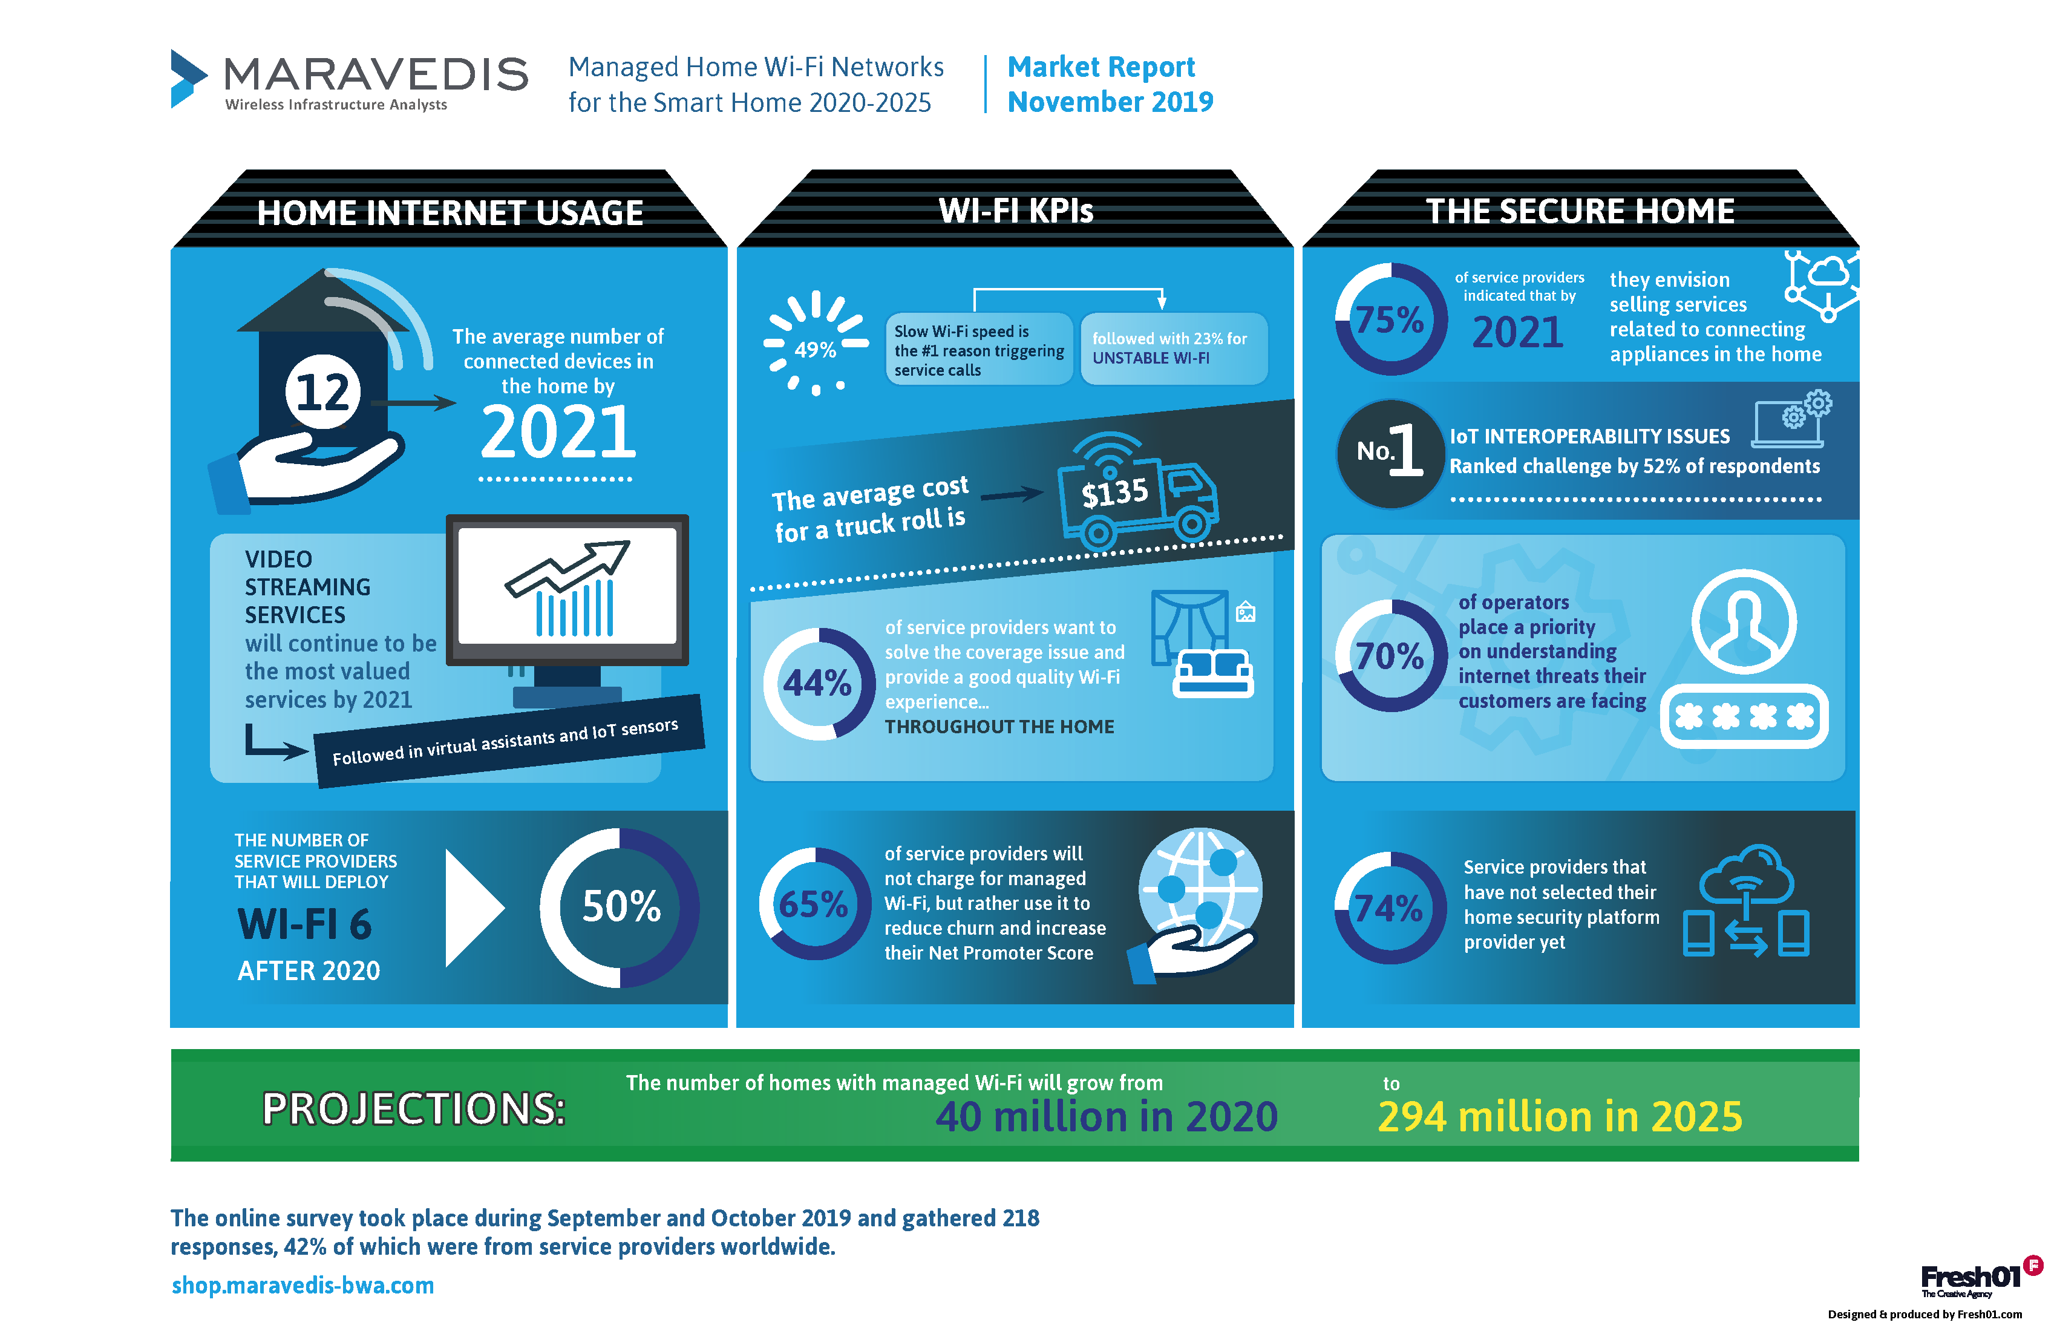
Key Ingredient for Smart Home Growth: Managed Wi-Fi Networks

Slide 26










Final State: Mesh Ecosystems That Promote UX & Supplier Innovation
Kitchen
Living Room
    Impacts on
    Device Suppliers
Impacts on
User Experience
Barriers to Entry
Hardware Costs
Developer Costs
Innovation
Specification Autonomy
Prices
Functionality
Adoption
Outage Risk
Bathroom
Garage & Outdoors
A Mesh Ecosystem involves hubs in different systems (e.g. the bathroom vs. the kitchen) and/or from different providers that are able to communicate with each other and with associated Smart Home devices.
“We think smart home devices should enable greater insight for consumers beyond the walls of the home… We want to orchestrate the habits, preferences and other consumer data to simplify daily planning and tasks that might occur in a vehicle or at a supermarket.”
– CTO and CO-Founder, Aira

Slide 27
Suppliers need to develop user-centric strategies to inform hardware, software and ecosystem roadmaps that address current market inefficiencies

Slide 28
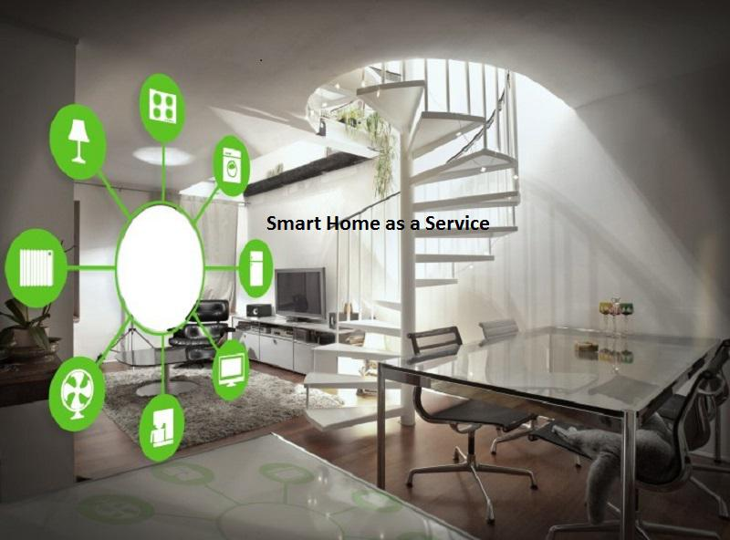
Current CABA Residential Research
“Smart Home as a Service” (SHaaS) – caba.org/shaas

Slide 29
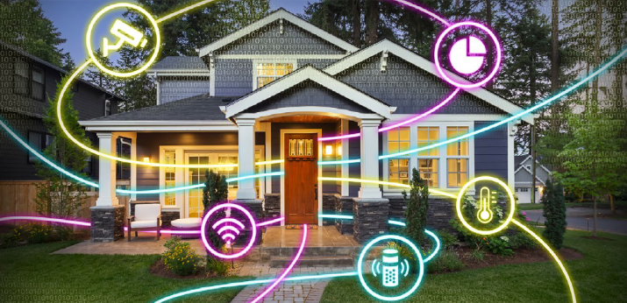
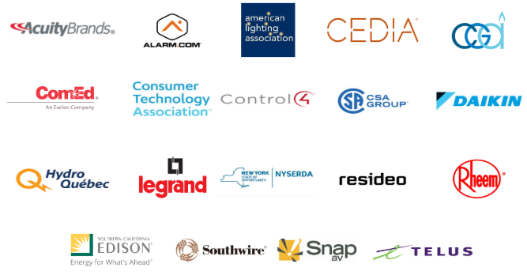


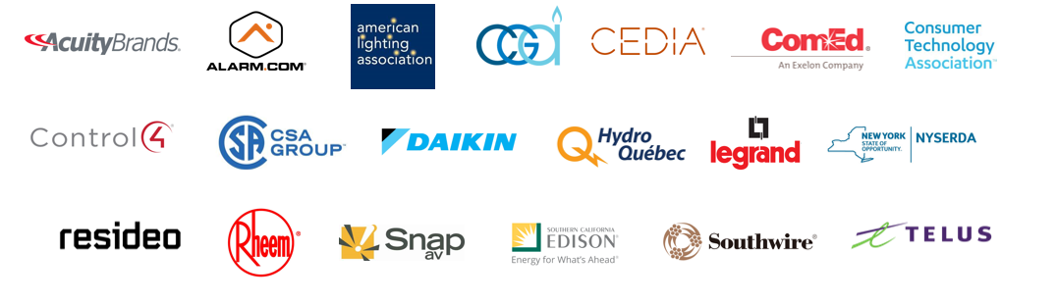

Current CABA Residential Research
2019 “Smart Home as a Service”
29

Slide 30

Thank You, Questions and Contact Info
Continental Automated Buildings Association
(CABA)
613.686.1814
Toll free: 888.798.CABA (2222)
caba@caba.org
www.CABA.org
www.twitter.com/caba_news
www.linkedin/groups/gid=2121884
Connect to what’s nextTM

