Slide 1
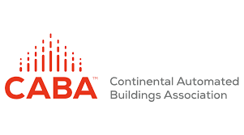
Smart City Planning Using The IEEE P2784 Smart City Planning and Technology Guide

Slide 2
Moderator
Jim Frazer
Chair – IEEE Smart City Planning and Technology Standard P2784
Moderator for the IEEE P2784 Webinar Series
VP Infrastructure and Smart Cities – ARC Advisory Group
Chair – Illuminating Engineering Society’s Roadway Lighting Committee
Led US Department of Transportation Standard for Electrical and Lighting Management Systems NTCIP 1213

Slide 3
Learning Objectives For Today!
What are Smart City Drivers, Barriers and Benefits
Review the five human factors that impact a Smart City
Examine the nine vertical applications and seven technologies that impact a Smart City
Examine use of the IEEE P2784 Smart City Planning and Technology Guide in envisioning, deploying and managing your Smart City Project

Slide 4
Learning Objective One
What are Smart City Drivers, Barriers and Benefits

Slide 5
The Digital Transformation of Public Agencies
“There’s a lot of discussion about digital transformation,” Salesforce.com Co-CEO Keith Block - at the World Economic Forum.
When I speak to other CEOs, we talk about the three pillars of digital transformation.
“The first is really a tech refresh.” Block was referring to updating technologies within an organization to maximize efficiency. An example of that would be when a company moves from on-site technology to cloud technology. However, just doing a tech refresh is not in and of itself digital transformation, according to Block. “You have to do all three elements of digital transformation.
Second is a business model change.” He explained that this not limited any one industry but applies to all industries. An example Block gave was how companies that typically have business to business (B2B) models are thinking about also moving to direct to consumer (DTC) strategies. These shifts are considered business model changes, according to Block.
Lastly, the third pillar of digital transformation is cultural. “So you’re introducing new technologies into an organization. You have to ask ‘what is the ethical use of that technology?’ You have to ask about the impact on the workforce, and is your organization ready to accept that technology? What are the implications of re-skilling, which is a big topic of the fourth industrial revolution.”
This is just the beginning, Block argued. “These transformations will take some time. Everybody absorbs these technologies at a different pace... We see a lot of opportunity to drive great results for our company but more importantly for our customers.”

Slide 6
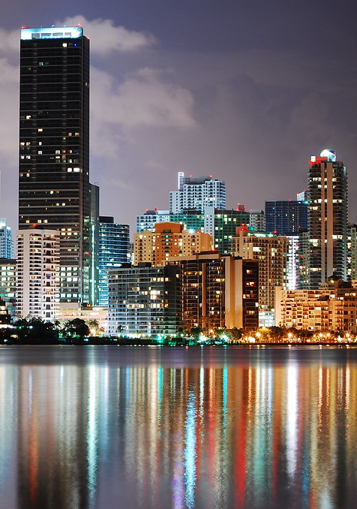
What are Major Smart City Drivers?
Growing urbanization. People are moving to cities at an unprecedented rate. Over 700 million people will be added to urban populations over the next 10 years.
Growing stress. Today’s cities face significant challenges – increasing populations, environmental and regulatory requirements, declining tax bases and budgets and increased costs
Inadequate infrastructure. Urbanization is putting significant strain on city infrastructures that were, in most cases, built for populations a fraction of their current size.
Growing economic competition. The world has seen a rapid rise in competition between cities to secure the investments, jobs, businesses and talent for economic success. Increasingly, both businesses and individuals evaluate a city’s “technology quotient” in deciding where to locate.
Notes:
Growing urbanization. Cities deliver many benefits – greater employment opportunities, greater access to healthcare
and education, and greater access to entertainment, culture and the arts. As a result, people are moving to cities at an
unprecedented rate. Over 700 million people will be added to urban populations over the next 10 years. The United
Nations projects that the world’s cities will need to accommodate an additional 3 billion residents by the middle of the
century. A recent UN report suggests that 40,000 new cities will be needed worldwide.
Growing stress. Today’s cities face significant challenges – increasing populations,
environmental and regulatory requirements, declining tax bases and budgets and
increased costs – at the same time many are experiencing difficult growing pains
ranging from pollution, crowding and sprawl to inadequate housing, high
unemployment and rising crime rates.
Inadequate infrastructure. Urbanization is putting significant strain on city
infrastructures that were, in most cases, built for populations a fraction of their current
size. Much of the developed world has infrastructure that is near or past its design
life, requiring massive upgrades. For instance, in 2013 the American Society of Civil
Engineers gave the United States an overall grade of D+ for its infrastructure.
Meanwhile, much of the developing world has missing or inadequate infrastructure,
requiring massive build-outs. The 2012 blackout in India that left more than 600
million people without electricity is a prime example; the country has inadequate
power generation to meet ever-increasing demand. The bottom line? McKinsey &
Company estimates that cities will need to double their capital investment by 2025,
to $20 trillion from today’s $10 trillion per year.
Growing economic competition. The world has seen a rapid rise in competition
between cities to secure the investments, jobs, businesses and talent for economic
success. Increasingly, both businesses and individuals evaluate a city’s “technology
quotient” in deciding where to locate. A real challenge for cities with economies
based on heavy industry is creating job opportunities that appeal to recent university
graduates so they will stay and help build the kind of high-quality workforce that new
industries, for instance those in technology, demand.
Growing expectations. Citizens are increasingly getting instant, anywhere,
anytime, personalized access to information and services via mobile devices and
computers. And they increasingly expect that same kind of access to city services. In
fact, a May 2013 United Nations survey of over 560,000 citizens from 194 countries
revealed their top priorities are a good education, better healthcare and an honest
and responsive government. We also know that people want to live in cities that can
provide efficient transportation, high-bandwidth communications and healthy job
markets.
Growing environmental challenges. Cities house half of the world’s population but
use two-thirds of the world’s energy and generate three-fourths of the world’s CO2
emissions. If we are going to mitigate climate change, it will have to happen in cities.
Many regions and cities have aggressive climate and environmental goals – goals
that cannot be reached without the help of smart technologies. Smart cities are better
able to address resiliency and adaptation to climate change
Rapidly improving technology capabilities. Many of the smart city drivers listed
above are negatives – problems that demand solutions. There are positive drivers
as well, especially the rapid progress in technology. The costs of collecting,
communicating and crunching data have plunged. What’s more, much of the needed
technology is already in place:

Slide 7
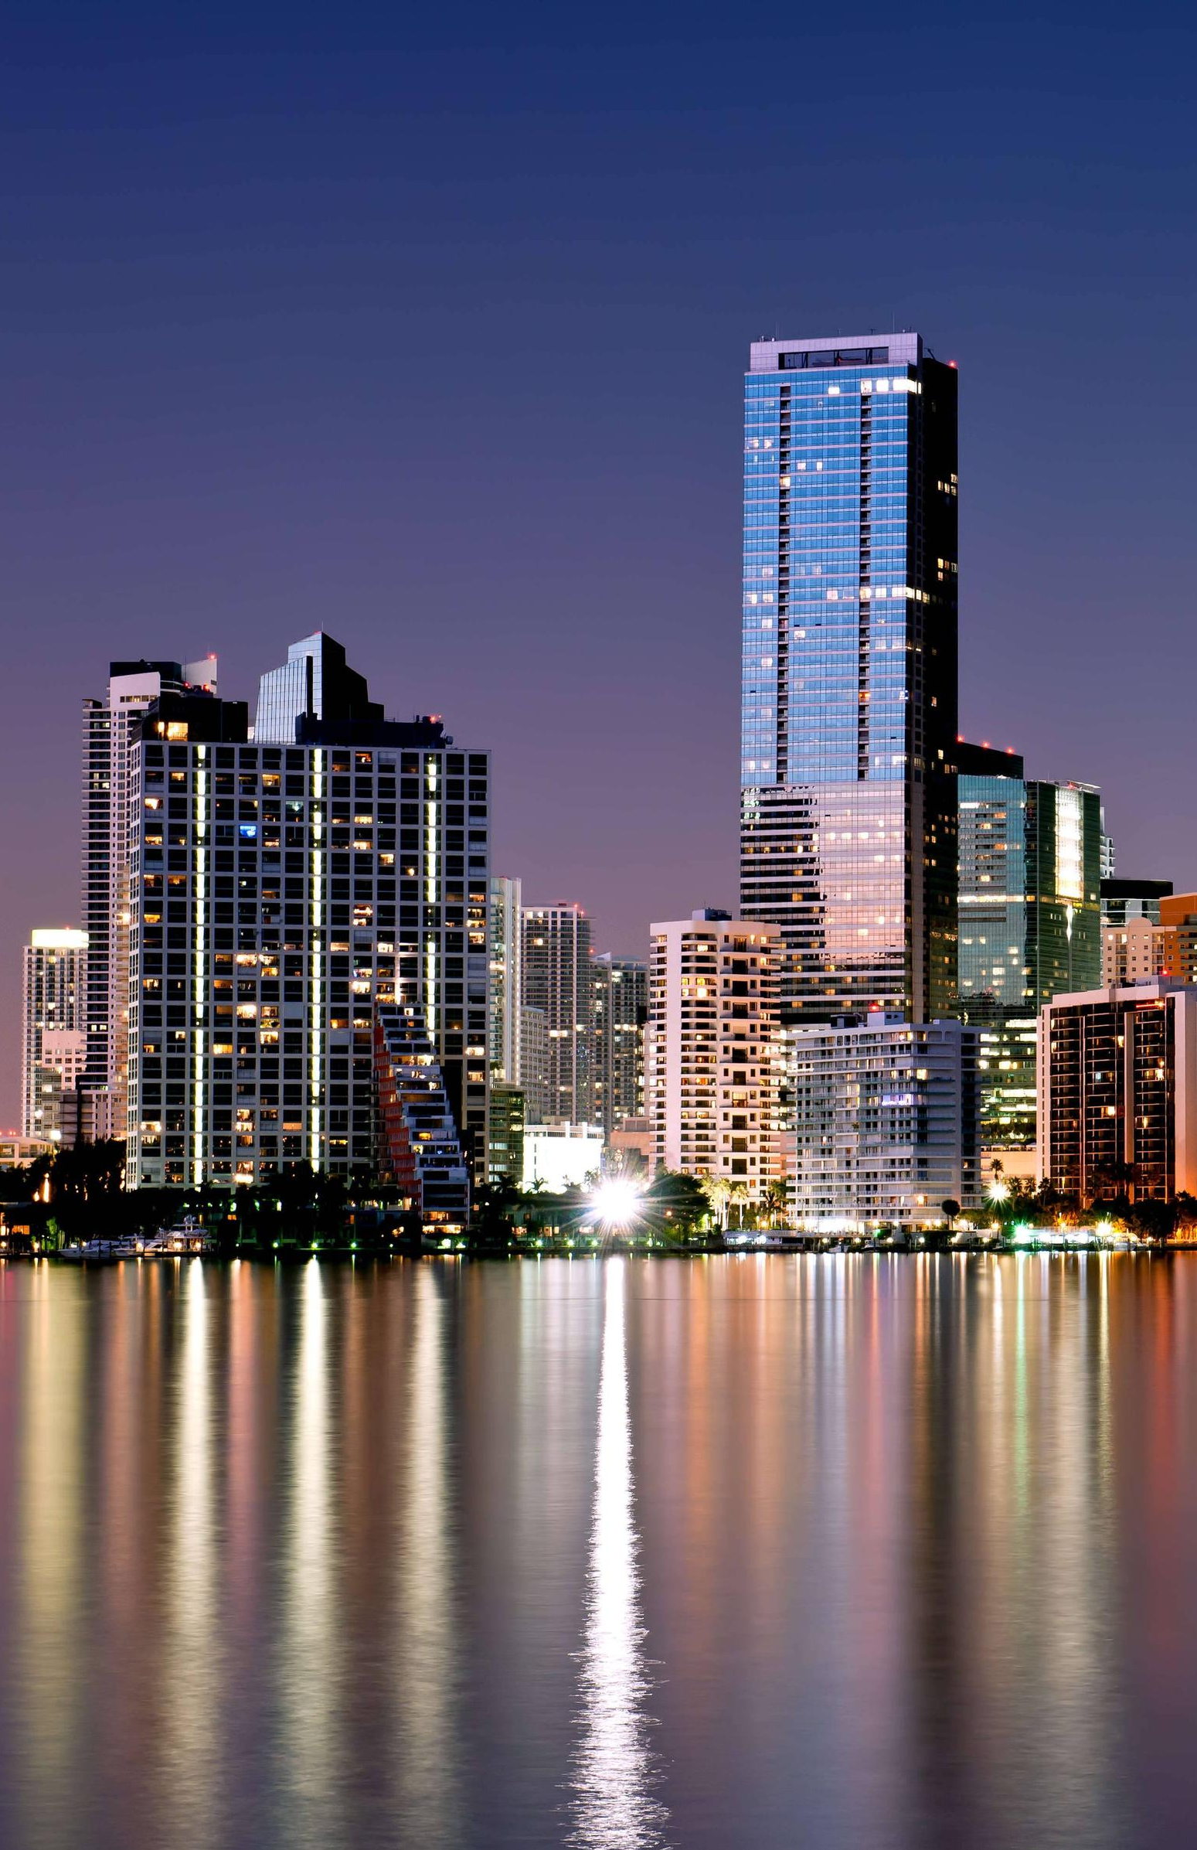
What are Major Smart City Drivers?
Growing environmental challenges. Cities house half of the world’s population but use two-thirds of the world’s energy and generate three-fourths of the world’s CO2 emissions. If we are going to mitigate climate change, it will have to happen in cities.
Growing expectations. Citizens are increasingly getting instant, anywhere, anytime, personalized access to information and services via mobile devices and computers. And they increasingly expect that same kind of access to city services
Rapidly improving technology capabilities. Many of the smart city drivers listed above are negatives – problems that demand solutions. Positive drivers do exist, especially the rapid progress in technology. The costs of solutions are dramatically declining. Additionally in some areas, a substantial amount of the infrastructure is already installed.
Notes:
Growing urbanization. Cities deliver many benefits – greater employment opportunities, greater access to healthcare
and education, and greater access to entertainment, culture and the arts. As a result, people are moving to cities at an
unprecedented rate. Over 700 million people will be added to urban populations over the next 10 years. The United
Nations projects that the world’s cities will need to accommodate an additional 3 billion residents by the middle of the
century. A recent UN report suggests that 40,000 new cities will be needed worldwide.
Growing stress. Today’s cities face significant challenges – increasing populations,
environmental and regulatory requirements, declining tax bases and budgets and
increased costs – at the same time many are experiencing difficult growing pains
ranging from pollution, crowding and sprawl to inadequate housing, high
unemployment and rising crime rates.
Inadequate infrastructure. Urbanization is putting significant strain on city
infrastructures that were, in most cases, built for populations a fraction of their current
size. Much of the developed world has infrastructure that is near or past its design
life, requiring massive upgrades. For instance, in 2013 the American Society of Civil
Engineers gave the United States an overall grade of D+ for its infrastructure.
Meanwhile, much of the developing world has missing or inadequate infrastructure,
requiring massive build-outs. The 2012 blackout in India that left more than 600
million people without electricity is a prime example; the country has inadequate
power generation to meet ever-increasing demand. The bottom line? McKinsey &
Company estimates that cities will need to double their capital investment by 2025,
to $20 trillion from today’s $10 trillion per year.
Growing economic competition. The world has seen a rapid rise in competition
between cities to secure the investments, jobs, businesses and talent for economic
success. Increasingly, both businesses and individuals evaluate a city’s “technology
quotient” in deciding where to locate. A real challenge for cities with economies
based on heavy industry is creating job opportunities that appeal to recent university
graduates so they will stay and help build the kind of high-quality workforce that new
industries, for instance those in technology, demand.
Growing expectations. Citizens are increasingly getting instant, anywhere,
anytime, personalized access to information and services via mobile devices and
computers. And they increasingly expect that same kind of access to city services. In
fact, a May 2013 United Nations survey of over 560,000 citizens from 194 countries
revealed their top priorities are a good education, better healthcare and an honest
and responsive government. We also know that people want to live in cities that can
provide efficient transportation, high-bandwidth communications and healthy job
markets.
Growing environmental challenges. Cities house half of the world’s population but
use two-thirds of the world’s energy and generate three-fourths of the world’s CO2
emissions. If we are going to mitigate climate change, it will have to happen in cities.
Many regions and cities have aggressive climate and environmental goals – goals
that cannot be reached without the help of smart technologies. Smart cities are better
able to address resiliency and adaptation to climate change
Rapidly improving technology capabilities. Many of the smart city drivers listed
above are negatives – problems that demand solutions. There are positive drivers
as well, especially the rapid progress in technology. The costs of collecting,
communicating and crunching data have plunged. What’s more, much of the needed
technology is already in place:

Slide 8
What are Smart City Barriers?
Lack of Information and communication technology (ICT) domain expertise – fortunately there's a robust ecosystem of private partners in this area, many of which specialize in public- private partnerships
Siloed, piecemeal implementations. Cities often tackle challenges in a phased approach, due to annual budgeting and as well as legacy issues that separate city functions into separate, “siloed” departments with little or no interaction. As a result, many projects are built to solve a single problem in a single department, creating “islands of automation” that duplicate expenses while making it difficult to share systems or data.
Lack of capital and financing. Tax revenues are declining in many areas, making infrastructure projects increasingly difficult to deliver. Fortunately, new financial models are emerging. “As-a-Service” monthly subscription payment models require little or no upfront capital from the city. Instead, the city “rents” its solution as it goes – and often once a predefined payment term ends – the city receives title to the infrastructure. This is often used in LED streetlighting retrofit projects.
Lack of citizen engagement – Significant stakeholder outreach and engagement is required – not enough discussion exists today
Notes:
Siloed, piecemeal implementations. Cities often tackle challenges in a phased approach, due to annual budgeting and as well as legacy issues that separate city functions into separate, “siloed” departments with little or no interaction. As a result, many projects are built to solve a single problem in a single department, creating “islands of automation” that duplicate expenses while making it difficult to share systems or data.
Lack of financing. Tax revenues are declining in many areas, making infrastructure projects increasingly difficult to deliver. Fortunately, new financial models are emerging. “As-a-Service” monthly subscription payment models require little or no upfront capital from the city. Instead, the city “rents” its solution as it goes – and often once a predefined payment term ends – the city receives title to the infrastructure. This is often used in LED streetlighting retrofit projects. Additionally performance contracts and shared revenue models between the city and solution vendors provide cities with attractive financing solutions. In many many cases, these smart city solutions have a
rapid payback
Lack of Information and communication technology (ICT) domain expertise – fortunately there's a robust ecosystem of private partners in this area, many of which specialize in public- private partnerships
Lack of integrated services – Siloing
Lack of citizen engagement – Stakeholder engagement is a MUST!

Slide 9
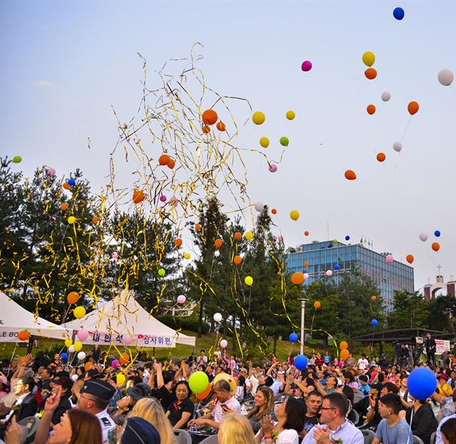
What are Smart City Benefits?
Enhanced livability
A better quality of life for city residents.
Access to a comfortable, clean, engaged, healthy and safe lifestyle.
Highly valued aspects include
inexpensive energy,
convenient mass transit,
good schools,
faster emergency responses,
clean water and air,
low crime and
access to diverse entertainment and cultural options

Slide 10
What are Smart City Benefits?
Enhanced workability
Accelerated economic development - more jobs and better jobs and increased local GDP.
Access to the foundations of prosperity – the fundamental infrastructure services that let them compete in the world economy.
These services include;
Broadband connectivity
Clean, reliable, inexpensive energy;
Educational opportunities
Affordable housing and commercial space;
Efficient cost-effective modes of transportation.

Slide 11
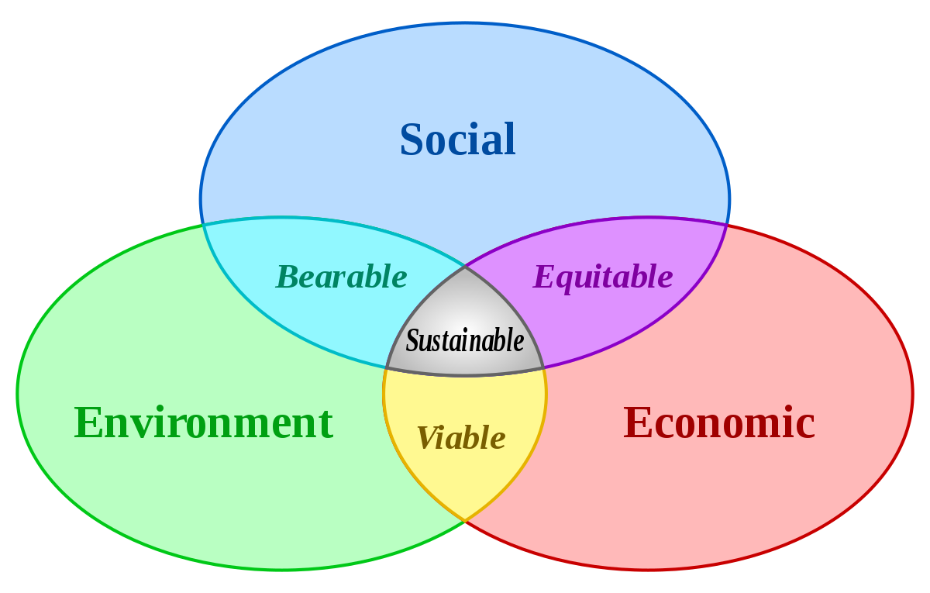
What are Smart City Benefits?
The Three Pillars of Sustainability
1. Preserve and Enhance the Natural Environment
Birds, turtles, bats, soybeans and the night sky
2. Preserve and Enhance the Human Quality of Life
Safety
Visual Acuity
Jobs & Economic Vitality
3. Doing #1 & #2 in an economically
reasonable approach
- Think quick payback!

Slide 12
Learning Objective Two
Review the five human factors
that impact a Smart City

Slide 13
The Five Human Factors
Technological
Social
Economics
Social
Technological
Economic
Environmental
Political
Environmental
Political

Slide 14
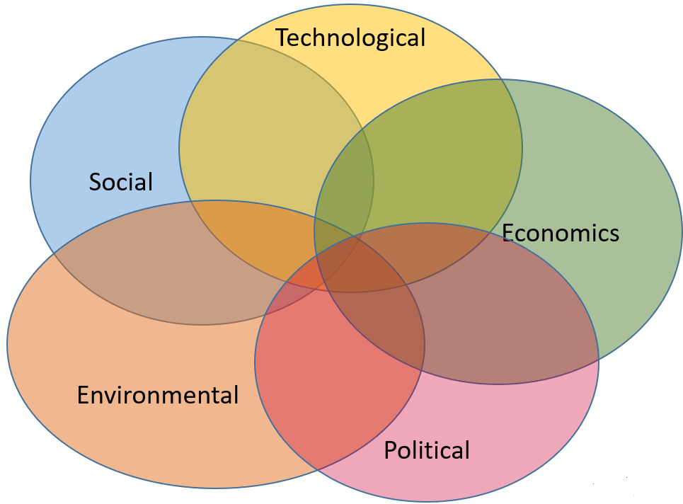
Social Factors
population growth
urban migration
aging society
mobile working
household patterns
inequality
employment
community cohesion
informal settlements
public health
education
individual safety
tourism
global middle class
well-being
sustainable behaviors
digital lifestyles
housing
infectious diseases
entrepreneurship
Next

Slide 15
Technological Factors
automation
Internet of Things
sensors and data
smart infrastructure
intelligent transportation systems
technology leapfrogging
energy efficiency
integration
autonomous vehicles
microgeneration
e-mobility
data connectivity
additive mfg
artificial intelligence
the quantified self
intelligent buildings
cybersecurity
small-scale solutions
remote services
digital modeling
Next

Slide 16
Economic Factors
regional connectivity
aging infrastructure
finance
circular economy
skills shortage
user centricity
responsible business
city resilience
digital economy
urban logistics
urban manufacturing
women’s economic influence
urban regeneration
small business
sharing economy
supply chain vulnerability
informal economy
self sufficiency
city identity
economic growth
Next

Slide 17
Environmental Factors
water management
food security
green infrastructure
ecosystem services
waste minimization
extreme weather
air quality
pollution
urban sprawl
recycling
biodiversity loss
heat stress
sanitation
non-motorized transportation
land use patterns
sea level rise
retrofitted buildings
infrastructure usage
transport motorization
decarbonization
Next

Slide 18
Political Factors
public space
building standards
devolution
policing
urban governance
subsidies
terrorism
system interdependence
environmental policy
leadership
transparency
institutional capacity
public opinion
stakeholder engagement
collective consciousness
public-private partnerships
privatization
competitiveness
global politics
electoral cycle

Slide 19
Learning Objective Three
Examine the nine vertical applications and seven technologies that impact a Smart City

Slide 20
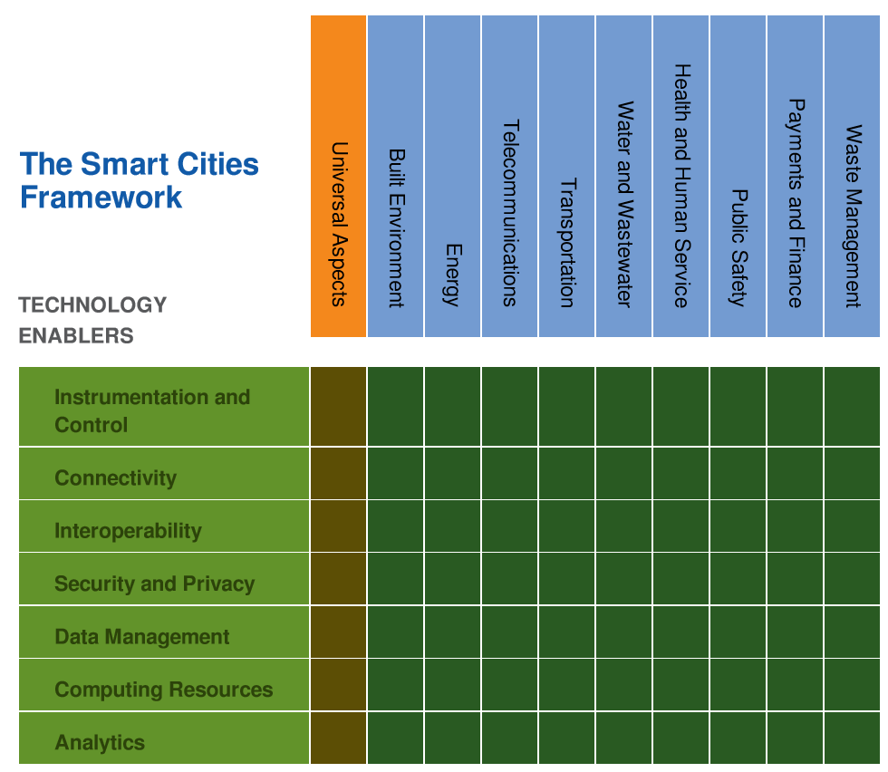
The Nine Smart City Vertical Applications
Buildings
Energy
Telecommunications
Transportation
Water and Wastewater
Health and Human
Services
Public Safety
Payments and Finance
Waste Management
LO1

Slide 21
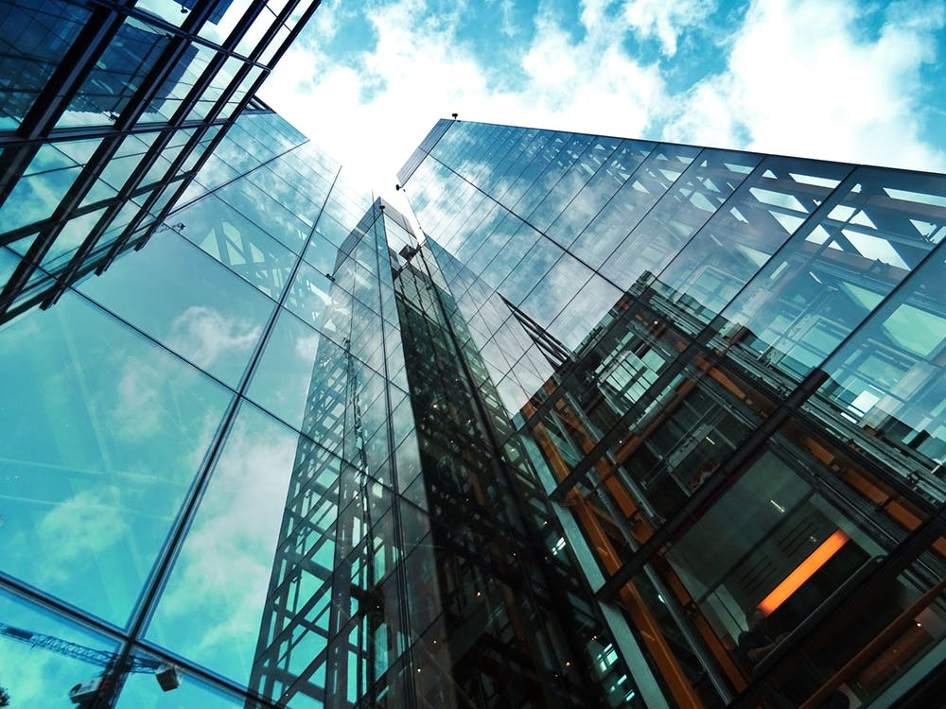
The Nine Smart City Vertical Applications
1. Buildings and The Built Environment
The Built Environment describes refers to all a city’s buildings, parks and public spaces.
This includes schools, firehouses, police stations and hospitals. HVAC, security, lighting are all important parts of this domain.
LO1

Slide 22
The Nine Smart City Vertical Applications
2. Energy Infrastructure
Energy Infrastructure produces and delivers energy, primarily electricity and gas for powering virtually all services and needs, processes and comfort.
This includes the substation, distribution assets, streetlighting and metering of municipally owned utilities as well as those of rural electrical cooperatives.
The technologies of microgrids and energy storage as well as photovoltaic and wind generation are increasingly making an impact in this domain.
LO1

Slide 23
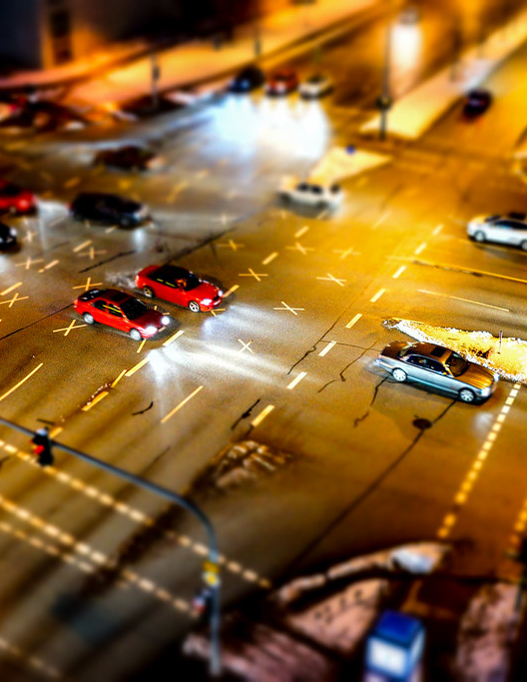
The Nine Smart City Vertical Applications
3. Telecommunications
Today telecommunications is critical for citizen’s safety and well-being as well as for economic vitality of the business community.
High capacity, well-priced broadband is required for virtually all business activities today – from call centers, and retail distribution hubs, to server farms and medical imaging and telepresence.
LO1

Slide 24
The Nine Smart City Vertical Applications
4. Transportation and Mobility
Roads, streets, bike lanes, walking paths, vehicles, public transport, air and maritime ports all are critical.
Today paradigm shifts are happening in many domains of mobility, from transportation service providers like Uber and Lyft, to more highly integrated Mobility-as-a-Service initiatives built on blockchain technology.
Connected Vehicle technologies promise a reduction of incidents by up to 80%, and autonomous vehicles may deliver you or your purchases to a final destination with an efficiency unimaginable just a few years ago.
LO1

Slide 25
The Nine Smart City Vertical Applications
5. Health and Human Services
Telemedicine and educational virtualization / is poised to bring these critical services to underserved communities whether rural or urban.
Community outreach and online voting are included here.

Slide 26
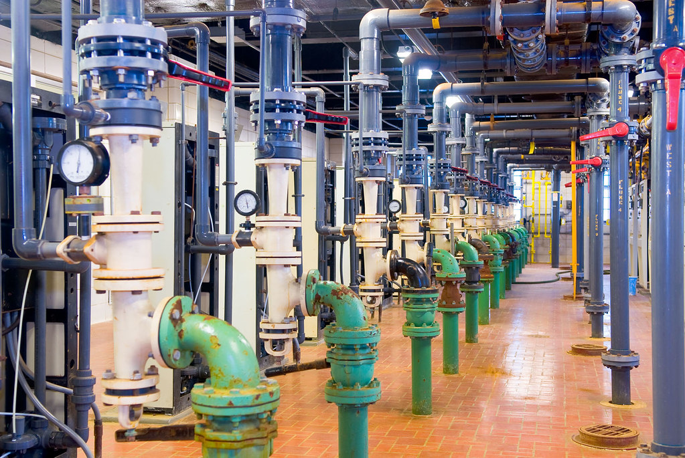
The Nine Smart City Vertical Applications
6. Water and Wastewater
Water infrastructure includes collection, distribution, metering and reclamation.
Water purity and cleanliness are also addressed here, as well as reuse of treated wastewater for irrigation.

Slide 27
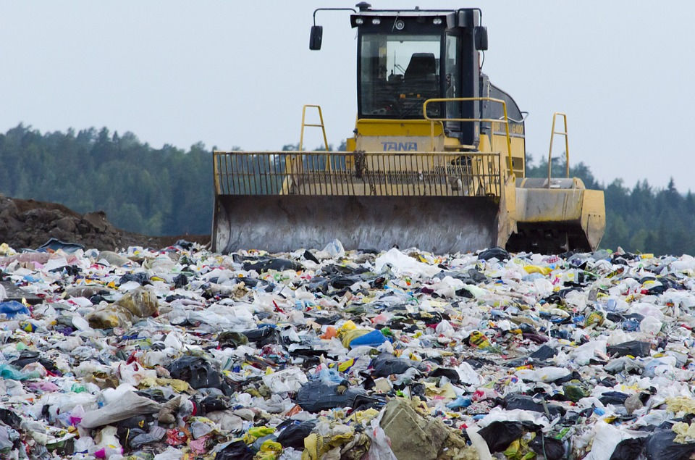
The Nine Smart City Vertical Applications
7. Waste Management
The infrastructure responsible for the collection, distribution, reuse and recycling of waste materials. Worldwide, incinerators and landfills are increasingly viewed as non-optimum methods for processing a city’s waste stream.
Thankfully insightful solutions are coming to market that address these critical issues.

Slide 28
The Nine Smart City Vertical Applications
8. Public Safety
Public safety infrastructure, agencies and personnel keep citizens safe.
This includes the police, fire and EMS first responders as well as emergency and disaster prevention and management agencies, courts and corrections facilities.
Law enforcement body cams as well as IoT-enabled gunshot location systems are in this domain.

Slide 29
The Nine Smart City Vertical Applications
9. Payments and Finance
Sales taxes, property taxes, income taxes or user fees are all dependent on vigorous economic environment.
Payments are at the core of economic activity in cities and underlie every economic transaction including salaries, consumer spending, business procurement and taxes.
Streamlining the payment process by a simple online bill payment process can yield great dividends.
Unified portals can drive enhanced revenue where registration in one domain – like a city co-ed softball league may detect an address change - creating revenue from a required driver’s license update.

Slide 30
The Seven Technologies of a Smart City
Instrumentation and Control
Connectivity
Interoperability
Security and Privacy
Data Management
Computing Resources
Analytics
LO1

Slide 31
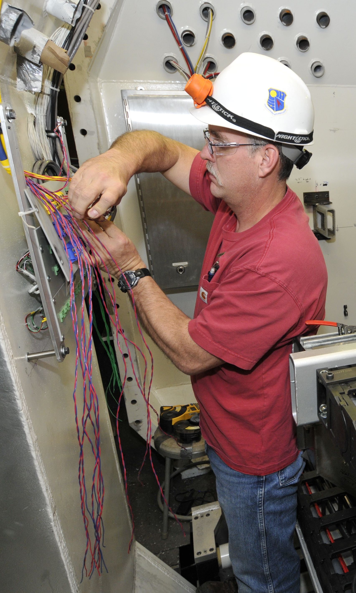
The Seven Technologies of a Smart City
1. Instrumentation and Control Systems
Instrumentation and Control Systems are how a smart city monitors and controls the operational parameters of their electric distribution and metering network, their water system, transportation network and more.
This includes smart meters for electricity, water and gas; air quality sensors; cameras and Intelligent Transportation Systems technology on the roadway.
Examples include switches, breakers and other devices that let operators measure, monitor and control both on-site and remotely.

Slide 32
The Seven Technologies of a Smart City
2. Connectivity
Connectivity is machine-to-machine communications and is how the smart city’s devices communicate both with each other and with the management center.
Connectivity ensures that data is promptly delivered to where it is analyzed.
Examples include citywide WiFi networks, cellular networks as well as networks for electric metering, streetlighting and traffic signal control.

Slide 33
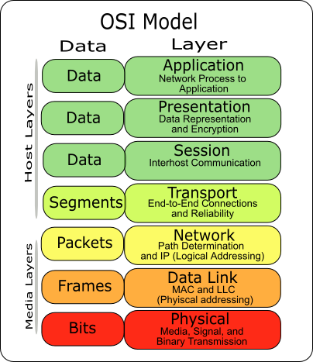
The Seven Technologies of a Smart City
3. Interoperability
Interoperability ensures that products and services from disparate providers can exchange information and work together seamlessly.
Interoperability’s many benefits include allowing city management to choose between many suppliers – thus eliminating long term costly sole source agreements.
Interoperability also drives product commoditization – thus driving down the acquisition costs.
Lastly, it allows future-proofing a project – a solution can be built out over time without concerns about whether newly added segments will “plug-and-play” with those installed earlier.

Slide 34
The Seven Technologies of a Smart City
4. Security and Privacy
Security and Privacy are technologies, policies and practices that safeguard data, privacy and physical assets.
Today, the publishing of clear privacy rules and the implementation of a cybersecurity system is of prime importance.
Security and privacy is foundational in smart cities efforts as it builds trust with citizens, public agency staff, the business community and other important stakeholder groups. Building this trust is an imperative, as without it, Smart City initiatives may experience significant stakeholder pushback.

Slide 35
The Seven Technologies of a Smart City
5. Data Management
Data Management includes processing and storage of data and ensuring its accuracy, accessibility, reliability and timeliness.
Data is perhaps the most foundational building block of a smart city initiative.
To maintain data integrity and value, good stewardship using industry best practices and standards is required – including proper policies around access, authentication and authorization.
To allow cross-pollenization of applications across a city’s often siloed departments, open data standards should be employed.

Slide 36
The Seven Technologies of a Smart City
6. Computing Resources
Computing Resources include embedded near real-time control system components up to substantial data center server farms.
It’s important to define this term broadly as it includes mobile phones, handheld communications device on private first responder networks, and all personal computers on the network.
It can include police body cams and other video surveillance systems as well as other edge devices.

Slide 37
The Seven Technologies of a Smart City
7. Information Analytics
Information Analytics create actionable information from the raw data that instrumentation and control system collects.
This can include
crowd control or gunshot detection analytics in order to determine where to best deploy a police presence,
electricity demand response analytics in order to determine the best energy efficiency incentive for customers - in near real-time, and
fastest and least expensive routes for transit users.

Slide 38
Learning Objective Four
Examine use of the IEEE P2784 Smart City Planning and Technology Guide in
envisioning, deploying and managing
your Smart City Project

Slide 39
What’s IEEE P2784 Smart City Planning and Technology Guide?
Three Major Sections
How to Create a Plan for Your Smart City
An Overview of the Nine Vertical Applications and the Seven technologies that Impact them
Where to go to learn more
Let’s focus on Section 1

Slide 40
Planning: The Systems Engineering Process
The Three Classical Steps of SEP
Develop USER NEEDS
Define the Stakeholder Communities Comprehensively
Extract narratives from each community describing their user needs over the entire life cycle of the proposed project
Examine the results to determine which have CONSENSUS
Develop FUNCTIONAL REQUIREMENTS for a Project Specification / RFP
-by refining those consensus-based needs into measurable functional requirements
Create TEST PLANS to confirm at every step of the project that
all consensus-based user needs are met, and that
No extra functional requirements have been inadvertently introduced

Slide 41
Defining Your Stakeholder Communities
Elected Officials | City Manager | Code Enforcement | Business Community | Taxpayers | Environmental Groups | Special Tax Districts
Bicyclists | Pedestrians | School Board | Parent Teacher Associations | Citizen Groups | Maintenance Staff | Operations Staff
City Engineer | City Attorney | Metropolitan Planning Organizations | Department of Transportation | State Energy Efficiency Statutes | Geographically adjacent agencies | Utilities

Slide 42
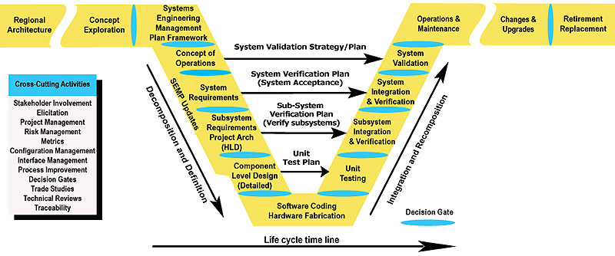
Stakeholder Management / SEP In Detail
Testing
User Needs
Functional Requirements

Slide 43
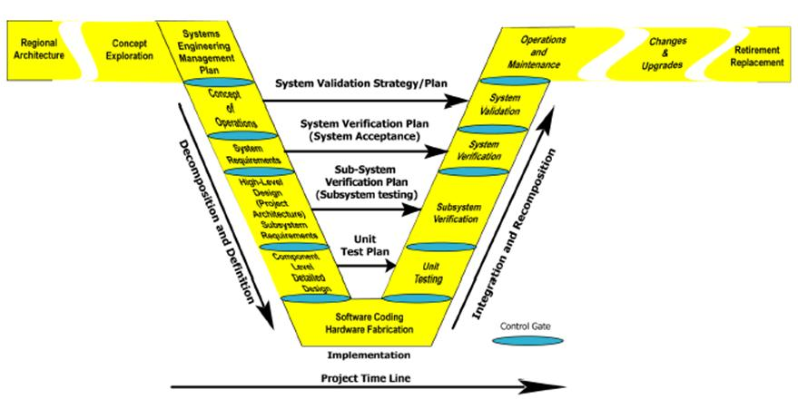
Key Concepts of Using the SEP
The systems engineering process (SEP) seeks to:
Consider the entire life cycle of a system
Focus on stakeholder involvement
Understand the problem to be addressed
Address project risks as early as possible
Clearly document the process and the output of each step
SEP is scalable based on size, complexity, and risk of project
Notes:
Key Message: Lists several key concepts of SEP.
Consider the entire life cycle of a system. SEP does not just concern itself with the timeline of a project’s start to completion; SEP considers planning activities that occur before the project starts. SEP covers steps following initial deployment including operations and maintenance and system retirement or replacement.
Focus on stakeholder involvement. SEP involves the stakeholder in all steps in the process, from identifying the needs through system validation. Stakeholder involvement is a key to the successful application of SEP.
Understand the problem to be addressed. View the problem from the stakeholders’ point of view by defining needs from the user’s perspective.
Address project risks as early as possible. The earlier a risk is identified and resolved, the less cost and/or schedule impact there will be on the project.
Clearly document the process and the output of each step. SEP should be tailored to each project—it is not one-size-fits-all. Regarding outputs, stakeholders must review the outputs of each step in the process and make informed decisions about proceeding to the next step.
SEP is scalable based on the size, complexity, and risk of a project. SEP is definitely not a one-size-fits-all process. It can and should be tailored to fit the needs of the project.

Slide 44
Benefits and Costs of SEP
Benefits
Improve the quality of products created by the project
Reduce the risk of schedule and cost overruns
Increase the likelihood that user needs will be met
Improve stakeholder participation
Provide better documentation
Reduce operational costs
Costs
SEP causes some reapportionment of cost with additional effort needed early in process and during verification
Notes:
Key Message: Summarizes benefits of SE and the cost of using the SEP.
Benefits: Systems engineering can improve the quality of the products created by an ITS project, reduce the risk of schedule and cost overruns, and increase the likelihood that the implementation will meet the user’s needs. Other benefits include improved stakeholder participation and better documentation of not only the end products, but of the development process itself. Anyone who has tried to pick up a project midstream after a key person unexpectedly leaves will understand the benefit of good documentation during the development effort. In addition, the benefits of using the SEP can continue throughout the life cycle of the system developed through reduced operational costs as a result of implementing the product correctly the first time, thereby reducing the need for later modifications.
Cost: The SEP has several outputs prior to the design phase that require expenditure of resources to complete, but doing this can provide the benefits shown. In general, the use of SEP will result in more effort expended at the early stage of the development process—those steps leading up to detailed design. Additional costs may also be incurred during the systematic verification.

Slide 45
What We Learned Today!
What are Smart City Drivers, Barriers and Benefits
Review the five human factors that impact a Smart City
Examine the nine vertical applications and seven technologies that impact a Smart City
Examine use of the IEEE P2784 Smart City Planning and Technology Guide in envisioning, deploying and managing your Smart City Project

Slide 46
Thank You
FREE Full Smart Cities Workshop
1-5PM This Thursday
Renaissance Seaworld Orlando
Tickets: https://bit.ly/38Y7fAe
Questions?
Jim Frazer
www.linkedin.com/in/jfrazer
jfrazer@arcweb.com
https://twitter.com/smartcityvwpts

