Slide 1
2018 Landmark Research Report: Monetization of Intelligent Buildings
Harbor Research

Slide 2
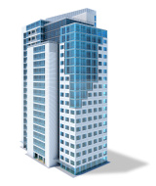
About CABA
CABA (Continental Automated Buildings Association)
Vision
CABA advances the connected home and intelligent buildings sectors.

Slide 3
CABA Steering Committee

Slide 4
CABA All Funders

Slide 5
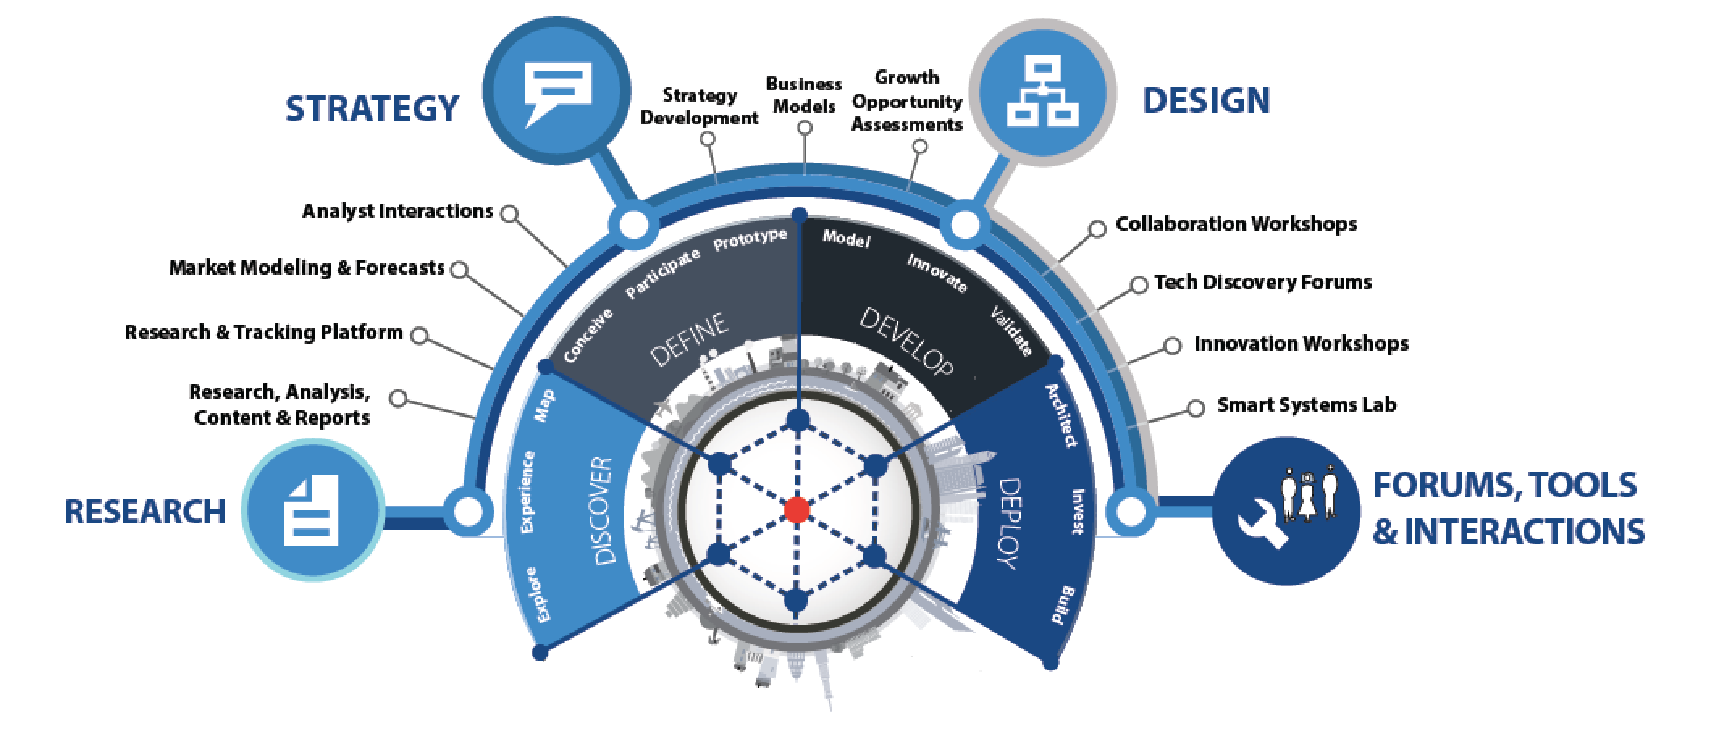
About Harbor Research
Founded in 1984, Harbor Research Inc. has more than thirty years of experience in providing strategic consulting and research services that enable our clients to understand and capitalize on emergent and disruptive opportunities driven by information and communications technology. The firm has established a unique competence in developing business models and strategy for Smart Systems and the Internet of Things.
Strategy Consulting
Our strategy and business development consulting services deliver creative innovation tools, practical methods and applied problem solving.
Research and Content
Our research, tracking, and market intelligence services provide an accessible learning environment for those who are trying to wrap their arms and minds around emerging disruptive opportunities.
Smart Systems Lab
We are creating a real-world laboratory where organizations design, prototype, and test new models for delivering value and differentiation. The Lab’s mission is to enable business model, technology, and system-level innovation enabled by the Internet of Things.

Slide 6
Research Goals
1
Examine the impact that “Internet of Things” (IoT) technologies will have in the intelligent buildings market.
Conduct a detailed analysis about the future state of the building marketplace, including key trends, buying behaviors, technology challenges and opportunities.
Identify top case studies of IoT technologies and applications and the innovative players driving successful solutions
Provide actionable insights as it relates to new and emerging monetization models and business strategies for intelligent buildings.
Develop go-to-market/channel requirements to highlight the role of different stakeholders
Make recommendations for how firms should structure their organization and offerings to capture new value from smart, connected offerings.
2

Slide 7
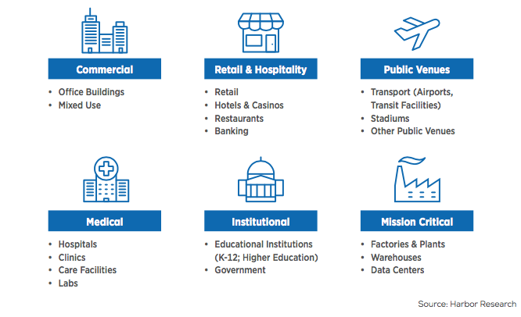
Report Organized by 6 Key Verticals Within Commercial Buildings

Slide 8
Summary
1
Emerging smart buildings technologies expand the potential opportunities for suppliers to monetize their products and solutions
2
Users’ payment preferences and coordination with other ecosystem players shape tech suppliers’ monetization opportunities
A
Users want to pay for things according to their perceived risk and return on investment, which is based on the use case category
B
Position in ecosystem, solution type, and relationship with stakeholders determines monetization opportunities
3
In turn, these business models will drive new, more profitable and dependable monetization models
4
Focusing on optimizing monetization can help suppliers unlock the $32.4 billion intelligent buildings opportunity by 2023

Slide 9
Emerging buildings technologies expand the potential opportunities for suppliers to monetize their products and solutions

Slide 10
Smart Systems Bring New Age of Value Creation and Data Monetization
Peer-to-peer information, social networking and pervasive computing are combining to create new modes of collaboration and decision making, enabling the convergence of physical and virtual worlds.
Social networking technologies are moving to the enterprise and will be embraced differently than in the consumer space. Network awareness will include pervasive knowledge share between people and things.
The foundation of smart systems is based on leveraging embedded computing, software and networking technology to deliver smart, remotely monitored assets that will support entirely new modes of customer-device interaction and service delivery.
The core platforms that inform smart systems combine new innovations in software and information architectures with data collection, aggregation, integration and management tools.
The three previous waves of technology each have had significant impacts on productivity and efficiencies; mainframes standardized transactions, personal computing placed processing power into the hands of professionals, and networked systems enabled business process automation. What is important about this next wave of smart systems is the combined impact of these innovation cycles.

Slide 11
Key Smart Systems Opportunities in Commercial Buildings
Innovation
As the world trends towards smart systems, innovations coinciding with each segment, will be necessary — monetization is dependent on the solution, supplier, and operator.
Addressing Horizontal Needs
The intelligent commercial buildings space is defined by horizontal pain points as well as segment-specific elements such as budget options, willingness to pay, and consumer interaction.
Proving Value
Horizontally, pain points such as budget and intangible ROI lead to operator preferences that typically need up-front solutions that increase operational efficiencies of existing and necessary systems.
Targeting Early Adopters
There are unique use cases across segments. Early adopters are used as proving grounds, before new products demonstrate tangible ROI and can be implemented in segments with operators that have a lower willingness to pay.
Optimizing Monetization
Important factors of monetization include use case category, operator attitudes (prefer to pay upfront, wants the solution to prove its worth with performance-based evaluation, etc.), and several other key considerations.

Slide 12
Combination of Trends Influences Outcomes of Monetization Strategies
Innovative startups are introducing new technologies and service models
Reduced costs of sensors and devices are driving new use of data and corresponding business models
Emerging data-centric business models are requiring new monetization models
Broader range of high-performance networks is introducing new and cost-effective solutions
'Strange bedfellow’ partnerships are creating opportunities to create value across systems
Access to real-time data is driving unprecedented visibility and control of building networks
Incumbent building tech vendors are opening their systems to incentivize multi-vendor collaboration
Adoption of advanced data management, AI, and machine learning is leading to more automation
Competitive
Technology
Socioeconomic
Customer
Regulations are driving building system upgrades with an emphasis on energy efficiency
Customers are demanding tangible value from building systems and software providers
Growing demand for Smart City systems is creating opportunities for integration with city infrastructure
Physical and cybersecurity threats highlight need for convergence of IT and facilities security
Increasingly tech-fluent occupants are creating demand for smarter and more robust experiences
Building occupant-centric solutions and services is creating a new value-added services opportunity

Slide 13
Device Installed Base Will Reach Just Over 1 Billion Units in 2023

Slide 14
Users’ payment preferences and coordination with other ecosystem players shape tech suppliers’ monetization opportunities

Slide 15
Different Buildings Venues Pose Unique Challenges for Suppliers
Commercial Buildings | Retail and Hospitality | Public Venues | Medical | Institutional (Education & Government) | Mission Critical
Suppliers must adopt new monetization models to ensure tenant comfort and maximize revenue. | Top applications include: comfort and convenience, and customer engagement and satisfaction. | Top priority is handling large fluctuations of people, including direction, security and maintenance. | Top priority is uptime assurance and operating cost optimization. | Socioeconomic factors impact requirements for scheduling, comfort, and efficiencies in the waiting room. | Industrial buildings need security, uptime, and safety, requiring vendor coordination for complex, interconnected machinery.
Juggling a desire for a lower price point and comfort can force owners/operators to be risk-averse when adopting technology. | Retailers must go beyond basic comfort requirements and generate customer engagement. | Compliance with regulatory oversight agencies presents pros and cons for suppliers. | Medical venues work with single building system vendors, or collective bargaining agreements with other medical facilities to lower prices. | Gaining approval through a single entity opens the door for the vendor to more easily pursue sales across multiple public facilities. | Data center performance requires cybersecurity, cooling, energy management, and ongoing equipment performance monitoring.
New uses are unlocked by extending communication abilities such as automated help and by adding new devices, such as digital signage. | Smart payment, smart kiosks, and digital signage are rising, shrinking wait time, improving experience, and reducing operational costs. | Top features include digital signage, smart parking, wayfinding, and ubiquitous connectivity. ROI is less tangible for operators and suppliers. | Asset management is top of mind, creating demand for RFID tags and real-time-location-services (RTLS). | As funding increases for smart cities, building upgrades create demand for technologies such as smart parking and digital signage. | Personnel wear tracking tags integrated with machine sensors to alert workers of emergency.

Slide 16
Decision Makers Face Challenges of Costly and Complex Implementation of Tech
Top Application Opportunities Across Commercial Building Segments
Energy Efficiency | 25 percent of respondents noted energy efficiency verification and measurement as the number one-use case that operators would be most willing to adopt and would make a positive impact on operations.
Building Occupancy Sensing | Detecting lighting and other means of converting energy efficiency garnered the vote for top use case from 20 percent of respondents.
Asset and Predictive Maintenance | 19 percent of votes for the top use case among operators
Top Buildings Tech Pain Points Across Commercial Building Segments
Complex and Costly Set-Up and Implementation | 38 percent of respondents noted the selection and price, both upfront and through services is a key inhibitor for adoption.
Complexity of Integration with Current Systems | 47 percent of respondents noted implementing or retrofitting new modern, connected devices into existing systems leads to problems with interoperability.

Slide 17
Tenants Value Comfort and Experience, While Owners Want Efficiency
Top Use Cases Across Commercial Building Segments
Tenants | Retail Consumers | Hospitality Consumers | Restaurant Consumers | Building Decision-Makers
Occupancy Sensing | Identity Management to Prevent Financial Data Fraud | Smart Signs | Building Energy Efficiency and Use of Renewable Energy | Energy Efficiency
Temperature Optimization | Smart Parking to Guide Shoppers to Open Parking Spots | Occupancy Sensing to support automatic lighting | AR and VR Applications for Food Before Ordering | Occupancy Sensing
Smart Sensors for Automated Lighting Control | Interactive Smart Signs to Guide Shoppers | Voice-Controlled Heating and Air Conditioning | Smart Reservation System | Predictive and Preventative Maintenance
Convenience Services | Interactive Customer Engagement Kiosks and Digital Signage | Smart Phone App for Maintenance and Housekeeping | Interactive Smart Menus | Air Quality
Higher
Rank of Priority
Lower

Slide 18
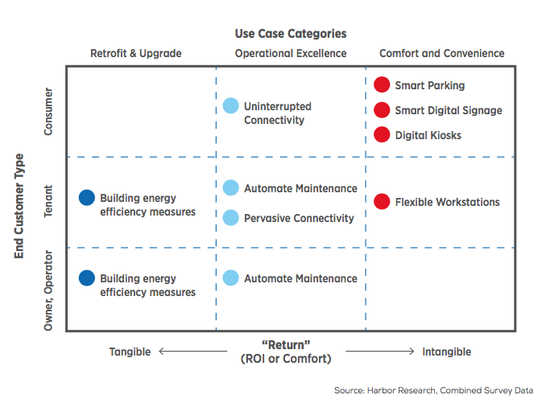
Use Case Categories Impact Owner / Operator Decision-Making
Retrofit & Upgrade: Use cases included in this category include those that are predominately energy management related and that have very tangible metrics for measuring the expected return on investment
Operational Excellence: Use cases that still have quantifiable returns but are less tangible than retrofit and upgrade use cases.
Comfort and Convenience: Use cases that don’t have objective or clear measures of return for the stakeholder
Example: Retail store customers desire interactive digital signage to enhance their user experience, pushing retail store owners/operators to choose less tangible ROI solutions in hopes that ROI is made up in customer loyalty or other qualitative metrics

Slide 19
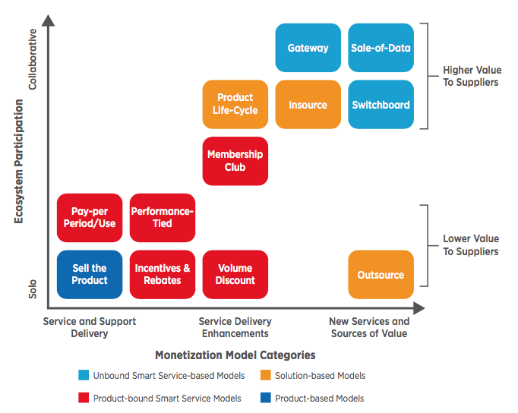
Top Use Cases Aligned with Player Types Result in Monetization Model Alignment
Unbound Smart Service:
Device serves as the point of access to other services which are less automated, or which are not sold directly to the device’s end-user.
Solution-based Smart Service:
Made possible by customer activity chains that have a total value far in excess of the purchase price of the device.
Product-bound:
Revenue is collected not simply for the product, but, in some way, for the associated service.
Product-based:
The embedding of connectivity into the product does not open a great opportunity for selling value-adding services. For these companies, the only revenue model is the same old one, the “one-time transaction” model.

Slide 20
These business models will drive new, more profitable and dependable monetization models

Slide 21
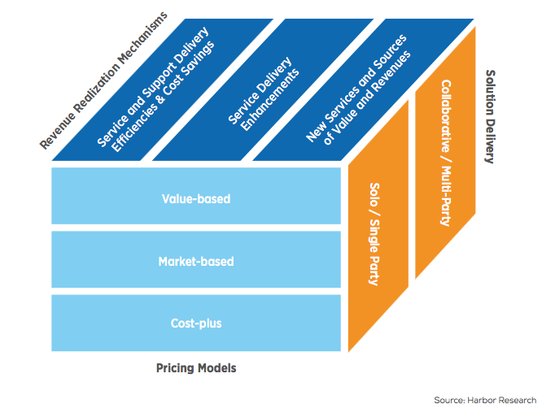
Product, Customers, and Collaboration Drive New Monetization Models
The Impact of Customer Product Life-Cycle Economics & Support Automation
What are the activities the customer engages in, to procure, own, use, and dispose of our product or service?
“Peripheral Vision”: Analyzing Customer Adjacencies and Collaboration
For each of these activities, what else is the customer close to or in contact with when performing the activity?
Solo versus Multi-Party Opportunities
Is there a community of participants who interact with the equipment beyond the primary vendor and the immediate operator of the service, equipment or device?

Slide 22
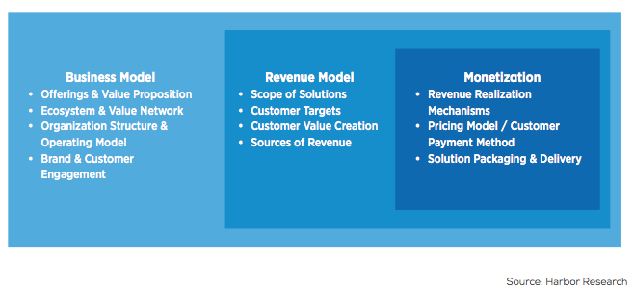
New Value Props Are Changing How Commercial Building Owners Monetize
Revenue Realization
Solution Delivery
Service and Support Delivery Efficiencies and Cost Savings:
As devices send home better information about required maintenance, inventory, the need for software updates or the replenishment of supplies
Service Delivery Enhancements:
Connected products enable the manufacturer to increase the level of extrinsic service the company provides to the customer, as well as the enhanced services impacts on customer loyalty
New Services and Sources of Value and Revenues:
New customer facing network-based services and values, as well as cross-vendor services such as data brokering, new analytics capabilities and other non-traditional values created by data.
Pricing Models

Slide 23
Monetization is Going Beyond Selling The Product
Revenue Realization
Solution-Based Models
Product-bound Service Models
Solution Delivery
Product Life-cycle Model:
Device manufacturer offers basic services based on highest points of device activity
Outsource Model:
Device manufacturer controls the use of the device itself
Insource Model:
A supplier shares risk and reward with the customer by undertaking penalties for downtime
Pay-Per-Period/Per-Usage Model:
Charges made per instance of use or per time period
Performance-Tied Model:
Key incentive for the customer is guaranteed levels of service
Incentives & Rebates Model:
In this model, the product is sold as the gateway to an incentive plan through which sales of other products or services
Volume Discount Model:
Users will be offered automatic discounts based upon volume
Membership Club Model:
A product is bundled with a membership for other products or services
Pricing Models
Unbound Smart Service-based Models
Sale-of-Data Model:
OEM or service provider to share information with third-parties
Switchboard Model:
A many-to-many marketplace in which buyers and sellers can find each other, and the owner of the meeting place takes a share of the proceeds
Gateway Model:
A many-to-one marketplace
Product-Based Models
Product-Based Model:
One-time transaction model

Slide 24
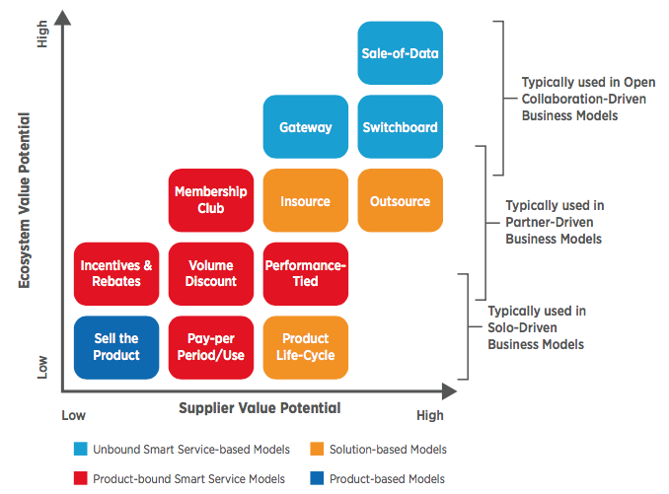
Monetization Models Correlate With Solution Delivery Mechanisms
Revenue Realization
Solution Delivery
Pricing Models

Slide 25
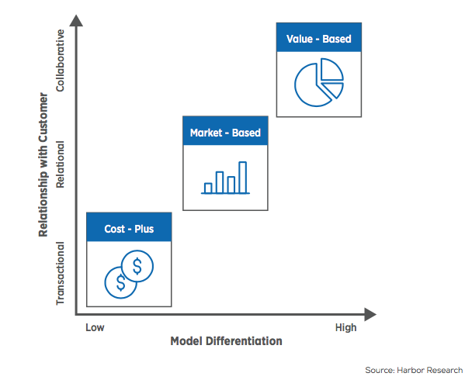
Pricing Model Considerations
Revenue Realization
Solution Delivery
Cost-Plus Pricing
The cost to deliver an offering to the market, multiplied by a desired and customer-acceptable margin, and set a price.
Pricing Models
Market-Based
Customer and competitor-based pricing, adjusted on customer elasticity to buy at a certain price or competitive offerings offering a different price point
Value-Based
Pricing an offering based on the value it gives the end-customer. Flexibility of metrics applied to “value,” including; dollars saved, dollars earned, or less tangible ROI

Slide 26
Focusing on optimizing monetization can help suppliers unlock the $32.4 billion intelligent buildings opportunity

Slide 27
The Intelligent Building Opportunity Will Reach $32B in 2023

Slide 28
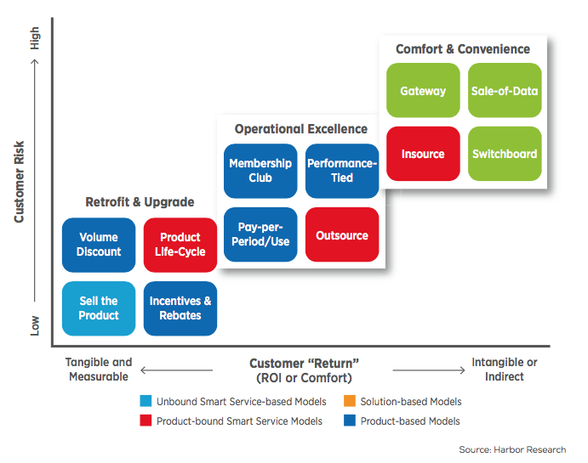
Use Case Categories Drive Customer ROI and Willingness to Pay
Retro-Fit & Upgrade
ROI is tangible (money saved, etc)
Value achieved by purchaser
Payment for proven ROI in 12-18 months typically takes place upfront
Operational Excellence
ROI is less tangible
Requires more complex, partner-driven business models
Payment is tied to value that solutions creates though adjacent or new revenue streams
Comfort & Convenience
Least tangible ROI (tenant comfort)
Use cases require a subscription or value based model
Given intangible ROI purchasers less likely to pay up front for solution

Slide 29
Moving Towards Collaborative Models Can Unlock Additional Value
Foreign to many legacy suppliers, these highly collaborative models are the only way to realize a suppliers’ total potential opportunity
Suppliers that do not move towards collaborative models will be pushed out of market share by suppliers who are collaborating
Upfront payment is enticing for suppliers but ultimately, basic sales of products will proliferate a stagnant spot in the value chain

Slide 30
Considerations by Stakeholder Type
Service Providers
”Role of supplier to customer liaison will facilitate capitalization of solutions.”
Service providers must utilize close proximity to customers and act as intermediaries for technology suppliers and OEMs in delivering value to customers
Owners & Operators
“Expanding indirect revenue streams and added value through technology integration, notably in energy management and tenant comfort and convenience.”
Owners and operators can capitalize on both direct revenue streams from tenants (e.g., energy efficiency or operational uptime) as well as indirect streams through raising rent or through partnerships with other solution providers.
Pure-Play Technology Suppliers
“Communicate the additional value of technology by way operational excellence through network connectivity, software platforms and services”
Focus should be on partner-driven and open collaboration-driven business models to succeed in the intelligent buildings market.
OEMs
“Expand product value through technology-enabled and information-based services”
Traditional sale-of-product models will need to evolve if OEMs and automation vendors hope to capitalize on the intelligent buildings opportunity.
Focus on ecosystem partnership and customer relationship development that is not typically necessary in product-only offerings. Product life-cycle, performance-tied, membership club, pay-per-use, and outsourcing models are all attractive opportunities for OEMs looking to capture value from new software and service solutions.

Slide 31
Contact Harbor Research
Harbor Research 2601 Blake Street, Suite 100 Denver, Colorado 80205
Glen Allmendinger
President
gallmendinger@harborresearch.com

Slide 32
CONTACT CABA
Continental Automated Buildings Association (CABA) 613.686.1814 Toll free: 888.798.CABA (2222)
caba@caba.org www.CABA.org www.twitter.com/caba_news www.linkedin.com/groups?gid=2121884
Connect to what’s next™

