Slide 1
Defining the Pathway to Building-to-Grid Opportunities of Digital Transformation
Casey Talon, Research Director, Navigant Research
January 15, 2019

Slide 2
Overview of CABA
CABA (Continential Automated Buildings Association)
Vision
CABA advances the connected home and intelligent buildings sectors.
Mission
CABA enables organizations and individuals to make informed decisions about the integration of technology, ecosystems and connected lifestyles in homes and buildings.
2
Notes:
- 390 members
- 27,000 contacts
Marketing, networking-councils & liaison,
Events (SBS)-100 companies
Library, WP, collaborative
----------------------------------------------------------------------------------------------------

Slide 3
CABA Board of Directors
3
Notes:
Our BoD feel this could be the most significant piece of research we can create
Different types of organizations
focusing on real ROI
True value of the building
2 spots left: share knowledge and network with key companies and individuals in this space.
---------------------------------------------------------------------------------------------------------------

Slide 4
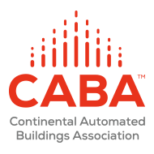
Defining the Pathway to Building-to-Grid
Opportunities of Digital Transformation
January 15, 2019

Slide 5
Agenda
Digital Transformation of the Energy Industry – Introducing the Energy Cloud
Evolution of the Building Technologies Segment – IP-addressable and data-driven
Key Intelligent Building Solutions – IoT, building automation, analytics, services
Business Opportunities – revenue, sustainability, experience

Slide 6
Digital Transformation of the Energy Industry

Slide 7
What is the energy cloud?
Linear value chains supporting one-way power flow from centralized generation to end customers will give way to a more sustainable, highly digitized, and dynamic energy system.
Moving toward a multidirectional network of networks and away from a linear hub-and-spoke model, this system will support two-way energy flows in which customer choice (optionality), clean energy, innovation, and agility command a premium.
Source: Navigant Consulting

Slide 8
What is the role for buildings?
Advanced automation and controls, analytics, services, and energy efficient systems are redefining the commercial building as a business asset.
BUILDING-TO-GRID
A construct to redefine the relationships between buildings and energy.
The B2G platform is the framework for transactions around energy supply and demand associated with the facilities and DER of commercial and
industrial sites.
The bundling of advisory services, data communications, controls, and analytics will be the foundation of B2G solutions that enable the aggregation and coordination of commercial and industrial (C&I) facilities to meet specific economic and corporate objectives, including power reliability, sustainability, and revenue growth.
Digital Transformation
Process of disruption through technology
Energy Cloud
Industry transformation
Building-to-Grid
Segment impact
Source: Navigant Research

Slide 9
What will B2G look like?
B2G is a construct for leveraging digital technologies to optimize the facility performance and experience and open the door to new business opportunities.
From: Automation
To: Integration & interoperability
Market Evolution:
Products & Services:
IoT
Analytics
Managed services for facilities+
Platform:
Building-to-Grid (B2G)
Enabling Technologies:
Building Optimization
DER Controls & Optimization
Smart Grid IT
Source: Navigant Research

Slide 10
Evolution of the Building Technologies Segment

Slide 11
How has the building tech market changed?
Technology has long played a critical role in managing commercial buildings, but today the sophistication has elevated and the reach has expanded.
Legacy
Evolution
Innovation
2019+ Era of Disruption
B2G
Occupant-Centric Experience as a Service
Pre-2005
Building Management Systems (BMS)
2005-2012
Energy Management Software (EMS)
2012-2018
Intelligent Building Analytics
Source: Navigant Research

Slide 12
What is the technology roadmap for B2G?
Customers may leverage existing technologies with supplemental updates or invest in new advanced alternatives. Suppliers are learning from the market development and being challenged to offer cost-effective solutions that utilize comprehensive datasets and analytics to deliver actionable insight.
Automated Systems
Integrated Controls and Automation
Optimized Operations & Business Systems
Orchestrated Energy and Facility Assets
BUILDING TO GRID PLATFORM
Source: Navigant Research

Slide 13
How does the intelligent building break down customer siloes?
Facilities Management: Siloed Operations and Objectives
IoT: Unified and Coordinated Optimization
C-Suite
Financial Management
Financial Management
Energy Management
Functional Lead
Brand
»
Services
Hardware
Intelligent Building Platform
Engineering/ Facilities Management
Energy Management
Analytics
Brand
Operations
Occupants
Operations
Source: Navigant Research

Slide 14
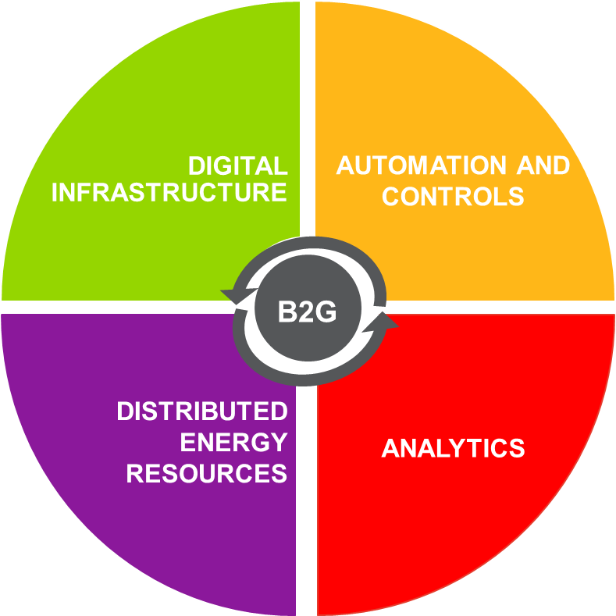
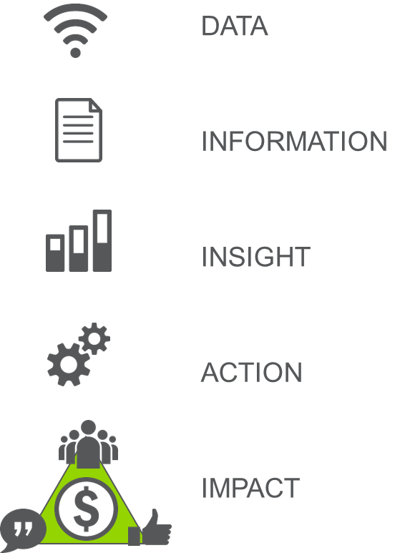
What are the key components to prepare for B2G?
Creating Impact from Data
Enabling Technologies
Source: Navigant Research

Slide 15
What do customers want to begin the journey?
The smart buildings market reflects customer expectations for holistic, data-driven decision-making tools and services that tackle their biggest business challenges.
Customer Expectations and Market-Leading Strategies
Single, Unified Platform
ROI
Flexible offering design to meet unique customer challenges
Focused customer-centric use cases
Business
Impact
SaaS foundation for stickiness and recurring revenue
Source: Navigant Research

Slide 16
How do business goals change priorites?
The generalized use case has proven insufficient to move the needle toward mass market adoption, customized case studies, data, and value propositions are necessary to garner serious interest.
Universal Use Case: Cost Savings via Energy or Operational Efficiency
Real Estate:
Education:
Healthcare:
Retail:
Hospitality:
Optimize rental space to meet customer demands as a means of maximizing Net Operating Income (NOI)
Optimize rental space to meet customer demands as a means of maximizing Net Operating Income (NOI)
Increase worker productivity to improve patient experience to manage costs and reduce hospitalization times
Increase worker productivity to improve patient experience to manage costs and reduce hospitalization times
Maximize indoor air quality and space conditioning to improve student performance and attract/retain students/employees
Maximize indoor air quality and space conditioning to improve student performance and attract/retain students/employees
Utilize wayfinding, space utilization, and indoor positioning solutions to create ease of experience for maximum sales
Utilize wayfinding, space utilization, and indoor positioning solutions to create ease of experience for maximum sales
Sustainability can be a part of the brand strategy, but cost savings, and efficiencies are more impactful benefits
Sustainability can be a part of the brand strategy, but cost savings, and efficiencies are more impactful benefits
Source: Navigant Research

Slide 17
Key Intelligent Building Solutions

Slide 18
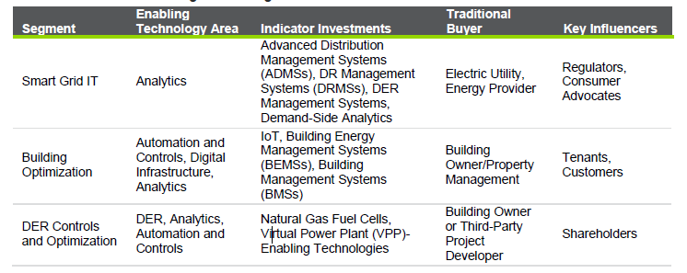
What assets are necessary for a B2G facility?
Source: Navigant Research

Slide 19
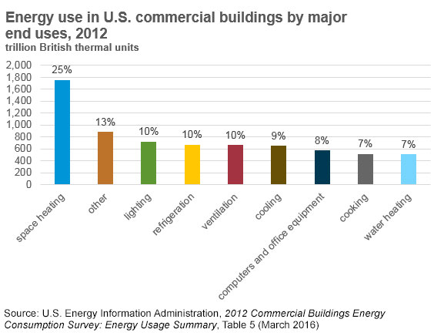
What is intelligent HVAC Optimization?
Reactive
Repair and replace on failure
Preventive
Scheduled maintenance
Predictive
Analytics-enabled proactive maintenance
Unpredictable operating and capital costs
Extended equipment lifespan
More predictable expenses
Integrated with automation and controls
Minimize downtime
Address comfort (hot/cold calls)
Space conditioning accounts for approximately 45% of total energy use in commercial buildings.
(Source: Navigant Research)

Slide 20
How makes intelligent lighting different?
Evolution of Commercial Lighting
Major shift in lighting controls in recent years due to a number of factors
LED technology
Integration of communication technologies
Deployment of sensing devices
Integration of data streams, data processing, and analytics
Results
Lower lighting energy use compared lighting systems without controls
Evolving platform for both lighting and non-lighting applications
Smarter lighting control systems in commercial buildings
Commercial & Industrial
Struggle with the plethora of lighting product and controls available
Market seeing increase in interest in Lighting as a Service (LaaS) business model
Manual Lighting
Sensor-Controlled Lighting
Connected Lighting
IoT Lighting
(Source: Navigant Research)

Slide 21
What is the Digital Backbone necessary to prepare for B2G?
IoT is a framework for connected devices to deliver data that can be analyzed and translated into actionable information.
Data Creation
Processing
Storage
Systems Integration
Communication
Source: Navigant Research
IT backbone: Cable, gateways, beacons, sensors, servers
Communications: Wi-Fi, cellular
Software: Middleware, analytics, edge computing
Cloud: Storage, analytics

Slide 22
What defines IoT in Buildings?
Buildings Systems, IoT Solution, and Data Flow Alignment
Field Level
Air Handling Units
Sensor Networks
Lighting Infrastructure
System Level
BAS (Control Systems
per Building System)
Management Level
BMS
BEMS
IoT Platform
Building Systems
Hardware Enabling Connectivity
Software Creating Intelligence
IoT Solution
Data Flow
Creation
Communication
Aggregation
Analysis
(Source: Navigant Research)

Slide 23
What are the key hardware components?
Smart Sensors and Meters are critical devices for data generation utilized by the analytics layer of a smart building solutions. These devices create information on energy and space use, system performance, and other aspects of building operations for analysis.
Controllers are dedicated hardware devices that govern the operations of specific controls, devices, and pieces of equipment. They typically connect into the electrical distribution system of a building and to the Internet via an electrical networking link that facilitates rapid data transmission and reception.
Gateways are devices that play an overarching role in integrating control and management systems and enabling the key communication links between systems that are typically islanded or disintegrated. They are often vendor-specific and are designed to enable the specific applications and supervisory capabilities specified by the software vendor. Gateways aggregate data from sensor nodes and send it to a data center. At the most basic level, gateways convert protocols to pass data from one protocol to another. Some gateways can store data and run applications via edge analytics as well.

Slide 24
What do analytics bring to the table?
Analytics are the foundation of value creation from connected things. The customer journey reflects a paradigm shift from reactive to preventive.
Source: Navigant Research

Slide 25
Cybersecurity
Increased connectivity of building systems and IT/OT integration brings about a new set of challenges to building owners and property managers regarding cybersecurity. Cloud-hosted software as a service (SaaS) offerings, remote access to BASs/BMSs, and data sharing across multiple corporate silos bring fundamental changes to the closed-looped nature of traditional building operations. Cybersecurity is an especially sensitive issue in commercial buildings, which are vulnerable to external threats.
Many industry participants note cybersecurity as a growing area of concern across their customer base. In some cases, cybersecurity represents a barrier to the adoption of advanced building controls capabilities. Particularly to a large-scale corporate enterprise that houses its BAS/BMS inside its corporate firewall, open access to building controls immediately raises a red flag. Some industry participants report a growing level of awareness among their customers of the need to place BMSs on a set of dedicated servers or otherwise establish a clear process for them to gain access into corporate network. Nonetheless, it is often the case that BAS customers (e.g., property managers) are not able to make a determination on whether the security features offered by vendors are sufficient to meet the requirements their IT security counterparts prescribe.
IT departments are the legacy domain for addressing cybersecurity, but as intelligent building solutions become more commonly deployed, it is important these experts are part of the investment decision-making process. In many cases, these groups are brought on late, or act only as a gatekeeper, not decision-maker

Slide 26
How can AI come into the mix?
AI Suitability for Key Commercial Buildings Activities
Activity | Illustrative Projects | Suitable Type of AI | Applications
Customer Service | CAPEX for HVAC or lighting replacement | Virtual personal assistants | Bots for customer service, application processing, and analysis of equipment specifications
Integration | IoT hardware deployment and integration with BASs, retrofits | Machine learning, robotics, speech recognition, computer vision | AI enhancements to automate legacy system discovery and integration with retrofit or supplemental technologies and data streams
Implementation | Managed services for energy optimization | Video content recognition, robotics | AI enhancement to equipment guidelines, retrofit installation
Advisory Services | Technology selection, energy efficiency, sustainability reporting | Virtual personal assistant, machine learning, speech recognition, video content recognition, computer vision | AI can innovate the engagement process between service providers and their customers, whether that customer is an employee, tenant, guest, or consumer
(Source: Navigant Research)

Slide 27
Emerging Business Opportunities

Slide 28
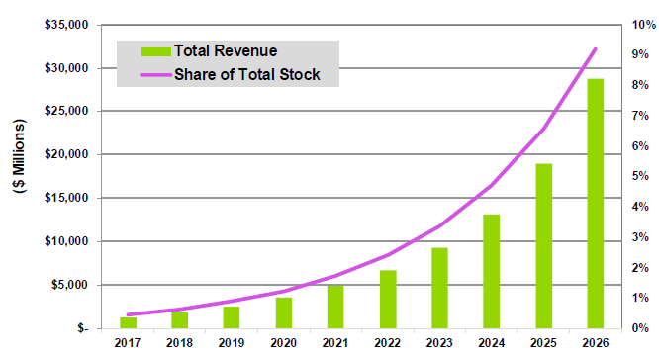
What does the future look like?
B2G Integration-Enabling Technologies Revenue and Share of Total Stock, World Markets: 2017-2026
According to Navigant Research, global revenue for C&I B2G integration is expected to grow at a 41.3% compound annual growth rate (CAGR) from $1.3 billion in 2017 to $28.8 billion in 2026, as illustrated in Chart 1.1. This report also projects the effect of B2G integration in terms of the share of C&I sites capable of being dispatched as new resources in the Energy Cloud. This share is projected to grow from 0.5% of sites in 2017 to 9.2% of sites in 2026, as depicted in Chart 1.1.
Source: Navigant Research

Slide 29
Who should care to Bring B2G to Life?
Utilities/Energy Providers
Value Added Services
Avoided T&D Upgrades
Technology Providers
Technical and Energy Advisory
Higher Product Sales
Building Owners
Energy Generation & Demand Management
Full occupancy, higher transaction values, lower operational and energy costs
Lost customers, load uncertainty creating near to mid term grid instability
New competition from utilities/energy providers
Vacancy, low asset prices, uncertain energy prices and stability
Key Constituent
Top Line Opportunity: New Recurring Revenue Streams
Bottom Line Opportunity
Lower Costs & Sustained Profits:
Critical Threats:
Source: Navigant Research

Slide 30
What does The roadmap mean for suppliers and customers?
A new ecosystem of partnership is emerging to support the journey to B2G
Automated Systems
Integrated Controls and Automation
Optimized Operations & Business Systems
Orchestrated Energy and Facility Assets
Intelligent Building Business Platform
Roadmap:
Equipment Management | Systems Performance | Bottom-Line Performance | Top-Line Growth
Comfort | Energy and Operations Improvements | Stakeholder Satisfaction | Maximized Brand
Building Incumbents | +Startups | ++Tech Vendors | +++Specialty Services
Co-Opetition Ecosystem
Focus:
Impact:
Partners:
Source: Navigant Research

Slide 31
What does the competitive landscape look like?
Vendors from many industries recognize the value of recurring revenue and deeper customer partnership. The market is competitive, yet fragmented.
IoT
OEMs/ Automation
Energy Providers
ESCOs / Services
IoT/Niche Disruptors
Telco/Tech
Source: Navigant Research

Slide 32
How can Vendors retain their competitive edge?
Incumbents are threatened by new market entrants, either refining solutions from adjacent markets or startups driving innovation with niche offerings.
BUY → SOFTWARE AMPLIFIED SERVICES OFFERINGS
BUILD → EXPANDED APPLICATIONS FOR NEW USE CASES
PARTNER → COMPLETE TECHNOLOGY-ENABLED SERVICES
Source: Navigant Research

Slide 33
What is the outlook for co-opetition?
The ecosystem of players in today’s smart buildings market bring different strengths and weaknesses which help map opportunities for partnership
Vendor Category | Foundational Strengths = Threat to Utilities | Common Gap/Challenge = Opportunity for Leadership
OEMs/Automation | Buildings domain expertise, sales channels | Cost, legacy proprietary approach, inflexibility
Telco/Tech | IT domain expertise, scale | Lack of buildings domain knowledge
IoT/Niche Disruptors | Innovation | Scale
ESCOs/Services | Relationships, financing | Lack of expertise in emerging technology expertise
Source Navigant Research

Slide 34
What are the obstacles to mass market adoption of key enabling tech?
IT-OT Convergence is the Foundation, but customer, service provider, and technology barriers remain
Technology: Requires integration and interoperability between existing building systems and new solutions
Marketing and education: There is an effective gap between technology maturity and customer readiness. Navigant Research suggests the disparity is two-pronged: (a) marketing long focused on the energy cost savings as the business case for investment; and (b) crowded and confusing competitive landscape.
Moving beyond Class A opportunities: To realize the full market opportunity, vendors must acknowledge the gaps in existing digital infrastructure, the condition of any automation and controls technologies, and the business priorities of the mass market. This need is driving the expanding use cases and even rebranding trends.

Slide 35
How can we overcome the barriers to mass market adoption?
Solution providers need to support customers throughout the journey
KEY BUSINESS REQUIREMENTS
Specific business goals
Executive leadership
IT department buy in and support
Cybersecurity strategy
Partner ecosystem
Metrics for success/Key Performance Indicators (KPIs)

Slide 36
What are the big benefits of B2G?
Economics, sustainability/climate, and experience improvements all go hand in hand.
The B2G platform will function through ongoing engagements between building owners and operators and the network orchestrator. Navigant Research suggests the follow steps:
Asset planning will support C&I customers as they define long-term business strategies for B2G participation. Capital or alternative financing options will enable investment in DER as a part of the site’s energy supply.
Engineering and design services will support customers by defining the roadmap for technology deployment and integration. These services will help customers ensure they effectively budget for technology to sustain their role in the B2G ecosystem.
Deployment services is the way Navigant Research characterizes the next generation of systems integrators capable of installing, commissioning, and ensuring the interoperability of B2G-enabling systems.
Operations services are a way of outsourcing asset management. Customers can rely on B2G partners or the eventual orchestrator to operate their DER.
Customer service will be the front line in communication between customers and B2G solutions providers that secures sustained customer commitment to the B2G platform. Technology innovation, such as artificial intelligence, may innovate the approaches customer service in the Energy Cloud.

Slide 37
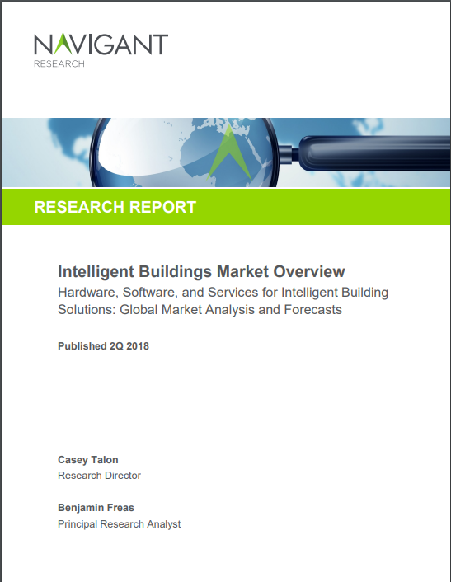
About Navigant Research
Navigant Research offers clients syndicated and custom market research from inside the Energy practice.
Research Reports
Subscription Insights
Custom Research
Access Navigant Research at:
https://navigantresearch.com/
Power & Utilities
Building Tech
Automotive
Telecommunications
High Tech & IT
Emerging value chain analysis
Market sizing and forecasting
Strategic marketing services
Trend monitoring and analysis
Market demand for new products
Competitive intelligence

Slide 38
Contact
Casey Talon Research Director +1.303.381.7774 casey.talon@navigant.com

Slide 39
CONTACT CABA
Continental Automated Buildings Association (CABA) 613.686.1814 Toll free: 888.798.CABA (2222)
caba@caba.org www.CABA.org www.twitter.com/caba_news www.linkedin.com/groups?gid=2121884
Connect to what’s next™
39

