Slide 1
Connected Home Roadmap
Final Webinar
Harbor Research

Slide 2
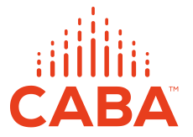
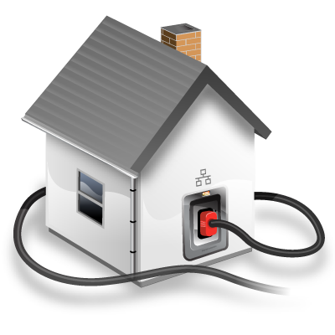
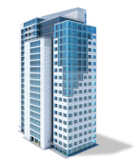


About CABA
CABA (Continental Automated Buildings Association)
Vision
CABA advances the connected home and intelligent buildings sectors.

Slide 3

CABA 30th Anniversary

Slide 4











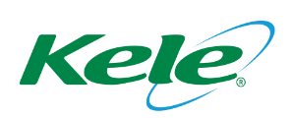
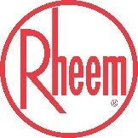










CABA Board of Directors
Notes:
Our BoD feel this could be the most significant piece of research we can create
Different types of organizations
focusing on real ROI
True value of the building
2 spots left: share knowledge and network with key companies and individuals in this space.
---------------------------------------------------------------------------------------------------------------

Slide 5
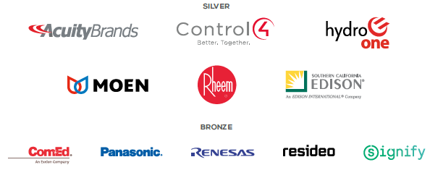
CABA Steering Committee

Slide 6
CABA All Funders

Slide 7
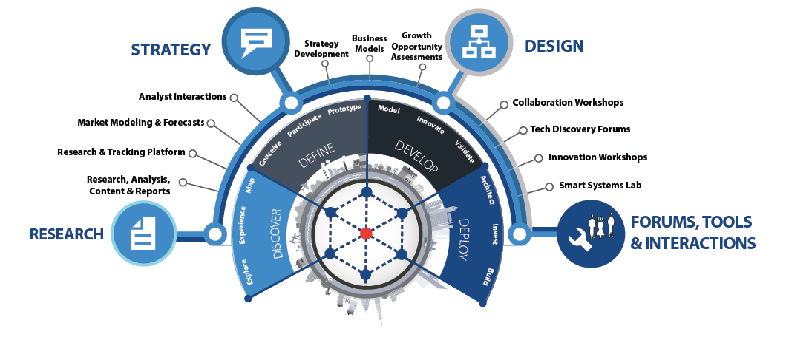
About Harbor Research
Strategy Consulting
Our strategy and business development consulting services deliver creative innovation tools, practical methods and applied problem solving.
Research and Content
Our research, tracking, and market intelligence services provide an accessible learning environment for those who are trying to wrap their arms and minds around emerging disruptive opportunities.
Smart Systems Lab
We are creating a real-world laboratory where organizations design, prototype, and test new models for delivering value and differentiation. The Lab’s mission is to enable business model, technology, and system-level innovation enabled by the Internet of Things.

Slide 8
Research Goals
1
Examine in depth the current and future development considerations that the “Internet of Things” (IoT) technologies and the services that these technologies enable will have in the connected home market.
  Conduct a detailed analysis about the current and future state of the connected home marketplace, including key trends, buying behaviors, technology challenges and opportunities.
  Identify and expand on the top current and future applications of IoT technologies in the context of plausible future connected home outcomes, outlining the technical makeup of solutions and value propositions for various market participants.
Provide actionable insights as it relates for current and future market opportunities and development considerations that influence the trajectory of the connected home.
  Develop product / technology, ecosystem, customer and application roadmaps context of each stakeholder to outline strategic priorities.
  Make recommendations for how firms should structure their organization and offerings to capture new value from smart, connected offerings.
2

Slide 9
Key Takeaways (1/2)
1
The growth of the Smart Home market is being stifled by a messy aggregation of network protocols, software incompatibility, and winner-take-all strategies across the supplier landscape
2
Poor user experience, a lack of privacy and security standards and the high costs of products and services are leaving smart home consumers frustrated—exacerbating the disconnect between suppliers and user preferences
3
The future market trajectory of the smart home is dependent on the following:
A
Progress around networking, security and computing protocol standardization
B
Collaborative engagement across supplier landscape to improve user experience
C
Technology advancements around AI, voice recognition, edge computing, cybersecurity, blockchain and networks that enable more advanced, complex smart home use cases / applications
D
The evolution of the player landscape towards mesh ecosystem architectures

Slide 10
Key Takeaways (2/2)
4
Future potential outcomes are illustrated by the following three scenarios:
Stagnant Smart Home: players continue to operate in isolated ecosystems, leaving the technology protocol landscape fragmented and reinforcing pain points around user experience, privacy and security, and cost
Scenario 1
Middle of the Road: while more complex use cases are introduced, player collaboration remains constrained to smart home hub ecosystems. This convergence on smart home ecosystems improves the disarray of technology protocols to a degree; however, challenges around user experience will limit mass adoption
Scenario 2
Smart Home Euphoria: open ecosystem architectures alleviate the protocol mess with collaborative product development that also addresses user experience issues. Technology advances around AI, edge computing, security and voice recognition catalyze use case complexity and contribute to increased consumer trust
Scenario 3
5
To unlock future Smart Home value of $66.5B, players need to:
A
Increase attention to driving network protocol standardization
B
Increase priority placed on software interoperability by tech suppliers
C
Move from a dictator model ecosystem architecture to a more localized ecosystem
D
Increase distributed edge computing to increase reliability and user experience satisfaction

Slide 11
The growth of the Smart Home market is being stifled by the messy aggregation of network protocols, software incompatibility, and winner-take-all attitudes by the main players

Slide 12
Diverse Device Networks Poses Significant Challenges
CHR Report Figure 1-2

Slide 13
Connected Home Trends & Forces Impacting Market Development
CHR Report Figure 1-3

Slide 14


















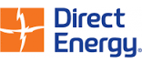


Connected Home Value Chain
Connectivity & Enablement
Smart Home OEMs
Network
Services & Infrastructure
Home Platforms
Value Added Applications
Service Providers
CHR Report Figure 2-1

Slide 15
Market Development Constrained By Hub-centric Collaboration
CHR Report Figure 1-4

Slide 16








Lack of Interoperability, UX Endangers Future Smart Home
Hardware
Ecosystem
Software
Compliance with Network Protocols
Separate protocols for Z-wave, Zigbee, and Wi-Fi prevent devices from working together.
Multiple Connectivity Models
Dispersion across Z-Wave, Zigbee, and Wi-Fi creates a mess of control points for consumers where a multiprotocol strategy would rescue user experience.
Transitioning from Centralized to Edge Computing
Centralized computing slows functionality and makes devices captive to the dictator home hub and its server.
Device Interoperability
Ecosystem collaboration is necessary to allow devices to communicate, share data, and control disparate devices and systems to improve user experience.
User Experience
Erratic smart home functionality results from a mess of siloed devices and outages due to over-reliance on centralized compute power. Third party “platform of platforms” and service providers offer temporary solution, pocketing smart home value and raising prices for consumers.
Data Integration
Devices must not only communicate with each other but must also have shared data and semantic interoperability. This will allow for better analytics to improve user experience and data monetization opportunities.
API Challenges
Suppliers must align on APIs to streamline user experience and reduce barriers to adopting new devices.
Security
As providers continue to leverage consumer data, privacy and security remain a massive barrier for consumer adoption.

Slide 17
Poor user experience, a lack of privacy and security standards and high costs of products and services are leaving smart home consumers frustrated—exacerbating a disconnect between suppliers and user preferences

Slide 18











Cost & Complexity Key Inhibitors; Energy & Security Mgmt. Top Apps
Top Consumer Challenges
Top Applications
Cost of device
Cost of recurring service
Difficult installation
Privacy and Safety Concerns
Security Management
Energy Management
Entertainment and Music
Top Means of Purchasing
Word of mouth or media with additional research
Online or to a store via word of mouth
Spontaneously in store
Spontaneously online

Slide 19
Consumer Survey Ensured Coverage Across Respondent Types
CHR Report Figure 2-2

Slide 20
Cost & Data Privacy Are Top Reported Pain Points
CHR Report Figure 2-4

Slide 21
Consumers See Cost As The Primary Barrier To Purchase
CHR Report Figure 2-5
CHR Report Figure 2-6

Slide 22










Key Traits, Determinants & Implications of User Profiles
Demographics
Use Case Differentiators and Adoption Behavior
Resulting Implications
Age: indicates familiarity and comfortability with new technologies
Income: indicates agency and ability to purchase smart home products
Home Ownership Status: indicates agency in installing smart home products
Time Spent in Home: indicates scope of use cases and interactions
Pace of Household: indicates automation and efficiency demands
Technology Adoption: indicates likelihood of new technology purchase
Audience Targeting
Use Case Prioritization
Sales and Go-to-Market
Channel Design

Slide 23
Smart Home User Profile Demographic & Behavioral Traits
CHR Report Figure 2-3

Slide 24
Millennial Renter Motivated By Time Savings & Entertainment

Slide 25
New Home Owner Care About Safety & Security

Slide 26
Experienced Home Owners Value Safety, Security & Energy Efficiency

Slide 27
Experienced Home Owners Value Safety, Security & Energy Efficiency

Slide 28
Collaborative, User-centric Strategies Are Required to Succeed
Drivers
Barriers
Advancements in AI and voice recognition
Resource management cost savings
Improved comfort and convenience
Safety and Security
Cost
Installation
Data privacy breaches
Limited connectivity
Limited integration

Slide 29
Suppliers need to develop user-centric strategies to inform hardware, software and ecosystem roadmaps that address current market inefficiencies

Slide 30

Levers Impacting the Future Connected Home Market
Current State
Future State
Ecosystem Architecture Evolution
Socioeconomic
Consumer Needs & Trends
Use Case & Application Evolution
Will players choose to continue developing ecosystems within a walled-garden or become truly interoperable across devices and applications?
Will data privacy concerns be solved in the near future?
Channel Evolution
Future Technology Advancements
Primary Levers
Secondary Levers

Slide 31











Current State: Dictator Architecture Dampens Market Growth
Impacts on
Device Suppliers
Impacts on
User Experience
Barriers to Entry
Hardware Costs
Developer Costs
Bargaining Power
Specification Influence
Device Cost
Complexity
Adoption
Ease of Use
Ease of Installation
The Dictator Model involves one Smart Home hub through which all devices are controlled. Devices cannot communicate with each other without the help of the dictator or hub, and hubs from different providers or in different systems (e.g. the kitchen vs. the bathroom) do not communicate with each other
“Current challenges in the market include interoperability and improving user experience. We're in an extremely fragmented market, so our long term strategy is to build a strong ecosystem around the smart home, which includes devices and services.”
– Program Manager, Sevenhugs

Slide 32






















Next Step: Siloed Coexistence
Dictator Model
Walled Garden
Mesh Ecosystem
Kitchen
Living Room
Bathroom
Garage & Outdoors
The Dictator Model involves a central control point, like a Smart Home hub, through which all devices are controlled. Devices cannot communicate with each other without the help of the dictator or hub, and hubs from different providers or in different systems (eg: the kitchen vs. the bathroom) do not communicate with each other.
A Walled Garden Model involves isolated ecosystems of devices bound to a given smart home hub or platform (e.g. Alexa or Honeywell Home). Device interoperability is limited to that of a given platform product, forcing the consumer to settle for siloed operations or invest solely in devices compatible with a single home hub or platform vendor.
A Mesh Ecosystem involves hubs in different systems (e.g.: the bathroom vs. the kitchen) and/or from different providers that are able to communicate with each other and with associated Smart Home devices.
“Compatibility is a given based on our platform capabilities. We don't solicit developers on our platform because we're too small - we connect the big players. We're a platform of platforms.”
- Founder & CEO, Independa

Slide 33


Final State: Mesh Ecosystems That Promote UX & Supplier Innovation
Kitchen
Living Room
    Impacts on
    Device Suppliers
Impacts on
User Experience
Barriers to Entry
Hardware Costs
Developer Costs
Innovation
Specification Autonomy
Prices
Functionality
Adoption
Outage Risk
Bathroom
Garage & Outdoors
A Mesh Ecosystem involves hubs in different systems (e.g. the bathroom vs. the kitchen) and/or from different providers that are able to communicate with each other and with associated Smart Home devices.
“We think smart home devices should enable greater insight for consumers beyond the walls of the home… We want to orchestrate the habits, preferences and other consumer data to simplify daily planning and tasks that might occur in a vehicle or at a supermarket.”
– CTO and CO-Founder, Aira

Slide 34
Demographic Shifts, Gov’t Regulations & Economic Conditions Dictate Future Growth
Millennials are renting and want to be always connected
Millennials have more trust in technology, granting technology suppliers access to personal data and allowing them the ability to create more advanced applications
Aging North American population needs health monitoring
As the NA population continues to extend its life expectancy and health care costs continue to increase, at-home and wearable health monitoring technologies will increasingly be demanded
Increased data security and privacy concerns, government regulation
Governments around the world (ex: GDPR in the EU) are issuing to policies and regulations around data security and privacy due to fears that technology players cannot protect an individual’s personal data
Economic certainty & open-trade policies encourage tech adoption
Economic certainty encourages consumers to spend more on emerging technologies; however, restrictive trade policies may reduce the consumer’s purchasing power and ability to pay for new technologies

Slide 35
Trust In Technologies By All Users Is A Requisite For Success
“Powerley stores no personal information. We use anonymized ID numbers--we don't associate any names or addresses with data. Furthermore, all data is stored remotely on customer smart phone/mobile app or on energy bridge in their home. So, there are multiple layers that address the security of consumer data.”
-Director, Product Management & Marketing, Powerley
CHR Report Figure 3-2
*Note: Smart Home Tech Expertise refers to the outcome of consumers engaging and experimenting with smart home technologies over time

Slide 36
New Technologies Will Enable Complex, Interrelated Applications
Application Evolution
Simple
Apps that involve single devices or narrow values that are based on basic network connectivity and monitoring
(e.g. energy management)
Compound
Apps that involve multiple collaborating, peer-peer devices or significant interactions between and among devices, systems and people
(e.g. ML-enabled energy management for comfort and convenience)
Complex
Apps that drive interactions between and among devices, device sub-systems and people
(e.g. interconnected, personalized energy management for an individual’s health & wellness)
Enabling Technologies
Time
“Currently, energy management is the biggest focus for us – understanding consumption info, improved savings and home management. But this will naturally evolve to a more holistic view of appliance health and monitoring over time... You can leverage data for a lot of different use cases, and this is only expected to expand in the future where we’re currently just scratching the surface in terms of application potential.”
-Director – Product Management & Marketing, Powerley
“We are basically working on scenarios, the ability to learn a sequence of actions by pressing one button. When I wake up in the morning, it turns on the lights, the radio, the heater, etc. We want to integrate AI to understand your habits and suggest a scenario.”
-Program Manager, Sevenhugs

Slide 37
Tech Such As AI & Blockchain Enable Complex Smart Home Apps
Application Evolution
Compound
Complex
Enabling Technologies
Time
Ubiquitous Connectivity | Ubiquitous, and reliable connectivity is required to enable devices that the end-user interacts with that are mobile
More Complex Data Sets | Advances in interoperability as a result of partnerships, or as a result of third-part software providers bridging the interoperability gap grant tech suppliers a more complete data that will ultimately offer better algorithms
Machine Learning & AI | Advances in ML are leading to a broad range of offerings that can then deliver customized convenience services to occupants, with minimal added complexity to the user experience
Blockchain | In order to create highly personalized experiences, companies must leverage highly personal data. Blockchain’s ability to encrypt personalized data, might satisfy consumer desires for data security
Voice Recognition & Control | Voice-enabled device interactions adds a level of increased simplicity and ease to applications for end-users, encouraging the adoption of that application

Slide 38




Suppliers Must Look Towards New, Expanded Channels To Market
Key Considerations for Future Channel Design
As systems become more integrated and complex, service providers (e.g. Amazon, Sears) will become a larger channel for new smart home technologies
Whole-unit offerings, focused around hardware hubs or software packages, are being delivered by systems integrators and installers to minimize complexity and deliver on-going support and maintenance
The implementation will be too complex to have a significant do-it-yourself population, so many of these technology suppliers will need to develop partnerships with service providers

Slide 39
Future potential outcomes for the connected home are illustrated by the three distinct scenarios that entail the varying impact of certain competitive, customer, technology and socioeconomic trends and forces and suppliers’ ability to respond to those impacts

Slide 40
Progress Around AI, Interoperability & Ecosystem Dynamics Impact Future

Slide 41
Suppliers Can Frame Future Scenarios Around The Four Key Trend Areas

Slide 42
Optimal Conditions for Supplier Collaboration, UX and Trust
Smart Home Euphoria
Competitive
Ecosystem siloes break down for supplier interoperability
New use cases are enabled by more complex interactions between devices, software and services
This encourages additional technology suppliers to push their innovations — creating a cycle of innovation
Technology
Connectivity enables new interactions across rooms or outside of the home, generating new data, transferred via blockchain with voice “wake-up” words
Advances in voice recognition allow non- savvy users to unlock new devices. The rising trust and 100% uptime means that software companies are incentivized to create more value-added applications for end-users
Consumer
Smart home-enabling infrastructure is now necessary for new home buyers due to rising adoption
Early adopters have integrated devices in and outside of the home, sharing data
Advances in voice recognition and AI have narrowed the generational divide
New payment plans allow lower income users to gradually pay off costly devices.
Consumers are increasingly trusting, lowering barriers to innovation
Socioeconomic
Stable economic times and new payment plans enable a larger consumer base.
Data privacy laws have been updated and met, developing user trust
Energy consciousness is on the rise, causing many users to seek energy efficient devices
Perception of AI to facilitate daily routine has been good, incentivizing innovation and partnership

Slide 43
Limited Ecosystem Development & Skeptical Consumers
Middle of the Road
Competitive
Similar to today, limited partnerships are formed, and families of devices continue to dominate the home
The Amazon and Google’s of the world continue to develop additional devices and services, selectively adding partners for various use cases, limiting options for the consumer
Technology
Connectivity has somewhat improved, strengthening Wi-Fi and Bluetooth for more interaction, but this doesn’t address all use cases, such as remote access
Interoperability is inhibited, limiting developers to create for popular devices like hubs. Use cases have expanded slightly, but software providers have not integrated and the magnitude of value-added applications and services is low
Consumer
The user base expands; however, early adopters continue to lead the way when it comes to new devices and use cases. There has not been an explosion in adoption — there is a slight but steady growth
Consumers are still typically high-income but do not demand smart home infrastructure in newly purchased homes or in newly rented apartment spaces
Socioeconomic
The current state of the market persists. There is a large constituency of smart home users, but many of these individuals are weary of smart home devices
This inhibits many advances in the space, particularly in new use case creation and value-added application development

Slide 44
Continued Siloes, Stalled Innovation and Lack Of Trust
Stagnant Smart Home
Competitive
Companies shut other players out, attempting to silo the smart home opportunity
Device suppliers make their equipment unable to communicate with other brand devices or software providers, enabling only a small amount of use cases per device and disallowing any compound of complex use cases that involve machine-to-machine communication
Technology
Technology suppliers have a focus on getting new users on existing devices instead of enabling new use cases. As a result, smart home adoption remains simple with only a few users developing complete smart home systems
Many of the same devices are in place today, but with a slightly larger user base. The scenario unlocks only a fraction of the total value possible in smart home
Consumer
Early adopters continue to be the only users, likely due to pain points in price and tech savviness
Users do not see that smart home technology as a necessity, and there have not been enough technology advances to justify the price for many users. The user base continues to grow very slightly, but there is not much traction for partnerships or innovations due to the lack of interest presented by the consumer
Socioeconomic
Users have a lower propensity to spend, as a result of restricted economic opportunity, and several more smart home data privacy scandals have broken out
Consumers are hesitant to adopt the technology because they believe their personal conversations are being shared with a malicious world, leaving the smart home market opportunity at its lower-bound

Slide 45
The North American Region Contains Over 150M Homes In 2018; 250M In 2023
 | 2018 | 2019 | 2020 | 2021 | 2022 | 2023 | CAGR
Single-family, detached | 82.64 | 83.05 | 83.46 | 83.87 | 84.28 | 84.69 | 0.49%
Single family, attached | 8.15 | 8.23 | 8.30 | 8.38 | 8.46 | 8.54 | 0.94%
MDUs | 61.10 | 73.85 | 89.46 | 108.57 | 131.98 | 160.64 | 21.33%
Mobile Homes | 4.25 | 3.61 | 3.07 | 2.62 | 2.24 | 1.92 | -14.73%
Total | 156.15 | 168.74 | 184.29 | 203.44 | 226.95 | 255.79 | 10.37%
CHR Report Figure 3-5

Slide 46
Installed Devices Will Grow 16.3% Annually Reaching Over 2.8B Units In 2023
CHR Report Figure 3-6

Slide 47
Smart Systems Revenue For Connected Home Will Reach $66.5B In 2023
 | 2018 | 2023 | CAGR
Enablement | $946.8 | $2,236.6 | 18.8%
Network Services | $4,977.9 | $10,427.1 | 15.9%
System Applications | $4,052.6 | $10,189.5 | 20.2%
Value Added Applications | $15,772.3 | $43,624.5 | 22.6%
Total | $25,749.6 | $ 66,477.7 | 20.9%
CHR Report Figure 3-7

Slide 48
Home Entertainment Will Be The Largest Opportunity In 2023 Reaching $12.2B
CHR Report Figure 3-8

Slide 49
To effectively tap into the $66.5 billion future connected home opportunity, players will need to develop distinct short-, medium- and long-term strategies around ecosystems, technology, customers, use cases / applications and devices

Slide 50
How to Rescue Crumbling UX: Integrated HW, SW & Eco Strategy
Hardware
Ecosystem
Network providers (Zigbee, Z-Wave, Wi-Fi) should align on standardized protocols to ease challenges for tech suppliers and improve user experience.
Tech suppliers should strive for multiprotocol strategies to build devices compatible with several network types.
Suppliers must develop edge computing machines.
Software
OEMs and tech suppliers should partner with software and service providers to drive indirect device sales and interoperability. This will allow suppliers to leverage devices as Smart Home control points.
Service providers should foster complex systems of local mesh networks.
Service providers should partner with real estate developers for long standing contracts and to install devices in new homes.
Software providers should build a platform of platforms to simplify user experience and improve security. OEMs should strive to create localized ecosystems.
Suppliers must future proof products as much as possible by removing contingencies on hardware, where over-the-air updates to software can be the core foundation for maintaining relevance of a product’s capabilities.
Given advancement of user maturity, suppliers must refine consumer data insights and solution R&D to best respond and predict behavior.
Players must invest in blockchain and security to instill confidence in consumers.

Slide 51
Connected Home Roadmap: Improve UX, Open Ecosystems & Build Trust
CHR Report Figure 4-1

Slide 52
While Stakeholder Priorities Vary, Collaboration Is Required Throughout

Slide 53
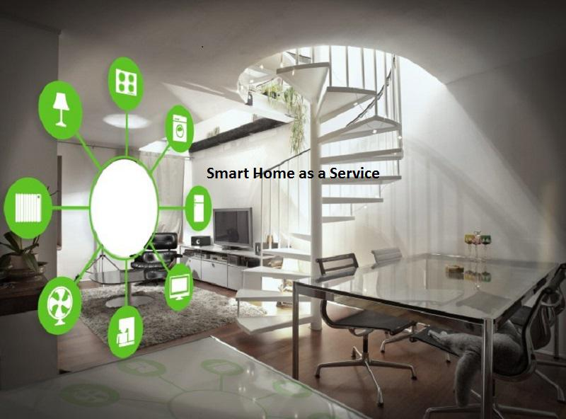
Next CABA Residential Research
“Smart Home as a Service” (SHaaS)

Slide 54
Contact Harbor Research
Harbor Research
2601 Blake Street, Suite 100
Denver, Colorado 80205
Glen Allmendinger
President
gallmendinger@harborresearch.com

Slide 55
CONTACT CABA
Continental Automated Buildings Association (CABA)
613.686.1814
Toll free: 888.798.CABA (2222)
caba@caba.org
www.CABA.org
www.twitter.com/caba_news
www.linkedin.com/groups?gid=2121884
Connect to what’s next™

