Slide 1
Connected Home Council (CHC) Webinar Wednesday, February 26, 2020, 12 NOON – 1:30 PM (ET)
Chair: Roy Perry (Alarm.com, Inc.)
Vice-Chair: Danny Sran (TELUS)

Slide 2
1. Agenda Greg Walker (CABA)
1. Agenda
2. Call to Order, Welcome, Introductions, about the CHC
Administrative
White Paper Sub-Committee Update
5. “Privacy and Cybersecurity in Connected Homes” (30 min)
- Roberta Gamble (Frost & Sullivan)
6. Research Update
7. New Business
8. Announcements
9. Adjournment

Slide 3
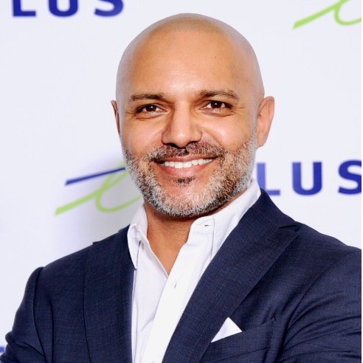
2. Call to Order, Welcome, Introductions, About the CHC Roy Perry (Alarm.com)
CHC Chair
Roy Perry
VP Ecosystem Alliances
Alarm.com
CHC Vice-Chair
Danny Sran
Mgr. Construction - New Growth Markets TELUS
Established in 2004, the CABA Connected Home Council initiates and reviews projects that relate to connected home and multiple dwelling unit technologies and applications. The Council also examines industry opportunities that can accelerate the adoption of new technologies, consumer electronics and broadband services within the burgeoning connected home market.
www.caba.org/chc

Slide 4
3. Administrative Roy Perry (Alarm.com)
3.1 Motion to approve past CHC Minutes:
Motion to approve the November 26, 2019 minutes was made by:
- Roberta Gamble (Frost & Sullivan)
Motion was seconded by:
- Ken Wacks (Ken Wacks Associates)

Slide 5
3. Administrative Roy Perry (Alarm.com)
3.2 Call for additional CHC Vice-Chairs
www.caba.org/chc

Slide 6
4. White Paper Sub-Committee Update Ken Wacks (Ken Wacks Associates)
4.1 Recently Completed: None

Slide 7
4. White Paper Sub-Committee Update Ken Wacks (Ken Wacks Associates)
4.2 In Progress:
“Power over Ethernet (PoE) & Digital Electricity (DE) in Commercial and Multiple Dwelling Residential Buildings”
Somfy Systems, Inc. (Chair)
Contemporary Controls Systems, Inc.
LumenCache, Inc.
National Electrical Manufacturers Association (NEMA)
Public Services and Procurement Canada
Renesas Electronics America Inc.
Southwire Company, LLC
UL LLC

Slide 8
4. White Paper Sub-Committee Update Ken Wacks (Ken Wacks Associates)
4.2 In Progress:
“Human Centric Lighting: Non-Energy Benefits of Lighting and its Smart Controls”
Human Centric Lighting Society (Chair)
ArcoLogix LLC
Control4
National Electrical Manufacturers Association
Syska Hennessy
UL LLC

Slide 9
4. White Paper Sub-Committee Update Ken Wacks (Ken Wacks Associates)
4.2 In Progress:
“The Evolution of Integrating LiFi Technology into Smart Lighting and Control Systems for the Intelligent Building”
Wharton County Junior College (Chair)
Acuity Brands, Inc.
ArcoLogix LLC
Control4
National Electrical Manufacturers Association
Telecommunications Industry Association (TIA)

Slide 10
4. White Paper Sub-Committee Update Ken Wacks (Ken Wacks Associates)
All proposals and previously completed CHC White Papers can be downloaded at:
www.caba.org/whitepapers

Slide 11
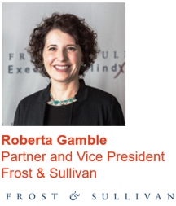
5. Keynote Greg Walker (CABA)
“Privacy and Cybersecurity in Connected Homes”

Slide 12
Smart Homes and
Cybersecurity
Technology Creating and Restraining Opportunities
Presented to CABA
February 2020

Slide 13
Energy Costs, Entertainment Top Drivers

Slide 14
Key Trends in Tech and Smart Homes
Smart home markets have been growing 6-10 percent annually for many years, which is expected to continue this decade
Entertainment is the largest segment (over 80%) of the smart home market, valued at about $160 Billion.
With the growth of IoT and roll out of 5G, Frost & Sullivan predicts at least 43 Billion devices will be connected by 2025
F&S data shows nearly 1 in 4 American homes have two or more integrated smart devices
Over 57% of the entertainment market for smart homes is currently owned by smart TVs, but mobile devices are increasingly competing
Digital assistants are one of the fastest growing devices, with over 200% growth rate from 2016 to 2019.
Smart thermostats and related controls continue to grow as well. Aside from entertainment, energy conservation is a top home owner priority
Over half of all web surfing is now done on mobile devices

Slide 15
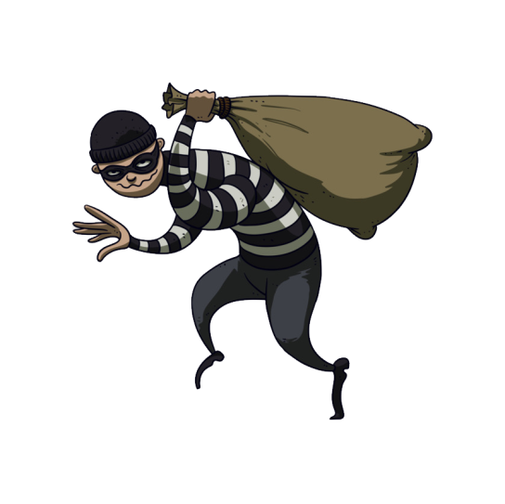
Common Ways Threat Actors Wage Campaign
Phishing: Acquire susceptible personal information, such as usernames, passwords or credit card details by masquerading as a reliable business website or electronic communication
Brute Force: Email address or log in lists are purchased and bots go through millions of potential passwords per second on a given site
Credential stuffing:
Email addresses, log ins and password combinations lists are bought cheap on the darknet
Bots spray these log ins and passwords across thousands of sites per second. I.e., someone gets a hold of your gym membership log in credentials, and you used the same log-in/password for your bank, they may now be able to get into that account as well
Access is gained and information is exploited and/or sold back onto the darknet
The United States is the top target in the world, with, according to the FBI, over $12.5 billion in damage from email based credential phishing alone.

Slide 16
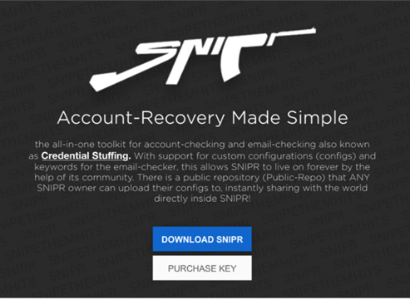
Data Purchase and Exploitation
Applications such as SNIPR is considered a “beginner” tool for cracking into online games, social and other media. It costs $20 and how-to videos on YouTube abound
Lists of tens of thousands of emails with passwords can be purchased for less than $10
Verified—and guaranteed—account log ins and passwords can be purchased for a few dollars
Source: Frost & Sullivan and IBM / Akamai
Read more at https://www.akamai.com/uk/en/multimedia/documents/state-of-the-internet/soti-security-credential-stuffing-attacks-and-economies-report-2019.pdf

Slide 17
Awareness Vs. Action
Data privacy, security important restraints, but do consumers appreciate the gravity of the situation?
About 3,800 cyber attacks happen every day in homes equipped with connected devices.

Slide 18
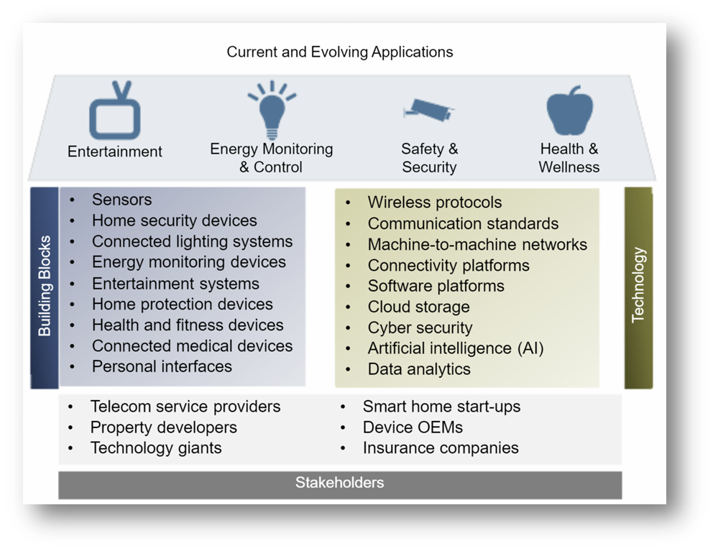
Smart home vulnerabilities abound
Smart home products often feature many to most of the following:
A physical, connected device
An in-person interface
An online log in and password
Information stored, analyzed, and delivered from somewhere else (usually cloud)
WiFi, Cellular, Zigby or other communication
Edge-based support or notification
Interaction with other products or parties

Slide 19
Connected Lives Enable “Breaking In” to Smart Homes
Virtually every part of daily life is connected and interconnected
Rise of new mobility models such as CASE (Connected, Autonomous, Shared, Electric) vehicles and Transportation network companies (TNCs) like Lyft and Uber
Online shopping: Black Friday and Cyber Monday are the two largest days for cybercrimes. Online food delivery alone will be a $200 Billion industry by 2025
Bricks and Mortar stores: 30 Million credit card records stolen from convenience store WAWA. It’s 850 stores were compromised, and the breach went undetected from March through December 2019. Attacks often go nearly 200+ days unnoticed.
Banking: More than 1 in 5 banks in Canada say they’ve been victims of cyber attacks
Social Media: Facebook’s 3rd party app on AWS servers exposed 540 million records

Slide 20
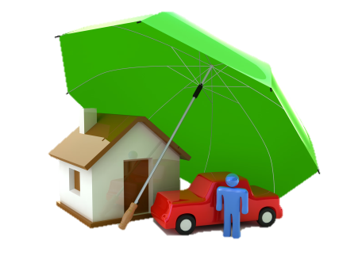
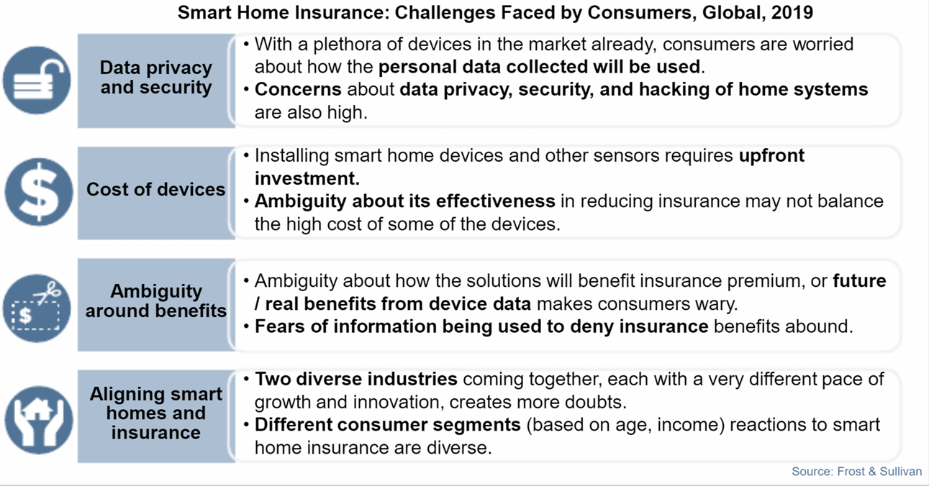
New Markets and Opportunities
“Smart Home Insurance” is an example of a market both created,
and hindered, by technology

Slide 21
What can be done?
Work with industry partners and organizations to create a consolidated front against attacks. Share knowledge, best practices, create and update standards
How might your solution be compromised outside of your current and direct control? If you can think of ways your technology can be hacked, it can probably be done (and has probably been tried)
Online access/mobile access/apps
Third parties with data access: financing, regulators, partners, etc.
Natural disasters or human error—about 49% of downtime is non-intentional
Cloud storage partners, do they know what to prioritize and are they expert in security as well? In some industries this responsibility is placed back on the data owner
Telecom operators and other ways information is transmitted
Ensure your strategy includes frequent employee training on best practices for themselves and any partners—vendors, customers, visitors—they interact with (remember Target?!)
Strongly consider partnering with a company experienced in your industry, customer industries, and value chain, to help vulnerabilities, create an end to end strategy, and who can also advise or put in place mitigation plans if problems do arise.
Bring value chain partners into the fold but also only share “need to know” info

Slide 22
5. Keynote Greg Walker (CABA)
“Privacy and Cybersecurity in Connected Homes”
Questions?

Slide 23
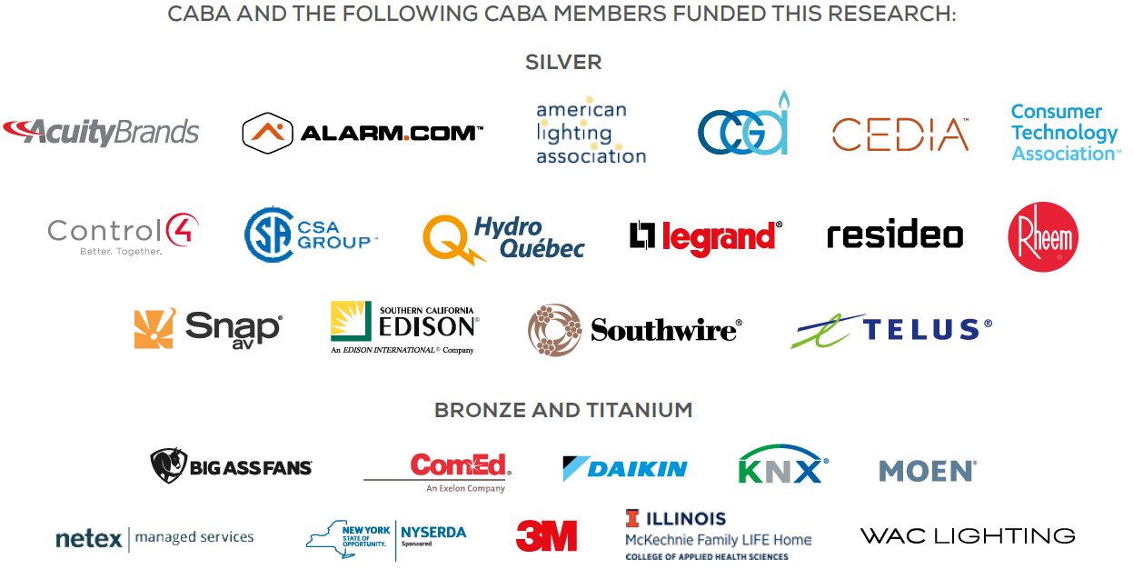
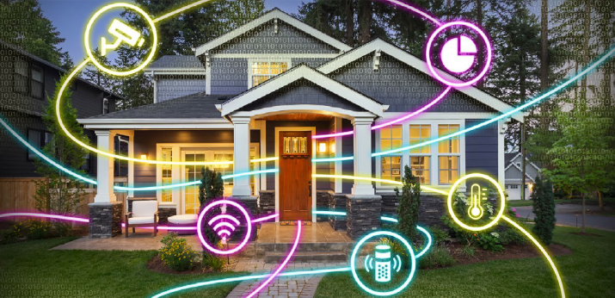
5. Research Update Greg Walker (CABA)
5.1 “Smart Home as a Service” 2019 CHC Landmark Research
www.caba.org/research

Slide 24
5. Research Update Greg Walker (CABA) (CABA)
5.2 “Privacy and Cybersecurity in the Connected Home” 2020 CHC Landmark Research
Topics: Best practices, role of devices, value proposition, industry standards, consumer awareness, interoperability, etc.

Slide 25
7. New Business Roy Perry (Alarm.com)
7.1 Other new CHC business?

Slide 26
7. New Business Roberta Gamble (Frost & Sullivan)
7.2 Frost & Sullivan Research Opportunity

Slide 27
8. Announcements Ron Zimmer (CABA)
8.1 Past Event Overview:
CABA AGM, Dec 5, via Webinar
CES International 2020, Jan 7-10, Las Vegas, NV
The NAHB International Builders' Show (IBS), Jan 21-23, Las Vegas, NV
The Kitchen & Bath Industry Show (KBIS), Jan 21-23, Las Vegas, NV
8.2 Upcoming events:
Internet of Things World, Apr 6-9, San Jose, CA
CONNECTIONS 2020, May 19-21, San Francisco

Slide 28
9. Adjournment Roy Perry (Alarm.com)
Next CHC Meeting: May 2020
Continental Automated Buildings Association (CABA) caba@caba.org www.CABA.org
www.caba.org/chc
Connect to what’s next™

