Slide 1
Intelligent Buildings Council (IBC)
Chair: Trevor Nightingale (National Research Council)
Vice-Chair: Harsha Chandrashekar (Honeywell International Inc)
Vice-Chair: Robert Lane (Robert H. Lane and Associates Inc.)
Vice-Chair: Bob Allan (The Siemon Company)

Slide 2


1. Agenda
Greg Walker (CABA)
1. Agenda
2. Call to Order, Welcome, Introductions, about IBC
3. Administrative
“Deploying Scalable Smart Building solutions” (30 minutes)
Bryan Anderson (Altair Engineering Inc.)
5. Research Update
6. White Paper Sub-Committee Update
7. New Business
8. Announcements
9. Adjournment

Slide 3
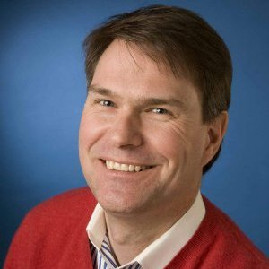
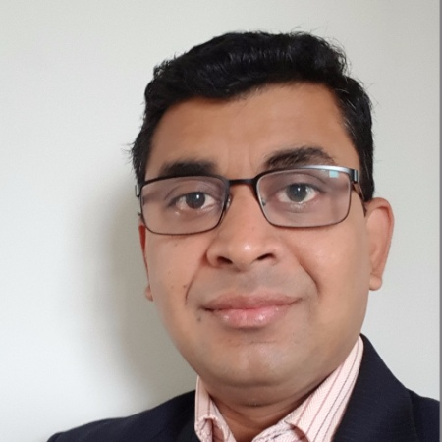
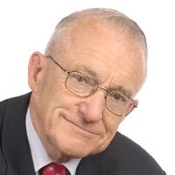
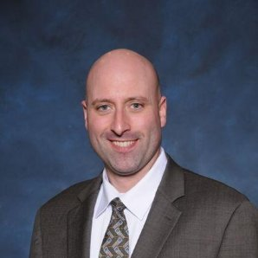




2. Call to Order, Welcome, Introductions, About the IBC
Trevor Nightingale (National Research Council)
IBC Chair
Trevor Nightingale
Director
National Research Council
IBC Vice-Chair
Harsha Chandrashekar
Product Approvals & Regulatory Leader
Honeywell International Inc
IBC Vice-Chair
Robert Lane
President & Managing Partner
Robert H. Lane and Associates Inc.
IBC Vice-Chair
Bob Allan
Global Business Development Manager, Intelligent Buildings
The Siemon Company
The CABA Intelligent Buildings Council works to strengthen the large building automation industry through innovative technology-driven research projects. The Council was established in 2001 by CABA to specifically review opportunities, take strategic action and monitor initiatives that relate to integrated systems and automation in the large building sector. The Council's projects promote the next generation of intelligent building technologies and incorporates a holistic approach that optimizes building performance and savings.
www.caba.org/ibc

Slide 4

3. Administrative
Trevor Nightingale (National Research Council)
3.1 Motion to approve past IBC Minutes (May 8): www.caba.org/ibc

Slide 5
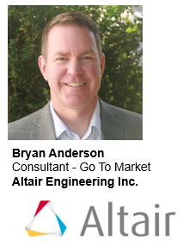
4. Keynote Speaker
Harsha Chandrashekar (Honeywell) (30 Minutes)
“Deploying Scalable Smart Building solutions” (30 min)

Slide 6

Deploying Scalable smart building solutions
Presented by Bryan Anderson

Slide 7
Welcome
Agenda
Introduction
Common challenges
Developing the optimal solution
Use cases

Slide 8
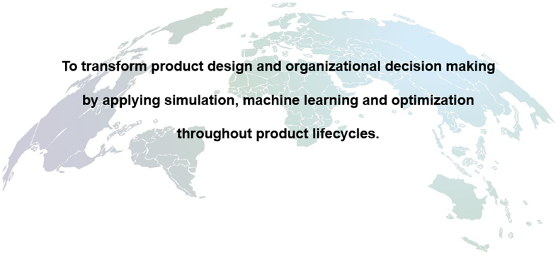
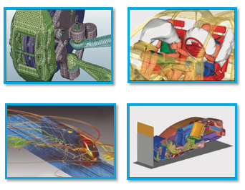
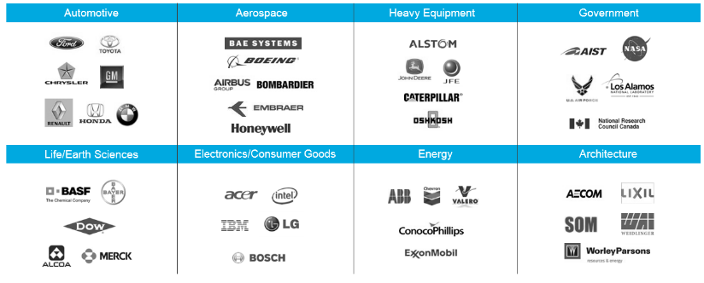
Altair at a Glance
Altair’s Vision
Long heritage of solving some of the most challenging engineering problems
Founded 1985
Headquartered in Troy, MI US
$396M
FY18 Revenues
5000+
Global blue chip customers
Tens of Thousands
Of global users
71 offices
In 24 countries
2000+
Engineers, scientists & creative thinkers
5,000 Customer Installations Worldwide

Slide 9



  COMMON CHARACTERISTICS OF SMALL AND MID SIZE BUILDINGS:
BASIC TECHNOLOGY TO MANAGE HVAC/LIGHTING
LIMITED OPERATING BUDGET
LIMITED INSIGHT OF BUILDING SYSTEM PERFORMANCE

Slide 10

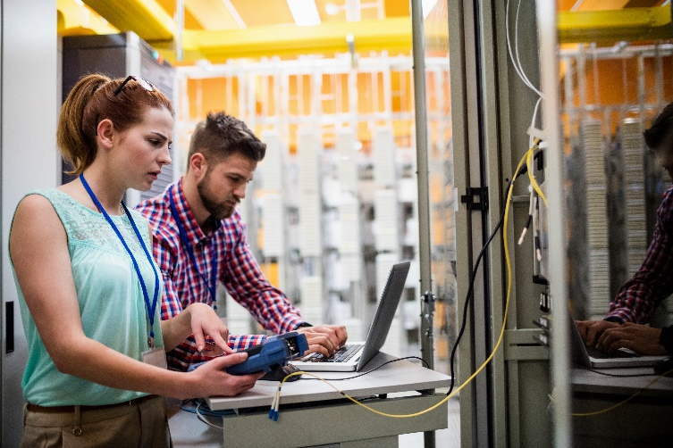
  MANY SMART & CONNECTED BUILDING SOLUTIONS ARE:
DESIGNED WITH SILOED SYSTEMS
EXPENSIVE TO DEPLOY & MAINTAIN
REQUIRE SPECIALIZED EXPERTISE
… Resulting in slow adoption of smart building solutions

Slide 11

A Scalable SMART BUILDING SOLUTION
  Simple to set-up and maintain
  Open platform design to reduce vendor lock-in
  Able to match needed complexity (upgradeable)
  State of the art controls technology
  Economical (short and long-term)
  Designed with end-user satisfaction at its core
  Rich with productive analytics

Slide 12
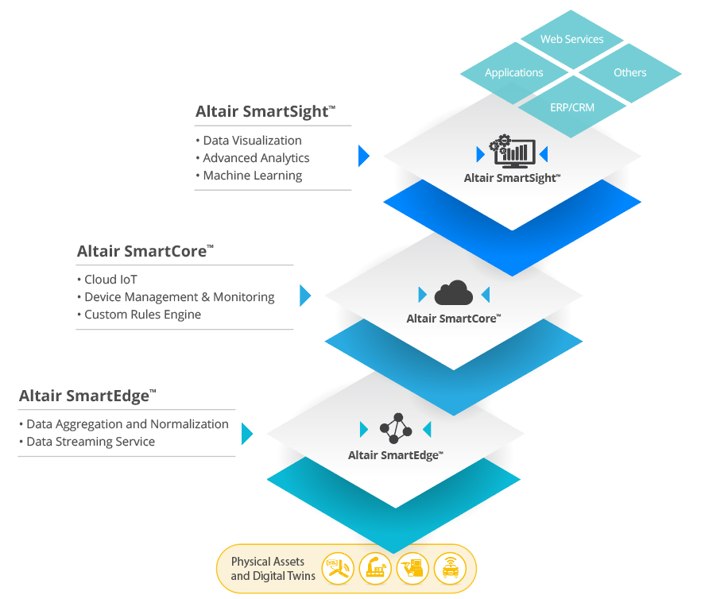
ALTAIR SMARTWORKS™ PLATFORM
Open scalable IoT solutions to enable, connect, and manage devices and optimize business performance

Slide 13
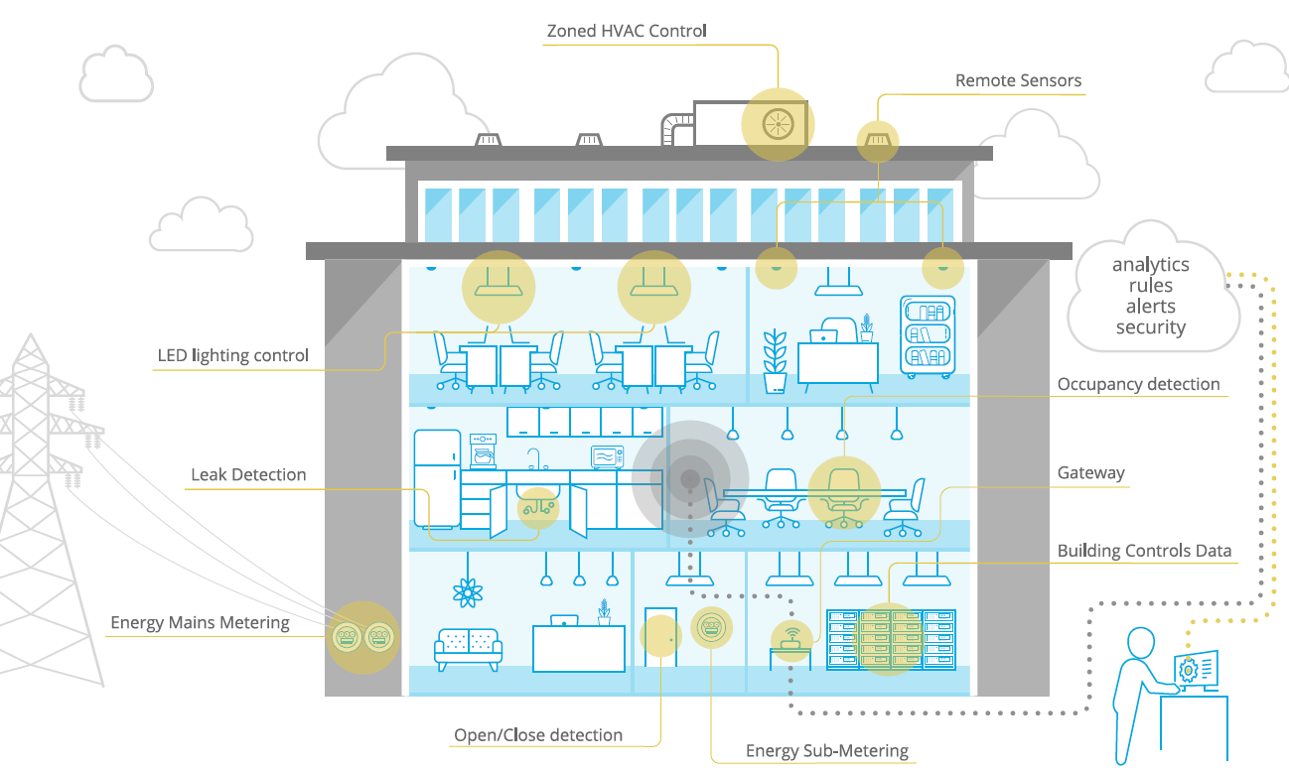
September 3, 2019 Altair Engineering, Inc. Proprietary and Confidential. All rights reserved.
MARKET-READY SOLUTIONS

Slide 14
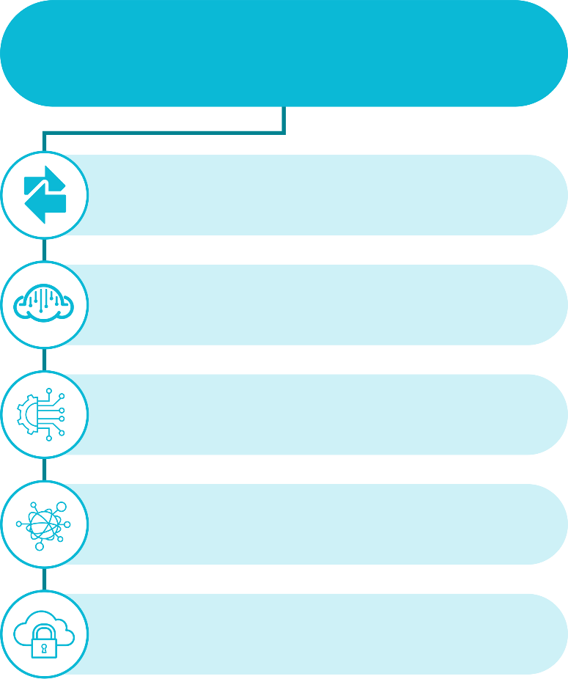
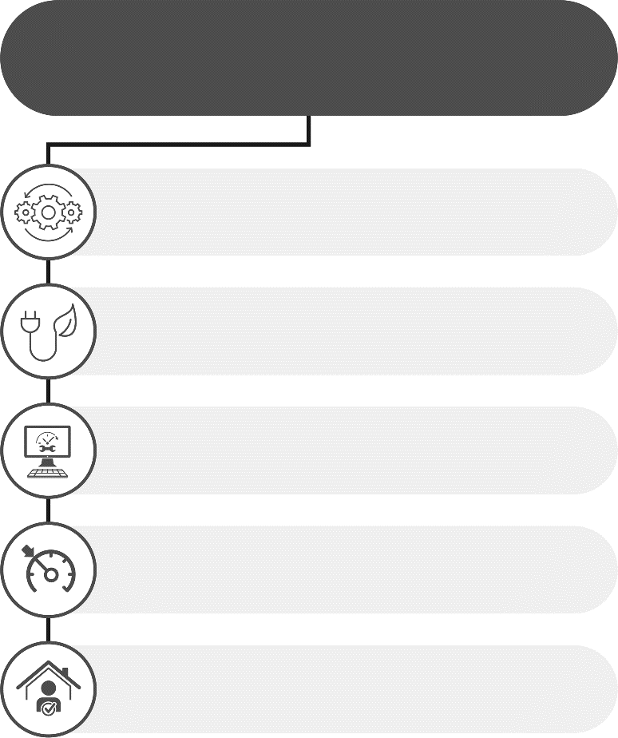
CONVERGENCE AT THE EDGE
ADVANTAGES
of SmartEdge
OUTCOMES
of SmartEdge
Technology interoperability
Asset Optimization
Communication protocols bridge
Energy Efficiency
Data aggregation and normalization
Proactive Maintenance
API for IoT apps and services
Real Time Insights
Automatic and secure
cloud connection
Tenant Satisfaction

Slide 15
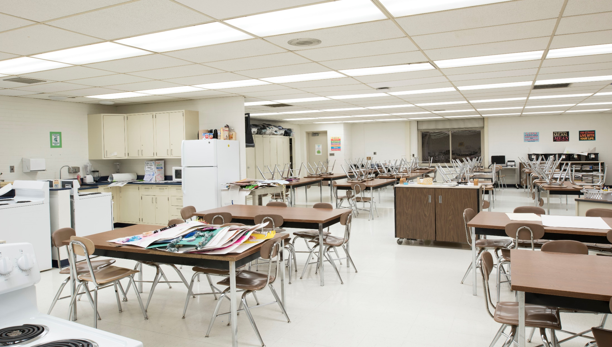

© 2017 Altair Engineering, Inc. Proprietary and Confidential. All rights reserved.
OPTIMIZE ENERGY USE
Facility Manager at a special needs elementary school in California deployed Altair’s cost-effective IoT platform to optimize energy use and remotely diagnose and control building HVAC while delivering a comfortable learning environment for students
CHALLENGES:
Facility Manager found it very difficult to optimize building hvac performance without the benefit of real time data analysis.
Facility Manager had no insight into off hours energy consumption which is likely contributing to higher than average energy bills

Slide 16

© 2017 Altair Engineering, Inc. Proprietary and Confidential. All rights reserved.
OPTIMIZE ENERGY USE
The Solution
Altair’s SmartEdge enabled gateway, low cost IoT sensors (3 thermostats/7 meters) and simple data visualization to monitor:
Energy Monitoring
HVAC Control

Slide 17
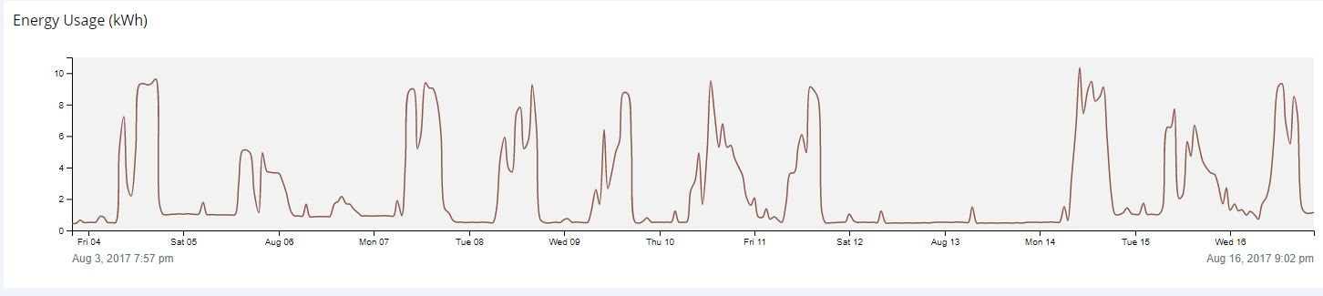
Summary of analytics
A
B
C
In Period A: higher-than-expected energy consumption on non-working days vs regular non-working day profile
In Periods B and C the graph shows extended energy consumption beyond normal working hours

Slide 18
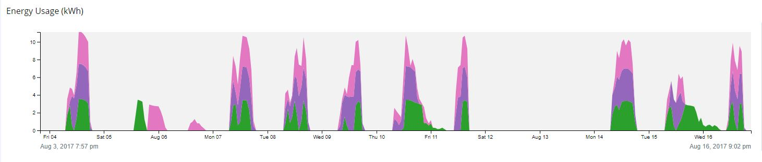
Summary of analytics
A
B
C
During Period A, the SHP-1 (Green) and SHP-2 (Pink) heat pumps were operating during off-hours on non-working days.
During Periods B and C the graph shows that SHP-1 extended its operation during these two off-hours windows.

Slide 19
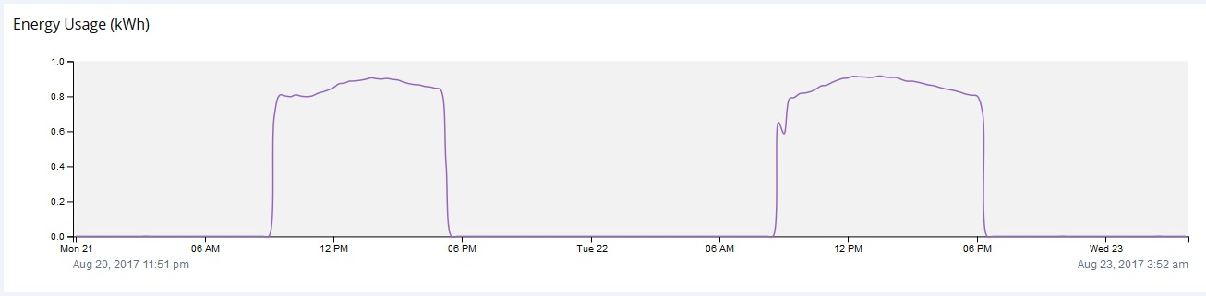
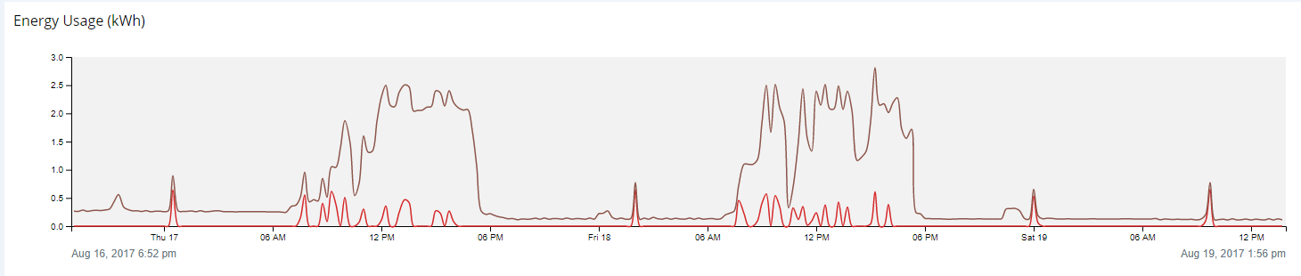
Summary of analytics
Thermostat Settings
Estimated 2016 curve
Current optimal curve
Electric Water Heater Load Profile

Slide 20
© 2017 Altair Engineering, Inc. Proprietary and Confidential. All rights reserved.
OPTIMIZE ENERGY USE
The Results
Preset thermostat schedules
Reduce off-hours energy consumption
Optimize equipment usage

Slide 21
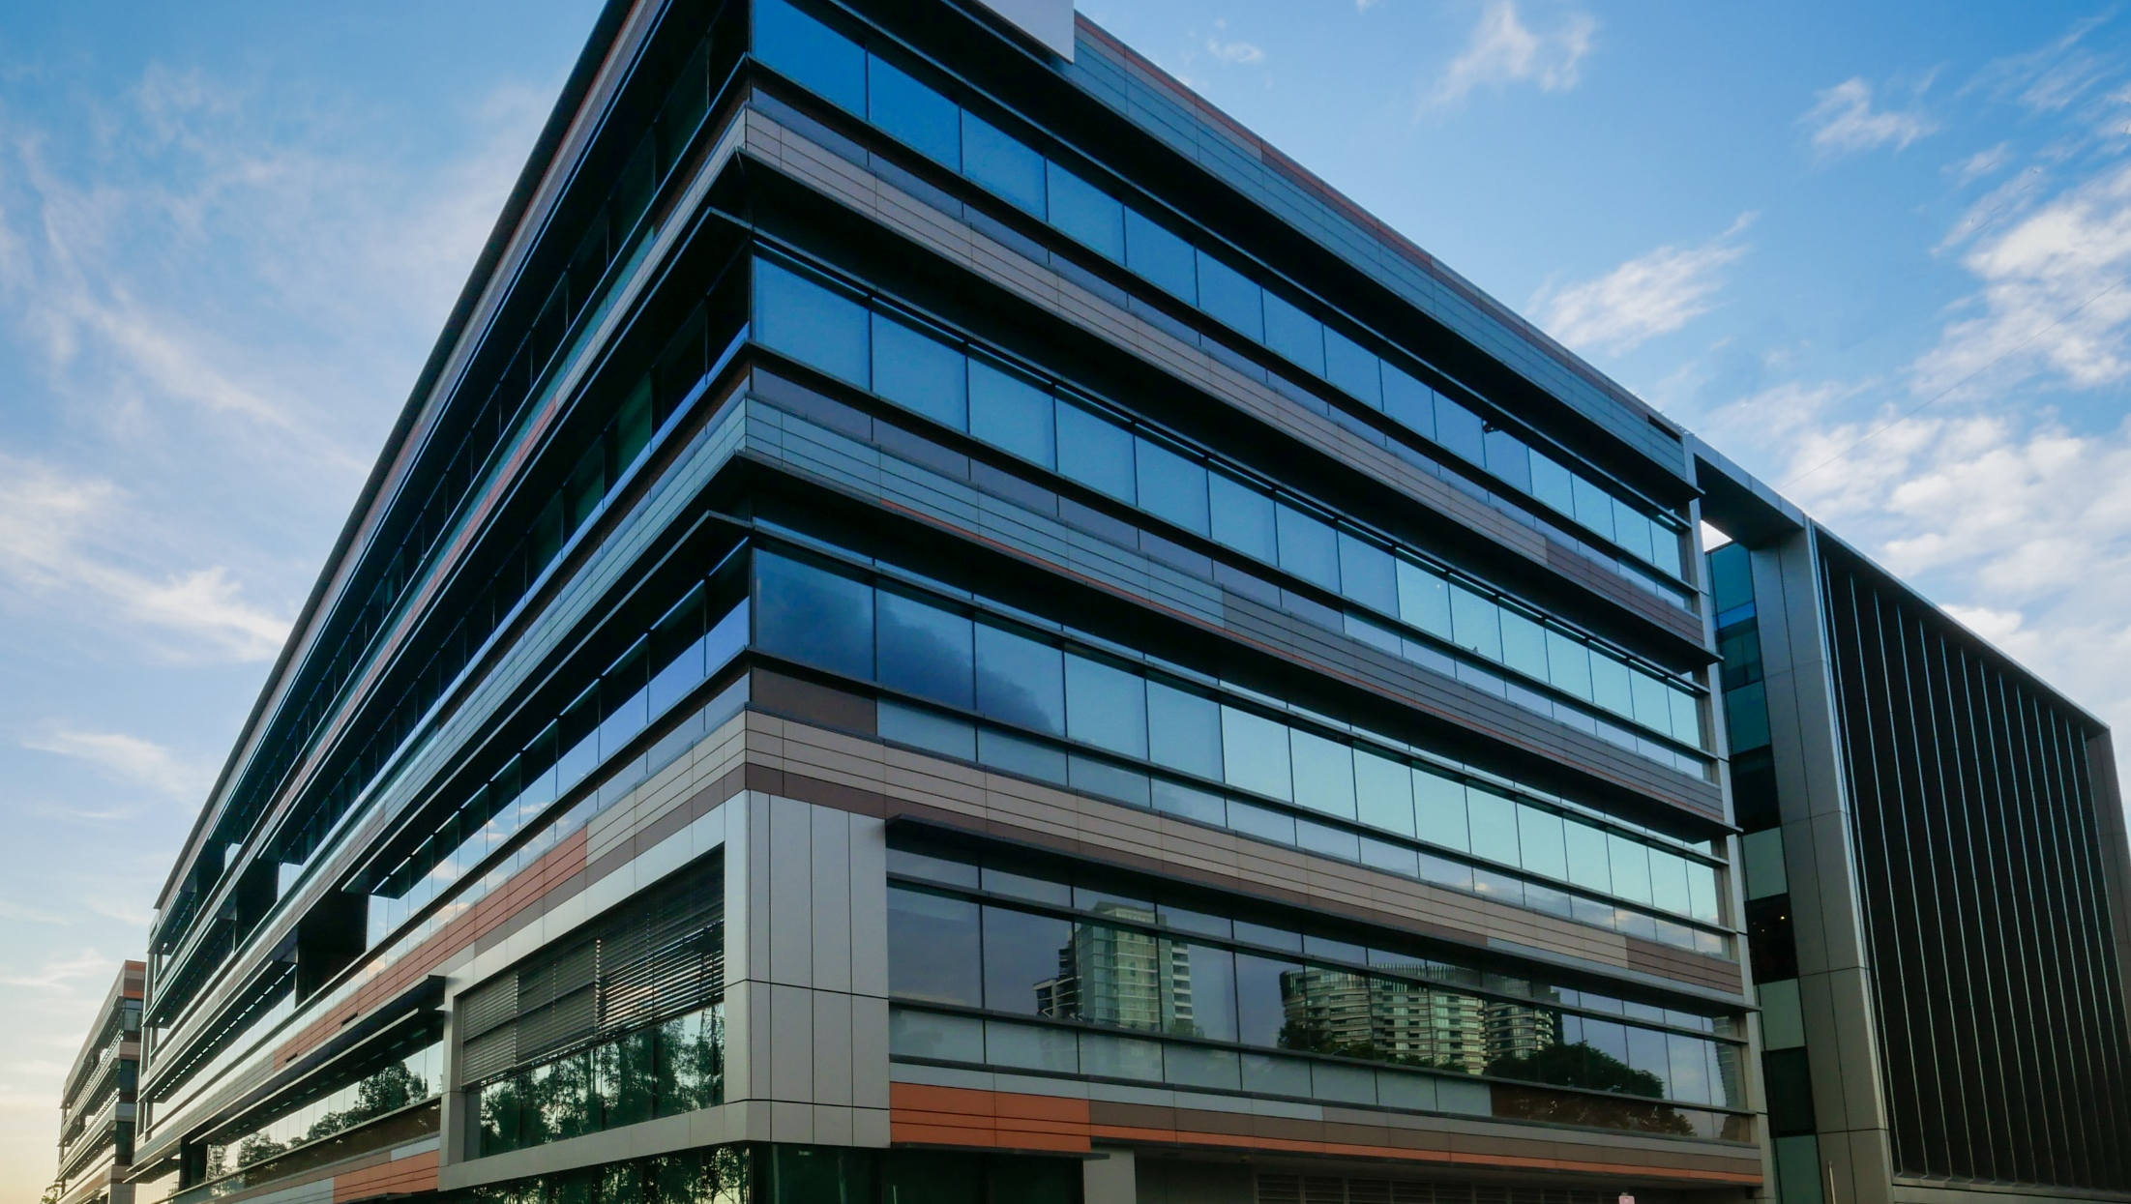
© 2017 Altair Engineering, Inc. Proprietary and Confidential. All rights reserved.
ENERGY MONITORING, HVAC CONTROL AND LEAK DETECTION
A Prominent Canadian commercial Real Estate management company deployed Altair’s SmartEdge technology to deliver several IoT based smart building solutions quickly and cost effectively at high profile 4-storey commercial building in Vancouver, BC.
CHALLENGES:
Provide tenant energy use bills fairly based on actual consumption
Need for real time flood detection monitoring to reduce the risk of new flood damage.
Looking to control thermostat settings throughout the buildings to manage after hours HVAC use

Slide 22
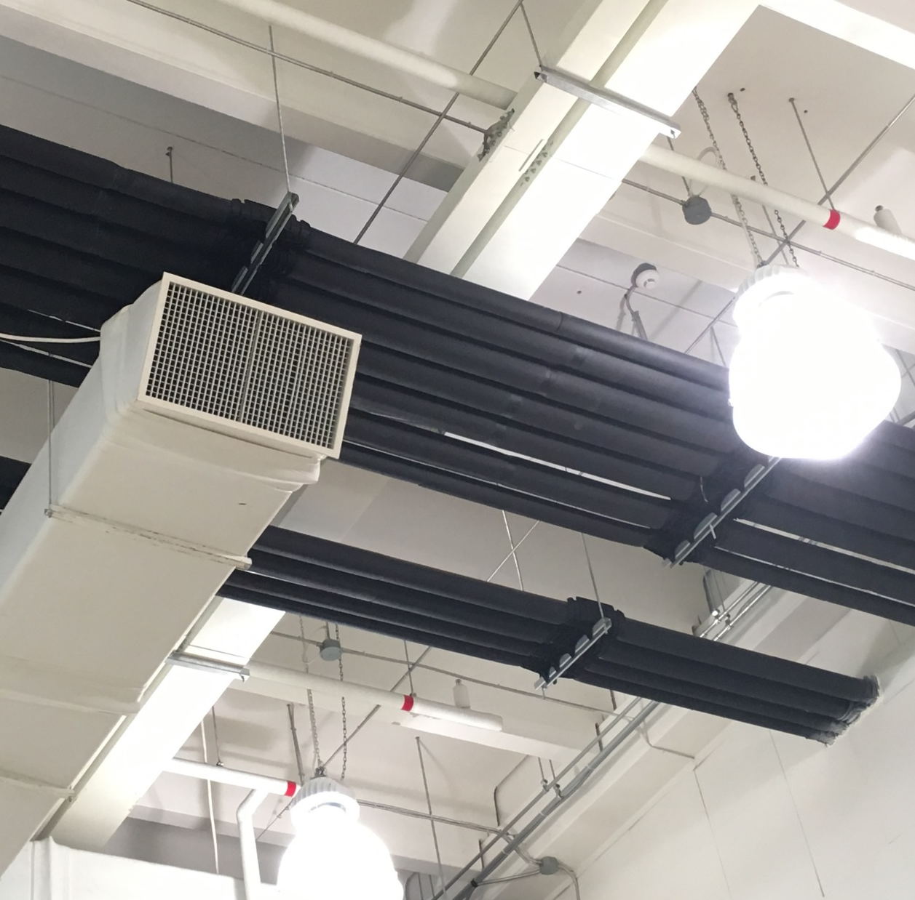

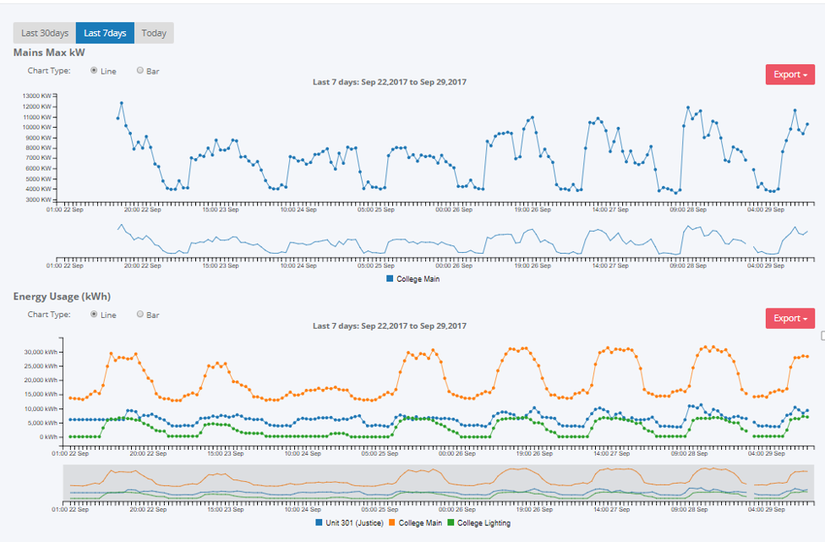
SMART BUILDINGS
© 2017 Altair Engineering, Inc. Proprietary and Confidential. All rights reserved.
SENSOR MONITORING
The Solution
Altair’s SmartEdge technology to deliver several IoT based smart building solutions quickly and cost effectively.
Energy Monitoring
HVAC Control
Leak Detection
The Results
Fair and balanced tenant billing
Reduced risk of flood detection and potential for reduced insurance premiums
Higher ROI than building management systems

Slide 23

Getting started
1. Establish Use Cases and desired outcomes
    Significant or unmanaged electric load (HVAC, lighting, pumps, fans etc)
2. Walk through of each site
    Catalogue existing systems, devices or configurations
3. Install IoT-generation sensors and controls
    Electric and gas metering; Temperature/Humidity/Flood monitoring
    HVAC control, lighting & discretionary load control
4. Visualize & Analyze
    Establish energy baseline with data acquired; overlay historical utility bills
    Create reports on specific equipment performance over time
5. Continuous Optimization
    Automation: real-time control of thermostat, lights and discretionary loads
    Sensors, alarms and thresholds alert out-of-bounds conditions
    Can be controlled by 3rd party Analytics, or user-generated rules

Slide 24

Thank you for attending!

Slide 25
Market ready solutions

Slide 26

4. Keynote - Questions?
Harsha Chandrashekar (Honeywell)

Slide 27






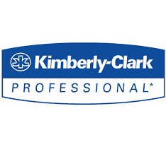







5. Research Update
Trevor Nightingale (National Research Council)
5.1 2019 IBC Landmark Research “Evidence for Building Retrofits that Improve Organizational Productivity (Phase 2)”
Free Download of Phase 1: www.caba.org/productivity
www.caba.org/research

Slide 28

6. White Paper Sub-Committee Update
Ken Wacks (Ken Wacks Associates)
6.1 Recently Completed:
“IoT Cyber Security Guidelines, Standards and Verification Systems”
Agelight Digital Trust Advisory Group
ARC Advisory Group
ArcoLogix LLC
Automation Standards Compliance Institute
BC Hydro
CANASA (Canadian Security Association)
Compass Intelligence, LLC
Consultant
Control4
CopperTree Analytics Inc.
CSA Group
Domotz
eMcRey
EXP
George Brown College
Honeywell International Inc.
Johnson Controls Inc.
Ken Wacks Associates
LonMark International
National Electrical Manufacturers Association (NEMA)
RYCOM Corporation
Sustainable Resources Management Inc.
Syska Hennessy Group
TC9, Inc
The Siemon Company
www.caba.org/WhitePapers

Slide 29

6. White Paper Sub-Committee Update
Ken Wacks (Ken Wacks Associates)
6.2 In Progress:
“Energy Metering and Power Quality Metering in North America”
ArcoLogix LLC
Asian Institute of Intelligent Buildings
Brainwave Research Corp.
CMG
Convergint Technologies
CopperTree Analytics Inc.
Current, powered by GE
Cyber Power Systems, Inc.
Domotz
Enercare Connections Inc.
EZ Meter Technologies
Honeywell International Inc.
Ken Wacks Associates
Public Works and Government Services Canada
Renesas Electronics America Inc.
Robert H Lane and Associates Inc.
Schneider Electric
Sustainable Resources Management
Triacta Power Solutions
Zinwave
www.caba.org/WhitePapers

Slide 30
6. White Paper Sub-Committee Update
Ken Wacks (Ken Wacks Associates)
6.2 In Progress:
“Multi-MHz Wireless Power Transfer and Its Commercial Applications”
Airfuel Alliance
University of Michigan - Shanghai Jiao Tong University Joint Institute
Princeton University
www.caba.org/WhitePapers

Slide 31
6. White Paper Sub-Committee Update
Ken Wacks (Ken Wacks Associates)
6.2 In Progress:
“The Evolution of Integrating LiFi Technology into Smart Lighting and Control Systems for the Intelligent Building”
Wharton County Junior College
Acuity Brands, Inc.
ArcoLogix LLC
Control4
National Electrical Manufacturers Association
Telecommunications Industry Association (TIA)
www.caba.org/WhitePapers

Slide 32


6. White Paper Sub-Committee Update
Ken Wacks (Ken Wacks Associates)
All proposals and previously completed IBC White Papers can be downloaded at:
www.caba.org/whitepapers

Slide 33
7. New Business
Roberta Gamble (Frost & Sullivan)
7.1 Frost & Sullivan Research Opportunity

Slide 34
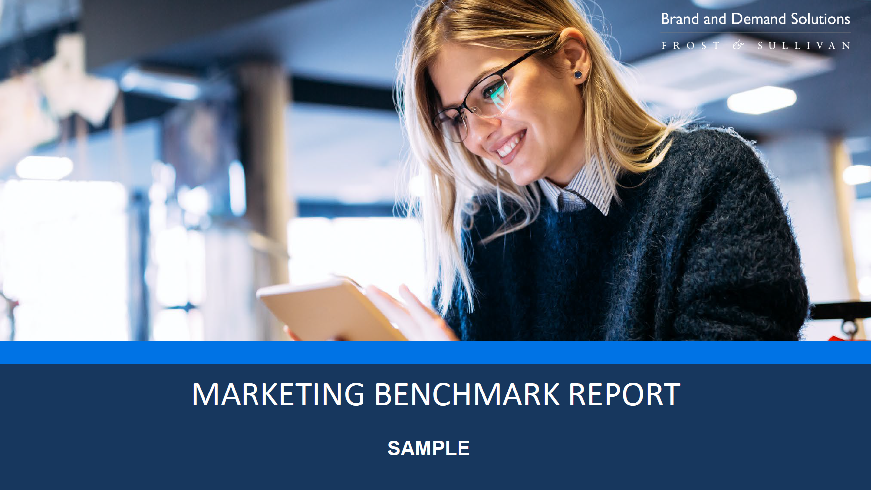

Slide 35


Slide 36

What is the Frost & Sullivan Benchmark Study?
20 minute interactive survey followed by 20+ page custom report within 2-3 weeks
Top level comparison of your spending activities and budge vs. goals and returns
How your marketing budget compares to others. Are you underfunded?
Where marketing departments are scaling up and what programs they're cutting back on
High level recommendations on how to drive greater returns

Slide 37
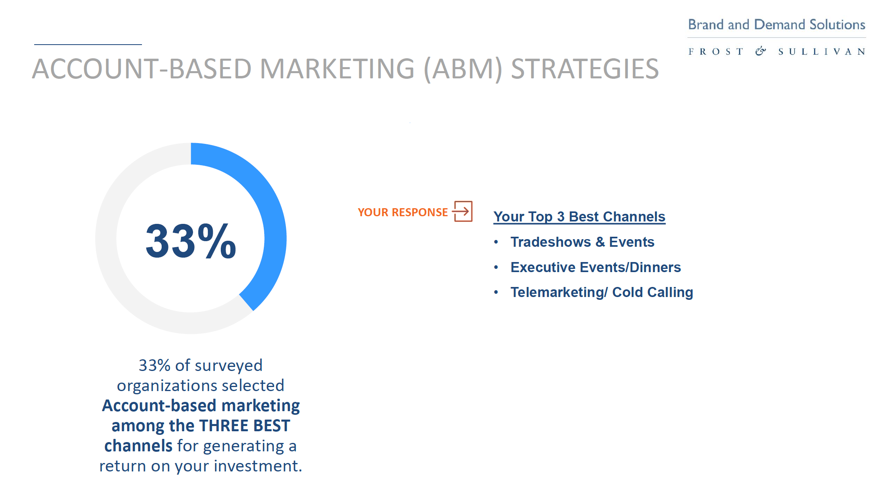
Sample slide – Confidential to CABA

Slide 38
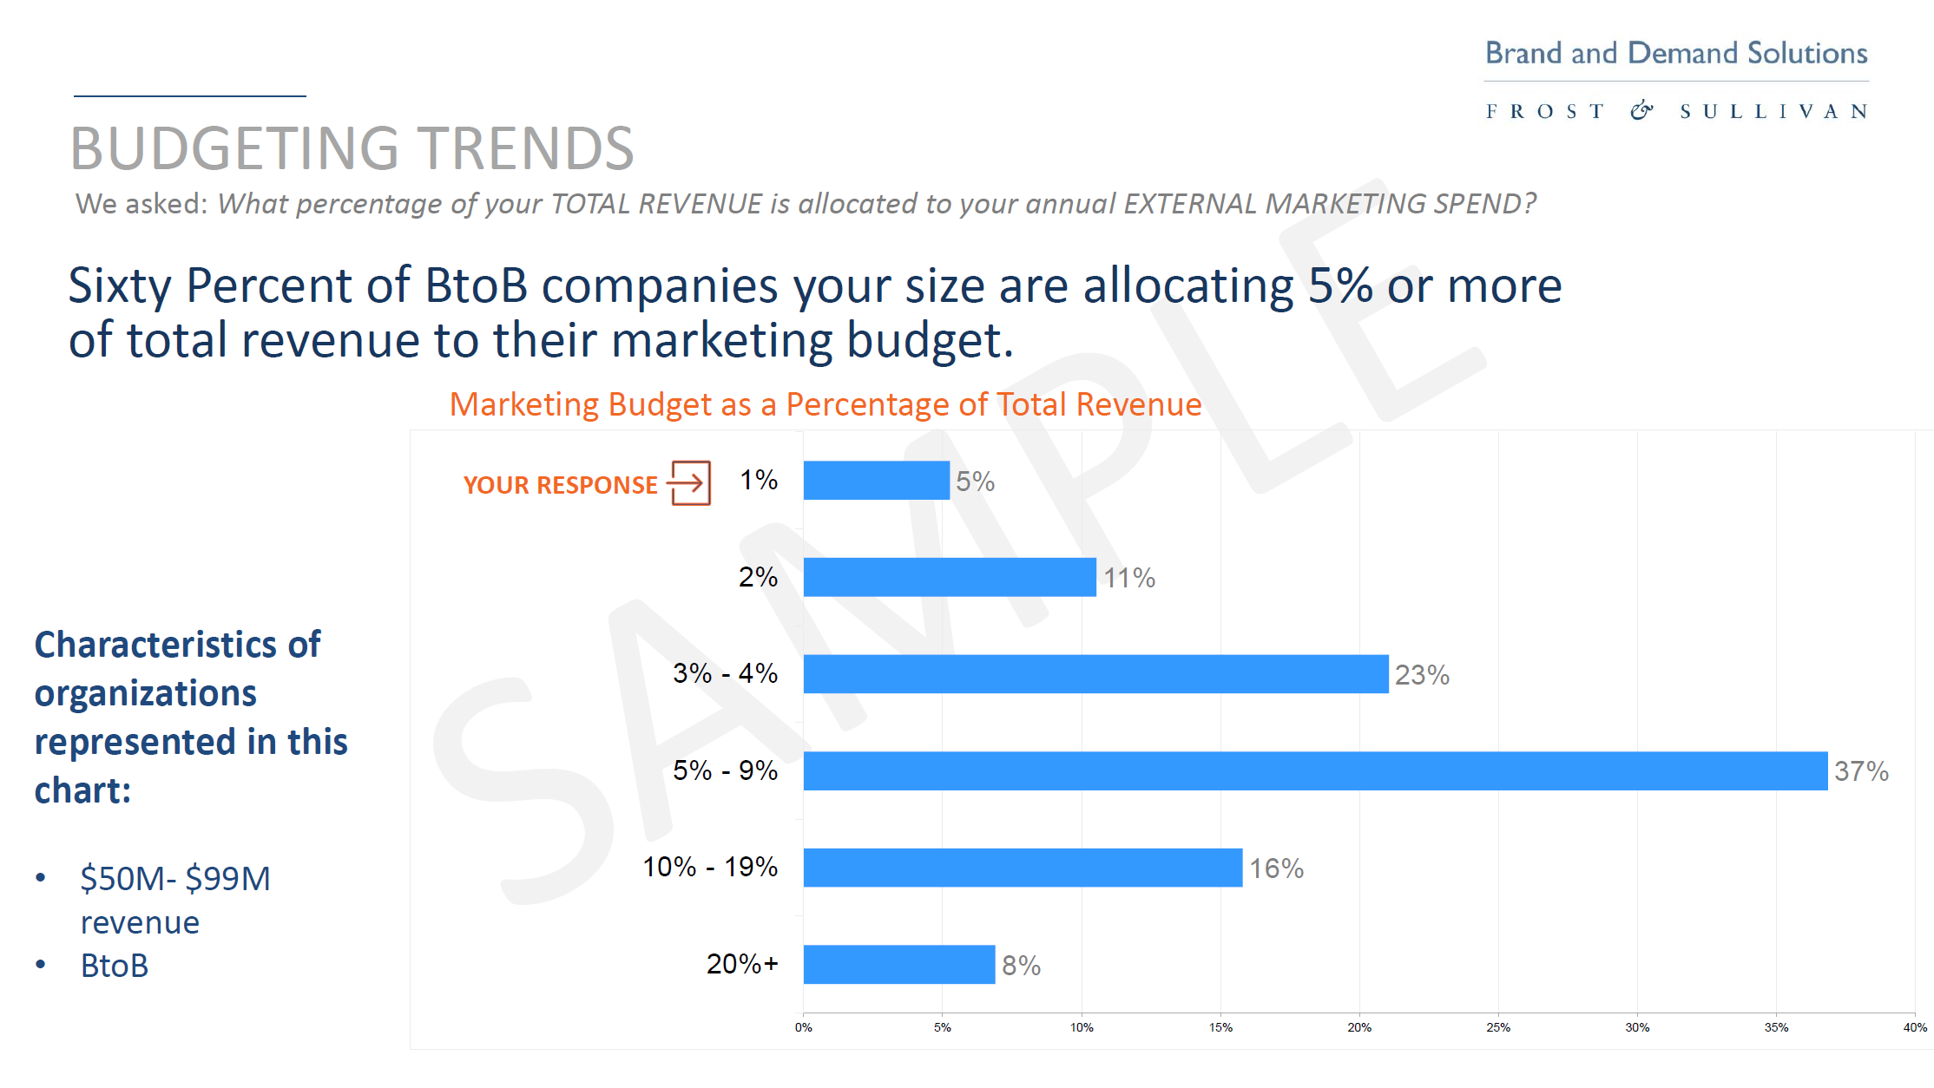
Sample slide – Confidential to CABA

Slide 39
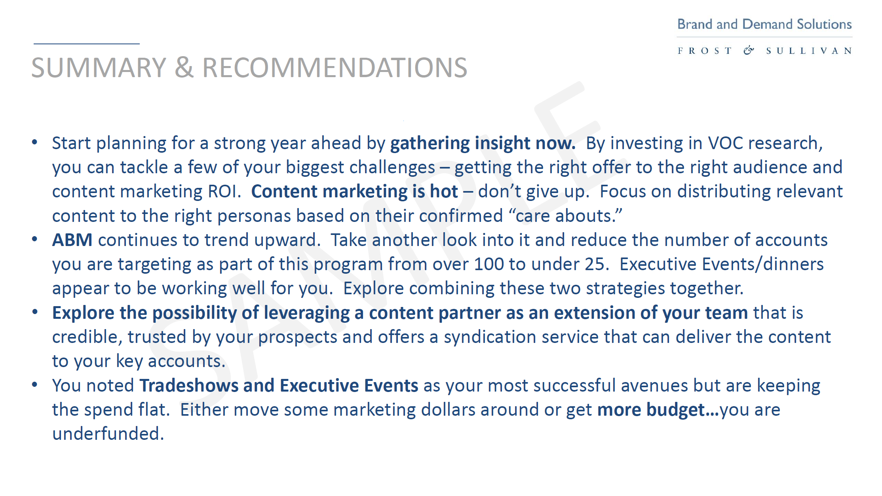
Sample slide – Confidential to CABA

Slide 40
How to receive your free CABA-member marketing benchmark survey?
Contact:
Frost & Sullivan at maurice.okawaki@frost.com
or
CABA at walker@caba.org

Slide 41
7. New Business
Michael Lake (Leading Cities)
7.2 Smart Building Challenge (2020 AcceliCITY)

Slide 42


AcceliCITY
Smart Building Challenge

Slide 43
AcceliCITY
Lowering the cost and risk of innovation.
AcceliCITY leverages the Leading Cities network of Smart Technology experts in the public, private, academic, and non-profit sectors to vet, validate and verify Smart Building technologies from around the world.

Slide 44
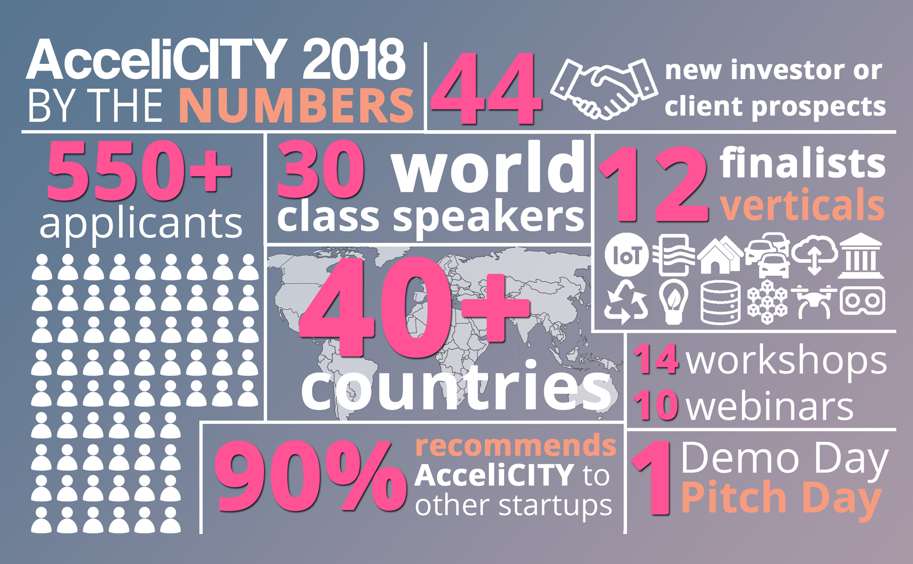
AcceliCITY By The Numbers

Slide 45
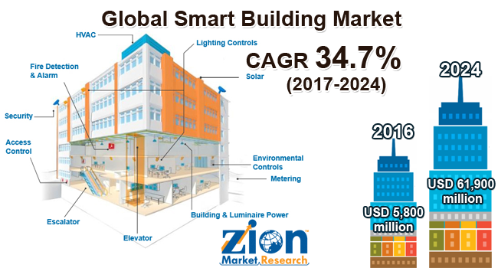
Smart Building Market
$62B
By 2024
Fueled by increasing energy consumption
Most popular solution to-date is the use of Smart Security systems
North America ranked 2nd behind Europe with Asia growing at 35% CAGR
34%
CAGR
Source: Zion Market Research
Notes:
https://readwrite.com/2017/01/07/smart-cities-market-will-grow-3-5-trillion-worldwide-2026-cl4/
https://www.linkedin.com/pulse/social-enterprise-statistics-from-around-world-jay-boolkin
http://www.huffingtonpost.com/ben-thornley/social-enterprise_b_2090144.html
http://www.echoinggreen.org/ideas/data-how-2017-applicants-are-impacting-world

Slide 46
Smart Building Track Sponsorship
6 steps for reduced cost and risk of implementing innovative Smart Building Tech in your portfolio:
  Identify a challenge specific to your needs/interests
  Receive globally sourced solutions vetted by an international panel of experts
  Review specific proposals based on your framework and needs
  Meet with the AcceliCITY Finalists you selected
  Choose your winner & receive their Leading Cities Due Diligence Report
  Implement your project together

Slide 47
Benefits
Sponsorship of the AcceliCITY Boot Camp will:
  Establish competitive advantages in a crowded marketplace
  Increase visibility as a Smart Buildings thought leader
  Provide access to innovators, state and local government leaders, and Smart City experts globally
Challenge Sponsors will have targeted access to innovative solutions in a focused area of your choosing.
  Contributing to increased client servicing by having a finger on the pulse of emerging solutions and technologies
  Creating opportunities for your internal leaders to become more entrepreneurial and better create a culture of innovation
  Provide a specific “prize project” for the winner you choose that creates a win-win situation for sponsor and the startup

Slide 48




For more information please E-mail us at AcceliCITY@LeadingCities.org
Phone. +1.617.506.3499
Like us on Facebook. Facebook.com/LeadingCities
Follow us on Twitter. @LeadingCities

Slide 49

7. New Business
Bob Allan (The Siemon Company)
7.3 Other new IBC business?

Slide 50

8. Announcements
Ron Zimmer (CABA)
8.1 Past Event Overview:
2019 Haystack Connect, May 13-15, San Diego, CA
Internet of Things World, May 13-16, Santa Clara, CA
LIGHTFAIR International 2019, May 21-23, Pennsylvania, PA
REMI/ISSA/IFMA '19 Shows, June 11-13, Toronto, ON
Realcomm/IBcon, June 13-14, Nashville, TN
Global Smart Build Summit 4th Edition, July 17, Pune, India
Smart Water Summit, Aug 24-27, Scottsdale, AZ

Slide 51
8. Announcements
Ron Zimmer (CABA)
8.2 Upcoming events:
Shanghai Intelligent Building Technology, Sept 3-5, Shanghai, China
SCTE-ISBE Cable Tec Expo, New Orleans, LA
IFMA’s World Workplace Conference & Expo, Oct 16-18, Phoenix, AZ
Smart Utility Summit, Oct 27-29, Phoenix, AZ
CoRETECH 2109, Nov 13-15, San Jose, CA

Slide 52
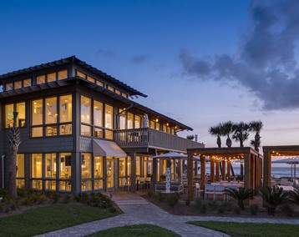


8. Announcements
Ron Zimmer (CABA)
8.2 Upcoming events:
2020 CABA Smart Buildings Summit (SBS), produced by AGORA
CABA
SMART BUILDINGS
SUMMIT
PRODUCED BY:
May 3 - 5, 2020
Sawgrass Marriott Resort & Spa | Ponte Vedra Beach, FL

Slide 53
9. Adjournment
Trevor Nightingale (National Research Council)
Next IBC Meeting, Late Nov/ early Dec, 2019
Continental Automated Buildings Association (CABA)
caba@caba.org
www.CABA.org
www.caba.org/ibc
Connect to what’s next™

